Slide 1
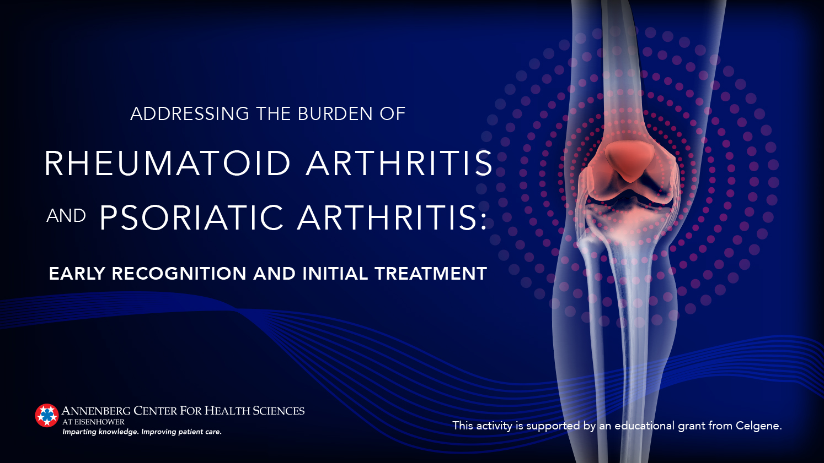

Slide 2
Daniel J. Wallace, MD, FACP, MACR
Associate Director, Rheumatology Fellowship Program
Board of Governors, Cedars-Sinai Medical Center
Professor of Medicine, Cedars-Sinai Medical Center
David Geffen School of Medicine Center at UCLA
In affiliation with Attune Health
Los Angeles, California

Slide 3
Disclosures
Consultant: EMD, Exagen, Glenmark, Lilly, Serono
Clinical area: Lupus

Slide 4
Learning Objectives
Describe the overall management, including diagnostic evaluation and initial treatment, in patients with PsA or RA.
Collaborate with the patient using a shared decision-making approach to better understand patient concerns and inform treatment goals and plan.
Perform a diagnostic evaluation, including differential diagnosis and assessment of comorbidities, for patients with possible PsA or RA.
Individualize evidence-based treatment for treatment-naïve patients with PsA or RA consistent with current guideline recommendations.
Consider a holistic management approach in patients with PsA or RA.

Slide 5
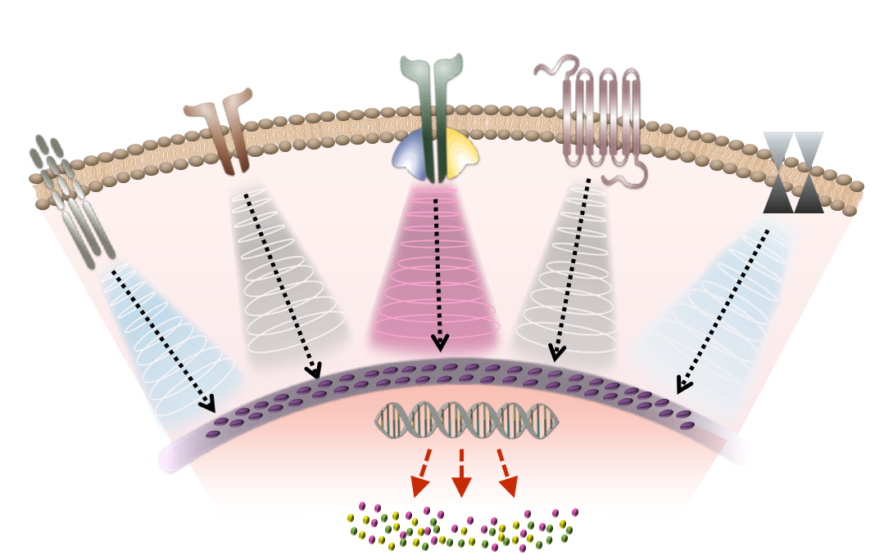


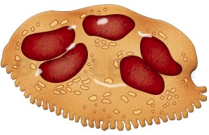
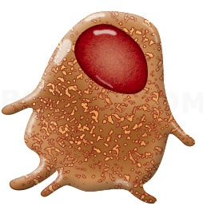

RA and PsA
Pathogenesis
Clinical signs/symptoms
Pruritus Swelling
Skin inflammation?
Erosion New bone formation Hyperkeratosis
Hyperkeratosis Dermal, epidermal, and synovial inflammation
Bone resorption
New bone formation
Enthesitis
IL-17 signaling
cascade
Macrophage
IL-17
Basophil
Mast cell
IL-1
TGF-β1
cAMP/PKA signaling
cascade
Eosinophil
Dendritic
cell
Naïve
T cell
IL-12/23
IL-6
IL-21
IFN-γ
JAK signaling
cascade
Neutrophil
IL-23ª
IL-22
IFN-α
MHC TCR
Keratinocyte
Synoviocyte
IL-1
MAPK signaling
cascade
TNF
IL-1
Osteoclast
TNF
NF_{K}B signaling
cascade
Osteoblast
CD8⁺ T cell
Coates LC, et al. Semin Arthritis Rheum. 2016;46:291-304.

Slide 6
Treatment of RA and PsA
Core Principles
Treatment should be based on shared decision-making between the patient and the health care provider
Treatment choices should be individualized and based on factors such as disease activity, prognosis, comorbidities, safety, cost, and availability of medications
Treat-to-target should be prioritized, whether that means low disease activity or remission
Overall treatment goals and plan should:
  aim for lowest possible disease activity
  optimize functional status
  improve quality of life
  minimize structural damage
  avoid/minimize complications from either active disease or medications
Aletaha D. Rheum Dis Clin North Am. 2019;45:xi-xii;
Falzer PR. Int J Rheum Dis. 2019;22:1706-1713;
Garrido-Cumbrera M, et al. Rheumatol Ther. 2017;4:219-231.

Slide 7
Rheumatoid Arthritis

Slide 8
Rheumatoid Arthritis
Most Common Autoimmune Inflammatory Arthritis in Adults
Onset is insidious, often beginning with fever, malaise, arthralgias, and weakness before progressing to joint inflammation and swelling
Annual incidence is ~40 per 100,000
Prevalence is ~1% in Caucasians but varies between 0.1% (in rural Africans) and ~5% (in Pima, Blackfeet, and Chippewa Indians)
Women are affected 2 to 3 times more often than men
Can occur at any age
  Peak onset is between ages 50-75
Smolen JS, et al. Nat Rev Dis Primers. 2018;4:18001;
Cross M, et al. Ann Rheum Dis. 2014;73:1316-1322;
McDougall C, et al. Semin Arthritis Rheum. 2017;46:675-686.

Slide 9
Rheumatoid Arthritis
Classification Criteria: ACR/EULAR 2010
A Score Of ≥6/10 Is Needed For Definite Classification of A Patient as Having RA
Joint involvement^{A} | Score
1 large joint^{B} | 0
2−10 large joints | 1
1−3 small joints (with or without involvement of large joints)^{C} | 2
4−10 small joints (with or without involvement of large joints) | 3
>10 joints (at least 1 small joint)^{D} | 5
Serology (at least 1 test result is needed for classification)^{E}
Negative RF and negative ACPA | 0
Low-positive RF or low-positive ACPA | 2
High-positive RF or high-positive ACPA | 3
A. Joint involvement refers to any swollen or tender joint on examination, which may be confirmed by imaging evidence of synovitis. Distal interphalangeal joints, first carpometacarpal joints and first metatarsophalangeal joints are excluded from assessment. Categories of joint distribution are classified according to the location and number of involved joints, with placement into the highest category possible based on the pattern of joint involvement.
B. ‘Large joints’ refers to shoulders, elbows, hips, knees and ankle.
C. ‘Small joints’ refers to the metacarpophalangeal joints, proximal interphalangeal joints, second to fifth metatarsophalangeal joints, thumb interphalangeal joints and wrists.
D. In this category, at least one of the involved joints must be a small joint; the other joints can include any combination of large and additional small joints, as well as other joints not specifically listed elsewhere (eg, temporomandibular, acromioclavicular, sternoclavicular, etc).
D. Negative refers to international unit (IU) values that are less than or equal to the upper limit of normal (ULN) for the laboratory and assay; low-positive refers to IU values that are higher than the ULN but 3 or less times the ULN for the laboratory and assay; high-positive refers to IU values that are more than 3 times the ULN for the laboratory and assay. When rheumatoid factor (RF) information is only available as positive or negative, a positive result should be scored as low-positive for RF.
Aletaha D, et al. Ann Rheum Dis. 2010;69:1580-1588.

Slide 10
Rheumatoid Arthritis
Classification Criteria: ACR/EULAR 2010 (cont.)
A Score of ≥6/10 Is Needed for Definite Classification of a Patient as Having RA
Acute-phase reactants (at least 1 test result is needed for classification)^{F} | Score
Normal CRP and normal ESR 0 | 0
Abnormal CRP or normal ESR 1 | 1
Duration of symptoms^{G}
<6 weeks | 0
≥6 weeks | 1
F. Normal/abnormal is determined by local laboratory standards.
G. Duration of symptoms refers to patient self-report of the duration of signs or symptoms of synovitis (eg, pain, swelling, tenderness) of joints that are clinically involved at the time of assessment, regardless of treatment status. ACPA, anti-citrullinated protein antibody; CRP, C-reactive protein; ESR, erythrocyte sedimentation rate.
Aletaha D, et al. Ann Rheum Dis. 2010;69:1580-1588.

Slide 11
Rheumatoid Arthritis
ACR 2015 Guidelines: Definitions to Know
Established RA
RA with duration of disease/symptoms of >=6 months or meeting 1987 ACR RA classification criteria
Disease activity
Low, moderate, or high as per validated scales
RA remission
A tender joint count, swollen joint count, C-reactive protein level (mg/dl), and patient global assessment of ≤1 each or a Simplified DAS of ≤3.3
Optimal dosing of RA treatments
Dosing to achieve a therapeutic target derived from mutual patient-clinician consideration of patient priorities
Given for at least 3 months before therapy escalation or switching
Singh JA, et al. Arthritis Rheumatol. 2016;68:1-26.

Slide 12
Rheumatoid Arthritis
ACR 2015 Guidelines
Instruments to Measure RA Disease Activity and to Define Remission
Instrument | Thresholds of Disease Activity
Patient Activity Scale (PAS) or PASII (range 0–10) | Remission: 0–0.25
 | Low activity: >0.25–3.7
 | Moderate activity: >3.7 to <8.0
 | High activity: ≥8.0
Routine Assessment of Patient Index Data 3 (RAPID-3) (range 0–10) | Remission: 0–1.0
 | Low activity: >1.0–2.0
 | Moderate activity: >2.0–4.0
 | High activity: .4.0—10
Clinical Disease Activity Index (CDAI) (range 0–76.0) | Remission: ≤2.8
 | Low activity: >2.8–10.0
 | Moderate activity: >10.0–22.0
 | High activity: >22
Singh JA, et al. Arthritis Rheumatol. 2016;68:1-26.

Slide 13
Rheumatoid Arthritis
ACR 2015 Guidelines (cont.)
Instruments to Measure RA Disease Activity and to Define Remission
Instrument | Thresholds of Disease Activity
Disease Activity Score 28 (DAS28) ESR (range 0–9.4) | Remission: <2.6
 | Low activity: ≥2.6 to <3.2
 | Moderate activity: ≥3.2 to ≤5.1
 | High activity: >5.1
Simplified Disease Activity Index (SDAI) (range 0–10) | Remission: ≤3.3
 | Low activity: >3.3 to ≤11.0
 | Moderate activity: >11.0 to ≤26
 | High activity: >26
Singh JA, et al. Arthritis Rheumatol. 2016;68:1-26.

Slide 14
ACR 2015 Guidelines
Drug Categories: Glucocorticoids (GCs)
Low-dose
  ≤10 mg/day of prednisone (or equivalent)
High-dose
  >10 mg/day of prednisone (or equivalent) and up to 60 mg/day with a rapid taper
Short-term
  <3 month treatment
Singh JA, et al. Arthritis Rheumatol. 2016;68:1-26;
Boers M, et al. Lancet. 1997;350:309-318.

Slide 15
ACR 2015 Guidelines
Drug Categories: DMARDs*
Methotrexate (MTX)
  Either oral or subcutaneous
Hydroxychloroquine (HCQ)
Leflunomide (LEF)
Sulfasalazine (SSZ)
Can be given as mono, double, or triple therapy.
*Excludes azathioprine, cyclosporine, minocycline, and gold.
Singh JA, et al. Arthritis Rheumatol. 2016;68:1-26.

Slide 16
ACR 2015 Guidelines
Drug Categories: TNFi Biologics*
Adalimumab
Certolizumab pegol
Etanercept
Golimumab
Infliximab
*Excludes anakirna.
Singh JA, et al. Arthritis Rheumatol. 2016;68:1-26.

Slide 17
ACR 2015 Guidelines
Drug Categories: Non-TNF Biologics* and Oral JAKi
Abatacept
Rituximab
Tocilizumab
Tofacitinib (oral synthetic small molecule)
*Excludes anakirna.
Singh JA, et al. Arthritis Rheumatol. 2016;68:1-26.

Slide 18
ACR 2015 Guidelines
Treatment of Early RA
Regardless of disease activity level:
Use a treat-to-target approach (low disease activity or remission)
use DMARD monotherapy (MTX preferred)
If moderate/high disease activity despite DMARD:
Use combo DMARDs or TNFi or non-TNF biologic +/- MTX
If moderate/high disease activity despite biologic:
Add low dose GCs (at lowest possible dose for shortest amount of time)
Singh JA, et al. Arthritis Rheumatol. 2016;68:1-26.

Slide 19
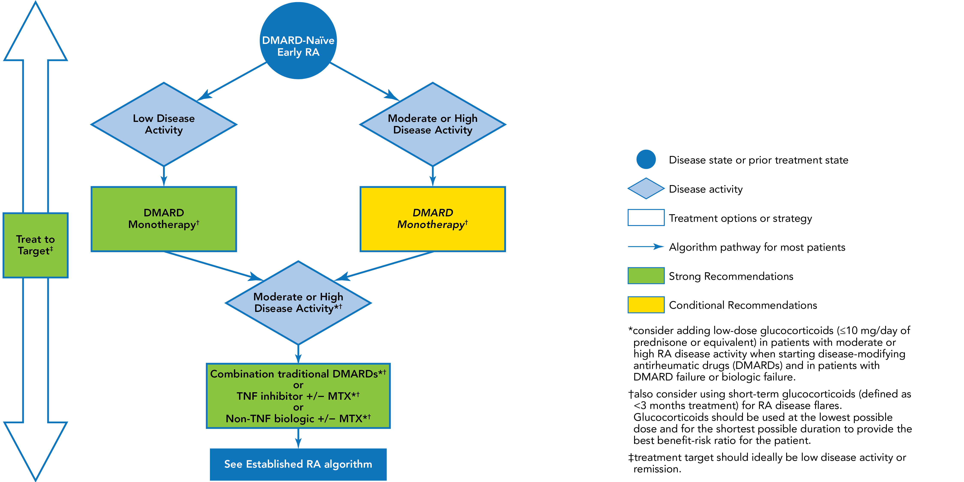
ACR 2015 Guidelines
Early RA Treatment Algorithm
Singh JA, et al. Arthritis Rheumatol. 2016;68:1-26.

Slide 20
ACR 2015 Guidelines
Treatment of Established RA
Regardless of disease activity level:
Use a treat-to-target approach (low disease activity or remission)
Use DMARD monotherapy (MTX preferred)
If moderate/high disease activity despite DMARD:
Use combo DMARDs or TNFi or non-TNF biologic +/- MTX
If moderate/high disease activity despite biologic:
Add low dose GCs (at lowest possible dose for shortest amount of time)
If in remission:
Taper DMARDs, TNFi, non-TNF biologic, or tofacitinib
Do not discontinue all therapy
If low disease activity:
Continue DMARDs, TNFi, non-TNF biologic, or tofacitinib rather than discontinuing
Singh JA, et al. Arthritis Rheumatol. 2016;68:1-26.

Slide 21
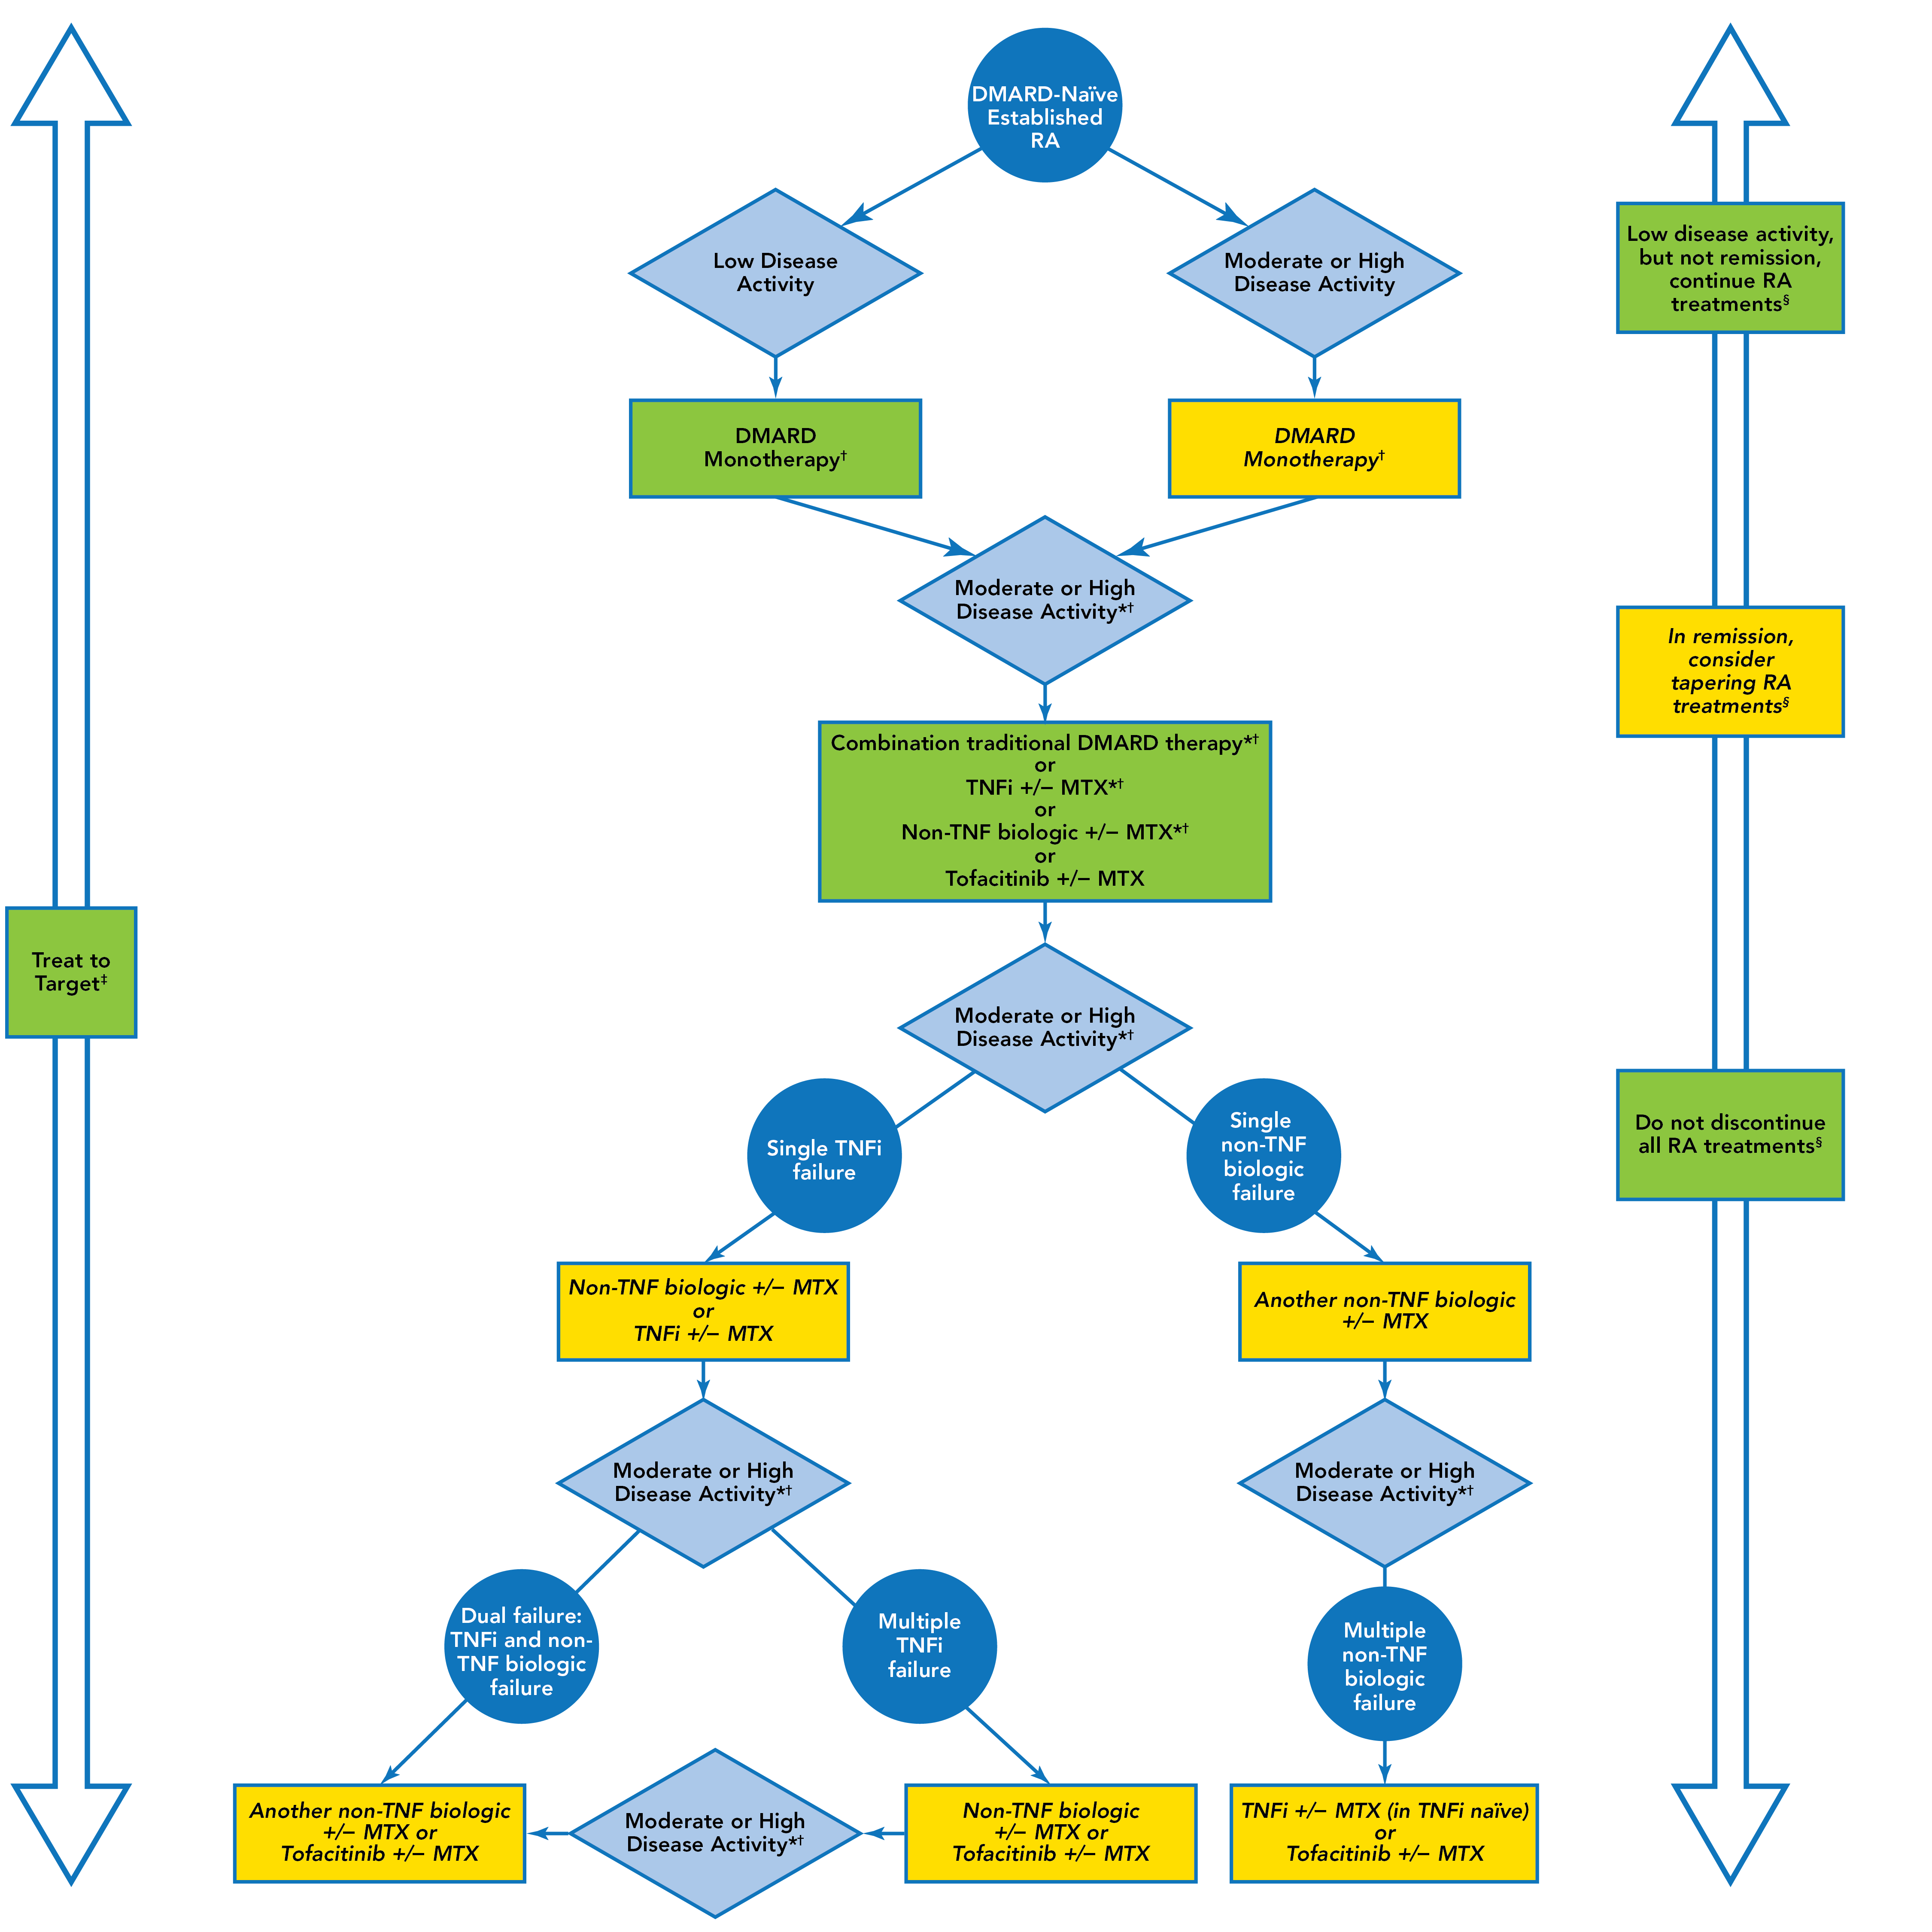
ACR 2015 Guidelines
Established RA Treatment Algorithm
Singh JA, et al. Arthritis Rheumatol. 2016;68:1-26.

Slide 22
ACR 2015 Guidelines
Established RA Treatment Algorithm
Singh JA, et al. Arthritis Rheumatol. 2016;68:1-26.

Slide 23
ACR 2015 Guidelines
Established RA Treatment Algorithm
Singh JA, et al. Arthritis Rheumatol. 2016;68:1-26.

Slide 24
Rheumatoid Arthritis
Differential Diagnosis
Viral polyarthritis —rubella, parvovirus B19, hepatitis B or C, Chikungunya, human T lymphotropic virus type 1 (HTLV-I)
Other systemic rheumatic diseases — systemic lupus erythematosus (SLE), Sjögren's syndrome, dermatomyositis (DM), or overlap syndromes such as mixed connective tissue disease
Hypermobility syndrome and fibromyalgia- no synovitis seen
Reactive arthritis and inflammatory bowel disease (IBD)-associated arthropathy — HLA-B27 often present
Psoriatic arthritis (PsA)
Polymyalgia rheumatica
Crystalline arthritis — gout and pseudo gout
Infectious arthritis — septic arthritis, Lyme disease
Osteoarthritis
Paraneoplastic disease
Smolen JS, et al. Nat Rev Dis Primers. 2018;4:18001; Aletaha D, Smolen JS. JAMA. 2018;320:1360-1372. Smolen JS, et al. Lancet. 2016;388:2023-2203.

Slide 25
Rheumatoid Arthritis
Comorbidities
Cardiovascular Disease
Myocardial infarction
Stroke
Atrial fibrillation
Heart failure
Hypertension
Vasculitis
Infectious Disease
Lung Disease
Chronic obstructive pulmonary disease (COPD)
Interstitial lung disease (ILD)
Dougados M, et al. Ann Rheum Dis. 2014;73:62-68.

Slide 26
Rheumatoid Arthritis
Comorbidities (cont.)
Osteoporosis
Depression
Malignancy
Lung cancer
Lymphoma
GI ulcerations
Eye Disease
Uveitis
Scleritis
Dougados M, et al. Ann Rheum Dis. 2014;73:62-68.

Slide 27
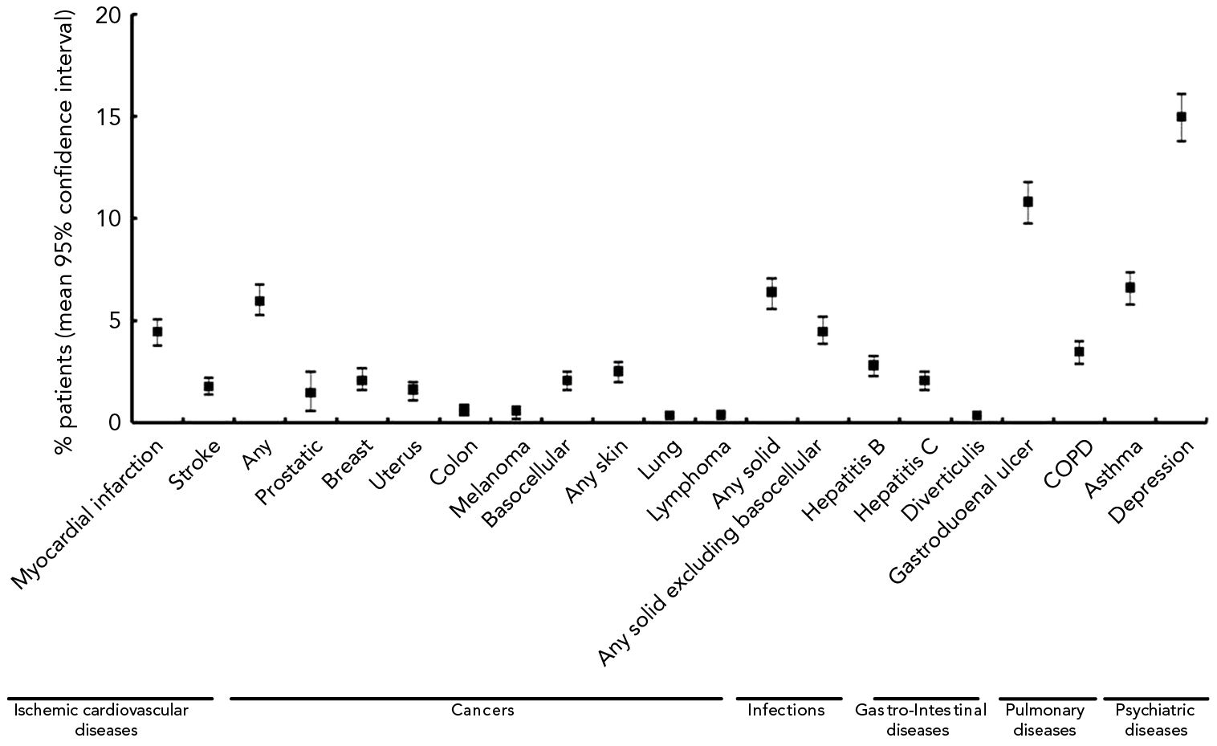
Rheumatoid Arthritis
Prevalence of Comorbidities
Dougados M, et al. Ann Rheum Dis. 2014;73:62-68.

Slide 28
Psoriatic Arthritis

Slide 29
Psoriatic Arthritis
CASPAR: ClASsification Criteria for Psoriatic ARthritis
Inflammatory musculoskeletal disease (arthritis, spondylitis, enthesitis) with 3 or more points from the following:
Evidence of psoriasis: Current psoriasis Personal history of psoriasis Family history of psoriasis | 2 1 1
Psoriatic nail dystrophy | 1
Negative Rheumatoid Factor | 1
Dactylitis (current or recorded by a rheumatologist) | 1
Radiographic evidence of juxta-articular new bone formation | 1
Taylor W, et al. Arthritis Rheum. 2006;54:2665-2673.

Slide 30
PsA Manifestations and Comorbidities
Extra-Articular and Extra-Cutaneous
Need for teamwork with PCP, Ophthalmology, GI, Psych
Uveitis (1.55%)¹
Ulcerative colitis (1.28%)¹
Cerebrovascular disease (7.32%)¹
Metabolic syndrome
  Obesity (16.45%), hypertension (47.28%), hyperlipidemia (47.47%)¹
Fatty liver/NASH (5.77%)¹
Depression (21.2%)¹, suicidal ideation (0.48%)¹
Fatigue (15.8%)²
Fibromyalgia (16.58%)¹
Osteoporosis (9.33%)¹
1. Shah K, et al. RMD Open. 2017;3:e000588.
2. Kaine J, et al. J Manag Care Spec Pharm. 2019;25:122-132.

Slide 31
Delayed Diagnosis of PsA
Worse Long-Term Outcomes
*
Association of clinical features† with >6-month delay in diagnosis
(univariate analysis model)
10.6 (1.4–80.6)
*p<0.05; **p<0.01; ***p<0.001
***
Odds ratio (95% CI)
4.6 (2.5–8.2)
*
**
**
2.3 (1.2–4.4)
2.2 (1.3–3.6)
1.1 (1.0–1.1)
*
0.4 (0.2–0.9)
†Clinical features recorded as percent, unless otherwise stated; DMARD, disease-modifying antirheumatic drug; HAQ, health assessment questionnaire; OR, odds ratio
Haroon M, et al. Ann Rheum Dis. 2015;74:1045-1050.
Notes:
The presence of arthritis mutilans, which is considered as the most severe end of PsA-related joint damage, was significantly associated with all studied intervals of the diagnostic delays on univariate analysis (>6 months, >1, >2 years),
and was significantly associated with a diagnostic delay of >1 year after adjusting for the confounders.’

Slide 32
Psoriatic Arthritis
Outcomes Measures
Domains | Instruments
Joint Assessment | 68/66 T/S joint count, ACR, DAS, PsARC, PsAJAI, DAPSA, cDAPSA
Axial Assessment | BASDAI, BASFI, BASMI
Skin Assessment | PASI, target lesion, global, PSI, PSD
Composite (holistic) | MDA, VLDA, PASDAS, CPDAI, AMDF
Pain | VAS, NRS
Patient Global | VAS (joint global, skin + joints global)
Physician Global | VAS (joint global, skin + joints global)
Function | HAQ, HAQ-S, PSAID
HRQoL | SF-36, PsAQoL, DLQI, PSAID
Fatigue | FACIT, Krupp, MFI, VAS
Enthesitis Assessment | Leeds, SPARCC, MASES, 4-point
Dactylitis Assessment | Leeds, present/absent, acute/chronic
Acute Phase Reactant | ESR, CRP
Imaging | X-ray (modified Sharp or van der Heijde–Sharp), MRI, US
Work/Home Productivity | WPAI, WPS
Mease P. Arthritis Care Res. 2011;63:64-85; Mease P, et al. Ann Rheum Dis. 2005;64:ii49-ii54; Mease P, van der Heijde D. Int J Adv Rheum. 2006;4:38-48.

Slide 33
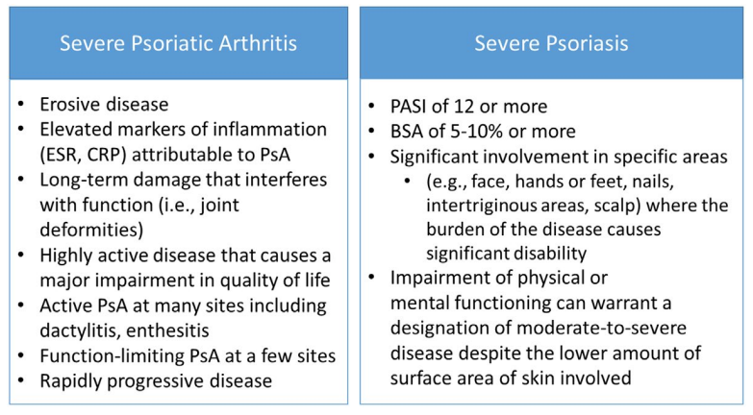
Psoriatic Disease
Severity Impact

Slide 34
PsA
GRAPPA Recommendations: 2015
Overarching Principles
Achieve lowest possible level of disease activity in all domains of disease
  Optimize functional status, improve QoL, and prevent structural damage
Assessment requires consideration of all major disease domains, including peripheral arthritis, axial disease, enthesitis, dactylitis, psoriasis, and nail disease
  The impact of disease on pain, function, QoL, and structural damage should be examined
  In addition, activity in other potential related conditions and comorbidities should be considered including CVD, uveitis, IBD, obesity, metabolic syndrome, gout, diabetes, liver disease, depression, and anxiety
  Patient-reported measures with a comprehensive history and physical examination, often supplemented by laboratory tests and imaging techniques, should also be included
Therapeutic decisions need to be individualized
Ideally, patients should be reviewed promptly
  Early diagnosis and treatment are likely to be of benefit
Coates L, et al. Arthritis Rheumatol. 2016;68:1060-1071.

Slide 35
PsA
EULAR Recommendations: 2015 Update
Overarching Principles
Treatment should maximize HRQoL through control of symptoms, prevention of structural damage, and normalization of function and social participation
  Abrogation of inflammation is an important component necessary to achieve these goals
  Aim should be best care based on a shared decision between patient and rheumatologist, considering efficacy, safety, and costs
Because of its heterogeneity and potential severity, multidisciplinary treatment may be required
  Rheumatologists should primarily care for musculoskeletal manifestations; in the presence of clinically significant skin involvement a rheumatologist and a dermatologist should collaborate in diagnosis and management
  Extra-articular manifestations, metabolic syndrome, CVD and other comorbidities should also be taken into account
Gossec L, et al. Ann Rheum Dis. 2016;75:499-510.

Slide 36
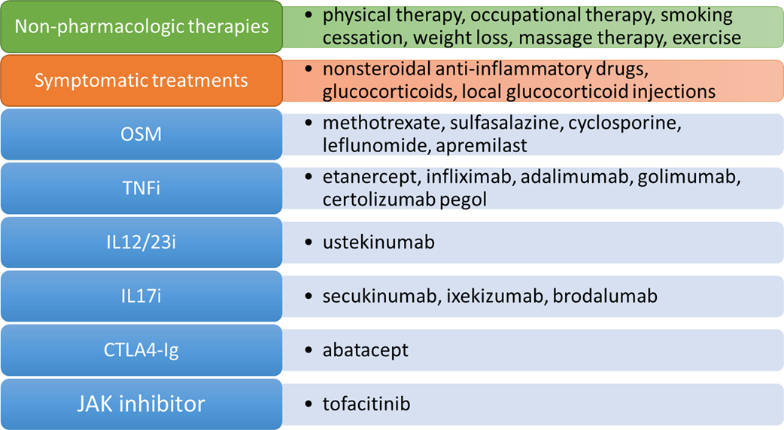
Psoriatic Arthritis
Types of Therapy
Singh A, et al. Arth Rheum. 2019;71;5-32.

Slide 37
Psoriatic Arthritis
Non-Pharmacologic Strategies
Education
  Patient
  Family
  Allied health professionals
Counselling
Diet/weight loss
Physical/occupational therapy
Exercise
  May consider no exercise in patients with existing muscle/tendon injury or multiple inflamed symptomatic joints with worsening pain with exercise
  May consider low-impact exercise (eg, tai chi, yoga, swimming) over high-impact exercise (eg, running)
Massage therapy
Acupuncture
Smoking cessation

Slide 38
Psoriatic Arthritis
GRAPPA Treatment Recommendations 2015
Which domains are involved?
Peripheral arthritis
Axial disease
Enthesitis
Dactylitis
Skin
Nails
NSAIDs only
NSAIDs
NSAIDs
Topicals (keratolytics, steroids, vit. D analogues, emollients, calcineurin i)
Biologics (TNFi, IL12/23i, IL17i) or PDE4i
DMARDs (MTX, SSZ, LFN), TNFi or PDE4i
Biologics (TNFi IL12/23i, IL17i) or PDE4i
DMARDs (MTX, LEF, SSZ) or PDE4i
TNFi, IL17i or *IL12/23i
Physiotherapy
Physiotherapy and NSAIDs
Corticosteroid injections as indicated
Topicals as indicated
Topical or procedural or DMARDs (CSA, LEF, MTX, acitretin)
Biologics (TNFi, IL12/23i IL17i) or PDE4i
Switch biologic (TNFi, IL17i or *IL12/23i)
Phototherapy or DMARDs (MTX, CSA, acitretin, fumaric acid esters) or PDE4i
Assess activity, impact and prognostic factors
Switch biologic (TNFi, IL12/23i, IL17i) or PDE4i
Biologics (TNFi, IL12/23i)
NSAIDs and IAI corticosteroids as indicated
Switch biologic (TNFi, IL12/23i, IL17i) or PDE4i
Switch biologic (TNFi, IL12/23i or IL17i)
No direct evidence for therapies in axial PsA recommendations based on axial SpA literature
CS injections: consider on an individual basis due to potential for serious side effects; no clear evidence for efficacy
Biologics (TNFi, IL12/23i, IL17i) or PDE4i
Switch biologic (TNFi, IL12/23i, IL17i) or PDE4i
Switch biologics (TNFi, IL12/23i, IL17i) or PDE4i
Standard therapeutic route
Expedited therapeutic route
Coates LC, et al. Arthritis Rheumatol. 2016;68:1060-1071.
Notes:
ABSTRACT NUMBER: 7L
Group for Research and Assessment of Psoriasis and Psoriatic Arthritis (GRAPPA): Treatment Recommendations for Psoriatic Arthritis 2015
Laura C Coates^{1,2}, Arthur Kavanaugh³, Philip J. Mease⁴, Enrique R. Soriano⁵, M Laura Acosta-Felquer⁶, April W Armstrong⁷, Wilson Bautista-Molano⁸, Wolf-Henning Boehncke⁹, Willemina Campbell¹⁰, Alberto Cauli¹¹, Luis Espinoza¹², Oliver FitzGerald¹³, Dafna D. Gladman¹⁴, Alice B. Gottlieb¹⁵, Philip S. Helliwell², M. Elaine Husni¹⁶, Thorvardur Love^{17,18}, Ennio Lubrano¹⁹, Neil J McHugh²⁰, Peter Nash²¹, Alexis Ogdie-Beatty²², Ana-Maria Orbai²³, Andrew Parkinson²⁴, Denis O'Sullivan²⁵, Cheryl F Rosen²⁶, Sergio Schwartzman²⁷, Evan Siegel²⁸, Sergio Toloza²⁹, William Tuong³⁰ and Christopher T. Ritchlin³¹, ¹Medicine, University of Rochester, Rochester, NY, ²Leeds Institute of Rheumatic and Musculoskeletal Medicine, University of Leeds, Leeds, United Kingdom,³University of California San Diego, La Jolla, CA, ⁴Rheumatology Research, Swedish Medical Center, Seattle, WA, ⁵Rheumatology, Hospital Italiano de Buenos Aires, Buenos Aires, Argentina, ⁶Rheumatology Unit, Internal Medicine Service, Hospital Italiano de Buenos Aires, Buenos Aires, Argentina, ⁷Keck School of Medicine, University of Southern California, Los Angeles, CA, ⁸Department of Rheumatology, Faculty of Medicine HMC/UMNG, Bogota, Colombia, Bogotá, Colombia, ⁹Department of Dermatology,, Geneva University Hospital, Geneva, Switzerland, ¹⁰Toronto Western Hospital, Toronto, ON, Canada, ¹¹University of Cagliari, Cagliari, Italy, ¹²Medicine-Section of Rheumatology, LSU Medical Center, New Orleans, LA, ¹³Department of Rheumatology, St. Vincent’s University Hospital, UCD School of Medicine and Medical Sciences and Conway Institute of Biomolecular and Biomedical Research, University College Dublin, Dublin, Ireland,¹⁴Division of Rheumatology, Toronto Western Hospital and University of Toronto, Toronto, ON, Canada, ¹⁵Tufts Medical Center, Boston, MA, ¹⁶Rheumatology Dept A50, Cleveland Clinic, Cleveland, OH, ¹⁷Faculty of Medicine, University of Iceland, Reykjavik, Iceland, ¹⁸Landspitali University Hospital, Reykjavík, Iceland, ¹⁹Cattedra di Reumatologia, Università del Molise, Campobasso, Italy, ²⁰Royal National Hospital for Rheumatic Diseases, Bath, United Kingdom, ²¹Department of Medicine, University of Queensland, Brisbane, Australia, ²²Medicine/Rheumatology, Epidemiology and Biostatistics, University of Pennsylvania, Philadelphia, PA, ²³Rheumatology, Johns Hopkins University, Baltimore, MD, ²⁴Chapel Allerton Hospital, Leeds, United Kingdom, ²⁵St. Vincent’s University Hospital, Dublin, Ireland, ²⁶Division of Dermatology, Toronto Western Hospital, University of Toronto, Toronto, ON, Canada, ²⁷Rheumatology, Hospital for Special Surgery, New York, NY, ²⁸Arthritis & Rheumatism Assoc, Wheaton, MD, ²⁹Rheumatology, Ministry of Health, San Fernando del Valle de Catamarca, Argentina, ³⁰Department of Dermatology, University of California David, Davis, CA, ³¹Allergy, Immunology and Rheumatololgy Division, University of Rochester Medical Center, Rochester, NY
Background/Purpose: Since
the 2009 GRAPPA treatment recommendations were published, therapeutic options
and management strategies for psoriatic arthritis (PsA) have advanced considerably.
We updated and improved these recommendations through development of
overarching management principles and evidence based guidance for treatment of
the different manifestations of PsA including associated comorbidities.
Methods: GRAPPA
rheumatologists, dermatologists, and patient research partners (PRPs) drafted
overarching principles for the management of adult PsA patients by consensus. We
updated systematic literature reviews based on data publicly available through
November 2014. Six separate literature reviews were performed covering
treatment for the key clinical manifestations of PsA (arthritis, spondylitis,
enthesitis, dactylitis, skin, and nail disease), and we reviewed a new topic
(PsA related comorbidities). Evidence was assessed, and the GRADE system was
applied to generate strong or conditional recommendations for therapies within
the domain groups and for the management of comorbidities. These
recommendations were then incorporated into an overall treatment schema. Consensus
for the overarching principles and treatment recommendations was obtained among
GRAPPA members with an online questionnaire.
Results: GRAPPA members
voted on six overarching principles developed through multiple iterations with significant
agreement among both health care professionals (HCPs; n=135, agreement
83.7-92.6% for individual principles) and PRPs (n=10, agreement 80-100%). Evidence
was assessed from the published literature reviews and formally evaluated with
the GRADE system to provide treatment recommendations (table 1). Based on the evidence,
individual groups developed treatment recommendations which were incorporated
into an overall schema including principles for management of arthritis,
spondylitis, enthesitis, dactylitis, skin, and nail disease, and comorbidities in
PsA (figure 1). Consensus amongst the GRAPPA members was 87.2% agreement
(n=176) for the treatment recommendations and 87.9% (n=176) for the schema.
Conclusion: Based on the results of the literature review and GRADE assessment of the evidence, we developed updated comprehensive treatment recommendations for the key manifestations of PsA, including related comorbidities. These recommendations are supplemented by overarching principles developed by consensus of GRAPPA members (rheumatologists, dermatologists, other HCPs, and PRPs).

Slide 39
GRAPPA 2015 Recommendations
Therapy Considerations vis-à-vis Comorbidities
Comorbidity | NSAIDs | Glucocorticoids | Cyclosporine | Sulfasalazine | Methotrexate | Leflunomide | Hydroxychloroquine | Etanercept | Adalimumab | Infliximab | Certolizumab | Golimumab | Ustekinumab | Apremilast
CVD | C | ?
CHF | C | C |  |  |  |  |  | C | C | C | C | C
Obesity |  |  |  |  | C
Metabolic syndrome |  | C |  |  | C
Diabetes |  | C |  |  | C
Crohn‘s Disease | ? |  |  | A | OL |  |  |  | A | A | A
Ulcerative Colitis | ? |  | OL | A |  |  |  |  | A | A |  | A
Uveitis |  | P* |  |  |  |  |  | ? | P | P
C | Caution
? | Data insufficient, concerns raised
A | Approved for primary therapy
OL | Off-label use
P | Preferred therapy
SM | Requires special monitoring
*Corticosteroids used as preferred therapy for uveitis are most commonly given as topical and/or intraocular injections in preference to oral steroids.
†When treating patients with chronic infections that can affect the liver, consider consultation with providers having expertise in the area.
Osteoporosis |  | C
Fatty liver disease | C |  |  | C | C | C
CKD | C |  | SM |  | C | ?
Depression |  |  |  |  |  |  |  |  |  |  |  |  |  | ?
Chronic HepB† | C |  |  |  | C | C |  | SM | SM | SM | SM | SM | ?
Chronic HepC† | C |  |  |  | C | C |  |  | ? | ? | ? | ? | ?
HIV |  |  |  |  |  |  |  | SM | SM | SM | SM | SM | ?
Malignancy |  |  |  |  |  |  |  | C | C | C | C | C | ?
Coates LC, et al. Arthritis Rheumatol. 2016;68:1060-1071.

Slide 40
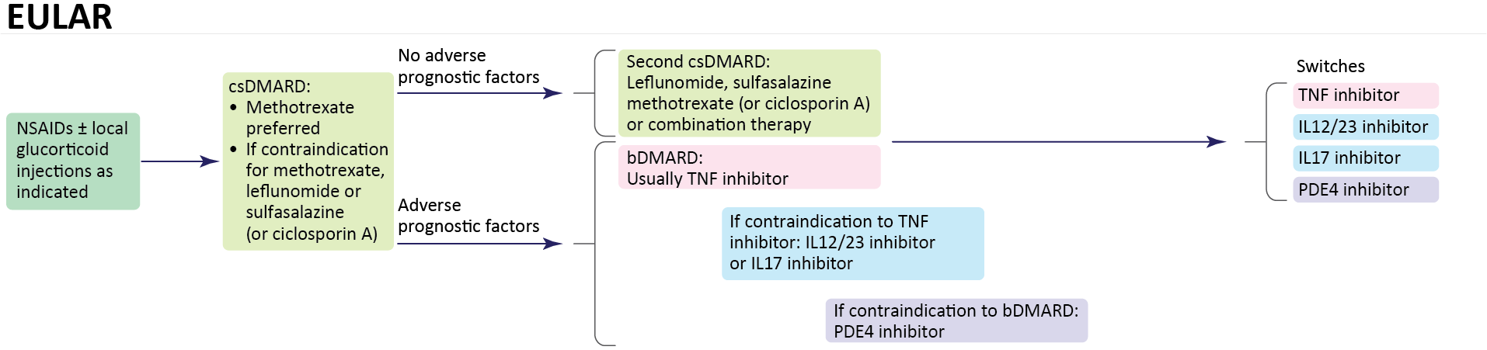
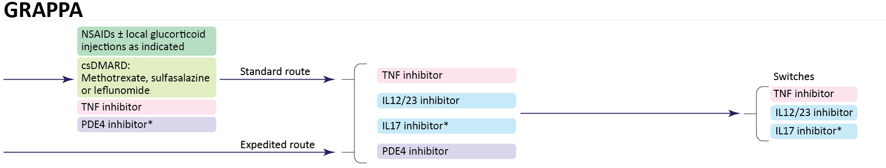
Predominant Peripheral PsA
EULAR 2015 vs GRAPPA 2015 Recommendations
*Conditional recommendation in the guidelines for drugs without current regulatory approval or where recommendations are based on abstract data only.
Gossec L, et al. Nat Rev Rheumatol. 2016;12:743-750.

Slide 41
PsA EULAR Recommendations
Update
Polyarthritis
Rapid use of csDMARD (MTX if psoriasis)
Biologics if 1 csDMARD failure (TNFi, IL17,
IL12/23)
Prefer IL17, IL12/23 if severe psoriasis
Oligoarthritis
Consider DMARD if poor prognostic factors (erosions, ⬆ CRP, steroid, nails)
Biologics if 1 csDMARD failure (TNFi, IL17,
IL12/23)
Enthesitis
No evidence for csDMARDs
First-line biologics
Axial
No evidence for csDMARDs
First-line biologics
(TNFi or IL17)
IL17 if severe psoriasis
Switch to alternative biologic (TNFi, IL17, IL12/23, abatacept) or JAKi
Apremilast for mild arthritis/skin where other options are not appropriate
Consider cautious tapering for patients with sustained remission
Gossec L, et al. EULAR 2019, Madrid.

Slide 42
Treatment-Naive Active PsA
ACR/NPF Treatment Recommendations
Begin with TNFi over OSMs, IL17, or IL12/23
Continued active disease?
Switch to different TNFi*
Continued active disease?
Switch to IL17i*
Continued active disease?
Switch to IL12/23i*
Methotrexate or other OSMs can be employed if indicated by cost or other reasons, depending on local situation, as monotherapy or in combination with biologics or tsDMARDs to bolster effect or combat immunogenicity
*Biologic therapy is recommended over biologic-with-MTX combination therapy
Singh A, et al. Arth Rheum. 2019;71;5-32.

Slide 43
Active PsA Post-OSM
ACR/NPF Treatment Recommendations
Begin with TNFi over OSMs, IL17, or IL12/23
Continued active disease?
Switch to different TNFi*
Continued active disease?
Switch to IL17i*
Continued active disease?
Switch to IL12/23i*
Tofacitinib may be considered if the patient prefers an oral therapy
*Biologic therapy is recommended over biologic-with-MTX combination therapy
Singh A, et al. Arth Rheum. 2019;71;5-32.

Slide 44
PsA With Predominant Enthesitis
ACR/NPF Treatment Recommendations
Start oral NSAIDs, TNFi biologic, or tofacitinib
over an OSM (specifically apremilast)
Continued active disease?
Switch to TNFi over IL17i, IL12/23i or another OSM
Continued active disease?
Switch to IL17i over IL12/23i or another OSM
Continued active disease?
Switch to IL12/23i over another OSM
*Biologic therapy is recommended over biologic-with-MTX combination therapy
Singh A, et al. Arth Rheum. 2019;71;5-32.

Slide 45
Psoriatic Arthritis
Risks of Therapy
Serious infections
TB/opportunistic infections
Neoplasia/lymphoma
Autoimmune disease
  Lupus
  MS
CHF-exacerbation
Liver toxicity
Hematologic toxicity
IBD
Shah K, et al. RMD Open. 2017;3:e000588; Kaine J, et al. J Manag Care Spec Pharm. 2019;25:122-132.

Slide 46
Psoriatic Arthritis
Treatment Strategies
Treat-to-target
  What target?
    MDA/VLDA
    DAPSA remission/LDA
    PASDAS remission/LDA
    CPDAI remission/LDA
    Etc.
  TICOPA
Controlled taper
Controlled withdrawal
Aletaha D. Reumatologia. 2016;54:1-2.

Slide 47
Minimal Disease Activity (MDA)
GRAPPA Criteria
A patient is classified as having MDA when they meet 5 out of 7 of the following criteria:
  Tender joint count ≤1
  Swollen joint count ≤1
  PASI ≤1 or BSA ≤3
  Patient pain VAS ≤15
  Patient global activity VAS ≤20
  HAQ ≤0.5
  Tender entheseal points ≤1
Coates LC, et al. Ann Rheum Dis. 2010;69;48-53.

Slide 48
TICOPA: Tight Control/T2T in PsA
Study Design
Radiograph hands/feet
Radiograph hands/feet
Safety visit
Wk
-4
0
4
8
12
16
20
24
28
32
36
40
44
48
52
TC (n=101)
Assessments
Q12 wks
in both groups; additional review
Q4 wks in tight control only
DMARD naive early PsA (n=206)
MDA
MDA
MDA
MDA
MDA
MDA
MDA
MDA
R: 1:1
StdC
(n=105)
Blinded assessment of clinical and PROs
T2T: Treatment escalation if MDA not reached
TC: Start on MTX
(n=101)
↑ MTX to 25 mg at
Wk 6 if tolerated
↑ To combination DMARDs
if MDA not reached
↑ To anti-TNF if ≥3 tender/swollen
joints or alternative DMARD + MTX
if no MDA but with <3 active joints
StdC (n=105)
Treatment at rheumatologist’s
discretion; no set protocol
0
6
12
24
48
Coates LC, et al. BMC Musculoskelet Disord. 2013 Mar 21;14:101.

Slide 49
TICOPA: Tight Control/T2T in PsA
ACR Responses
Tight control was associated with significantly greater improvements in signs and symptoms of disease at week 48.
Primary outcome: complete case analysis
Tight control
Standard care
ITT with multiple imputations
Outcome measure | OR | Lower 95% CI | Upper 95% CI | P
ACR20 | 1.91 | 1.03 | 3.55 | 0.0392
ACR50 | 2.36 | 1.25 | 4.47 | 0.0081
ACR70 | 2.64 | 1.32 | 5.26 | 0.0058
Coates LC, et al. BMC Musculoskelet Disord. 2013 Mar 21;14:101.

Slide 50
TICOPA
PASI Responses
Reduction in psoriasis severity was achieved in a higher proportion of patients in the tight control arm.
Outcome measure | OR | Lower 95% CI | Upper 95% CI | P
PASI75 | 2.92 | 1.51 | 5.65 | 0.0015
Coates LC, et al. BMC Musculoskelet Disord. 2013 Mar 21;14:101.

Slide 51
TICOPA
AEs and SAEs Incidence: Up to Week 48
 | Tight control | Standard care
Any AE, # | 622 | 249
AE related to study drug (%) | 423 (68.0) | 179 (71.8)
Common AEs
Nausea | 54 | 38
LFT abnormality | 37 | 39
URTI – common cold | 46 | 14
GI upset | 35 | 13
Fatigue | 33 | 8
Deaths | 0 | 0
SAE | 25 (14 pts) | 8 (6 pts)
Drug-related SAE | 8 | 2
Coates LC, et al. BMC Musculoskelet Disord. 2013 Mar 21;14:101.

Slide 52
Addressing the Burden of RA and PsA
The Key Take-Home Point: A Multidisciplinary Approach
Rheumatic diseases are complex systemic illnesses that can affect many aspects of the patient’s life. A collaborative effort between a diverse group of professionals is needed to streamline an effective management strategy.
Rheumatologists, psychologists, physician assistants and nurse specialists should collaborate to adopt an individualized, multidisciplinary approach to the care of RA and PsA patients (the latter should include dermatologists as well).
The role of the multidisciplinary team is to assess and manage the patient’s symptoms and their effects on physical, psychological, and social functioning.
Patients should be encouraged and empowered to take an active role in setting individualized, achievable therapeutic goals and working with their providers to choose an appropriate management plan.

Slide 53
Psoriatic Arthritis Patient Resources
National Psoriasis Foundation
https://www.psoriasis.org/connect-kit
https://www.psoriasis.org/publications/patient-education/booklets
https://www.psoriasis.org/publications/patient-education/fact-sheets
Arthritis Foundation
https://www.arthritis.org/toolkits/better-living/about/psoriatic-arthritis/
https://www.arthritis.org/about-arthritis/types/psoriatic-arthritis/
https://www.arthritis.org/about-arthritis/types/psoriatic-arthritis/articles/
http://blog.arthritis.org/psoriatic-arthritis/?_ga=2.265133391.1150616224.1575976313-781067379.1575976313

Slide 54
Rheumatoid Arthritis Patient Resources
American College of Rheumatology
https://www.rheumatology.org/I-Am-A/Patient-Caregiver
https://www.rheumatology.org/I-Am-A/Patient-Caregiver/Patient-FAQs
https://www.rheumatology.org/I-Am-A/Patient-Caregiver/Diseases-Conditions
https://www.rheumatology.org/I-Am-A/Patient-Caregiver/Patient-Education-Videos
https://www.rheumatology.org/I-Am-A/Patient-Caregiver/Patient-and-Caregiver-Resources
http://simpletasks.org/share-your-story/
https://www.rheumatology.org/Advocacy/Legislative-Action-Center
https://www.rheumatology.org/Portals/0/Files/Assistance%20Programs.pdf
Arthritis Foundation
https://www.arthritis.org/about-arthritis/types/rheumatoid-arthritis/
https://www.arthritis.org/about-arthritis/types/rheumatoid-arthritis/articles/

