Slide 1


Slide 2

Faculty
C. Ola
LANDGREN, MD PhD
Chief
Myeloma Service
Memorial Sloan-Kettering Cancer Center
New York, New York

Slide 3
Disclosures
C. Ola Landgren, MD, PhD
Research Grant | Amgen, Celgene, Janssen, Takeda
Honoraria | Amgen, Celgene, Janssen

Slide 4
Learning Objectives
Assess the factors that determine the choice of therapy for patients with relapsed/refractory multiple myeloma (RRMM), including disease heterogeneity, risk stratification, prior therapies, patient characteristics and comorbidities, performance status, and treatment goals
Compare and contrast the current and emerging immunotherapy approaches for patients with RRMM, including the evolving role of immunotherapies targeting BCMA in this setting
Adequately translate immunotherapy clinical trial findings into the real-world setting for patients with RRMM
Manage adverse events associated with the use of immunotherapy in patients with RRMM

Slide 5
Multiple Myeloma
Stats
The most common hematologic malignancy in the adult population
  Over 120,000 people living with the disease
    In the absence of curative therapies, the number of people living with MM will continue to rise rapidly
US estimates for 2020:
  32,270 new cases
  12,830 deaths
Incidence rates:
  8.7 per 100,000 men
  5.6 per 100,000 women
  More than twice as high in blacks as in whites
Median age at the time of diagnosis: 69 years
5-year survival rate: 52.2%
Landgren O. Best Pract Res Clin Haematol. 2020;33:101155;
Siegel R, et al. CA Cancer J Clin. 2020;70:7-30;
NCI/SEER. Available at: seer.cancer.gov/statfacts/html/mulmy.html;

Slide 6
Multiple Myeloma
Complex Genetic and Molecular Landscape
Historically, two main categories of abnormalities described:
  Hyperdiploidy, characterized by gains of odd numbered chromosomes
  Immunoglobulin heavy chain (IGH) translocations, including t(4;14), t(6;14), t(11;14), t(14;16), and t(14;20)
In addition, recurrent chromosomal gains and losses have been reported, eg, gain 1q, del(13q), and del(17p)
Some of these aberrations define subgroups of patients associated with poor prognosis, e.g., t(4;14), t(14;16), and del(17p)
Yellapantula V, et al. Blood Cancer J. 2019;9:101;
Manier S, et al. Nat Rev Clin Oncol. 2017;14:100-113;
Morgan GJ, et al. Nat Rev Cancer. 2012;12:335-348.

Slide 7
Multiple Myeloma
Complex Genetic and Molecular Landscape (cont.)
Emerging data suggest that current high-risk definition can be further improved
  For example, bi-allelic events including TP53 and >3 copies of 1q have been recently associated with poor outcomes
Current standard-of-care setting:
  Conventional chromosome analysis, myeloma-targeted FISH panels, and single nucleotide polymorphism (SNP) microarrays to detect translocations and gain/losses
Neither FISH nor SNP microarray approaches are able to capture somatic point mutations
Yellapantula V, et al. Blood Cancer J. 2019;9:101; Maura F, et al. Nat Commun. 2019;10:3835; Walker BA, et al. Leukemia. 2019;33:159-170;
Walker BA, et al. Blood. 2018;132:587-597; Lohr JG, et al. Cancer Cell. 2014;25:91-101; Bolli N, et al. Nat Commun. 2014;5:2997.

Slide 8
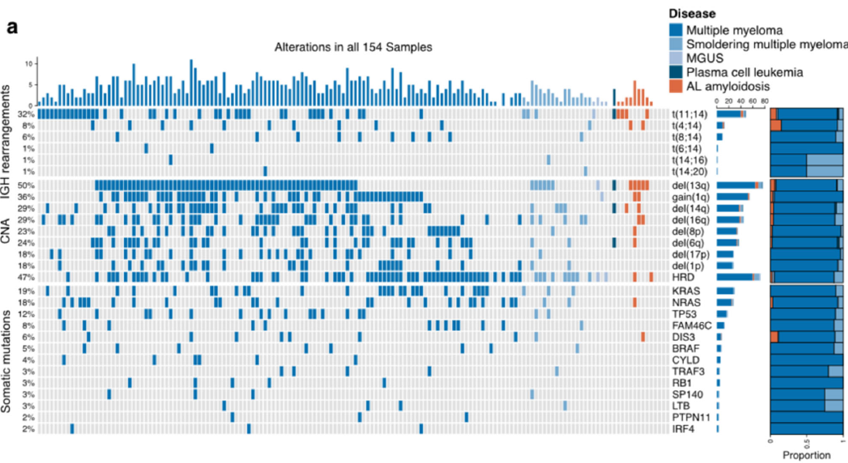
MM-Specific NGS Assay
Going Beyond Conventional Cytogenetic Classification
Yellapantula V, et al. Blood Cancer J. 2019;9:101.
Notes:
With the custom capture NGS assay (myTYPE), IGH translocations were detected in 51%, MM-relevant CNAs in 83%, and somatic mutations in 85% percent of patients.
The overall sensitivity and specificity for the custom capture NGS assay were 99% and 99%, respectively, using SNP microarray as reference.
19% and 18% of the samples each harbored KRAS and NRAS mutations, respectively, and 5% of patients harbored a BRAF V600E mutation. TP53, FAM46C, and DIS3 were detected in 12%, 8%, and 6% of patients, respectively.
Moreover, a tumor-specific clonal V (D)J rearrangement sequence in 127 of 154 samples (82%) were identified.
The ability to capture relevant somatic mutations as well as recurrent IGH translocations and all CNAs with high sensitivity and specificity in a single assay supports the clinical strengths of MM custom capture NGS assays as optimal for patient care in the modern era.

Slide 9
Relapsed/Refractory MM
Growing Unmet Need
Despite new and more effective treatments, MM remains incurable.
Recently, a new subset of patients with triple-refractory disease, ie, refractory to IMiDs, PIs, and mAbs, has emerged.
  These patients have poor survival outcomes.
  Thus, there is an urgent and growing unmet clinical need for newer therapeutic strategies for such patients.
Kumar SK, et al. Leukemia. 2017;31:2443-2448;
Ravi P, et al. Blood Cancer J. 2018;8:26;
Gandhi UH, et al. Leukemia. 2019;33:2266-2275;
Mikhael J. Clin Lymphoma Myeloma Leuk. 2020;20:1-7;
Shah N, et al. Leukemia. 2020;34:985-1005.
Notes:
Despite the availability of numerous treatment options, MM remains an incurable disease whose natural history is characterized by phases of disease remission followed by relapses. The remission duration tends to progressively decrease at every subsequent relapse and MM inevitably becomes refractory to all available agents.

Slide 10
Relapsed/Refractory MM
Current Treatment Options
DaraRd
EloRd
KRd
IRd
DaraVd
PanoVD
EloVD
VCD
Vd
IMiD-based
DaraVd
Kd
PanoVd
EloVD
VCD
VMP
VTD
Vd
1st relapse
Kd
PomD
CycloPomD
IPomD
PomVD
DaraPomD
EloPomD
Dara monotherapy
DaraVd
Clinical trail
PomD
CycloPomD
IPomD
PomVD
DaraPomD
EloPomD
Dara monotherapy
DaraRd
Clinical trail
PomD
CycloPomD
IPomD
PomVD
DaraPomD
EloPomD
Dara monotherapy
DaraRd
Clinical trail
2nd relapse
Mateos MV. Hemasphere. 2018;3:e163.
Notes:
Current treatment options for patients with MM at 1st and 2nd relapse.
CycloPomD = cyclophosphamide, pomalidomide, and dexamethasone; Dara = daratumumab, DaraPomD = daratumumab, pomalidomide, and dexamethasone; DaraRd = daratumumab, lenalidomide, and dexamethasone; DaraVd = daratumumab, bortezomib, and dexamethasone; EloPomD = elotuzumab, pomalidomide, and dexamethasone; Elo-Rd = elotuzumab, lenalidomide, and dexamethasone; Elo-Vd = elotuzumab, bortezomib, and dexamethasone; IPomD = ixazomib, pomalidomide, and dexamethasone; IRd = ixazomib, lenalidomide, and dexamethasone; Kd = carfilzomib and dexamethasone; KRd = carfilzomib, lenalidomide, and dexamethasone; Len = lenalidomide; Pano-Vd = panobinostat, bortezomib, and dexamethasone; PomD = pomalidomide and dexamethasone; PomVD = pomalidomide, bortezomib, and dexamethasone; Rd = lenalidomide and dexamethasone; VCD = bortezomib, cyclophosphamide, and dexamethasone; Vd = bortezomib and dexamethasone; VMP = bortezomib, melphalan, prednisolone; VTD = bortezomib, thalidomide, and dexamethasone.

Slide 11
Relapsed/Refractory MM
Subsequent Therapy Considerations
Patient Factors
Age
Comorbidities
  Renal function
  Hepatic function
  Neuropathy
  Thrombosis
  Other
Bone marrow reserve
  Prior HDT/ASCT
  Long-term IMiD therapy
  Received alkylating agents
QOL and patient preference
Treatment/Disease Factors
Cytogenetics
R-ISS
Severity and aggressiveness of relapse
  Progression after therapy
  Progression on therapy
Previous therapies
  Types
  Single vs multidrug treatment regimen
  Duration
Remission
  Depth
  Duration
Bazarbachi AH, et al. Leukemia. 2019;33:2343-2357.
Pawlyn C, Davies FE. Blood. 2019;133:660-675.

Slide 12
Relapsed/Refractory MM
Current and Emerging Immunotherapy
Targets
CD38
SLAMF7 (CS1)
BCMA
Immune checkpoints
  PD-1/PD-L1, Tim-3, LAG-3, TIGIT
FcRH5
GPRC5D
NKG2D ligands
κ light chain
Activated integrin β7
CD19, CD46, CD48, CD56, CD74, CD138, CD229
Therapeutic Modalities
Naked mAbs
ADCs
Bispecific mAbs
BiTEs
CAR T cells
CAR NK cells
Cohen AD. Hematology Am Soc Hematol Educ Program. 2019;2019:266-272;
Sidana S, Shah N. Hematology Am Soc Hematol Educ Program. 2019;2019:260-265;
Shah UA, Mailankody S. Best Pract Res Clin Haematol. 2020;33:101141;
Tamura H. Int J Hematol. 2018;107:278-285; Radhakrishnan SV, et al. Nat Commun. 2020;11:798; Hosen N. Cancers. 2019;11:2024.

Slide 13
Targeting CD38
Rationale and Anti-CD38 mAbs MoA
Bonello F, et al. Cancers. 2020;12:15.
Notes:
CD38, a transmembrane type II glycoprotein that is highly expressed on normal plasma cells and MM cells, acts as a receptor, adhesion molecule, and ectoenzyme.
Anti-CD38 mAbs act by inducing antibody-dependent cell-mediated cytotoxicity (ADCC), antibody-dependent cell-mediated phagocytosis (ADCP), and complement-dependent cytotoxicity (CDC).
In addition, anti-CD38 mAbs suppress immune cells such as myeloid-derived suppressor cells (MDSCs), subset of regulatory T cells (Tregs), and regulatory B cells (Bregs), while simultaneously expanding CD8+ cytotoxic and CD4+ helper T cells, which show increased killing capacity due to augmented levels of granzyme B that activates caspases and triggers cell apoptosis.
Anti-CD38 mAbs also increase NAD+ in T effector cells, thus enhancing their antitumor activity.
Finally, there seem to be a marked synergism between anti-CD38 mAbs and IMiDs, mainly owing to an enhanced NK activity elicited by IMiDs that increases both number and activity of NK cells and consequently ADCC, as well as the cytotoxic activity of macrophages, thus stimulating ADCP.

Slide 14
Targeting CD38 in RRMM
Current and Select Emerging Immunotherapy
Daratumumab (naked mAb), FDA approved:
  In combination with Rd in pts who have received ≥1 prior therapy
  In combination with Vd in pts who have received ≥1 prior therapy
  In combination with Pd in pts who have received ≥2 prior therapies including lenalidomide and a PI
  As monotherapy, in pts who have received ≥3 prior lines of therapy including a PI and an IMiD or who are double-refractory to a PI and an IMiD
Isatuximab (naked mAb), FDA approved
  In combination with Pd in pts who have received ≥2 prior therapies including lenalidomide and a PI
MOR202 (naked mAb, discontinued)
TAK-079 (naked mAb)
TAK-573 (naked mAb)
TAK-169 (naked mAb)
GBR 1342 (BiTE)
CD38 CAR T cells
Cohen AD. Hematology Am Soc Hematol Educ Program. 2019;2019:266-272; Wudhikarn K, et al. Best Pract Res Clin Haematol. 2020;33:101143;
Sidana S, Shah N. Hematology Am Soc Hematol Educ Program. 2019;2019:260-265;
Tamura H. Int J Hematol. 2018;107:278-285; Bonello F, et al. Cancers. 2020;12:15; Martin TG, et al. Cells. 2019;8:1522;
DARZALEX® (daratumumab): http://www.janssenlabels.com/package-insert/product-monograph/prescribing-information/DARZALEX-pi.pdf;
SARCLISA® (isatuximab): http://products.sanofi.us/Sarclisa/sarclisa.pdf.
Notes:
Daratumumab was first FDA approved in November 2015 to be used as monotherapy for the treatment of patients with RRMM. A Biologics License Application (BLA) was submitted to the FDA in July 2019 seeking approval for a new subcutaneous (SC) formulation of daratumumab in patients with RRMM. This application was based on the results of the phase 3 COLUMBA trial (NCT03277105).
On May 2, the FDA has approved isatuximab in combination with pomalidomide and dexamethasone for the treatment of adults with RRMM who have received at least two prior therapies including lenalidomide and a proteasome inhibitor (https://www.sanofi.com/en/media-room/press-releases/2020/2020-03-02-19-51-16).

Slide 15
Daratumumab
Select Trials in RRMM
Study | Phase | Patients (#) | Previous Therapy (Median #) | Regimen | ORR (%) | Median PFS (Months) | Median OS (Months)
GEN501 + SIRIUS POOLED | 2 | 148 | 5 | Daratumumab monotherapy | 31.1 | 4 | 20.1
POLLUX | 3 | 569 | 1 | Dara-Rd vs Rd | 92.9 vs 76.4 | NR vs 17.5 | 1-year OS 92.1% vs 86.8%
CASTOR | 3 | 498 | 2 | Dara-Vd vs Vd | 83.8 vs 63.2 | 16.7 vs 7.1 | NA
EQUULEUS | 2 | 103 | 4 | Dara-Pom-d | 60 | 8.8 | 17.5
MMY1001 | 1b | 85 | 2 | Dara-Kd | 84 | 1-year PFS 74% | 1-year OS 82%
Bonello F, et al. Cancers. 2020;12:15.

Slide 16
Daratumumab
Select Ongoing Trials in RRMM
Study | Setting | Phase | Study Design
EMN14 | RRMM (302 pts) | 3 | Dara-Pom-d vs Pom-d
CANDOR | RRMM (466 pts) | 3 | Dara-Kd vs Kd
Bonello F, et al. Cancers. 2020;12:15.

Slide 17
Isatuximab
Select Trials in RRMM
Study | Phase | Patients (#) | Previous Therapy (Median #) | Regimen | ORR (%) | Median PFS (Months) | Median OS (Months)
NCT01749969 | 1b | 57 | 5 | Isa-Rd | 56 | 8.5 | NR
NCT02283775 | 1b | 45 | 3 | Isa-Pd | 62 | 17.6 | NR
NCT02332850 | 1b | 33 | 3 | Isa-Kd | 66 | NR | NR
ICARIA-MM | 3 | 307 | 3 | Isa-Pd vs Pd | 60 vs 35 | 11.5 vs 6.5 | NA
Bonello F, et al. Cancers. 2020;12:15.

Slide 18
Isatuximab
Select Ongoing Trials in RRMM
Study | Patients (#) | Phase | Study Design
IKEMA | 302 | 3 | Isa-Kd vs Kd
ICARIA-MM | 307 | 3 | Isa-Pom-d vs Pom-d
Bonello F, et al. Cancers. 2020;12:15.

Slide 19
Daratumumab and Isatuximab
Comparison
Bind to distinct CD38 epitopes, which may contribute to the differences in their mode of action.
  Both induce ADCP and CDC, and both demonstrate ADCC that can be potentiated by other antimyeloma agents.
  Isatuximab, unlike daratumumab, can also induce direct apoptosis.
  Isatuximab does not lead to decreased CD38 expression, whereas daratumumab leads to the CD38 clustering and release in microvesicles.
  Isatuximab, unlike daratumumab, inhibits CD38 ectoenzymatic activity.
Both are well tolerated, with IRRs being the most common AEs.
  Mostly grade 1 and 2, seen commonly during the first and second infusions.
Martin TG, et al. Cells. 2019;8:1522;
Plesner T, Krejcik J. Front Immunol. 2018;9:1228;
Nooka AK, et al. J Oncol Pract. 2018;14:414-422;
van de Donk NWCJ, Usmani SZ. Front Immunol. 2018;9:2134.
Notes:
IRRs = infusion-related reactions.

Slide 20
Anti-CD38 mAbs
Mechanism of Resistance
Saltarella I, et al. Cells. 2020;9:167.
Notes:
Anti-CD38 mAb mechanisms of resistance include the following: (i) clone selection of CD38dim MM cells; (ii) CD38 reduction via CD38 endocytosis, trogocytosis by granulocytes and monocytes, and via release of CD38-expressing microvesicles that contribute to ADO production and immunosuppression; (iii) immunomodulatory effects via downregulation of intracellular pathways in BMSCs, a decrease of effector memory T cells, M1 macrophages, and of the co-stimulatory CD28 expression on T cells; (iv) MM cells overexpression of CD46 and of the membrane-associated complement-inhibitory proteins (CD55 and CD59) that prevent CDC; (v) MM cells’ overexpression of CD47 that recognizes SIRPα on TAMs inhibiting ADCP; and (vi) depletion of CD38+ NK cells via fratricide ADCC.

Slide 21
Targeting SLAMF7/CS1
Rationale and Anti-SLAMF7/CS1 mAb MoA
Campbell KS, et al. Front Immunol. 2018;9:2551.
Notes:
Elotuzumab promotes numerous innate immune mechanisms to enhance attack of MM cells by NK cells and macrophages, including: (1) Facilitating NK cell-mediated ADCC of MM cells through Fc-dependent interactions with FcγRIIIA (CD16); (2) Promoting SLAMF7-SLAMF7 interactions to enhance ITSM-mediated co-stimulatory signaling in NK cells, which likely requires simultaneous engagement of ITAM-linked activating receptors on NK cells with ligands on MM cells; (3) Triggering ITSM-mediated co-stimulatory signaling in NK cells to enhance calcium signaling originating from ITAM-linked activating receptors (such as NKp46 or CD16) engaging with ligands on MM cells; (4) Promoting macrophage-mediated ADCP of MM cells through Fc-dependent interactions with Fcγ receptors. The operative Fcγ receptors in macrophages that can promote ADCP are FcγRIIIA (CD16), FcγRIIA (CD32), and FcγRI (CD64); (5) Although not yet established, it is possible that elotuzumab may also be able to promote SLAMF-SLAMF7 interactions and co-stimulatory signaling to enhance ADCP in macrophages expressing both SLAMF7 and EAT-2.

Slide 22
Targeting SLAMF7/CS1 in RRMM
Current Immunotherapy
Elotuzumab (naked mAb), FDA approved:
  In combination with Rd for the treatment of adult pts with MM who have received 1-3 prior therapies
  In combination with Pd for the treatment of adult pts with MM who have received ≥2 prior therapies including lenalidomide and a PI
ABBV-838 (ADC, discontinued)
Vij R, et al. Clin Cancer Res. 2020 Jan 22. [Epub ahead of print]
EMPLICITI® (elotuzumab): http://packageinserts.bms.com/pi/pi_empliciti.pdf.

Slide 23
Elotuzumab
Select Trials in RRMM
Study | Phase | Patients (#) | Previous Therapy (Median #) | Regimen | ORR (%) | Median PFS (Months) | Median OS (Months)
NCT00425347 | 1 | 35 | 5 | Elo (0.5–20 mg/kg) | 0 | NA | NA
ELOQUENT-2 | 3 | 321 | 2 | Elo-Rd vs Rd | 79 vs 66 | 19.4 vs 14.9 | 48 vs 40
ELOQUENT-3 | 2 | 117 | 3 | Elo-Pom-d vs Pd | 53 vs 26 | 10.3 vs 4.7 | NA
NCT00726869 | 1 | 28 | 2 | Elo-V | 48 | 9.5 | NA
NCT01478048 | 2 | 152 | NA | Elo-Vd vs Vd | 66 vs 63 | 9.7 vs 6.9 | 2-year OS 73% vs 66%
Ongoing
Elotuzumab-PomVd (NCT02718833)
Bonello F, et al. Cancers. 2020;12:15.

Slide 24
Anti-CD38 mAbs and Elotuzumab
Management of IRRs: Prevention
Premedication consists of steroids, antihistamines, and acetaminophen, 30-60 min. prior to infusion.*
For pts treated with CD38-targeting mAbs with higher risk of respiratory complications (eg, FEV1 <80%), post-infusion medication should be considered (eg, antihistamines, ꞵ-2 adrenergic receptor agonist by inhalation, or inhalation corticosteroids for pts with asthma and COPD).
*Prophylactic treatment with the oral leukotriene antagonist montelukast 10 mg the day before and again on the morning of infusion is considered by some investigators to be a useful adjunct to the standard premedication with acetaminophen, antihistamine, and corticosteroid to prevent airway reactions following the administration of CD38-targeting antibodies.
van de Donk NW, et al. Blood. 2016;127:681-695.

Slide 25
Anti-CD38 mAbs and Elotuzumab
Management of IRRs: Prevention (cont.)
Because pts who had COPD with a FEV1 <50% of the predicted normal value and moderate or severe persistent asthma within the past 2 years, or who had uncontrolled asthma, were excluded from daratumumab trials, it is recommended to perform FEV1 testing, if there is a suspected COPD; it should be considered to exclude pts from daratumumab treatment, if FEV1 is <50% of predicted normal value.
FEV1 testing is also recommend for pts who are planned to be treated with isatuximab, given the similar pattern and frequency of IRRs.
*Prophylactic treatment with the oral leukotriene antagonist montelukast 10 mg the day before and again on the morning of infusion is considered by some investigators to be a useful adjunct to the standard premedication with acetaminophen, antihistamine, and corticosteroid to prevent airway reactions following the administration of CD38-targeting antibodies.
van de Donk NW, et al. Blood. 2016;127:681-695.

Slide 26
Anti-CD38 mAbs and Elotuzumab
Management of IRRs: Treatment
Interrupt infusion, consider administration of corticosteroids, antihistamines, IV fluid, or ꞵ-2 adrenergic receptor agonist by inhalation; after infusion reaction is resolved, restart infusion at lower rate (eg, half of that used before the interruption).
Pts experiencing respiratory events, which occur more frequently with CD38-targeting mAbs, may benefit from pre- and post-infusion prophylaxis with a bronchodilator or, in case patients have concomitant asthma or COPD, additional medication such as inhalation corticosteroids.
*Prophylactic treatment with the oral leukotriene antagonist montelukast 10 mg the day before and again on the morning of infusion is considered by some investigators to be a useful adjunct to the standard premedication with acetaminophen, antihistamine, and corticosteroid to prevent airway reactions following the administration of CD38-targeting antibodies.
van de Donk NW, et al. Blood. 2016;127:681-695.

Slide 27
Anti-CD38 mAbs and Elotuzumab
Management of Other AEs
AE | mAb | Prevention and Management
Any (other than IRR) | CD38-targeting antibodies and elotuzumab | In general, dose-delay is the primary method for the management of side effects (and not dose-reductions)
Infections | CD38-targeting antibodies and elotuzumab | No formal recommendations can be made at the present time. Herpes zoster prophylaxis should be considered. It is recommended to screen patients for HIV, HBV, and HCV before start of therapy.
van de Donk NW, et al. Blood. 2016;127:681-695.

Slide 28
Anti-CD38 mAbs and Elotuzumab
Management of Laboratory Interference
Laboratory test | mAb | Management
Interference with serum protein electrophoresis and immunofixation assays | Several therapeutic mAbs | DIRA should be performed when daratumumab-treated patients with IgG-k M-protein have achieved deep response (M-protein <2 g/L) New assays are in development for elotuzumab, isatuximab and MOR202
Interference with multiparametric flow cytometry | Daratumumab, isatuximab, MOR202, and possibly other therapeutic mAbs | Use of newly developed Abs for flow cytometry, which bind to different epitopes compared with the therapeutic mAb Application of alternative plasma cell identification markers
Interference with blood compatibility testing | CD38-targeting mAbs (also observed with anti-CD44 mAbs) | Denaturation of CD38 from reagent RBCs by dithiothreitol Neutralization of therapeutic mAb with neutralizing Abs or recombinant soluble CD38 Extensive RBC antigen phenotyping before the patient receives the first infusion of the CD38-targeting antibody or RBC antigen genotyping when the patient has already received treatment with an anti-CD38 mAb or a recent blood transfusion (<3 mos) A wallet card that informs physicians and blood banks of the interference with blood compatibility testing should be provided to all patients treated with CD38-binding mAbs
van de Donk NW, et al. Blood. 2016;127:681-695.
Notes:
DIRA = daratumumab interference reflex assay.

Slide 29
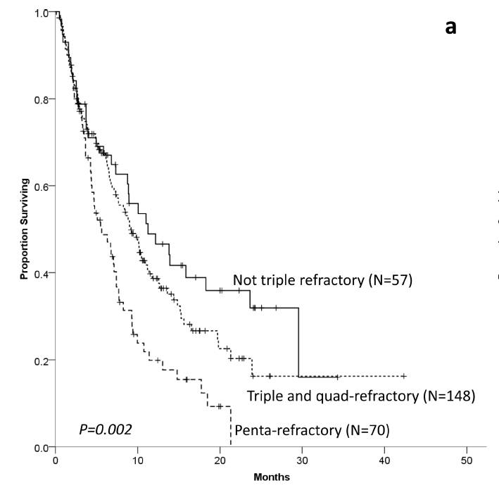
Anti-CD38 mAb-Refractory MM
MAMMOTH
275 pts refractory to daratumumab or isatuximab, from 14 US academic centers
  57 pts “not triple-refractory” (refractory to 1 CD38 mAb, and not to both a PI and an IMiD); mOS = 11.2 mos
  148 pts “triple/quad-refractory” (refractory to 1 CD38 mAb + 1 PI + 1 or 2 IMiDs, or 1 CD38 mAb + 1 or 2 PIs + 1 IMiD); mOS = 9.2 mos
  70 pts “penta-refractory” (refractory to 1 CD38 mAb + 2 PIs + 2 IMiDs); mOS = 5.6 mos
249 pts (90%) received further therapy
OS
Gandhi UH, et al. Leukemia. 2019;33:2266-2275.

Slide 30
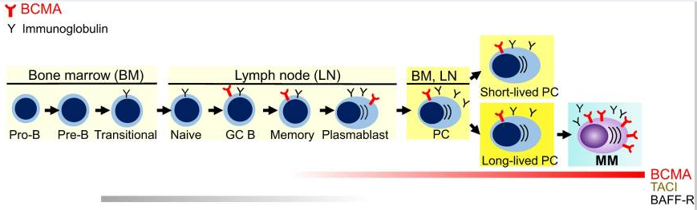
BCMA as Target in MM
Malignant vs Normal PCs Expression
BCMA
Y Immunoglobulin
BCMA
TACI
BAFF-R
BCMA exspression significantly increased on malignant vs normal PCs
Cho SF, et al. Front Immunol. 2018;9:1821.
Notes:
BCMA is selectively induced during PC differentiation, associated with loss of BAFF-R. It is expressed on late-stage B-cells, short-lived proliferating plasmablasts, and long-lived PCs. BCMA does not maintain normal B-cell homeostasis but is required for the survival of long-lived PCs. In MM, expression of BCMA is significantly increased on malignant vs normal PCs.

Slide 31
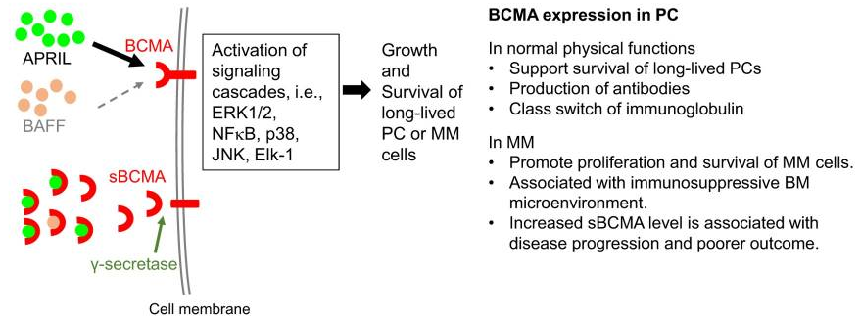
BCMA Function
Malignant vs Normal PCs
Cho SF, et al. Front Immunol. 2018;9:1821.

Slide 32
Targeting BCMA
Treatment Modalities
Cho SF, et al. Front Immunol. 2018;9:1821.
Notes:
Various BCMA-targeted treatment modalities with multiple mechanisms of action against MM cells are under clinical development. BCMA-NK Bi or Tri Ab, not shown here, can also specifically induce effector cell-mediated lysis of MM cells.
(ADC, antibody drug conjugate; Bi, bispecific full-length immunoglobulin; BiTE, bispecific T-cell engager; CAR T, chimeric antigen receptor T cell; NK, natural killer cell; Mφ, macrophage)

Slide 33
Targeting BCMA
Emerging Therapies
ADC
Belantamab mafodotin (GSK2857916)
MEDI2228
CC-99712
BiTE/DuoBody Ab
AMG 420
AMG 701
CC-93269
REGN5458
PF-06863135
JNJ-64007957
CAR T cell
Idecabtagene vicleucel (bb2121)
LCAR-B38M
bb21217
MCARH171
P-BCMA-101
ALLO-715
Shah N, et al. Leukemia. 2020;34:985-1005.

Slide 34
Targeting BCMA
ADCs MoA
ADCs are tumor-associated antigen (TAA)-targeted mAbs conjugated to toxic payloads.
Once bound to TAA-expressing target cells, ADCs are internalized, and the toxic payload is released to induce DNA damage and cell death.
Cleavable linkers are enzymatically processed within the target cell, while the action of ADCs with non-cleavable linkers requires degradation of the attached antibody within lysosomes to release the payload.
Shah N, et al. Leukemia. 2020;34:985-1005.
Notes:
ADCs are tumor-associated antigen (TAA)-targeted mAbs conjugated to toxic payloads, such as tubulin polymerization inhibitor monomethyl auristatin F (MMAF), pyrrolobenzodiazepine (PBD), or the RNA polymerase II inhibitor α-amanitin, using a cleavable or non-cleavable linker. Once bound to TAA-expressing target cells, ADCs are internalized, and the toxic payload is released to induce DNA damage and cell death.
Cleavable linkers are enzymatically processed within the target cell, while the action of ADCs with non-cleavable linkers requires degradation of the attached antibody within lysosomes to release the payload.
.

Slide 35
Belantamab Mafodotin
DREAMM-2
196 pts refractory to prior IMiD, PI, and an anti-CD38 mAb randomized to receive 2 doses of belantamab mafodotin:
  2.5 mg/kg IV Q3W (n=97)
  3.4 mg/kg IV Q3W (n=99)
ORR:
  31% (2.5 mg/kg cohort)
  34% (3.4 mg/kg cohort)
Median DoR, PFS, and OS: not reached in either cohort
The most common grade 3-4 AEs were keratopathy (27% and 21%), thrombocytopenia (20% and 33%), and anaemia (20% and 25%) in 2.5 mg/kg and 3.4 mg/kg cohorts, respectively.
2 deaths were potentially treatment-related and caused by sepsis (2.5 mg/kg cohort) and hemophagocytic lymphohistiocytosis (3.4 mg/kg cohort).
Lonial S, et al. Lancet Oncol. 2020;21:207-221.

Slide 36
BCMA-Targeted ADCs
Select Trials in RRMM
Belantamab mafodotin vs Pd (DREAMM-3; NCT04162210)
Belantamab mafodotin + pembrolizumab (DREAMM-4; NCT03848845)
Belantamab mafodotin ± GSK3174998 or GSK3359609 (DREAMM-5; NCT04126200)
Belantamab mafodotin + Rd or Vd (DREAMM-6; NCT03544281)
Belantamab mafodotin + Vd vs Dara-Vd (DREAMM-7; NCT04246047)
MEDI2228 (NCT03489525)
CC-99712 (NCT04036461)

Slide 37
Targeting BCMA
BiTE/DuoBody Ab MoA
Shah N, et al. Leukemia. 2020;34:985-1005.
Notes:
Bispecific antibody constructs are engineered to have dual antigen specificity to facilitate cell-to-cell interactions between the patients’ own T cells and malignant cells expressing tumor-specific antigens. Several different structures have been used for bispecific antibody constructs investigated in oncological clinical trials.
Forms of these constructs that have been investigated in MM include BiTE® and DuoBody®, among others.
BiTE® molecules are fusion proteins consisting of single-chain variable fragments (scFv) with unique antigen specificities.
DuoBody® bispecific antibody constructs are generated via Fab-arm exchange, which uses mutations and recombination at the CH3–CH3 antibody interface to combine heavy and light chain homodimers from two separate mAbs into a single heterodimeric, bispecific antibody structure.
Of these two modalities, BiTE® molecules are currently the only type of bispecific antibody construct with pre- liminary efficacy data from clinical trials in MM.

Slide 38
AMG 420
First-in-Human Phase 1 Dose Escalation Study
42 pts (median 5 prior therapies) received AMG 420 at 0.2-800 mg/d
  Up to 10 cycles of AMG 420 were given (4-week infusions/6-week cycles)
800 mg/d was deemed not tolerable because of 1 grade 3 CRS and 1 grade 3 PN, both of which resolved.
ORR=31%
  At the MTD of 400 mg/d, the ORR was 70% (7/10); of these, 5 pts had MRD-negative CR, and 1 had a PR, and 1 had a VGPR; all 7 pts responded during the first cycle, and some responses lasted > 1 year
Serious AEs (n=20; 48%) included infections (n=14) and PN (n = 2); treatment-related serious AEs included 2 grade 3 PNs and 1 grade 3 edema; there were no grade ≥3 CNS toxicities
Topp MS, et al. J Clin Oncol. 2020;38:775-783.

Slide 39
BCMA-Targeted BiTEs and DuoBody Ab
Select Trials in RRMM
AMG 420 (NCT04162210)
AMG 701 (NCT03287908)
REGN5458 (NCT03761108)
PF-06863135 (NCT03269136)
CC-93269 (NCT03486067)
JNJ-64007957 (DuoBody Ab; NCT03145181)

Slide 40
Targeting BCMA
CAR T Cell Therapy MoA
Shah N, et al. Leukemia. 2020;34:985-1005.
Notes:
Chimeric antigen receptor (CAR) T cells are genetically modified T cells that express a CAR targeted against a specific TAA, which upon binding initiates T-cell activation in a human leukocyte antigen–independent manner.
These CAR constructs consist of TAA-targeted scFvs (typically murine or human) connected to the CD3ζ intracellular signaling domain along with costimulatory domains (e.g., CD28, OX40, 4-1BB) by an extracellular spacer and transmembrane domain. First-generation CARs only contained a CD3ζ signaling domain, but next-generation CARs have included multiple costimulatory domains to enhance the likelihood of CAR T-cell proliferation. Proliferation of CAR T cells in vivo has been shown to correlate with clinical activity and is frequently assessed in preclinical and clinical studies.

Slide 41
CAR T Cell Therapy
Production Process
A patient's T cells are harvested through leukapheresis, followed by T cell activation on Ab-coated beads serving as artificial dendritic cells.
The activated T cells are then genetically reprogrammed ex vivo by transduction with a construct encoding the CAR, and the CAR T cells are further expanded ex vivo.
After the CAR T cell product has been prepared and has passed all quality control testing, the patient receives lymphodepleting chemotherapy and CAR T cell infusion.
Maus MV, June CH. Clin Cancer Res. 2016;22:1875-1884.
Notes:
A patient's T cells are harvested through leukapheresis, followed by T cell activation on antibody-coated beads serving as artificial dendritic cells.
The activated T cells are then genetically reprogrammed ex vivo by transduction with a construct encoding the CAR, and the CAR T cells are further expanded ex vivo. When the CAR T cell product has been prepared and has passed all quality control testing, the patient receives lymphodepleting chemotherapy and CAR T cell infusion.

Slide 42
BCMA-Targeted CAR T Cells
Distinct Modular Structures
Lin Q, et al. Mol Cancer. 2019;18:154.
Notes:
The schematic diagram of representative structures of BCMA-targeted CARs.
The BCMA CARs contain a single-chain of BCMA antibody variable fragment (ScFv), a transmembrane domain, a hinge region, a co-stimulation domain (4-1BB, CD28 or OX40), and a CD3z domain. Additional sequences (such as PI3K inhibitor) are added to enhance identification of CAR+ T cells.
LCAR-B38M CAR contains two epitopes of BCMA ScFv, VHH1 and VHH2.

Slide 43
Idecabtagene Vicleucel (bb2121)
CRB-401
36 pts who received ≥3 prior lines of therapy, including a PI and an IMiD, or were refractory to both PIs and IMiDs, were infused with 50×10⁶, 150×10⁶, 450×10⁶, or 800×10⁶ CAR T cells in the dose-escalation phase and 150×10⁶ to 450×10⁶ CAR T cells in the expansion phase
ORR: 85% (CR: 45%)
Hematologic AEs were the most common grade ≥3 events, including neutropenia (85%), leukopenia (58%), anemia (45%), and thrombocytopenia (45%)
76% of pts had CRS (grade 1 or 2, 70%; grade 3, 6%)
42% of pts had neurologic AEs (grade 1 or 2 in 39% of pts)
Raje N, et al. N Engl J Med. 2019;380:1726-1737.

Slide 44
CRB-401
Responses
Shown are the best responses among individual patients according to dose (50×10⁶ to 800×10⁶) of CAR T cells.
Asterisks indicate patients with a high tumor burden (≥50% bone mar­row plasma cells).
Raje N, et al. N Engl J Med. 2019;380:1726-1737.
Notes:
Shown are the best responses among individual patients according to dose (50×10⁶ to 800×10⁶) of CAR+ T cells.
All responses were confirmed and assessed according to the International Myelo­ma Working Group Uniform Response Criteria for Multiple Myeloma.
Asterisks indicate patients with a high tumor burden (≥50% bone mar­row plasma cells).

Slide 45
LCAR-B38M
LEGEND-2
57 pts who received median 3 prior lines of therapy, including a PI (68%) and an IMiD (86%) or both (60%), were infused with a dual epitope-binding CAR T cell therapy directed against 2 distinct BCMA epitopes (median 0.5 × 10⁶ cells/kg delivered in 3 separate infusions).
65% of pts had Grade ≥3 AEs (leukopenia, 30%; thrombocytopenia, 23%; and increased AST, 21%).
90% of pts had CRS (7% had grade ≥ 3).
ORR: 88% (CR: 68%; MRD⎺: 63%)
At a median follow-up of 8 months, mPFS: 15 months; mOS: not reached.
Zhao WH, et al. J Hematol Oncol. 2018;11:141.

Slide 46
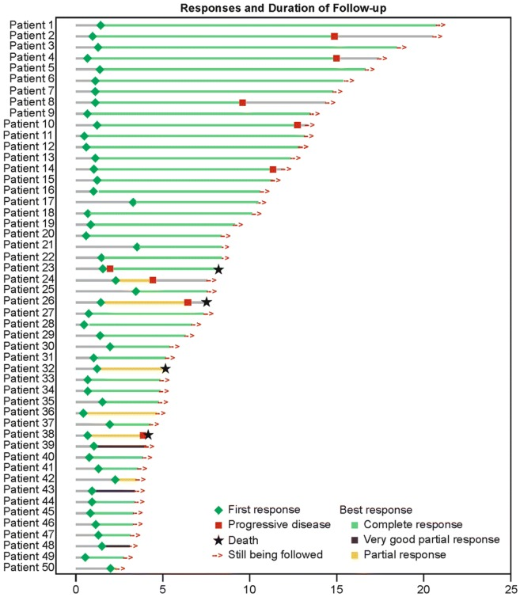
LEGEND-2
Duration of Responses
Shown are individual responses and duration of follow-up for patients who achieved at least a PR (n = 50).
The median time to initial response was 1 month (range, 0.4 to 3.5).
Zhao WH, et al. J Hematol Oncol. 2018;11:141.
Notes:
Individual patient response and duration of follow-up for patients who achieved at least a PR (n = 50).
The median time to initial response was 1 month (range, 0.4 to 3.5).

Slide 47
BCMA-Targeted CAR T-Cell Therapy
Select Trials in RRMM
Idecabtagene vicleucel (KarMMa, NCT03361748)
Idecabtagene vicleucel (KarMMa-2, NCT03601078)
Idecabtagene vicleucel vs DPd, DVd, or IRd (KarMMa-3, NCT03651128)
LCAR-B38M/JNJ-68284528 (CARTITUDE-1, NCT03548207)
LCAR-B38M/JNJ-68284528 (CARTIFAN-1, NCT03758417)
P-BCMA-101 (PRIME, NCT03288493)
JCARH125 (EVOLVE, NCT03430011)
bb21217 (CRB402; NCT03274219)
ALLO-715 (UNIVERSAL, NCT04093596)

Slide 48
CAR T Cell Therapy
Grading and Management of CRS
ASBMT CRS Grade | Defining Features of Grade | Management
Grade 1 | Fever with temperature ≥38°C but no hypotension or hypoxia | Antipyretics and IV hydration Diagnostic work‐up to rule out infection Consider growth factors and antibiotics if neutropenic
Grade 2 | Fever with hypotension not requiring vasopressors and/or hypoxia requiring low‐flow nasal cannula | Supportive care as in grade 1 IV fluid boluses and/or supplemental oxygen Tocilizumab +/− dexamethasone or its equivalent of methylprednisolone
Grade 3 | Fever with hypotension requiring one vasopressor with or without vasopressin and/or hypoxia requiring high‐flow nasal cannula, facemask, nonrebreather mask, or venturi mask | Supportive care as in grade 1 Consider monitoring in intensive care unit Vasopressor support and/or supplemental oxygen Tocilizumab + dexamethasone 10‐20 mg IV q 6 hrs or its equivalent of methylprednisolone
Grade 4 | Fever with hypotension requiring multiple vasopressors (excluding vasopressin) and/or hypoxia requiring positive pressure (eg, CPAP, BiPAP, intubation and mechanical ventilation) | Supportive care as in grade 1 Monitoring in intensive care unit Vasopressor support and/or supplemental oxygen via positive pressure ventilation Tocilizumab + methylprednisolone 1000 mg/day
Neelapu SS. Hematol Oncol. 2019;37 Suppl 1:48-52.
Notes:
CRS = cytokine release syndrome.

Slide 49
CAR T Cell Therapy
Grading and Management of ICANS
ASBMT Grade | Defining Features of Grade | Management
Grade 1 | ICE score 7‐9 and/or depressed level of consciousness but awakens spontaneously No seizures, motor weakness, or raised ICP/cerebral edema | Aspiration precautions and IV hydration Seizure prophylaxis with levetiracetam EEG Imaging of brain Consider tocilizumab if there is concurrent CRS
Grade 2 | ICE score 3‐6 and/or depressed level of consciousness but awakens to voice. No seizures, motor weakness, or raised ICP/cerebral edema | Supportive care as in grade 1 Consider dexamethasone or its equivalent of methylprednisolone
Neelapu SS. Hematol Oncol. 2019;37 Suppl 1:48-52.
Notes:
CRS = cytokine release syndrome.

Slide 50
CAR T Cell Therapy
Grading and Management of ICANS (cont.)
ASBMT Grade | Defining Features of Grade | Management
Grade 3 | ICE score 0‐2 and/or depressed level of consciousness but awakens to tactile stimulus Any clinical seizure focal or generalized that resolves rapidly, or nonconvulsive seizures on EEG that resolve with intervention No motor weakness Focal/local edema on neuroimaging | Supportive care as in grade 1 Dexamethasone 10‐20 mg IV q 6 hours or its equivalent of methylprednisolone Control seizures with benzodiazepines (for short‐term control) and levetiracetam +/− phenobarbital and/or lacosamide High‐dose methylprednisolone 1000 mg/day for focal/local edema
Grade 4 | ICE score 0 and patient is unarousable or requires vigorous or repetitive tactile stimuli to arouse or stupor or coma Life‐threatening prolonged seizure (>5 min); or repetitive clinical or electrical seizures without return to baseline in between Deep focal motor weakness such as hemiparesis or paraparesis Diffuse cerebral edema on neuroimaging; decerebrate or decorticate posturing; or cranial nerve VI palsy; or papilledema; or Cushing's triad | Supportive care as in grade 1 High‐dose methylprednisolone 1000 mg/day Control seizures with benzodiazepines (for short‐term control) and levetiracetam +/− phenobarbital and/or lacosamide Imaging of spine for focal motor weakness Lower ICP by hyperventilation, hyperosmolar therapy with mannitol/hypertonic saline, and/or neurosurgery consultation for ventriculoperitoneal shunt in patients with cerebral edema
Neelapu SS. Hematol Oncol. 2019;37 Suppl 1:48-52.
Notes:
CRS = cytokine release syndrome.

Slide 51
BCMA-Targeted Treatment Modalities
Comparison
 | CAR-T | Bispecific Abs | ADC
Off-the-shelf | Not yet | Yes | Yes
Ease of administration | + | + ~ ++ | ++++
Dependent on patient T cell condition | Yes | Yes | No
Results of representative clinical trials
Protocol | Bb2121 (n = 33) | AMG420 (n = 42) | GSK2857916 (n = 35)
Median age, years (range) | 58 (37–74) | 63 | 60 (40–75)
Prior treatment lines | Median 7 (range 3–14) | Median 4 (range 2–13) | ≥5 prior lines 57%
Response | ORR 85% MRD(–) CR 45% | ORR 70% MRD(–) CR 40% | ORR 60%
Median PFS | 12 months | 9 months | 8 months
Major toxicity | Neutropenia 85%, anemia 45%, thrombocytopenia 45%, CRS 76% (grade 3: 6%), neurologic toxic effects 42% | CRS: all grades 38% (severe CRS 2%), serious peripheral neuropathy 5% | Grade 3–4 AEs 80%; corneal AEs (vision blurred, keratitis, photophobia, dry eye, keratopathy, eye pain), thrombocytopenia
Tamura H, et al. Cancers. 2019;11:2009.

Slide 52
Immunotherapy Advances in RRMM
Summary
Immunotherapies are rapidly expanding and are likely to provide numerous new treatment options
Different BCMA-targeted treatment modalities including ADCs, BiTEs, and CAR T cell therapy, with their unique strengths and limitations, have shown high antimyeloma activity that may address a critical unmet need in heavily pretreated and refractory patients.

Slide 53
Immunotherapy Advances in RRMM
Summary (cont.)
Future studies should help identify optimal combinations and sequencing of different immunotherapies.
Key to the improvement of current and emerging immunotherapies will be a better understanding of the role of the immune system in the pathogenesis of MM.

