Slide 1
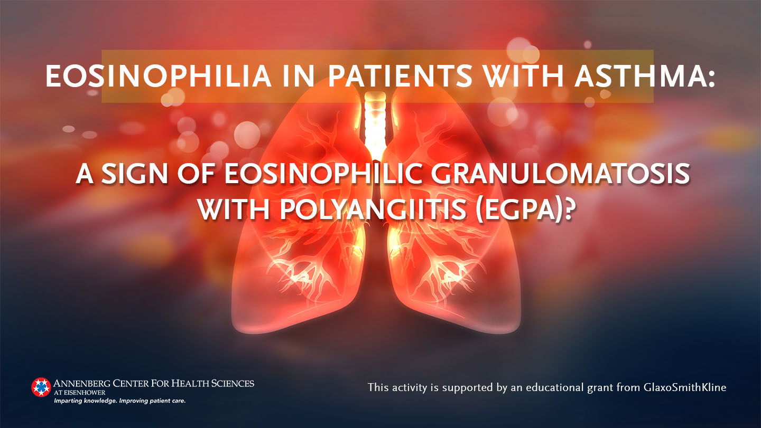

Slide 2
Faculty/Disclosure
Michael E. Wechsler, MD
Professor of Medicine
Director, NJH Cohen
Family Asthma Institute
Department of Medicine
National Jewish Health
Denver, Colorado
Research Support: AstraZeneca, Regeneron, Sanofi, Teva
Consultant: AstraZeneca, Equillium, Genentech, GSK, Novartis, Regeneron, Sanofi, Teva

Slide 3
Learning Objectives
Discuss the clinical signs and symptoms that support a diagnosis of EGPA
Describe the clinical progression of EGPA
Classify patient’s risk based on disease activity and the presence of ANCA
Select an appropriate therapy for EGPA based on patient’s disease activity and characteristics

Slide 4
ANCA-Associated Vasculitides
Inflammatory disorders of the blood vessel walls
Leukocyte infiltration affects vessel structure and integrity
Categorized by size of affected vessel
Commonly associated with ANCA
Antineutrophil cytoplasmic antibodies
Require urgent recognition and intervention
Can be fatal or cause organ damage
Heterogenous presentation
Most cause constitutional symptoms with single- or multi-organ involvement
Mansi IA, et al. Am Fam Physician 2002;65:1615-20.

Slide 5
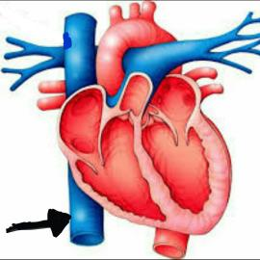
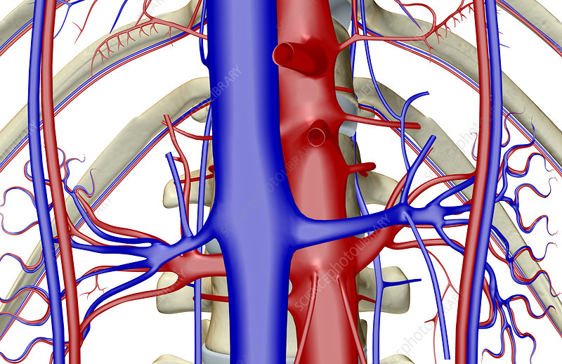
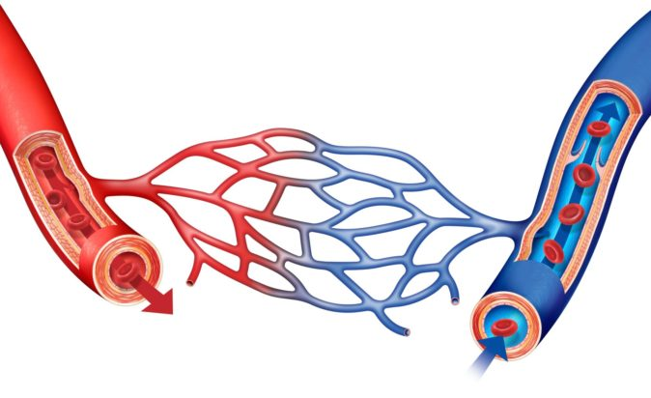
Recognizing Vasculitides
Large Vessel Vasculitis
Granulomatous Disease
(eg, giant cell arteritis, Takayasu arteritis)
Polyarteritis nodosa
Medium Vessel Vasculitis
Kawasaki disease
(anti-endothelial cell antibodies)
ANCA-associated
Small Vessel Vasculitis
Non-ANCA associated
Jennette JC, Falk RJ. Curr Opin Rheumatol 2007;19:10.

Slide 6
ANCA- and Immune-Complex Associated Small Vessel Vasculitides
Wegener’s Granulomatosis
ANCA-Associated
Vasculitides (AAVs)
Microscopic Polyangiitis
More Common
EGPA (Churg-Strauss syndrome)
Drug-induced
Small Vessel Vasculitis
Paraneoplastic vasculitis
Inflammatory bowel disease vasculitis
Non-ANCA Associated Vasculitides
Immune-complex Mediated (eg, Infection-induced vasculitis, systemic lupus erythematosus, Henoch-Schönlein purpura, cryoglobulinemic vasculitis, Goodpasture disease, drug-induced)
Less Common
Jennette JC, Falk RJ. Curr Opin Rheumatol 2007;19:10. Mansi IA, et al. Am Fam Physician 2002;65:1615-1620.

Slide 7
ANCA-associated Small-vessel Vasculitides
Designation* | Distinguishing Features of AAVs
Microscopic polyangiitis (MPA) (Microscopic polyangiitis) | Common Necrotizing glomerulonephritis Pulmonary capillaritis ANCA⁺ Few or none Immune deposits with NV Absent Granulomatous inflammation
Granulomatosis with polyangiitis (GPA) (Wegener’s granulomatosis) | Common Upper and lower respiratory tract Necrotizing glomerulonephritis ANCA⁺
Eosinophilic granulomatosis with polyangiitis (EGPA) (Churg-Strauss Syndrome) | Common Eosinophil-rich NG involving respiratory tract Asthma Eosinophilia ANCA⁺ 30-70% ANCA more common with glomerulonephritis
Small Vessel Vasculitis
Necrotizing vasculitis affecting arteries, arterioles, capillaries, venules
Medium vessels can be affected
Ig deposits rare or not present on vessel walls
*CHCC2012 Designation (abbreviation), (former name). Ig, immunoglobulin; NG, necrotizing granulomatous inflammation; NV, necrotizing vasculitis. Groh M, et al. Eur J Intern Med 2015;26:545-553. Mansi IA, et al. Am Fam Physician 2002;65:1615-1620.

Slide 8
AAVs are Rare (and Under-reported)
Incidence Microscopic polyangiitis Granulomatosis with polyangiitis Eosinophilic granulomatosis with polyangiitis | ≈3 per 10⁶ ≈10 per 10⁶ 0.5-6.8 per 10⁶
Prevalence Eosinophilic granulomatosis with polyangiitis | 10-13 per 10⁶
Age of onset | Rare in children and adolescents Median age of onset in 4th or 5th decade Uncommon after 65 years of age
Gender discrepancy | None (women are 48-64%)
Association with asthma Incidence in asthma population Prior history of bronchial asthma Duration of asthma (median) | 60-80 per 10⁶ >90% 5-9 years before EGPA diagnosis
National Organization of Rare Diseases. https://rarediseases.org/rare-diseases/churg-strauss-syndrome/.
Groh M, et al. Eur J Intern Med 2015;26:545-553.
American Partnership for Eosinophilic Disorders. https://apfed.org/about-ead/eosinophilic-granulomatosis-with-polyangiitis/.

Slide 9
Suspect Small-vessel Vasculitis in Patients with a Multisystem Disease not Associated with Infection or Malignancy
Common Primary Complaints
New-onset asthma in an adult patient | Recently worsening asthma in an adult patient
Additional Manifestations of Small-vessel Vasculitis to Look for
Constitutional symptoms Fever, weight loss, anorexia, general malaise | Musculoskeletal symptoms Myalgia, arthralgia
Skin rashes Palpable purpura, urticaria | Neurologic symptoms Peripheral neuropathy (especially mononeuritis)
Pulmonary disease Dyspnea, cough, hemoptysis, lung infiltrate, interstitial lung disease, pulmonary hemorrhage
Renal dysfunction Proteinuria, hematuria, renal insufficiency, renal failure, necrotizing glomerulonephritis
Gastrointestinal Fecal blood, elevated liver enzymes, diarrhea, nausea, vomiting, abdominal pain
Mansi IA, et al. Am Fam Physician 2002;65:1615-20.

Slide 10
EGPA Progresses Through 3 Variable Phases
Asthma Onset
>20 years
6 months
3-9 years
Prodromal/Allergic Phase
2nd or 3rd decade
Variable onset/variable duration
Clinical manifestations Upper respiratory Late-onset or worsening asthma Nonspecific (eg, arthralgia, myalgia, malaise, fever, weight loss)
Eosinophilic Phase
Peripheral eosinophilia
Eosinophilic organ involvement
Pulmonary infiltrates
Eosinophilic gastroenteritis
Serosal effusion
Vasculitic Phase
3rd or 4th decade
Emergence of life-threatening complications of systemic vasculitis
Neurologic symptoms
Granulomatosis
Full range of renal symptoms
Necrotizing glomerulonephritis
Skin lesions
Chakraborty RK, Aeddula NR. Available from: https://www.ncbi.nlm.nih.gov/books/NBK537099/.
National Organization of Rare Diseases. https://rarediseases.org/rare-diseases/churg-strauss-syndrome/.

Slide 11
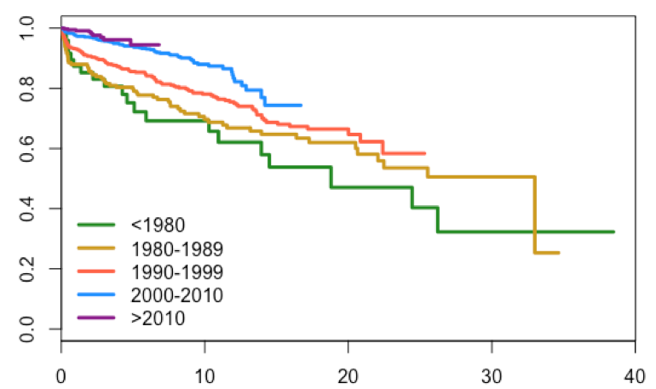
Survival Has Improved with Treatment to Reduce Vasculitic Flares and Complications*
Overall survival of patients according to the period of diagnosis
Survival
Years from Diagnosis
*Includes polyarteritis nodosa (16%), GPA (42%), EGPA (23%), and MPA (19%).
Jardel S, et al. Arthritis Rheumatol. 2017; 69 (suppl 10).
https://acrabstracts.org/abstract/long-term-survival-in-systemic-necrotizing-vasculitides/. Accessed March 19, 2020.

Slide 12
Pathogenesis: Genetic and Environmental Factors
ACQUIRED DETERMINANTS
Allergens
Infections
Vaccinations
Drugs
Silica exposure
GENETIC DETERMINANTS
HLA-DRB1 *04 and *07
HLA-DRB4
IL-10 SNP
EOSINOPHILIC GRANULOMATOSIS WITH POLYANGIITIS
IgG4
Eotaxin-3
Eosinophils
T-Regs
Th17
Th2
ANCA
IL-4
IL-5
IL-13
B cells
IL-25
IL-17
T cells
Gioffredi A, et al. Frontiers Immunol 2014. doi: 10.3389/fimmu.2014.00549.

Slide 13
Eosinophils in EGPA
Normal Range
Eosinophilia
Hypereosinophilia
30-350 cells/µL
>450 cells/µL
>1500 cells/µL
  Normal functions
  Homeostatic tasks in lymphoid organs, bone marrow, gut, and some non-lymphoid organs
  T cells and mast cells can recruit eosinophils to inflammatory sites
  Pathogenesis in EGPA
  Maintain an (aberrant) Th2 immune response
  Participate in both granulomatous and vasculitic features
  Cause tissue damage via innate and antibody-dependent mechanisms
Reviewed in Ramirez GA, et al. BioMed Res Intl 2018;doi.org/10.1155/2018/9095275.

Slide 14
Eosinophils in EGPA
Normal Range
Eosinophilia
Hypereosinophilia
30-350 cells/µL
>450 cells/µL
>1500 cells/µL
Cytokine control of eosinophils
  IL3, GM-CSF, IL5 promote development and maturation in bone marrow
  IL5 key for survival and persistence in circulating and tissue eosinophils
Cellular interactions
  Several lymphoid and myeloid cells (eg, mast cells and Th2 lymphocytes) produce IL5
  Eosinophil-mediated IL5 secretion has autocrine and paracrine effects
  Eotaxins and CCR3 are important for eosinophil recruitment into tissues
Reviewed in Ramirez GA, et al. BioMed Res Intl 2018;doi.org/10.1155/2018/9095275.

Slide 15
EGPA Diagnostic/Classification Criteria
Lanham Criteria
Asthma
Peak peripheral blood eosinophil count >1.5 x 10⁶/cc
Systemic vasculitis involving ≥2 extrapulmonary organs
All 3 criteria should be fulfilled for diagnosis of EGPA
1990 ACR Criteria
Asthma
Eosinophilia >10%
Neuropathy (mono or poly)
Pulmonary infiltrates (non-fixed)
Paranasal sinus abnormality
Extravascular eosinophils
EGPA is diagnosed if 4 of the 6 criteria are met
Lanham JG, et al. Medicine (Baltimore)1984;63:65-81. Masi AT, et al. Arthritis Rheum 1990;33:1094-1100.

Slide 16
Differential Diagnosis and Common Misdiagnoses
Eosinophilic asthma
Eosinophilic pneumonia
HES
Idiopathic chronic eosinophilic pneumonia
Allergic bronchopulmonary aspergillosis
Drug-induced eosinophilia
Infection
  Parasitic (eg, toxocariasis)
  Fungal (aspergillosis)
  Tuberculosis
  Viral (HIV, HTLV-1)
Paraneoplastic eosinophilia

Slide 17
Recognizing EGPA Common Presentations
49-year old woman | The median age of onset is in the 4th decade, with children and adolescents rarely being affected.
14-year history of asthma Recent symptom worsening Required treatment in ED Intermittent OCS Persistent cough | Adult-onset asthma starting in the prodromal phase and worsening is a common presentation (96-100%). Systemic corticosteroid therapy for asthma control is also seen in up to 75% of cases.
Additional history
Nasal polyps Prior surgery Currently using topical steroid nasal spray | Upper respiratory symptoms are present in a majority of patients (47-93%).
Neurology consult for difficulty walking | Neurologic symptoms may be present in 60-70% of patients
“Hypereosinophilia, unknown significance” 6385/mm³ noted by allergist during blood work 3 years ago | Hypereosinophilia may have been documented previously but its significance not realized at the time
Physical exam findings
Areas of petechiae around knees and elbows | Skin manifestations are common during the vasculitic phase.

Slide 18
Recognizing EGPA Common Presentations
49-year old woman | The median age of onset is in the 4th decade, with children and adolescents rarely being affected.
14-year history of asthma Recent symptom worsening Required treatment in ED Intermittent OCS Persistent cough | Adult-onset asthma starting in the prodromal phase and worsening is a common presentation (96-100%). Systemic corticosteroid therapy for asthma control is also seen in up to 75% of cases.
Additional history
Nasal polyps Prior surgery Currently using topical steroid nasal spray | Upper respiratory symptoms are present in a majority of patients (47-93%).
Neurology consult for difficulty walking | Neurologic symptoms may be present in 60-70% of patients
“Hypereosinophilia, unknown significance” 6385/mm³ noted by allergist during blood work 3 years ago | Hypereosinophilia may have been documented previously but its significance not realized at the time
Physical exam findings
Areas of petechiae around knees and elbows | Skin manifestations are common during the vasculitic phase.

Slide 19
Prevalence of Clinical Features
Clinical Feature | Prevalence (%)
Asthma | 91-100
Pulmonary infiltrates | 65-91
Neuropathy | 55-72
Ear, nose, and throat involvement | 48-75
Cutaneous involvement | 40-52
Cardiac involvement | 27-35
Renal involvement | 27
Gastrointestinal involvement | 23-32
Central nervous system involvement | 5-9
Gioffredi A, et al. Frontiers Immunol 2014. doi: 10.3389/fimmu.2014.00549.

Slide 20
EGPA Imaging Characteristics
Common findings: consolidation or ground glass opacities
  Transient, bilateral, non-segmental
  No predilection for any lung segment or zone
  Patchy
  Small centrilobular nodules
Uncommon findings
  Large nodules, interlobular septal thickening, pleural effusion
Santos YA, et al. Respir Med Case Rep 2017;21:1-6.

Slide 21
Recommended Minimum Initial Work-up
Rule out infectious disease or new drug reactions
Blood work CBC with differentials ANCA Tryptase Vitamin B₁₂ Peripheral blood smear (especially for dysplastic eosinophils or blasts) ESR, CRP, RF, ANA, and IgE may be elevated
Chest X-ray or CT
Pulmonary function testing
Biopsy may be helpful Sample sites determined on case-by-case basis Skin, nerve, muscle commonly used; endomyocardial, renal, and gastrointestinal may be useful Eosinophilic vasculitis or perivascular eosinophilic infiltration
Groh M, et al. Eur J Intern Med 2015;26:545-553.

Slide 22
Initial and Ongoing Screening Once EGPA Diagnosis is Established
Cardiac Electrocardiography, transthoracic echocardiography, pro-brain natriuretic peptide, troponin I
Gastrointestinal Radiologic or endoscopic investigations for patients with GI symptoms
Renal Renal function and urinalysis (proteinuria, hematuria/casts)
As indicated Electromyography and nerve conduction when clinically indicated
Groh M, et al. Eur J Intern Med 2015;26:545-553.

Slide 23
ANCA is Present in Some but not all AAV Cases
Antineutrophil Cytoplasmic Antibodies (ANCAs)
  PR3-ANCA: cytoplasmic proteinase 3
  MPO-ANCA: peri-nuclear myeloperoxidase
Useful for diagnosis but not sensitive, specific, or prognostic
Mansi IA, et al. Am Fam Physician 2002;65:1615-1620. Mahr A, et al. Ann Rhem Dis 2013;72:1003-1010. Sinico RA, et al. Arth Rheum 2005;52:2926-2935.

Slide 24
ANCA Status May Be Associated With Disease Course and Prognosis
More common if ANCA-positive
More common if ANCA-negative
Weight loss Myalgias and arthralgias
Renal involvement |  | Cardiomyopathy
Biopsy findings Vasculitis Glomerulonephritis Leukocytoclastic capillaritis Eosinophil infiltration in arterial walls
Mononeuritis multiplex Peripheral neuropathy |  | Mononeuritis multiplex in up to 1/5th
Case Series
Newly-diagnosed
Renal involvement |  | Cardiovascular disease
Peripheral neuropathy |  | Fever
Biopsy-proven vasculitis
Pagnoux C, Guillevin L. Curr Opin Rheumatol 2010;22:21. Comarmond C, et al. Arthritis Rheum 2013; 65:270. Cottin V, et al. Autoimmun Rev 2017;16:1. Sablé-Fourtassou R, et al. Ann Intern Med 2005;143:632.

Slide 25
Anti-asthmatic Drugs May Unmask EGPA
Onset of EGPA has been associated with anti-asthmatic drug treatment
  Leukotriene receptor antagonists (eg, montelukast, zafirlukast)
  Anti-IgE (omalizumab)
By improving asthma control, asthma medications may reduce the need for systemic corticosteroids
Reducing steroids may unmask pre-existing, subclinical EGPA
Wechsler ME, et al. Chest 2000;117:708-713. Hauser T, et al. Thorax 2008;63:677-682.

Slide 26
Remission and Relapse
Remission
  Absence of a clinical systemic manifestation (excluding asthma and/or ENT)
    Minimum prednisone dose of 7.5 mg/day (ideal but no consensus)
  ENT and asthma flares do not reflect vasculitic activity and may not be controlled by treatment
  Eosinophilia may still be present (no accepted definition of response)
Relapse
  New appearance or recurrence or worsening of clinical EGPA manifestations
  Excludes ENT and asthma flares
    Transient and reversible asthma flares with an identifiable cause
    Asthma or sinusitis exacerbations with or without eosinophil increase
  Eosinophilia is not a mandatory criterion for a relapse
    Organ-limited eosinophilic activity is possible in the absence of blood eosinophilia
Groh M, et al. Eur J Intern Med 2015;26:545-553.

Slide 27
The Five-factor Score Can Predict Prognosis…
Risk Factors | Score if Present
Age >65 years | +1
Presence of symptomatic cardiac insufficiency | +1
Presence of severe gastrointestinal involvement Bowel perforation, bleeding, and pancreatitis | +1
Presence of renal insufficiency Creatinine >150 µmol/L | +1
Absence of ear, nose, and throat symptoms | +1
FFS is Associated with 5-Year Mortality Risk
FFS=0
FFS>1
FFS≥2
Groh M, et al. Eur J Intern Med 2015;26:545-553. Guillevin L, et al. Medicine (Baltimore) 2011;90:19-27.

Slide 28
And Guide Treatment Decisions
Five-factor Score
Severe alveolar hemorrhage, eye involvement, fulminant mononeuritis multiplex
FFS = 0
FFS ≥ 1
Better prognosis
Glucocorticoid alone Prednisone 1 mg/kg/day for 1 month, then tapered)
Poor prognosis
Glucocorticoids Prednisone 1 mg/kg/day for 1 month, then taper
Immunosuppressant Cyclophosphamide 2 mg/kg/day
Caveat: no randomized controlled trials to support recommendation
Groh M, et al. Eur J Intern Med 2015;26:545-553.

Slide 29
Glucocorticoids are the Mainstay of Treatment
Glucocorticoids (GCS) can be used to induce remission
  For patients with life-threatening symptoms: pulse methylprednisone 7.5-15 mg/kg/day
  Patients with organ- or life-threatening symptoms should receive prednisone ~1 mg/kg/day for 2-3 weeks
    Follow with gradual taper (0.3 mg/kg/day after 3 months, 0.15 mg/kg/day after 6 months)
Patients without organ- or life-threatening disease may only need GCS
  A maintenance dose <7.5 mg/day limits glucocorticoid-related side effects
  Additional immunosuppression can be considered for patients who have recurrent disease after 3-4 months of prednisone >7.5 mg/day
  Patients with FFS=0 treated with GCS alone had a 5-year survival of 97%, but a third required additional immunosuppression
    Even these patients may benefit from an immunosuppressant during maintenance
GCS, glucocorticoids
Groh M, et al. Eur J Intern Med 2015;26:545-553. Comarmond C, et al. Arthritis Rheum 2013;65(1):270–81.

Slide 30
Immunosuppression is Needed for Patients with Organ- or Life-Threatening Disease
Patients with FFS≥1 should have an immunosuppressant added to GCS treatment to induce remission
Cyclophosphamide (CYC)
  Oral (2 mg/kg/day) or IV pulse (15 mg/kg for 3 infusions every 2 weeks, then 3-6 cycles of 15 mg/kg every 3 weeks)
  Anticipate toxicity during CYC treatment
    Adjust dosing based on renal function and age (≥65 may have fewer side effects at
    lower doses)
    Fertility is affected
    Prophylaxis for Pneumocystis
    Screen for drug-induced neutropenia
CYC, cyclophosphamide; GCS, glucocorticoids
Groh M, et al. Eur J Intern Med 2015;26:545-553. Cohen P, et al. Arth Rheum 2017;57:686-693.

Slide 31
Maintain Remission in Patients with Organ- or Life-Threatening Disease with an Immunosuppressant
After remission induction with GCS and CYC
  Survival is >92% at 8 years without any maintenance therapy, but…
  Relapse rates remain high (74% after 12 cycles of CYC)
Azathioprine 2 mg/kg/day
  Mixed results, may not be effective for many patients
Methotrexate (10-30 mg/wk) and mycophenolate mofetil have also been considered as options
CYC, cyclophosphamide; GCS, glucocorticoids
Groh M, et al. Eur J Intern Med 2015;26:545-553. Cohen P, et al. Arth Rheum 2017;57:686-693. Puechal X, et al. Arth Rheum 2017;69:2175-2186.

Slide 32
Rituximab Can be Considered for ANCA-positive Patients with Renal Involvement or Refractory Disease
Rituximab MOA
  Anti-CD20 B-cell depletion
  Reduced IL-5 production from T-cells
Based on studies with other ANCA-Associated Vasculitides
  Rituximab is as effective as CYC for induction, and can reduce CYC exposure
    Rituximab plus GCS and 2 pulses of CYC ≈ 3 doses CYC every 2 weeks followed by 3 doses every 3 weeks for 3-6 months of CYC followed by AZA
    Response rate, time to remission, and adverse events were similar for rituximab and CYC
  Rituximab is superior to AZA for maintenance
Limited data suggest rituximab is safe and effective in EGPA
  Remission rates are higher for ANCA-positive EGPA
AZA, azathioprine; CYC, cyclophosphamide; GCS, glucocorticoids
Groh M, et al. Eur J Intern Med 2015;26:545-553. Jones RB, et al. N Engl J Med 2010;363:211-220.

Slide 33
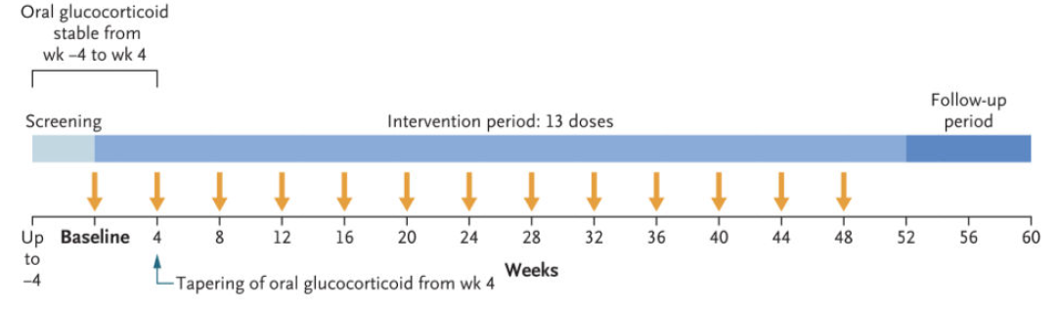
Mepolizumab Is Steroid-sparing and Eliminates the Need for Conventional Immunosuppression
Mepolizumab is an anti-IL-5 humanized monoclonal antibody
  Binds IL-5 and prevents binding to IL-5 receptors on eosinophils and basophils
  Reduces absolute eosinophil count and eosinophil maturation
As a maintenance therapy for refractory or relapsing EGPA
  Standard GCS ± immunosuppression and either 300 mg SC every 4 weeks vs placebo
GCS, glucocorticoids; SC, subcutaneous
Wechsler ME, et al. N Engl J Med 2017;376:1921-1932.

Slide 34
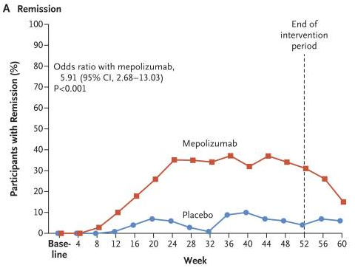
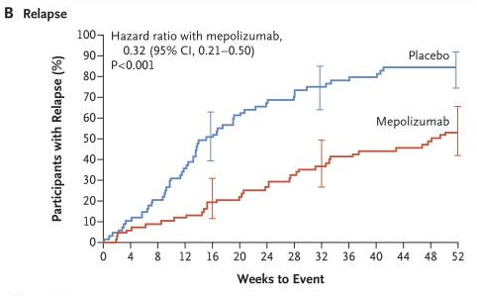
Mepolizumab Is Steroid-sparing and Eliminates the Need for Conventional Immunosuppression
At least 24 weeks accrued time in remission
  Mepolizumab (28%) > Placebo (3%)
Achieved remission
  Mepolizumab (53%) > Placebo (19%)
  A post-hoc analysis using a target GCS dose of ≤7.5 mg/day improved remission to 79% in the mepolizumab group and 46% in the placebo group
Annualized relapse rate
  Mepolizumab (1.14) < Placebo (2.27)
GCS dose, weeks 48-52
  <4 mg/day: Mepolizumab (44%) > Placebo (7%)
  Discontinue GCS: Mepolizumab (18%) > Placebo (3%)
Patients with an absolute eosinophil count >150/mm³ had the greatest benefit
Wechsler ME, et al. N Engl J Med 2017;376:1921-1932.
Steinfeld J, et al. J Allergy Clin Immunol 2019;143:2170-2177.

Slide 35
The Optimal Application of Mepolizumab is Not Established
Outcomes
  Remission
  Zero relapses
  50% steroid reduction
Optimal dose and administration route
  Pilot studies used IV 750 mg monthly, randomized trial used SC 300 mg
Ongoing need for immunosuppression
Patient populations
  The low remission rate suggests that not all patients will benefit equally
  May depend on disease features (eg, existing vasculitic damage), eosinophil count, or duration of GCS treatment
GCS, glucocorticoids; IV, intravenous; SC, subcutaneous
Faverio P, et al. Ther Clin Risk Management 2018;14:2385-2396. Wechsler ME, et al. N Engl J Med 2017;376:1921-1932. Steinfeld J, et al. J Allergy Clin Immunol 2019;14:2170-2177.

Slide 36
Navigating Treatment Decisions
FFS=0
GCS Alone
Unable to Taper GCS OR Refractory Disease OR Frequent Relapses
Consider Alternatives Mepolizumab Azathioprine Methotrexate
EGPA Diagnosis
FFS ≥1 OR Poor Prognostic Features
GCS + CYC
Rituximab*
*May be considered in some cases in place of CYC or AZA
CYC, cyclophosphamide; FFS, Five-factor Score; GCS, glucocorticoids

Slide 37
Summary
EGPA is a vasculitis characterized by asthma, eosinophilia, pulmonary infiltrates, and vasculitis to ≥1 end-organ(s)
Pathophysiology is complex
Requires an extensive work-up
Treat aggressively
For patients who cannot taper steroids or have refractory disease, add additional immunosuppression or anti-IL-5 treatment

