Slide 2
Diagnosing Rare Diseases Brings New Treatments to Patients
Education for Advanced Care Practitioners
Barbara K. Burton, MD
Division of Genetics, Birth Defects and Metabolism
Ann & Robert H. Lurie Children’s Hospital
Chicago, Illinois

Slide 3
Disclosures
Consultant | Aeglea,Biomarin, Denali, JCR Pharm, Takeda
Speaker | Biomarin, Horizon, Sanofi, Takeda

Slide 4
Learning Objectives
Recognize in patients the most common presenting signs and symptoms of the treatable LSDs
Recognize red flags in a patient’s medical history that differentiate LSDs from common misdiagnoses
Describe what types of testing are used to confirm the presence of an LSD
Describe the treatment approaches available for treating inborn errors of metabolism

Slide 5
Introduction to Lysosomal Storage Disorders

Slide 6
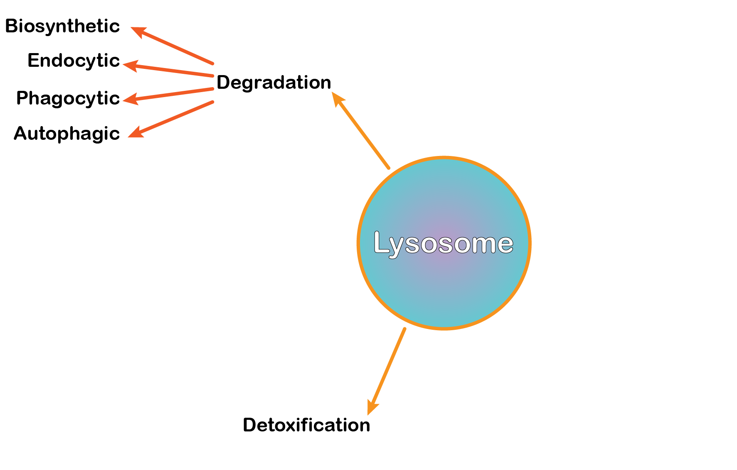
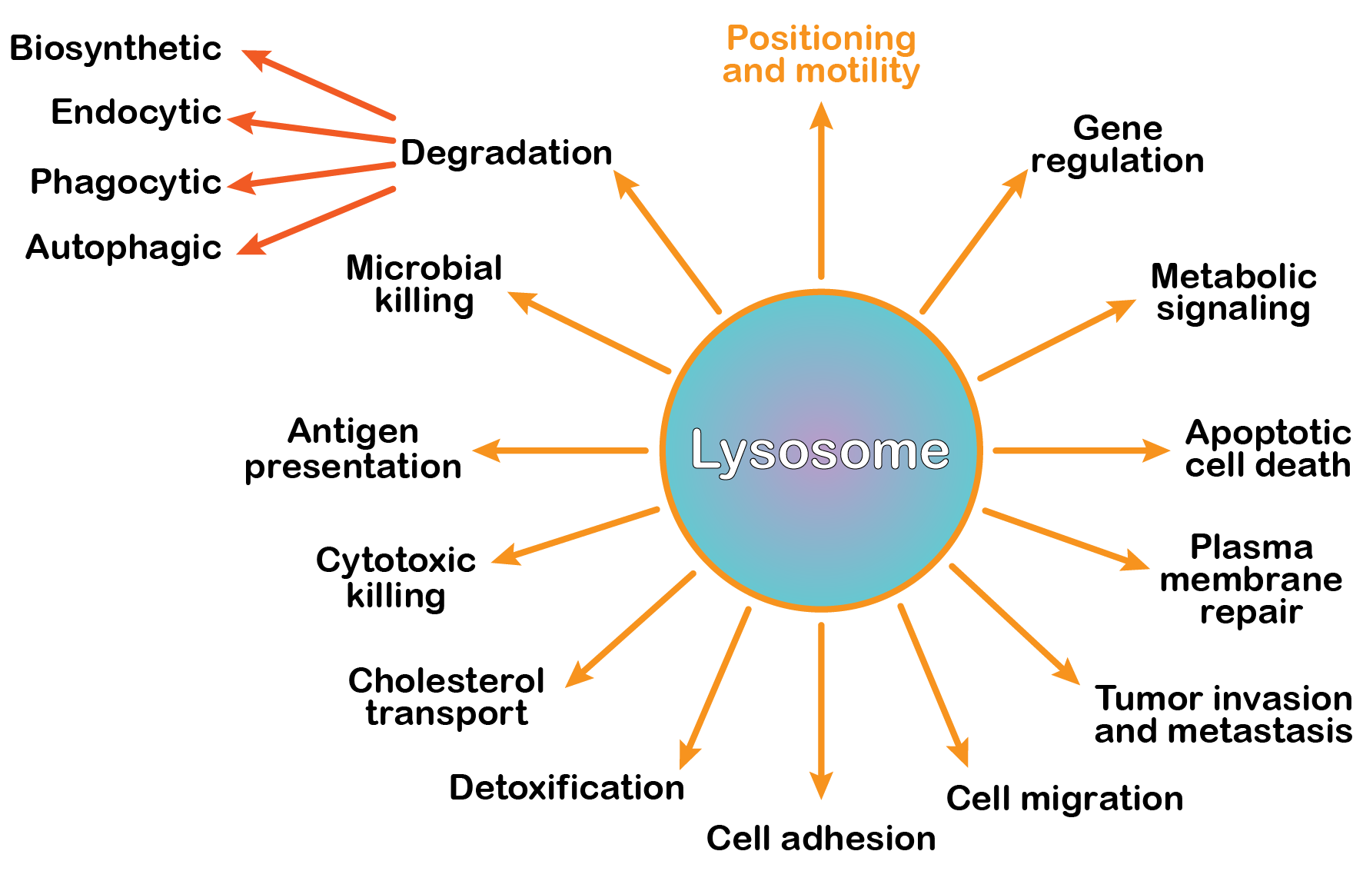
The Lysosome in Metabolism
The cell’s garbage disposal
  Complex membrane-enclosed organelle
  Isolates harsh environment from the cytoplasm
  Houses substrate-specific enzymes that degrade biomolecules
More than just a garbage disposal
Pu J, et al. J Cell Sci. 2016;129:4329-4339. Platt FM, et al. J Cell Biol. 2012;199:723-734. Wappner RS. Pediatr Ann. 1993;22(5):282-292.

Slide 7
The Lysosome in Disease
For successful disposal, waste must be
  Recognized
  Transported into the lysosome
  Degraded by a specific enzyme
Marques ARA, Saftig P. J Cell Sci. 2019;132. doi:10.1242/jcs.221739.

Slide 8
The Lysosome in Disease
For successful disposal, waste must be
  Recognized
  Transported into the lysosome
  Degraded by a specific enzyme
A defect in a substrate-specific enzyme results in an LSD
  No degradation
  Substrate accumulates
  Excess substrate causes cell damage
  Cell damage and death leads to tissue and organ dysfunction
Marques ARA, Saftig P. J Cell Sci. 2019;132. doi:10.1242/jcs.221739.

Slide 9


Epidemiology of LSDs: Common Rare Diseases
40
Marsden D, Levy H. Clin Chem. 56:1071-1079.

Slide 10
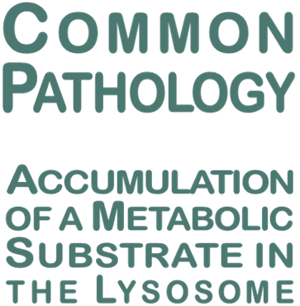

Epidemiology of LSDs: Common Rare Diseases
40
Marsden D, Levy H. Clin Chem. 56:1071-1079.

Slide 11
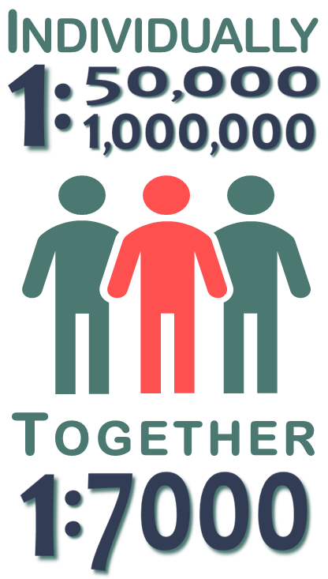
Epidemiology of LSDs: Common Rare Diseases
40
Marsden D, Levy H. Clin Chem. 56:1071-1079.

Slide 12



Epidemiology of LSDs: Common Rare Diseases
40
Marsden D, Levy H. Clin Chem. 56:1071-1079.

Slide 13




Autosomal Recessive Inheritance
Common inheritance pattern
Unaffected carrier parents
1:4 children develop disease
Unaffected
Carrier
Carrier
Affected
Meikle PJ, et al. JAMA. 1999;281:249-254.

Slide 14


X-linked Inheritance
Unaffected carrier mother
Only males can be affected
Unaffected
Carrier
Unaffected
Affected
Meikle PJ, et al. JAMA. 1999;281:249-254.

Slide 15
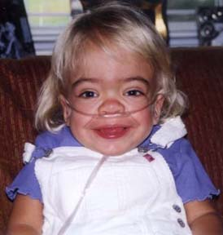
Residual Enzyme Activity Creates a Spectrum of Disease Severity
Enzyme Activity
Normal
Intermediate
None
None
Mild
Moderate
Severe
Disease Severity
Courtesy Barbara K Burton
Parenti G, et al. Mol Ther. 2015;23:1138-1148. Bley AE, et al. Pediatrics. 2011;128:e1233-e1241.

Slide 16
Early Recognition of an LSD Is Important
Death
Early
Diagnosis
Treatments are not curative
Untreated
Severe Disability
Symptom Severity
Early
Treatment
Initiation
Treatments do not reverse damage
Diagnosis and treatment initiation
Disability onset
Diagnosis and treatment initiation
Treatments may slow disease progression
Best Patient
Outcomes
Birth
Age
Staretz-Chacham O, et al. Pediatrics. 2009;123:1191-1207. Beck M. Dev Med Child Neurol. 2018;60:13-18.

Slide 17

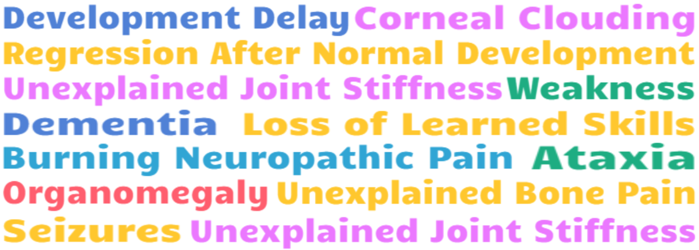
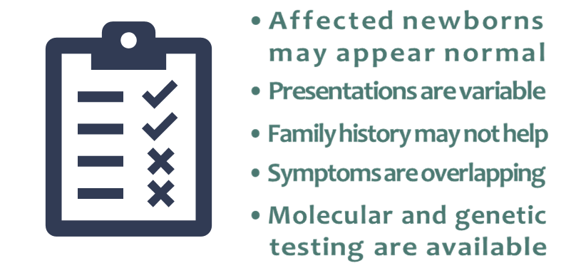


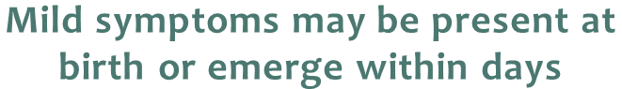
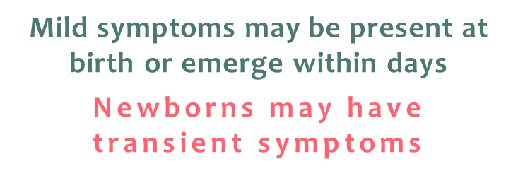
Clinical Diagnoses Are Very Difficult
Recognizing an LSD is not Easy
Diagnostic algorithms*
Nonimmune hydrops fetalis (NIHF)
Coarse facial features, organomegaly, skeletal dysplasia, severe skin changes
Disease-specific algorithms
*See supplemental slides below.
* Algorithms included at the end of the presentation
NIHF, nonimmune hydrops fetalis
Wenger DA, et al. Arch Neurol. 2003;60:322-328. Staretz-Chacham O, et al. Pediatrics. 2009;123:1191-1207. Marsden D, Levy H. Clin Chem. 56:1071-1079.

Slide 18
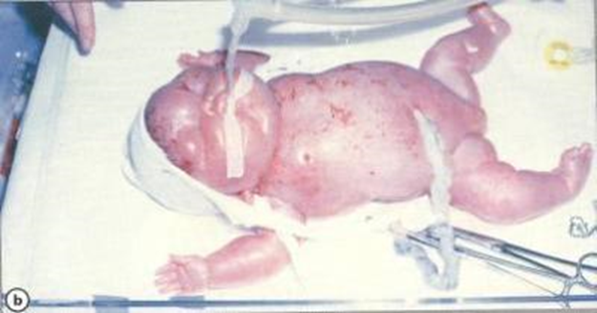
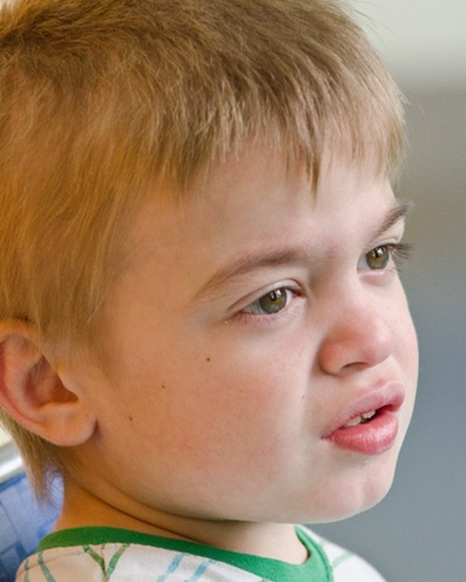

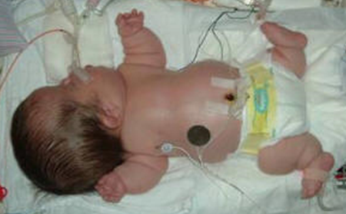
Generic Diagnostic Algorithms
Family history
Familial diseases
Consanguinity
Recurrent fetal loss
NIHF
Severe skin conditions
Organomegaly
Skeletal dysplasia
Coarse facial features
Top left: photo credit Science Based Medicine –PAJM; Used under terms of a Creative Commons License (CCL 4.0) Lower left: Photo credit Medical Show. Rt. Side: Photo credit https://www.hunterpatients.com.

Slide 19
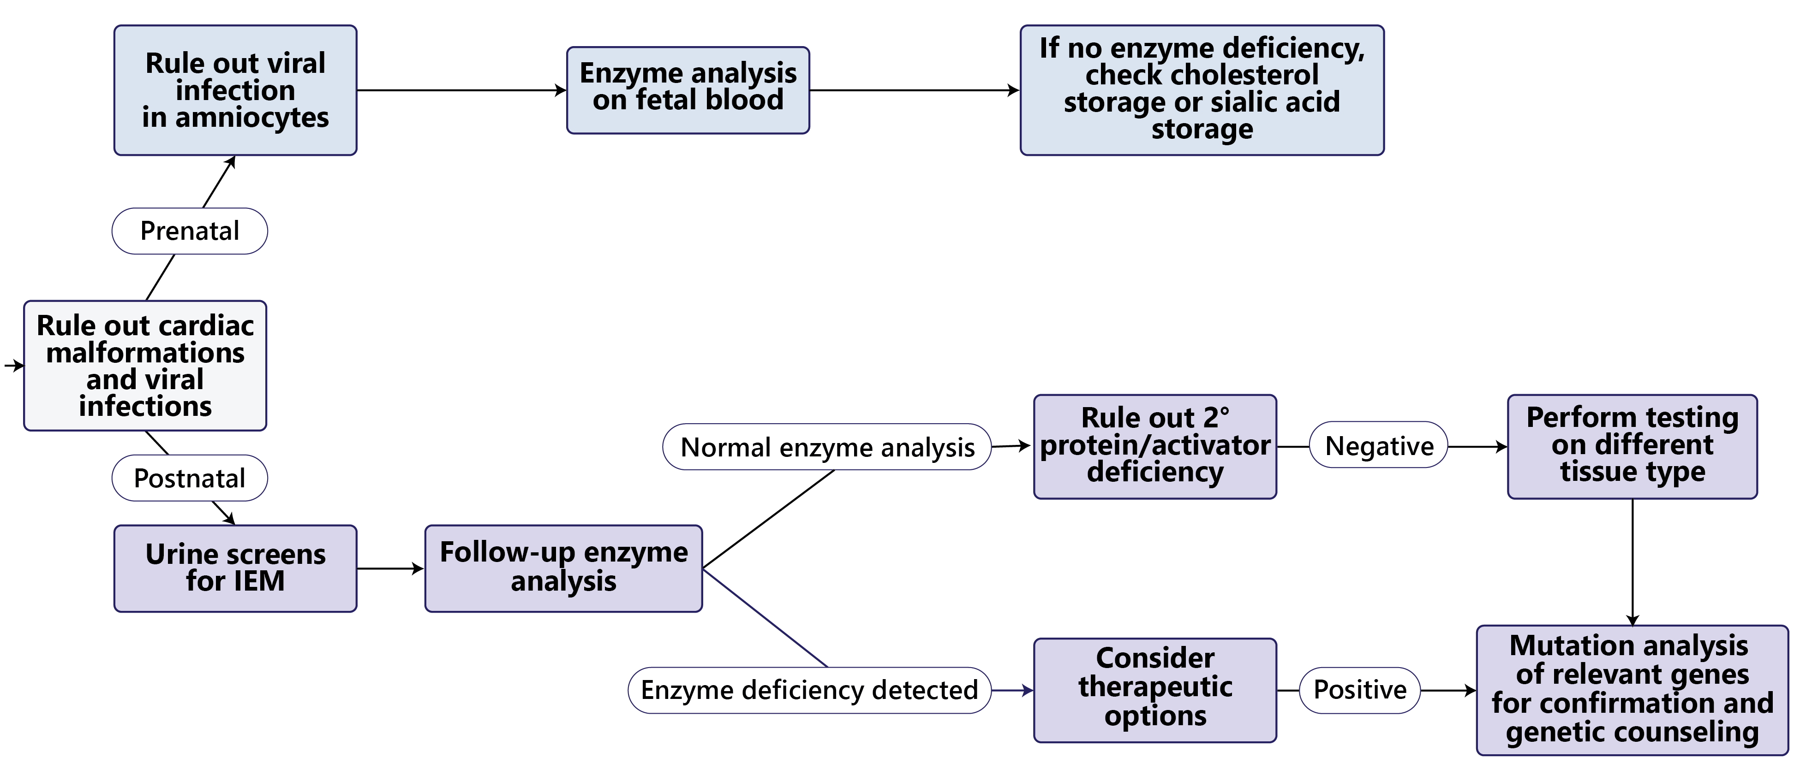
Generic Diagnostic Algorithm: Fetus or Newborn*
*Simplified algorithm for illustration only; download the complete algorithm here.
Staretz-Chacham O, et al. Pediatrics. 2009;123:1191-1207. BenHamida E, et al. Pan Afr Med J . 2015;21:110 doi:10.11604/pamj.2015.21.110.7052.

Slide 20
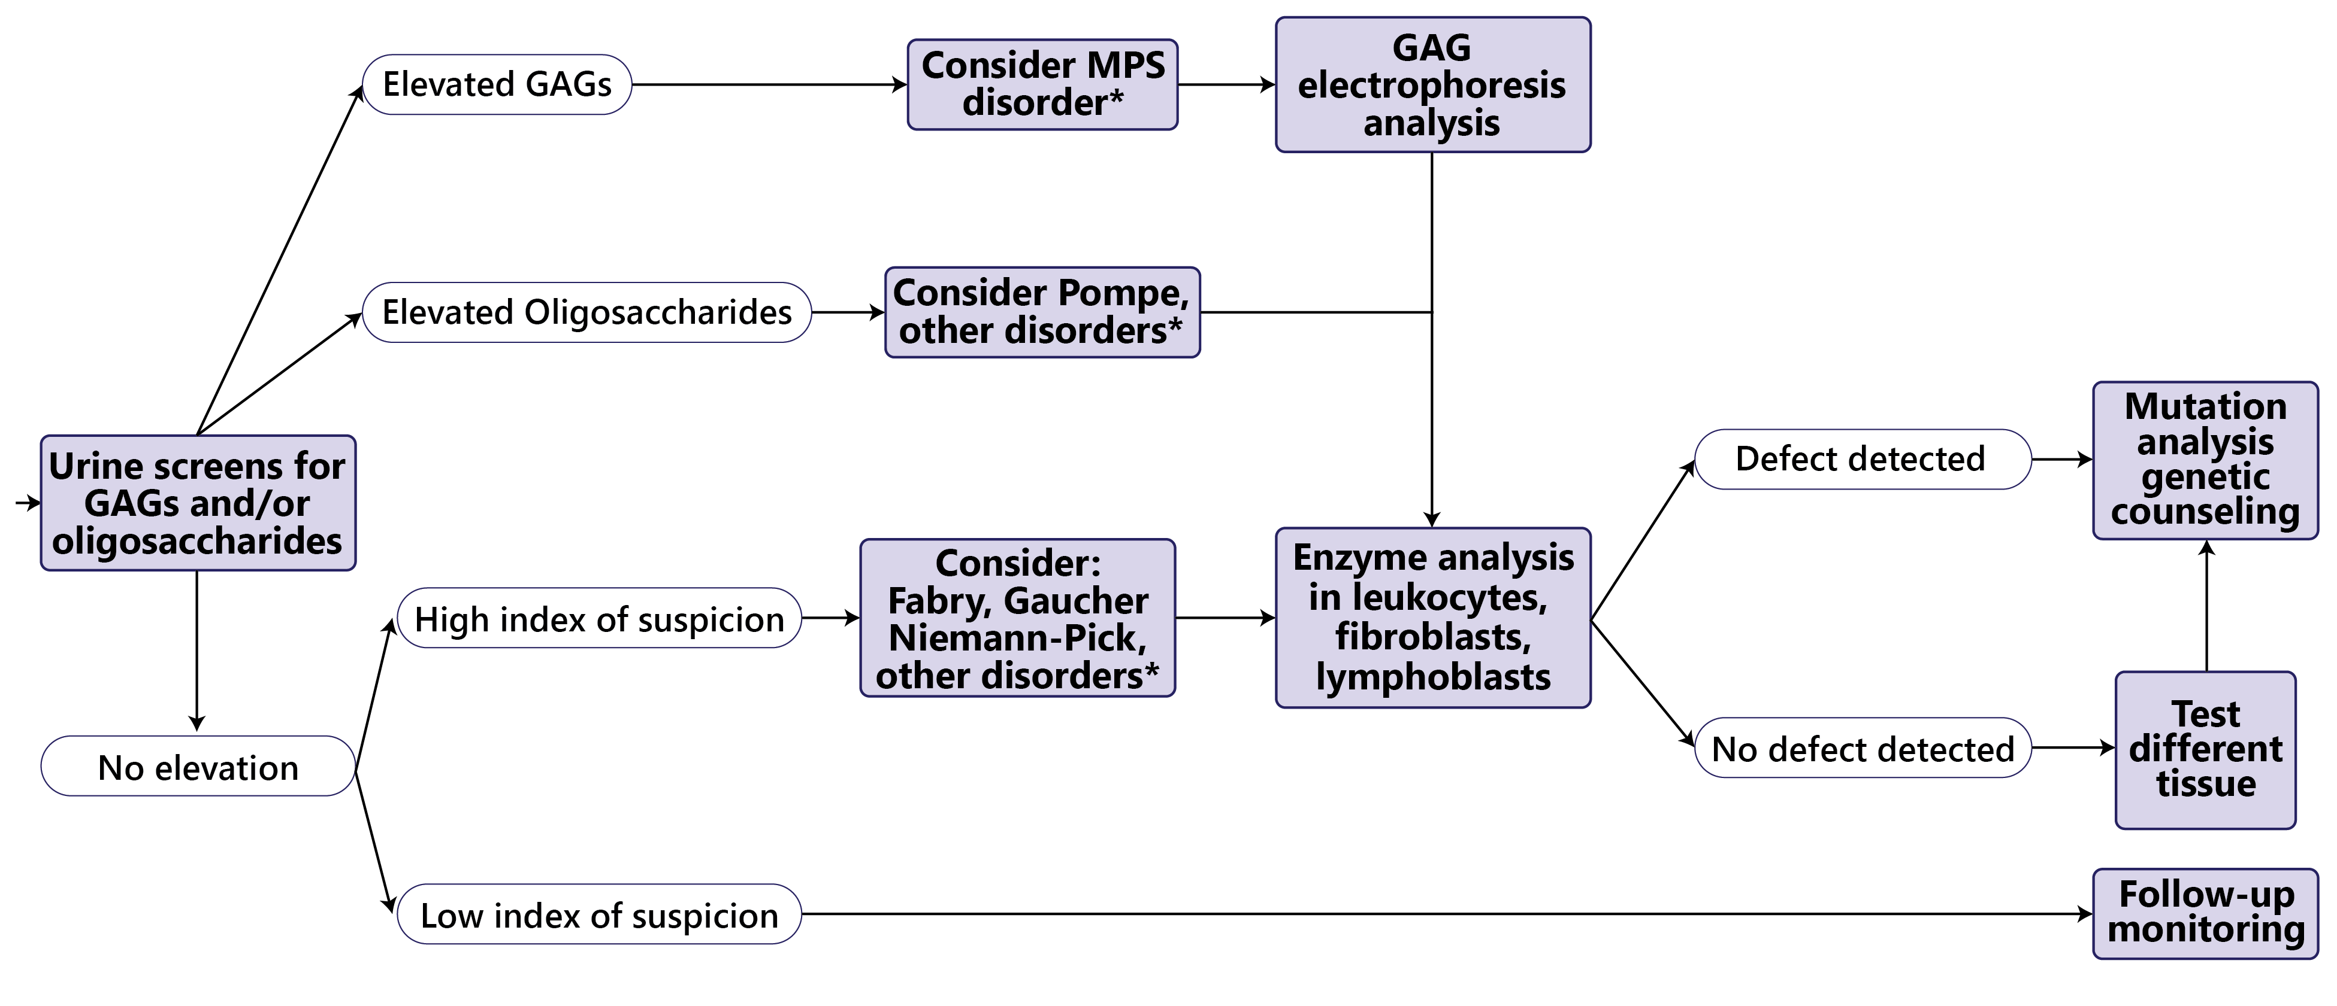
Generic Diagnostic Algorithm: Infant With Suspected LSD*
*Simplified algorithm for illustration only; download the complete algorithm here.
Staretz-Chacham O, et al. Pediatrics. 2009;123:1191-1207. BenHamida E, et al. Pan Afr Med J. 2015;21:110 doi:10.11604/pamj.2015.21.110.7052.

Slide 21
Common Presentations of Missed LSDs

Slide 22
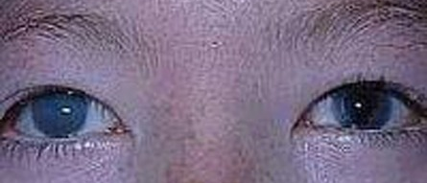
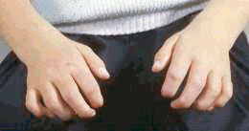
An 8-Year-Old Girl Presents to Rheumatology Clinic With a Diagnosis of Juvenile Rheumatoid Arthritis
Presentation Slowly progressive joint stiffness in hands and fingers, previous diagnosis of juvenile rheumatoid arthritis Symptoms not responsive to prior courses of steroids
Cimaz R, et al. Ped Rheum. 2009;7:18. doi:10.1186/1-0096-7-18. Bruni S, et al. Mol Genet Metabol Rep. 2016;8:67-73. Galimberti C, et al. Ital J Pediatr. 2018;44:133. doi:10.1186/s13052-018-0550-5. 546 Photo credit J. Edmond Wraith with permission

Slide 23
An 8-Year-Old Girl Presents to Rheumatology Clinic With a Diagnosis of Juvenile Rheumatoid Arthritis
Presentation Slowly progressive joint stiffness in hands and fingers, previous diagnosis of juvenile rheumatoid arthritis Symptoms not responsive to prior courses of steroids
Examination Impaired fine motor skills, limited range of motion in her shoulders No redness or swelling in joints Negative for Rh-factor, ESR and CRP within normal range Corneal clouding
Cimaz R, et al. Ped Rheum. 2009;7:18. doi:10.1186/1546-0096-7-18. Bruni S, et al. Mol Genet Metabol Rep. 2016;8:67-73. Galimberti C, et al. Ital J Pediatr. 2018;44:133. doi:10.1186/s13052-018-0550-5. Photo credit J. Edmond Wraith with permission

Slide 24
An 8-Year-Old Girl Presents to Rheumatology Clinic With a Diagnosis of Juvenile Rheumatoid Arthritis
Presentation Slowly progressive joint stiffness in hands and fingers, previous diagnosis of juvenile rheumatoid arthritis Symptoms not responsive to prior courses of steroids
Examination Impaired fine motor skills, limited range of motion in her shoulders No redness or swelling in joints Negative for Rh-factor, ESR and CRP within normal range Corneal clouding
Additional history Surgical repair for an umbilical hernia Tympanostomy tube placement for frequent ear infections Evaluation for mild hearing loss Heart murmur
Cimaz R, et al. Ped Rheum. 2009;7:18. doi:10.1186/1546-0096-7-18. Bruni S, et al. Mol Genet Metabol Rep. 2016;8:67-73. Galimberti C, et al. Ital J Pediatr. 2018;44:133. doi:10.1186/s13052-018-0550-5. Photo credit J. Edmond Wraith with permission.

Slide 25

An 8-Year-Old Girl Presents to Rheumatology Clinic With a Diagnosis of Juvenile Rheumatoid Arthritis
Presentation Slowly progressive joint stiffness in hands and fingers, previous diagnosis of juvenile rheumatoid arthritis Symptoms not responsive to prior courses of steroids
Examination Impaired fine motor skills, limited range of motion in her shoulders No redness or swelling in joints Negative for Rh-factor, ESR and CRP within normal range Corneal clouding
Additional history Surgical repair for an umbilical hernia Tympanostomy tube placement for frequent ear infections Evaluation for mild hearing loss Heart murmur
Diagnostic Inconsistencies
Symptoms progress despite treatment
No additional signs of inflammation
Symptom Complex
Corneal clouding
Respiratory or ENT infections
Carpal tunnel syndrome
Cardiac disorder
Hearing loss
Hernia repair
Cimaz R, et al. Ped Rheum. 2009;7:18. doi:10.1186/1546-0096-7-18. Bruni S, et al. Mol Genet Metabol Rep. 2016;8:67-73. Galimberti C, et al. Ital J Pediatr. 2018;44:133. doi:10.1186/s13052-018-0550-5.

Slide 26
Mucopolysaccharidosis I (MPS I)
Alternate Names | Hurler / Hurler-Scheie / Scheie
Metabolic Deficiency | α-iduronidase (IDUA)
Definitive Testing | Urinary glycosaminoglycan quantitative and qualitative testing IDUA enzyme activity in fibroblasts, leukocytes, serum, or blood spots
H/O, history of
Meikle PJ, et al. JAMA. 1999;281:249-254. Beck M. Dev Med Child Neurol. 2018;60:13-18. Ballabio A, Gieselmann V. Biochimi Biophys Acta. 2009;1793:684-696. Cimaz R, et al. Ped Rheum. 2009;7:18. doi:10.1186/1546-0096-7-18. Bruni S, et al. Mol Genet Metabol Rep. 2016;8:67-73. Galimberti C, et al. Ital J Pediatr. 2018;44:133. doi:10.1186/s13052-018-0550-5.

Slide 27
Mucopolysaccharidosis I (MPS I)
Alternate Names | Hurler / Hurler-Scheie / Scheie
Metabolic Deficiency | α-iduronidase (IDUA)
Definitive Testing | Urinary glycosaminoglycan quantitative and qualitative testing IDUA enzyme activity in fibroblasts, leukocytes, serum, or blood spots
Early Clinical Characteristics | Joint pain, stiffness, or contractures without systemic or local signs of inflammation; no response to anti-inflammatory treatment or steroids H/O umbilical or inguinal hernia H/O frequent ENT infections | Carpal tunnel syndrome Cardiac valve disease Coarse facies Hearing loss Corneal clouding
Forms | Severe and Attenuated
H/O, history of
Meikle PJ, et al. JAMA. 1999;281:249-254. Beck M. Dev Med Child Neurol. 2018;60:13-18. Ballabio A, Gieselmann V. Biochim Biophys Acta. 2009;1793:684-696. Cimaz R, et al. Ped Rheum. 2009;7:18. doi:10.1186/1546-0096-7-18. Bruni S, et al. Mol Genet Metabol Rep. 2016;8:67-73. Galimberti C, et al. Ital J Pediatr. 2018;44:133. doi:10.1186/s13052-018-0550-5.

Slide 28
Mucopolysaccharidosis I (MPS I)
Alternate Names | Hurler / Hurler-Scheie / Scheie
Metabolic Deficiency | α-iduronidase (IDUA)
Definitive Testing | Urinary glycosaminoglycan quantitative and qualitative testing IDUA enzyme activity in fibroblasts, leukocytes, serum, or blood spots
Early Clinical Characteristics | Joint pain, stiffness, or contractures without systemic or local signs of inflammation; no response to anti-inflammatory treatment or steroids H/O umbilical or inguinal hernia H/O frequent ENT infections |  | Carpal tunnel syndrome Cardiac valve disease Coarse facies Hearing loss Corneal clouding
Forms | Severe and Attenuated
Common Misdiagnoses and Referrals | Rheumatology for autoimmune disease, rheumatoid arthritis Cardiology | ENT specialists Ophthalmology Pediatrics
Diagnostic Algorithm | Cimaz R, et al. Available here
Approved Treatment(s) | Enzyme replacement (laronidase)
H/O, history of
Meikle PJ, et al. JAMA. 1999;281:249-254. Beck M. Dev Med Child Neurol. 2018;60:13-18. Ballabio A, Gieselmann V. Biochim Biophys Acta. 2009;1793:684-696. Cimaz R, et al. Ped Rheum. 2009;7:18. doi:10.1186/1546-0096-7-18. Bruni S, et al. Mol Genet Metabol Rep. 2016;8:67-73. Galimberti C, et al. Ital J Pediatr. 2018;44:133. doi:10.1186/s13052-018-0550-5.

Slide 29
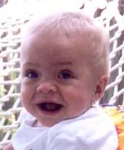
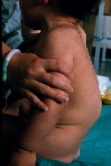
Clinical Features in MPS I
Severe disease, 10 months
Less severe, 11 years
Courtesy of Barbara K Burton

Slide 30
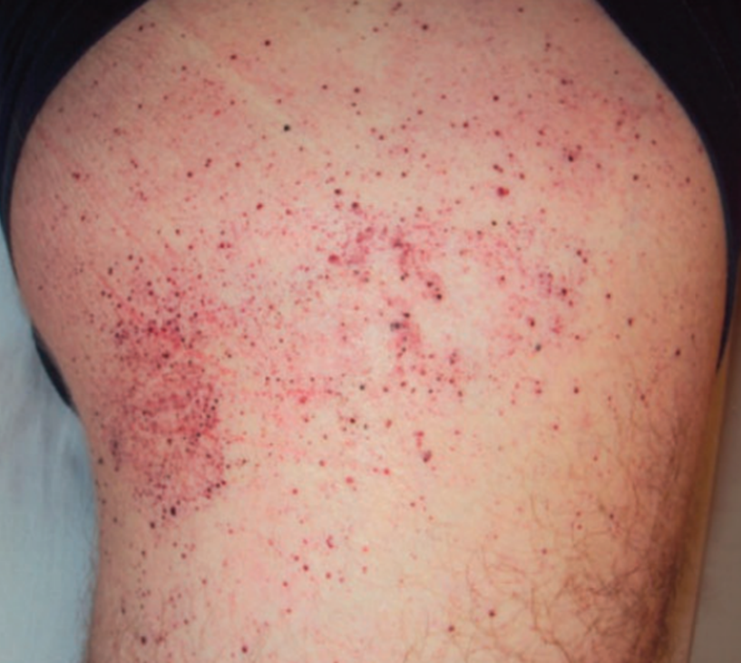
An Adolescent Male Presents for Evaluation of Cutaneous Lesions
Presentation 14-year-old with skin lesions
Examination Angiokeratomas on abdomen, buttocks, and thighs
Additional history Intermittent and progressive burning pain in limbs since age 10, no response to treatment with analgesics Heat and exercise intolerant History of irritable bowel syndrome (abdominal cramping, diarrhea) exacerbated by stress Mild proteinuria (+1)
Lidove O, et al. In: Mehta A, et al. Oxford PharmaGenesis; 2006. Chapter 24. Available from: www.ncbi.nlm.nih.gov/books/NBK11605/
Patil R, et al. JAPI 2014;62:69-71. https://www.mayocliniclabs.com/it-mmfiles/Fabry_Disease_Testing_Algorithm.pdf. Photo credit SAGE Publishing used under Creative Commons Attribution 3.0

Slide 31
An Adolescent Male Presents for Evaluation of Cutaneous Lesions
Presentation 14-year old with skin lesions
Examination Angiokeratomas on abdomen, buttocks, and thighs
Additional history Intermittent and progressive burning pain in limbs since age 10, no response to treatment with analgesics Heat and exercise intolerant History of irritable bowel syndrome (abdominal cramping, diarrhea) exacerbated by stress Mild proteinuria (+1)
Diagnostic Inconsistencies
Often treated for a dermatologic, cardiovascular/cerebrovascular, renal, or autoimmune condition without recognition of Fabry symptom complex
Symptom Complex
Family history of renal, cardiac, or neuronal disease
Angiokeratoma
Peripheral neuropathy exacerbated by stress, exercise, or temperature changes
Proteinuria or renal disease
Abdominal pain, diarrhea
Cardiovascular disease
Absence of neuronal involvement
Zar-Kessler C, et al. Ther Adv Gastrointerol. 2016;9:626-634. Bekri S, et al. Nephron Clin Pract. 2005;101:c33-38. Mehta A, Hughes DA. GeneReviews. Pagon RA, et al, Eds. 1993 University of Washington. Lidove O, et al. In: Mehta A, et al. Oxford PharmaGenesis; 2006. Chapter 24. Available from: www.ncbi.nlm.nih.gov/books/NBK11605/
Patil R, et al. JAPI. 2014;62:69-71. https://www.mayocliniclabs.com/it-mmfiles/Fabry_Disease_Testing_Algorithm.pdf

Slide 32
Fabry Disease
Alternate Names | N/A
Metabolic Deficiency | α-Galactosidase A
Definitive Testing | α-galactosidase A activity in leukocytes, GLA mutation analysis
Zar-Kessler C, et al. Ther Adv Gastrointerol. 2016;9:626-634. Bekri S, et al. Nephron Clin Pract. 2005;101:c33-38. Mehta A, Hughes DA. GeneReviews. Pagon RA, et al, Eds. 1993 University of Washington. Lidove O, et al. In: Mehta A, et al. Oxford PharmaGenesis; 2006. Chapter 24. Available from: www.ncbi.nlm.nih.gov/books/NBK11605/
Patil R, et al. JAPI. 2014;62:69-71. https://www.mayocliniclabs.com/it-mmfiles/Fabry_Disease_Testing_Algorithm.pdf

Slide 33
Fabry Disease
Alternate Names | N/A
Metabolic Deficiency | α-Galactosidase A
Definitive Testing | α-galactosidase A activity in leukocytes, GLA mutation analysis
Early Clinical Characteristics | Painful paresthesias Angiokeratoma Renal disease Cardiomyopathy Stroke | Abdominal pain, diarrhea Hypohidrosis, temperature sensitivity Neuronal involvement absent Widespread lipid storage in endothelial and vascular smooth muscle cells
Forms/Onset | X-linked, but symptoms possible in female heterozygous carriers Childhood or adolescent onset
Zar-Kessler C, et al. Ther Adv Gastrointerol. 2016;9:626-634. Bekri S, et al. Nephron Clin Pract. 2005;101:c33-38. Mehta A, Hughes DA. GeneReviews, Pagon RA, et al, Eds. 1993 University of Washington. Lidove O, et al. In: Mehta A, et al. Oxford PharmaGenesis; 2006. Chapter 24. Available from: www.ncbi.nlm.nih.gov/books/NBK11605/
Patil R, et al. JAPI. 2014;62:69-71. https://www.mayocliniclabs.com/it-mmfiles/Fabry_Disease_Testing_Algorithm.pdf

Slide 34
Fabry Disease
Alternate Names | N/A
Metabolic Deficiency | α-Galactosidase A
Definitive Testing | α-galactosidase A activity in leukocytes, GLA mutation analysis
Early Clinical Characteristics | Painful paresthesias Angiokeratoma Renal disease Cardiomyopathy Stroke | Abdominal pain, diarrhea Hypohidrosis, temperature sensitivity Neuronal involvement absent Widespread lipid storage in endothelial and vascular smooth muscle cells
Forms/Onset | X-linked, but symptoms possible in female heterozygous carriers Childhood or adolescent onset
Common Misdiagnoses and Referrals | Rheumatology Neuropsychological disease Cardiology | Gastroenterologists Nephrologists, idiopathic chronic kidney disease
Diagnostic Algorithm | Available here and here
Approved Treatment(s) | Enzyme replacement (agalsidase beta) Chaperone (migalastat)
Zar-Kessler C, et al. Ther Adv Gastrointerol. 2016;9:626-634. Bekri S, et al. Nephron Clin Pract. 2005;101:c33-38. Mehta A, Hughes DA. GeneReviews. Pagon RA, et al, Eds. 1993 University of Washington. Lidove O, et al. In: Mehta A, et al. Oxford PharmaGenesis; 2006. Chapter 24. Available from: www.ncbi.nlm.nih.gov/books/NBK11605/
Patil R, et al. JAPI. 2014;62:69-71. https://www.mayocliniclabs.com/it-mmfiles/Fabry_Disease_Testing_Algorithm.pdf

Slide 35
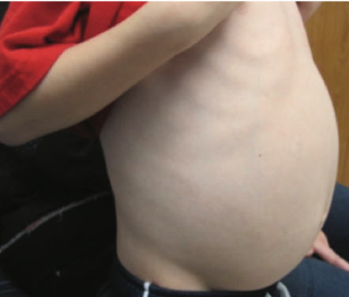
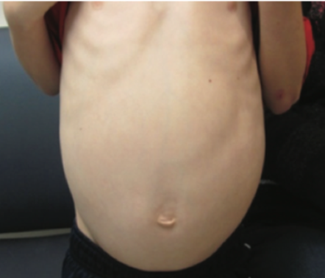
A Child With Splenomegaly and Cytopenia
Presentation 6 years old Gradually increasing abdominal girth and pallor
Examination Liver and spleen palpably enlarged Petechiae
Family History 2 older, healthy siblings
Mistry PK, et al. Am J Hematol. 2011;86:110-115. Linari S, Castaman G. Clin Cases Mineral Bone Met. 2015;12:157-164. Ortega-Rosales A, et al. F1000Res. 2019;8:755. Watson MS, et al. Genet Med 2006:8(5, Supplement):12S–252S. Photo credit Consultant for Pediatricians, and/or Consultant360.com, used with permission by HMP Global.

Slide 36
A Child With Splenomegaly and Cytopenia
Presentation 3 years old Gradually increasing abdominal girth and pallor
Examination Liver and spleen palpably enlarged Petechiae
Family History 2 older, healthy siblings
Symptom Complex
Splenomegaly, H/O splenectomy
OR
Hepatomegaly
AND
Bone complications
(bone pain, pathologic fractures)
Thrombocytopenia, bleeding, anemia
Growth retardation
Elevated ferritin, chitotriosidase
Mistry PK, et al. Am J Hematol. 2011;86:110-115. Linari S, Castaman G. Clin Cases Mineral Bone Met. 2015;12:157-164. Ortega-Rosales A, et al. F1000Res. 2019;8:755.

Slide 37
Gaucher Disease (Type 1, Non-neuronal)
Alternate Names | N/A
Metabolic Deficiency | β-Glucocerebrosidase
Definitive Testing | Glucocerebrosidase activity in leukocytes
* Links included at the end of the presentation and as a downloadable resource from LINK
Mistry PK, et al. Am J Hematol. 2011;86:110-115. Linari S, Castaman G. Clin Cases Mineral Bone Met. 2015;12:157-164. Ortega-Rosales A, et al. F1000Res. 2019;8:755.

Slide 38
Gaucher Disease (Type 1, Non-neuronal)
Alternate Names | N/A
Metabolic Deficiency | β-Glucocerebrosidase
Definitive Testing | Glucocerebrosidase activity in leukocytes
Early Clinical Characteristics | Most common variant Visceral and skeletal disorders in the absence of neurologic impairment More prevalent in Ashkenazi population | High phenotypic variability, even among siblings Hepatosplenomegaly Bone fractures, delayed skeletal growth, skeletal deformations Thrombocytopenia, signs of bleeding
Forms/Onset | Incidental finding in adulthood or asymptomatic to childhood (<24 mos) onset of symptoms
* Links included at the end of the presentation and as a downloadable resource from LINK
Mistry PK, et al. Am J Hematol. 2011;86:110-115. Linari S, Castaman G. Clin Cases Mineral Bone Met. 2015;12:157-164. Ortega-Rosales A, et al. F1000Res. 2019;8:755.

Slide 39
Gaucher Disease (Type 1, Non-neuronal)
Alternate Names | N/A
Metabolic Deficiency | β-Glucocerebrosidase
Definitive Testing | Glucocerebrosidase activity in leukocytes
Early Clinical Characteristics | Most common variant Visceral and skeletal disorders in the absence of neurologic impairment More prevalent in Ashkenazi population | High phenotypic variability, even among siblings Hepatosplenomegaly Bone fractures, delayed skeletal growth, skeletal deformations Thrombocytopenia, signs of bleeding
Forms/Onset | Incidental finding in adulthood or asymptomatic to childhood (<24 mos) onset of symptoms
Common Misdiagnoses and Referrals | Niemann-Pick (usually more severe)
Diagnostic Algorithm | Algorithms for Ashkenazi Jewish ancestry and non-Ashkenazi Jewish origin here Pediatric patients: Di Rocco M, et al. Pediatr Blood Cancer 2014;61:1905-1909.*
Approved Treatment(s) | Enzyme replacement (imiglucerase, velaglucerase, taliglucerase) Substrate reduction (miglustat, eliglustat)
* Algorithm included at the end of the presentation
Mistry PK, et al. Am J Hematol. 2011;86:110-115. Linari S, Castaman G. Clin Cases Mineral Bone Met. 2015;12:157-164. Ortega-Rosales A, et al. F1000Res. 2019;8:755.

Slide 40
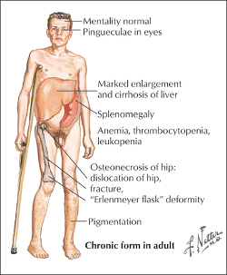
Type 1 Gaucher Disease Symptom Complex
Photo credit Netter Images with permissions.

Slide 41
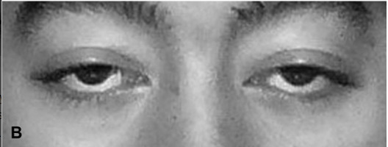
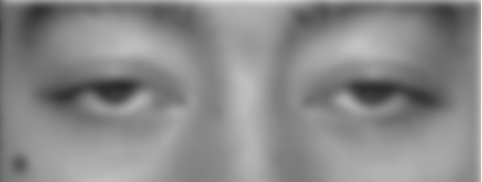
Progressive Limb Weakness and New-Onset Dyspnea
Presentation 29-year-old man presents to PCP about worsening dyspnea
Examination Ptosis Weakness in shoulders and hips
Kishnani PS, et al. Genet Med. 2006;8:267-288. Dasouki M, et al. Neurol Clin. 2014;32:751. Toscano A, et al. Acta Myologica. 2013;XXXII:78-81. Photo image permission received thru RightsLinks, Journal of Neuro-Ophthalmology.

Slide 42
Progressive Limb Weakness and New-Onset Dyspnea
Presentation 29-year-old man presents to PCP about worsening dyspnea
Examination Ptosis Weakness in shoulders and hips
Chart Review Seeing neurologist for difficulty walking, fatigue, myalgias; tentative diagnosis of limb-girdle muscular dystrophy Elevated CK, LDH, AST/ALT
Additional History Treated for mild scoliosis at age 14 Uses CPAP machine for sleep apnea
Kishnani PS, et al. Genet Med. 2006;8:267-288. Dasouki M, et al. Neurol Clin. 2014;32:751. Toscano A, et al. Acta Myologica. 2013;XXXII:78-81. Photo image permission received thru RightsLinks, Journal of Neuro-Ophthalmology.

Slide 43
Progressive Limb Weakness and New-Onset Dyspnea
Presentation 29-year-old man presents to PCP about worsening dyspnea
Examination Ptosis Weakness in shoulders and hips
Chart Review Seeing neurologist for difficulty walking, fatigue, myalgias; tentative diagnosis of limb-girdle muscular dystrophy Elevated CK, LDH, AST/ALT
Additional History Treated for mild scoliosis at age 14 Uses CPAP machine for sleep apnea
Late-Onset Symptom Complex
Signs of exercise intolerance, fatigue, back pain, myalgias
Respiratory symptoms (dyspnea, shortness of breath, obstructive sleep apnea, recurrent pneumonia, morning headache, excessive daytime sleepiness)
Neurological signs indicating weakness in axial and proximal muscles, limb-girdle distribution
History of skeletal abnormalities
Kishnani PS, et al. Genet Med. 2006;8:267-288. Dasouki M, et al. Neurol Clin. 2014;32:751. Toscano A, et al. Acta Myologica. 2013;XXXII:78-81.

Slide 44
Pompe Disease
Alternate Names | Acid maltase deficiency (AMD) glycogen-storage-disease type II (GSDII)
Metabolic Deficiency | Acid α-Glucosidase (GAA)
Definitive Testing | GAA activity in cultured fibroblasts from skin or muscle biopsy
Kishnani PS, et al. Genet Med. 2006;8:267-288. Dasouki M, et al. Neurol Clin. 2014;32:751. Toscano A, et al. Acta Myologica. 2013;XXXII:78-81.

Slide 45
Pompe Disease
Alternate Names | Acid maltase deficiency (AMD) glycogen-storage-disease type II (GSDII)
Metabolic Deficiency | Acid α-Glucosidase (GAA)
Definitive Testing | GAA activity in cultured fibroblasts from skin or muscle biopsy
Early Clinical Characteristics | Late-onset Forms Absent or less-severe cardiac involvement Progressive skeletal muscle dysfunction | Proximal lower limb, paraspinal trunk muscles affected first; diaphragm and respiratory muscles affected later
Forms/Onset | Infantile: rapidly progressive cardiomegaly, hepatomegaly, weakness, hypotonia, and death from cardiorespiratory failure in the first year Non-classic infantile: slower progressive, less severe or absent cardiac involvement Childhood onset, muscular variant: lacks cardiomyopathy Adult-onset: slowly progressive myopathy, predominantly in skeletal muscle
Kishnani PS, et al. Genet Med. 2006;8:267-288. Dasouki M, et al. Neurol Clin. 2014;32:751. Toscano A, et al. Acta Myologica. 2013;XXXII:78-81.

Slide 46
Pompe Disease
Alternate Names | Acid maltase deficiency (AMD) glycogen-storage-disease type II (GSDII)
Metabolic Deficiency | Acid α-Glucosidase (GAA)
Definitive Testing | GAA activity in cultured fibroblasts from skin or muscle biopsy
Early Clinical Characteristics | Late-onset Forms Absent or less-severe cardiac involvement Progressive skeletal muscle dysfunction |  | Proximal lower limb, paraspinal trunk muscles affected first; diaphragm and respiratory muscles affected later
Forms/Onset | Infantile: rapidly progressive cardiomegaly, hepatomegaly, weakness, hypotonia, and death from cardiorespiratory failure in the first year Non-classic infantile: slower progressive, less severe or absent cardiac involvement Childhood onset, muscular variant: lacks cardiomyopathy Adult-onset: slowly progressive myopathy, predominantly in skeletal muscle
Common Misdiagnoses and Referrals | Limb girdle muscular dystrophy
Diagnostic Algorithm | Algorithm available here Infantile and late-onset forms: ACMG Work Group on Management of Pompe Disease. Genet Med 2006;8:267-288.
Approved Treatment(s) | Enzyme replacement (alglucosidase alfa)
Kishnani PS, et al. Genet Med. 2006;8:267-288. Dasouki M, et al. Neurol Clin. 2014;32:751. Toscano A, et al. Acta Myologica. 2013;XXXII:78-81.

Slide 47
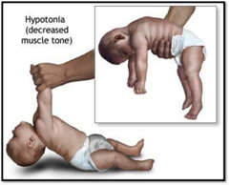
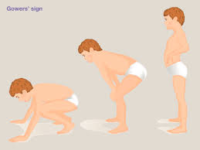
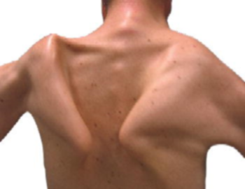
Clinical Features of Pompe Disease
Infantile-onset
Late-onset
Hypotonia
Gowers’ sign
Winging scapula
Left photo credit A.D.A.M. Images with permission. Middle photo credit Elsevier with permission. Right photo credit Oncohema Key under terms of a Creative Commons License.

Slide 48
Hepatosplenomegaly With Respiratory Infections and Bleeding Episodes
Presentation A 6-year-old presents to pediatrician for routine visit Occasionally has very bad nosebleeds
Chart Review 80th percentile for growth through age 3; currently 40th percentile
McGovern MM, et al. Gen Med. doi:10.1038/gim.2017.7. Patino-Escobar B, et al. Cureus. 2019;11:e4767.

Slide 49
Hepatosplenomegaly With Respiratory Infections and Bleeding Episodes
Presentation A 6-year-old presents to pediatrician for routine visit Occasionally has very bad nosebleeds
Chart Review 80th percentile for growth through age 3; currently 40th percentile
Additional history Currently seeing a hematologist for idiopathic splenomegaly
Additional History Mild pancytopenia LDL 180 mg/dL, HDL 20 mg/dL
McGovern MM, et al. Gen Med. doi:10.1038/gim.2017.7. Patino-Escobar B, et al. Cureus. 2019;11:e4767.

Slide 50
Hepatosplenomegaly With Respiratory Infections and Bleeding Episodes
Presentation A 6-year-old presents to pediatrician for routine visit Occasionally has very bad nosebleeds
Chart Review 80th percentile for growth through age 3; currently 40th percentile
Additional history Currently seeing a hematologist for idiopathic splenomegaly
Additional History Mild pancytopenia LDL 180 mg/dL, HDL 20 mg/dL
Symptom Complex
Splenomegaly with or without hepatomegaly
Thrombocytopenia
Mixed dyslipidemia
McGovern MM, et al. Gen Med. doi:10.1038/gim.2017.7. Patino-Escobar B, et al. Cureus. 2019;11:e4767.

Slide 51
Niemann-Pick B Disease
Alternate Names | Acid sphingomyelinase deficiency, chronic visceral ASMD
Metabolic Deficiency | Sphingomyelinase
Definitive Testing | Acid sphingomyelinase activity in peripheral blood leukocytes or fibroblasts
McGovern MM, et al. Gen Med. doi:10.1038/gim.2017.7. Patino-Escobar B, et al. Cureus. 2019;11:e4767. Sanofi Press Release, available at https://www.sanofi.com/en/media-room/press-releases/2020/2020-01-30-07-00-00

Slide 52
Niemann-Pick B Disease
Alternate Names | Acid sphingomyelinase deficiency, chronic visceral ASMD
Metabolic Deficiency | Sphingomyelinase
Definitive Testing | Acid sphingomyelinase activity in peripheral blood leukocytes or fibroblasts
Clinical Characteristics | Splenomegaly with or without hepatomegaly Hyperlipidemia Possible pulmonary involvement Growth retardation | Infection secondary to progressive leukopenia Bleeding episodes secondary to thrombocytopenia Variable liver dysfunction, cardiac disease
Forms/Onset | Panethnic, non-neuronopathic
McGovern MM, et al. Gen Med. doi:10.1038/gim.2017.7. Patino-Escobar B, et al. Cureus. 2019;11:e4767. Sanofi Press Release, available at https://www.sanofi.com/en/media-room/press-releases/2020/2020-01-30-07-00-00

Slide 53
Niemann-Pick B Disease
Alternate Names | Acid sphingomyelinase deficiency, chronic visceral ASMD
Metabolic Deficiency | Sphingomyelinase
Definitive Testing | Acid sphingomyelinase activity in peripheral blood leukocytes or fibroblasts
Clinical Characteristics | Splenomegaly with or without hepatomegaly Hyperlipidemia Possible pulmonary involvement Growth retardation |  | Infection secondary to progressive leukopenia Bleeding episodes secondary to thrombocytopenia Variable liver dysfunction, cardiac disease
Forms/Onset | Panethnic, non-neuronopathic
Common Misdiagnoses | Gaucher disease
Diagnostic Algorithm | McGovern MM, et al. Gen Med. doi:10.1038/gim.2017.7. Available here
Approved Treatment(s) | None approved Olipudase alfa enzyme replacement therapy (investigational)
McGovern MM, et al. Gen Med. doi:10.1038/gim.2017.7. Patino-Escobar B, et al. Cureus. 2019;11:e4767. Sanofi Press Release, available at https://www.sanofi.com/en/media-room/press-releases/2020/2020-01-30-07-00-00

Slide 54
Newborn Screening

Slide 55
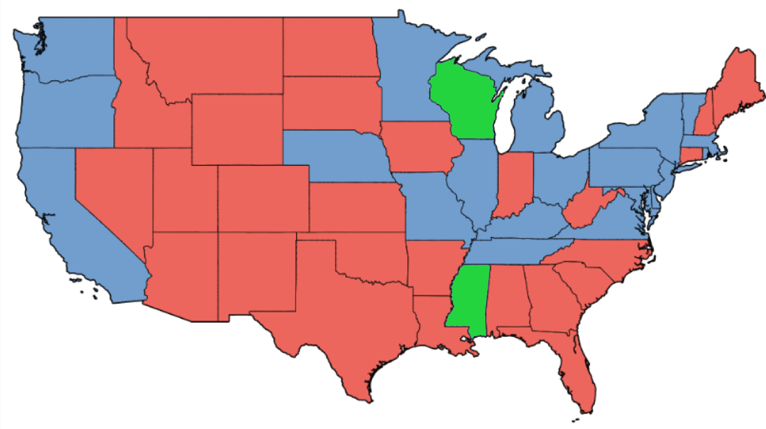
Newborn Screening (NBS) in the US
Recommended Uniform Screening Panel (RUSP)
  Federal recommendations
  35 disorders, including MPS I and Pompe
NBS is implemented by state health departments
Current Implementation of RUSP for Pompe and MPS I
Both MPS I and Pompe
Pompe disease only
No testing for Pompe or MPS I
https://www.babysfirsttest.org/newborn-screening/rusp-conditions, data current as of 1/24/2020

Slide 56
Additional NBS Programs
 | Fabry Disease | Gaucher Disease | Krabbe Disease* | Niemann-Pick | MPSII
Illinois | Yes | Yes | Yes | Yes | Yes
Kentucky |  |  | Yes
Maryland | Yes
Missouri | Yes | Yes | Yes |  | Yes
New York |  |  | Yes
Ohio |  |  | Yes
Tennessee | Yes | Yes | Yes
* Galactocerebrosidase deficiency
https://www.babysfirsttest.org/newborn-screening/rusp-conditions, data current as of 1/24/2020

Slide 57
Newborn Screening (NBS)
LSDs are candidates for NBS
  Patients usually normal at birth
  Progressive, debilitating, often life-threatening
  Correct diagnosis difficult and often delayed
  Treatments are available
  Ideal treatment begins before symptom onset or accumulation of irreversible pathology
  Early diagnosis and intervention can have a significant impact on patient outcomes
Marsden D, Levy H. Clin Chem. 2010;56:1071-1079.

Slide 58
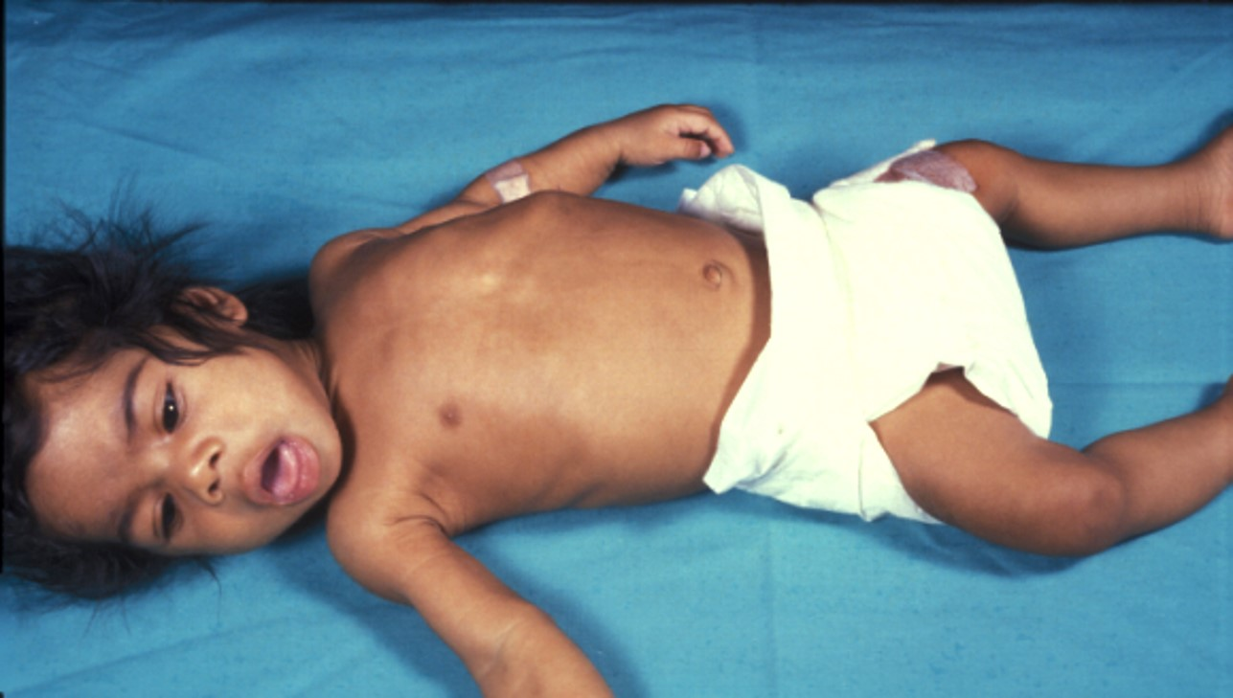
Patient Disease Course, 1985
Presentation A 4-month-old presents with hypotonia, macroglossia, congestive heart failure
Diagnosis No acid α-glucosidase activity in leukocytes = Pompe disease
Outcome Death at 7 months due to intractable heart failure
Courtesy Barbara K Burton
McGovern MM, et al. Gen Med. doi:10.1038/gim.2017.7. Patino-Escobar B, et al. Cureus. 2019;11:e4767.

Slide 59
Patient Disease Course, 2015
Medical history Discharged home after normal labor and delivery 36 hours after birth
Presentation Returned 1 day later with tachypnea
Clinical and laboratory findings Cardiomegaly on chest X-ray Biventricular hypertrophy with severely diminished function CK 3488 IU/L (normal range <136 IU/L)
NBS results Received positive result on day 5
NG, nasogastric; OSA, obstructive sleep apnea
McGovern MM, et al. Gen Med. doi:10.1038/gim.2017.7. Patino-Escobar B, et al. Cureus. 2019;11:e4767.

Slide 60

Patient Disease Course, 2015
Treatment ERT started at age 10 days Treated in cardiac ICS Heart failure regimen identified NG feeding started OSA addressed
Follow-up Discharged with weekly ERT Began oral feedings at 6 months Hypotonia persisted for 12 months At 14 months, physical exam normal, age-appropriate development At 4 years of age, patient is healthy, normal development
Courtesy Barbara K Burton
NG, nasogastric; OSA, obstructive sleep apnea
McGovern MM, et al. Gen Med. doi:10.1038/gim.2017.7. Patino-Escobar B, et al. Cureus. 2019;11:e4767.

Slide 61
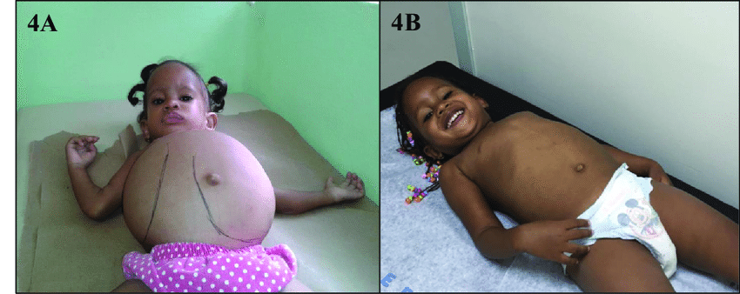
Child with Gaucher Disease
Hepatosplenomegaly Prior to Treatment
Regression of Hepatosplenomegaly During ERT
Estrada-Veras JI, et al. Mol Genet Genomic Med. 2016;4:243-256. Photos used under terms of the Creative Commons Attribution License.

Slide 62
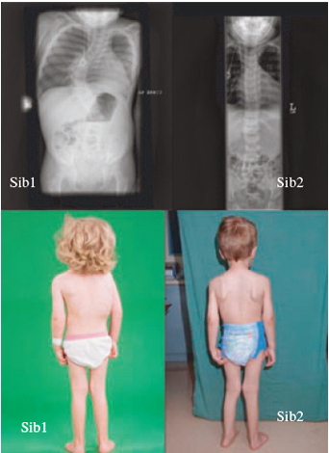
Scoliosis in Siblings With MPS VI
Older sibling, age 3.6 years
Younger sibling, age 3.6
No ERT
ERT since 8 weeks of age after prenatal diagnosis
Muenzer J. Mol Genet Metab. 2014;111:63-72.; https://www.sciencedirect.com/science/article/pii/S1096719213004186; Permission not needed to use these images. Photos used under terms of the Creative Commons CC-BY License.

Slide 63
≠
A Positive Result on a Newborn Screening Test
Confirmed Diagnosis
A positive test is an indication of an abnormality that requires further testing
  Heterozygous carrier
  Pseudodeficiency
Confirming the diagnosis requires
  Finding evidence of substrate accumulation
  Genotype testing
Limitations of genetic testing
≠
A Positive Newborn Screening Test
A Positive Test From a Patient with Clinical Features

Slide 64
Treatment Overview

Slide 65
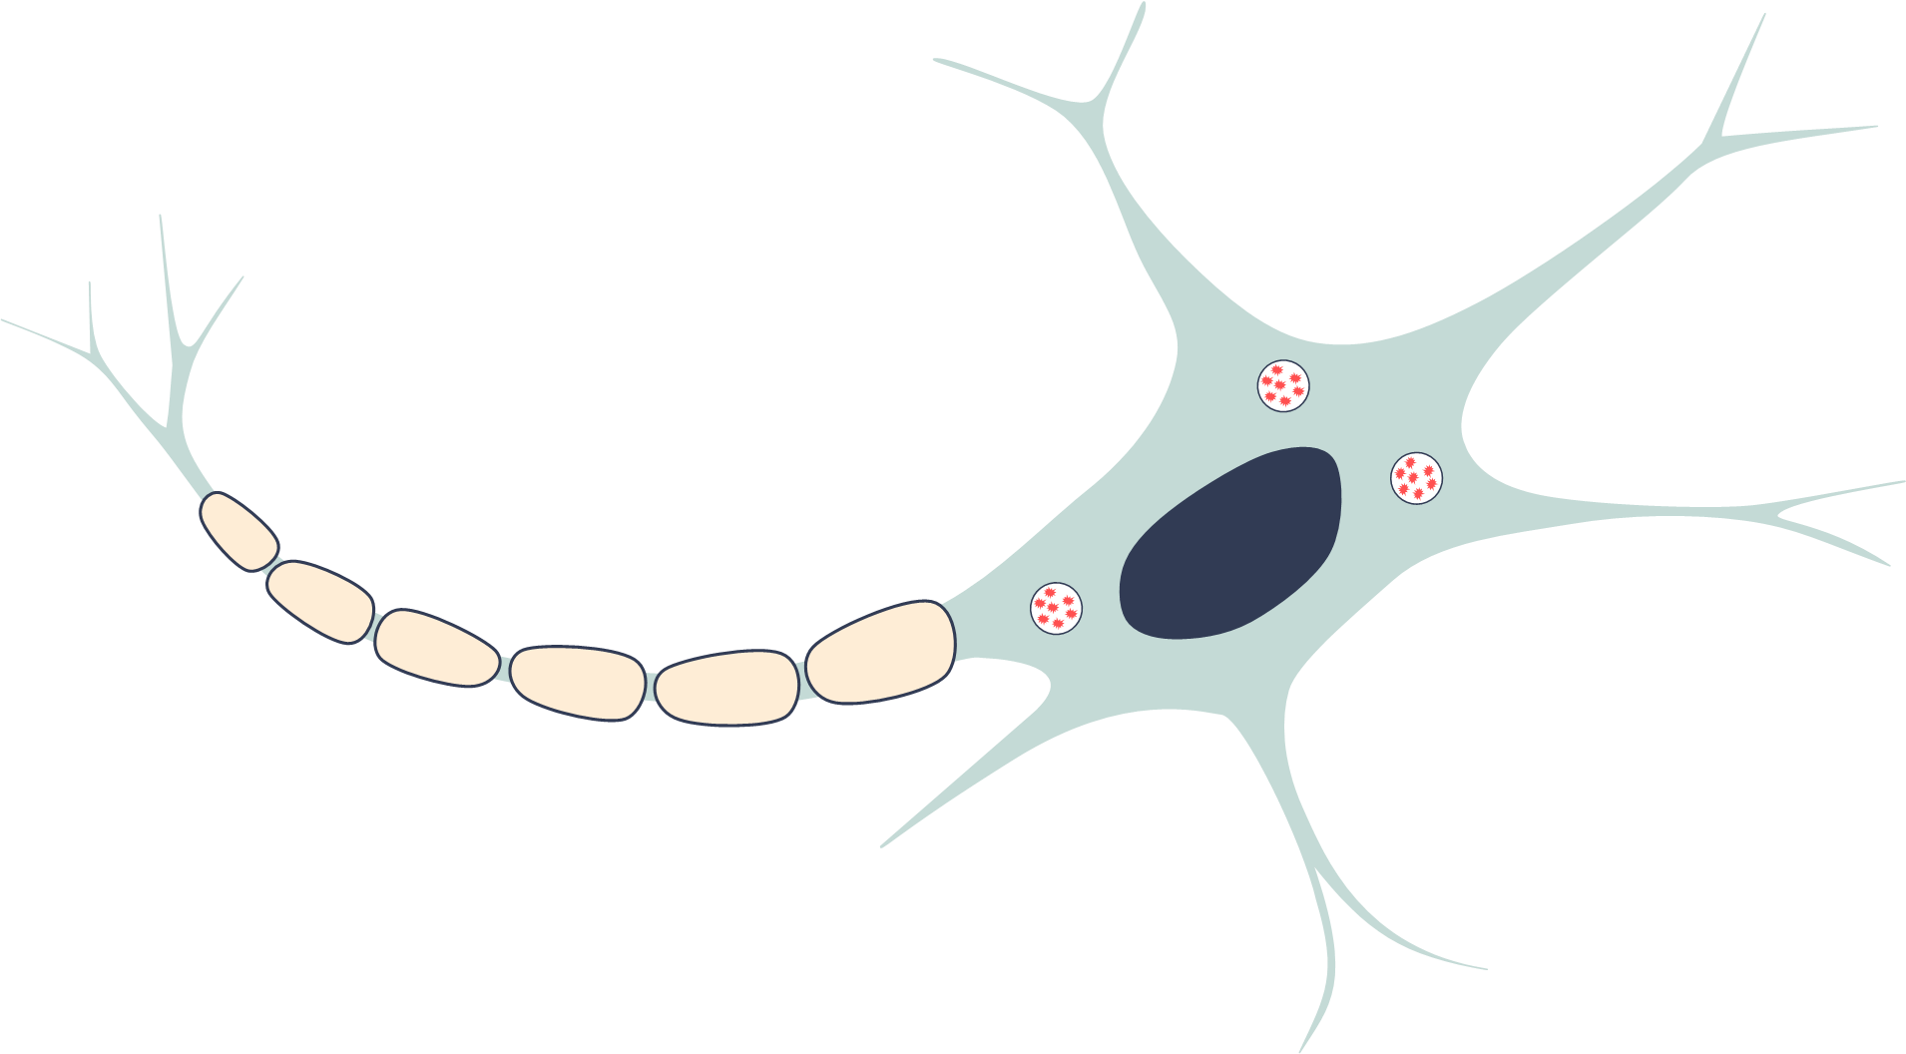
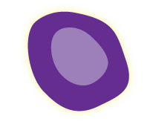
Treatment for LSDs
Hematopoietic stem cell transplant
Transplanted cells supply deficient enzyme
HLA-identical donor marrow provides healthy stem cells that produce deficient enzyme
Morbidity/mortality (graft-vs-host disease, treatment toxicity, graft failure)
Marsden D, Levy H. Clin Chem. 2010;56:1071-1079.

Slide 66

Treatment for LSDs
Hematopoietic stem cell transplant
Enzyme replacement therapy
Infusion of modified enzyme to replace deficient enzyme and reduce accumulated substrate
Weekly to monthly infusions
Usually do not cross blood-brain barrier
Marsden D, Levy H. Clin Chem. 2010;56:1071-1079.

Slide 67
Treatment for LSDs
Hematopoietic stem cell transplant
Enzyme replacement therapy
Substrate reduction therapy
Reduce production of substrate by inhibiting upstream biochemical pathway
May cross blood-brain barrier
Marsden D, Levy H. Clin Chem. 2010;56:1071-1079.

Slide 68
Treatment for LSDs
Hematopoietic stem cell transplant
Enzyme replacement therapy
Substrate reduction therapy
Pharmacologic chaperone therapy
Rescues misfolded enzyme
Only works for a subset of amenable mutations
May cross blood-brain barrier
Marsden D, Levy H. Clin Chem. 2010;56:1071-1079.

Slide 69
Treatment for LSDs
Hematopoietic stem cell transplant
Enzyme replacement therapy
Substrate reduction therapy
Pharmacologic chaperone therapy
Gene therapy
Replace defective enzyme
Investigational
Marsden D, Levy H. Clin Chem. 2010;56:1071-1079.

Slide 70
Approved Therapies for LSDs
LSD | Enzyme Replacement |  | Substrate Reduction |  | Chaperone
MPS I | Laronidase
Fabry Disease | Agalsidase beta |  |  |  | Migalastat
Gaucher Disease | Imiglucerase Velaglucerase Taliglucerase |  | Miglustat Eliglustat
Pompe Disease | Alglucosidase alfa
MPS II | Idursulfase
MPS IVA | Elosulfase alfa
MPS VI | Galsulfase
MPS VII | Vestronidase alfa-jvbk
Lysosomal acid lipase deficiency | Sebelipase alfa
Zimran A, et al. Blood. 2011;118:5767-5773. Gonzalez DE, et al. Am J Hematol. 2013;88:166-171. Martins AM, et al. J Pediatr. 2009;155:S10-18. Eng CM, et al. N Engl J Med. 2001;345:9-16. Schiffmann R, et al. JAMA. 2001;285:2743-2749. Germain DP, et al. N Engl J Med. 2016;375:545-555. Parini R, Deodato F. Int J Mol Sci. 2020;21:2975. Wraith JE. Expert Opin Pharmacother. 2005;6:489-506. Nicolino M, et al. Genet Med. 2009;11:210-219. Muenzer J, et al. Genet Med. 2011;13:95-101. Hendriksz CJ, et al. J Inherit Metab Dis. 2014;37:979-90. Harmatz PR, et al. J Inherit Metab Dis. 2014;37:277-287. Harmatz P, et al. Mol Genet Metab. 2018;123:488-494. Burton BK, et al. N Engl J Med. 2015;373:1010-1020.

Slide 71
Program Summary
Look for symptom complexes that would suggest an underlying LSD
Early recognition is important
  Begin treatment before irreversible pathology manifests
  Family planning for LSDs that cannot currently be treated
Newborn screening
  Positive screening test results are not sufficient for diagnosis
Approved treatments are available to address several of the LSDs

Slide 72
Supplemental Slides

Slide 73
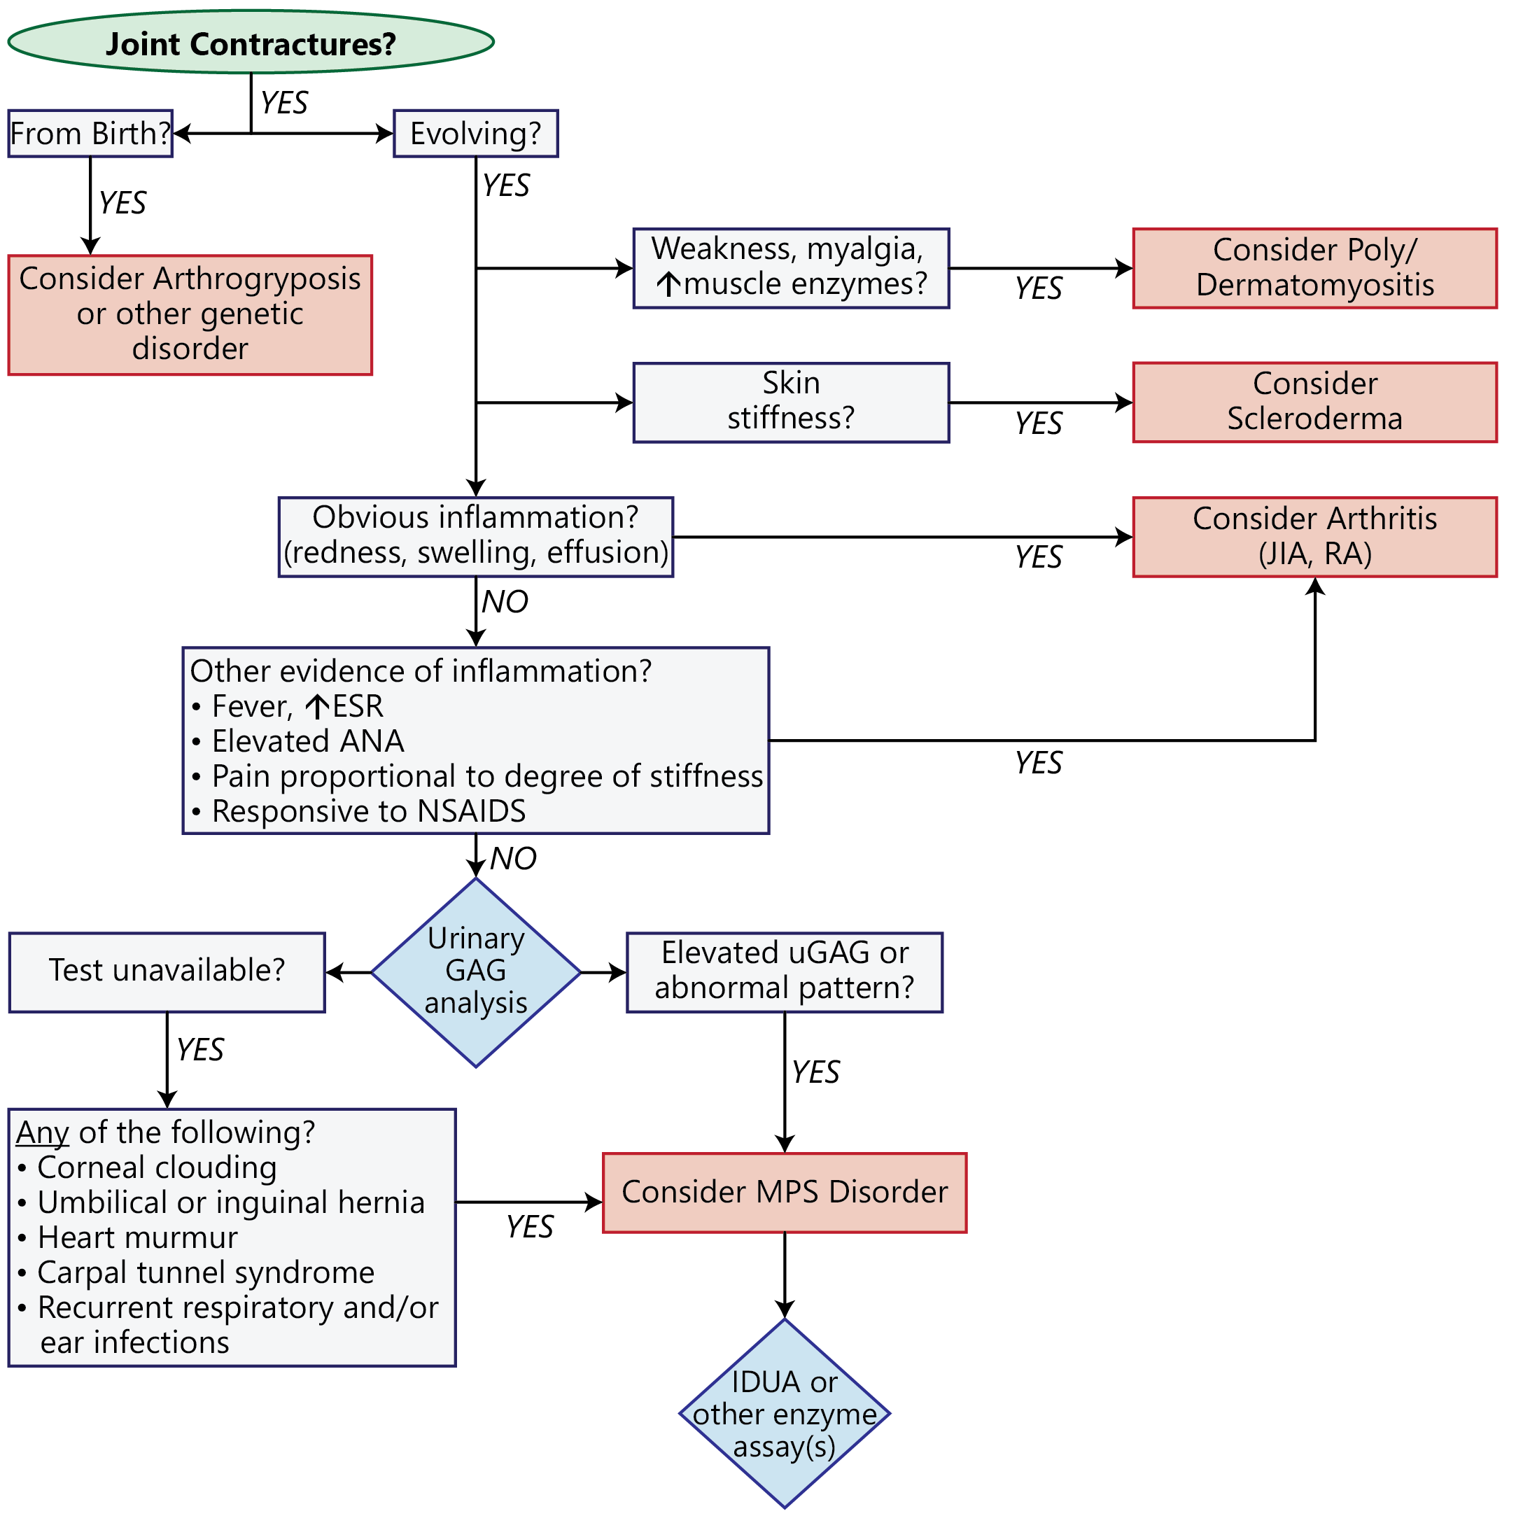
Attenuated Mucopolysaccharidoses Diagnostic Algorithm
Cimaz R, et al. Ped Rheum. 2009;7:18. doi:10.1186/1546-0096-7-18.

Slide 74
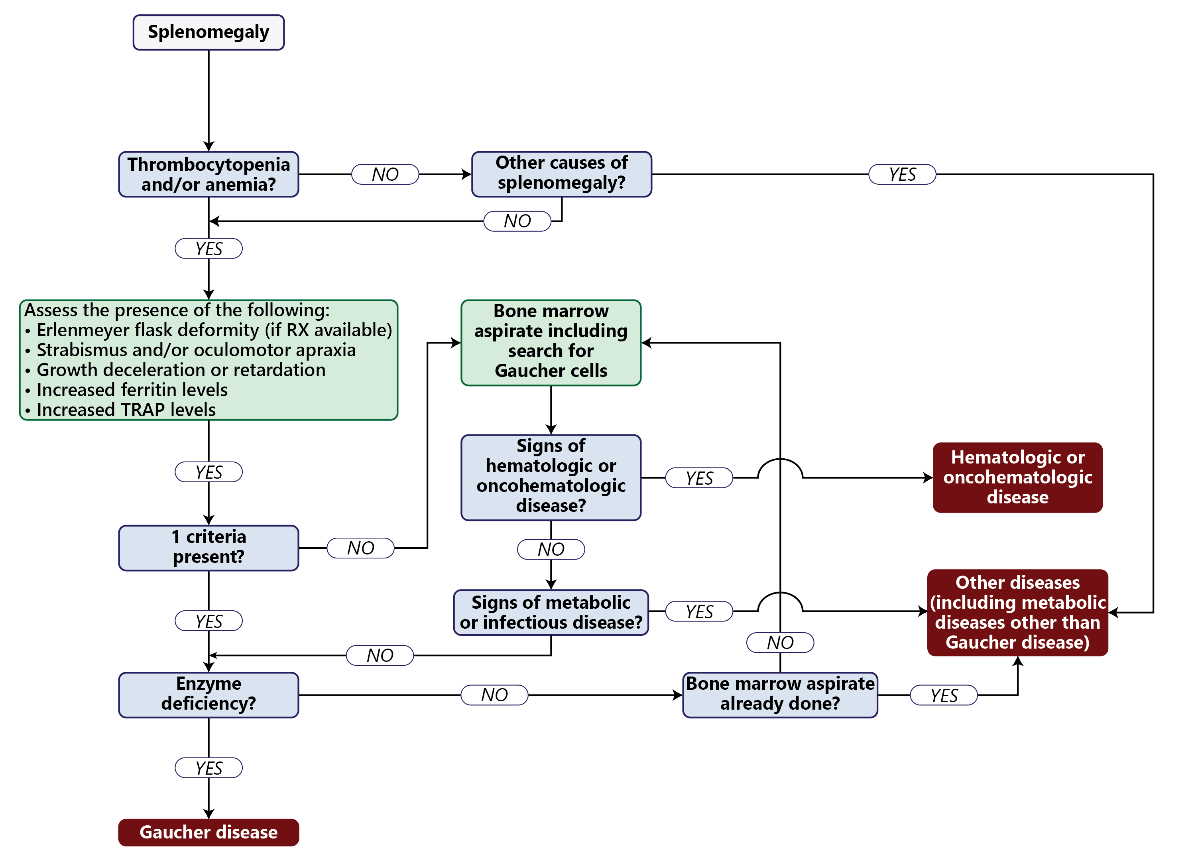
Pediatric Gaucher Disease Diagnostic Algorithm
Adapted from Di Rocco M, et al. Pediatr Blood Cancer. 2014;61:1905-1909.

Slide 75
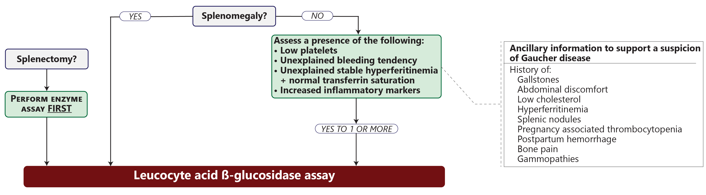
Gaucher Disease Diagnostic Algorithm: Ashkenazi Ancestry
(Gaucher disease frequency ~1:800; Hematologic malignancies 1:2,500)
Mistry PK, et al. Am J Hematol. 2011;86:110-115.

Slide 76
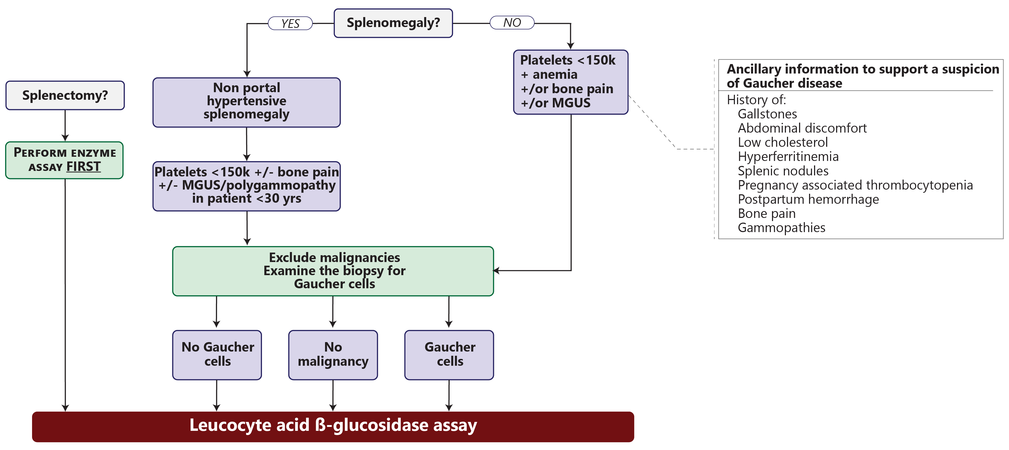
Gaucher Disease Diagnostic Algorithm: No Ashkenazi Ancestry
(Gaucher disease frequency ~1:40,000–100,000; Hematologic malignancies ~40:100,000)
Mistry PK, et al. Am J Hematol. 2011;86:110-115.

Slide 77
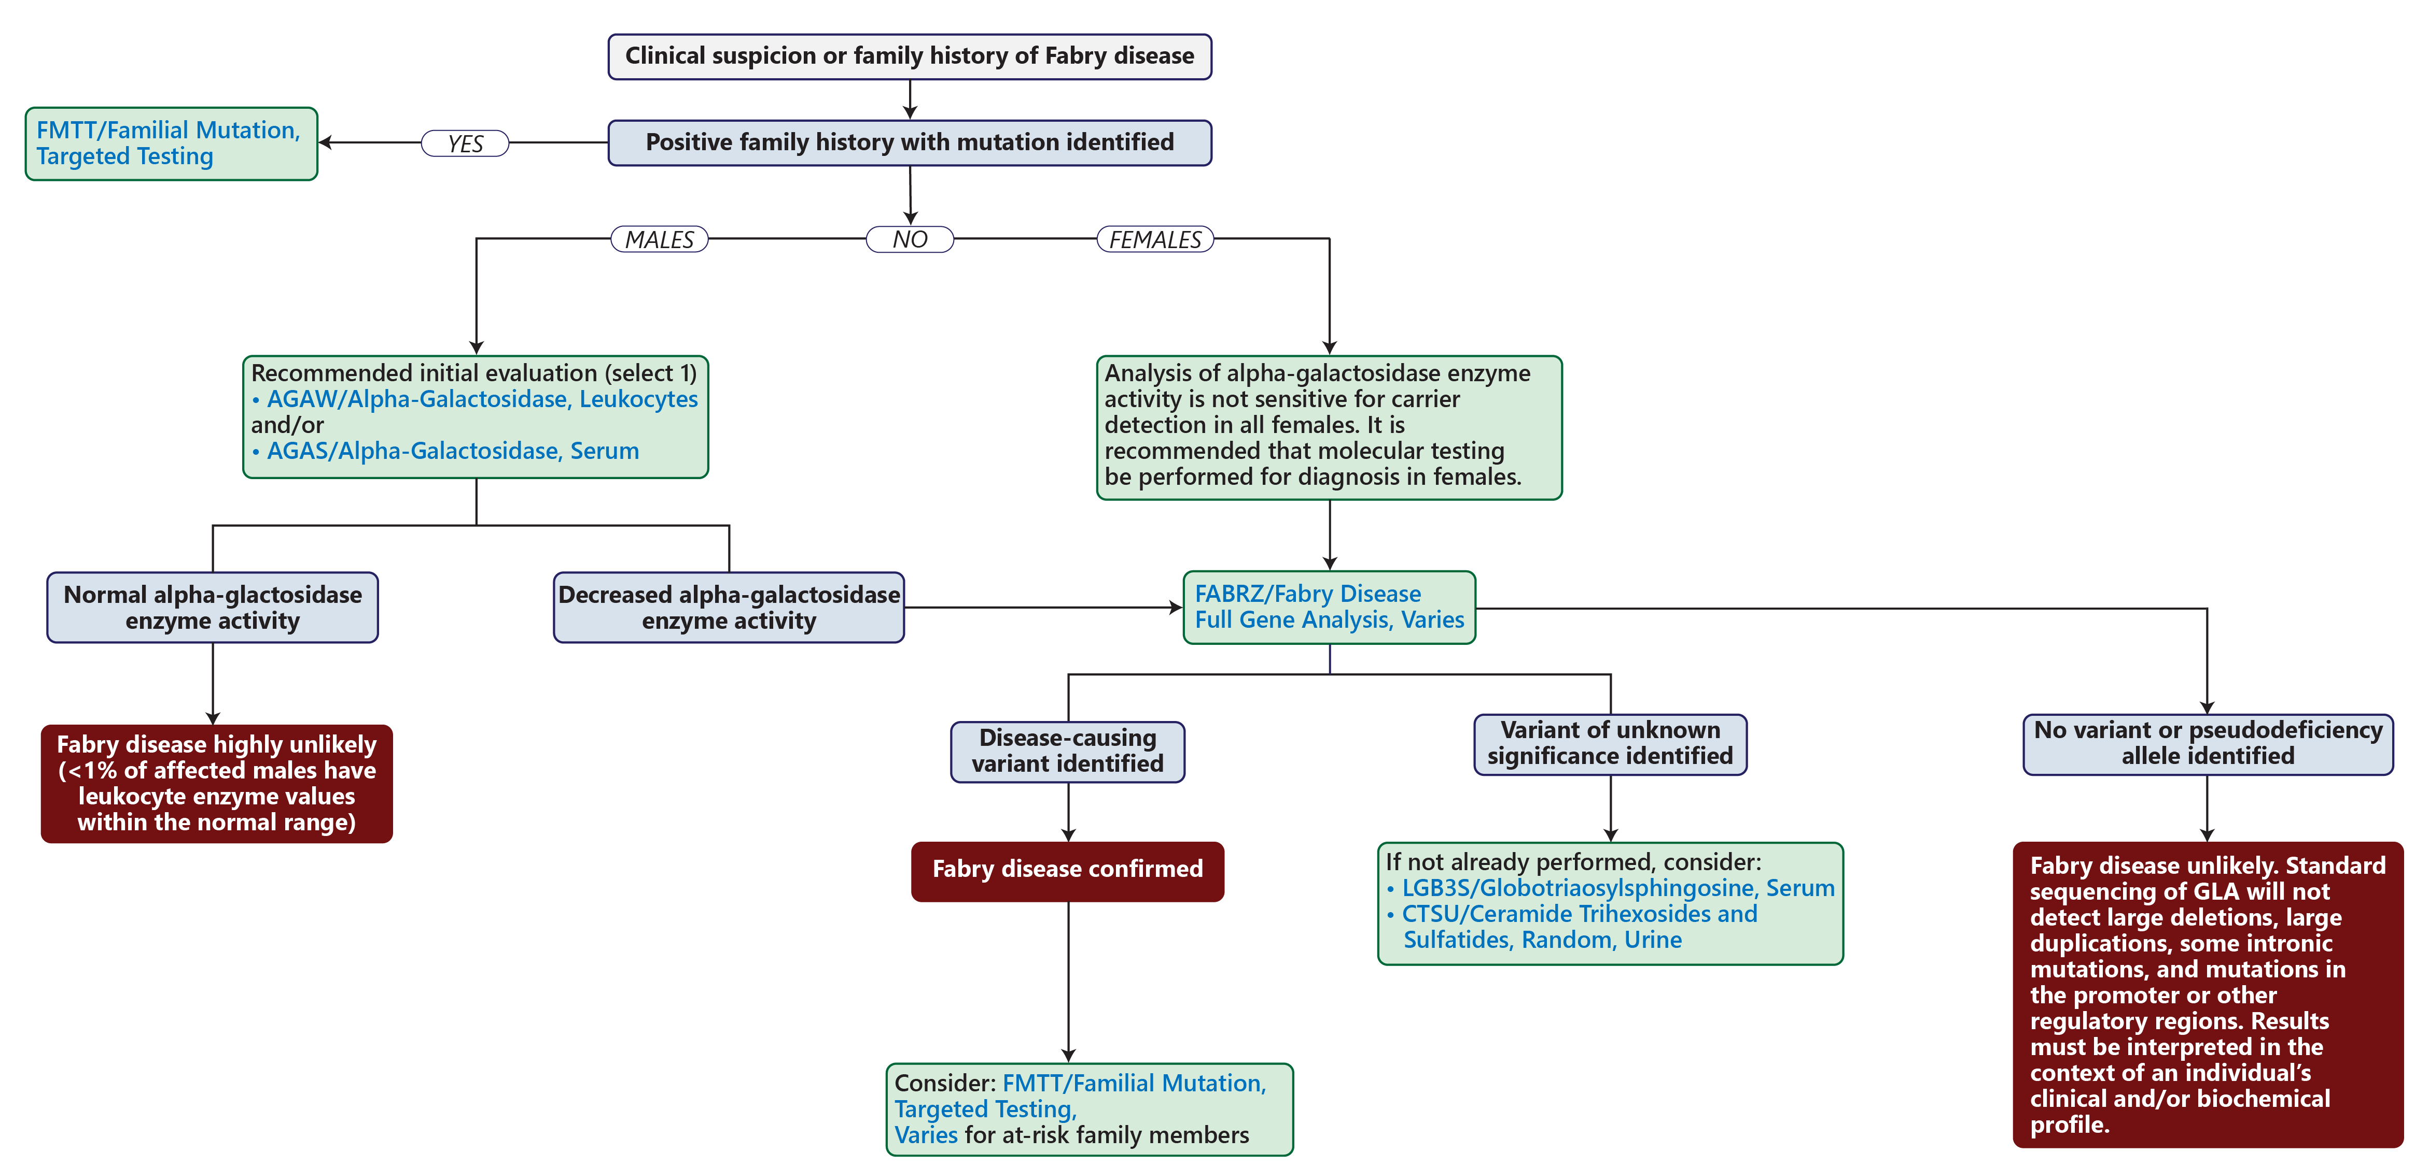
Fabry Disease Diagnostic Algorithm
www.mayocliniclabs.com/it-mmfiles/Fabry_Disease_Testing_Algorithm.pdf

Slide 78
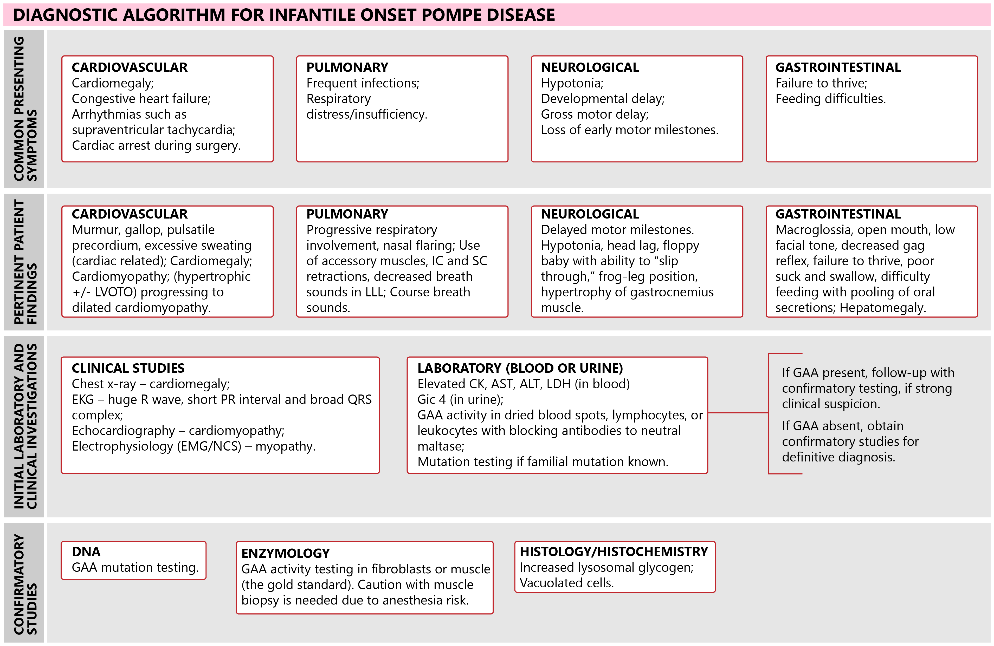
Pompe Disease Diagnostic Algorithm: Infantile Onset
Adapted from Kishnani PS, et al. Genet Med. 2006;8:267-288.

Slide 79
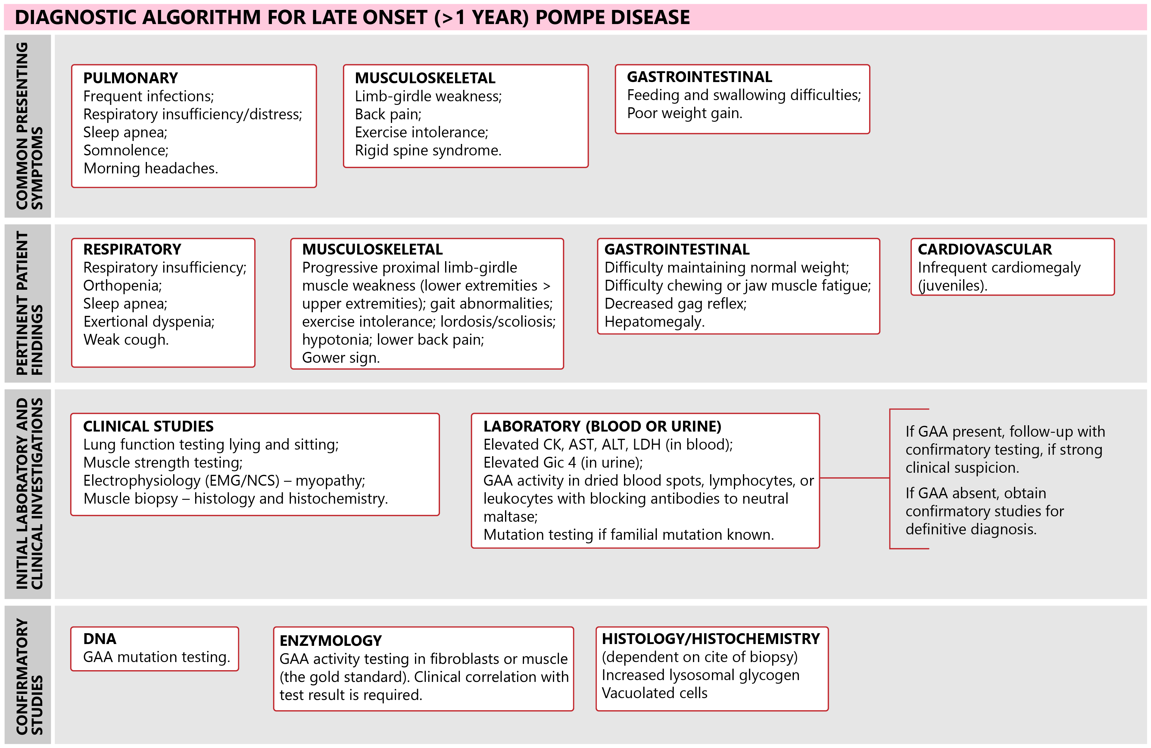
Pompe Disease Diagnostic Algorithm: Late-Onset
Adapted from Kishnani PS, et al. Genet Med. 2006;8:267-288.

Slide 80
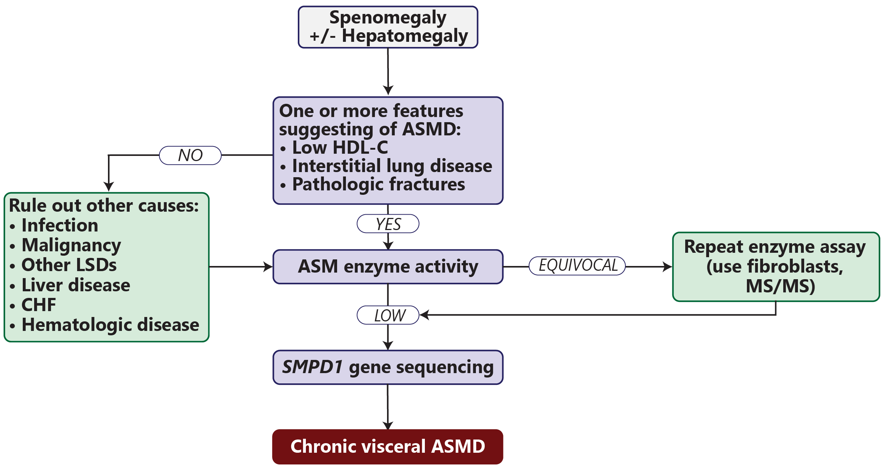
Niemann-Pick Disease Diagnostic Algorithm
ASM, acid sphingomyelinase; ASMD, acid sphingomyelinase deficiency; CHF, congestive heart failure; HDL-C, high-density lipoprotein cholesterol; LSD, lysosomal storage disorder; MS/MS, tandem mass spectrometry; SMPD2, ASM gene.
McGovern MM, et al. Gen Med. doi:10.1038/gim.2017.7.

