Slide 1
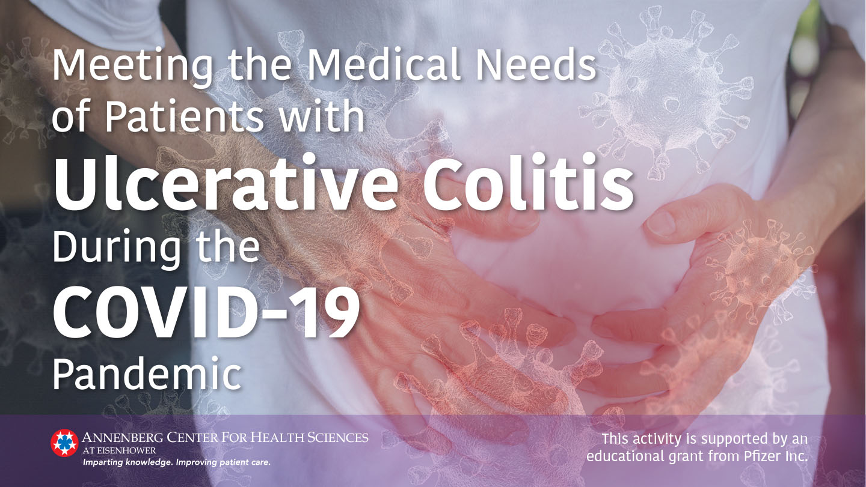

Slide 2
Presenter
Russell D. Cohen, MD
Professor of Medicine, Pritzker School of Medicine
Director, Inflammatory Bowel Disease Center
Co-Director, Advanced IBD Fellowship Program
The University of Chicago Medicine

Slide 3
Disclosures
Russell D. Cohen, MD
Speakers Bureau | AbbVie; Takeda
Consultant/ Advisory/Scientific Advisory Board | AbbVie; BMS/Celgene; Eli Lilly, Janssen (Johnson & Johnson); Pfizer; Takeda; UCB Pharma
Clinical Trials (Principal Investigator) | Astra-Zeneca; BMS/Celgene; Boehringer Ingelheim; Gilead Sciences; Hollister; MedImmune; Mesoblast Ltd.; Osiris Therapeutics; Pfizer; Receptos; RedHill Biopharma; Sanofi-Aventis; Schwarz Pharma; Seres Therapeutics; Takeda Pharma; UCB Pharma

Slide 4
Learning Objectives
Summarize the relative risk and signs of SARS-CoV-2 infection among patients with ulcerative colitis
Modify management and education of UC patients not infected with SARS-CoV-2 in order to reduce the risk of such infection
Safely modify UC treatments in patients testing positive for
SARS-CoV-2 but asymptomatic
Safely modify UC treatments in patients with symptomatic COVID-19, including those with active UC inflammation

Slide 5
Overview
Module 1: Risks and signs of SARS-CoV-2 in IBD population
Module 2: Management of UC patients not infected with SARS-CoV-2
Module 3: Medication management of UC patients testing positive for SARS-CoV-2 but who are asymptomatic
Module 4: Medication management of UC patients with symptomatic COVID-19 but without suspicion of active UC inflammation
Module 5: Medication management of UC patients with symptomatic COVID-19 with symptoms of active inflammation

Slide 6
Module 1:
Risks and signs of SARS-CoV-2 in IBD population
COVID-19 is the disease caused by the SARS-CoV-2 virus.
Management of IBD patients involves treating uncontrolled inflammation, with most patients requiring immune‐based therapies.
These therapies, however, may weaken the immune system and potentially place IBD patients at an increased risk of infections and complications, including those from COVID‐19.

Slide 7


Situation in numbers (by WHO Region) Total (new cases in last 24 hours)
Globally | 10,021,401 cases (178,328) | 499,913 deaths (4153)
Africa | 288,347 cases (9532) | 5879 deaths (94)
Americas | 5,042,486 cases (108,514) | 244,791 deaths (2860)
Eastern Mediterranean | 1,041,774 cases (17,552) | 23,888 deaths (439)
Europe | 2,673,131 cases (16,694) | 196,835 deaths (294)
South-East Asia | 760,816 cases (24,962) | 21,078 deaths (457)
Western Pacific | 214,106 cases (1074) | 7429 deaths (9)
WHO.int. Coronavirus disease (COVID-19) Situation Report—161. Data received June 29, 2020.

Slide 8
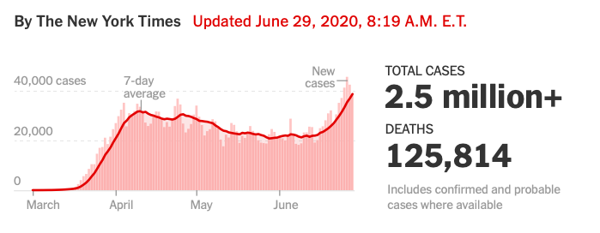
Current Status: Interactive COVID Map in the
United States
The New York Times Interactive COVID Map and Case Count
Coronavirus in the US: Latest Map and Case Count. nytimes.com. https://www.nytimes.com/interactive/2020/us/coronavirus-us-cases.html. Accessed June 29, 2020.
Notes:
Reference:
Coronavirus in the US: Latest Map and Case Count. nytimes.com. https://www.nytimes.com/interactive/2020/us/coronavirus-us-cases.html. Accessed June 9, 2020.

Slide 9
Symptoms Reported by the CDC for Patients
With COVID-19
Fever or chills
(83%–99%)
Nausea, vomiting, diarrhea
(<10%)
Lymphopenia
(83%)
Headache
(<10%)
[Dry] Cough
(59%–82%)
Common COVID Symptoms
Sore throat
(<10%)
Fatigue
(44%–70%)
Anosmia
(30%)*
Myalgia
(11%–35%)
Dyspnea
(31%–40%)
Anorexia
(40–84%)
This list does not include all
possible symptoms. The CDC continues to update this list as more is learned about COVID-19.
CDC.gov. Coronavirus Disease 2019 (COVID-19). Symptoms of Coronavirus. Updated June 2, 2020;
*Gautier JF. Obesity (Silver Spring). 2020;28:848. Rubin DT… Cohen RC, et al. Gastroenterology. 2020;S0016-508530482-0.
Notes:
Reference:
Rubin DT, et al. Gastroenterology. 2020;S0016-508530482-0:
most common symptoms of COVID-19 are fever and respiratory symptoms ; a significant proportion of patients with COVID-19 will have al- terations in bowel habits or other digestive symptoms.
CDC.gov. Coronavirus Disease 2019 (COVID-19). Symptoms of Coronavirus. Last reviewed May 13, 2020. Available at https://www.cdc.gov/coronavirus/2019-ncov/symptoms-testing/symptoms.html. Accessed June 19, 2020.
Fever or chills
Cough
Shortness of breath or difficulty breathing
Fatigue
Muscle or body aches
Headache
New loss of taste or smell
Sore throat
Congestion or runny nose
Nausea or vomiting
Diarrhea
*30% loss sense of smell per So Korea study:
Gautier JF, Ravussin Y. A New Symptom of COVID-19: Loss of Taste and Smell. Obesity (Silver Spring). 2020;28(5):848. doi:10.1002/oby.22809
https://www.cdc.gov/coronavirus/2019-ncov/hcp/clinical-guidance-management-patients.html. Updated June 2, 2020;
Patients will experience:
Fever (83–99%)
Cough (59–82%)
Fatigue (44–70%)
Anorexia (40–84%)
Shortness of breath (31–40%)
Sputum production (28–33%)
Myalgia (11–35%)
CDC.gov. https://www.cdc.gov/coronavirus/2019-ncov/faq.html#covid19-basics. Accessed DATE.
For Healthcare Professionals. CDC.gov. https://www.cdc.gov/coronavirus/2019-nCoV/hcp/index.html. Accessed DATE
Figure 1. Rubin DT, et al. Gastroenterology. 2020;S0016-508530482-0.
Symptoms and findings of COVID-19:
fever (83%–99%)
cough (59%–82%)
fatigue (44%–70%)
anorexia (40%–84%)
shortness of breath (31%–40%)
sputum production (28%–33%)
myalgias (11%–35%)
headache, confusion, rhinorrhea, sore throat, hemoptysis, vomiting and diarrhea (<10%)
lymphopenia (83%)

Slide 10
Common Gastro COVID Symptoms
A significant proportion of patients with COVID-19 may have alterations in bowel habits or other digestive symptoms
  10.1% of hospitalized patients with COVID-19 in Wuhan presented with diarrhea and nausea 1 to 2 days prior to developing fever and dyspnea
  Study (n=204) from Hubei, China reported 50.5% hospitalized patients presented with gastrointestinal-specific symptoms, including diarrhea (34%), vomiting (3.9%), or abdominal pain (1.9%)
Symptoms may reflect inoculation of the GI tract from swallowing the virus and due to the ACE2 expression in the intestines
Recent reports have focused on both GI-related manifestations of COVID-19, as well as the virus detected in the stool long after resolution of respiratory symptoms or even detection of virus in the oropharynx
ACE2, angiotensin-converting enzyme 2; GI, gastrointestinal.
Rubin DT… Cohen RC, et al. Gastroenterology. 2020;S0016-508530482-0. Wang D, et al. JAMA. 2020;323:1061–1069.
Pan L, et al. Am J Gastroenterol. 2020;115:766-773.
Notes:
References:
Rubin DT, Feuerstein JD, Wang AY, Cohen RD. AGA clinical practice update on management of inflammatory bowel
disease during the COVID-19 pandemic: expert commentary. Gastroenterology. 2020. doi: https://doi.org/10.1053/j.gastro.2020.04.012.
Wang D, Hu B, Hu C, et al. Clinical Characteristics of 138 Hospitalized Patients With 2019 Novel Coronavirus–Infected Pneumonia in Wuhan, China. JAMA. 2020;323(11):1061–1069. doi:10.1001/jama.2020.1585.
Pan L, Mu M, Yang P, et al. Clinical Characteristics of COVID-19 Patients With Digestive Symptoms in Hubei, China: A Descriptive, Cross-Sectional, Multicenter Study. Am J Gastroenterol. 2020;115(5):766-773. doi:10.14309/ajg.0000000000000620.

Slide 11
Risk Factors of IBD Patients to Consider
Patients with active UC and CD have a greater tissue concentration of ACE2, which allows SARS-CoV-2 spike protein to bind the host cell and infect humans
Serine protease level is ~10 times higher in patients with IBD than in healthy subjects, suggesting an increased risk of infection in these patients
Digestive system is vulnerable to COVID-19 infection
ACE2, angiotensin-converting enzyme 2.
D'Amico F, et al. Gastroenterology. 2020;158:2302‐2304. Garg M, et al. Gut. 2020;69:841‐851. Jablaoui A, et al. Front Cell Infect Microbiol. 2020;10:21.
Notes:
References:
D'Amico F, Peyrin-Biroulet L, Danese S. Inflammatory Bowel Diseases and COVID-19: The Invisible Enemy. Gastroenterology. 2020;158(8):2302‐2304. doi:10.1053/j.gastro.2020.04.032
Garg M, Royce SG, Tikellis C, et al. Imbalance of the renin-angiotensin system may contribute to inflammation and fibrosis in IBD: a novel therapeutic target? Gut. 2020;69(5):841‐851. doi:10.1136/gutjnl-2019-318512.
Jablaoui A, Kriaa A, Mkaouar H, et al. Fecal Serine Protease Profiling in Inflammatory Bowel Diseases. Front Cell Infect Microbiol. 2020;10:21. Published 2020 Feb 4. doi:10.3389/fcimb.2020.00021

Slide 12
Virus Detected in Stool
Studies reveal ACE2 was also highly expressed in esophagus upper and stratified epithelial cells and absorptive enterocytes from ileum and colon
SARS-CoV-2 virus detected in the stool in >20% of patients nearly 5 weeks after respiratory samples tested negative
Evidence also suggests potential for coronavirus transmission through fecal shedding
Two independent laboratories from China isolated live COVID-19 from stool of patients
ACE2, angiotensin-converting enzyme 2.
Gu J, et al. Gastroenterology. 2020;158:1518‐1519. Centers for Disease Control and Prevention. Coronavirus Disease 2019 (COVID-19). Joint GI Society Message: COVID-19 clinical insights. Gastro.org. Posted March 16, 2020. Neurath MF. Gut. 2020. Wu Y, et al. Lancet Gastroenterol Hepatol. 2020.
Notes:
Reference:
Centers for Disease Control and Prevention. Interim clinical guidance for management of patients with confirmed coronavirus disease (COVID-19). Updated June 2, 2020. Available at https://www.cdc.gov/coronavirus/2019-ncov/hcp/clinical-guidance-management-patients.html Date accessed: June 11, 2020.
Joint GI society message: COVID-19 clinical insights for our community of gastroenterologists and gastroenterology care providers. Gastro.org. https://www.gastro.org/press-release/joint-gi-society-message-covid-19-clinical-insights-for-our-community-of-gastroenterologists-and-gastroenterology-care-providers. Posted March 16, 2020. Accessed June 12, 2020.
Gu J, Han B, Wang J. COVID-19: Gastrointestinal Manifestations and Potential Fecal-Oral Transmission. Gastroenterology. 2020;158(6):1518‐1519. doi:10.1053/j.gastro.2020.02.054
Neurath MF. Covid-19 and immunomodulation in IBD. Gut. 2020 Apr 16. doi: 10.1136/gutjnl-2020-321269.
Wu Y, Guo C, Tang L, et al. Prolonged presence of SARS-CoV-2 viral RNA in faecal samples. Lancet Gastroenterol Hepatol. 2020;5(5):434‐435. doi:10.1016/S2468-1253(20)30083-2.

Slide 13
IBD Patients Potentially at Risk for COVID-19
Having IBD does not appear to increase the risk of SARS-CoV-2 infection or development of COVID-19
Impact of immunosuppression on the severity of COVID-19 disease remains unclear
Patients on immunosuppressive drugs for IBD should continue taking their medications
Although no data indicate true risk of patient with IBD for COVID,
there is data in relation to other immune diseases, such as diabetes
The risk of disease flare outweighs the chance of contracting coronavirus
Joint GI Society Message: COVID-19 clinical insights. Gastro.org. Posted March 16, 2020; Kennedy NA, et al. Gut. 2020;69:984‐990.
Notes:
Reference:
Kennedy NA, Jones GR, Lamb CA, et al. British Society of Gastroenterology guidance for management of inflammatory bowel disease during the COVID-19 pandemic. Gut. 2020;69(6):984‐990. doi:10.1136/gutjnl-2020-321244.
Joint GI Society Message: COVID-19 clinical insights for our community of gastroenterologists and gastroenterology care providers. Gastro.org. https://www.gastro.org/press-release/joint-gi-society-message-covid-19-clinical-insights-for-our-community-of-gastroenterologists-and-gastroenterology-care-providers. Posted March 16, 2020. Accessed June 12, 2020.
Infection risk may increase due to immunosuppressive treatment or immune-modifying therapies

Slide 14
Immunocompromised Patient Groups
Data show inflammatory and immune mechanisms are involved in every aspect of COVID-19 infection
Risk factors in other immunocompromised patient groups include
  Age >50 years
  Individuals with type 2 diabetes, specifically those with obesity
  and hypertension
    Prevalence of COVID-19 in patients with diabetes ranges from 10% to 20%
  Patients using corticosteroids
  Lymphopenia and neutropenia (liver and other solid-organ
  transplant recipients)
Al‐Ani AH, et al. Aliment Pharmacol Ther. 2020:10.1111/apt.15779. Goldenberg DL. Practicalpainmanagment.com. April 2020.
Notes:
References:
Al‐Ani AH, Prentice RE, Rentsch CA, et al. Review article: prevention, diagnosis and management of COVID‐19 in the IBD patient. Aliment Pharmacol Ther. 2020: 10.1111/apt.15779. doi: 10.1111/apt.15779 [Epub ahead of print]
Goldenberg DL. Practicalpainmanagment.com. COVID-19: What it means for diabetics, the obese, and those with other immune diseases. Posted April 2020. Available at https://www.practicalpainmanagement.com/coronavirus-diabetics-obesity-immune-diseases. Accessed June 12, 2020.
Joint GI society message: COVID-19 clinical insights for our community of gastroenterologists and gastroenterology care providers. Gastro.org. https://www.gastro.org/press-release/joint-gi-society-message-covid-19-clinical-insights-for-our-community-of-gastroenterologists-and-gastroenterology-care-providers. Posted March 16, 2020. Accessed June 12, 2020.

Slide 15

IBD Patients in China Diagnosed With COVID-19
Chinese studies on patients using immunosuppressants
  >72,000 cases of COVID-19 from China
  Diabetes increased the mortality rate 3-fold, from 2.3% to 7.3% of cases
Reported CFR of 10.5% and 7.3% in patients with CVD and diabetes, respectively, compared to 0.9% for people without any prior disease
CFR, case fatality rates; CVD, cardiovascular disease.
Chinese Centre for Disease Control and Prevention. Goldenberg DL. Practicalpainmanagment.com. April 2020; Hackethal V. Medscape.com. Diabetes, CVD Tied to Worse Prognosis for COVID-19 Infection. Posted February 25, 2020.
Notes:
References:
Chinese Centre for Disease Control and Prevention. Available at https://www.the-hospitalist.org/hospitalist/article/219144/diabetes/covid-19-extra-caution-needed-patients-diabetes.
Goldenberg DL. Practicalpainmanagment.com. COVID-19: What it means for diabetics, the obese, and those with other immune diseases. Posted April 2020. Available at https://www.practicalpainmanagement.com/coronavirus-diabetics-obesity-immune-diseases. Accessed June 12, 2020.
Hackethal V. Medscape.com. Diabetes, CVD Tied to Worse Prognosis for COVID-19 Infection. Posted February 25, 2020. Available at https://www.medscape.com/viewarticle/925681. Accessed June 12, 2020.

Slide 16
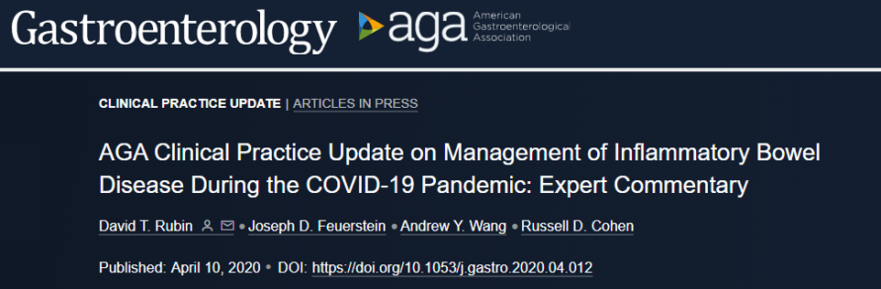
AGA Clinical Practice Update
Issues gastroenterologists should consider when managing IBD patients during current COVID-19 pandemic
Patients’ best protection against virus transmission:
  Wash hands
  Don’t touch your face
  Cough etiquette
  Social distancing (2 meters or ≥6 feet)
  Decrease time outside and avoid crowds
  Wear mask when in public
Rubin DT… Cohen RC, et al. Gastroenterology. 2020;S0016-508530482-0. Joint GI Society Message: COVID-19 clinical insights. Gastro.org. Posted March 16, 2020.
Notes:
References:
Rubin DT, Feuerstein JD, Wang AY, Cohen RD, AGA Clinical Practice Update on Management of Inflammatory Bowel Disease During the COVID-19 Pandemic: Expert Commentary. Gastroenterology. 2020;S0016-5085(20)30482-0. doi: 10.1053/j.gastro.2020.04.012. Available at https://www.gastrojournal.org/article/S0016-5085(20)30482-0/fulltext.
https://www.gastrojournal.org/article/S0016-5085(20)30482-0/fulltext
Joint GI society message: COVID-19 clinical insights for our community of gastroenterologists and gastroenterology care providers. Gastro.org. https://www.gastro.org/press-release/joint-gi-society-message-covid-19-clinical-insights-for-our-community-of-gastroenterologists-and-gastroenterology-care-providers. Posted March 16, 2020. Accessed June 12, 2020.

Slide 17
AGA Recommendations for Patients With IBD
Continue IBD therapies and infusions
Infusion centers should have protocols that include prescreening patients for exposure or symptoms of COVID-19:
Fever checks at the door
Adequate spacing between chairs
Masks and gloves used by providers and provided to patients
Adequate deep cleaning after patient departure
The AGA does not endorse specific products. Current guidance may change as more information becomes available.
Rubin DT… Cohen RC, et al. Gastroenterology. 2020;S0016-508530482-0
Notes:
Reference:
Rubin DT, Feuerstein JD, Wang AY, Cohen RD. AGA clinical practice update on management of inflammatory bowel disease during the COVID-19 pandemic: expert commentary. Gastroenterology. 2020;S0016-5085(20)30482-0. doi: https://doi.org/10.1053/j.gastro.2020.04.012.

Slide 18

Joint Society Recommendations
Patients on immunosuppressive drugs for IBD should continue taking their medications in the absence of COVID-19 symptoms
The risk of disease flare outweighs the chance of contracting coronavirus
Patients should follow CDC guidelines for at-risk groups avoiding crowds, exercise social distancing, and limiting travel
Patients need to exercise social distancing and be up to date with influenza and pneumococcal vaccines
ACG, American College of Gastroenterology; AGA, American Gastroenterological Association; ASGE, American Society for Gastrointestinal Endoscopy.
IOIBD Update on COVID19 for Patients with Crohn’s Disease and Ulcerative Colitis. IOIBD.org. Kennedy NA, et al. BSG guidance. Gut. 2020;69:984‐990. An P, et al. Lancet. 2020; 5:525-527. Al‐Ani AH, et al. Aliment Pharmacol Ther. 2020:10.1111/apt.15779.
Notes:
Reference:
Joint GI society message: COVID-19 clinical insights for our community of gastroenterologists and gastroenterology care providers. Gastro.org. https://www.gastro.org/press-release/joint-gi-society-message-covid-19-clinical-insights-for-our-community-of-gastroenterologists-and-gastroenterology-care-providers. Posted March 16, 2020. Accessed June 12, 2020.
Al‐Ani AH, Prentice RE, Rentsch CA, et al. Review article: prevention, diagnosis and management of COVID‐19 in the IBD patient. Aliment Pharmacol Ther. 2020: 10.1111/apt.15779. doi: 10.1111/apt.15779 [Epub ahead of print]
Resources for IBD healthcare professionals: 2019 novel coronavirus (COVID-19). Crohnsandcolitisfoundation.org. https://www.crohnscolitisfoundation.org/coronavirus/professional-resources. Accessed DATE.

Slide 19

ACG, AGA, ASGE and IOIBD—Similar Key Points
Encourage patients to stay on their IBD medications
Reduce dose or stop steroids
Offer remote office visits via telemedicine when possible
Before initiating biologics,
screen for opportunistic infections
Reschedule elective nonurgent medical/surgical services (including endoscopic procedures)
Classify procedures as nonurgent/
postpone and nonurgent/perform
High-priority procedures include cancer evaluations, prosthetic removals, and evaluation of significant symptoms
For patients who need to be seen, minimize chance of exposure to COVID-19 before, during, and after each patient visit
Kennedy NA, et al. Gut. 2020;69:984‐990. IOIBD Update on COVID19 for Patients with Crohn’s Disease and Ulcerative Colitis. IOIBD.org. Joint GI Society Message: COVID-19 clinical insights. Gastro.org. Posted March 16, 2020.
Notes:
References:
BSG expanded consensus advice for the management of IBD during the COVID-19 pandemic. The British Society of Gastroenterology. https://www.bsg.org.uk/covid-19-advice/bsg-advice-for-management-of-inflammatory-bowel-diseases-during-the-covid-19-pandemic/. Published April 6, 2020. Accessed May 27, 2020.→ Updated to Kennedy NA, Jones GR, Lamb CA, et al. British Society of Gastroenterology guidance for management of inflammatory bowel disease during the COVID-19 pandemic. Gut. 2020;69(6):984‐990. doi:10.1136/gutjnl-2020-321244
IOIBD Update on COVID19 for Patients with Crohn’s Disease and Ulcerative Colitis. IOIBD.org. https://www.ioibd.org/ioibd-update-on-covid19-for-patients-with-crohns-disease-and-ulcerative-colitis/. Accessed May 27, 2020.
Joint GI society message: COVID-19 clinical insights for our community of gastroenterologists and gastroenterology care providers. Gastro.org. https://www.gastro.org/press-release/joint-gi- society-message-covid-19-clinical-insights-for-our-community-of-gastroenterologists-and- gastroenterology-care-providers. Accessed DATE.

Slide 20
Monitor Patients
Patients who develop new digestive symptoms, but who do not have fever or respiratory symptoms
Potentially test for SARS-CoV-2
Monitor symptoms for progression in case of false-negative test
Rubin DT… Cohen RC, et al. Gastroenterology. 2020;S0016-508530482-0.
Notes:
Reference:
Rubin DT, Feuerstein JD, Wang AY, Cohen RD, AGA Clinical Practice Update on Management of Inflammatory Bowel Disease During the COVID-19 Pandemic: Expert Commentary. Gastroenterology. 2020;S0016-5085(20)30482-0. doi: 10.1053/j.gastro.2020.04.012. https://www.gastrojournal.org/article/S0016-5085(20)30482-0/fulltext.

Slide 21
Module 2:
Management of UC patients who are not infected with SARS-CoV-2
Goal for patients is to sustain remission
Relapsing IBD may strain available medical resources, require steroid therapy, or necessitate hospitalization
Patient Precautions and Education Resources
Rubin DT… Cohen RC, et al. Gastroenterology. 2020;S0016-508530482-0.
Notes:
Reference:
Rubin DT, Feuerstein JD, Wang AY, Cohen RD. AGA clinical practice update on management of inflammatory bowel disease during the COVID-19 pandemic: expert commentary. Gastroenterology. 2020;S0016-5085(20)30482-0. doi: https://doi.org/10.1053/j.gastro.2020.04.012.

Slide 22
Avoid COVID Risk—Patient Need to
Continue Precautions
Wash hands frequently
Wear a mask
Strict social distancing
Extra precautions for patients with comorbidities
Work from home, if possible
Limit close contacts
Minimize time with others in indoor spaces
Avoid close conversa-tions

Slide 23
Additional Precautions
Check health in your state and community
  Be aware of indicators for COVID-19 in your community through
  online tools
  America’s COVID warning system: https://covidactnow.org/
  Percentage of COVID-positive tests
  Overall case rates: goal is ≤5%–2% positive rates for 2 weeks
Covid ActNow. America’s COVID warning system. https://covidactnow.org/. Accessed June 11, 2020.

Slide 24
AGA & IOIBD Recommendations
Reduction or withdrawal of corticosteroid
Postpone elective medical procedures
Remain in clinical trials
Address patient anxiety
Maintain infusion center visits
  Ensure adequate safety and screening at center
Rubin DT… Cohen RC, et al. Gastroenterology. 2020;S0016-508530482-0; Kennedy NA, et al. Gut. 2020;69:984‐990; IOIBD Update on COVID19 for Patients with Crohn’s Disease and Ulcerative Colitis. IOIBD. https://www.ioibd.org/. Accessed June 10, 2020.
AGA, American Gastroenterological Association
IOIBD, The International Organization for the Study of Inflammatory Bowel Diseases
Notes:
References:
Rubin DT, Feuerstein JD, Wang AY, Cohen RD, AGA Clinical Practice Update on Management of Inflammatory Bowel Disease During the COVID-19 Pandemic: Expert Commentary. Gastroenterology. 2020;S0016-5085(20)30482-0. doi: 10.1053/j.gastro.2020.04.012. https://www.gastrojournal.org/article/S0016-5085(20)30482-0/fulltext.
BSG expanded consensus advice for the management of IBD during the COVID-19 pandemic. The British Society of Gastroenterology. https://www.bsg.org.uk/covid-19-advice/bsg-advice-for-management-of-inflammatory-bowel-diseases-during-the-covid-19-pandemic/. Published April 6, 2020. Accessed May 27, 2020.
IOIBD Update on COVID19 for Patients with Crohn’s Disease and Ulcerative Colitis. IOIBD. https://www.ioibd.org/ioibd-update-on-covid19-for-patients-with-crohns-disease-and-ulcerative-colitis/. Accessed May 27, 2020.

Slide 25
Patient Education Sources
Crohn’s & Colitis Foundation COVID-19 Resource
  https://www.crohnscolitisfoundation.org/coronavirus/what-ibd-patients-should-know
Stress and Anxiety related to COVID-19 Among IBD Patients
  https://www.crohnscolitisfoundation.org/coronavirus/mental-health
CDC—Coronavirus 2019 Homepage
  https://www.cdc.gov/coronavirus/2019-ncov/index.html
For patients COVID-free, adherence to UC treatment!!
Prevent the need to start corticosteroid

Slide 26
Module 3:
Medication management of UC patients testing positive for SARS-CoV-2 but who are asymptomatic
Management for asymptomatic UC patients
Treatment adjustment for COVID-positive patients
Testing
Service considerations

Slide 27
Medication Management Positive for COVID-19 but Asymptomatic
Per AGA recommendations, patients with IBD who have known COVID-19 but have not developed COVID-19 symptoms, should
Taper corticosteroids—lower doses of prednisone (<20 mg/d)
Switch to budesonide when feasible
Hold thiopurines, methotrexate, and tofacitinib temporarily
  Restart after complete symptom resolution or when follow-up viral testing is negative or serologic tests demonstrate the convalescent stage of illness
Delay dosing of biologic monoclonal antibodies by 2 weeks while monitoring symptoms of COVID-19
  Re-start biologic therapies after 2 weeks if no symptoms or negative viral test
Rubin DT… Cohen RC, et al. Gastroenterology. 2020;S0016-508530482-0; Rubin DT, et al. Results of an IOBD Meeting [published online ahead of print, 2020 Apr 6].
Notes:
Reference:
Rubin DT, Feuerstein JD, Wang AY, Cohen RD. AGA clinical practice update on management of inflammatory bowel disease during the COVID-19 pandemic: expert commentary. Gastroenterology. 2020;S0016-5085(20)30482-0. doi: https://doi.org/10.1053/j.gastro.2020.04.012.
Rubin DT, Abreu MT, Rai V, Siegel CA; International Organization for the Study of Inflammatory Bowel Disease. Management of Patients with Crohn's Disease and Ulcerative Colitis During the COVID-19 Pandemic: Results of an International Meeting [published online ahead of print, 2020 Apr 6].

Slide 28
Testing—Managing UC Treatment in Positive
Asymptomatic Patients
More testing is needed and could reveal more cases
It is required to test patients before endoscopic procedures or surgery, even if they have no specific symptoms suggesting COVID-19
Testing for SARS-CoV-2 infection is not required for IBD patients presenting diarrhea (unless they have fever and/or chills
and/or cough)
And more testing helps contain disease spread
Slide corrected based on more recent studies and clinical practice
Taxonera C, et al. Aliment Pharmacol Ther. 2020;10.1111/apt.15804.
Notes:
References:
Taxonera C, Sagastagoitia I, Alba C, Mañas N, Olivares D, Rey E. 2019 novel coronavirus disease (COVID-19) in patients with inflammatory bowel diseases. Aliment Pharmacol Ther. 2020;10.1111/apt.15804. doi:10.1111/apt.15804

Slide 29
Considerations for Services—Infusion Service
Patients should not attend if they are symptomatic for COVID-19
Screen on arrival for symptoms and pyrexia.
Parenteral electrolyte and iron replacement services should be reserved for urgent cases only.
If capacity is reduced due to staff shortages, implement daily or weekly triage of infusions.
Kennedy NA, et al. Gut. 2020;69:984‐990.
Notes:
Reference:
Kennedy NA, Jones GR, Lamb CA, et al. British Society of Gastroenterology guidance for management of inflammatory bowel disease during the COVID-19 pandemic. Gut. 2020;69(6):984‐990. doi:10.1136/gutjnl-2020-321244

Slide 30
Considerations for Services—Endoscopy
IBD surveillance procedures should be deferred.
IBD disease assessment scopes need to be assessed for priority.
Alternative methods of disease assessment, including the use of biomarkers, radiology, and capsule endoscopy should be considered.
Kennedy NA, et al. Gut. 2020;69:984‐990.
Notes:
Reference:
Kennedy NA, Jones GR, Lamb CA, et al. British Society of Gastroenterology guidance for management of inflammatory bowel disease during the COVID-19 pandemic. Gut. 2020;69(6):984‐990. doi:10.1136/gutjnl-2020-321244

Slide 31
Considerations for Services—Imaging
Capacity for outpatient imaging may be reduced.
Access to different imaging modalities may vary during the pandemic, which may influence the choice of investigation for patients with IBD.
Kennedy NA, et al. Gut. 2020;69:984‐990.
Notes:
Reference:
Kennedy NA, Jones GR, Lamb CA, et al. British Society of Gastroenterology guidance for management of inflammatory bowel disease during the COVID-19 pandemic. Gut. 2020;69(6):984‐990. doi:10.1136/gutjnl-2020-321244

Slide 32
Considerations for Services—Surgery
Defer elective operations.
Urgent management of perianal sepsis should be undertaken as a day‐case procedure.
Complex IBD surgery should be deferred where possible and its timing reviewed regularly.
Emergency procedures (eg, subtotal colectomy in acute severe UC) will continue as part of routine care.
Choice of postoperative therapy to prevent recurrence will need to be considered in the context of the COVID-19 pandemic.
Kennedy NA, et al. Gut. 2020;69:984‐990.
Notes:
Reference:
Kennedy NA, Jones GR, Lamb CA, et al. British Society of Gastroenterology guidance for management of inflammatory bowel disease during the COVID-19 pandemic. Gut. 2020;69(6):984‐990. doi:10.1136/gutjnl-2020-321244

Slide 33
Considerations for Services—Clinical Trials
Participant screening, recruitment, and continuation (for those already recruited) should be reviewed at local level for appropriateness in the current clinical situation.
Kennedy NA, et al. Gut. 2020;69:984‐990.
Notes:
Reference:
Kennedy NA, Jones GR, Lamb CA, et al. British Society of Gastroenterology guidance for management of inflammatory bowel disease during the COVID-19 pandemic. Gut. 2020;69(6):984‐990. doi:10.1136/gutjnl-2020-321244

Slide 34
Module 4:
Medication management of UC patients with symptomatic COVID-19 but without suspicion of active UC inflammation
Treatment adjustment for symptomatic patients
AGA decision tool
UC patients with severe COVID symptoms
Therapy considerations

Slide 35
Medication Management Symptomatic for COVID-19 but Without Suspicion of Active UC
Determine if patient is in remission
Refer to AGA, BSG, and IOBD guidelines when deciding whether to hold or continue specific IBD therapies
Base treatment adjustment on the immune activity of the therapy and whether therapy may worsen outcomes with COVID-19
Choose therapies that may have secondary benefit in IBD, or that do not induce bowel inflammation
Dosing of biological therapies should be delayed for 2 weeks, monitoring for symptoms of COVID-19
Rubin DT…Cohen RC, et al. Gastroenterology. 2020;S0016-508530482-0.
Notes:
Reference:
Rubin DT, Feuerstein JD, Wang AY, Cohen RD. AGA clinical practice update on management of inflammatory bowel disease during the COVID-19 pandemic: expert commentary. Gastroenterology. 2020;S0016-5085(20)30482-0. doi: https://doi.org/10.1053/j.gastro.2020.04.012.
Note: Ongoing anti-cytokine–based treatment studies, anti-TNF therapies might reduce progression to acute respiratory distress syndrome and multi-organ system failure

Slide 36
Treatment Adjustment for Symptomatic but Without Suspicion of Active UC Inflammation
IBD treatments safe to continue
  Aminosalicylates (first line and maintenance treatment)
  Topical rectal treatment
  Dietary management
  Antibiotics
  Budesonide, continue if needed for ongoing control of IBD
5-ASAs, 5-aminosalicylates.
Rubin DT… Cohen RC, et al. Gastroenterology. 2020;S0016-508530482-0. Al‐Ani AH, et al. Aliment Pharmacol Ther. 2020:10.1111/apt.15779.
Notes:
Reference:
Rubin DT, Feuerstein JD, Wang AY, Cohen RD, AGA Clinical Practice Update on Management of Inflammatory Bowel Disease During the COVID-19 Pandemic: Expert Commentary. Gastroenterology. 2020;S0016-5085(20)30482-0. doi: 10.1053/j.gastro.2020.04.012. https://www.gastrojournal.org/article/S0016-5085(20)30482-0/fulltext.

Slide 37
Overall Treatment Modification for
UC Patients With Severe COVID Symptoms but Stable UC
Discontinue thiopurines, methotrexate, tofacitinib
Discontinue anti-TNF, ustekinumab, unless updated clinical data suggest benefit
Discontinue vedolizumab?
Re-start therapies after complete symptom resolution, plus follow-up viral or serologic tests to confirm recovery
Rubin DT…Cohen RC, et al. Gastroenterology. 2020;S0016-508530482-0.
Notes:
References:
Rubin DT, Feuerstein JD, Wang AY, Cohen RD, AGA Clinical Practice Update on Management of Inflammatory Bowel Disease During the COVID-19 Pandemic: Expert Commentary. Gastroenterology. 2020;S0016-5085(20)30482-0. doi: 10.1053/j.gastro.2020.04.012. https://www.gastrojournal.org/article/S0016-5085(20)30482-0/fulltext.
BSG expanded consensus advice for the management of IBD during the COVID-19 pandemic. The British Society of Gastroenterology. https://www.bsg.org.uk/covid-19-advice/bsg-advice-for-management-of-inflammatory-bowel-diseases-during-the-covid-19-pandemic/. Published April 6, 2020. Accessed May 27, 2020.
IOIBD Update on COVID19 for Patients with Crohn’s Disease and Ulcerative Colitis. IOIBD. https://www.ioibd.org/ioibd-update-on-covid19-for-patients-with-crohns-disease-and-ulcerative-colitis/. Accessed May 27, 2020.

Slide 38
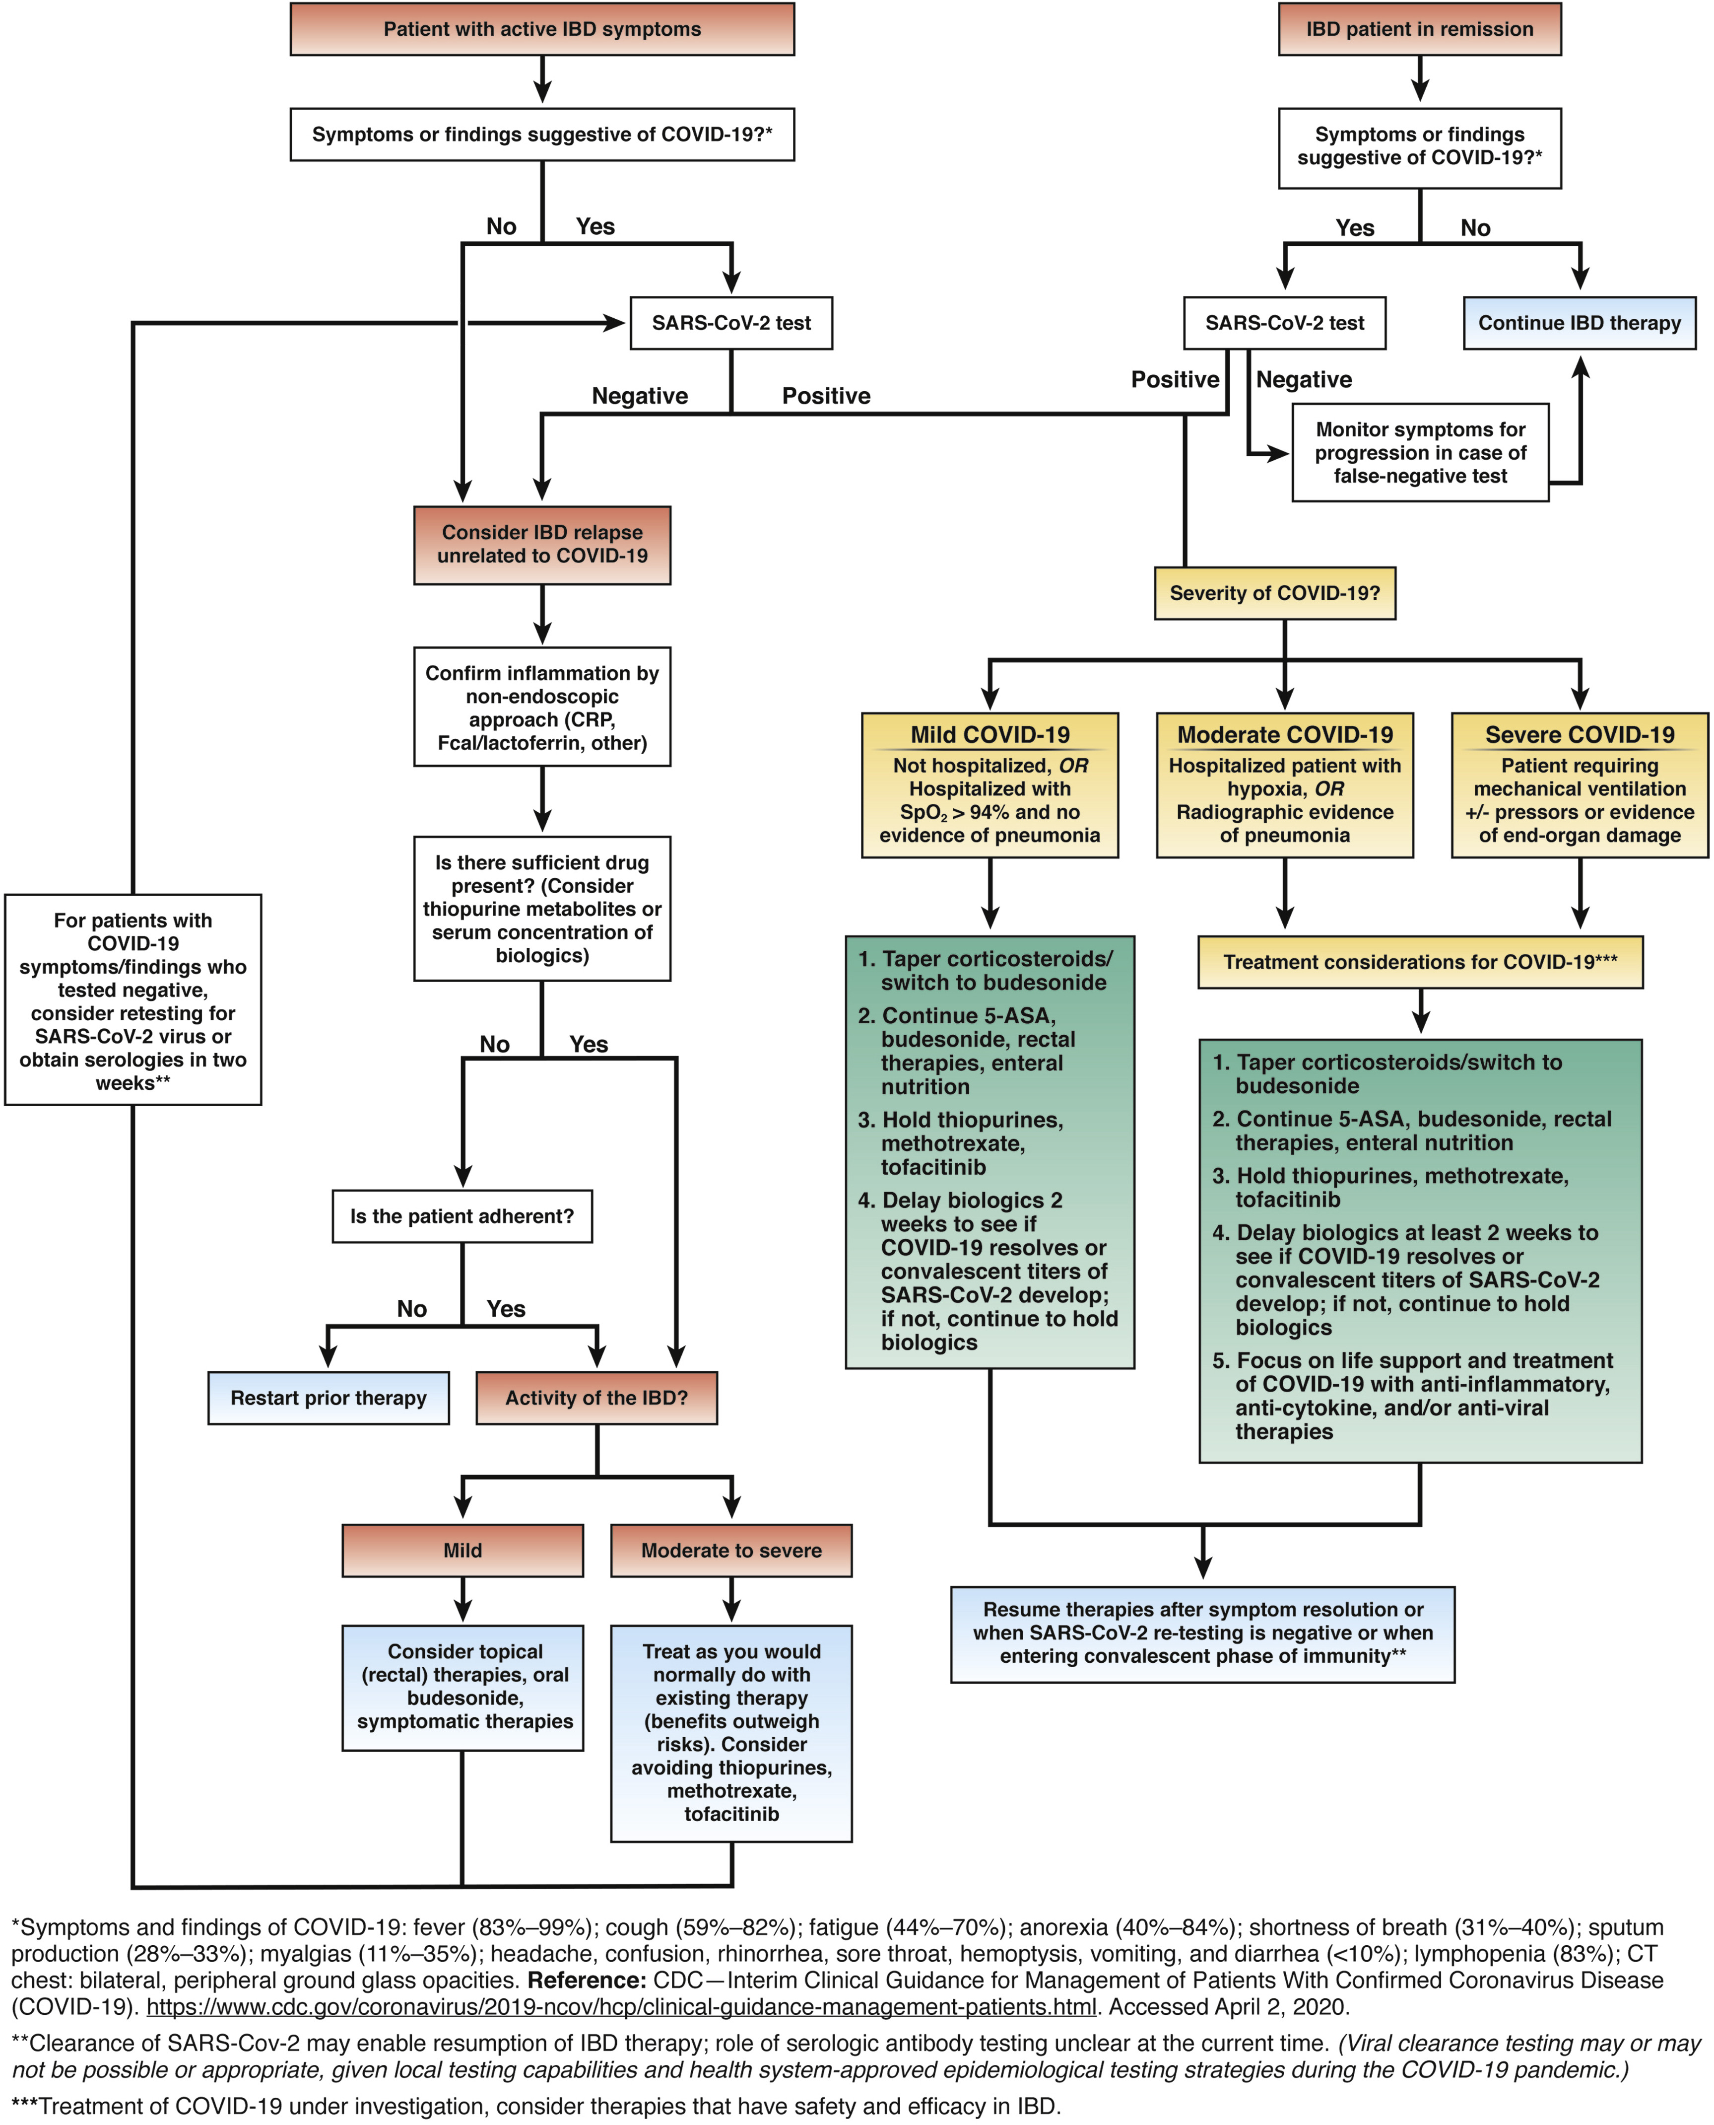
AGA Decision Tool—Algorithm
AGA Clinical Practice Update on Management of Inflammatory Bowel Disease During the COVID-19 Pandemic: Expert Commentary.
David T. Rubin, Joseph D. Feuerstein, Andrew Y. Wang, Russell D. Cohen
Gastroenterology. DOI: 10.1053/j.gastro.2020.04.012
Algorithm Guide to assist with complex clinical decisions when your patient is symptomatic or with active UC inflammation
Flowchart provides management of patients with IBD during the COVD-19 pandemic
Rubin DT… Cohen RC, et al. Gastroenterology. 2020;S0016-508530482-0.
Notes:
Reference:
Rubin DT, Feuerstein JD, Wang AY, Cohen RD, AGA Clinical Practice Update on Management of Inflammatory Bowel Disease During the COVID-19 Pandemic: Expert Commentary. Gastroenterology. 2020;S0016-5085(20)30482-0. doi: 10.1053/j.gastro.2020.04.012. https://www.gastrojournal.org/article/S0016-5085(20)30482-0/fulltext.

Slide 39
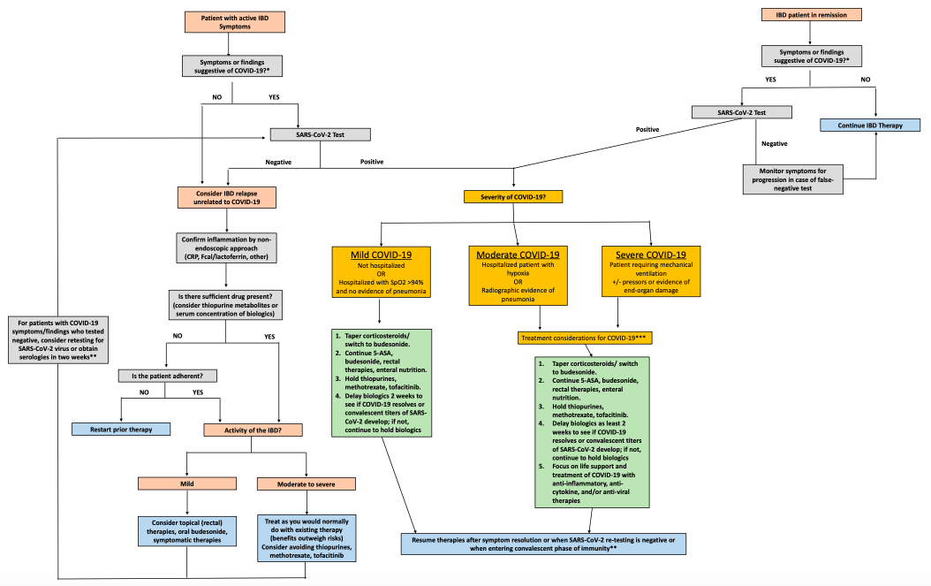
Figure 1. Management of patients with IBD during the COVID-19 pandemic.
5-ASA, 5-aminosalicylic acid medication; CRP, C-reactive protein; mAb, monoclonal antibodies.
∗Symptoms and findings of COVID-19: fever (83%–99%); cough (59%–82%); fatigue (44%–70%); anorexia (40%–84%); shortness of breath (31%–40%); sputum production (28%–33%); myalgias (11%–35%); headache, confusion, rhinorrhea, sore throat, hemoptysis, vomiting, and diarrhea (<10%); lymphopenia (83%); computed tomography chest: bilateral, peripheral, ground-glass opacities.∗∗Clearance of SARS-Cov-2 may enable resumption of IBD therapy; role of serologic antibody testing unclear at the current time. (Viral clearance testing may or may not be possible or appropriate, given local testing capabilities and health system-approved epidemiological testing strategies during the COIVD-19 pandemic.) ∗∗∗Treatment of COVID-19 under investigation, consider therapies that have safety and efficacy in IBD.
Rubin DT… Cohen RC, et al. Gastroenterology. 2020;S0016-508530482-0. Used with permission from Elsevier.CDC.gov. Updated June 2, 2020. https://www.cdc.gov/coronavirus/2019-ncov/hcp/clinical-guidance-management-patients.html.
Notes:
References:
Rubin DT, Feuerstein JD, Wang AY, Cohen RD, AGA Clinical Practice Update on Management of Inflammatory Bowel Disease During the COVID-19 Pandemic: Expert Commentary. Gastroenterology. 2020;S0016-5085(20)30482-0. doi: 10.1053/j.gastro.2020.04.012. https://www.gastrojournal.org/article/S0016-5085(20)30482-0/fulltext.
Centers for Disease Control and Prevention. Interim clinical guidance for management of patients with confirmed coronavirus disease (COVID-19). Updated June 2, 2020. Available at https://www.cdc.gov/coronavirus/2019-ncov/hcp/clinical-guidance-management-patients.html Date accessed: June 11, 2020.

Slide 40

Corona and Its Prevalence Specific to IBD
Surveillance Epidemiology of Coronavirus Under Research Exclusion
(SECURE)-IBD database
  An international collaboration between experts in epidemiology and IBD created a voluntary registry for professionals to report patients who test positive
  for SARS-COV-2
  Tracks impact and clinical outcomes with dynamic data
  Publicly accessible and updated every day
  International database monitors and reports outcomes of COVID-19 occurring in pediatric and adult patients with IBD
  Tracks epidemiology of COVID-19 among individuals with IBD
  Evaluates for potential associations between COVID-19 prevalence and severity
  and demographic and medical factors
Covidibd.org. https://covidibd.org/. Accessed June 10, 2020.
Notes:
Reference:
Covidibd.org. https://covidibd.org/. Accessed June 10, 2020.
https://ioibd.org/please-register-your-covid-19-ibd-patients-in-the-secure-ibd-database/

Slide 41
SECURE-IBD Registry Protocol
IBD clinicians worldwide are encouraged to report all cases of confirmed COVID‐19 in individuals with IBD in a secure electronic database using a secure web-based platform
Report a case https://covidibd.org
Report after ≥7 days with sufficient time to observe disease course through resolution of acute illness and/or death
The case report form includes items relating to the patient’s:
Demographics (eg, age, gender, race)
Country/state of residence
Diagnosis
Year of COVID-19 diagnosis
Immunosuppressive medication at time
of diagnosis
COVID-19-related death
COVID-19 treatments prescribed
Hospitalization (includes name of hospital, length of stay, if need of a ventilator)
Covidibd.org. https://covidibd.org/. Accessed June 10, 2020.

Slide 42
SECURE-IBD Cases Report by Country
(n=1572)
Brenner EJ, Ungaro RC, Colombel JF, Kappelman MD. SECURE-IBD Database Public Data Update. covidibd.org. Accessed on June 29, 2020.
Notes:
Reference:
Brenner EJ, Ungaro RC, Colombel JF, Kappelman MD. SECURE-IBD Database Public Data Update. covidibd.org. Accessed on June 11, 2020.

Slide 43
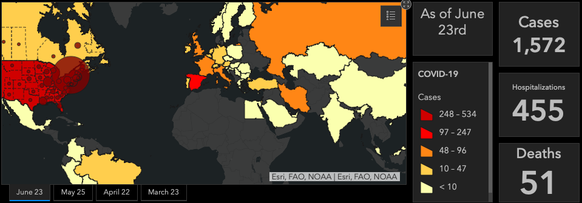
COVID-19 in People With
Inflammatory Bowel Disease
Brenner EJ, Ungaro RC, Colombel JF, Kappelman MD. SECURE-IBD Database Public Data Update. covidibd.org. Accessed on June 29, 2020.
Notes:
Reference:
Brenner EJ, Ungaro RC, Colombel JF, Kappelman MD. SECURE-IBD Database Public Data Update. covidibd.org. Accessed on June 11, 2020.

Slide 44
COVID-19 in IBD Patients
Unknown
4.2%
Moderate/
Severe
21.25%
Ulcerative colitis
44.47%
Female, 48.23%
Crohn’s disease
55.53%
Remission
56.68%
Male, 51.77%
Brenner EJ, Ungaro RC, Colombel JF, Kappelman MD. SECURE-IBD Database Public Data Update. covidibd.org. Accessed on June 11, 2020.

Slide 45
IBD Patients With COVID-19 Recent Hospitalization
Patients with severe IBD and COVID-19 are more likely to be hospitalized than patients with mild to moderate symptoms of COVID.
SECURE-IBD (as of June 29, 2020)
  n=1572
  455 (29%) hospitalized, of those:
    220 (25%) Crohn’s disease
    234 (34%) Ulcerative colitis
Brenner EJ, Ungaro RC, Colombel JF, Kappelman MD. SECURE-IBD Database Public Data Update. covidibd.org. Accessed on June 29, 2020.

Slide 46
Initial Published Analysis of
SECURE-IBD Registry
Brenner et al.
  n=525 from 33 countries (data collection as of May 8, 2020)
  37 patients had severe COVID-19 infection
  161 were hospitalized
  16 died
Monotherapy with anti-TNF and anti-IL12/23 agents appear to have a lower association for IBD patients with severe COVID who require hospitalizations, ICU, intubation, death.
Risk factors for severe COVID-19 infection included increasing age and use of systemic corticosteroids, sulfasalazine, or 5-aminosalicylate. Anti-TNF treatment was not correlated with severe illness.
Risk factors in patients with IBD for severe COVID-19 (similar general population): age or increasing number of comorbidities ≥2, in addition to IBD.
Strongest risk factor in patients with IBD for severe COVID-19 was systemic corticosteroid use.
Patients had at least a 6-fold higher risk for developing severe COVID-19. Findings reiterate importance of limiting and tapering use of steroids in IBD patients during era of COVID-19.
anti-TNF, anti-tumor necrosis factor.
Brenner EJ, et al. Gastroenterology. 2020;10.1053.
Notes:
Reference:
Brenner EJ, Ungaro RC, Gearry RB, et al. Corticosteroids, but not TNF Antagonists, are Associated with Adverse COVID-19 Outcomes in Patients With Inflammatory Bowel Diseases: Results from an International Registry. Gastroenterology. 2020;10.1053/j.gastro.2020.05.032. doi:10.1053/j.gastro.2020.05.032. [published online ahead of print, 2020 May 18]
Ryan C. Ungaro, MD, a gastroenterologist with Mount Sinai Hospital’s Feinstein IBD Center
Note: Data from Brenner & Ungaro study is in contrast to Rubin Cohen: ‘With regard to IBD therapies, aminosalicylates, topical rectal therapy, dietary management, and antibi- otics are considered safe and may be continued.’
&
Al‐Ani AH, et al April 2020: 10.1111/apt.15779. 'Treatment with 5-ASA therapy should continue without concern for increased risk of contracting or developing severe COVID-19.'

Slide 47
IBD Medications Used in Patients With Severe COVID-19
Steroid, Immunosuppressive Agents
Source: https://covidibd.org/current-data/
Date last updated: 06/29/2020
IBD Medication | Total N | Outpatient only n (%) | Hospitalized n (%) | ICU n (%) | Ventilator n (%) | Death n (%) | ICU/Ventilator/Death n (%)
 | 1572 | 1097 (70%) | 455 (29%) | 85 (5%) | 69 (4%) | 51 (3%) | 118 (8%)
Sulfasalazine/ mesalamine | 481 | 284 (59%) | 193 (40%) | 41 (9%) | 38 (8%) | 27 (6%) | 60 (12%)
Budesonide | 41 | 25 (61%) | 15 (37%) | 4 (10%) | 3 (7%) | 2 (5%) | 4 (10%)
Oral/parenteral steroids | 126 | 52 (41%) | 71 (56%) | 20 (16%) | 15 (12%) | 11 (9%) | 25 (20%)
6MP/azathioprine monotherapy | 156 | 104 (67%) | 52 (33%) | 13 (8%) | 10 (6%) | 3 (2%) | 15 (10%)
Methotrexate monotherapy | 11 | 6 (55%) | 5 (45%) | 0 (0%) | 0 (0%) | 1 (9%) | 1 (9%)
Brenner EJ, Ungaro RC, Colombel JF, Kappelman MD. SECURE-IBD Database Public Data Update. https://covidibd.org/current-data/. Accessed on June 29, 2020.

Slide 48
IBD Medications Used in Patients With Severe COVID-19
Biologics
Source: https://covidibd.org/current-data
IBD Medication | Total N | Outpatient only n (%) | Hospitalized n (%) | ICU n (%) | Ventilator n (%) | Death n (%) | ICU/Ventilator/ Death n (%)
 | 1572 | 1097 (70%) | 455 (29%) | 85 (5%) | 69 (4%) | 51 (3%) | 118 (8%)
Anti-TNF without 6MP/AZA/MTX | 454 | 377 (83%) | 72 (16%) | 9 (2%) | 5 (1%) | 3 (1%) | 10 (2%)
Anti-TNF + 6MP/AZA/MTX | 150 | 101 (67%) | 49 (33%) | 10 (7%) | 5 (4%) | 3 (2%) | 12 (8%)
Anti-integrin | 153 | 108 (71%) | 40 (26%) | 7 (5%) | 7 (5%) | 5 (3%) | 11 (7%)
IL-12/23 inhibitor | 139 | 116 (83%) | 19 (14%) | 5 (4%) | 4 (3%) | 1 (1%) | 5 (4%)
JAK inhibitor | 22 | 17 (77%) | 5 (23%) | 2 (9%) | 1 (5%) | 1 (5%) | 2 (9%)
Other IBD Medication | 60 | 35 (58%) | 24 (40%) | 5 (8%) | 3 (5%) | 2 (3%) | 5 (8%)
6-MP, 6-mercaptopurine; AZA, azathioprine; MTX, methotrexate.
Brenner EJ, Ungaro RC, Colombel JF, Kappelman MD. SECURE-IBD Database Public Data Update. https://covidibd.org/current-data/. Accessed on June 29, 2020.
Notes:
TNF antagonists are the most commonly prescribed biologic therapy for patients with IBD
Ref: Brenner EJ, et al. Gastroenterology. 2020;10.1053.

Slide 49
Module 5:
Medication management of UC patients with symptomatic COVID-19 with symptoms of active inflammation
Confirm active inflammation
Mildly active UC
Moderate to severely active UC
Managing UC patients hospitalized for COVID-19
Post-pandemic considerations

Slide 50
Outpatient Clinics—Confirm Active Inflammation
Confirm active inflammation with non-endoscopic tests
Limit endoscopy
Clinical scenarios that may prompt endoscopy include need to
  Obtain biopsies to diagnose new severe IBD,
  Exclude cytomegalovirus (CMV) if noninvasive tests are equivocal,
    Note: CMV testing may be done as a serum polymerase chain reaction to avoid need for colonoscopic procedures
  or in patients with severe disease or suspected cancer where mucosal inspection might direct surgical intervention
Rubin DT… Cohen RC, et al. Gastroenterology. 2020;S0016-508530482-0.

Slide 51
Mild or Moderate to Severely Active UC
Mildly active UC
Use safer therapies
5-ASA (UC)
Budesonide (CD and UC)
Partial or full enteral nutrition (CD, mostly pediatric)
Moderate to severely active UC
usual treatments if COVID
symptoms are mild
Avoid steroids if possible
(even for induction)
Treat with the same therapies you would choose in the
pre-COVID-19 era
5-ASA, 5-aminosalicylates; CD, Chron’s disease; UC, ulcerative colitis.
Rubin DT…Cohen RC, et al. Gastroenterology. 2020;S0016-508530482-0.
Notes:
References:
Rubin DT, Feuerstein JD, Wang AY, Cohen RD, AGA Clinical Practice Update on Management of Inflammatory Bowel Disease During the COVID-19 Pandemic: Expert Commentary. Gastroenterology. 2020;S0016-5085(20)30482-0. doi: 10.1053/j.gastro.2020.04.012. https://www.gastrojournal.org/article/S0016-5085(20)30482-0/fulltext.

Slide 52
Hospital Admission Requirements:
Criteria
≥6 bowel movements along with ≥1 of:
Medical resistance +/- systemic toxicity
Tachycardia
Fever
Hemoglobin <10.5g/dL
CRP elevated
Initial Workup
IBD Management
Clinical Response Assessment
  Test for COVID-19
  Rule out CDI and CMV
  VTE prophylaxis
  Assess for toxic megacolon
  Endoscopy only if it changes management
IV corticosteroids (max 60mg/day of methylprednisolone) for 3–5 days
Topical hydrocortisone enemas/
budesonide foam
Surgical consultation
Serial KUB if dilated colon seen on imaging
Assess symptoms and CRP daily
NO narcotics/anticholinergics/antimotility therapies
NO
YES
Initiate therapy with either infliximab or tacrolimus
Consider tofacitinib in select patients
Surgery
Transition to oral prednisone
Treat as outpatient
Adapted from Kaur M, et al. Clin Gastroenterol Hepatol. 2020;18:1346‐1355.
Adapted from Rubin DT… Cohen RC, et al. Am J Gastroenterol. 2019;114:384-413.
Notes:
References:
Kaur M, Dalal RL, Shaffer S, Schwartz DA, Rubin DT. Inpatient Management of Inflammatory Bowel Disease-Related Complications. Clin Gastroenterol Hepatol. 2020;18(6):1346‐1355. doi:10.1016/j.cgh.2019.12.040
Rubin DT, Ananthakrishnan AN, Siegel CA, Sauer BG, Long MD. ACG Clinical Guideline: Ulcerative Colitis in Adults. Am J Gastroenterol. 2019;114(3):384‐413. doi:10.14309/ajg.0000000000000152

Slide 53
Patient Hospitalized for Ulcerative Colitis
With mild COVID symptoms
  Standard UC treatment but limit IV steroids to 3 days
With severe COVID symptoms
  UC therapy not recommended
  Exceptions with some treatments that may enhance COVID therapy
Avoid surgery with stopgap measures
Surgery only in
  Emergent situations
  Nonemergent but urgent or time sensitive
  Decided on a case-by-case basis in discussions with surgery colleagues
Keep in mind
  Limited operating room resources
  Lack of family members for patient support
Danese S, et al. Nat Rev Gastroenterol Hepatol. 2020;1–3. Kaur M, et al. Clin Gastroenterol Hepatol. 2020;18:1346‐1355.
Notes:
References:
Danese S, Cecconi M, Spinelli A. Management of IBD during the COVID-19 outbreak: resetting clinical priorities. Nat Rev Gastroenterol Hepatol. 2020;1–3. doi: 10.1038/s41575-020-0294-8 [Epub ahead of print]
Kaur M, Dalal RL, Shaffer S, Schwartz DA, Rubin DT. Inpatient Management of Inflammatory Bowel Disease-Related Complications. Clin Gastroenterol Hepatol. 2020;18(6):1346‐1355.

Slide 54
Post-Pandemic Considerations
Pertinent questions for gastroenterologists and those treating patients with UC:
  Address lapses in monitoring and follow-up
  Assess patient adherence to therapy
  Consider reintroduction to therapy
  Uncover symptom exacerbation
  Revisit HCP-patient communication
Notes:
Info adapted from Abbvie slide deck…

Slide 55
Key Takeaways
IBD medication adherence should be encouraged to prevent disease flare¹
When possible, high-dose of systemic corticosteroids should be avoided¹
Patients who test positive for COVID-19 should¹
  Stop use of corticosteroids
  Withhold immune-suppressing medications until infection resolves
Anti-TNF not associated with an increased risk for COVID-19 infection
Therapeutic approach needs to be personalized and based on balance between risk of viral infection and the risk of disease recurrence²
  Effective disease control carries less risk than poorly considered withdrawal of therapy³
If your patient with IBD has had COVID-19, report the case in SECURE-IBD registry: https://covidibd.org⁴
1. Al‐Ani AH, et al. Aliment Pharmacol Ther. 2020: 10.1111/apt.15779; 2. D'Amico F, et al. Gastroenterology. 2020;158:2302‐2304. 3. Goodsall TM, et al. Med J Aust. 2020;212:490‐490.e1. 4. Covidibd.org. https://covidibd.org. Accessed June 10, 2020.
Notes:
References:
1. Al‐Ani AH, Prentice RE, Rentsch CA, et al. Review article: prevention, diagnosis and management of COVID‐19 in the IBD patient. Aliment Pharmacol Ther. 2020:10.1111/apt.15779. doi:10.1111/apt.15779 [Epub ahead of print]
2. Goodsall TM, Costello SP, Bryant RV. COVID-19 and implications for thiopurine use. Med J Aust. 2020;212(10):490‐490.e1. doi:10.5694/mja2.50613.
3. Covidibd.org. https://covidibd.org/. Accessed June 10, 2020.
D'Amico F, Peyrin-Biroulet L, Danese S. Inflammatory Bowel Diseases and COVID-19: The Invisible Enemy. Gastroenterology. 2020;158(8):2302‐2304. doi:10.1053/j.gastro.2020.04.032
https://www.ncbi.nlm.nih.gov/pmc/articles/PMC7161529/pdf/main.pdf

Slide 56
ANY
Questions?
Please type your question into the Ask a Question box
and hit send.

