Slide 1
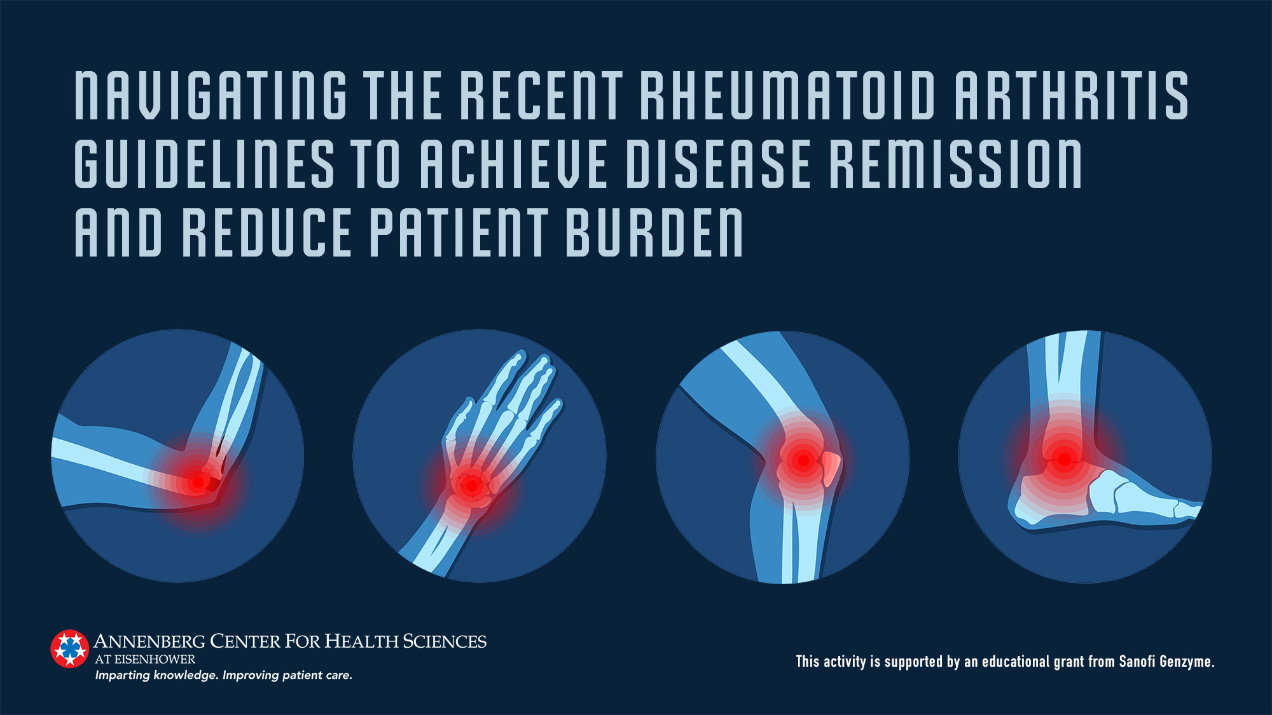

Slide 2
Roy Fleischmann, MD, MACR
Clinical Professor of Medicine
University of Texas Southwestern Medical Center at Dallas
Co-Medical Director
Metroplex Clinical Research Center
Dallas, Texas

Slide 3
Disclosures
Consultant:
  AbbVie, ACEA, Akros, Amgen, BMS, Celltrion, Gilead, GSK, Jansen, Eli Lilly, EMD Merck-Serrano, Novartis, Pfizer, Sanofi Aventis, Taiho, UCB
Clinical Trial Grants:
  AbbVie, ACEA, Amgen, BMS, Genentech, Gilead, GSK, Eli Lilly, EMD Merck-Serrano, Novartis, Pfizer, Regeneron, Roche, Sanofi Aventis, UCB

Slide 4
Learning Objectives
After participating in this activity, the learner will be able to:
Describe the clinical pharmacology, safety and efficacy of the latest approved treatments for rheumatoid arthritis (RA)
Incorporate bDMARDs and tsDMARDs into management of patients with moderate-to-severe RA based on their individual needs, best evidence, and treatment guidelines
Use a treat-to-target approach guided by validated tools for assessing disease activity and patient-reported outcomes
Select evidence-based therapy options including combination therapy when RA treatment goals are not achieved with initial DMARD therapy
Identify extra-articular manifestations in a patient with RA through collaboration with the primary care provider

Slide 5
Epidemiology

Slide 6
Overview of Rheumatoid Arthritis
Rheumatoid arthritis (RA) is a common, systemic autoimmune disease¹
  Causes inflammation of large and small joints
  Associated with myriad extra-articular manifestations
    Affecting ≥1 organs
    Causing symptoms such as fatigue, depression, unexplained weight loss
More common in females^{2,3}, adults age ≥65 years⁴
1. England BR, et al. BMJ. 2018;361:k1036.
2. Myasoedova E, et al. Arthritis Rheum. 2010;62(6):1576-1582.
3. Hunter TM, et al. Rheumatol Int. 2017;37(9):1551-1557.
4. Rasch EK, et al. Arthritis Rheum. 2003;48(4):917-926.

Slide 7
Pharmacologic Options

Slide 8
Evolution of Treatment of RA
Aspirin
Gold
NSAIDs
csDMARD
bDMARD
tsDMARD
Early DMARDs
bDMARD, biologic DMARD; csDMARD, conventional synthetic DMARD; DMARD, disease-modifying anti-rheumatic drug; NSAIDs, nonsteroidal anti-inflammatory drugs; tsDMARD, targeted synthetic DMARD
Medications that produce pain relief/reduction are shown in orange
DMARDs are shown in green

Slide 9
Conventional Synthetic DMARDs
Methotrexate, leflunomide, sulfasalazine
Produce efficacy response in many
  ACR20, ACR50, ACR70
  Clinical Disease Activity Index
  Health Assessment Questionnaire- patient function
Many experience slowed disease progression (X-ray)
Relatively slow onset of efficacy (>1-2 mos)
Adverse events are common and require close monitoring
ACR Subcommittee on Rheumatoid Arthritis Guidelines. Arthritis Rheum. 2002;46(2):328-346.

Slide 10
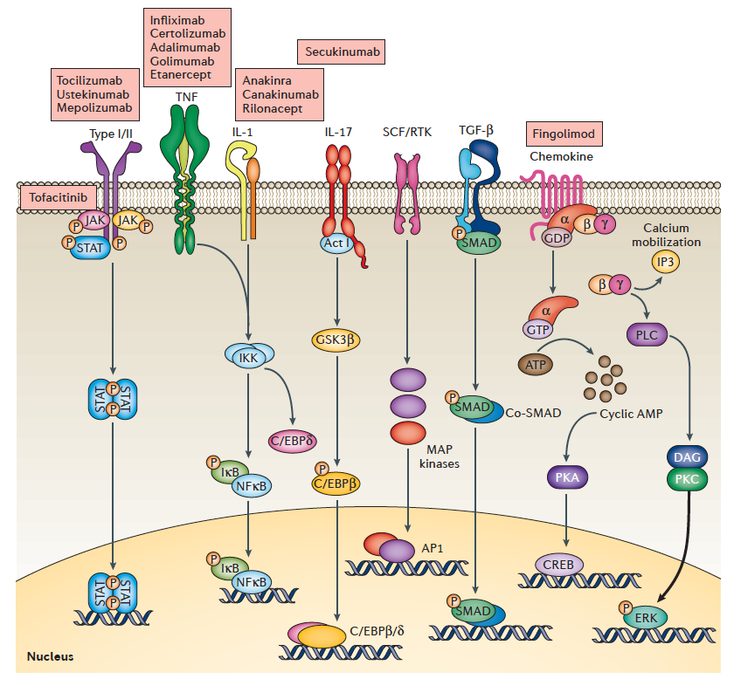
Therapeutic Targets in RA
IL17i
JAKi
Schwartz DM, et al. Nat Rev Rheumatol. 2016;12(1):25-36.

Slide 11
Cytokine Signaling via JAK Isoforms and Their Inhibitors
Note: decernotinib, filgotinib, pefcitinib are investigational in the US
Choy EH. Rheumatology. 2019:58(6):953-962.

Slide 12
Biologic DMARDs
bDMARDs
  Etanercept, infliximab, adalimumab, certolizumab pegol, golimumab
  Abatacept
  Sarilumab, tocilizumab
  Rituximab
Efficacy in various RA subgroups has changed the landscape of RA treatment
  All are effective in patients who do not achieve a complete response with methotrexate
If a patient cannot take or does not tolerate a csDMARD, sarilumab or tocilizumab are preferred
ACR Subcommittee on Rheumatoid Arthritis Guidelines. Arthritis Rheum. 2002;46(2):328-346.

Slide 13
Targeted Synthetic DMARDs: JAK Inhibitors
Tofacitinib, baricitinib, upadacitinib
Oral medications
Only 5 mg dose of tofacitinib and 4 mg dose of baricitinib have been tested in key patient subgroups
Good choice for patients who achieve an incomplete response with or cannot take or do not tolerate a csDMARD

Slide 14
Management Principles

Slide 15
Measures Recommended by ACR to Assess Response in RA
Disease Activity Score in 28 Joints (DAS28)
  Erythrocyte Sedimentation Rate [DAS28(ESR)]
  C-Reactive Protein Level [DAS28(CRP)]
Clinical Disease Activity Index (CDAI)
Simplified Disease Activity Index (SDAI)
Routine Assessment of Patient Index Data 3 (RAPID3)
Patient Activity Scale-II (PASII)
England BR, et al. Arthritis Care Res. 2019;71(12):1540-1555.

Slide 16
Measures in Clinical Practice: Key Takeaways
Source | Measure
Patient-clinician-laboratory | DAS28(ESR)
 | DAS28(CRP)
 | SDAI
Patient-clinician | CDAI
Patient | RAPID3
 | PASII
Imaging- X-ray, magnetic resonance imaging, ultrasound
Important use multiple measures
  Clinical disease activity
  Patient-reported outcome
  Imaging
PAS, Patient Activity Scale; RAPID 3, Routine Assessment of Patient Index Data with 3 measures; CDAI, Clinical Disease Activity Index; DAS28, Disease Activity Score with 28-joint counts; ESR, erythrocyte sedimentation rate; CRP, C-reactive protein; SDAI, Simplified Disease Activity Index
England BR, et al. Arthritis Care Res. 2019;71(12):1540-1555.

Slide 17
Treatment Considerations
Confirm diagnosis
Select treatment
Factors predictive of disease activity
Patient characteristics
Disease activity level
Benefit-risk ratio of treatment option(s)

Slide 18
Treat-to-Target
Treat-to-target
GOAL
Disease remission*
*Low disease activity in selected patients
Smolen JS, et al. Ann Rheum Dis. 2016;75(1):3–15.

Slide 19
Overarching Principles
Shared decision-making
Goal is to maximize long-term health-related quality of life
Eliminate/Minimize disease inflammation
Treat-to-target by modifying therapy as needed guided by clinical disease activity measures
Smolen JS, et al. Ann Rheum Dis. 2016;75(1):3–15.

Slide 20
ACR 2015 Recommendations: Key Concepts
Treat-to-target
Start with csDMARD
If goal not reached → switch to different bDMARD/tsDMARD
If goal reached → consider tapering (not discontinuing) DMARD
If goal not reached → add bDMARD or tsDMARD
Consider IL-6 inhibitor or JAK inhibitor for monotherapy
Short course of corticosteroid for disease flare
bDMARD, biologic DMARD; csDMARD, conventional synthetic DMARD; DMARD, disease-modifying antirheumatic drug; tsDMARD, targeted synthetic DMARD
Singh JA, et al. Arthritis Care Res. 2016;68(1):1-25.

Slide 21
EULAR 2019 Recommendations: Key Concepts
Treat-to-target
Start with csDMARD
–Use corticosteroid as bridge therapy
If goal not reached → switch to different bDMARD/tsDMARD
If goal reached → consider tapering (not discontinuing) DMARD
If goal not reached → add bDMARD or tsDMARD
Consider IL-6 inhibitor or JAK inhibitor for monotherapy
bDMARD, biologic DMARD; csDMARD, conventional synthetic DMARD; DMARD, disease-modifying antirheumatic drug; tsDMARD, targeted synthetic DMARD
Smolen JS, et al. Ann Rheum Dis. 2020;79(6):685-689.

Slide 22
Modifying Therapy

Slide 23
RA BIODAM
Demonstrated impact of failure to follow to treat-to-target
Despite computer prompt → adherence to treat-to-target therapy was 52%
40% to 75% of patients who achieved treat-to-target therapy achieved disease remission
  DAS28(CRP) overestimates disease remission
12% to 30% of patients who did not achieve treat-to-target therapy achieved disease remission
69% of those who did not adhere to treat-to-target therapy was due to clinician preference
  Clinician difficulty in assessing risk-benefit of treatment
Maksymowych WP, et al. J Rheumatol. 2020;47(6):796-808.

Slide 24
SELECT-COMPARE: Treat-to-Target
CDAI, Clinical Disease Activity Index; LDA, low disease activity; MOA, mechanism of action
Fleischmann R, et al. Ann Rheum Dis. 2020;in press.
Notes:
No comparison can be made between switch groups (NR vs. IR)

Slide 25
Treatment Options if Goal Is Not Achieved With csDMARD
TNF Inhibitors
– Adalimumab, certolizumab, etanercept, golimumab, infliximab
B-Cell Inhibitors
– Rituximab
JAK Inhibitors
– Baricitinib, tofacitinib, upadacitinib
IL-6 Inhibitors
– Sarilumab, tocilizumab
Costimulatory Molecular Inhibitors
– Abatacept
Singh JA, et al. Arthritis Care Res. 2016;68(1):1-25.
Smolen JS, et al. Ann Rheum Dis. 2020;79(6):685-689.

Slide 26
Case Scenarios

Slide 27
Case #1: Incomplete Response to Methotrexate
2019
June
Pain, stiffness; fatigue
July
PCP visit
2020
February
Unchanged clinically
March
Significantly improved
July
Rheumatologist visit
August
Improved but not in remission
November
Improving but persistent synovitis
April
Improvement maintained
June
Improvement maintained
August
Feels well
57-yo Caucasian female

Slide 28
Case #2: Comanagement by Rheumatologist & PCP
48-year-old Caucasian female diagnosed with RA 3 y ago
  Lives far from rheumatologist
Current RA treatment
  Sarilumab 200 mg every 2 wks
  MTX 15 mg/wk
  Folic acid 1 mg/d
Clinical measures of disease activity have been stable for 1.5 y → sees rheumatologist once a year
PCP
  Treats the patient for hypertension and hyperlipidemia
  Provides routine assessments; sends results to rheumatologist
  Provides needed vaccinations
Consults with rheumatologist for flares

