Slide 1
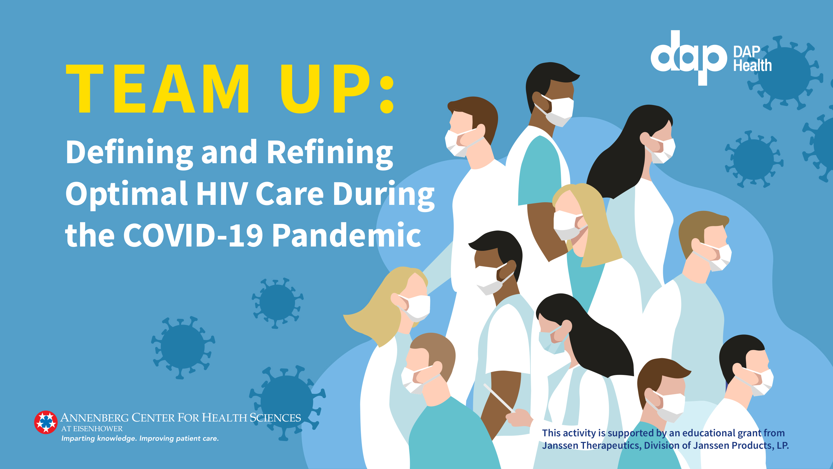

Slide 2

Management: COVID-19 and HIV
Shubha Kerkar, MD, FACP, AAHIVS, FIDSA
Director, Infectious Diseases

Slide 3
NIH Definitions of COVID-19 Disease Severity
Severity | Characteristics
Asymptomatic OR presymptomatic | Positivity for SARS-CoV-2 using a virologic antigen or PCR test but with no symptoms consistent with COVID-19
Mild | Presence of signs and symptoms of COVID-19 but no shortness of breath, dyspnea, or abnormal chest imaging
Moderate | Presence of lower respiratory disease during clinical assessment of imaging and with SpO₂ ≥94% on room air
Severe | SpO₂ <94% on room air plus PaO₂/FiO₂ <300 mm Hg, respiratory frequency >30 bpm, or lung infiltrates >50%
Critical | Presence of respiratory failure, septic shock, and/or multiple organ dysfunction
bpm, beats per minute; COVID-19, novel coronavirus disease 2019; NIH, National Institutes of Health; PaO₂/FiO₂, ratio of arterial partial pressure of oxygen to fraction of inspired oxygen; PCR, polymerase chain reaction; SARS-CoV-2, severe acute respiratory syndrome coronavirus 2; SpO₂, saturation of oxygen.
NIH. Clinical Presentation of People with SARS-CoV-2 Infection. Updated October 9, 2020. Accessed November 12, 2020. https://www.covid19treatmentguidelines.nih.gov/overview/management-of-covid-19/

Slide 4
Mild or Moderate COVID-19 Management
Most patients, including PLWH, can manage COVID-19 at home by:
  Self-isolating and staying home
  Resting and staying hydrated
  Carefully monitoring symptoms
  Following infection control procedures (eg, covering coughs, washing hands often)
Decision to monitor in an inpatient or outpatient setting can be made on a case-by-case basis by considering:
  Clinical presentation
  Requirement for supportive care
  Risk factors for severe disease
  Ability to self-isolate
CDC. What to Do If You Are Sick. Updated September 11, 2020. Accessed November 13, 2020. https://www.cdc.gov/coronavirus/2019-ncov/if-you-are-sick/steps-when-sick.html
CDC. Interim Clinical Guidance for Management of Patients with Confirmed Coronavirus Disease (COVID-19). Updated November 3, 2020. Accessed November 13, 2020. https://www.cdc.gov/coronavirus/2019-ncov/hcp/clinical-guidance-management-patients.html

Slide 5
Management of ARVs at Home During Illness With COVID-19
PLWH and COVID-19 should be managed following the same guidance as those without HIV¹
PLWH should continue their ARVs and any opportunistic infection prophylaxis during SARS-CoV-2 infection¹
NOTE: To maintain access to ARVs, PLWH should maintain a 30-day–and ideally a 90-day—supply of ARVs on-hand at all times¹
Negative Results From RECOVERY Trial²
100
30
25
20
15
10
5
0
Lopinavir-ritonavir
Usual care
Mortality (%)
Rate ratio, 1.03 (0.91-1.17)
Log-rank P = .60
 | 0 | 7 | 14 | 21 | 28
Active | 1616 | 1422 | 1325 | 1269 | 1238
Control | 3424 | 3018 | 2799 | 2700 | 2650
Number at risk
Time since randomization (days)
NOTE: No ARV has been shown to be effective to treat or prevent COVID-19. In the phase 3 RECOVERY trial, liponavir-ritonavir did NOT improve outcomes in patients hospitalized with COVID-19.² PLWH should not switch their ARV regimens for the purpose of protecting against or treating COVID-19.¹
HIV.gov. Interim Guidance for COVID-19 and Persons with HIV. Updated June 19, 2020. Accessed November 12, 2020. https://clinicalinfo.hiv.gov/en/guidelines/covid-19-and-persons-hiv-interim-guidance/interim-guidance-covid-19-and-persons-hiv
RECOVERY Collaborative Group. Lancet. 2020;396(10259):1345-1352.

Slide 6
Inpatient COVID-19 Management Goals
Infection control
Reduce the risk of COVID-19 spread in the community and among health care providers
Hemodynamic support
Manage septic shock and maintain hemodynamic stability
Oxygenation and ventilatory support
Treat hypoxemia
Pharmacotherapy
Reduce the severity and/or duration of COVID-19 illness
NIH. Care of Critically Ill Patients With COVID-19. Updated October 9, 2020. Accessed November 13, 2020. https://www.covid19treatmentguidelines.nih.gov/critical-care/

Slide 7
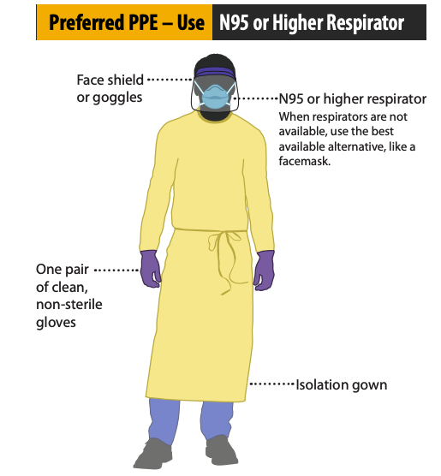
Infection Control
When performing aerosol-generating procedures, use an N95 respirator (or equivalent/higher-level respirator) in addition to other personal protective equipment (ie, gloves, gown, and eye protection)¹
  Follow CDC recommendations for donning and doffing gear²
Endotracheal intubation should be performed¹:
  By providers with extensive airway management experience
  Using video laryngoscopy
Image courtesy of CDC. https://www.cdc.gov/coronavirus/2019-ncov/downloads/A_FS_HCP_COVID19_PPE.pdf.
NIH. Infection Control. Updated October 9, 2020. Accessed November 13, 2020. https://www.covid19treatmentguidelines.nih.gov/critical-care/infection-control/
CDC. Sequence for Putting on Personal Protective Equipment (PPE). 2020. Accessed November 13, 2020. https://www.cdc.gov/niosh/npptl/pdfs/PPE-Sequence-508.pdf

Slide 8
Oxygenation and Ventilatory Support: Treatment of Hypoxemia
HFNC is preferred over NIPPV by the NIH¹
  HFNC resulted in more ventilator-free days and a 2.5-fold lower risk of 90-day mortality than NIPPV among patients in acute hypoxemic respiratory failure prior to the COVID-19 pandemic²
NIPPV (eg, BiPAP, CPAP, high-flow O₂) can be considered if HFNC is not available¹
  May generate aerosols¹
  Has been shown to have a high failure rate for non-COVID-19 acute respiratory distress syndrome³
Intubation and mechanical ventilation is recommended for refractory hypoxemia and for select patients with comorbidities, acute organ dysfunction, or other indications¹
BiPAP, bilevel positive airway pressure; CPAP, continuous positive airway pressure; HFNC, high-flow nasal canula; NIPPV, noninvasive positive-pressure ventilation; PEEP, positive end-expiratory pressure.
NIH. Oxygenation and Ventilation. Updated July 17, 2020. Accessed November 13, 2020. https://www.covid19treatmentguidelines.nih.gov/critical-care/oxygenation-and-ventilation/
Frat JP et al. N Engl J Med. 2015;372(23):2185-2196.
He H et al. Crit Care. 2019;23(1):300.

Slide 9
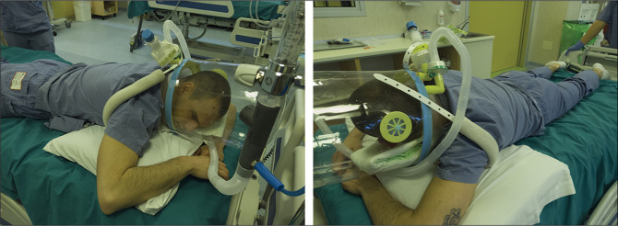
Awake Prone Positioning
Prone Positioning With Helmet Interface to Enable Continuous Positive Airway Pressure
Prone positioning can improve oxygenation¹
  PaO₂/FiO₂ improved from supine to prone positioning in patients with COVID-19 (180.5 vs 285.5 mm Hg; P < .0001)²
However, the benefit of prone positioning for preventing intubation is uncertain³
  Awake prone positioning did not reduce the risk of intubation in a cohort study (RR, 0.87; P = .6)
Contraindications:
Patients in respiratory distress requiring immediate intubation
Hemodynamically unstable patients, those who received abdominal surgery, and those with an unstable spine
RR, risk ratio.
Image courtesy of Coppo A et al. Lancet Respir Med. 2020;8(8):765-774.
NIH. Care of Critically Ill Patients With COVID-19. Updated October 9, 2020. Accessed November 13, 2020. https://www.covid19treatmentguidelines.nih.gov/critical-care/
Coppo A et al. Lancet Respir Med. 2020;8(8):765-774.
Ferrando C et al. Crit Care. 2020;24(1):597.

Slide 10
Hemodynamic Support
For adults with COVID-19 and shock, the NIH recommends following standard protocol for patients with septic shock with the following exceptions:
  Use dynamic parameters, skin temperature, capillary refilling time, and/or lactate levels instead of static parameters to assess fluid responsiveness
  Use buffered/balanced crystalloids for acute resuscitation instead of unbalanced crystalloids
  Do not use albumin for initial resuscitation
NIH. Hemodynamics. Updated October 9, 2020. Accessed November 13, 2020. https://www.covid19treatmentguidelines.nih.gov/critical-care/hemodynamics/

Slide 11
Pharmacotherapy Recommendations Are Based on
Viral Stage
Stage I
Early infection
Stage II
Pulmonary phase
Stage III
Hyperinflammation phase
Viral replication
Host inflammatory response
Vaccines
Disease severity
Treatment options
Treatment window
Time course
Anti-SARS-CoV2 antibodies
Convalescent plasma
Antivirals
Anti-inflammatory drugs
Lippi G et al. Ann Transl Med. 2020;8(11):693.
Siddiqi HK, Mehra MR. J Heart Lung Transplant. 2020;39(5):405-407.

Slide 12
Pharmacotherapy: Treatment Considerations
Not hospitalized or hospitalized but does not require supplemental oxygen
Hospitalized and requires supplemental oxygen
Hospitalized and requires oxygen delivery
via HFNC or NIPPV
Insufficient evidence to recommend for or against specific antivirals. SARS-CoV-2 neutralizing antibodies (ie, bamlanivimab or casirivimab plus imdevimab) are available through EUAs for outpatients at high risk of progression.
Hospitalized and requires invasive mechanical ventilation or ECMO
Dexamethasone has shown mortality benefit
Dexamethasone plus remdesivir as at left
Dexamethasone dosed as at left
Dexamethasone dosed as at left
Dexamethasone recommended against—may increase mortality
Insufficient data to recommend for routine use of remdesivir.
Remdesivir as above plus dexamethasone 5 mg IV or PO for up to 10 days or until hospital discharge
Remdesivir 200 mg IV for 1 day followed by remdesivir 100 mg IV once daily for 4 days or until hospital discharge
Baricitinib plus remdesivir can be considered
NIH. Therapeutic Management of Patients with COVID-19. Updated December 3, 2020. Accessed February 2, 2021. https://www.covid19treatmentguidelines.nih.gov/therapeutic-management/

Slide 13
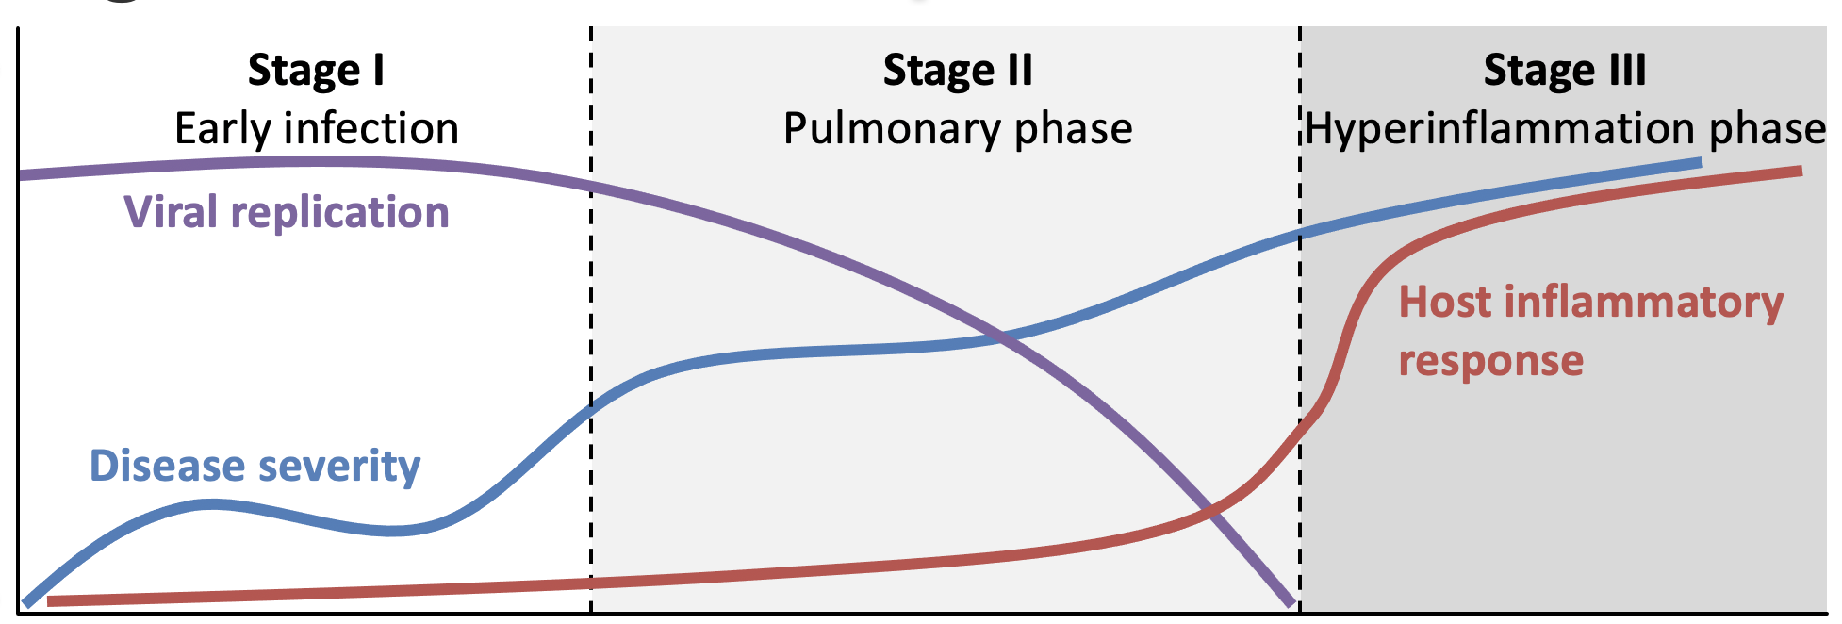
Anti-SARS-CoV-2 Antibodies (Bamlanivimab and Casirivimab/Imdevimab)
Treatment window
Bamlanivimab and casirivimab/imdevimab target the S protein and made available by EUA for nonhospitalized patients at risk for progressing to severe disease¹
BLAZE-1: bamlanivimab²
  Decreased the proportion of patients who progressed to hospitalization, ED visit, or death (6.3% vs 1.6%)
R10933-10987-COV-2067: casirivimab/imdevimab³
  Decreased the proportion of patients who required medically attended visits related to COVID-19 within 28 days of treatment (6.5% vs 2.8%)
1. NIH. Therapeutic Management of Patients with COVID-19. Updated December 3, 2020. Accessed February 2, 2021. https://www.covid19treatmentguidelines.nih.gov/therapeutic-management/
2. Chen P et al. N Engl J Med. 2021;384(3):229-237.
3. Weinreich DM et al. N Engl J Med. 2021;384(3):238-251.

Slide 14
Remdesivir and COVID-19
Outcomes of the ACTT Trial²
Subgroup | N | Recovery rate ratio (95% CI)
All patients | 1062 |  | 1.29 (1.12-1.49)
Race
White | 566 |  | 1.29 (1.06-1.57)
Black | 226 |  | 1.25 (0.91-1.72)
Asian | 135 |  | 1.07 (0.73-1.58)
Other | 135 |  | 1.68 (1.10-2.58)
Symptoms duration
≤10 days | 676 |  | 1.37 (1.14-1.64)
>10 days | 383 |  | 1.20 (0.94-1.52)
Baseline ordinal score
4 (not receiving oxygen) | 138 |  | 1.29 (0.91-1.83)
5 (receiving oxygen | 435 |  | 1.45 (1.18-1.79)
6 (receiving high-flow oxygen or noninvasive mechanical ventilation) | 193 |  | 1.09 (0.76-1.57)
7 (receiving mechanical ventilation or ECMO) | 285 |  | 0.98 (0.70-1.36)
Remdesivir is the only approved pharmacotherapy for the treatment of COVID-19 requiring hospitalization¹
Approved for adults and children 12 years or older weighing at least 40 kg¹
Can be used in younger children under the EUA¹
Recommended for COVID-19 treatment in³:
  Hospitalized patients with SpO₂ ≤94%
  Patients requiring supplemental O₂
  Patients who are on mechanical ventilation or ECMO
Recommending dosing of 200 mg on day 1 followed by 100 mg once-daily for 4 days (can be extended to 10 days)³
0.33
0.50
1.00
2.00
3.00
Placebo better
Remdesivir better
Treatment window
EUA, emergency use authorization.
FDA Approves First Treatment for COVID-19. Updated October 22, 2020. Accessed November 13, 2020. https://www.fda.gov/news-events/press-announcements/fda-approves-first-treatment-covid-19
Beigel JH et al. N Engl J Med. 2020;383:1813-1826.
NIH. Therapeutic Management of Patients with COVID-19. Updated October 9, 2020. Accessed November 13, 2020. https://www.covid19treatmentguidelines.nih.gov/therapeutic-management/

Slide 15
Dexamethasone and COVID-19
In preliminary results from a randomized open-label trial, dexamethasone reduced the risk for mortality¹
Recommended for COVID-19 treatment in²:
  Patients with COVID-19 who are mechanically ventilated
  Patients with COVID-19 who require supplemental O₂ but not mechanically ventilated
Recommended dosing of 6 mg/day for 10 days²
28-Day Mortality Outcomes of the RECOVERY Trial¹
Respiratory support at randomization | Dexamethasone | Usual care | Recovery rate ratio (95% CI)
Invasive mechanical ventilation | 95/324 (29.3%) | 283/683 (41.4%) |  | 0.64 (0.51-0.81)
Oxygen only | 298/1279 (23.3%) | 682/2604 (26.2%) |  | 0.82 (0.72-0.94)
No oxygen | 89/501 (17.8%) | 145/1034 (14.0%) |  | 1.19 (0.91-1.55)
All patients | 482/2104 (22.9%) | 1110/4321 (25.7%) |  | 0.83 (0.75-0.93)
Chi-square trend across categories: 11.5 |  |  |  | P < .001
0.50
0.75
1.00
1.50
2.00
Dexamethasone better
Usual care better
Treatment window
RECOVERY Collaborative Group et al. N Engl J Med. 2020;NEJMoa2021436.
NIH. Therapeutic Management of Patients with COVID-19. Updated October 9, 2020. Accessed November 13, 2020. https://www.covid19treatmentguidelines.nih.gov/therapeutic-management/

Slide 16
Convalescent Plasma
Treatment window
In a randomized controlled trial (N = 103), the
28-day rate of clinical improvement was 51.9% in those treated with convalescent plasma compared with 43.1% of controls (HR, 1.40; P = .26)
  However, clinical improvement was significant in patients with severe disease (P = .03)
Thousands of patients with COVID-19 have been treated with convalescent plasma in prospective and retrospective studies, which suggest that the treatment is safe
According to the NIH, there is insufficient evidence to recommend for or against convalescent plasma for the treatment of COVID-19
Li L et al. JAMA. 2020;324(5):460-470.
NIH. Convalescent plasma. Updated October 9, 2020. Accessed November 13, 2020. https://www.covid19treatmentguidelines.nih.gov/immune-based-therapy/blood-derived-products/convalescent-plasma/

Slide 17
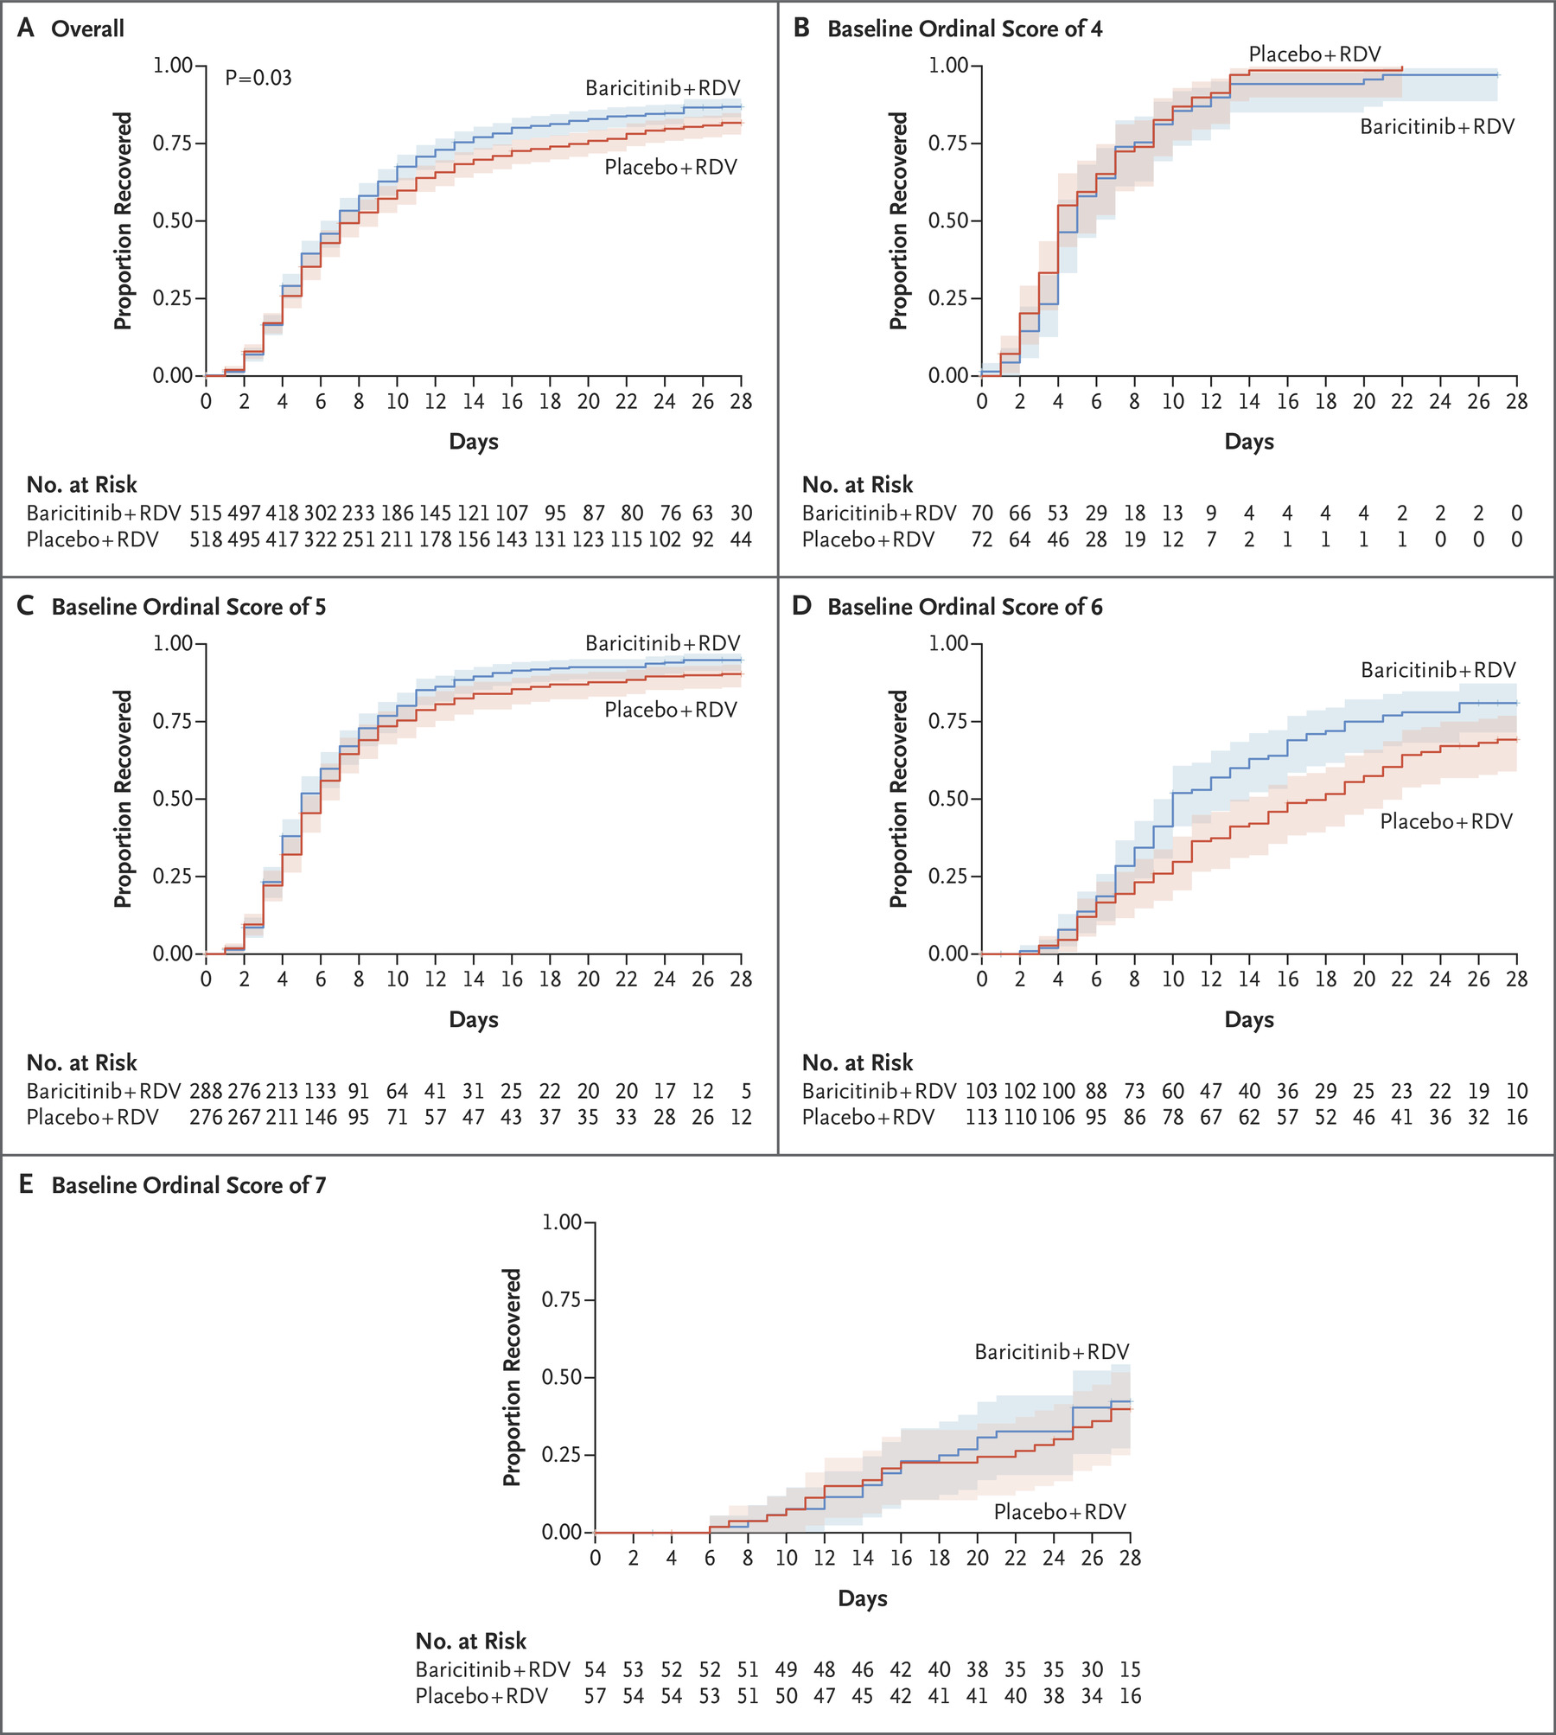
Baricitinib Plus Remdesivir and COVID-19
Population Receiving High-Flow O₂
or Noninvasive Ventilation
In a randomized controlled trial, baricitinib plus remdesivir reduced recovery time and accelerated improvement
Baricitinib was dosed in combination with remdesivir at 4 mg orally for up to 14 days
According to the NIH, there is insufficient evidence to recommend for or against convalescent plasma for the treatment of COVID-19
Overall Population
Treatment window
Kalil AC et al. N Engl J Med. 2020;10.1056/NEJMoa2031994.
NIH. Updated December 14, 2020. Accessed February 3, 2021. https://www.covid19treatmentguidelines.nih.gov/statement-on-baricitinib-eua/.

Slide 18
ISTH Algorithm for Prevention of and Evaluation for VTE and Other Coagulopathies
D-dimer
Prothrombin time
Platelet count
Fibrinogen
D-dimer markedly raised
Prothrombin time prolonged
Platelet count <100 x 10⁹/L
Fibrinogen <2.0 g/L
D-dimer not markedly raised
Prothrombin time normal
Platelet count normal
Fibrinogen elevated
Admit (even if no other concerns)
Monitor once or twice daily
If admitted for other clinical reasons, monitor daily
If discharged, use as baseline for re-presenting with symptoms
In all patients
Worsening
Start prophylactic dose low molecular weight heparin
In non-bleeding patients, keep:
Platelet count >25 x 10⁹/L
In bleeding patients, keep:
Platelet count >50 x 10⁹/L
Fibrinogen >1.5 g/L
PT ratio <1.5 (not the same as INR)
Blood products as per protocol
Consider experimental therapies
ISTH, International Society of Thrombosis and Haemostasis.
Thachil J et al. J Thromb Haemost. 2020;18(5):1023-1026.

Slide 19
Managing Polypharmacy in People With COVID-19
Patients taking ACEis and ARBs should continue those medications¹
  In the BRACE CORONA trial, pausing ACEis or ARBs did not improve days alive and out of the hospital (21.9 vs 22.9 for suspending vs continuing; P = .09)²
Statin use may decrease the risk of severe COVID-19
  In a retrospective trial, statin use significantly decreased the risk for severe COVID-19 (aOR, 0.29; P < .01) and decreased time to recovery (aHR, 2.69; P < .01)³
  In-hospital use of statins decrease the risk for 28-day all-cause mortality (aHR, 0.58; P < .001)
AHA. Patients taking ACE-i and ARBs who contract COVID-19 should continue treatment, unless otherwise advised by their physician. March 17, 2020. Accessed November 13, 2020. https://newsroom.heart.org/news/patients-taking-ace-i-and-arbs-who-contract-covid-19-should-continue-treatment-unless-otherwise-advised-by-their-physician
Lopes RD et al. Presented at the European Society of Cardiology Virtual Congress. September 1, 2020. Accessed November 13, 2020. https://esc365.escardio.org/Congress/ESC-CONGRESS-2020-The-Digital-Experience/Hot-Line-BRACE-CORONA/224200-brace-corona-continuing-vs-suspending-ace-inhibitors-and-arbs-in-covid-19
Daniels LB et al. Am J Cardiol. 2020;136:149-155.
Zhang XJ et al. Cell Metab. 2020;32(2):176-187.e4.

Slide 20
Managing COVID-19 and ARVs in Hospitalized PLWH
Continue ARV regimens, including investigational agents if possible¹
Avoid ARV substitutions¹
  If necessary, consult the US Department of Health and Human Services guidelines for recommendations on ARV drugs that can be switched²
For patients who are critically ill and tube feeding, consider either liquid formulations or crushing pills—if allowable—in consultation with an HIV specialist and/or pharmacist¹
  If necessary, information on pill crushing or liquid drug formulations for ARVs can be obtained from the Toronto General Hospital Immunodeficiency Clinic³
For patients receiving COVID-19 pharmacotherapy, drug-drug interactions should be considered:
  Remdesivir: few known drug interactions⁴
  Dexamethasone: CYP3A4 inducer, which could decrease the levels of selected ARVs (ie, darunavir, elvitegravir, indinavir, lopinavir, and saquinavir)⁵
HIV.gov. Interim Guidance for COVID-19 and Persons with HIV. Updated June 19, 2020. Accessed November 13, 2020. https://clinicalinfo.hiv.gov/en/guidelines/covid-19-and-persons-hiv-interim-guidance/interim-guidance-covid-19-and-persons-hiv?view=full
HIV.gov. Guidance for Non-HIV-Specialized Providers Caring for Persons with HIV Who Have been Displaced by Disasters (such as a Hurricane). Updated September 14, 2018. Accessed November 13, 2020. https://clinicalinfo.hiv.gov/en/guidelines/caring-persons-hiv-disaster-areas/appendix-c-antiretroviral-medications-can-be-switched
Foisy M et al. Oral Antiretroviral/HCV DAA Administration: Information on Crushing and Liquid Drug Formulations. May 2020. Accessed November 13, 2020. https://www.hivclinic.ca/main/drugs_extra_files/Crushing%20and%20Liquid%20ARV%20Formulations.pdf
Liverpool Drug Interactions Group. Interactions With Experimental COVID-19 Antiviral Therapies. Updated September 24, 2020. Accessed October 20, 2020. https://www.covid19-druginteractions.org/
University of California San Francisco. Database of Antiretroviral Drug Interactions. 2019. Accessed November 13, 2020. http://arv.ucsf.edu/insite?page=ar-00-02&post=8&param=138

Slide 21
Candidacy for Clinical Trials
PLWH should not be excluded from clinical trials on the basis of HIV status
However, consult with pharmacists and/or HIV specialists about the possibility of drug-drug interactions
Consult with ClinicalTrials.gov or hospital research administrators to determine the availability of clinical trials and find resources for studies investigating COVID-19 treatments
HIV.gov. Interim Guidance for COVID-19 and Persons with HIV. Updated June 19, 2020. Accessed November 13, 2020. https://clinicalinfo.hiv.gov/en/guidelines/covid-19-and-persons-hiv-interim-guidance/interim-guidance-covid-19-and-persons-hiv?view=full

Slide 22
Providing Patient-Centered Care
Example of Patient-Centered Communication During Contingency Planning⁴
COVID-19 may lead to anxiety, PTSD, and other mental health issues in PLWH—particularly older PLWH^{1,2}
  May be particularly true for those who are socially isolated for long periods of time
Consider arranging family contact through video conferencing with a tablet or laptop³
Use patient-centered communications skills
  For guidance on COVID-19 communication, reference the Vitaltalk COVID Ready Communication Playbook⁴
CALMER principles | Example of communication
Check in | “How are you doing with this?”
Ask about COVID | “What have you been thinking about your COVID diagnosis?”
Lay out issues | “Is there anything you want us to know if your COVID gets bad?”
Motivate them to talk about what matters | “Who is your backup person, meaning who helps us make decisions if you can’t speak?”
Expect emotion | “I know this is difficult to think about.”
Record the discussion | “Thank you, this has been helpful. I’ll note what you said in your chart so that we have a record of it.”
Rogers JP et al. Lancet Psychiatry. 2020;7(7):611-627.
Shiau S et al. AIDS Behav. 2020;24(8):2244-2249.
Wakam GK et al. N Engl J Med. 2020;382(24):e88.
VitalTalk. COVID Ready Communication Playbook. Accessed November 13, 2020. https://www.vitaltalk.org/guides/covid-19-communication-skills/

Slide 23
Using the Opportunity to Control Comorbidities
During inpatient care, PLWH should be brought up-to-date for screening and evaluations for common comorbidities:
  Hypertension
  Diabetes
  Cardiovascular disease
  Respiratory diseases
  Hepatic diseases (eg, hepatitis B and hepatitis C)
Treatment can be initiated in hospital with instructions to follow-up with primary care
Jakhmola S et al. Front Physiol. 2020;11:984.

Slide 24
Summary and Key Points
PLWH who have COVID-19 should be managed in the same way as the general population
ARVs should be continued during COVID-19, and efforts should be made to avoid switching regimens
During inpatient care, PLWH should be evaluated for common comorbidities and treated
Hypercoagulability may be particularly relevant for PLWH due to high rates of hypertension, CVD, and inflammation

