Slide 1
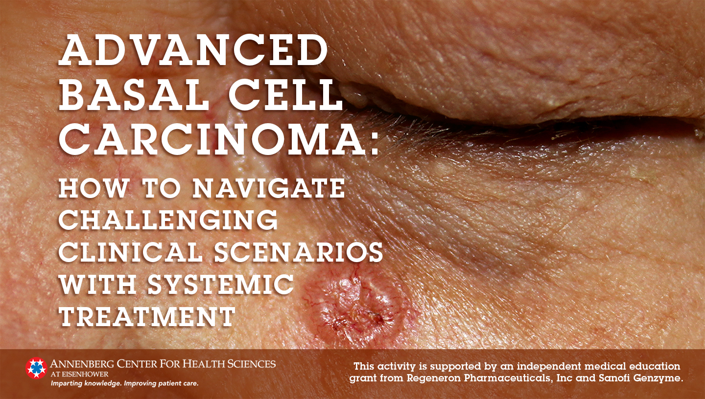

Slide 2
Learning Objectives
After participating in this CME activity, the learner should be able to:
Explain how the target pathways of systemic treatment for advanced basal cell carcinoma (BCC) align with the current understanding of the pathogenesis of the disease (knowledge)
Evaluate the profiles of and clinical data related to current and emerging systemic treatments to support the optimal care of patients with advanced BCC (knowledge)
Create systemic treatment plans for patients with advanced BCC who are intolerant to hedgehog pathway inhibitors (competence)
Identify opportunities to improve the management of patients with advanced BCC whose disease has progressed despite previous treatment with hedgehog pathway inhibitors (competence)

Slide 3
Types of Skin Cancer
Malignant Skin Cancers
Nonmelanoma
Basal cell
Squamous Cell
Melanoma
Other
--Merkel cell
--Apocrine gland
--Cutaneous T-cell lymphoma
--Others

Slide 4
Epidemiology of Basal Cell Carcinoma
Nonmelanoma skin cancer is most common of all malignancies, but accounts for <0.1% of cancer-related deaths¹
  >1 out of 3 new cancers are skin cancers
  Incidence increases with:
    Lighter skin complexion
    Increased ultraviolet light exposure
∼5.4 million basal and squamous cell skin cancers diagnosed each year in the US¹
  ∼80% are basal cell cancers → 4.3 million
Incidence of nonmelanoma skin cancers is estimated to have increased 77% from 1994 to 2014²
Socioeconomic and psychological burden is high^{3,4}
1. American Cancer Society. https://www.cancer.org/cancer/basal-and-squamous-cell-skin-cancer/about/key-statistics.html. Accessed November 23, 2020. 2. Skin Cancer Foundation. Basal Cell Carcinoma - The Skin Cancer Foundation. Accessed November 24, 2020. 3. Migden M, et al. J Am Acad Dermatol. 2017;77(1):55-62. 4. Wu X, et al. Future Oncol. 2015;11(22):2967-2974.

Slide 5
Treatment Overview: NCCN
Basal Cell Cancer
Low risk
High risk
Advanced
Local
Nodal or distant metastases
-Hedgehog inhibitor
-Surgery
-Radiation therapy
-Clinical trial
-Curettage & electrodessication
-Excision
-Radiation therapy
-Mohs surgery
-Excision
-Radiation therapy
-Systemic therapy
¹4mm margins and postoperative margin assessment and second intention healing, linear repair, or skin graft
²Wider margins and postoperative margin assessment and with linear or delayed repair
³Conisder HhI for locally advanced disease in which curative RT and curative surgery are not feasible
NCCN, National Comprehensive Cancer Network
National Comprehensive Cancer Network. https://www.nccn.org/professionals/physician_gls/pdf/nmsc.pdf. Accessed November 24, 2020.

Slide 6
Treatment Recommendations for Locally Advanced or Metastatic BCC: AAD
Advanced BCC
If surgery and RT are contraindicated or inappropriate, or if residual tumor persists following surgery and/or RT and further surgery and RT are contraindicated or inappropriate, a smoothened inhibitor should be considered
Metastatic BCC
Consider a smoothened inhibitor
If smoothened inhibitors are not feasible, platinum-based chemotherapy or best supportive care is recommended
Provide multidisciplinary care
AAD, American Academy of Dermatology; RT, radiation therapy
Bichakjian C, et al. J Am Acad Dermatol. 2018;78:540-559.

Slide 7
Two Hedgehog Inhibitors Currently Approved for Locally Advanced BCC by FDA
Hedgehog Inhibitor | Indication | Dosage & Administration
Sonidegib (Odomzo)¹ | Adult with laBCC that has recurred following surgery or RT, or those who are not candidates for surgery or RT | 200 mg PO QD on an empty stomach
Vismodegib (Erivedge)² | Adults with laBCC that has recurred following surgery or those who are not candidates for surgery and who are not candidates for RT | 150 mg PO QD
BCC, basal cell carcinoma; laBCC, locally advanced basal cell carcinoma; RT, radiation therapy
1. Odomzo [package insert]. Cranbury, NJ: Sun Pharmaceutical Industries, Inc.; July 2020.
2. Erivedge [package insert]. South San Francisco, CA: Genentech USA, Inc.; August 2020.

Slide 8
Clinical Trials Programs of Hedgehog Inhibitors for Advanced BCC
Sonidegib
BOLT
ERIVANCE
Vismodegib
Clinical Trials
Programs
STEVIE
MIKIE

Slide 9
ERIVANCE: Phase 2 Study of Vismodegib in Advanced BCC
Sekulic
Metastatic BCC
(RECIST-measurable)
(n=33)
RECIST
Vismodegib
150 mg PO QD
Progression
Intolerable toxicity
Withdrawal from study
REGISTRATION
Composite
endpoint
Locally advanced BCC
(n=63)
Locally advanced BCC:
  Inoperable
  Surgery inappropriate
    ≥1 cm
    ≥2 recurrences after surgery and curative resection unlikely and/or anticipated substantial morbidity and/or deformity from surgery
RECIST, Response Evaluation Criteria In Solid Tumors
Sekulic A, et al. N Engl J Med. 2012;366(23):2171-2179.

Slide 10
ERIVANCE at 9 Months: Maximum Tumor Shrinkage*
  Objective response rate (primary endpoint)
    mBCC: 30.3%
    laBCC: 42.9%
  Median duration of response (DOR):
    mBCC: 7.6 mos
    laBCC: 7.6 mos
Maximum Tumor Shrinkage: Metastatic BCC
Maximum Tumor Shrinkage: Locally Advanced BCC
Sekulic A, et al. N Engl J Med. 2012;366(23):2171-2179.; permission granted by PMC Copyright Notice
*Central review

Slide 11
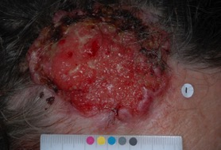
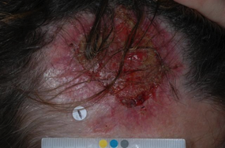
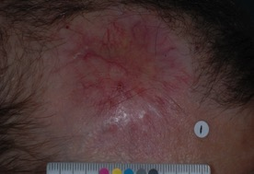
ERIVANCE at 9 Months: Vismodegib in Locally Advanced BCC
Baseline
Week 8
Week 20
Week 16: no BCC on biopsy
Sekulic A, et al. N Engl J Med. 2012;366(23):2171-217; Permission granted by PMC Copyright Notice.

Slide 12
ERIVANCE: Efficacy* at 39 Months
Outcome | mBCC (n=33) | laBCC (n=63)
Objective response, % Complete response Partial response Stable disease Progressive disease | 48.5% 0% 48.5% 42.4% 6.1% | 60.3% 31.7% 28.6% 23.8% 9.5%
Median duration of response | 14.8 mos | 26.2 mos
Median progression-free survival | 9.3 mos | 12.9 mos
Median overall survival | 33.4 mos | NE
2-y survival rate | 62.3% | 85.5%
NE, not estimable
*Investigator assessed
Sekulic A, et al. BMC Cancer. 2017;17:332.

Slide 13
ERIVANCE: Safety
Treatment-emergent adverse event | Exposure <12 mos (n=48) |  | Exposure ≥12 mos (n=56)
 | Any grade | Grade ≥3 | Any grade | Grade ≥3
Any adverse event | 100.0% | 56.3% | 100.0% | 55.4%
Muscle spasms | 52.1% | 4.2% | 87.5% | 7.1%
Alopecia | 50.0% | NA | 80.4% | NA
Dysgeusia | 41.7% | NA | 67.9% | NA
Weight decreased | 37.5% | 0% | 64.3% | 16.1%
Fatigue | 35.4% | 8.3% | 50.0% | 1.8%
Nausea | 22.9% | 0% | 41.1% | 0%
Decreased appetite | 31.3% | 4.2% | 25.0% | 1.8%
Diarrhea | 20.8% | 0% | 32.1% | 5.4%
Constipation | 20.8% | 0% | 17.9% | 0%
Sekulic A, et al. BMC Cancer. 2017;17:332.

Slide 14
STEVIE: Open-Label Study of Vismodegib in Advanced BCC
Metastatic BCC
(n=96)
RECIST
Vismodegib
150 mg PO QD
Progression
Intolerable toxicity
Withdrawal from study
REGISTRATION
Composite
endpoint
Locally advanced BCC
(n=1119)
Locally advanced BCC not eligible for surgery
Basset-Seguin N, et al. Lancet Oncol. 2015;16(6):729-736.

Slide 15
STEVIE: Preplanned Interim Analysis
Interim analysis preplanned to occur after 500 patients achieved 1 y of follow-up
  N= 499 patients (median exposure 36.4wks)
    400 (80%) discontinued treatment
      36% due to AE
      14% due to progressive disease
      10% due to patient request
    Serious AE in 22%
    AE causing death in 4.2%
  Of 453 with laBCC: 33.8% CR, 32.9% PR
Basset-Seguin N, et al. Lancet Oncol. 2015;16(6):729-736.

Slide 16
STEVIE: Primary Analysis − Efficacy* at Median 8.6 Months
Outcome | mBCC (n=84) | laBCC (n=1077)
Overall response, % Complete response Partial response Stable disease Progressive disease | 36.9% 4.8% 32.1% 46.4% 10.7% | 68.5% 33.4% 35.1% 25.1% 1.9%
Median duration of response | 13.9 mos | 23.0 mos
Median progression-free survival | 13.1 mos | 23.2 mos
*Investigator assessed
Basset-Seguin N, et al. Eur J Cancer. 2017;86:334-348.

Slide 17
STEVIE: Primary Analysis − Safety at Median 8.6 Months
Most common TEAE
Any AE | 98%
Muscle spasm | 66%
Alopecia | 62%
Dysgeusia | 55%
Weight decreased | 41%
Decreased appetite | 25%
Asthenia | 24%
Basset-Seguin N, et al. Eur J Cancer. 2017;86:334-348.

Slide 18
MIKIE: Intermittent Dosing Regimens With Vismodegib
Goal: Assess safety and efficacy of long-term intermittent dosing of vismodegib in patients with multiple basal cell carcinomas
  ≥1 histologically confirmed and ≥6 clinically evident
All patients received vismodegib 150 mg/d
Primary endpoint: % reduction in number of clinically-evident BCCs at wk 73
24 wks
vismodegib
8 wks placebo
8 wks vismodegib
8 wks placebo
8 wks vismodegib
8 wks vismodegib
8 wks placebo
12 wks vismodegib
8 wks placebo
12 wks vismodegib
8 wks placebo
12 wks vismodegib
8 wks placebo
12 wks vismodegib
72 weeks
Group A
Group B
Dreno B, et al. Lancet Oncol. 2017;18(3):404-412.

Slide 19
MIKIE: Intermittent Dosing Regimens With Vismodegib – Efficacy
Dreno B, et al. Lancet Oncol. 2017;18(3):404-412.

Slide 20
MIKIE: Intermittent Dosing Regimens With Vismodegib – Safety
Safety Outcome | Group A | Group B
TEAE | 99% | 97%
Grade ≥3 treatment-related muscle spasms | 4% | 11%
Grade ≥3 treatment-related increased creatine kinase | 1% | 4%
Grade ≥3 treatment-related hypophosphatemia | 0% | 3%
Serious TEAE | 19% | 17%
Discontinued treatment due to AE | 20% | 27%
Conclusion: Both intermittent dosing regimens provided good efficacy with similar/better safety profile than in STEVIE
Dreno B, et al. Lancet Oncol. 2017;18(3):404-412.

Slide 21
Clinical Trials Programs of Hedgehog Inhibitors for Advanced BCC
Sonidegib
BOLT
ERIVANCE
Vismodegib
Clinical Trials
Programs
STEVIE
MIKIE

Slide 22
BOLT: Phase 2 Study of Sonidegib in Advanced BCC
Screening/
baseline
Treatment
Follow-up
Survival
Sonidegib
200 mg QD
(n=79)
Tumor assessments until disease progression
Information collected on other antineoplastic therapy received
Safety follow-up 30 days after last dose of study treatment
Survival follow-up every 12 weeks until 1 of the following:
Death
Loss to follow-up
Withdrawal of consent
Final analysis
Patient
populationª:
laBCC (aggressive and nonaggressive subtypes)
mBCC
Treatment until 1 of the following:
Disease progression
Unacceptable toxicity
Death
Discontinuation for any other reason
Stratification^{b} and
randomization (1:2)^{c}
Sonidegib
800 mg QD*
(n=151)
≤ 21 days
ª Patients previously treated with sonidegib or other Hh pathway inhibitors were excluded. ^{b} Patients were stratified based on stage, disease histology for laBCC (nonaggressive vs aggressive), and geographic region. ^{c} Patients were randomized to receive sonidegib 200 mg QD (lowest dose level tested that showed antitumor activity) and 800 mg QD (highest well-tolerated, biologically active dose) based on the phase 1 study.⁸
*Dosing regimen not approved by US FDA
Migden M, et al. Lancet Oncol. 2015;16(6):716-728.

Slide 23
BOLT: Efficacy* at 13.9 Months
Outcome¹ | Sonidegib 200 mg |  | Sonidegib 800 mg**
 | laBCC (n=42) | mBCC (n=13) | laBCC (n=93) | mBCC (n=23)
Complete response | 5% | 0% | 0% | 0%
Partial response | 38% | 15% | 38% | 17%
Stable disease | 50% | 77% | 42% | 65%
Time to tumor response | 3.9 mos | 4.6 mos | 3.7 mos | 1.0 mo
Duration of response | NR | NR | NR | 8.3²
Progression-free survival | NR | 13.1 mos | NR | 7.6 mos
*Central review ** Dosing regimen not approved by US FDA
¹Primary efficacy analysis ²Not estimable
NR, not reached
Migden M, et al. Lancet Oncol. 2015;16(6):716-728.

Slide 24
BOLT: Efficacy* by Histology at 30 Months
*Central review
Lear JT, et al. JEADV. 2018;32:372-381.

Slide 25
BOLT: Efficacy* at 42 Months
% of Patients who remained on treatment at 42 mos: 200 mg (8%); 800 mg (3.3%)
Outcome | laBCC |  | mBCC
 | 200 mg (n=66) | 800 mg (n=128) | 200 mg (n=13) | 800 mg (n=23)
Objective response | 56% | 46% | 8% | 17%
Complete response | 5% | 2% | 0% | 0%
Duration of response, median | 26.1 mos | 23.3 mos | 24.0 mos | NE
Progression-free survival, median | 22.1 mos | 24.9 mos | 13.1 mos | 11.1 mos
Time to tumor response, median | 4.0 mos | 3.8 mos | 9.2 mos | 1.0 mo
NE, not estimable
*Central review
Dummer R, et al. Br J Dermatol. 2020;182:1369-1378.

Slide 26
BOLT: Safety Over 42 Months
Muscle spasms
Alopecia
Dysgeusia
Nausea
Diarrhea
Creatine kinase increase
Weight decrease
Fatigue
Appetite decreased
Dummer R, et al. Br J Dermatol. 2020;182:1369-1378. Permission granted: http://creativecommons.org/licenses/by-nc-nd/4.0/

Slide 27
BOLT: Safety Over 42 Months (continued)
Dummer R, et al. Br J Dermatol. 2020;182:1369-1378. Permission granted: http://creativecommons.org/licenses/by-nc-nd/4.0/

Slide 28

Adverse Events Associated With Hedgehog Pathways Inhibitors
Dysgeusia/Ageusia
Bitter/Sweet responsivity
Taste buds
Treatment
Nutrition consult
Alopecia
↓ Dermal papillae function/hair growth
Muscle spasms
Myogenic factors
Injury recovery
Treatment
Hydration, electrolyte replacement
Muscle relaxant (eg, cyclobenzaprine)
Amlodipine
L-carnitine
Weight loss
Glucose uptake in
muscle/brown adipocytes
Treatment
Nutrition consult
Lacouture ME, et al. Oncologist. 2016;21(10):1218-1229.
Ally MS, et al. JAMA Dematol. 2015;151(10):1132-1134.
Dinehart M, et al. Skin. 2018;2(2):90.

Slide 29
Hedgehog Inhibitors
Pros | Cons
Oral | Not well tolerated
High efficacy | Primary/secondary resistance
Can achieve histologic clearance

Slide 30
Sonidegib in Advanced BCC Resistant to Vismodegib
9 patients with aBCC previously resistant to vismodegib
  3 primary resistance
  6 secondary resistance
Treated with sonidegib 800 mg QD*
Median treatment: 6 wks
5 progressive disease, 3 stable disease, 1 not evaluable (due to Gr3 AE)
SMO mutations with previously reported functional resistance in vitro were identified in 5/8 available baseline tumor samples
Conclusion: Sonidegib after vismodegib failure is not likely to improve response
*Dosing regimen not approved by US FDA
Danial C, et al. Clin Cancer Res. 2016;22(6):1325-1329.

Slide 31
Editor’s note: The video interviews for this activity were recorded several weeks prior to approval of cemiplimab-rwlc (Libtayo) on February 9, 2021, by the U.S. Food and Drug Administration for basal cell carcinoma (see: https://www.accessdata.fda.gov/drugsatfda_docs/label/2021/761097s009lbl.pdf). Please check back for updated information regarding the use of cemiplimab-rwlc for patients with locally advanced basal cell carcinoma.

Slide 32
What Should Be Used to Treat Resistant BCC? …Immunotherapy?
Rationale:
  Immune system plays critical role in surveillance and eradication of nonmelanoma skin cancer
    Solid organ transplant pts: Increase: 65-fold for cutaneous squamous cell carcinoma, 10-fold BCC¹
  Tumor microenvironment of UV-induced tumors is immunosuppressive²
  Innate immune system can eradicate UV-associated tumors
    Imiquimod: Toll-like receptor-7 agonist in BCC³
  Activity in other cutaneous malignancies (? High mutation burden)
    Melanoma
    Merkel cell carcinoma (PD-1 and PDL-1 antibodies)
    Cutaneous squamous cell carcinoma
    Several PD-1 inhibitors already approved
1. Euvrard S et al. N Engl J Med. 2003;348(17):1681-1691.
2. Fisher MS, et al. Science. 1982;216(4550):113301134.
3. Gollnick HA, et al. Eur J Dermatol. 2008;18(6):677-682.

Slide 33
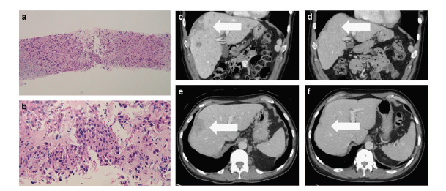
Immunotherapy in Resistant BCC
BCC resistant to hedgehog inhibitor treated with PD-1 antibody (nivolumab).
Baseline
4 months
Ikeda S, et al. NPJ Genom Med. 2016;1:16037. Permission granted from http://creativecommons.org/licenses/by/4.0/

Slide 34
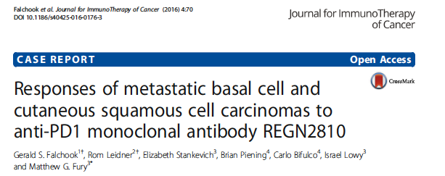
Phase 1 trial of cemiplimab* (REGN2810)
After planned 48 weeks of treatment, patient with mBCC maintained PR on post-treatment follow-up (12+ months).
*Not approved for use in basal cell carcinoma in the US
Falchook GS, et al. J Immunother Cancer. 2016;4:70. Permission granted under creative commons license 4.0

Slide 35
Phase 2 Study of Cemiplimab* for Locally Advanced BCC
laBCC cohort of study investigating cemiplimab in patients with advanced BCC who experienced progression on or were intolerant of HhI therapy
Open-label treatment with cemiplimab 350 mg Q3 wks for up to 93 wks or disease progression
Median follow-up: 15 mos
*Not approved for use in basal cell carcinoma in the US
HhI, hedgehog inhibitor; laBCC, locally advanced basal cell carcinoma
Stratigos AJ, et al. Ann Oncol. 2020;31(suppl 4):S1142-S1215. Abstract LBA47.

Slide 36
Phase 2 Study of Cemiplimab* for Locally Advanced BCC (continued)
Median baseline tumor mutational burden
  58.2 mutations/Mb among responders
  23.5 mutations/Mb among nonresponders
Among 84 patients:
  ORR 31%
  5 CR, 21 PR
  85% of responses ongoing at 12 mos
Not reached
  Median DOR
  Median PFS
  OS
Most common AEs
  Fatigue (30%), diarrhea (24%), pruritus (21%)
17% discontinued treatment due to AEs
*Not approved for use in basal cell carcinoma in the US
CR, complete response; DOR, duration of response; ORR, objective response rate; PR, partial response
Stratigos AJ, et al. Ann Oncol. 2020;31(suppl 4):S1142-S1215. Abstract LBA47.

Slide 37
Other Agents Under Phase 2/3 Investigation
Agent | BCC Population | Clinical Trial
Nivolumab with/without ipilimumab | laBCC, mBCC | NCT03521830

Slide 38
Case #1
65-yo male presents with history of multiply recurrent basal cell carcinoma of the left nasal sidewall.
He was treated twice within 3 years by Mohs surgery including a closure with paramedian forehead flap.
Two years later, local recurrence was noted and irradiated with clinical clearance.
Now 4 years later, he presents with a new nodule at the edge of the surgical scar and double vision. Biopsy is consistent with infiltrative BCC.
What are the best next steps in management of this patient?

Slide 39
Case #1 (continued)
Imaging of head and neck shows significant tumor extension proximally under the skin along the left nasal sidewall into the orbit, with likely impingement on his inferior rectus muscle.
Surgery was considered but deemed challenging and unlikely to be curative, as was further radiation.
What is the best next step?

Slide 40
Case #1 (continued)
Vismodegib was initiated.
Patient tolerated it well and within 2 months visible tumor had disappeared (skin biopsy negative) and his diplopia resolved.
How often do you continually monitor these patients that seem to have a response? What methods do you use and how long do you treat in this kind of scenario?

Slide 41
Case #1 (continued)
Patient continued on vismodegib with exams and imaging at scheduled intervals demonstrating continued resolution of subcutaneous tumor over the subsequent 4 months.
Therapy was discontinued but monitoring continued over the subsequent 3 years with no recurrence.

Slide 42
Case #2
An 83-yo spry, thin female presents with a large neglected BCC on her forehead.
Surgery is considered, but the likely associated morbidity was considered significant.
How would you treat her?

Slide 43
Case #2 (continued)
Patient wished to avoid radiation therapy.
Patient started on sonidegib and, although clear response was noted, she developed significant issues with loss of taste and weight loss.
What would you do next?

Slide 44
Case #2 (continued)
Treatment holidays were introduced and patient tolerated therapy for a total of 4 months, with the tumor decreasing in size by 80%.
However, side effects became worse.
What would you do next?

Slide 45
Case #3
56-yo male with h/o BCC on left shoulder
Treated with excision in 2011
In 2012, developed enlarged lymph nodes in the left neck consistent with mBCC
Treatment included dissection and postoperative radiation therapy
  6/24 lymph nodes involved
In 2015, enlarged pulmonary nodules were noted consistent with BCC on biopsy
  Vismodegib initiated but poor tolerability → on-off treatment x 1½ years
  CT showed progressive disease in lung metastases
What are the treatment options?

Slide 46
Summary
Advanced BCC – unmet medical need
Hedgehog pathway plays key role in pathogenesis
2 hedgehog inhibitors approved (sonidegib, vismodegib)
  Highly active, but resistance is common
  Toxicities predictable but can be treatment-limiting
Emerging opportunities
  Immunotherapy
    Cemiplimab and other agents in phase 2/3 investigation
  Combination therapies

