Slide 1
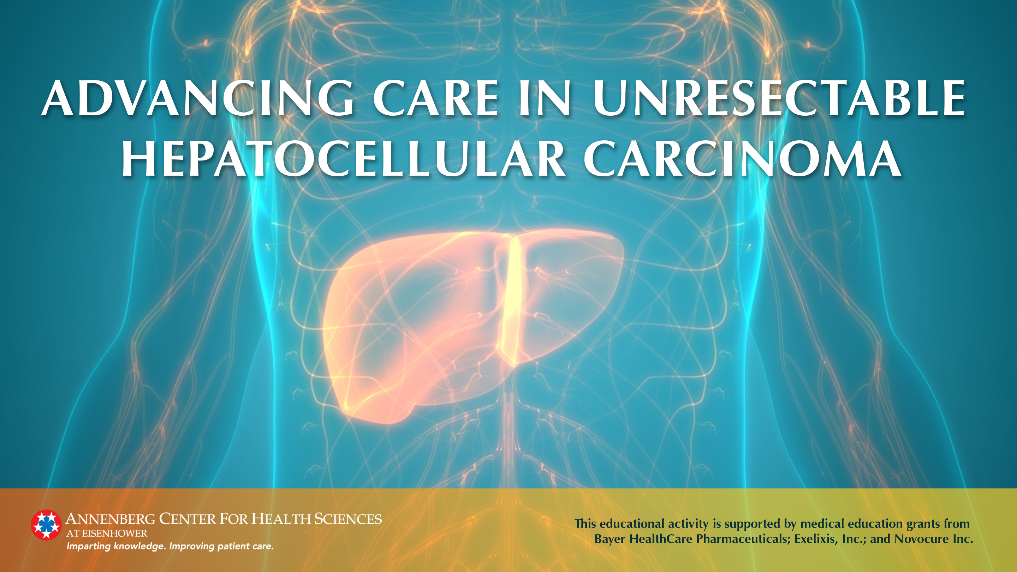

Slide 2
Red Line:
Overview

Slide 3
Current Epidemiology &
Future Trends

Slide 4
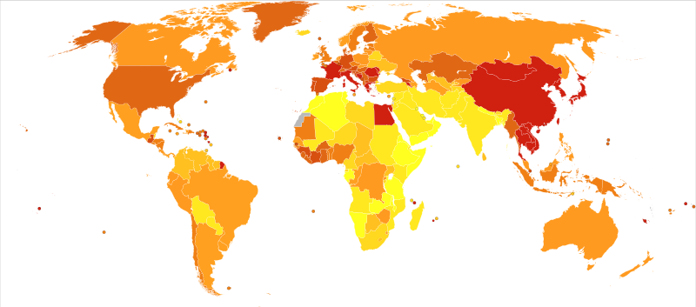
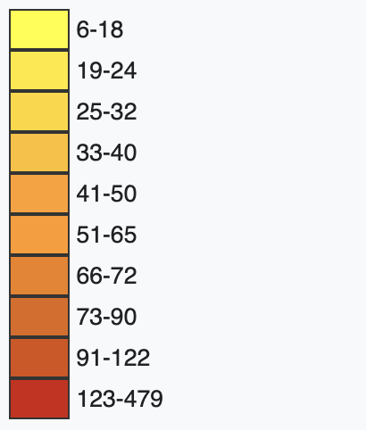
Worldwide Liver Cancer Incidence & Mortality
2012 HCC Mortality Ratesª
Age-standardized rates per million
Image courtesy of Wikimedia Commons. https://en.wikipedia.org/wiki/File:Liver_cancer_world_map-Deaths_per_million_persons-WHO2012.svg. CC BY-SA 4.0.
ªDeveloped using 2012 WHO data.

Slide 5
The Incidence and Prevalence of Liver Cancerª Are Increasing in the US
HCC Incidence Over Time¹
In 2020, an estimated 42,810 cases of liver cancer will be diagnosed, and liver cancer will cause an estimated 30,160 deaths.
ªData include liver and intrahepatic bile duct cancer.
Centers for Disease Control and Prevention (CDC). June 2020. Accessed November 24, 2020. https://gis.cdc.gov/Cancer/USCS/DataViz.html.
Siegel RL et al. CA Cancer J Clin. 2020;70(1):7-30.

Slide 6
HCC Incidence and Prevalence Are Expected to Increase Over the Next Decade With Changes in the HCC Population
Decompensated Cirrhosis, HCC, and Liver Deaths in the NAFLD Population¹
120,000
Estimated Changes
by 2030¹
Decompensated cirrhosis: 180%
HCC prevalence: +146%
HCC incidence: +137%
100,000
80,000
Incident cases/deaths
60,000
40,000
Incident decompensated cirrhosis
Incident HCC
Incident liver-related deaths
20,000
2015
2016
2017
2018
2019
2020
2021
2022
2023
2024
2025
2026
2027
2028
2029
2030
Estes C et al. Hepatology. 2018;67(1):123-133.
Lange N, Dufour JF. Dig Dis Sci. 2019;64(4):903-909.

Slide 7
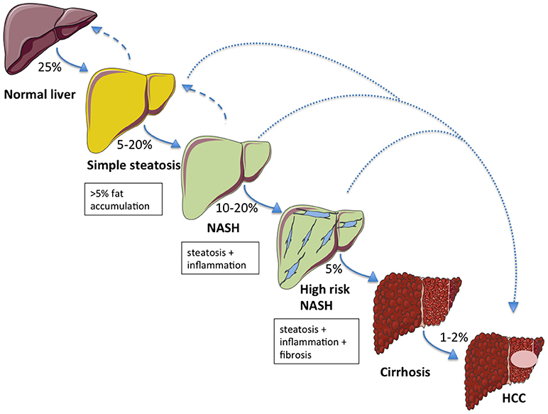
Natural History of HCC Development¹
Image courtesy of Seghieri M et al. Front Endocrinol. 2018;9:649. CC BY 4.0.
1. Seghieri M et al. Front Endocrinol. 2018;9:649.

Slide 8


HCC Disproportionately Affects Men¹
Up to 4 in every 5 cases of HCC is diagnosed in men¹
1. Schutte K et al. Dig Dis. 2009;27:80-92.

Slide 9
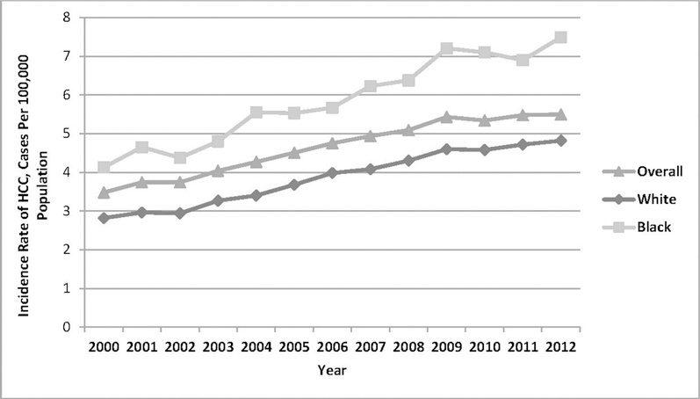
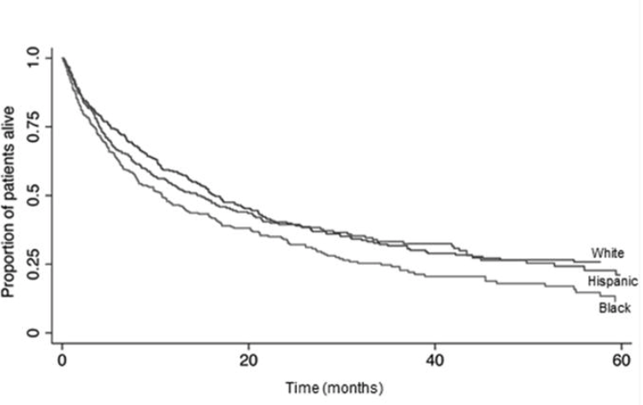
HCC Disproportionately Impacts Racial Minorities and Results in Worse Outcomes in These Populations
Incidence by Race¹
Survival by Race²
Franco RA et al. Am J Prev Med. 2018;55(5 Suppl 1):S40-S48.
Rich NE et al. Clin Gastroenterol Hepatol. 2019;17(3):551-559.e1.

Slide 10
Causes of Disparities in HCC Incidence and Outcomes
National, state, and local environment
Family & social supports
Individual patient
Organization and/or practice setting
Provider/team
Medicare/Medicaid reimbursement
Systemic racism and inequities in housing, education, health, and trauma and violence
Leadership
Knowledge and communication skills
Family dynamics
Stigma of liver disease
Biological factors
Socioeconomic factors
Resources available
Clinical decision support
Kim AK, Singal AG. Clin Liver Dis (Hoboken). 2015;4(6):143-145.
Adler NE, Newman K. Health Aff (Millwood). 2002;21(2):60-76.

Slide 11
Pathophysiology

Slide 12
HCC Pathophysiology Is Complex and Varies by Etiology But Almost Always Involves Inflammation and Liver Regeneration
Aflatoxin B1 ingestion
HBV or HCV viral and/or host factors
NAFLD/NASH
HCV Viral and/or host factors
Alcohol
p53 mutations
Lipotoxicity
p53 inactivation
Inflammation
Oxidative stress
Cirrhosis
Expanded or altered stem cell compartment
Necrosis
Mutations and modulation of cancer signaling pathways
Cell proliferation and loss of growth control
Regeneration
Microenvironment changes
Genetic alterations and microenvironment changes
HCC
Farazi PA, DePinho RA. Nat Rev Cancer. 2006;6(9):674-687.
Takakura K et al. Front Oncol. 2019;9:762.

Slide 13
HBV Is Directly Oncogenic, While HCV Typically Leads to HCC Only in the Context of Inflammation & Fibrosis
HBV infection
HCV infection
Note: Compared with HBV, HCV results in higher rates of chronic infection and higher rates of liver cirrhosis
Expression of oncogenic viral proteins
Insertional mutagenesis caused by integration of
HBV DNA into host genome
Host inflammatory response, leading to cycles of inflammation, necrosis, and regeneration
Cellular changes predisposing
HBV- and HCV-infected individuals to HCC
Genetic instability
Decreased apoptosis
Abnormal cell proliferation
Immune evasion
Guerrieri F et al. Semin Liver Dis. 2013;33(2):147-156.
Villanueva A. N Engl J Med. 2019;380;15:1450-1462.
Brar TS et al. In: Precision Molecular Pathology of Liver Cancer. Springer; 2017: 1-15.

Slide 14
NAFLD and NASH Can Lead to HCC Through Complex Inflammatory Pathways
NAFLD is the most common cause of liver disease worldwide
Visceral adiposity and insulin resistance leads to elevated levels of:
  Free fatty acids
  Proinflammatory cytokines (eg, IL-6, TNF-ɑ)
  Insulin-like growth factor-1 (IGF-1)
These molecules activate several prooncogenic pathways, including:
  mTOR
  C-JUN
  MAPK
  JNK
  NFκB
Brar TS et al. In: Precision Molecular Pathology of Liver Cancer. Springer; 2017: 1-15.

Slide 15
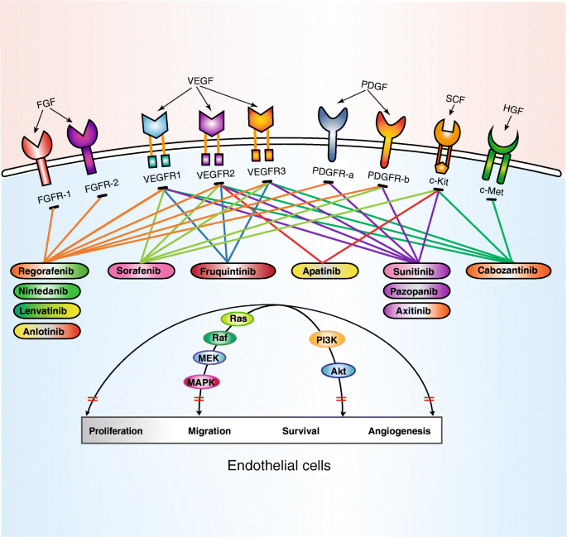
Activation of the RAS/MAPK Pathway and VEGF Signaling Is an Important Component of HCC Pathogenesis
Abnormal growth factor signaling leads to increased levels of:
  Neovascularization
  Invasiveness
  Metastasis
VEGFR-1 and VEGFR-2 are found on endothelial cells and initiate the proangiogenic signaling cascade
Image courtesy of Qin S et al. J Hematol Oncol. 2019;12:27. CC BY 4.0.
Brar TS et al. In: Precision Molecular Pathology of Liver Cancer. Springer; 2017: 1-15.

Slide 16
SCREENING

Slide 17
HCC Symptoms Are Often Nonspecific and May Only Present in Advanced Disease
Early-stage HCC:
Typically asymptomatic
Advanced-stage HCC:
Palpable mass in the upper abdomen or a hard, irregular liver surface
Tenderness or pain in the upper right abdominal quadrant
Symptoms of cirrhosis
Signs of HCC in patients with previously compensated cirrhosis:
Rapid deterioration of liver function or increased jaundice
New-onset or refractory ascites or encephalopathy
Acute intra-abdominal bleeding or variceal bleeding
Weight loss and fever
Ferenci P et al. J Clin Gastroenterol. 2010:44(4):239-245.

Slide 18
Therefore, HCC Screening Is Recommended for High-Risk Populations
There is no universal definition of high risk; factors to consider include patient age, health status, function, and willingness and/or ability to adhere to a screening program
Benefit | Population Group | Threshold incidence for screening efficacy | Incidence of HCC
Established | Asian male HBV carriers ≥40 years | 0.2 | 0.4%-0.6% per year
 | Asian female HBV carriers ≥50 years | 0.2 | 0.4%-0.6% per year
 | HBV carrier with family history of HCC | 0.2 | Higher than without family history
 | African and/or North American Blacks with HBV | 0.2 | Occurs at a younger age
 | HBV carriers with cirrhosis | 0.2-1.5 | 3%-8% per year
 | HCV cirrhosis | 1.5 | 3%-5% per year
 | Stage 4 PBC | 1.5 | 3%-5% per year
 | Genetic hemochromatosis and cirrhosis | 1.5 | Unknown, but probably >1.5% per year
 | Alpha-1 antitrypsin deficiency and cirrhosis | 1.5 | Unknown, but probably >1.5% per year
 | Other cirrhosis | 1.5 | Unknown
Uncertain | HBV carriers <40 years (males) or <50 years (females) | 0.2 | <0.2% per year
 | HCV and stage 3 fibrosis | 1.5 | <1.5% per year
 | NAFLD without cirrhosis | 1.5 | <1.5% per year
Marrero JA et al. Hepatology. 2018;68(2):723-750.
Kanwal F, Singal AG. Gastroenterology. 2019;157(1):54-64.

Slide 19
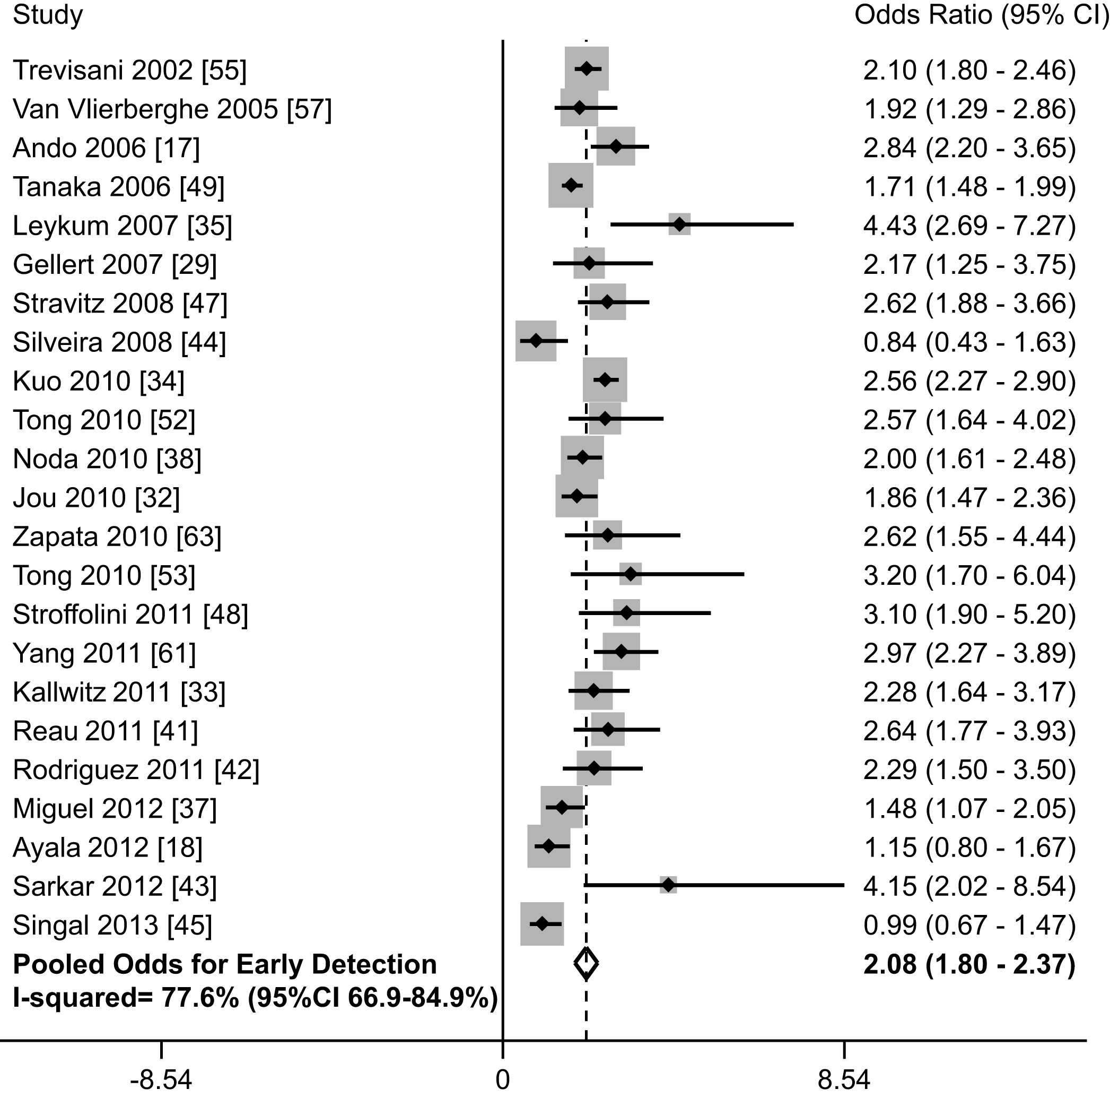
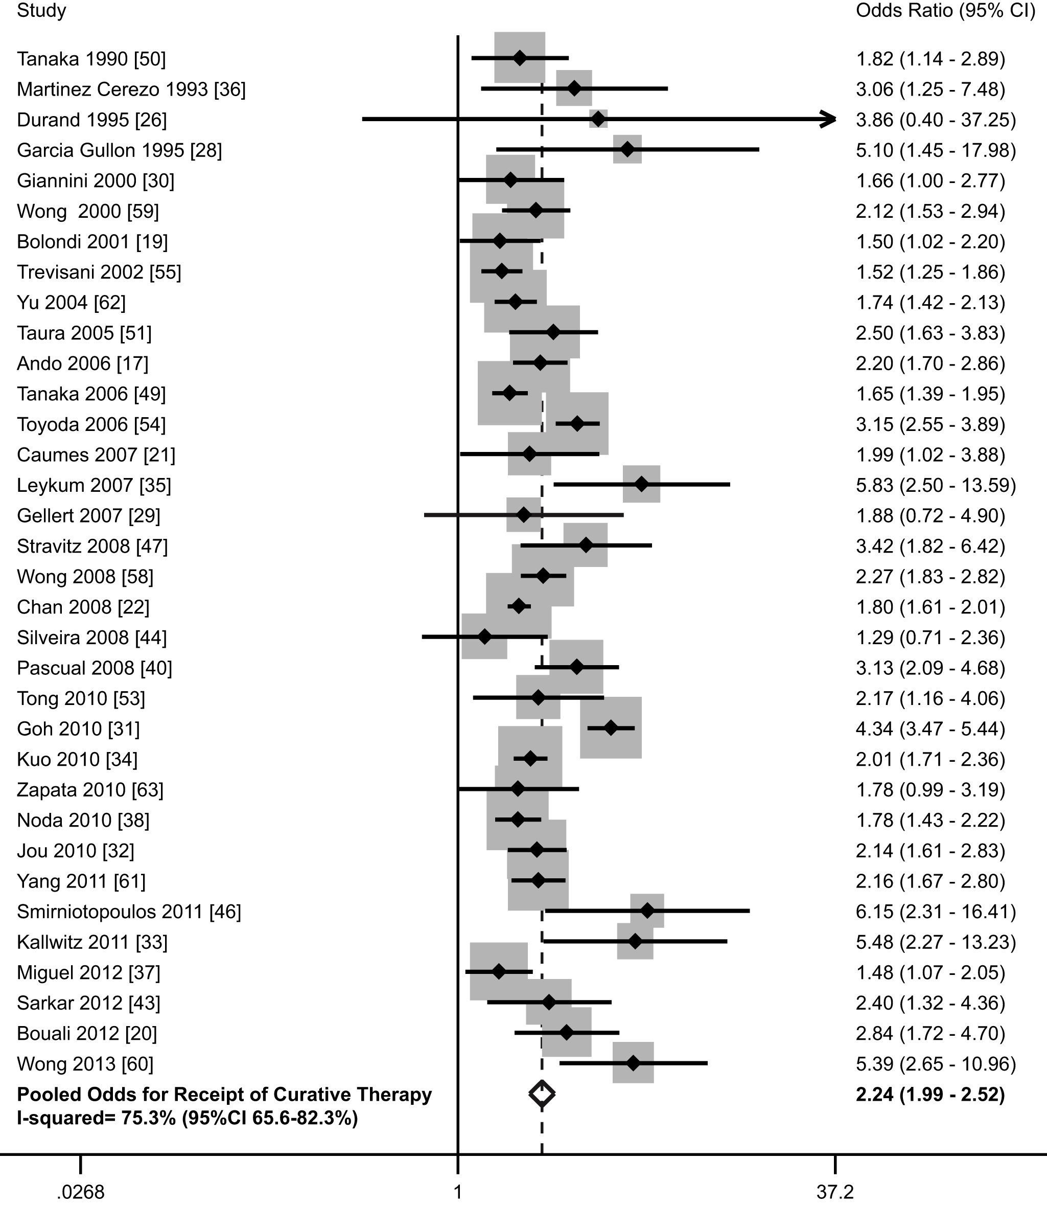
Implementation of HCC Screening Programs Can Improve Outcomes
HCC Screening & Early Tumor Detectionª
HCC Screening & Curative Treatmentª
Early-stage
Advanced
ªIn a meta-analysis conducted from 1990 through 2014 of 47 studies with 15,158 patients, including 6284 diagnoses of HCC with screening.
Images courtesy of Singal AG et al. PLoS Med. 2014;11(4):e1001624. CC BY 4.0.
.
Singal AG et al. PLoS Med. 2014;11(4):e1001624.

Slide 20
In a Randomized Controlled Trial, Screening Was Associated With Earlier Tumor Detection and Improved Survivalª
 | Screening group (n = 86) | Control group (n = 67)
Stage
Stage I | 61% | 0
Stage II | 14% | 37%
Stage III | 26% | 63%
Small HCC | 45% | 0
Treatment
Resection | 47% | 8%
TACE/PEI | 33% | 42%
Conservative treatment | 21% | 51%
Survival (%)
1-year | 66% | 31%
2-year | 60% | 7%
3-year | 53% | 7%
4-year | 53% | 0
5-year | 46% | 0
ªIn a randomized controlled trial of 18,816 patients aged 35 to 59 years with HBV infection or a history of chronic hepatitis in urban Shanghai.
Zhang BH et al. J Cancer Res Clin Oncol. 2004;130:417-422.

Slide 21
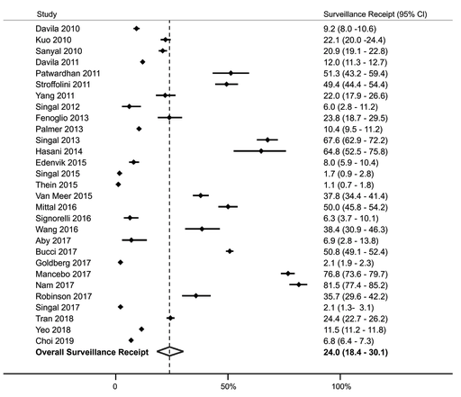
However, Screening Is Underused in Clinical Practice
About three-quarters of patients with cirrhosis do not receive HCC screeningª
The following factors have been shown to increase the likelihood of screening:
  Management at subspecialty clinics
  Patient, provider, and public health education initiatives
  Reminder and recall systems
The following factors have been shown to decrease the likelihood of screening:
  Alcohol-associated cirrhosis
  NASH-associated cirrhosis
  Possible Black race
  Presence of medical comorbidities
  Ongoing alcohol use disorder
Proportion of patients undergoing screening
ªIn a systematic review of cohort studies, 118,799 patients with cirrhosis were evaluated for receipt of screening.
Wolf E et al. Hepatology. 2020;10.1002/hep.31309.

Slide 22
Several Barriers to HCC Screening Have Been Identified
Patient-reported barriers¹
Knowledge deficits (eg, belief that screening is unnecessary if physical examination or laboratory results are normal)
Costs
Provider-reported barriers²
Misconceptions about screening (eg, use of liver enzyme levels)
Difficulty scheduling
Transportation
Cost effectiveness
Not being up-to-date on HCC screening
Limited time in the clinic
Competing clinical concerns
Other considerations include societal barriers of people at high risk for HCC (eg, immigrants, people who inject drugs, people with low socioeconomic status), which can impact health care access.
Singal AG et al. Clin Gastroenterol Hepatol. 2020;S1542-3565(20)30912-5.
Simmons OL et al. Clin Gastroenterol Hepatol. 2019;17(4):766-773.
Guss DA, Mohanty SR. Transl Cancer Res. 2017;6(2).

Slide 23
Examples of Interventions to Improve Screening Rates
Engagement of key stakeholders, including PCPs, nurses, and radiologists
Electronic medical records reminders
Mailed outreach
Radiology-led recall
Nurse-led clinics
Wolf E et al. Hepatology. 2020;10.1002/hep.31309.

Slide 24
Orange Line:
Assessment, Diagnosis, & Risk Stratification

Slide 25
HCC Assessment & Diagnosis

Slide 26
Abdominal Ultrasound Is Used to Screen Patients at High Risk for HCC
For high-risk patients, screening with abdominal ultrasound is recommended
every 6 months
Screening ultrasound
± AFP
Selected high-risk patients
Consider:
Body habitus
Visibility of liver at ultrasound
Registration on transplant waiting list
Negative
Subthreshold
(<10 mm lesions)
Positive
(≥10 mm lesions or AFP ≥20 ng/mL)
Repeat screening in 6 months
Repeat screening in
3 to 6 months
Perform multiphase
CT or MRI
AFP, alpha-fetoprotein.
Marrero JA et al. Hepatology. 2018;68(2):723-750.

Slide 27
The Addition of Alpha-Fetoprotein (AFP) Testing to Ultrasound Screening Can Improve Sensitivity
AFP is a protein found in fetal liver during early development
Levels of AFP in healthy adults are usually low
AFP elevation of 20 ng/mL or higher has been associated with the development and recurrence of HCC
However, AFP is not specific to HCC and may be elevated due to other conditions, such as benign liver disease and pregnancy
Sensitivity of Ultrasound With or Without AFP^{1,a}
Population | Sensitivity (%) |  | Relative risk (95% CI)
 | Ultrasound alone | Ultrasound + AFP | Relative risk
Any-stage HCC | 78% | 97% | 0.88 (0.83-0.93)
Early-stage HCC | 45% | 63% | 0.81 (0.71-0.93)
ªIn a systematic review of 32 studies, 13,367 patients who were screened for HCC with or without AFP testing were enrolled, and sensitivity was assessed.
Tzartzeva K et al. Gastroenterology. 2018;154(6):1706-1718.e1.
Behne T, Sitki Copur M. Int J Hepatol. 2012;2012:859076.
Marrero JA et al. Hepatology. 2018;68(2):723-750.

Slide 28
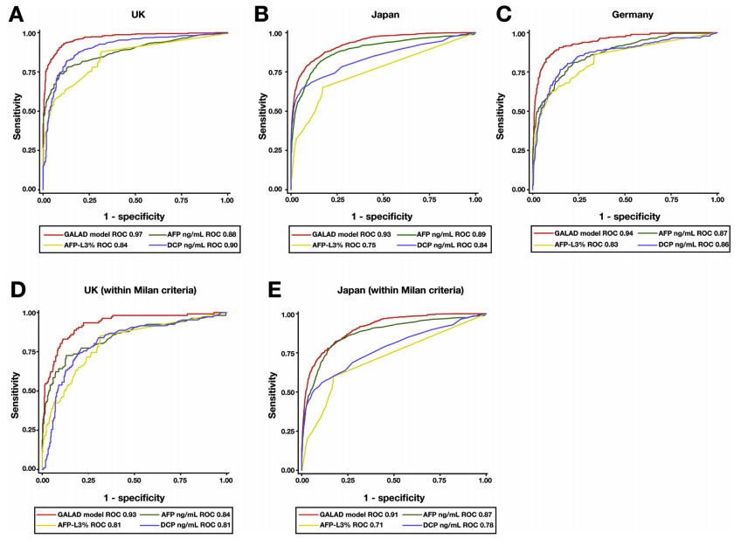
GALAD Is a Statistical Model Using AFP and Other Markers to Estimate the Risk of HCC in Individuals With Liver Disease
UK
Japan
Germany
Sensitivity and Specificity of GALAD Model Compared With Individual Biomarkers in Distinct Patient Cohorts
UK (within Milan criteria)
Japan (within Milan criteria)
Berhane S et al. Clin Gastroenterol Hepatol. 2016;13:875-886.

Slide 29
In Patients at High Risk for HCC, Liver-Specific Contrast MRI Improved HCC Detection Rates¹
Surveillance method and category | Detection rate for any HCC (sensitivity)
Ultrasound
4 (suspicious) | 28%
3 (equivocal) | 28%
2 (probably benign) | 33%
1 (definitely benign/negative) | 100%
MRI
5 (highly suggestive) | 61%
4 (suspicious) | 86%
3 (equivocal) | 88%
2 (probably benign) | 88%
1 (definitely benign/negative) | 100%
ªIn a trial of 407 patients with cirrhosis and annual risk of HCC >5% who underwent 1 to 3 biannual screening examinations with paired ultrasound and MRI with liver-specific contrast
Kim SY et al. JAMA Oncol. 2017;3(4):456-463.

Slide 30
For Those With Positive Ultrasound or AFP Results, Imaging With Multiphase CT or MRI Is Recommended
CT and MRI have similar diagnostic performance
Selection of imaging modality and contrast agent should consider:
  Modality availability
  Scan time,
  Throughput
  Scheduling urgency and backlog
  Institution technical capability (MRI is more technically complex than CT)
  Costs
  Radiologist expertise and preference
  Patient preference
Marrero JA et al. Hepatology. 2018;68(2):723-750.

Slide 31
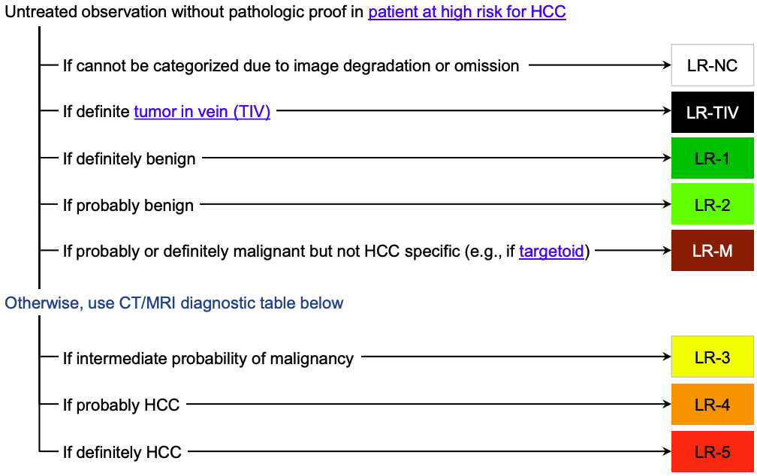
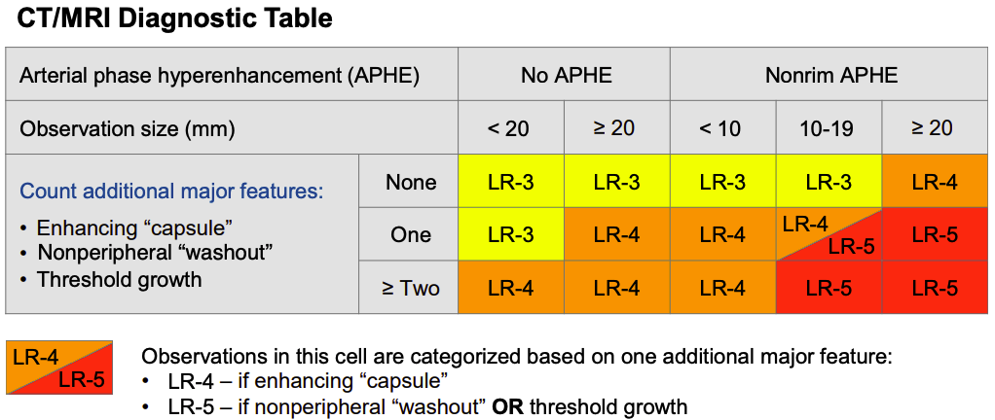
Imaging Findings Should Be Performed, Interpreted, and Reported Through ACR LI-RADS
LI-RADS v2018 Classes
LI-RADS v2018 Major Criteria
APHE: enhancement in arterial phase definitely greater than that in background liver
Nonperipheral washout: relative hypointensity of lesion compared with background liver on the portal venous and delayed phases
Enhancing capsule: peripheral rim of smooth hyperenhancement in portal venous, transitional, or delayed phase
Threshold growth: diameter increase ≥50% in ≤6 months
Images courtesy of the American College of Radiology. CC BY-NC-ND 4.0.
American College of Radiology (ACR). 2018. Accessed November 19, 2020. https://www.acr.org/Clinical-Resources/Reporting-and-Data-Systems/LI-RADS.

Slide 32
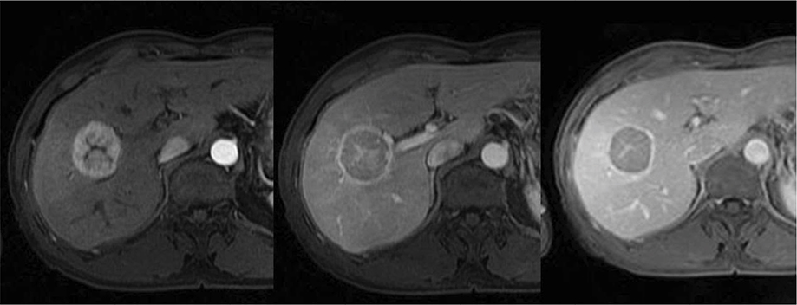
Typical HCC With Arterial Phase Hypervascularity With Washout and Delayed Pseudocapsule Enhancement
Image courtesy of Balogh VJ et al. J Hepatocell Carcinoma. 2016;3:41-53. CC BY-NC 3.0.
Balogh VJ et al. J Hepatocell Carcinoma. 2016;3:41-53.

Slide 33
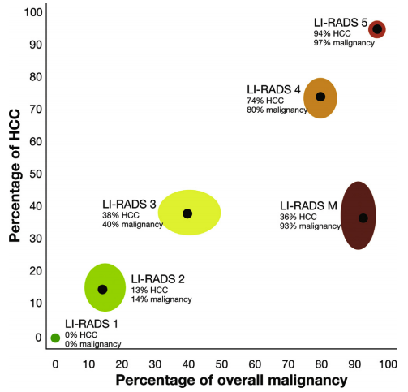
Risk of HCC and Overall Malignances by LI-RADS Category
van der Pol CB et al. Gastroenterology. 2019;156(4):976-986.

Slide 34
After Imaging, the LI-RADS Category Determines Next Steps
LI-RADS NC
Noncategorizable
LI-RADS 1
Definitely benign
LI-RADS 2
Probably benign
LI-RADS 3
Intermediate
LI-RADS 4
Probably HCC
LI-RADS 5
Definitely HCC
LI-RADS M
Malignant, not definitely HCC
Repeat or alternative diagnostic imaging in ≤3 months
Return to screening imaging in 6 months
Return to screening imaging in 6 months
Consider repeat diagnostic imaging in ≤6 months
Repeat or alternative diagnostic imaging in 3 to 6 months
Recommend multidisciplinary discussion for tailored workup
May include biopsy in select cases
Repeat or alternative diagnostic imaging in ≤3 months
HCC confirmed
Recommend multidisciplinary discussion for tailored workup
May include biopsy in most cases
Repeat or alternative diagnostic imaging in ≤3 months
Marrero JA et al. Hepatology. 2018;68(2):723-750.

Slide 35
Role of Biopsy & Histopathology

Slide 36
Liver Biopsy Has Been Associated With Several Risks
Pain and bleeding are the most common risks of liver biopsy
Other more serious risks are rare and include:
  Hemorrhage
  Perforation of gallbladder
  Bile peritonitis
  Hemobilia
  Pneumothorax or hemothorax
The risk of needle track seeding of cancerous cells is also an important concern
Di Tommaso L et al. World J Gastroenterol. 2019;25(40):6041-6052.

Slide 37
Because of the Risks, Liver Biopsy Should Be Reserved for Select Patients
LI-RADS NC
Noncategorizable
LI-RADS 1
Definitely benign
LI-RADS 2
Probably benign
LI-RADS 3
Intermediate
LI-RADS 4
Probably HCC
LI-RADS 5
Definitely HCC
LI-RADS M
Malignant, not definitely HCC
Repeat or alternative diagnostic imaging in ≤3 months
Return to screening imaging in 6 months
Return to screening imaging in 6 months
Consider repeat diagnostic imaging in ≤6 months
Repeat or alternative diagnostic imaging in 3 to 6 months
Recommend multidisciplinary discussion for tailored workup
May include biopsy in select cases
Repeat or alternative diagnostic imaging in ≤3 months
HCC confirmed
Recommend multidisciplinary discussion for tailored workup
May include biopsy in most cases
Repeat or alternative diagnostic imaging in ≤3 months
Marrero JA et al. Hepatology. 2018;68(2):723-750.

Slide 38
Repeat Biopsies May Be Necessary
First FNB (n = 60)
Positive HCC
(n = 42)
Negative HCC
(n = 18)
False negative: 30%
Radiologic diagnosis. OLT.
Explant analysis (n = 1)
Second FNB
(n = 17)
Positive HCC
(n = 11)
Negative HCC
(n = 6)
Radiologic diagnosis. PEI.
No histologic confirmation (n = 1)
False negative: 38.9%
Third FNB
(n = 5)
Positive HCC
(n = 4)
Negative HCC
(n = 1)
Final diagnosis of HCC
(n = 60)
Radiologic diagnosis. OLT.
Explant analysis (n = 1)
FNA, fine needle aspiration; OLT, orthotopic liver transplantation; PEI, percutaneous ethanol injection.
Forner A et al. Hepatology. 2008;47(1):97-104.

Slide 39
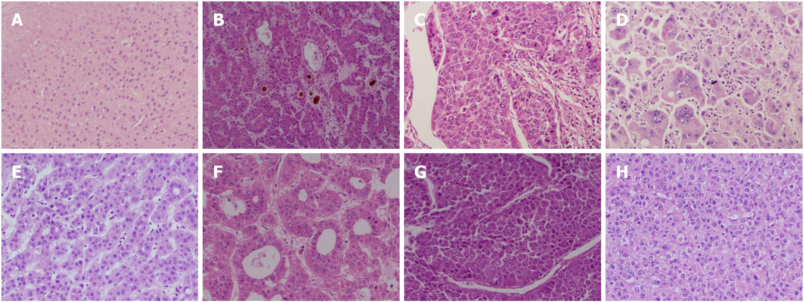
Histopathology Can Be Used for Diagnosis, Prognostication, and Treatment Decision Making
Grade 1
Grade 2
Grade 3
Grade 4
Edmonson and Steiner grading
Microtrabecular
Pseudoglandular
Macrotrabecular
Compact
Common histopathologic patterns
Images courtesy of Rastogi A. World J Gastroenterol. 2018;24(35):4000-4013. CC BY-NC 4.0.
Rastogi A. World J Gastroenterol. 2018;24(35):4000-4013.

Slide 40
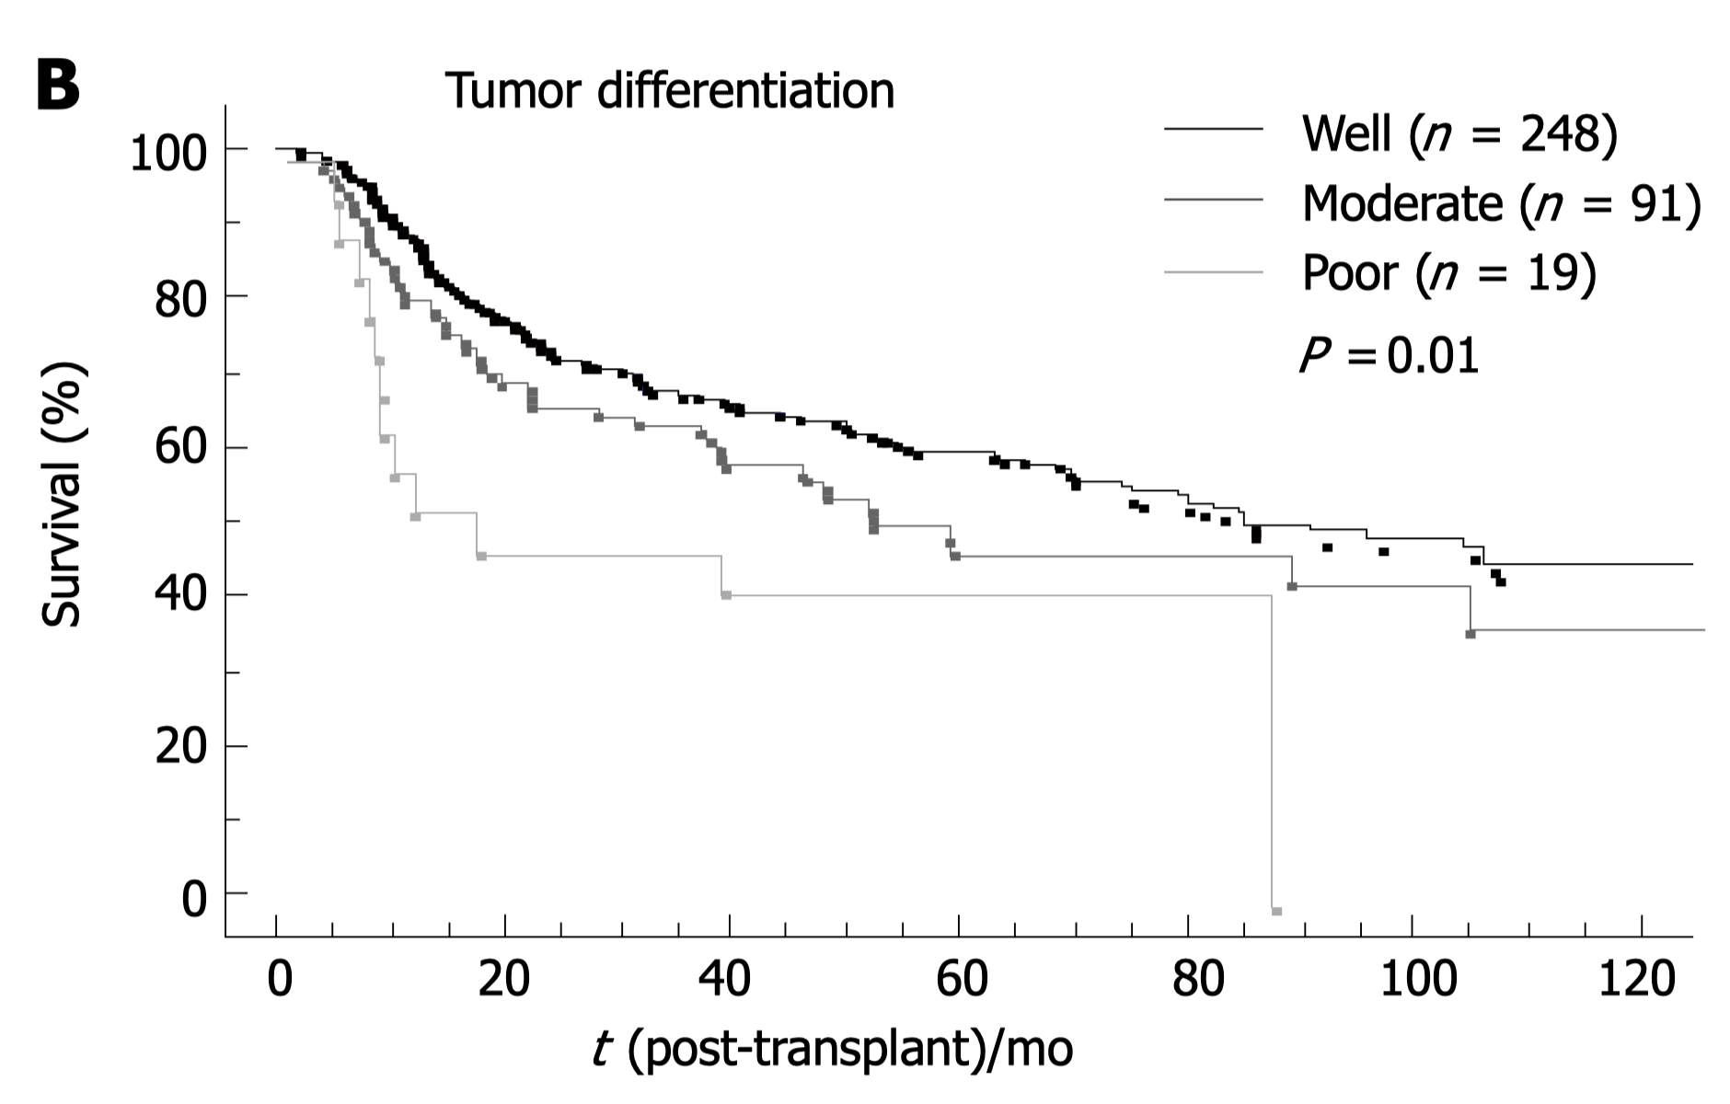
Tumor Grade Influences Outcomes, Including Survival
Image courtesy of Decaens T. World J Gastroenterol. 2006;12(45):7319-7325. CC BY-NC 4.0.
Decaens T. World J Gastroenterol. 2006;12(45):7319-7325.

Slide 41
BCLC Staging

Slide 42
BCLC Staging Is a Well-Accepted Classification Scheme for Clinical Trial Enrollment and Treatment Decision Making
BCLC staging classifies tumors based on several key clinical criteria:
  Tumor size and number
  Presence of portal vein invasion
  Presence of extrahepatic metastasis
  Liver functional status (Child-Pugh score)
  Performance status
BCLC classification was developed using randomized clinical trial data and the natural history of untreated HCC
Vogel A, et al. Ann Oncol. 2018;29(Suppl 4):iv238-iv255.
Kinoshita A, et al. World J Hepatol. 2015;7(3):406-424.

Slide 43
BCLC Staging Ranges From 0 (Very Early Stage) to D (Terminal Stage)
HCC
Very early stage (0)
Single <2 cm
Preserved liver function (CP A)
PS 0-1
Early stage (A)
Single or 2-3 nodules <3 cm
Preserved liver function (CP A/B)
PS 0-1
Intermediate stage (B)
Multinodular
Preserved liver function (CP A/B)
PS 0-1
Advanced stage (C)
Portal invasion/extrahepatic spread
Preserved liver function (CP A/B)
PS 1-2
Terminal stage (D)
Not transplantable
End-stage liver function
PS 3-4
Solitary
2-3 nodules
≤3 cm
Optimal surgical candidate
Yes
No
Transplant candidate
Yes
No
Treatment
Ablation
Resection
Transplant
Ablation
TACE
Systemic therapy
BSC
Survival
>5 years
>2.5 years
≥10 months
3 months
European Association for the Study of the Liver (EASL). J Hepatol. 2018;69(1):182-236.
Marrero JA et al. Hepatology. 2018;68(2):723-750.

Slide 44
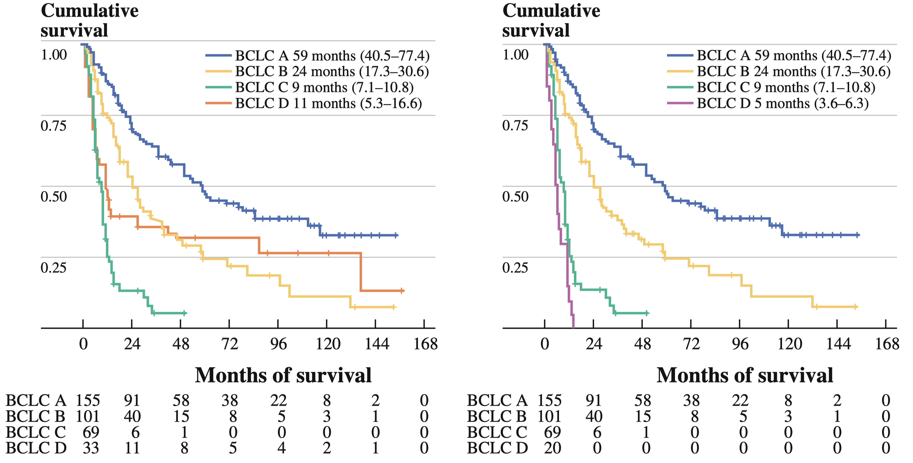
BCLC Stage Is Correlated With Overall Survival
Survival, Including Those Who Received Transplantation in BCLC Dª
Survival, Excluding Those Who Received Transplantation in BCLC Dª
ªIn a retrospective study of 359 newly diagnosed patients with HCC from a single center over a 14-year period, outcomes were assessed by stage at diagnosis.
D'Avola D et al. Ann Surg Oncol. 2011;18(7):1964-1971.

Slide 45
Concordance Among Staging Systemsª
Staging system | Comparator | C-index (difference between staging systems; column A vs B) | 95% CI | P value
ITA.LI.CA | BCLC | 0.018 | -0.010 to 0.044 | 0.17
 | HKLC | -0.019 | -0.044 to 0.006 | 0.12
 | CLIP | 0.005 | -0.019 to 0.030 | 0.69
 | MESIAH | -0.016 | -0.039 to 0.006 | 0.15
BCLC | HKLC | -0.037 | -0.065 to -0.011 | 0.004
 | CLIP | -0.012 | -0.043 to 0.017 | 0.43
 | MESIAH | -0.034 | -0.064 to -0.005 | 0.026
HKLC | CLIP | 0.024 | -0.007 to 0.058 | 0.16
 | MESIAH | 0.003 | -0.027 to 0.035 | 0.91
CLIP | MESIAH | -0.021 | -0.049 to 0.006 | 0.1
Bolding indicates statistical significance.
ªIn a retrospective cohort study of 320 newly diagnosed patients
Parikh ND et al. Clin Gastroenterol Hepatol. 2018;16(5):781-782.

Slide 46
The Hong Kong Liver Cancer Staging System Is Often Used for HCC Staging
ECOG 0-1, Child A-B
ECOG 2-4/ Child C
No EVM
EVM
Early tumor, no EVM
Other tumors/
EVM
Early tumor
Intermediate tumor
Locally advanced tumor
Child A
Child B
ECOG 0,
Child A
ECOG 1/
Child B
Child A
Child B
I
IIa
IIb
IIIa
IIIb
IVa
IVb
Va
Vb
Treatment
Resection/
transplant/
ablation
Resection
TACE
Systemic therapy
Systemic therapy/BSC
Transplant
BSC
Yau T et al. Gastroenterology. 2014;146(7):1691-700.e3. doi:10.1053/j.gastro.2014.02.032

Slide 47
The ITA.LI.CA Tumor Staging System Is a Relatively New and More Granular Staging Option
Diameter of the Largest Nodule (cm) | Number of nodules | Vascular Invasion or metastases | Stage
≤2 | 1 | No | 0
≤3 | 2-3 | No | A
2-5 | 1 | No | A
3-5 | 2-3 | No | B1
>5 | 1 | No | B1
>5 | 2-3 | No | B2
≤5 | >3 | No | B2
>5 | >3 | No | B3
Any | Any | Intrahepatic | B3
Any | Any | Extrahepatic | C
Farinati F et al. PLoS Med. 2016;13(4):e1002006.

Slide 48
Yellow Line:
Systemic Therapies

Slide 49
TKIs

Slide 50
Until 2007, Few Therapies Were Available for the Management of HCC Due to the Poor Effectiveness of Cytotoxic Chemotherapy in HCC
In 2007, sorafenib was approved for use in 1L HCC, marking the first systemic option. Since then, tyrosine kinase inhibitors (TKIs) have been the primary agents for systemic management of HCC.
2005
2015
2020
Sorafenib
Approved for 1L unresectable
HCC (uHCC)
2007
Burroughs A et al. Lancet Oncol. 2004;5(7):409-18.
Marrero JA et al. Hepatology. 2018;68(2):723-750.
US Food & Drug Administration (FDA). April 27, 2017. Accessed November 25, 2020. https://www.fda.gov/news-events/press-announcements/fda-expands-approved-use-stivarga-treat-liver-cancer.

Slide 51
OS With SHARP and Asia-Pacific: Sorafenib vs Placebo^{1,2}
SHARP¹
Asia-Pacific²
100
Sorafenib (n = 299)
Median OS, 10.7 months
100
Sorafenib (n = 150)
Median OS, 6.5 months
Placebo (n = 303)
Median OS, 7.9 months
Placebo (n = 76)
Median OS, 4.2 months
75
75
Survival probability
Survival probability
50
50
25
25
HR = 0.69 (95% CI: 0.55-0.87)
P < .001
HR = 0.68 (95% CI: 0.50-0.93)
P = .014
0
0
0
2
4
6
8
10
12
14
16
18
0
2
4
6
8
10
12
14
16
18
20
22
Months
Months
Llovet JM et al. N Engl J Med. 2008;359(4):378-390.
Cheng AL et al. Lancet Oncol. 2009;10(1):25-34.

Slide 52
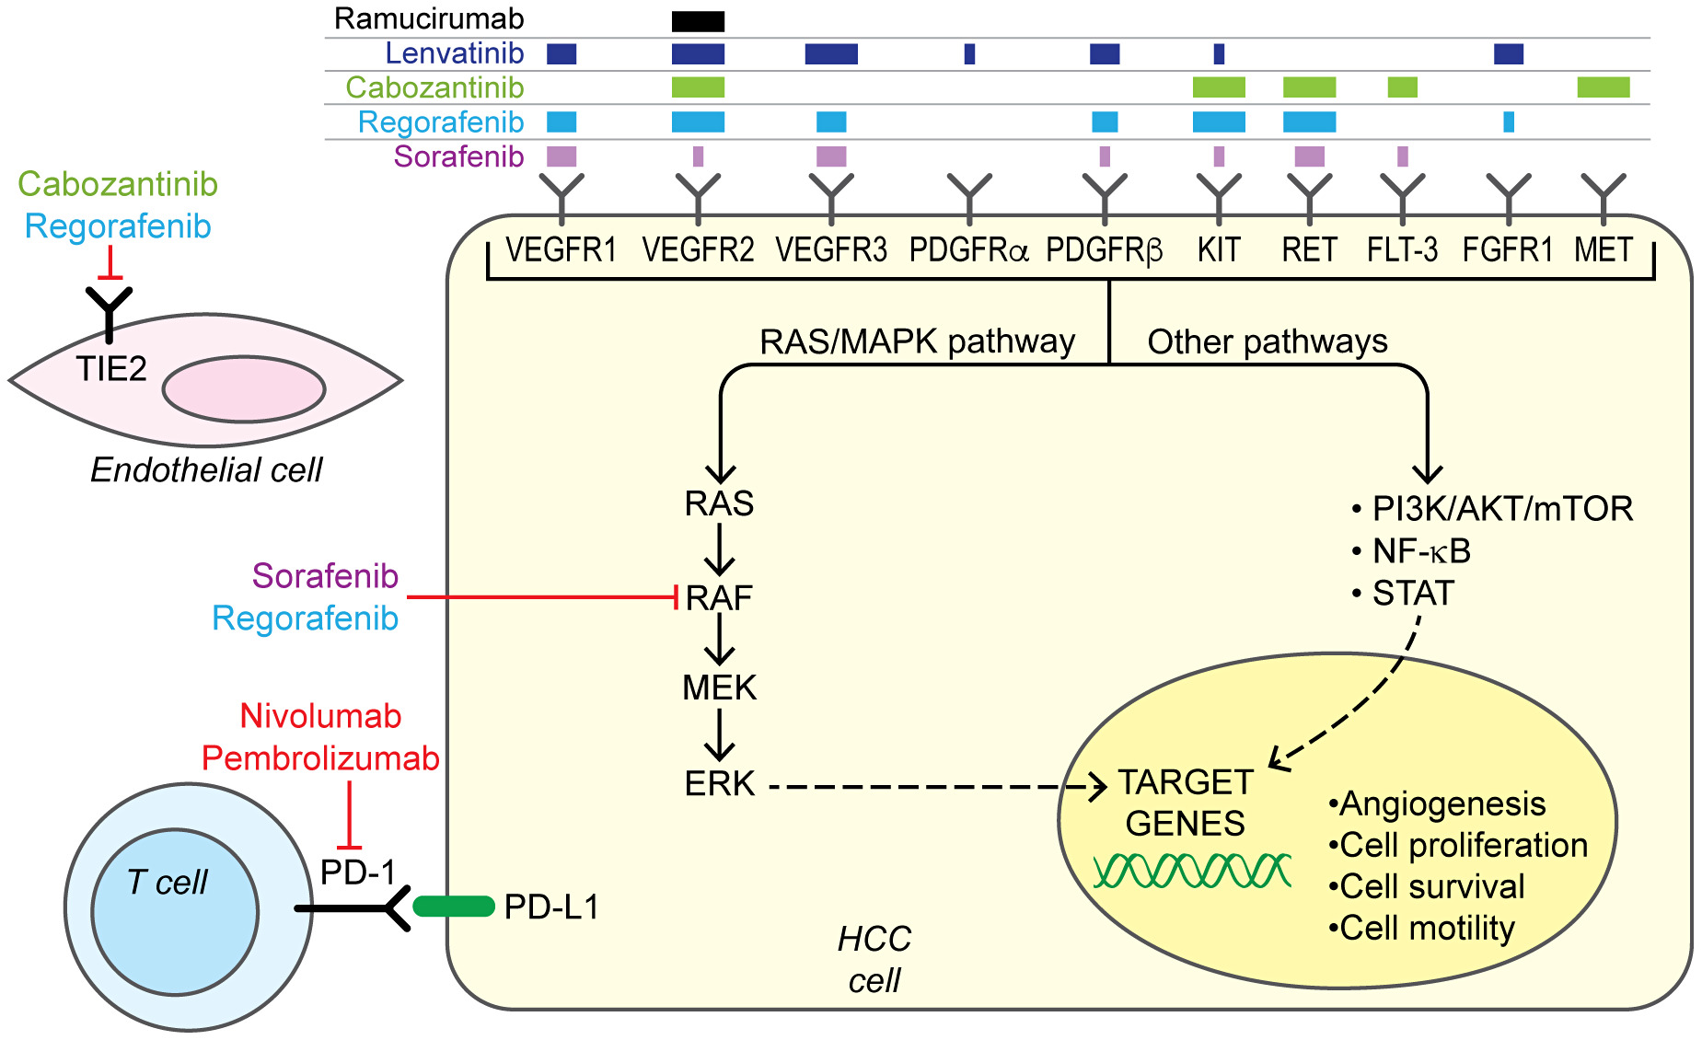
TKIs and Anti-VEGF Agents Have Been Shown to Inhibit Multiple Cancer Signaling Pathways
All TKIs approved for use in HCC act on the VEGFR2 receptor, which has antiangiogenic effects
  The anti-VEGF ramucirumab specifically inhibits VEGFR2
Most of the TKIs block other pathways involved in cancer signaling, including TIE2
The multipathway effects of TKIs are responsible for the on- and off-target effects of these agents
Sarcognato S et al. Clin Liver Dis (Hoboken). 2019;14(2):62-65.

Slide 53
Over the Last 3 Years, Targeted Treatment Options Have Expanded Dramatically
2005
2015
2020
Regorafenib
Approved for 2L HCC
April 2017
Ramucirumab
Approved for 2L HCC
(AFP >400 ng/mL)
May 2019
Sorafenib
Approved for 1L unresectable
HCC (uHCC)
2007
Lenvatinib
Approved for 1L uHCC
August 2018
Cabozantinib
Approved for 2L HCC
January 2019
Lee A, Lee FC. Front Med. 2020;14(3):273-283.

Slide 54
TKIs and Anti-VEGF Agents Improve Outcomes for Patients With HCC
Drug (clinical trial) | Comparator | Target population | OS results
Sorafenib (SHARP) | Placebo | 1L HCC, BCLC B or C, CP A or B | 10.7 vs 7.9 months HR, 0.69 (95% CI, 0.55-0.87) P < .001
Lenvatinib (REFLECT) | Sorafenib | 1L HCC, BCLC B or C, CP A or B | 13.6 vs 12.3 months HR, 0.92 (95% CI, 0.79-1.06) Met criteria for noninferiority
Regorafenib (RESORCE) | Placebo | 2L HCC, BCLC A-C, CP A | 10.6 vs 7.8 months HR, 0.63 (95% CI, 0.50-0.79) P < .0001
Cabozantinib (CELESTIAL) | Placebo | 2L HCC, CP A | 10.2 vs 8.0 months HR, 0.76 (95% CI, 0.63-0.92) P = .005
Ramucirumab (REACH-2) | Placebo | 2L HCC, BCLC B or C, CP A, ≥400 ng/mL AFP | 8.5 vs 7.3 months HR, 0.710 (95% CI, 7.0-10.6) P = .0199
Llovet JM et al. N Engl J Med. 2008;359(4):378-90.
Bruix J et al. Lancet. 2017;389(10064):56-66.
Kudo M et al. Lancet. 2018;391(10126):1163-1173.
Abou-Alfa GK et al. N Engl J Med. 2018;379(1):54-63.
Zhu AX et al. Lancet Oncol. 2019;20(2):282-296.

Slide 55
PD-1 Inhibitors

Slide 56
Immunotherapies Are Relatively New Options for
HCC Treatment
Nivolumab
Approved for 2L HCC
September 2017 (accelerated)
Immunotherapy
Pembrolizumab
Approved for 2L HCC
November 2018 (accelerated)
2005
2015
2020
Regorafenib
Approved for 2L HCC
April 2017
Ramucirumab
Approved for 2L HCC
(AFP >400 ng/mL)
May 2019
Sorafenib
Approved for 1L unresectable
HCC (uHCC)
2007
TKIs/
anti-VEGF
Lenvatinib
Approved for 1L uHCC
August 2018
Cabozantinib
Approved for 2L HCC
January 2019
Lee A, Lee FC. Front Med. 2020;14(3):273-283.

Slide 57
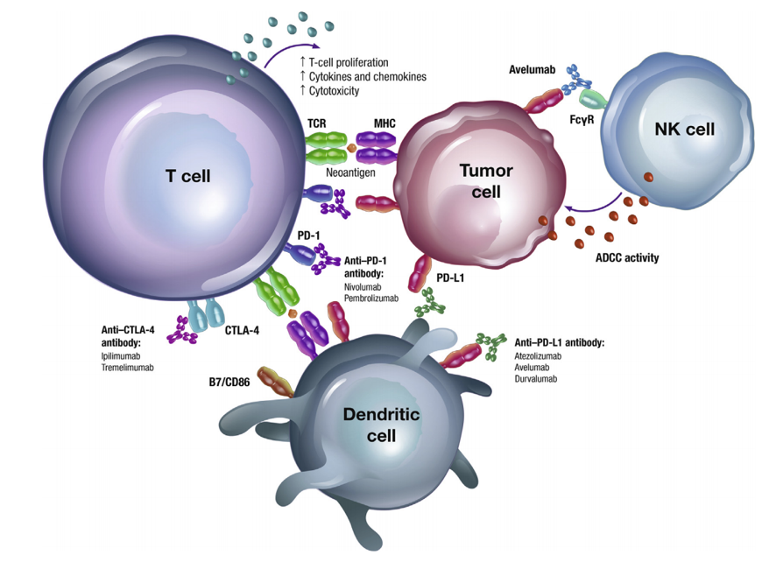
Immune Checkpoint Inhibitors Activate Immune Responses
Inflammation and immune dysregulation are common in chronic liver disease and HCC
Immune checkpoint inhibitors target PD-1 and CTLA-4, resulting in increased activated T cells and reduced levels of immunosuppressive cells
Image courtesy of Taieb J et al. Cancer Treatment Rev. 2018;66:104-113. CC BY-NC-ND 4.0.
Kudo M. Oncology. 2017;92(Suppl 1):50-62.
Taieb J et al. Cancer Treatment Rev. 2018;66:104-113.
The Cancer Genome Atlas Research Network. Cell. 2017;169(7):1327–1341.e23.

Slide 58
Although Single-Agent Immunotherapies Resulted in Response in a Phase 2 Trial, Primary End Points Were Not Reached in Phase 3
Nivolumab & CheckMate Trials
CheckMate 040 (Phase 2)¹
Patient population | 1L or 2L HCC
N in dose-expansion phase | 214
Objective response, n (%) | 42 (20%)
Complete response, n | 3
Partial response, n | 39
Stable disease, n (%) | 96 (45%)
Disease control rate, n (%) | 138 (64%)
Median duration of response | 9.9 months
CheckMate 459 (Phase 3)²
 | Nivolumab (n = 371) | Sorafenib (n = 372)
Median OS | 16.4 months | 14.7 months
 | HR, 0.85 (95% CI, 0.72-1.02) P = .0752
12-month OS rate | 59.7% | 55.1%
24-months OS rate | 36.8% | 33.1%
Objective response | 15% | 7%
Complete response | 4% | 1%
Partial response | 12% | 6%
El-Khoueiry AB et al. Lancet. 2017;389(10088):2492-2592.
Yau T et al. Presented at ESMO 2020. Accessed November 25, 2020. https://oncologypro.esmo.org/meeting-resources/esmo-2019-congress/CheckMate-459-A-Randomized-Multi-Center-Phase-3-Study-of-Nivolumab-NIVO-vs-Sorafenib-SOR-as-First-Line-1L-Treatment-in-Patients-pts-With-Advanced-Hepatocellular-Carcinoma-aHCC.

Slide 59
Although Single-Agent Immunotherapies Resulted in Response in a Phase 2 Trial, Primary End Points Were Not Reached in Phase 3
Pembrolizumab & KEYNOTE Trials
KEYNOTE-224 (Phase 2)¹
Patient population | 104
Objective response, n (%) | 19 (18.3%)
Complete response, n | 4
Partial response, n | 15
Stable disease, n (%) | 45 (43.3%)
Disease control rate, n (%) | 64 (61.5%)
Median duration of response | 21.0 months
KEYNOTE-240 (Phase 3)²
 | Pembrolizumab (n = 371) | Placebo (n = 372)
Median OS | 13.9 months | 10.6 months
 | HR, 0.781 (95% CI, 0.611-0.998) P = .0283 (not statistically significant by prespecified criteria)
Objective response | 18.3% | 4.4%
Complete response | 2.2% | 0
Partial response | 16.2% | 4.4%
Kudo M et al. J Clin Oncol. 2020;38(4_suppl):518.
Finn RS et al. J Clin Oncol. 2020;38(3):193-202.

Slide 60
Combination Therapy

Slide 61
Combination TKI-Immunotherapy Regimens Are Emerging Treatment Options for HCC
Combination therapy
Atezolizumab + bevacizumab
Approved for 1L HCC
May 2020
Nivolumab
Approved for 2L HCC
September 2017 (accelerated)
Immunotherapy
Pembrolizumab
Approved for 2L HCC
November 2018 (accelerated)
2005
2015
2020
Regorafenib
Approved for 2L HCC
April 2017
Ramucirumab
Approved for 2L HCC
(AFP >400 ng/mL)
May 2019
TKIs/
anti-VEGF
Sorafenib
Approved for 1L unresectable
HCC (uHCC)
2007
Lenvatinib
Approved for 1L uHCC
August 2018
Cabozantinib
Approved for 2L HCC
January 2019
Lee A, Lee FC. Front Med. 2020;14(3):273-283.
US FDA. June 1, 2020. Accessed November 27, 2020. https://www.fda.gov/drugs/drug-approvals-and-databases/fda-approves-atezolizumab-plus-bevacizumab-unresectable-hepatocellular-carcinoma.

Slide 62
TKIs Have Been Shown to Upregulate PD-L1, Which May Lead to Treatment Resistance
Changes in PD-L1 Expression Before and After Sorafenib Treatment^{2,a}
PD-L1 levels increase after sorafenib use
High PD-L1 expression levels have been linked with sorafenib resistance
It has been hypothesized that concurrent inhibition of PD-L1 and VEGF pathways may delay resistance and improve outcomes
ªIn a study of 23 patients with HCC, matched tumor samples were evaluated for PD-L1 levels by immunohistochemistry (IHC) before and after administration of sorafenib.
Cheng H et al. Am J Cancer Res. 2019;9(8):1536-45.
Lu L-C et al. Liver Cancer. 2019;8:110-20.

Slide 63
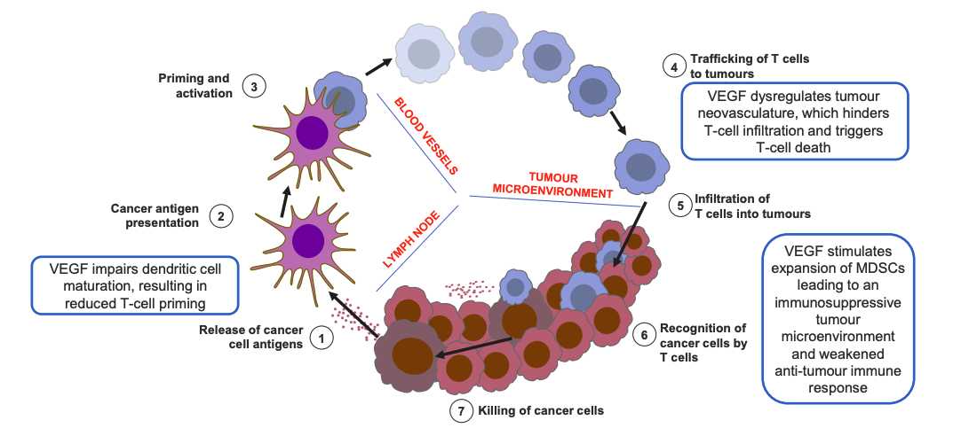
VEGF Expression Can Inhibit the Effectiveness of Immunotherapy Through Immune Dysregulation
Use of antiangiogenic agents can paradoxically normalize tumor vasculature and reduce levels of hypoxia
In untreated tumor tissue, abnormal blood flow may facilitate tumor immune evasion
In treated tumor tissue, increased blood flow may improve the outcomes of immunotherapy
VEGF Affects Tumor Immune Response Through Multiple Pathways¹
Image courtesy of Kudo M. Liver Cancer. 2020;9(2):119-137. CC BY-NC-ND 4.0.
Kudo M. Liver Cancer. 2020;9(2):119-137.
Maj E et al. Int J Oncol. 2016;49(5):1773-1784.

Slide 64
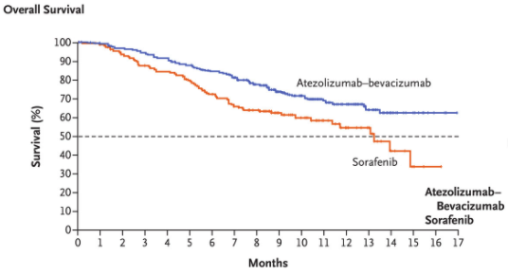
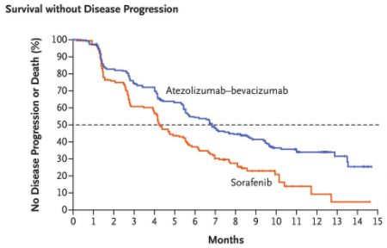
In the Phase 3 IMbrave150 Trial, Combination Atezolizumab-Bevacizumab Improved Survival
Enrolled 336 patients with untreated unresectable HCC
Randomized to atezolizumab (anti-PD-L1) and bevacizumab (anti-VEGF) or sorafenib
Combination atezolizumab-bevacizumab significantly improved PFS and OS compared with sorafenib
Finn RS et al. N Engl J Med. 2020;382(20):1894-1905.

Slide 65
Combination Therapy: AEs Occurred More Frequently With Atezolizumab/Bevacizumab Than With Sorafenib
High-grade AEs occurred in 38.0% of patients in the combination group compared with 30.8% in the sorafenib group
Hypertension was the most common grade 3 or 4 AE with atezolizumab/bevacizumab (15.2%), which was consistent with established safety data for bevacizumab
Finn RS et al. N Engl J Med. 2020;382(20):1894-1905.

Slide 66
Ongoing Combination Therapy Trials
Trial | Treatment line | Agents vs comparator(s) | Estimated enrollment | Estimated primary completion date
HIMALAYA NCT03298451 | 1L | Durvalumab + tremelimumab vs durvalumab vs sorafenib | 1504 | December 2021
COSMIC-312 NCT03755791 | 1L | Atezolizumab + cabozantinib vs sorafenib | 740 | June 2021
LEAP-002 NCT03713593 | 1L | Lenvatinib + pembrolizumab vs lenvatinib | 750 | May 2022
ClinicalTrials.gov. Accessed January 15, 2021. https://clinicaltrials.gov/ct2/home.

Slide 67
Tumor Treating Fields (TTFields) Investigational Therapy

Slide 68
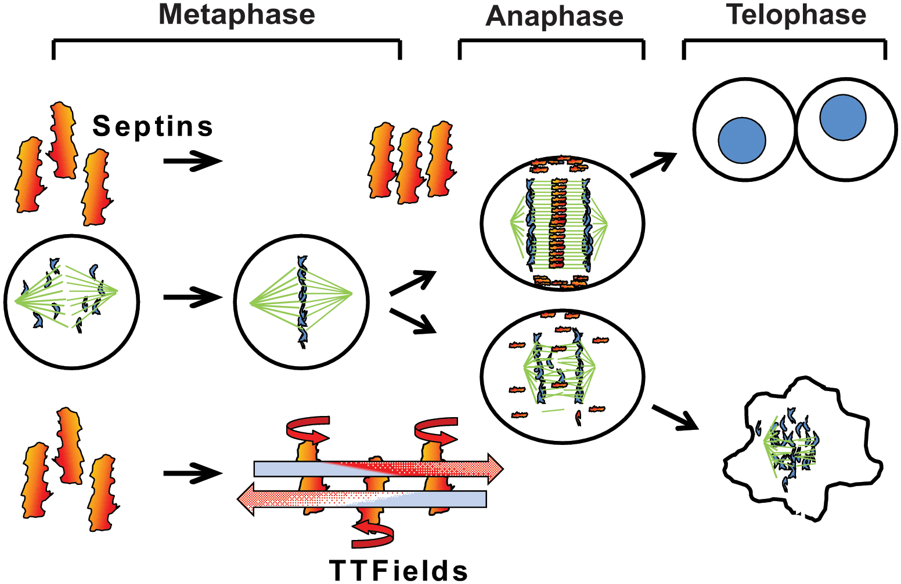
Introduction to Tumor-Treating Fields (TTFields)
TTFields is a noninvasive anticancer treatment used for glioblastomas and under investigation for HCC
TTFields delivers low-intensity, intermediate-frequency alternating electric fields through transducer arrays placed around the region of the tumor
TTFields have been shown to produce antimitotic effects, disrupting cell division
Image courtesy of Gera N et al. PLoS One. 2015;10(5):e0125269. CC BY 4.0.
Mun EJ et al. Clin Cancer Res. 2018;24(2):266-275.

Slide 69
Preclinical Findings With TTFields Plus Sorafenib
In vitro studies in HCC cell lines
  TTFields at 150 kHz reduced cell counts by 53% to 64%
  TTFields also reduced clonogenic potential by more than 70%
  Combination with sorafenib significantly reduced cell counts compared with either treatment alone
In vivo studies in rat model of HCC
  TTFields at 150 kHz significantly decreased tumor growth
  No TTFields-related adverse events were noted
Voloshin T et al. Int J Rad Oncol Biol Physics. 2020;108(3):E652.

Slide 70
HEPANOVA Trial: Ongoing Phase 2 Trial
Study population: 25 participants with newly diagnosed advanced HCC
  BCLC stage, 0-C
  Child-Pugh score, 5-8
  ECOG PS, 0-2
Intervention: TTFields in combination with sorafenib (400 mg twice daily)
Primary outcome: ORR
Secondary outcomes: OS, PFS, DMFS, safety
In an early analysis of HEPANOVA, no unanticipated device-related serious AEs were reported, with most AEs related to the disease or systemic therapy
Primary results are expected in September 2021.
Effect of Tumor Treating Fields (TTFields, 150kHz) Concomitant With Sorafenib For Advanced Hepatocellular Carcinoma (HCC) (HEPANOVA). Updated July 29, 2020. Accessed February 22, 2021. https://clinicaltrials.gov/ct2/show/NCT03606590.
Gkika E et al. Cancer Res. 2020;80(16):CT186.

Slide 71
Unresectable HCC Treatment algorithms

Slide 72
Treatment With Curative Intent Is the Preferred Option for Candidate Patients
Potentially curative |  |  | Extends survival
Surgical interventions | Percutaneous ablation | Transarterial therapies | Systemic therapies
Resection: surgical removal of the tumor along with surrounding liver tissue Liver transplantation: replacement of the liver with a healthy donor liver | Ablation: destruction of liver tumors using extreme temperatures or chemicals: Percutaneous ethanol injection (PEI) Radiofrequency ablation (RFA) Microwave ablation (MWA) Cryoablation | Transarterial chemoembolization (TACE): blockade of blood flow to the liver with concurrent delivery of chemotherapy Radioembolization (yttrium-90 [Y90]): delivery of high-dose radiation to the liver | TKIs and anti-VEGFs: targeted therapies that inhibit angiogenic pathways Immunotherapy: checkpoint inhibitors Combination therapy: combination of targeted and immunotherapy
Marrero JA et al. Hepatology. 2018;68(2):723-750.
EASL. J Hepatol. 2018;69:182-236.
National Comprehensive Cancer Network (NCCN). Hepatobiliary cancer version 5.2020. August 4, 2020. Accessed November 27, 2020. https://www.nccn.org/professionals/physician_gls/pdf/hepatobiliary_blocks.pdf.

Slide 73
However, Many Patients Are Not Candidates for Resection, Emphasizing the Importance of Locoregional and Systemic Therapies
Resection is generally only considered in patients who meet the following criteria:
  Disease confined to the liver without vascular invasion
  Size and location of tumor(s) are amenable to resection
  Underlying liver function is sufficient to prevent excessive morbidity and mortality
  No clinically significant portal hypertension
Marrero JA et al. Hepatology. 2018;68(2):723-750.
Villanueva A. New Engl J Med. 2019;380;15:1450-1462.

Slide 74
Milan Criteria Can Be Used to Determine Transplantation Eligibility
Milan criteria¹:
  Single lesion ≤5 cm or ≤3 separate lesions, none larger than 3 cm
  No evidence of vascular invasion
  No regional nodal or distant metastases
Downstaging involves locoregional therapy to attempt to reduce tumor burden to within the Milan criteria. The following downstaging cases can result in priority listing²:
  Single lesion, <8 cm in size
  2-3 lesions, <5 cm
  4-5 lesions, <3 cm
Mazzaferro V, et al. N Engl J Med. 1996;334(11):693.
Yao FY, et al. Hepatology. 2015;61(6):1968–1977.

Slide 75
Outcomes With Locoregional Therapy
Author and year | Patients (n) | OS (%)
 |  | 1-year | 3-year | 5-year
Lencioni et al, 2005
Child-Pugh A | 144 | 100 | 76 | 51
Child-Pugh B | 43 | 89 | 46 | 31
Tateishi et al, 2005
Child-Pugh A | 221 | 96 | 83 | 63
Child-Pugh B-C | 98 | 90 | 65 | 31
Choi et al., 2007
Child-Pugh A | 359 | NA | 78 | 64
Child-Pugh B | 160 | NA | 49 | 38
N’Kontchou et al, 2009
BCLC resectable | 67 | NA | 82 | 76
BCLC unresectable | 168 | NA | 49 | 27
Lencioni R. Hepatology. 2010;52(2):762-773.

Slide 76
With More Effective Systemic Therapies Available, Systemic Treatment Has Moved Earlier in the Treatment Paradigm
TACE-refractory uHCC
Old
TACE
TACE rechallenge(s)
Systemic therapy
BCLC C
BCLC B
TACE
Systemic therapy
New
TACE-refractory uHCC
Kudo M. Cancers (Basel). 2018;10(11):412.

Slide 77
Systemic Therapy Sequencing Has Become Increasingly Complex
Regorafenib
Sorafenib
Cabozantinib
Ramucirumab
AFP ≥400 ng/mL only
TACE-refractory or unsuitable for TACE
Different systemic option?
Lenvatinib
BSC
Nivolumab
Atezolizumab/
bevacizumab
Nivolumab + ipilimumab
Pembrolizumab
Kudo M. Cancers (Basel). 2018;10(11):412.
NCCN. Hepatobiliary cancer version 5.2020. August 4, 2020. Accessed November 27, 2020. https://www.nccn.org/professionals/physician_gls/pdf/hepatobiliary_blocks.pdf.
Roderburg C et al. Fut Med. 2020;7(2).

Slide 78
Blue Line:
Multidisciplinary Care

Slide 79
Multidisciplinary care team

Slide 80
With the Availability of Novel Agents, Treatment Selection and Sequencing for HCC Has Become More Complex
Medical
oncologist
Diagnostic
radiologist
Interventional
radiologist
Tumor Registry
Transplant
Surgeon
Hepatologist
research
coordinator
Nutrition
specialist
Patient with HCC
Cancer
support
groups
Radiation oncologist
Liver
pathologist
Surgical
oncologist
Oncology
nurse
Palliative
care
Byrd K et al. Semin Liver Dis. 2021;10.1055/s-0040-1719178.

Slide 81
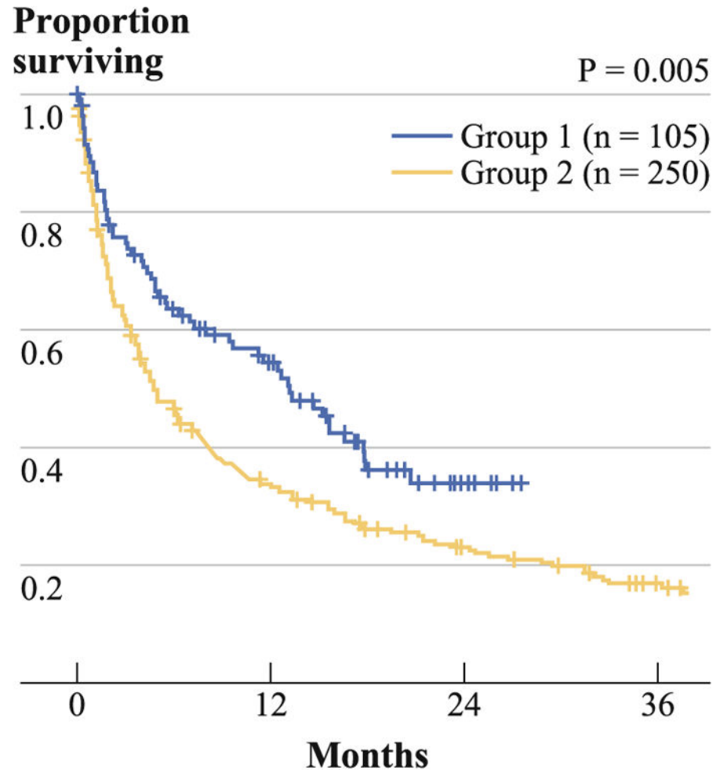
Implementation of a Multidisciplinary Care Team Improves HCC Outcomes
Survival by Receipt of Treatment Before Initiation of MDT (Blue) or After (Yellow)²
The development of a multidisciplinary care team has been shown to improve patient outcomes in several distinct ways^{1,2}:
  Increase the detection of stage I and stage II disease
  Higher rates of curative treatment
  Higher rates of palliative treatment
  Longer overall survival
Chang TT et al. HPB (Oxford). 2008;10(6):405-411.
Yopp AC et al. Ann Surg Oncol. 2014;21(4):1287-1295.

Slide 82
MKI AEs

Slide 83
TKIs Have Been Associated With Relatively High Rates of Adverse Events That Can Be Dose-Limiting
Up to ~50% of patients who receive TKIs for HCC require dose interruptions, reductions, or withdrawal due to adverse events
The most commonly reported treatment-related adverse events include:
  Diarrhea
  Fatigue
  Hand-foot-skin reaction (HFSR)
  Hypertension
With appropriate monitoring, counseling, and management, many TKI-related adverse events can be prevented or alleviated.
Winters AC et al. Clin Liver Dis. 2020;24(4):755-769.

Slide 84
TKI-Associated Diarrhea
Diarrhea is reported in more than one-third of patients receiving TKIs
  May be more common in patients with sarcopenia
Management recommendations and considerations
  For those with hepatic encephalopathy, adjust lactulose doses if diarrhea occurs
  Limit caffeine and dairy
  Keep a food diary to document and avoid trigger foods
  Consider loperamide for those refractory to supportive care
Winters AC et al. Clin Liver Dis. 2020;24(4):755-769.

Slide 85
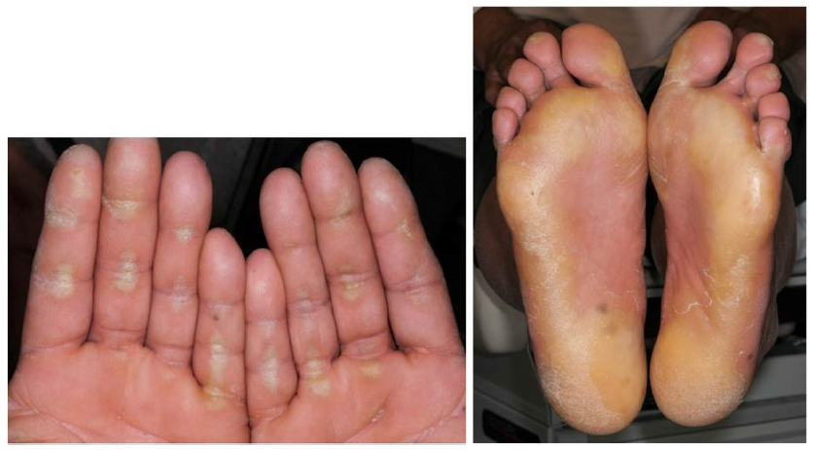
TKI-Associated HFSR
HFSR is a common cause of dose reduction and is characterized by painful hyperkeratotic rash in areas of high friction (typically hands and feet)
Management recommendations and considerations
  Monitor closely for development of symptoms
  Use emollients on hands and feet
  Avoid tight shoes and bare feet
  Regular pedicures and manicures to remove hyperkeratotic skin
  Avoid hot water
Image courtesy of Weitzman S, Cabanillas M. Cancer Manag Res. 2015;2015:265-78. CC BY-NC 3.0.
Winters AC et al. Clin Liver Dis. 2020;24(4):755-769.

Slide 86
TKI-Associated Hypertension
Hypertension has been reported in about one-quarter of patients treated with TKIs
The presence of hypertension is suggestive of treatment effectiveness
Management recommendations and considerations
  Treat any preexisting hypertension before initiating TKIs
  Monitor blood pressure every 2 to 3 weeks
  Promptly initiate standard antihypertensive agents as needed
Winters AC et al. Clin Liver Dis. 2020;24(4):755-769.

Slide 87
TKI-Associated Hepatic Dysfunction
Elevated levels of bilirubin and transaminases have been reported with regorafenib
Management recommendations and considerations
  On elevation, monitor twice weekly for 2 weeks and then weekly for a month to ensure levels return to baseline
  Delay treatment if levels rise to grade 2 (>2.5-5.0 x ULN for AST/ALT; 1.5–3.0 x ULN for bilirubin)
Winters AC et al. Clin Liver Dis. 2020;24(4):755-769.

Slide 88
irAEs

Slide 89
Checkpoint Inhibitors Have Been Associated With Immune-Related Adverse Events (irAEs)
irAEs have been attributed to immune activation caused by checkpoint inhibition
irAEs are often monitored with glucocorticoids or other immunosuppressive regimens
Immune-related hepatitis is of particular concern for patients receiving checkpoint inhibitors for HCC
Winters AC et al. Clin Liver Dis. 2020;24(4):755-769.

Slide 90
Immune-Related Hepatitis Presentation
Up to 21% of those treated with checkpoint inhibitors experience immune-related hepatitis
  Typically presents with elevated transaminase levels between 6 and 14 weeks after treatment initiation
  Most common reason for checkpoint inhibitor discontinuation
Elevated transaminase levels should prompt consideration of the following conditions to prevent unnecessary immunosuppressive treatment:
  Drug-related liver injury
  Herbal supplement use
  Alcohol use
  Opportunistic infection (eg, EBV)
  Thromboembolism
  Progression of underlying liver disease or HCC
Recommended Testing for Elevated Transaminases
Viral hepatitis serologies
EBV and CMV PCR
Autoantibody testing
Ultrasound or CT imaging
Liver biopsy (for grade 3 and higher hepatotoxicity)
Winters AC et al. Clin Liver Dis. 2020;24(4):755-769.

Slide 91
Management of Immune-Related Hepatitis Varies
According to Grade
Grade 1
Grade 2
Grade 3 or 4
Continue checkpoint inhibitor if asymptomatic
Discontinue other hepatotoxic medications and alcohol use
Check hepatitis serologies
Abdominal imaging with ultrasound or CT/MRI
Monitor liver tests 1-2 times per week until resolution
Withhold checkpoint inhibitor
Discontinue other hepatotoxic medications and alcohol use
Check hepatitis serologies
Abdominal imaging with ultrasound or CT/MRI
Monitor liver tests every 3 days
Resume checkpoint inhibitor if tests return to grade 1 or lower
Discontinue checkpoint inhibitor, other hepatotoxic medications, and alcohol use
Intravenous prednisone (1-2 mg/kg/day or equivalent)
Hepatology consultation and liver biopsy
Abdominal imaging with ultrasound or CT/MRI
Rule out acute hepatitis
Serum drug panel (acetaminophen and salicylate)
Monitor liver tests daily
Persistent (after 3-5 days) elevation
Progressive elevation
Persistent (after 3-5 days) elevation
Initiate oral prednisone (0.5-1 mg/kg or equivalent)
Referral to hepatology for consideration of liver biopsy for persistent elevation
Progressive elevation
Add MMF (500-1000 mg twice daily)
In patients who respond, taper prednisone over 4-6 weeks
Discontinue MMF when prednisone tapered to 10 mg daily
Tacrolimus should be reserved for MMF-refractory patients
Monitor liver tests until resolution
Grover S et al. Am Soc Clin Oncol Educ Book. 2018;38:13-19.

Slide 92
For Those With Grade 1 or 2 Immune-Related Hepatitis Who Improve, Checkpoint Inhibitor Can Be Resumed
Taper prednisone over 1 month or longer
Checkpoint inhibition can be resumed when liver tests are grade 1 or lower and prednisone is dosed at 10 mg/day or less
Liver tests should be monitored 1 to 2 times per week until resolution
Patients with grade 3 or 4 immune-related hepatitis should not be restarted on checkpoint inhibition.
Grover S et al. Am Soc Clin Oncol Educ Book. 2018;38:13-19.

