Slide 1
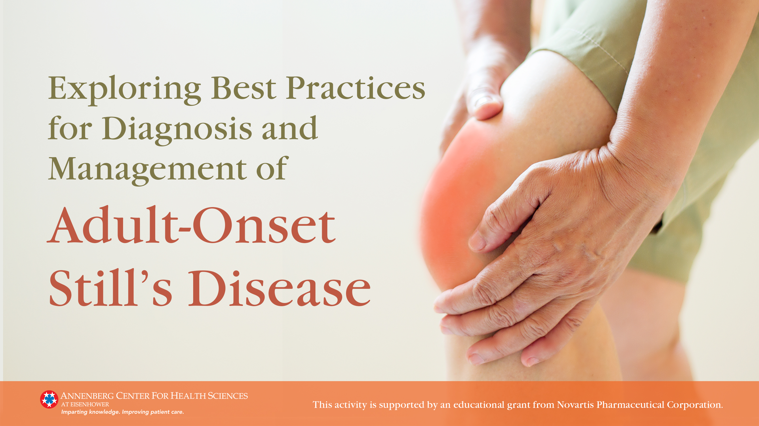

Slide 2
Faculty
Petros
Olga
Efthimiou, MD, FACR
Petryna, MD, FACR
New York Rheumatology Care, PC
New York, NY
Clinical Professor of Medicine
Ross University School of Medicine
Miramar, Florida
Clinical Assistant Professor
Division of Rheumatology
NYU Grossman School of Medicine
New York, New York

Slide 3
Learning Objectives
Describe the optimal pathway of diagnosis for a patient presenting with possible adult-onset Still’s Disease (AOSD), using resources available in the average clinical setting
Develop a treatment strategy for AOSD, taking into consideration a patient’s subtype and risk assessment for systemic complications
Describe the mechanism of action, safety and efficacy of new and emerging biologic treatments for AOSD
Consider patient HRQoL as part of an AOSD treatment monitoring protocol

Slide 4
Module 1
Pathogenesis & Clinical Features

Slide 5
Overview
Rare, polygenic autoinflammatory syndrome
Prevalence
  10 per million
  Rising over past 20 years
Incidence^{1,2}
  1 to 10 per 1 million; may be as high as 34 per million in some groups
  Bimodal: 15-25 years and 36-46 years
    Onset also may occur in older adults
  Men = Women
Diagnosis often delayed 6 months to 1 year
1. Feist E, et al. Nat Rev Rheumatol. 2018;14(10):603-618.
2. Efthimiou P, et al. Chapter 19 in Clinical and Experimental Rheumatology, vol 24; 2006.

Slide 6

Pathogenesis of Adult-Onset Still’s Disease
Genetic
  Associated with several HLA alleles
Viral infection
  Temporal association with parvovirus B19, rubella, Epstein-Barr, cytomegalovirus, others
Immune dysregulation
  Acute phase reactants, eg, IL-1β, IL-6,IL-18, tumor necrosis factor-α, β8, Toll-like receptor 7
Genetic Factors?
Viral Infection?
Immune Dysregulation?
Kadavath S, Efthimiou P. Ann Med. 2015;47:6-14.
Di Cola I, et al. J Clin Med. 2021;10:1164.
Wang MY, et al. Chin Med J. 2019;132(23):2856-2864.

Slide 7
Pathogenesis of Adult-Onset Still’s Disease (cont)
Systemic Juvenile Inflammatory Arthritis
Adult-Onset Still’s Disease
Children & Adolescents
Adults
Similar endotype to systemic juvenile inflammatory arthritis
  IL-1 plays a key role
  High levels of IL-6 and IL-18
  Similar peripheral blood gene expression signatures
IL-6, interleukin-6; IL-8, interleukin-8
Colafrancesco S, et al. Arthritis Res Ther. 2019;21:275.

Slide 8
Pathogenic Pathways in Adult-Onset Still’s Disease
Genetic Factors
Triggering Factors
Innate Immunity
-Macrophage
-Dendritic cell
-Polymorphonuclear neutrophil
Adaptive Immunity
-T-helper cells 1 & 17
Cytokine Burst
-IL-1, -6, -17, -18
-Tumor necrosis factor-α
Feist E, et al. Nat Rev Rheumatol. 2018;14:603-618.

Slide 9

Three Stages of AOSD
Monocyclic/Self-limited
30%
Active phase <1 year; permanent remission
Most favorable prognosis
High risk of complications during active phase
Polycyclic/Intermittent
30%
Disease flares with remission lasting weeks to 1-2 years
Chronic
40%
Destructive arthritis common
Persistently active
Poor prognosis, especially if articular (vs systemic) disease at onset
AOSD, Adult-onset Still’s disease

Slide 10
Still’s Disease Triad
AOSD
Daily Fevers
Evanescent Rash
Arthritis
Typically >39.5°C
Early afternoon/Evening
Salmon-pink
Macular/Maculopapular
Nonpruritic
Trunk/Proximal extremities
Occurs with fever
Small joints (wrists) > large joints
AOSD, Adult-onset Still’s disease

Slide 11
Additional Clinical Features
Common^{1,2}
Myalgia
Pharyngitis
Lymphadenopathy
Splenomegaly
Other
  Anxiety, depression³
Infrequent^{1,2}
Hepatomegaly
Pleurisy
Pericarditis
Abdominal pain
1. Kadavath S, Efthimiou P. Ann Med. 2015;47:6-14.
2. Feist E, et al. Nat Rev Rheumatol. 2018;14:603-618.
3. Chi H, et al. Clin Rheumatol. 2020;39(12):3723-3732.

Slide 12
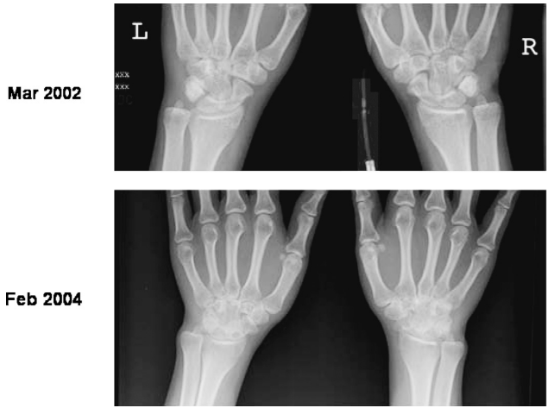
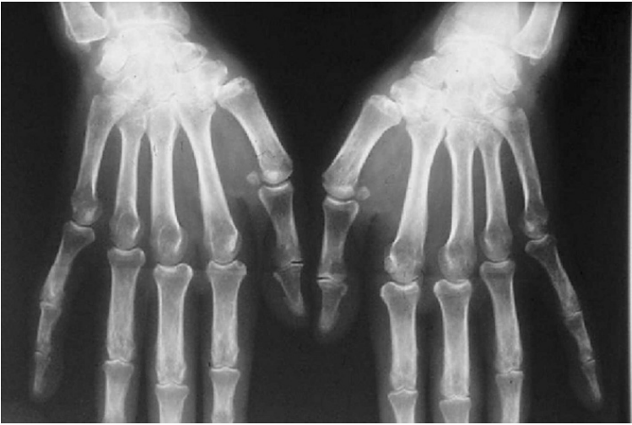
Radiograph of Patients With Still’s Disease
SJIA
AOSD
Rapid progression of joint space loss, erosions, and ankylosis of both wrists
Intercarpal and carpometacarpal joint space narrowing
Reproduced with permission from Batthish and Schneider.¹
Reproduced with permission from Efthimiou, et al.²
AOSD, adult-onset Still’s disease; SJIA, systemic juvenile idiopathic arthritis
1. Batthish M, Schneider R. Systemic juvenile idiopathic arthritis. In: Cimaz R, Lehman, eds. Handbook of Systemic Autoimmune Diseases. Elsevier B.V.; 2016:53-84; Reprinted with Permission from Elsevier.
2. Efthimiou P, et al. Ann Rheum Dis. 2006;65(5):564-572; with permission from BMJ Publishing Group Ltd.

Slide 13
Comorbidities Are Common in AOSD
More common in AOSD cohort (n=106)
More common in control cohort (n=530)
Patients in the AOSD cohort were observed over a mean of 750 days
AOSD, Adult-onset Still’s disease
Lenert A, et al. Rheumatology. 2020;59:1725-1733.

Slide 14
Complications
Life-Threatening Complications | Macrophage activation syndrome (hemophagocytic lymphohistiocytosis) Disseminated intravascular coagulation Thrombotic thrombocytopenia purpura Diffuse alveolar hemorrhage Pulmonary arterial hypertension Septic shock
Rare Clinical Manifestations | Fulminant hepatitis Myocarditis, myocardial necrosis Pleurisy, temporary pulmonary infiltrates, acute respiratory distress syndrome, restrictive pulmonary disease Pure red cell aplasia Syndrome of inappropriate antidiuretic hormone secretion; low sodium level | Pericardial fluid, tamponade Serositis Aseptic meningitis with neutrophilic pleiocytosis Stroke Disseminated cerebral thrombotic microangiopathy Fatal infections
Kadavath S, Efthimiou P. Ann Med. 2015;47:6-14.
Feist E, et al. Nat Rev Rheumatol. 2018;14:603-618.

Slide 15
Macrophage Activation Syndrome Is a Common Cause of Death
Retrospective analysis of 447 patients with AOSD
  55 (12.3%) diagnosed with MAS
Mortality rate of entire cohort: 4.47%
MAS was the main cause of death (odds ratio 11.7; P<0.0001)
Factors associated with poor prognosis
  Platelets ≤100,000/mm³ (P=0.0001)
  Fibrinogen <1.5 g/L (P=0.0286)
  Splenomegaly (P=0.0002)
  Liver dysfunction (P=0.0008)
AOSD, Adult-onset Still’s disease
Wang R, et al. Clin Rheumatol. 2020;39(8):2379-2386.

Slide 16
Prognosis of Hospitalized Patients With AOSD
Analysis of nationwide inpatient sample from 2009-2013 with ∼8 million hospitalizations/y
5820 patients with AOSD were hospitalized
  Mean age 53.6 y
  65.6% female
  56% Caucasian, 3% Asian
Mehta BY, et al. Semin Arthritis Rheum. 2019;49(3):469-473.

Slide 17
Prognosis of Hospitalized Patients With AOSD (cont)
Characteristic | Odds Ratio for Death (95% CI)
Race Caucasian Asian Black/Hispanic/Others | 1.00 (reference) 6.39 (1.77-23.1) 0.84 (0.26-2.75)
Number of chronic conditions | 1.20 (1.05-1.37)
DIC | 29.69 (5.5-160.41)
154 Deaths (2.6%)
Mean age 62.4 y
13.9% Asian
Rate increased with rising household income
DIC 14%
CI, confidence interval; DIC, disseminated intravascular coagulation
Mehta BY, et al. Semin Arthritis Rheum. 2019;49(3):469-473.

Slide 18
Module 2
Recognition & Diagnosis

Slide 19
History & Physical Examination
Diagnosis of exclusion
History
  Close attention to daily fever, rash, joint pain/swelling, myalgia, sore throat, enlarged lymph nodes
  Assess for history of known risk factors
  Response to prior therapy, especially nonsteroidal anti-inflammatory drugs and antibiotic therapy that did not alter signs/symptoms
Physical examination
  Skin, preferably during febrile period
  Lymphadenopathy, splenomegaly, hepatomegaly
  Joint examination of upper/lower extremities and spine

Slide 20
Laboratory Findings
Elevated erythrocyte sedimentation rate
Leukocytosis ≥15,000/mm³
  Neutrophils ≥80%
Elevated C-reactive protein
Elevated ferritin level
Glycosylated ferritin level <20% of normal
Liver dysfunction (ALT, AST)
Serum albumin ≤3.5 g/dL
Hemoglobin ≤10 g/dL
Platelets ≥400,000/mm³
Elevated serum amyloid A
Negative antinuclear antibody
Negative rheumatoid factor
Elevated germinal center kinase-like kinase (GLK or MAP4K3)
Elevated Th17 cytokine levels (IL-6, IL-17A)
Elevated S100 proteins
ALT, alanine aminotransferase; AST, aspartate aminotransferase
Kadavath S, Efthimiou P. Ann Med. 2015;47:6-14.
Pouchot J, et al. Medicine (Baltimore). 1991;70(2):118-136.
Ohta A, et al. J Rheumatol. 1990;17(8):1058-1063.
Gopalarathinam R, et al. Case Rep Rheumatol. 2016;2016:6502373.
Feist E, et al. Nat Rev Rheumatol. 2018;14:603-618.

Slide 21
Radiologic Findings
Early: normal or soft tissue swelling and joint effusions
Common: nonerosive narrowing of carpometacarpal/intercarpal joint spaces of wrist → bony ankylosis
Knee and wrist joints most commonly involved in adults
Periarticular osteopenia may develop
Pouchot J, et al. Medicine (Baltimore). 1991;70(2):118-136.
Gopalarathinam R, et al. Case Rep Rheumatol. 2016;2016:6502373.

Slide 22
Diagnostic Criteria
Yamaguchi et al¹ | Fautrel et al²
Major criteria
Arthralgia ≥ 2 wks Fever >39°C, intermittent ≥1 wk Typical rash White blood cell count >10,000/mm³ (>80% granulocytes) | Spiking fever ≥39°C Arthralgia Transient erythema Pharyngitis Polymorphonuclear leukocytes ≥80% Glycosylated ferritin ≤20%
Minor criteria
Sore throat Lymphadenopathy and/or splenomegaly Liver function test(s) abnormal | Negative antinuclear antibody titer and rheumatoid factor Maculopapular rash Leukocytes ≥10,000/mm³
Exclusion criteria
Absence of infection, especially sepsis and Epstein-Barr Absence of malignant disease, especially lymphoma Absence of inflammatory disease, especially polyarteritis nodosa | None
Diagnostic
5 criteria (≥2 major) | 4 major criteria or 3 major criteria + 2 minor criteria
1. Yamaguchi M, et al. J Rheumatol. 1992;19:424-430.
2. Fautrel B, et al. Medicine (Baltimore). 2002;81:194-200.

Slide 23
Differential Diagnosis
Infections | Pyogenic infection, including sepsis Infectious endocarditis Occult infections | Brucellosis, tuberculosis, yersiniosis Viral hepatitis Toxoplasmosis, abscessed parasitosis
Malignancy | Hodgkin’s disease or non-Hodgkin lymphoma Myeloproliferative disorders Angio-immunoblastic lymphadenopathy | Solid tumors of the colon, lung, kidney Paraneoplastic syndrome
Systemic Diseases | Polyarteritis nodosa Vasculitides Polymyositis, dermatopolymyositis, systemic lupus Seronegative rheumatoid arthritis Sarcoidosis Sweet syndrome | Post-streptococcal arthritis or other reactive arthritis Hereditary auto-inflammatory syndromes Whipple disease Drug-related hypersensitivity syndrome or pseudo-lymphoma Schnitzler’s syndrome
Kadavath S, Efthimiou P. Ann Med. 2015;47:6-14.
Feist E, et al. Nat Rev Rheumatol. 2018;14:603-618.

Slide 24
Module 3
Treatment Strategies & Options

Slide 25
Goals of Therapy
Control inflammation
  Fever, rash, morning stiffness, joint pain, swelling
  Elevated erythrocyte sedimentation rate, C-reactive protein
Prevent joint injury and end-organ damage
Minimize risk of treatment-related adverse events
Address patient concerns/burden of disease

Slide 26
Burden of Disease: The Patient’s Experience
https://www.youtube.com/watch?v=ZVv0SkLXx2o
  0:00 to 1:13;1:28 to 2:00; 4:22 to 4:30; 5:03 to 5:20
  [From the Mayo Clinic]
Permissions pending

Slide 27
Treatment Overview by Severity
Mild
Moderate
Severe
NSAIDs
±
Low-dose Corticosteroids
NSAIDs
±
Corticosteroids
NSAIDs
±
High-dose Corticosteroids
(Pulse then oral)
±
DMARDs
(Methotrexate, Biologics)
bDMARDs, biologic disease-modifying anti-rheumatic drugs; NSAIDs, nonsteroidal anti-inflammatory drugs

Slide 28
Treatment Overview by Features
AOSD
Systemic
Chronic Articular
-High inflammatory state
-Multi-organ damage
-Hematological complications
-May begin with systemic symptoms but evolves to an RA-like disease
-Fever >39°C
-High liver enzyme levels
-High CRP level
-Female sex
-Polyarthritis at onset
-Steroid dependence
Clinical Features
Predictive Factors
AOSD, Adult-onset Still’s disease; CRP, C-reactive protein
Tomaras S, et al. J Clin Med. 2021;10:733.

Slide 29
Medications for Adult-Onset Still’s Disease*
Traditional Medications
Nonsteroidal anti-inflammatory drugs
Glucocorticoids
Disease-modifying antirheumatic drugs
  Methotrexate
  Others
    Leflunomide
    Cyclosporine A
    Azathioprine
    Hydroxychloroquine
    Gold
    Tacrolimus
Intravenous immunoglobulin
Biologics
  IL-1 receptor antagonists
  Anti-IL-1β
  IL-1 trap
  IL-6 receptor antagonists
  Anti-IL-18
  TNF-α inhibitors
  B-cell directed
  T-cell directed
  JAK inhibitors
*Only the anti-il-1β canakinumab is approved in the United States for adult-onset Still’s disease
Efthimiou P, et al. Nat Clin Pract Rheumatol. 2007;3(6):328-335.
Feist E, et al. Nat Rev Rheumatol. 2018;14(10):603-618.

Slide 30
Possible Treatment Strategy
Mild Activity | Moderate-to-Severe Systemic Activity | Chronic Articular Activity
NSAIDs or low-dose steroids If chronic, csDMARD (eg, MTX) | High-dose steroid Non responder/Life-threating condition → IL-1 inhibitor (anakinra or canakinumab) Non-responder → switch to IL-6 inhibitor or JAK inhibitor | Low-dose steroid csDMARD (eg, MTX) Refractory → IL-1 inhibitor (anakinra or canakinumab) Refractory → IL-6 inhibitor or TNF-blocker
csDMARD, conventional synthetic disease-modifying antirheumatic drug; MTX, methotrexate; TNF, tumor necrosis factor
Tomaras S, et al. J Clin Med. 2021;10:733.

Slide 31
Medication Approved for Adult-Onset Still’s Disease
Canakinumab is an anti-IL-1β monoclonal antibody
Approval of canakinumab for AOSD was based on:
  pharmacokinetic exposure and extrapolation of established efficacy in patients with systemic juvenile inflammatory arthritis
  phase 2 CONSIDER trial
AOSD, adult-onset Still’s disease

Slide 32
Canakinumab: CONSIDER Trial
N=35
Mean age: 41 y
DAS28(ESR) at baseline: 5.3-5.4
Previous bDMARD: 72% to 77%
Randomized 1:1 to:
  Canakinumab 4 mg/kg
  Placebo
After 12 wks,
  Responders continued treatment
  Placebo nonresponders received canakinumab
bDMARD, biologic disease-modifying anti-rheumatic drug
Kedor C, et al. Ann Rheum Dis. 2020;79:1090-1097; Reproduced with permission from Creative Commons License / http://creativecommons.org/licenses/by-nc/4.0/.

Slide 33
Canakinumab Efficacy: CONSIDER Trial
Improvement in Disease Activity Score 28 Based on Erythrocyte Sedimentation Rate and C-Reactive Protein
DAS28-ESR
DAS28-CRP
DAS28-ESR response rates at 12 weeks: canakinumab 66.7% vs placebo 41.2%; P=0.18
DAS28-CRP response rates at 12 weeks: canakinumab 66.7% vs placebo 41.2%; P=0.18
Green line: LS means canakinumab group; green area: 95% CI of the LS means of the canakinumab group; red line: LS means of the placebo group; red area: 95% CI of the LS means of the placebo group; brown area: overlap of both 95% CI areas
Reproduced without modification from Kedor C, et al. Ann Rheum Dis. 2020;79:1090-1097 under Creative Commons License CC BY-NC 4.0.

Slide 34
Canakinumab Safety: CONSIDER Trial
Weeks 0 to 12
  2 SAEs in 2 canakinumab patients
    Increased liver enzymes
    Patellofemoral pain syndrome leading to hospitalization
Weeks 12 to 24
  7 SAE
    2 canakinumab patients
      Deep vein thrombosis
      Hypotonia
    5 placebo patients
      Fracture (2)
      Removal of medical device at MCP 5
      Upper abdominal pain
      Acute cholecystitis
MCP, metacarpophalangeal; SAEs, serious adverse events
Kedor C, et al. Ann Rheum Dis. 2020;79:1090-1097.

Slide 35
Canakinumab: Precautions
Infection: caution; avoid during active infection requiring treatment
Live vaccine- do not give concurrently
Most common adverse events (≥10%)
  Nasopharyngitis/Upper respiratory tract infection; abdominal pain; injection site reaction
Macrophage activation syndrome
May normalize formation of CYP450 enzymes
Pregnancy/Lactation: no information
Ilaris [package insert]. East Hanover, NJ: Novartis Pharmaceuticals Corp.; September 2020.

Slide 36
Investigational Medications for Adult-Onset Still’s Disease
Medication and Usual Dose* | Target | Complete Remission | Follow up (mos)
Anakinra 100 mg SC daily | IL-1 receptor antagonist | 80% | >12
Rilonacept 100-320 mg SC x1, then 100-320 mg weekly | IL-1 trap | 100% | >12
Infliximab 3-7.5 mg/kg IV wks 0, 2, and 6; then Q6-8 wks | TNF blocker | 0-100% | >12
Etanercept 50 mg SC weekly
Tocilizumab 8 mg/kg IV monthly | IL-6 receptor antagonist | 60-85% | >12
Sarilumab 200 mg Q2 wks | sIL-6R/mIL-6R antagonist | − | −
Rituximab 1g IV days 1 and 15 every 6 months | B-cell-directed | − | −
Abatacept 500-1000 mg IV monthly or 125 mg SC weekly | T-cell-directed | − | −
Tofacitinib 5 mg QD/BID | Janus kinase inhibitor | − | −
Baricitinib 4 mg QD |  | − | −
Emapalumab 3 mg/kg QOD** | Interferon-γ blocker | − | −
*Not approved for use in the United States for adult-onset Still’s disease. **Not approved for use in the United States for macrophage activation syndrome
Feist E, et al. Nat Rev Rheumatol. 2018;14(10):603-618. Simeni Njonnou SR, et al. Rheumatology (Oxford). 2019;58(10):1878-1879.
Hu Q, et al. Ann Rheum Dis. 2020;79(6):842-844. Lacar M, et al. RMD Open. 2020;6:e001246. Gabr JB, et al. Ann Transl Med. 2020;8(14):887.

Slide 37
Patient Monitoring
No standardized approach
Assessment:
  Impact on patient burden of disease (critical)
  Resolution/Reduction of signs/symptoms
    Disease remission
  Systemic inflammation/Organ involvement
  Early identification of complications
  Treatment-related adverse events

Slide 38
It Takes a Team
Patient
Rheumatologist
Cardiologist
Social Worker
Psychiatrist
Orthopedic Surgeon
Physiotherapist
Primary Care
Pain Specialist
Pulmonologist

Slide 39
Module 4
Cases Scenarios

Slide 40
Case #1
LB is a 23-yo Asian woman referred from her PCP
She reports experiencing chronic pain and intermittent swelling in knees and wrists
  Repeated courses of NSAIDs have provided minimal relief
  Although her joint symptoms predominate, she also experiences an intermittent skin rash with low grade fevers every few months
Laboratory
  Elevated ESR and C-reactive protein
    Rest of serologies are within normal limits
  Elevated ferritin
X-rays show erosive arthritis of the wrists and knee effusions
ESR, erythrocyte sedimentation rate; NSAIDs, nonsteroidal anti-inflammatory drugs; PCP, primary care provider

Slide 41
Case #2
KA is a 37-yo Caucasian female referred from her PCP
She reports experiencing recurrent fevers up to 100°F
  Occur in the late afternoon
  Associated with salmon-colored rash on forearms and chest
Other symptoms include
  Intermittent sore throat and cervical lymphadenopathy every 2-3 mos
    Not responsive to antibiotics
  Fatigue and stiffness
Laboratory
  Elevated ESR, C-reactive protein, and ferritin
ESR, erythrocyte sedimentation rate; PCP, primary care provider

Slide 42
Case #3
RP is a 39-yo female with a 3-y history of AOSD
She experiences chronic oligoarticular arthritis and flexion contractions that limit mobility
Over the past 5 mos, she has missed work 7 days due to flares of systemic symptoms (fever, sore throat, etc)

Slide 43
Case #4
HL is a 29-yo male diagnosed with AOSD 7 mos ago
He continues to experience moderate systemic inflammatory symptoms (fever, sore throat, fatigue) despite anakinra
Mild pulmonary arterial hypertension
Experienced 1 episode of macrophage activation syndrome
Laboratory
  Ferritin remains elevated

