Slide 1
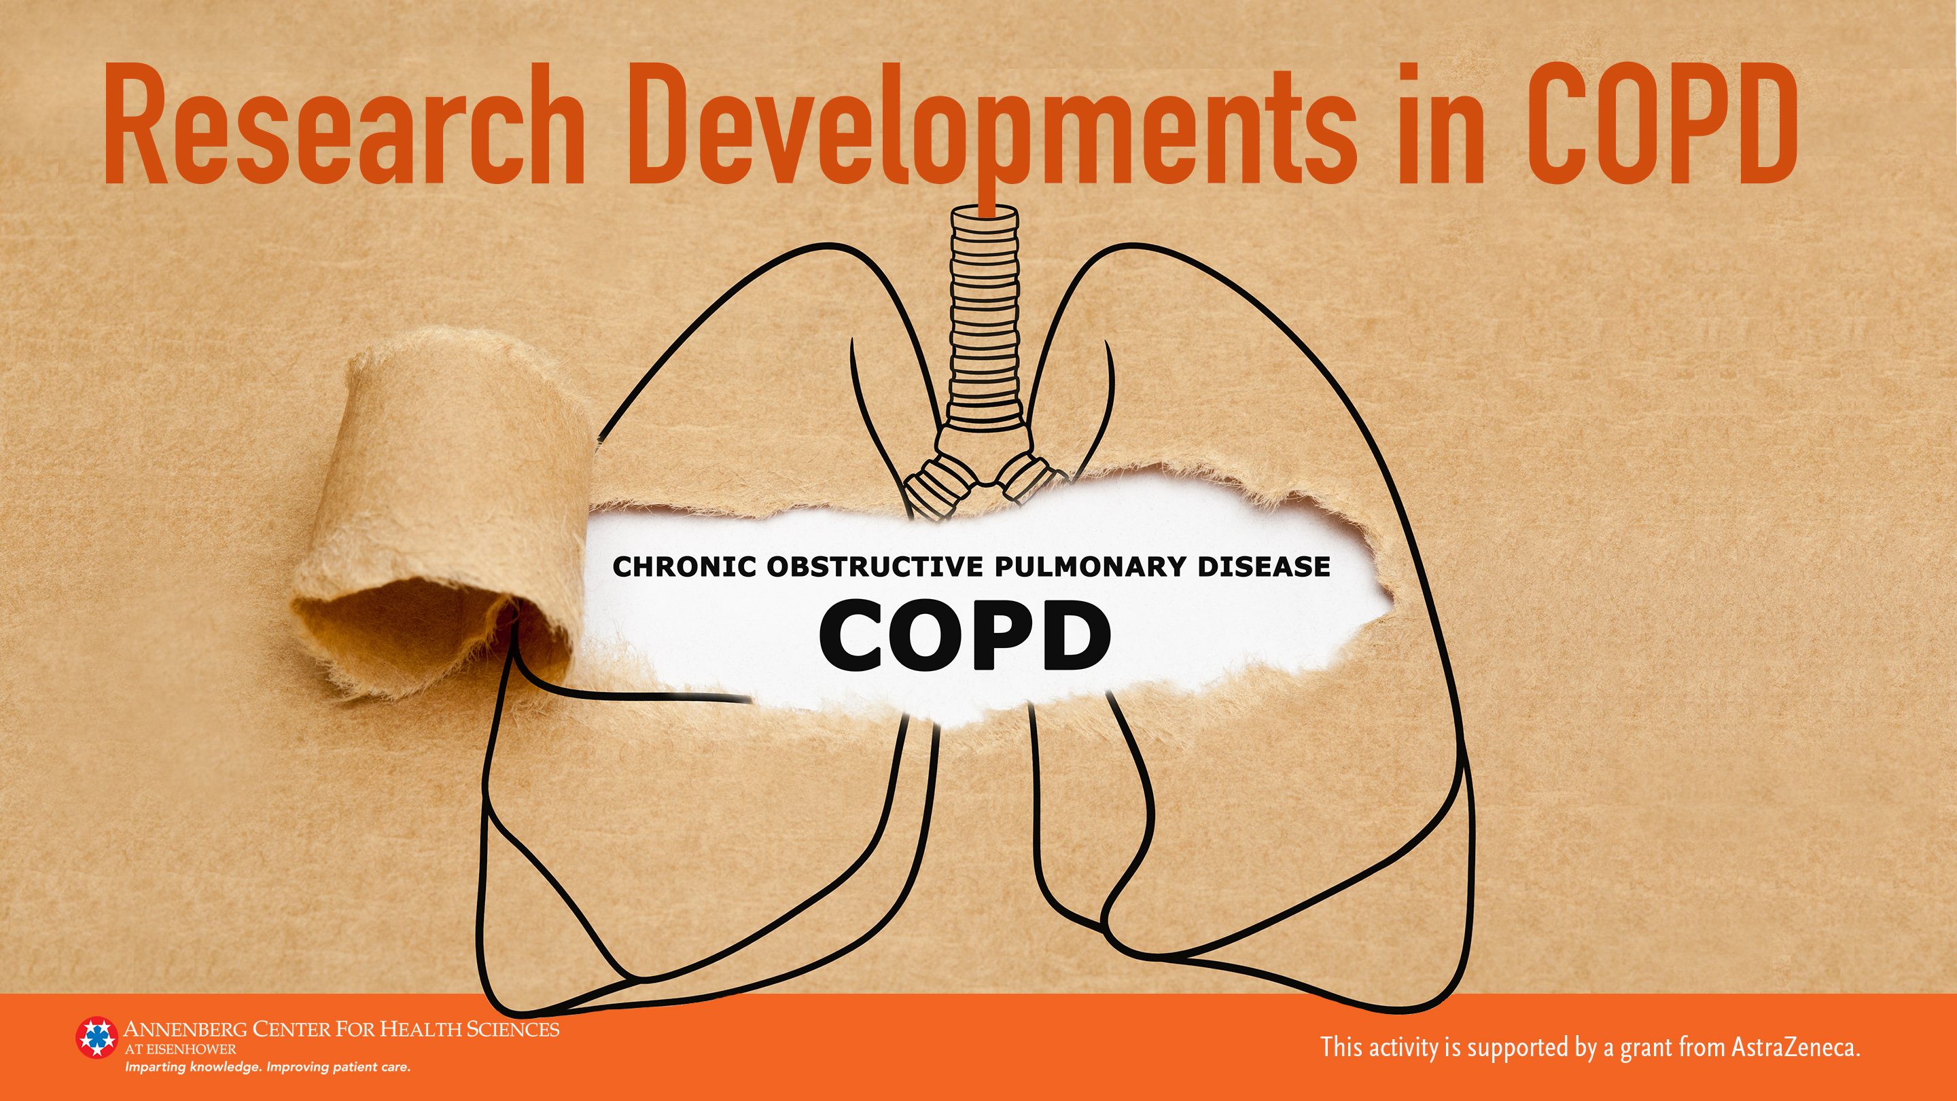

Slide 2
TRIPLE THERAPY REDUCES COPD EXACERBATIONS REQUIRING SYSTEMIC CORTICOSTEROIDS: A POST-HOC ANALYSIS OF THE ETHOS STUDY
Celli B, et al.
https://journal.chestnet.org/article/S0012-3692(21)03101-9/fulltext

Slide 3
Study Details
Objective: To compare systemic corticosteroid (SCS) use and the duration of oral corticosteroids (OCS) between 3 therapies in patients with moderate-to- very-severe COPD
Post-hoc analysis of the ETHOS trial
3 groups:
  Triple therapy with inhaled corticosteroid, long-acting beta agonist and long-acting muscarinic agent--ICS/LABA/LAMA (320 mcg budesonide, 9.6mcg formoterol, 18 mcg glycopyrrolate)
  Dual bronchodilator (LAMA/LABA) (18 mcg glycopyrrolate, 9.6 mcg formoterol) or
  Dual therapy with ICS/LABA (320 mcg budesonide, 9.6 mcg formoterol).

Slide 4
Study Details (continued)
Used negative binomial regression to compare actual number and adjusted annual rate of moderate-to-severe exacerbations requiring SCS
Summary statistics used to compare the number of days per year of OCS

Slide 5
Study Results
Patients in each group:
  ICS/LABA/LAMA: 2137
  LAMA/LABA: 2120
  ICS/LABA: 2131
Exacerbations requiring SCS
  ICS/LABA/LAMA: 1539
  LAMA/LABA: 1837
  ICS/LABA: 1729
Adjusted rate ratio (95% CI) for moderate-to-severe exacerbations
  ICS/LABA/LAMA vs LAMA/LABA: 0.71 (0.64-0.78)
  ICS/LABA/LAMA vs ICS/LABA: 0.84 (0.76-0.93)

Slide 6
Study Results (continued)
Mean number of OCS days
  ICS/LABA/LAMA: 20.9
  LAMA/LABA: 30.0
  ICS/LABA: 23.2

Slide 7
Discussion and Clinical Implications
In people with moderate-to-very-severe COPD, treatment with ICS/LABA/LAMA results in reduced:
  Exacerbation rates requiring SCS
  Number of days of OCS
For those people at high risk of repeated exacerbations—those with frequent prior exacerbations and those with low lung function—triple therapy should be considered as suggested in the ATS guidelines and GOLD recommendations
More research is needed to assess the impact of blood eosinophil levels that may be important in better targeting people most responsive to ICS as part of triple therapy

Slide 8
EFFECTIVENESS OF COPD MAINTENANCE THERAPY WITH LAMA/LABA VS LAMA/LABA/ICS IN A UNITED STATES CLAIMS DATABASE
Quint J, et al.
https://journal.chestnet.org/article/S0012-3692(21)03115-9/pdf

Slide 9
Study Details
Objective: To compare the time to a hospitalization for community-acquired pneumonia or first COPD exacerbation in treatment-naïve patients prescribed dual or triple inhaled therapy
Retrospective analysis using administrative data from the US HealthCore Integrated Research Database
Key inclusion criteria
  Patients with COPD age ≥40 y
  Initiated treatment with ≥1 prescriptions of a LAMA/LABA (tiotropium/olodaterol) or LAMA/LABA/ICS
Key exclusion criteria:
  COPD exacerbation within 30 days of study initiation and in subanalyses if they had prior use of maintenance therapy
A Cox proportional hazard regression model was used to determine outcomes
Reweighting and stratification were used to balance the covariates between the groups including prior exacerbation history

Slide 10
Study Results
2785 patients with LAMA/LABA therapy
15,465 patients with LAMA/LABA/ICS therapy
Adjusted hazard ratio for pneumonia:
  LAMA/LABA vs LAMA/LABA/ICS: 0.83 (95% CI: 0.64-1.07)
Adjusted hazard ratio for time to first COPD exacerbation:
  LAMA/LABA vs LAMA/LABA/ICS: 1.04 (95% CI: 0.91-1.19)
Results were similar when restricting to treatment-naïve patients

Slide 11
Discussion and Clinical Implications
In this cohort of patients, risk of pneumonia and exacerbations did not differ between the 2 choices even when the group included only treatment-naïve patients.
The study required extensive adjustments to the populations and results to account for differences in the groups—especially the higher baseline rate of severe exacerbations in the triple therapy group.
In practice, treatment choice might be further guided by blood eosinophil counts, smoking status, and prior medication use.
The study highlights the need to consider initiation of dual bronchodilator therapy as highlighted in ATS guidelines and GOLD recommendations.

Slide 12
PROMPT INITIATION OF MAINTENANCE THERAPY IN THE UNITED STATES (PRIMUS): AN ANALYSIS OF TRIPLE THERAPY FOLLOWING A DISEASE EXACERBATION AMONG PATIENTS WITH COPD
Tkazc J, et al.
https://journal.chestnet.org/article/S0012-3692(21)03086-5/pdf

Slide 13
Study Details
Goal: To compare the risk of future COPD exacerbations between patients receiving early vs delayed initiation of inhaled triple therapy (TT) following either a severe (hospital treated) exacerbation or ≥2 moderate (outpatient steroid treated) exacerbations.
Patients were identified from the IBM MarketScan databases between 2010 and 2019.
Patients were categorized based on the timing of the initiation of TT following the severe or second moderate exacerbation:
  Prompt (<30 days)
  Delayed (31-180 days)
  Very delayed (>180 days)
Chi-square and ANOVA were used to compare the number and severity of exacerbations during the 12 months after initiation of TT.

Slide 14
Study Results
Patient groups stratified by time of treatment initiation:
  Prompt: 7577
  Delayed: 9676
  Very delayed: 7517
Mean (SD) number of severe exacerbations
  Prompt 1.3 (1.6)
  Delayed 2.1 (1.8)
  Very delayed 2.8 (2.2)
Results in the prompt initiation group were statistically different vs delayed and very delayed groups

Slide 15
Study Results (continued)
Proportion of patients with ≥4 exacerbations
  Prompt 9.6%
  Delayed 19.3%
  Very Delayed 32.6%
Proportion of patients with a severe exacerbation
  Prompt 9.4%
  Delayed 14.7%
  Very delayed 21.7%
Results in the prompt initiation group were statistically different vs delayed and very delayed groups

Slide 16
Discussion and Clinical Implications
Delay in initiating triple therapy in this group of severe or frequent exacerbators resulted in greater morbidity, higher hospital admission rates, and more frequent exacerbations
This study highlights the importance of follow-up visits after exacerbations to review medications and start appropriate therapy
Smoking status and blood eosinophil levels were not considered which might further help to identify the group with the best response to TT
Additionally, a study of barriers to early treatment (lack of follow-up, cost of therapy, patient reluctance or physician reticence) would be helpful

