Slide 1
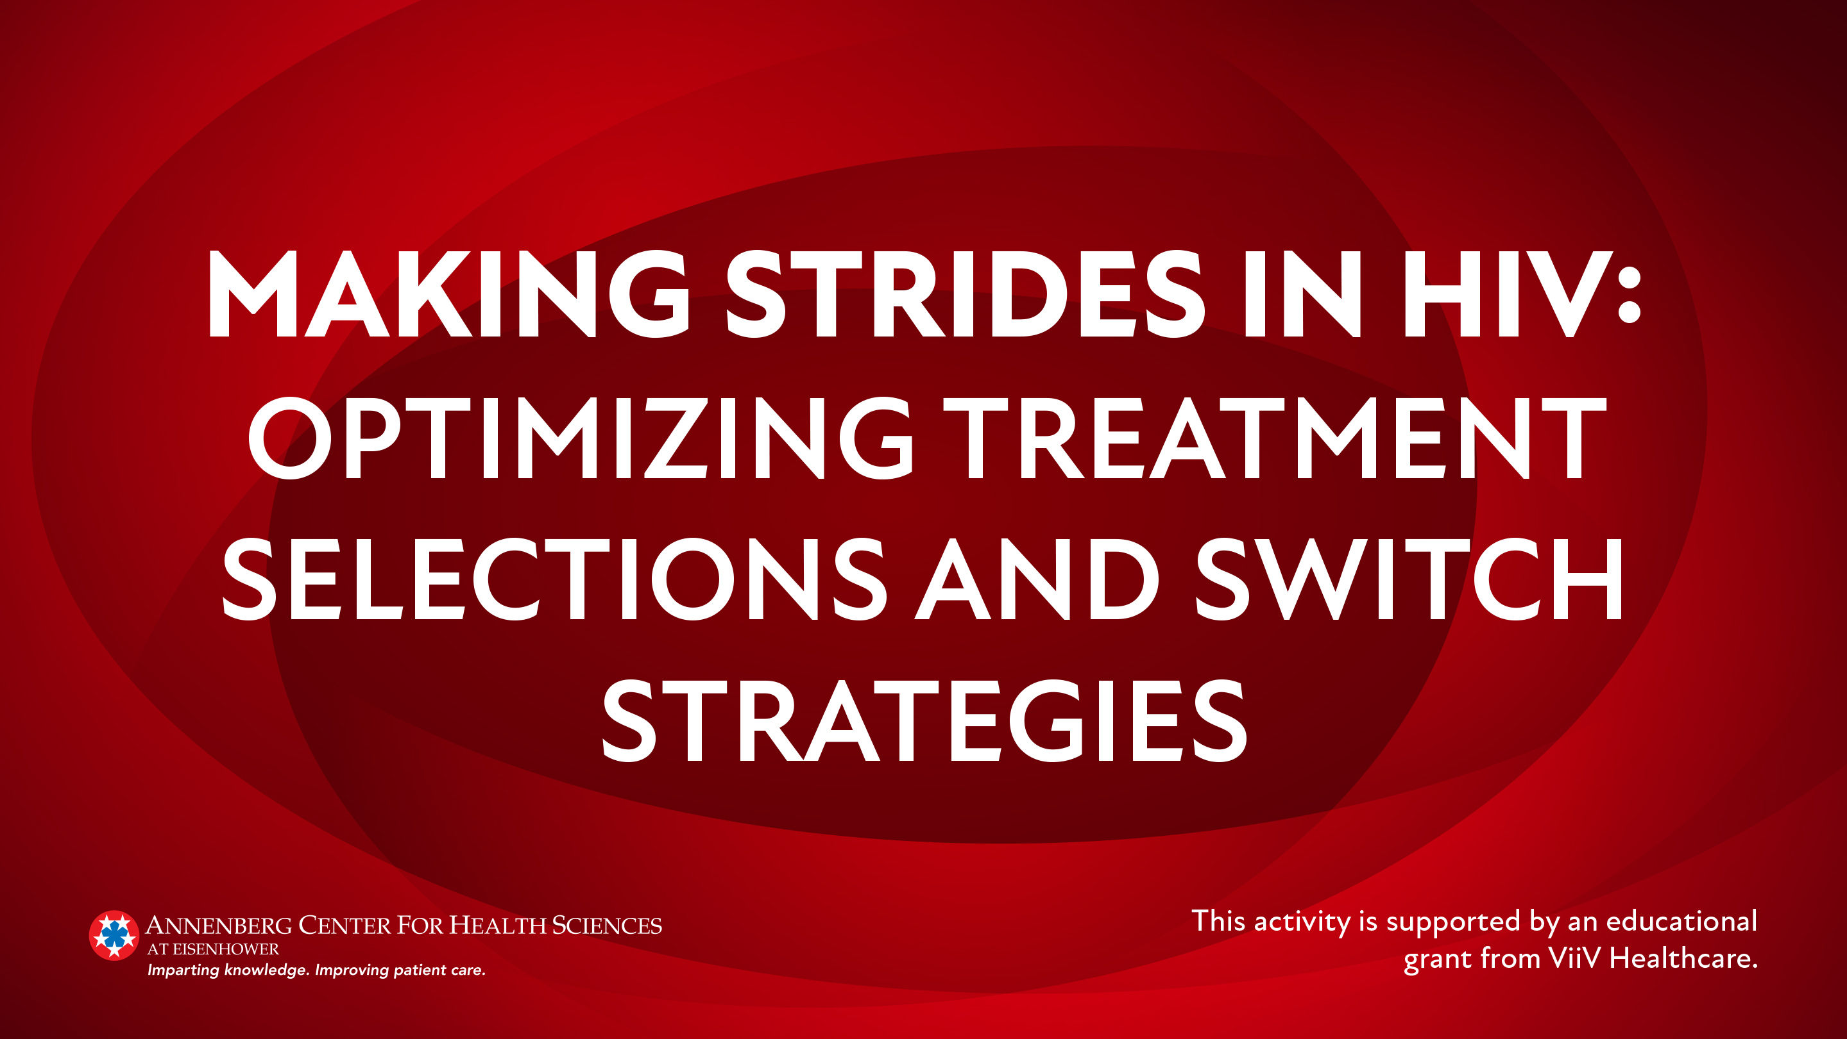

Slide 2
Faculty
W. David Hardy, MD, AAHIVS
Scientific and Medical Consultant
Adjunct Clinical Professor of Medicine, Division of Infectious Diseases
Keck School of Medicine of USC
David Alain Wohl, MD
Professor of Medicine, Division of Infectious Diseases
Site Leader, HIV Prevention and Treatment Clinical Trials Unit at Chapel Hill
University of North Carolina School of Medicine
Co-Lead, UNC Viral Hemorrhagic Fever Research Working Group

Slide 3
Red Line
Epidemiology of HIV in a
(Post-)pandemic Era

Slide 4
HIV Epidemiologic Trends in the
Setting of the COVID-19 Pandemic

Slide 5
The Number of HIV Diagnoses in the US Was Decreasing Pre-Pandemic for Most Persons at Risk: By Gender Identity
Number of New HIV Diagnoses in the US^{1,2}
2006: Approx. 56,300
2014: Approx. 40,200
2018: Approx. 37,500
2014ª
Cisgender Men: 31,972
Cisgender Women: 7,657
Transgender Women: 523
Transgender Men: 27
2018ª
Cisgender Men: 29,794
Cisgender Women: 7,109
Transgender Women: 553
Transgender Men: 47
ªNot enough data for additional gender identities to determine trends
¹Centers for Disease Control and Prevention (CDC). May 2020. Accessed June 1, 2021. https://www.cdc.gov/hiv/library/reports/hiv-surveillance/vol-31/content/diagnoses.html
²Centers for Disease Control and Prevention (CDC). August 2008. Accessed June 1, 2021. https://www.cdc.gov/nchhstp/newsroom/docs/fact-sheet-on-hiv-estimates.pdf

Slide 6
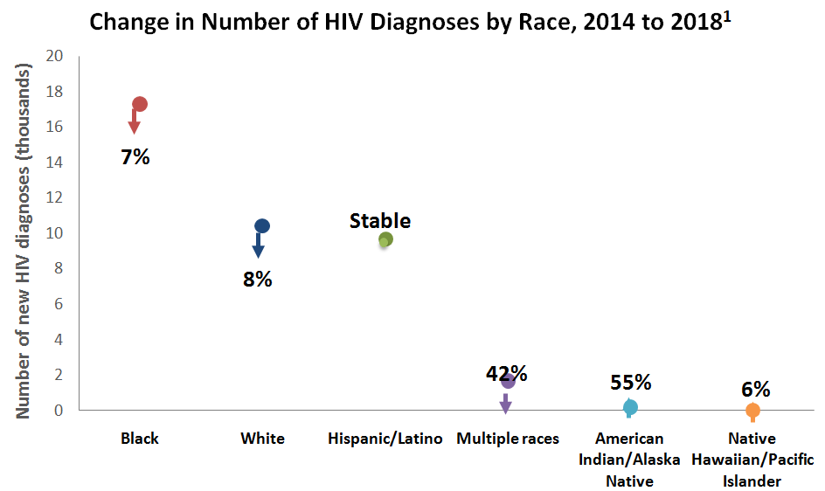
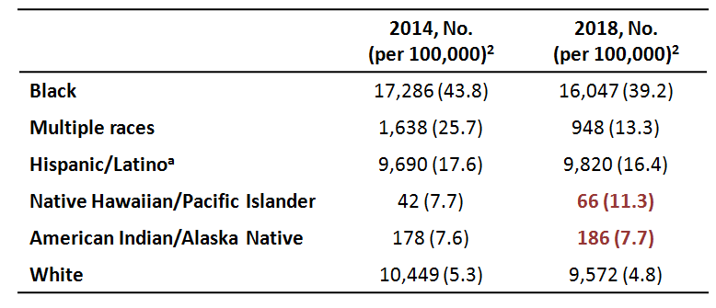
The Number of HIV Diagnoses in the US Was Decreasing Pre-Pandemic for Most Persons at Risk: By Race/Ethnicity
-
-
-
+
+
ªHispanic/Latino individuals can be of any race
¹Centers for Disease Control and Prevention (CDC). November 2020. Accessed June 1, 2021. https://www.cdc.gov/hiv/statistics/overview/ataglance.html
²Centers for Disease Control and Prevention (CDC). May 2020. Accessed June 1, 2021. https://www.cdc.gov/hiv/library/reports/hiv-surveillance/vol-31/content/diagnoses.html

Slide 7
Women of Color Have Experienced the Greatest Declines in HIV Diagnoses From 2014 to 2018
Males
Females
Cisgender males (total)¹: –7%
Black males^{2,a}: –6%
Hispanic/Latino males^{3,a}: Stable
Asian males^{4,a}: Stable
Cisgender females (total)¹: –7%
Black females^{2,a}: –10%
Hispanic/Latino females^{3,a}: –9%
Asian females^{4,a}: –18%
ªBased on sex at birth, includes cisgender and transgender people
¹Centers for Disease Control and Prevention (CDC). May 2020. Accessed June 1, 2021. https://www.cdc.gov/hiv/library/reports/hiv-surveillance/vol-31/content/diagnoses.html
²Centers for Disease Control and Prevention (CDC). January 2021. Accessed June 1, 2021. https://www.cdc.gov/hiv/group/racialethnic/africanamericans/index.html
³Centers for Disease Control and Prevention (CDC). March 2021. Accessed June 1, 2021. https://www.cdc.gov/hiv/group/racialethnic/hispaniclatinos/index.html
⁴Centers for Disease Control and Prevention (CDC). May 2020. Accessed June 1, 2021. https://www.cdc.gov/hiv/group/racialethnic/asians/index.html
Notes:
Jessica Martin 7/29/2021
Highlighted declines in Black, Hispanic, and Asian females to emphasize the declines in women of color

Slide 8
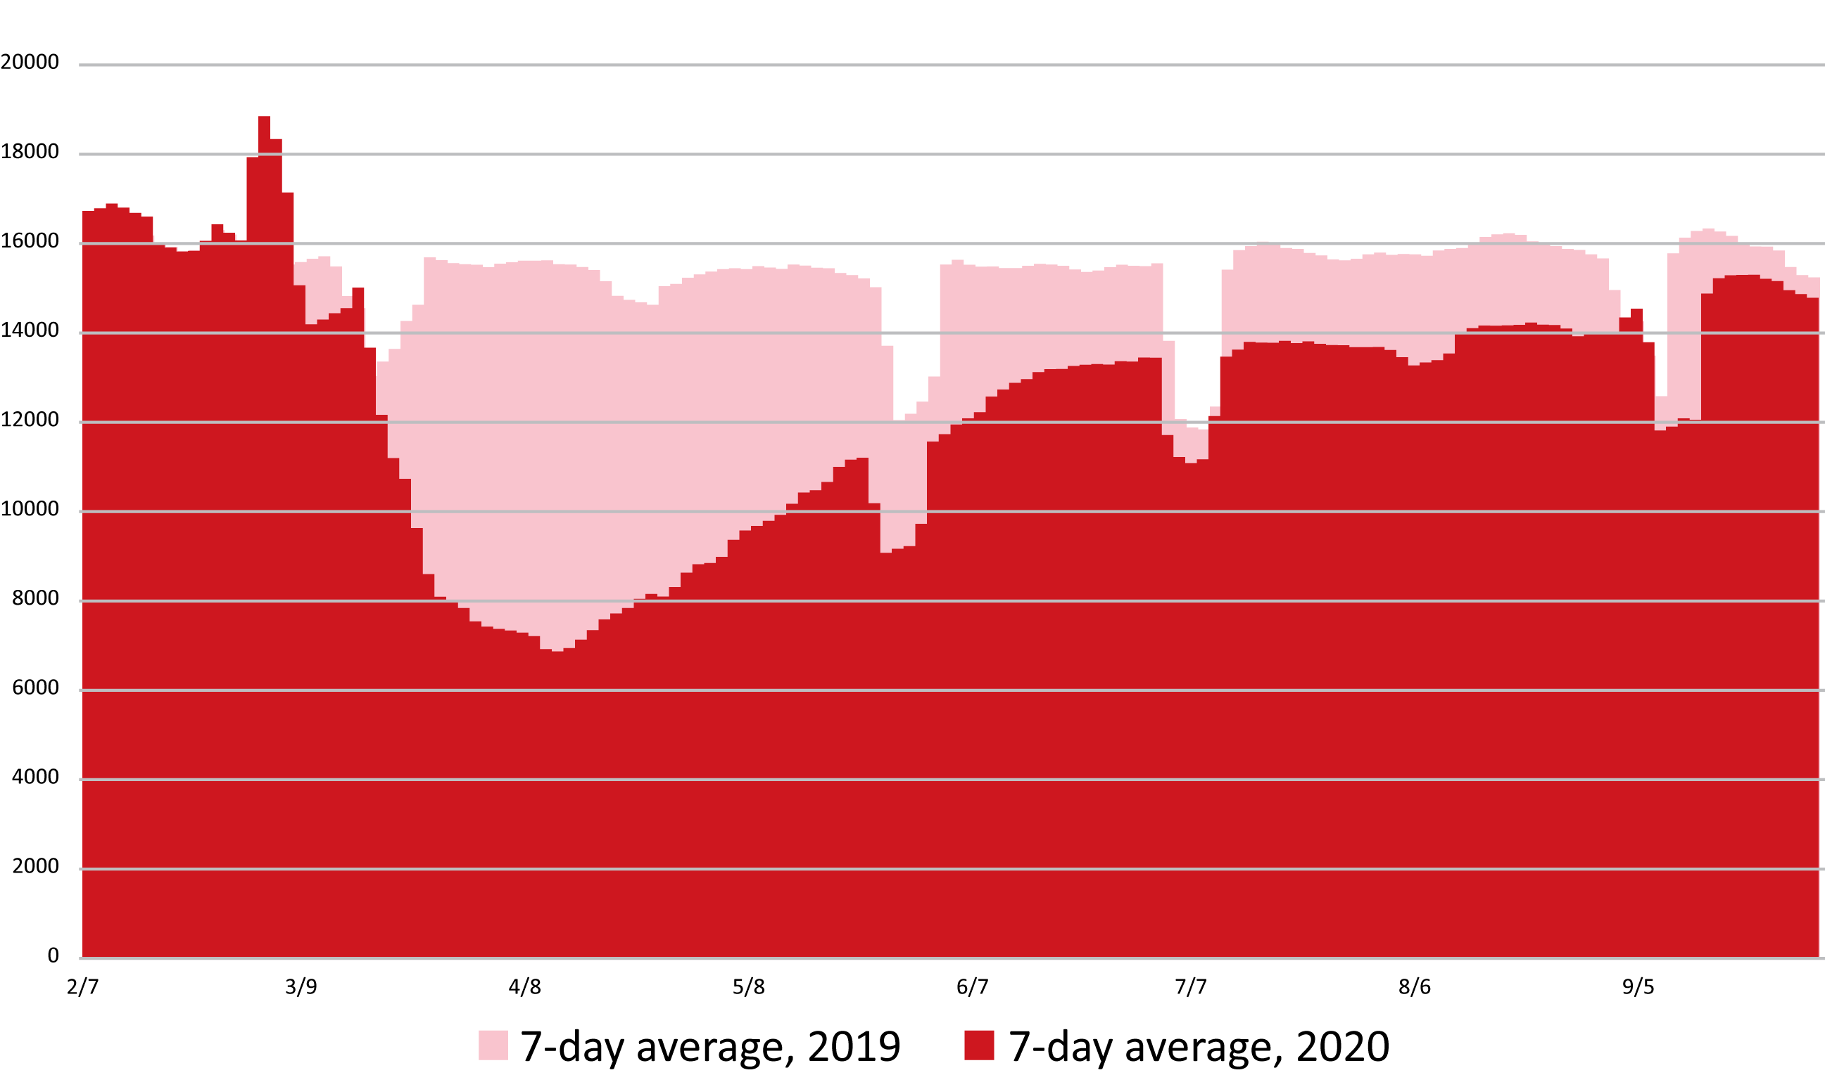
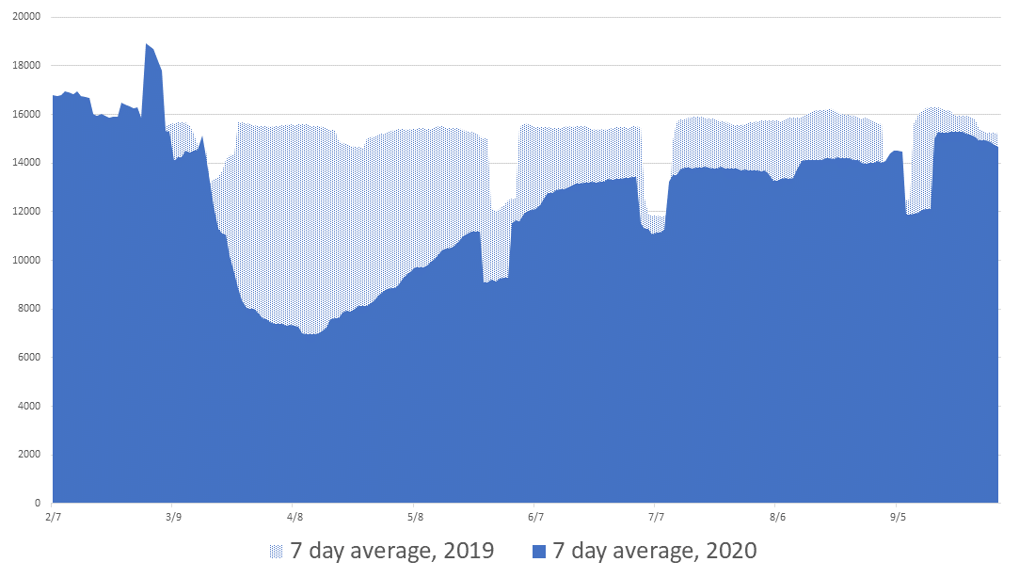
Screening for HIV Declined During the COVID-19 Pandemic…
According to National Syndromic Surveillance Program laboratory data, between March 13 and September 30, 2020, there were:
7-Day Moving Average of HIV Screening Tests From February 1 to September 30
669,847
Fewer HIV screening tests performedª
4,910
Fewer HIV-1 diagnosesª
67,694
Fewer HIV-1 viral load tests performedª
ªCompared with the same period in 2019
Delaney KP et al. Conference on Retroviruses and Opportunistic Infections (CROI). 2021. Abstract 739. https://www.croiconference.org/abstract/impact-of-covid-19-on-commercial-laboratory-testing-for-hiv-in-the-united-states/
Notes:
Jessica Martin 6/9/2021
Permissions needed for the chart on the right.

Slide 9
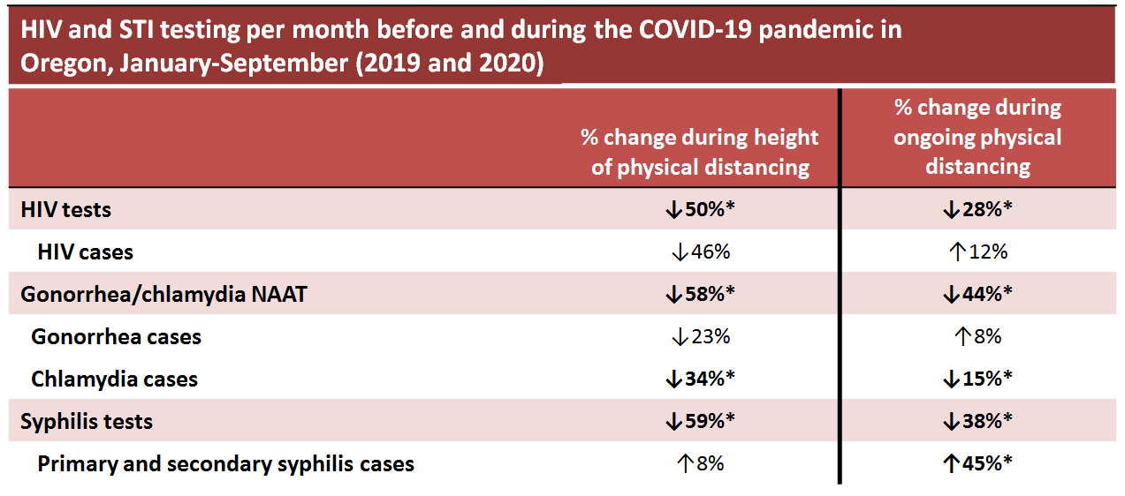
…But Rate of Positive HIV and STI Tests May be Stable or Increased Depending on COVID-19 Mitigation Conditions
*P <.01
STI, sexually transmitted infection; CI, confidence interval; IRR, incidence rate ratio; NAAT, nucleic acid amplification test; RPR, rapid plasma regain
Menza TW et al. Conference on Retroviruses and Opportunistic Infections (CROI). 2021. Abstract 144. https://ww2.aievolution.com/cro2101/index.cfm?do=abs.viewAbs&abs=1168

Slide 10
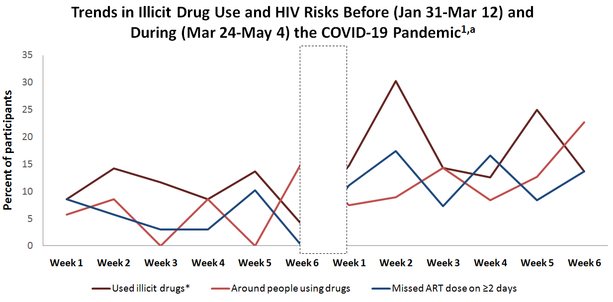
Substance Use and Availability of Syringe Exchange Programs May Have Been Affected by the Pandemic
Changes in syringe service programs across early COVID-19 hot spots^{2,b}
-43%
Decrease in services, including HIV testing
25%
Closed
ªAccording to weekly surveys completed by PLWH and substance use disorder treated at HIV clinics within Wisconsin
^{b}According to a survey of 173 programs in Detroit, New Orleans, New York City, Philadelphia, and Seattle
*Besides marijuana
PLWH, people living with HIV
¹Hochstatter KR et al. AIDS Behav. 2021;25(2):354-359.
²Glick SN et al. AIDS Behav. 2020;24(9):2466-2468.

Slide 11
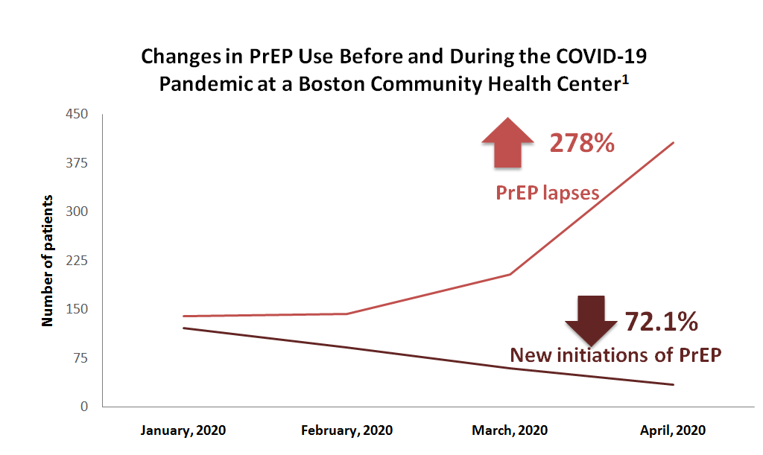
PrEP Use Decreased During the Early Days of the Pandemic
Refill lapses were associated with being:¹
  - ≤26 years old (P =.001)
  - Non-White (P =.001)
  - Latinx (P =.049)
  - Publicly insured (P =.002)
Across the US, models estimate that there was a 31.3% reduction in expected new PrEP users from March to June 2020²
PrEP, preexposure prophylaxis
¹Krakower D et al. AIDS 2020: 23rd International AIDS Conference Virtual. 2020. Abstract OACLB0104. https://programme.aids2020.org/Abstract/Abstract/11755
²Huang YLA et al. Conference on Retroviruses and Opportunistic Infections (CROI). 2021. Abstract 731. https://www.croiconference.org/abstract/impact-of-covid-19-on-prep-prescriptions-in-the-united-states-a-time-series-analysis/

Slide 12
COVID-19 and Ongoing HIV Disparities

Slide 13
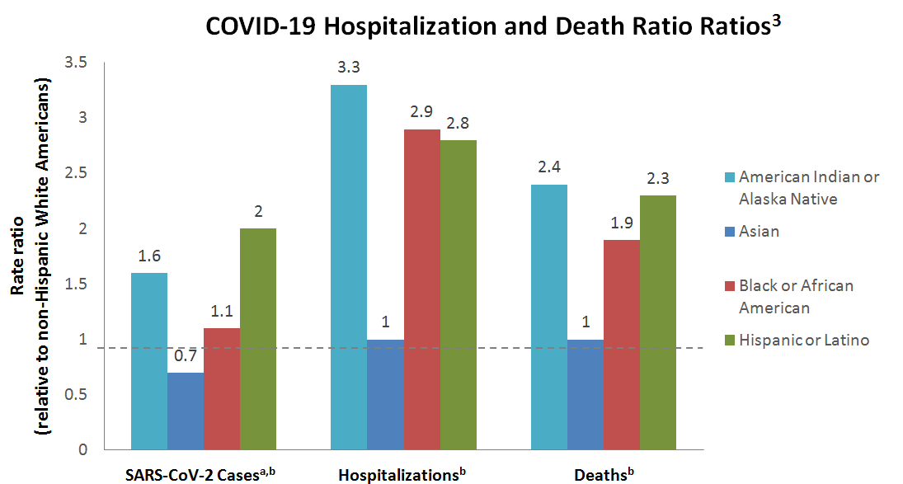
The COVID-19 Pandemic Has Exacerbated Existing Health Inequities Among PLWH
BIPOC communities are disproportionately impacted by both HIV and COVID-19^{1,2}
ªBased on 61% of case reports that include race/ethnicity
^{b}Age-adjusted standardized rates based on 2019 US population
BIPOC, Black, Indigenous, and people of color
¹Millett GA. J Int AIDS Soc. 2020;23(11):e25639.
²Fields EL et al. Lancet. 2021;397(10279):1040-1042.
³Centers for Disease Control and Prevention (CDC). May 2021. Accessed June 7, 2021. https://www.cdc.gov/coronavirus/2019-ncov/covid-data/investigations-discovery/hospitalization-death-by-race-ethnicity.html

Slide 14
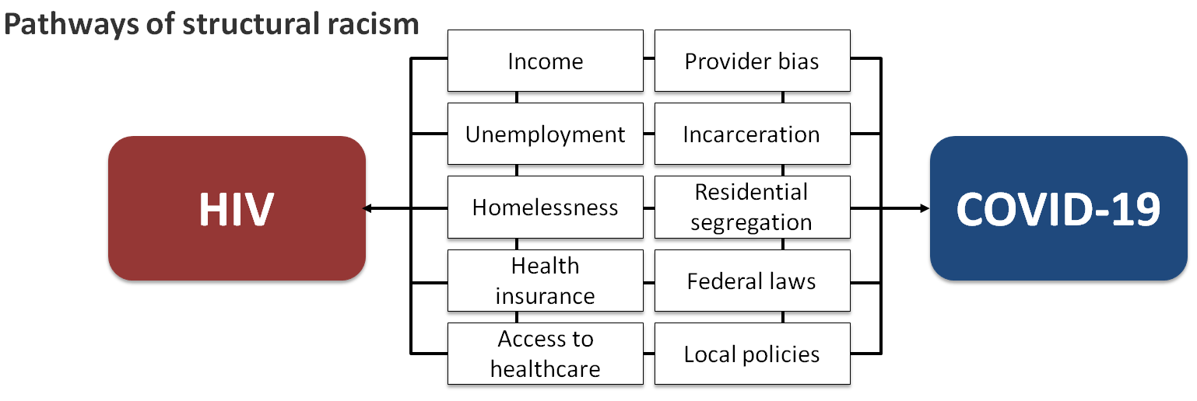
Health Inequities Stem From Structural Racism
Social determinants of health, including socioeconomic status and physical environment, are more significant drivers of health outcomes than health care alone
Millett GA. J Int AIDS Soc. 2020;23(11):e25639.

Slide 15
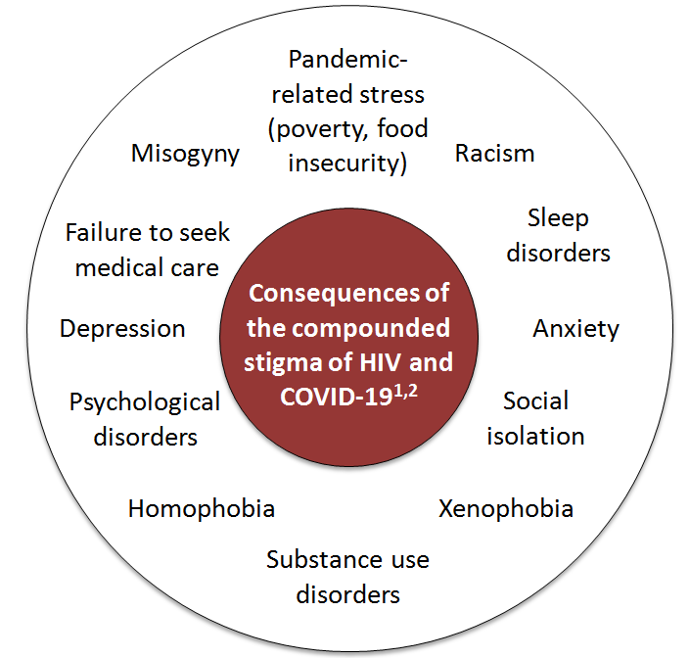
COVID-19 and HIV Stigma: Double Jeopardy
The compounded stigma associated with HIV and COVID-19 diagnoses may lead to mental health distress and failure to seek care¹
Stigma is additive for disenfranchised individuals and may exacerbate health disparities^{1,3}
These stigmas may cause patients to be hesitant to disclose their positivity status¹
¹Waterfield KC et al. BMC Public Health. 2021;21(1):299.
²Shiau S et al. AIDS Behav. 2020;24(8):2244-2249.
³Okonkwo NE et al. BMJ Evid Based Med. 2020;bmjebm-2020-111426.

Slide 16
The Transition to Telehealth May Exacerbate Health Disparities
Black Americans are significantly less likely to access telemedicine compared with White Americans.^{1,2}
Black patients are offered the option of telemedicine at lower rates than White and Hispanic patients and are less likely to have access to the necessary technology.³
The use of telemedicine is also reduced for:²
  Older adults
  Patients from urban areas
  Self-paying patients
  Patients on publicly-funded insurance
  Patients with limited English proficiency⁴
Young females are driving increased use of telemedicine among Black patients.¹
¹Chunara R et al. J Am Med Inform Assoc. 2021 ;28(1):33-41.
²Pierce RP et al. J Telemed Telecare. 2020;1357633X20963893.
³Jacobs M et al. J Am Geriatr Soc. 2021.
⁴Rodriguez JA et al. Health Aff (Millwood). 2021;40(3):487-495.

Slide 17
Common Comorbidities in HIV

Slide 18
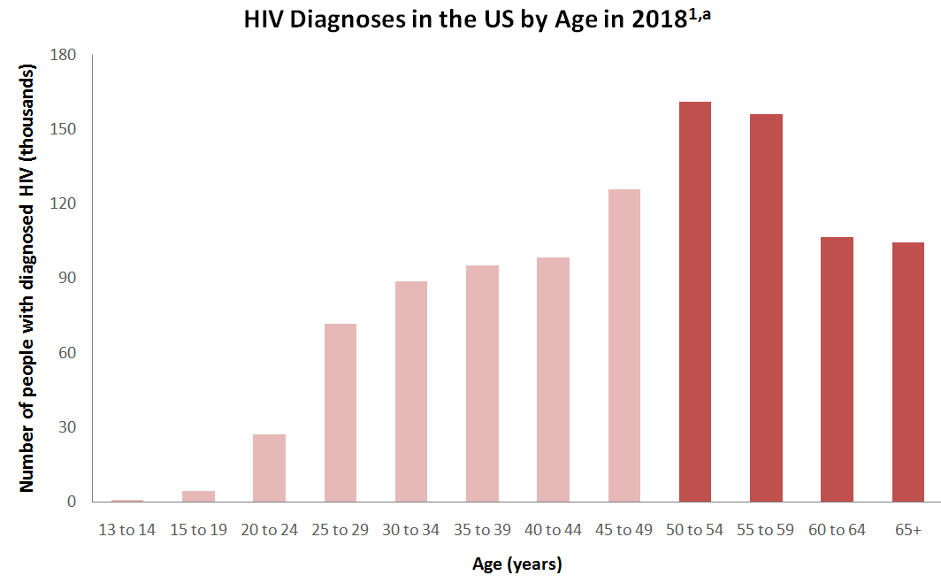
PLWH Are Increasing in Age
51%
Proportion of adults and adolescents with diagnosed HIV in the US ≥50 years^{1,a}
17%
Proportion of new HIV diagnoses in the US occurring in people ≥50 years^{1,a}
¹Centers for Disease Control and Prevention (CDC). September 2020. Accessed June 1, 2021. https://www.cdc.gov/hiv/group/age/olderamericans/index.html
²Back D and Marzolini C. J Int AIDS Soc. 2020;23(2):e25449.

Slide 19
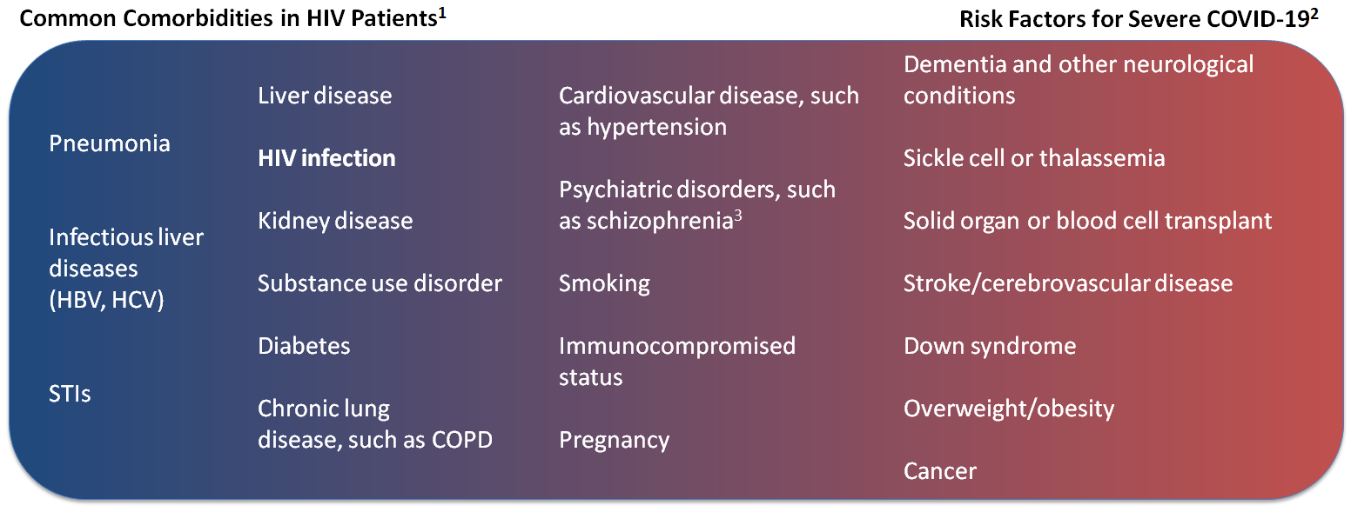
Risk Factors for Severe COVID-19 Overlap With Common HIV Comorbidities
¹Lorenc A et al. London J Prim Care (Abingdon). 2014;6(4): 84–90.
²Centers for Disease Control and Prevention (CDC). May 2021. Accessed June 1, 2021. https://www.cdc.gov/coronavirus/2019-ncov/need-extra-precautions/people-with-medical-conditions.html
³Nemani K et al. JAMA Psychiatry. 2021;78(4):380-386.
Notes:
Jessica Martin 7/29/2021
Updated slide to be a gradient rather than distinct overlapping boxes

Slide 20
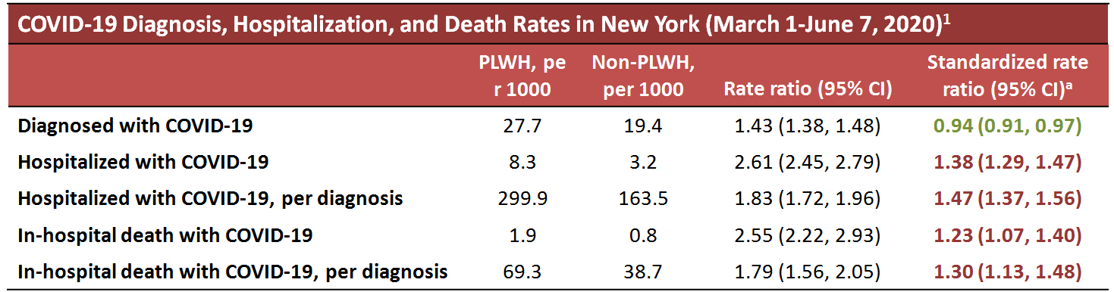
Overlapping Comorbidities Increase the Risk for Hospitalization and Death With COVID-19 But Not COVID-19 Itself
PLWH are at increased risk for hospitalization and death due to COVID-19.^{1,2}
After adjusting for comorbidities, the risk for COVID-19 hospitalization is similar to that observed in HIV-negative individuals.^{2,a}
  Comorbidities: Severe liver disease, diabetes, cancer, renal disease, and total number of comorbidities
ªAccording to a review of data from 292,226 patients across 34 sites in the US National COVID Cohort Collaborative²
¹Tesoriero JM et al. JAMA Netw Open. 2021;4(2):e2037069.
²Sun J et al. Conference on Retroviruses and Opportunistic Infections (CROI). 2021. Abstract 103. https://www.croiconference.org/abstract/covid-19-hospitalization-among-people-with-hiv-or-solid-organ-transplant-in-the-us/
Notes:
Jessica Martin 7/29/2021
Added highlights to emphasize that HIV does not increase the risk for COVID-19, but does increase the risk for complications from COVID-19 (due to comorbidities). Also modified title. Let me know if this is more clear or if it would be best to alter this in another way.

Slide 21
Orange Line
2-Drug Regimens vs 3-Drug Regimens

Slide 22
Current Guideline Recommendations for Newly Diagnosed PLWH (DHHS, IAS-USA)

Slide 23
Rapid Initiation of ART is Recommended by Guidelines
Clinical guidelines from the Department of Health and Human Services (DHHS) and International Antiviral Society (IAS)-USA recommend initiating ART as soon as possible after diagnosis, including immediate initiation if possible.^{1,2}
Rapid ART: Initiation of ART as soon as possible, within 7 days of HIV diagnosis¹
Immediate/same-day ART: Initiation of treatment on the day of diagnosis¹
Rapid ART is recommended in order to:²
  Increase the uptake of ART and engagement in care
  Decrease the time to virologic suppression within individuals
  Reduce the time during which newly diagnosed PLWH can transmit HIV
  Improve the rate of virologic suppression among PLWH
¹Saag MS et al. JAMA. 2020;324(16):1651-1669.
²Department of Health and Human Services (DHHS). December 2019. Accessed May 28, 2021. https://clinicalinfo.hiv.gov/en/guidelines/adult-and-adolescent-arv/initiation-antiretroviral-therapy?view=full
Notes:
Wohl, David A 7/14/2021
Define rapid.
Jessica Martin 7/29/2021
This is in the first bullet point--should another/different definition be added?

Slide 24
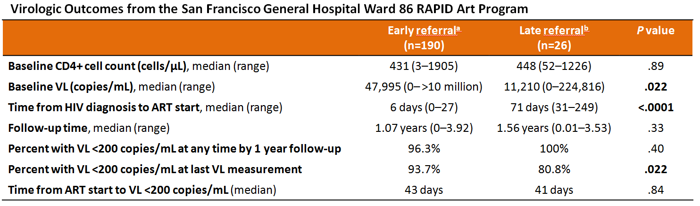
RAPID: Rapid Initiation of ART can Help Maintain Virologic Control in an Urban Environment
Considerations and caveats
Large, well-funded clinic in an urban setting; clinic had supply of medications on hand, which were covered by local government
High rates of substance use (51.4%), mental illness (48.1%), and housing instability (30.6%) in cohort
RAPID, Rapid ART Program for Individuals with an HIV Diagnosis; VL, viral load
ªReferred <30 days after HIV diagnosis
^{b}Referred 30 days to 6 months after HIV diagnosis
Coffey S et al. AIDS. 2019;33(5):825-832.

Slide 25
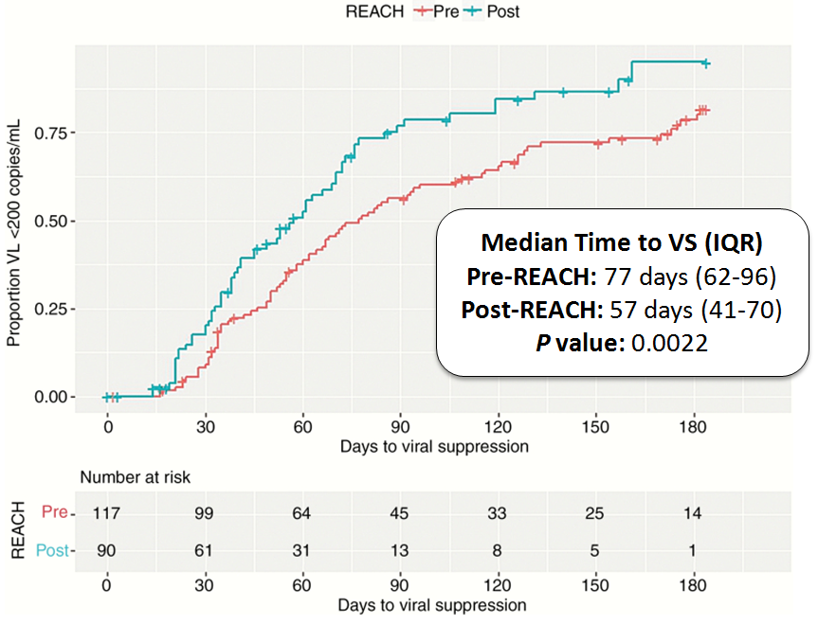
REACH: Rapid Initiation of ART in Atlanta, GA
The REACH program allowed for initiation of ART within 72 hours of HIV diagnosis
Served disenfranchised populations
  87.9% using publicly-funded insurance
  75.8% unemployed
  60.9% with housing instability
  44% with active substance use
No difference observed in the proportion of patients who achieved VS compared with historical rates
  Significantly reduced time to VS
Funding challenges implementation and sustainability
REACH, Rapid Entry and ART in Clinic for HIV; VS, virologic suppression; IQR, interquartile range
Image courtesy of Colasanti J et al. Open Forum Infect Dis. 2018;5(6):ofy104. CC BY-NC-ND 4.0.
Colasanti J et al. Open Forum Infect Dis. 2018;5(6):ofy104.

Slide 26
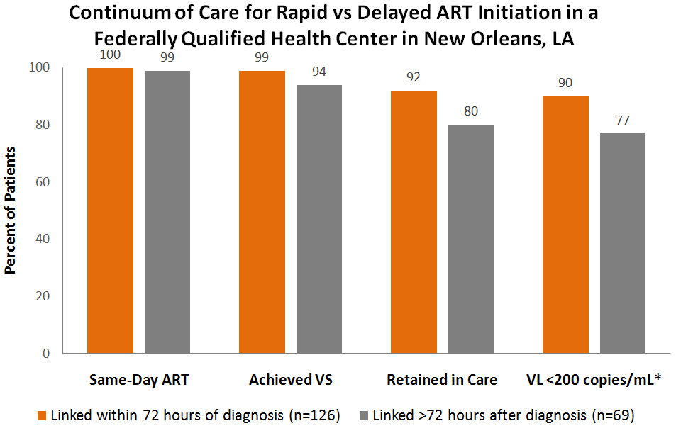
Immediate Initiation of ART May Improve Virologic Suppression
Participants (N=195) were started on a 30-day regimen of TAF/FTC + DTG
  The majority of patients were referred from ambulatory care setting
  Over half of patients were enrolled in Medicaid
Differences in retention and virologic suppression were significant (P <.05)
*Between March 1 and September 1, 2018
TAF, tenofovir alafenamide; FTC, emtricitabine; DTG, dolutegravir
Halperin J et al. Open Forum Infect Dis. 2019;6(4):ofz161.

Slide 27
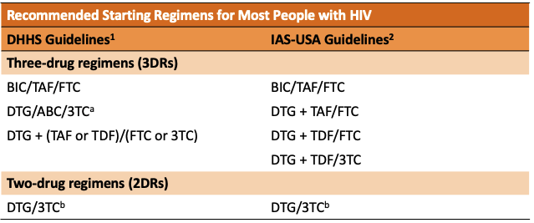
Guideline-Recommended Initial ART Regimens
NOTE: DTG/3TC not recommended as rapid-start regimen.
ªIf HLA-B*5701 negative
^{b}Not recommended for rapid ART, requires baseline laboratory evaluation. Not recommended for patients with HIV RNA >500,000 copies/mL, HBV coinfection, baseline M184V mutations, and perhaps CD4+ T cell count <200 cells/μL, although the latter is unclear.
BIC, bictegravir; TAF, tenofovir alafenamide; FTC, emtricitabine; DTG, dolutegravir; ABC, abacavir; 3TC, lamivudine; TDF, tenofovir disoproxil fumarate; RAL, raltegravir
¹Department of Health and Human Services (DHHS). December 2019. Accessed May 28, 2021. https://clinicalinfo.hiv.gov/en/guidelines/adult-and-adolescent-arv/initiation-antiretroviral-therapy?view=full
²Saag MS et al. JAMA. 2020;324(16):1651-1669.

Slide 28
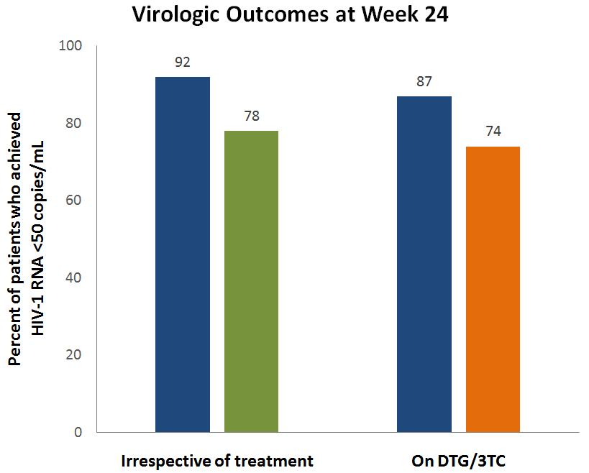
STAT Trial: Rapid Initiation of DTG/3TC
DTG/3TC initiated within 14 days of HIV diagnosis (n=131)
Efficacy endpoints
  Observed: Proportion with plasma HIV-1 RNA <50 copies/mL, regardless of change in regimen, among those with available data at week 24 (n=111)
  ITT-E missing = failure: Participants with no HIV-1 RNA data at week 24 classified as HIV-1 RNA ≥50 copies/mL (n=131)
  FDA snapshot: Proportion of participants with plasma HIV-1 RNA <50 copies/mL at week 24 still taking DTG/3TC (n=131ª)
Confirmed virologic failure with no resistance development occurred in 2 participants (remained on DTG/3TC)
ª11 participants had no virologic data at week 24
Rolle CP et al. HIV Glasgow Virtual Meeting. 2020. Abstract P020. https://onlinelibrary.wiley.com/doi/10.1002/jia2.25616

Slide 29
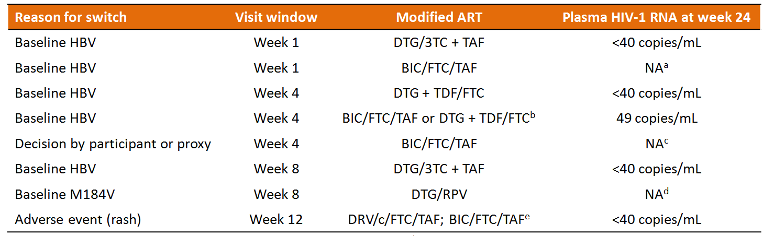
STAT Trial: Reasons for Switching DTG/3TC
ªParticipant in study but missing data in window. Week 36 HIV-1 RNA <40 copies/mL; ^{b}Participant enrolled in another double-blind clinical trial; ^{c}Participant withdrew after switch from DTG/3TC; ^{d}Participant had HIV-1 RNA 18,752 copies/mL at baseline, <40 copies/mL at day 47, switched treatment at day 49, had HIV-1 RNA 54 copies/mL on day 57, and withdrew consent due to relocation at week 12; ^{e}Participant switched ART twice
NA, not available; RPV, rilpivirine; c, cobicistat; DRV, darunavir
Rolle CP et al. HIV Drug Therapy Glasgow Virtual Meeting. 2020. Abstract P020.

Slide 30
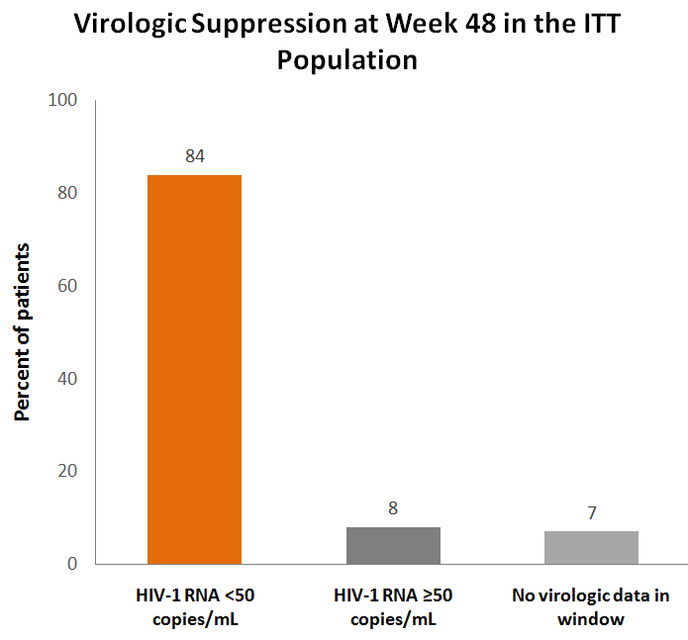
DIAMOND: Initiation of DRV/c/FTC/TAF
D/C/F/TAF initiated within 14 days of HIV diagnosis
Two patients with baseline M184V/I mutations achieved HIV-1 RNA <50 copies/mL by week 4
  One discontinued due to D/C/F/TAF food requirements
  One maintained an undetectable viral load through week 48
ITT, intention to treat
Huhn GD et al. Clin Infect Dis. 2020;71(12):3110-3117.
Notes:
Jessica Martin 7/29/2021
Re comment in last version from Dr Hardy: Unfortunately, no other reported reasons for outcomes <50 copies/mL.

Slide 31
Discussion: How Realistic is Same-Day Start?
Rapid is a relative term
  Is there a difference between same day, <7 days, and <14 days?
What logistical changes do clinics/practices need to make to offer same-day initiation of ART?
There is a lack of high-quality evidence to compare
  Ethical implications of a control arm in rapid-start studies
  B-HASTE (NCT04249037): rapid vs standard start in HIV therapy (ongoing)
How do the populations in these studies compare with most real-world settings?

Slide 32
Animation:
Introduction to 2 Drug ART Regimens

Slide 33
Introduction to 2 Drug ART Regimens
Link to Annenberg HIV 2DRs Video 1 091721.mp4

Slide 34
Clinical Trials of Oral 2DR in
Treatment-naïve PLWH

Slide 35
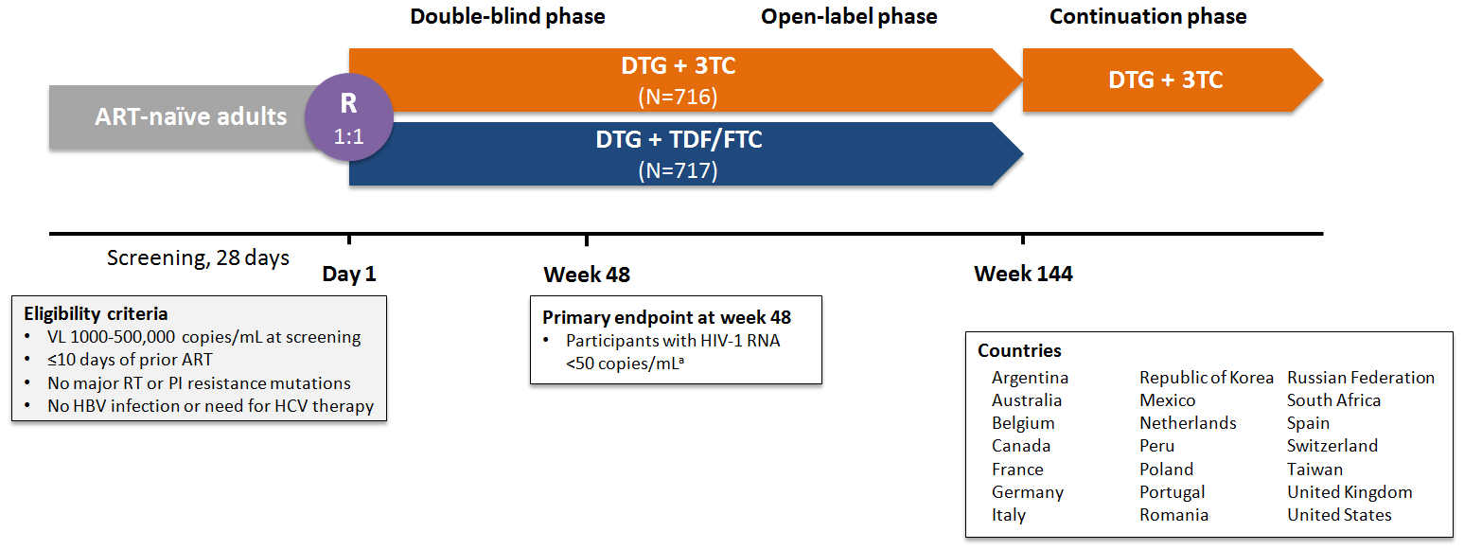
GEMINI: Durable Efficacy of DTG + 3TC in Treatment-Naïve PLWH
ª10% noninferiority margin for individual studies
R, randomized
Cahn P, et al. Durable efficacy of dolutegravir (DTG) plus lamivudine (3TC) in antiretroviral treatment-naïve adults with HIV-1 infection – 3-year results from the GEMINI studies. HIV Glasgow 2020: Abstract P18.

Slide 36
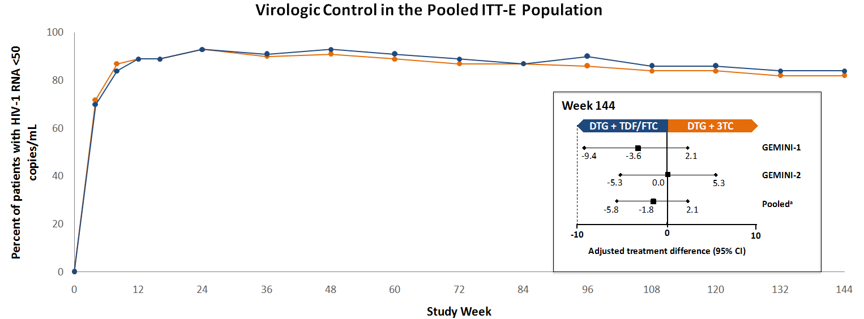
DTG + 3TC Was Noninferior to DTG + TDF/FTC at Week 144
ªBased on Cochran-Mantel-Haenszel stratified analysis adjusting for baseline plasma HIV-1 RNA (≤100,000 vs >100,000 copies/mL), baseline CD4+ cell count (≤200 or 200 cells/mm3), and study (GEMINI-1 vs GEMINI-2)
ITT-E, intention to treat-exposed
Cahn P, et al. Durable efficacy of dolutegravir (DTG) plus lamivudine (3TC) in antiretroviral treatment-naïve adults with HIV-1 infection – 3-year results from the GEMINI studies. HIV Glasgow 2020: Abstract P18

Slide 37
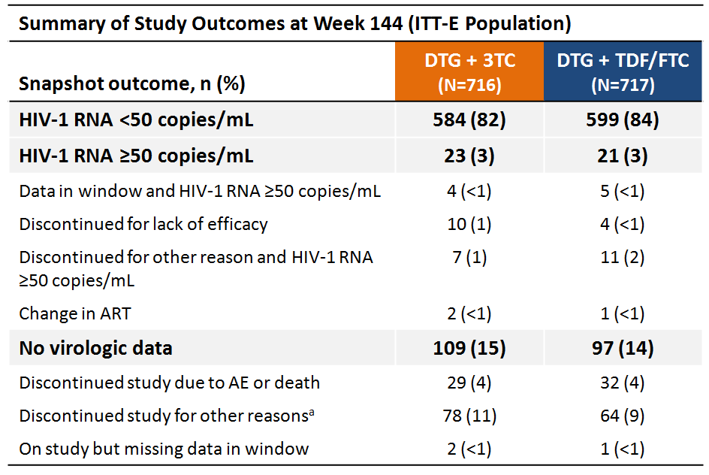
Virologic Outcomes in the Pooled GEMINI Trials at Week 144
Confirmed virologic withdrawal through week 144
  DTG + 3TC: 12 participants (1 since week 96)
  DTG + TDF/FTC: 9 participants (2 since week 96)
  None with treatment-emergent INSTI or NRTI resistance mutations
One participant with reported nonadherence in the DTG + 3TC group developed M184V at week 132 and R263R/K at week 144
  Week 132 HIV-1 RNA: 61,927 copies/mL
  Week 144 HIV-1 RNA: 135 copies/mL
  Conferred 1.8-fold change in resistance to DTG
ªIncluding protocol deviation, loss to follow-up, physician decision, withdrawal by participant, and lack of efficacy
AE, adverse event; INSTI, integrase strand transfer inhibitor; NRTI, nucleoside reverse transcriptase inhibitor
Cahn P, et al. Durable efficacy of dolutegravir (DTG) plus lamivudine (3TC) in antiretroviral treatment-naïve adults with HIV-1 infection – 3-year results from the GEMINI studies. HIV Glasgow 2020: Abstract P18

Slide 38
Current Guideline Recommendations for ART Switching in PLWH with Virologic Suppression

Slide 39
Treatment Switching is Recommended for Simplification or Enhanced Tolerability
“The fundamental principle of regimen optimization is to maintain viral suppression without jeopardizing future treatment options.”¹
Guideline-recommended reasons for treatment switching:¹
Simplification of treatment and pill burden/dosing reduction
Reduce toxicity and/or enhance tolerability
Prevent or mitigate drug-drug interactions
Eliminate food requirements
In the case of pregnancy
To reduce costs
HBV Coinfection
In the case of HBV coinfection, continuation or switch to another first-line HBV antiviral (TDF or TAF) is recommended.¹
Integrase Resistance Mutations
EVG and RAL have relatively low barriers to resistance, and resistance mutations to one typically confer resistance to the other^{1,2}
Other INSTI (BIC and DTG) have higher barriers to resistance¹
¹Department of Health and Human Services (DHHS). December 2019. Accessed May 28, 2021. https://clinicalinfo.hiv.gov/en/guidelines/adult-and-adolescent-arv/initiation-antiretroviral-therapy?view=full
²Anstett K et al. Retrovirology. 2017;14:36.
Notes:
IAS-USA

Slide 40
Clinical Trials of Switching to Oral 2DR in the Context of Virologic Suppression

Slide 41
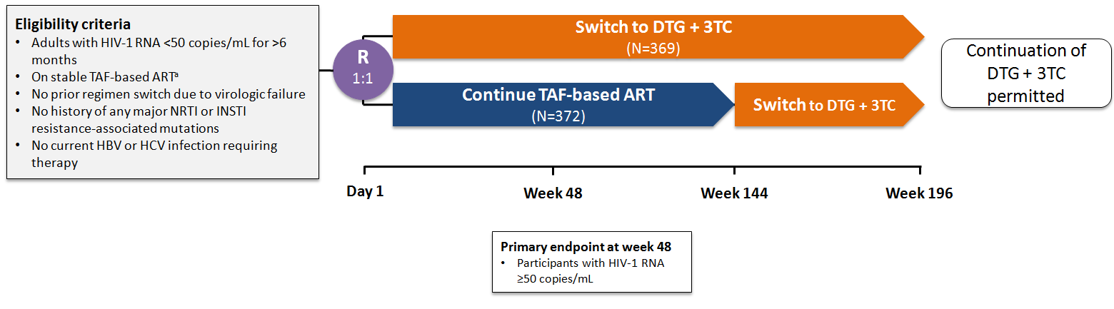
TANGO: Switching to DTG + 3TC in Virologically Suppressed PLWH Receiving Stable TAF-Based ART
Multicenter, randomized, open-label phase 3 noninferiority study
ªPatients eligible if initial regimen was TAF/FTC with PI, NNRTI, or INSTI, or TDF switched to TAF ≥3 months prior to screening with no other regimen change
van Wyk J, et al. Clin Infect Dis. 2020;71(8):1920-1929.

Slide 42
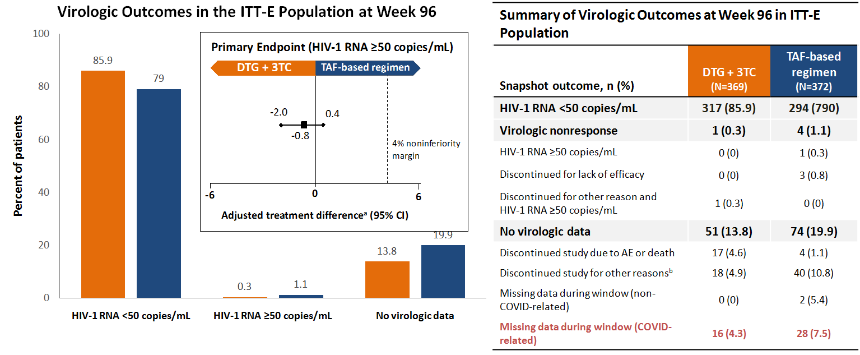
DTG + 3TC Was Noninferior in Maintaining Virologic Suppression Compared With a TAF-Based Regimen
ªBased on Cochran-Mantel-Haenszel stratified analysis adjusting for baseline third agent class
^{b}Protocol deviation, loss to follow-up, physician discretion, participant withdrawal, lack of efficacy (n=1 in TAF-based regimen arm)
van Wyk J, et al. Clin Infect Dis. 2020;71(8):1920-1929.

Slide 43
SALSA: Switching to DTG + 3TC in Virologically Suppressed PLWH Receiving Any Stable ART
Broadened the scope of TANGO from those previously receiving TAF-based ART to those receiving any common 3- or 4-drug regimen ART
Llibre JM et al. IAS 2021, 11th IAS Conference on HIV Science. 2021. Abstract OALB0303.

Slide 44
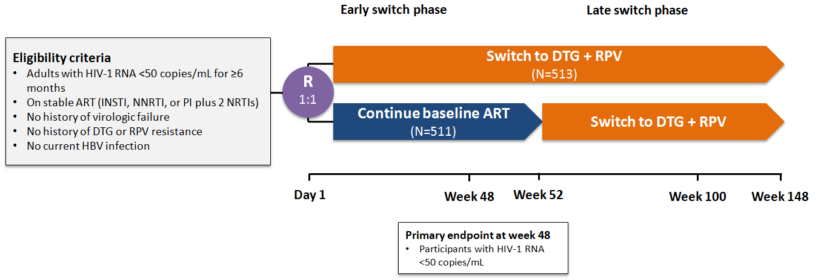
SWORD-1 and -2: Switching to DTG + RPV in Virologically Suppressed PLWH
Multicenter, randomized, open-label, parallel phase 3 noninferiority studies^{1,2}
¹Llibre JM et al. Lancet. 2018;391(10123):839-849.
²Aboud M et al. Lancet HIV. 2019;6(9):e576-e587.

Slide 45
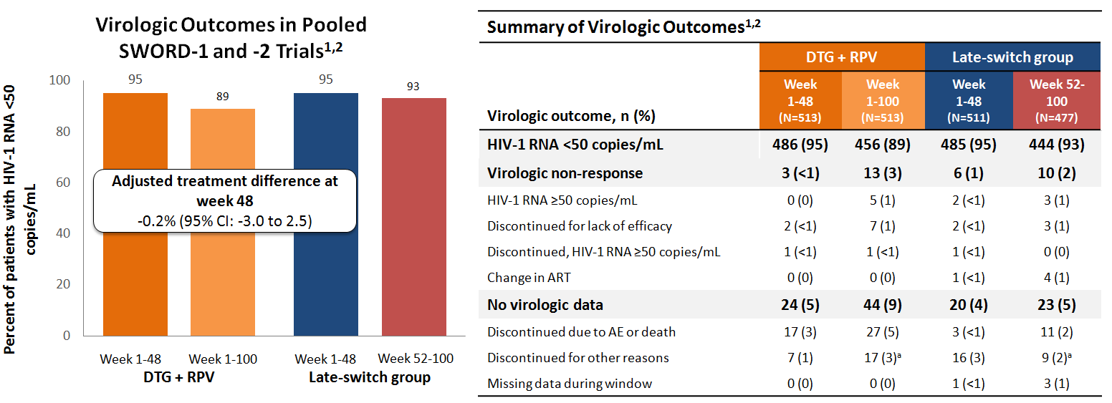
Switching to DTG + RPV Maintains HIV Suppression Over 100 Weeks and Is Noninferior to Standard ART
ª10 out of 990 (1%) confirmed virologic withdrawals through week 100 (treatment-emergent NNRTI resistance mutations documented in 3 cases, all from early switch arm)
¹Llibre JM et al. Lancet. 2018;391(10123):839-849.
²Aboud M et al. Lancet HIV. 2019;6(9):e576-e587.

Slide 46
Real-World Evidence Supporting
Use of 2DR

Slide 47
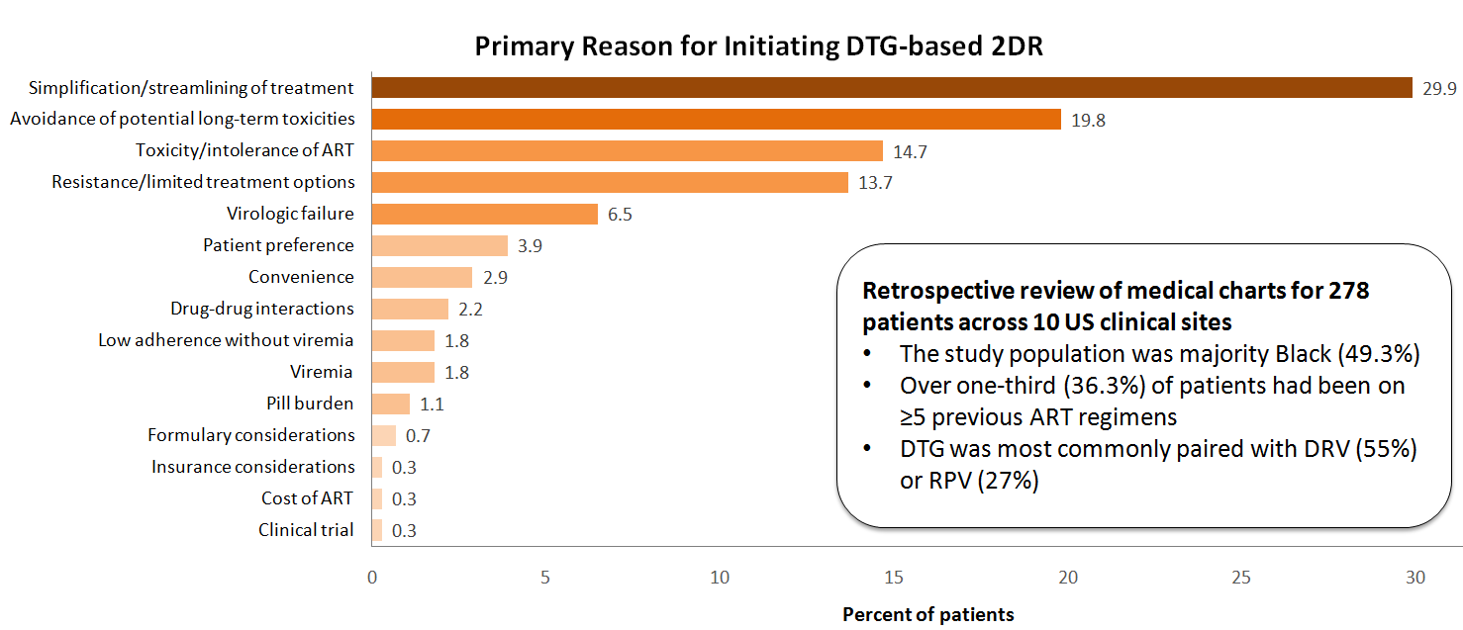
Real-World Reasons for Switching to DTG-based 2DR
Ward D et al. AIDS Res Treat. 2020:5923256.

Slide 48
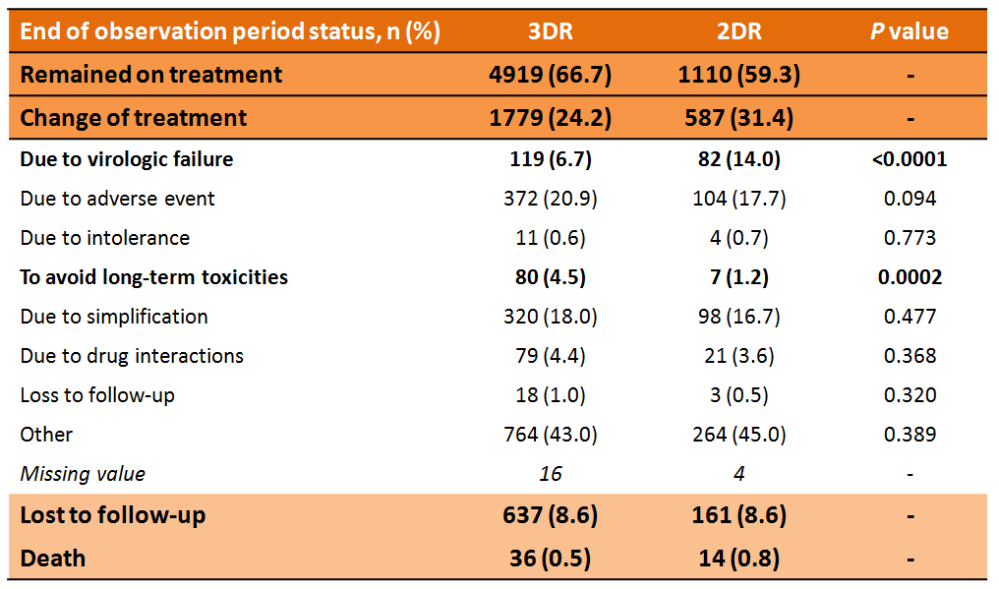
Virologic Failure May Be More Common in 2DRs Than in 3DRs
Retrospective analysis of data for 7,481 patients in a multicenter Spanish cohort
3DR: INSTI-containing triple therapy
2DR: DTG- and/or boosted PI-based two-drug combination
Adjusted hazard ratios (95% CI)
for 2DR vs 3DR
Discontinuation: 1.29 (1.15-1.44)
Virologic failure: 2.06 (1.54-2.77)
Toxicity: 1.18 (0.94-1.48)
Teira R et al. PLoS One. 2021;16(4):e0249515.

Slide 49
Yellow Line
Emerging Long-Acting Injectable ART

Slide 50
Introduction to Long-acting Injectable ART

Slide 51
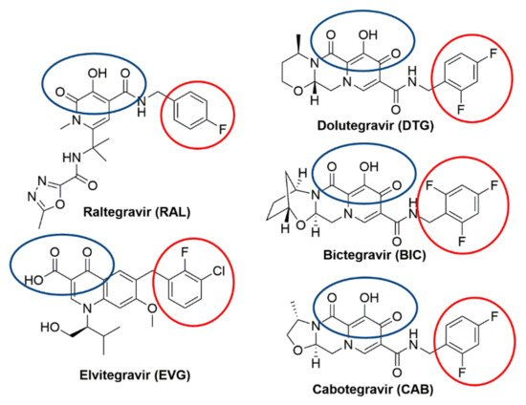
Cabotegravir + Rilpivirine: the First Extended-Release Injectable Drug Regimen for Adults With HIV
In January 2021, the Food and Drug Administration approved long-acting injectable cabotegravir plus rilpivirine for adults living with HIV-1.¹
Cabotegravir (CAB): Integrase inhibitor
  Structural analog of DTG²
Rilpivirine (RPV): NNRTI
Long-acting injectable CAB + RPV can be given once monthly following a 1-month lead in with oral CAB + RPV to ensure tolerability.¹
HIV-1, human immunodeficiency virus type 1;
NNRTI, nonnucleoside reverse transcriptase inhibitor.
Image courtesy of Smith SJ et al. Viruses. 2021;13(2):205. CC BY 4.0
¹Food and Drug Administration (FDA). News Release. January 2021. Accessed June 8, 2021. https://www.fda.gov/news-events/press-announcements/fda-approves-first-extended-release-injectable-drug-regimen-adults-living-hiv
²Smith SJ et al. Viruses. 2021;13(2):205.
Notes:
https://retrovirology.biomedcentral.com/articles/10.1186/s12977-018-0420-7#citeas

Slide 52
Long-Acting CAB + RPV is Approved for Virologically Suppressed Adults with HIV-1
In February 2021, the DHHS released a statement outlining the use of CAB + RPV injections as a treatment optimization strategy for PLWH currently on oral ART
CAB + RPB can be considered in those who have been virally suppressed for ≥3 months, and who:²
  Have no baseline resistance to CAB or RPV
  Have no history of virologic failure
  Do not have active HBV infection, unless also treated with an oral anti-HBV regimen
  Are not pregnant or planning to become pregnant
  Are not receiving contraindicated medications with potential drug interactions
DHHS, Department of Health and Human Services
¹Food and Drug Administration (FDA). News Release. January 2021. Accessed June 8, 2021. https://www.fda.gov/news-events/press-announcements/fda-approves-first-extended-release-injectable-drug-regimen-adults-living-hiv
²Dept. of Health and Human Services (DHHS). February 2021. Accessed June 8, 2021. https://clinicalinfo.hiv.gov/en/guidelines/adult-and-adolescent-arv/hhs-adults-and-adolescents-antiretroviral-guidelines-panel?view=full
Notes:
https://retrovirology.biomedcentral.com/articles/10.1186/s12977-018-0420-7#citeas

Slide 53
Animation:
Introduction to Dosing and Scheduling for Long-Acting Injectable ART (LAIs)

Slide 54
Introduction to Dosing and Scheduling for Long-Acting Injectable ART (LAIs)
Link to Annenberg HIV LAIs Video 2 091721.mp4

Slide 55
Clinical Trial Evidence for Long-acting Injectable ART

Slide 56
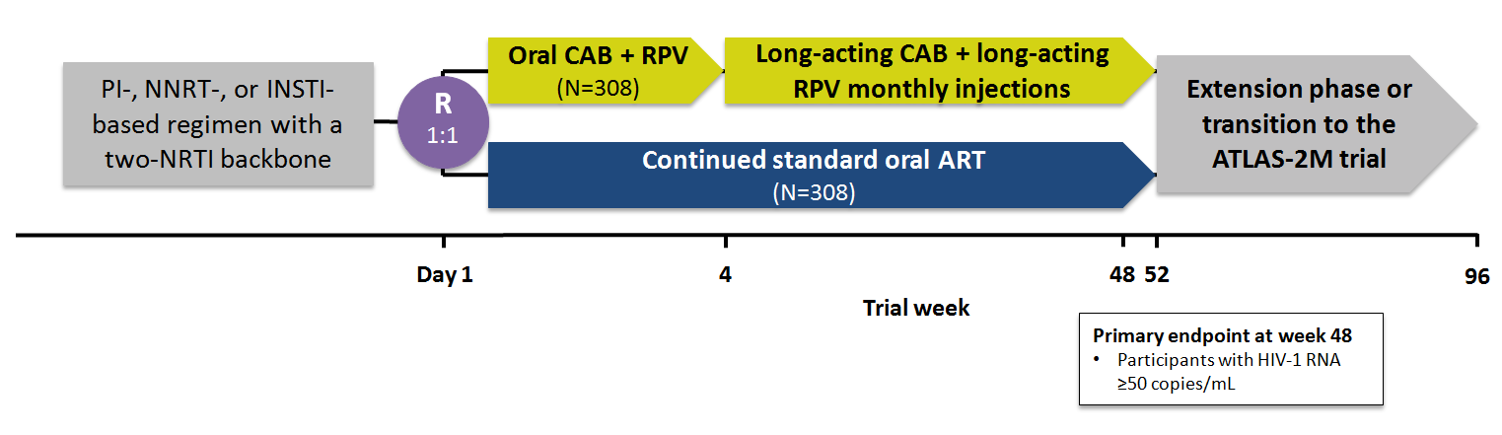
ATLAS Trial: Efficacy of Long-acting CAB + RPV Injections vs Oral ART
Swindells S et al. NEJM. 2020;382:1112-1123.

Slide 57
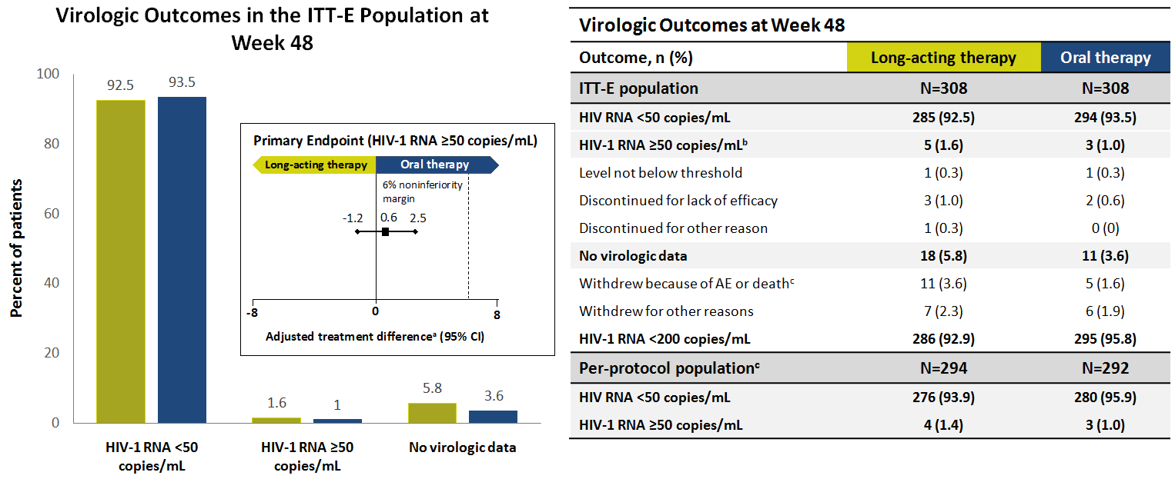
Long-acting Therapy Is Noninferior to Continuation of Oral Therapy in Virologically-Suppressed Adults with HIV
ªaBased on Cochran-Mantel-Haenszel stratified analysis with adjustment for sex at birth and class of third agent as baseline ^{b}A level of ≥50 copies/mL was observed at week 48 or at the time of discontinuation before week 48 ^{c}There was 1 death in the oral therapy group due to methamphetamine overdose ^{d}Excluded participants with protocol deviations that were likely to affect efficacy assessments or lead to discontinuation of treatment
Swindells S et al. NEJM. 2020;382:1112-1123.

Slide 58
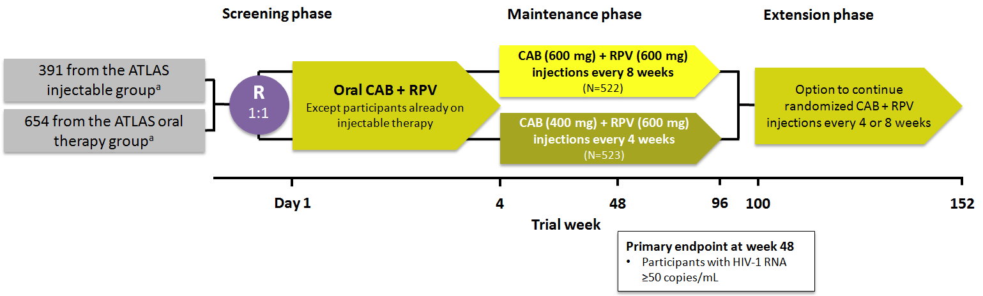
ATLAS-2M: Long-acting CAB + RPV Dosed Every 4 or 8 Week in Virologically Suppressed PLWH
Multicenter, randomized, open-label, phase 3b noninferiority trial
ªFrom the ITT-E population, with HIV-1 RNA <50 copies/mL
Overton ET et al. Lancet. 2021;396(10267):1994-2005.

Slide 59
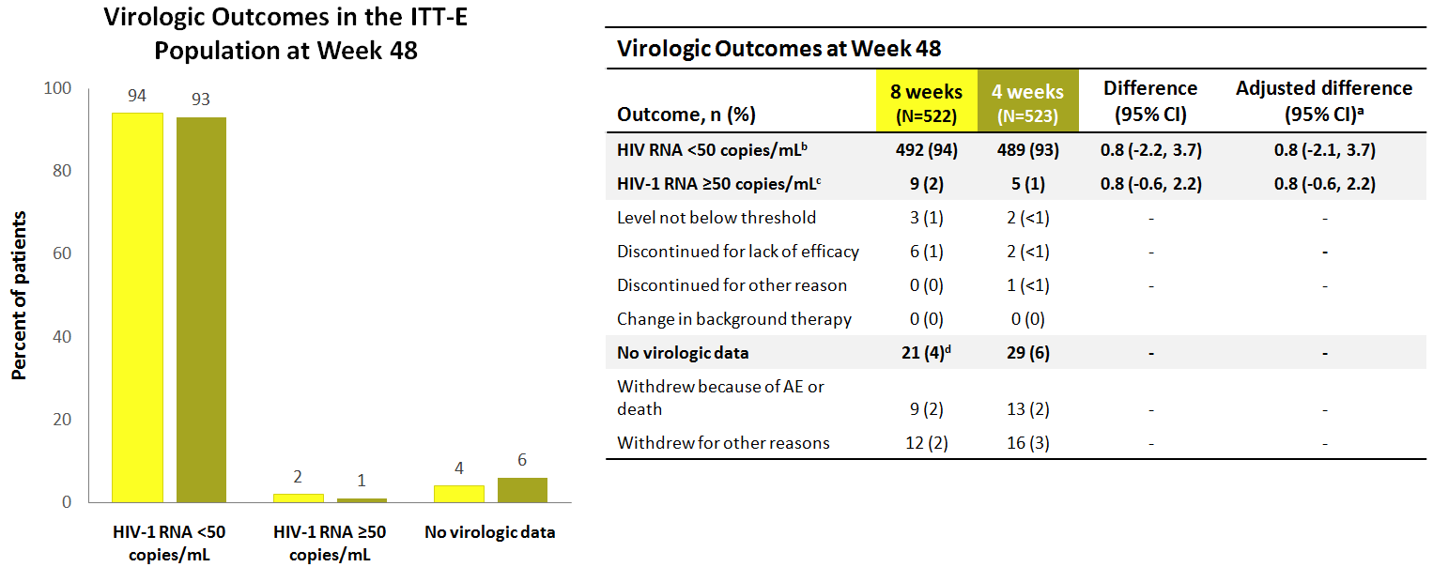
The Efficacy of 8- and 4-Week Dosing of Long-acting Injectable CAB + RPV Is Similar
ªCochran-Mantel-Haenszel stratified analysis adjusting for previous CAB + RPV long-acting exposure; ^{b}Noninferiority determined if lower bound of adjusted difference was above -10%; ^{c}Noninferiority determined if upper bound of adjusted difference was below 4%; ^{d}Lost to follow-up (2), withdrawal by participant (4), protocol deviation (1), investigator decision (4), lack of efficacy (1)
Overton ET et al. Lancet. 2021;396(10267):1994-2005.
Notes:
https://www.thelancet.com/journals/lancet/article/PIIS0140-6736(20)32666-0/fulltext

Slide 60
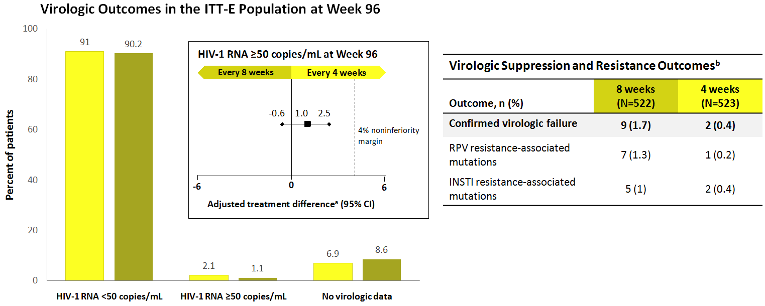
Virologic Suppression Is Maintained at 96 Weeks
ªCochran-Mantel-Haenszel stratified analysis adjusting for previous CAB + RPV long-acting exposure
^{b}At week 96
Jaeger H et al. Conference on Retroviruses and Opportunistic Infections (CROI). Abstract 401. https://www.croiconference.org/abstract/week-96-efficacy-and-safety-of-cabotegravir-rilpivirine-every-2-months-atlas-2m/

Slide 61
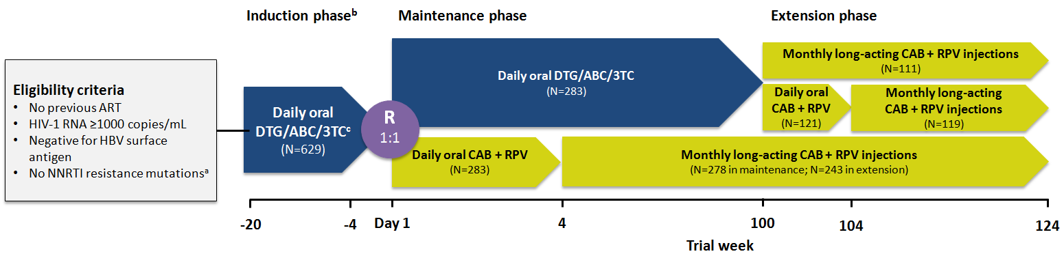
FLAIR: Long-acting Injectable CAB + RPV Every 4 Weeks vs Daily Oral DTG/ABC/3TC in Treatment-Naïve PLWH
All patients in extension phase switched from oral DTG/ABC/3TC to injectable, but some elected no oral CAB + RPV lead-in
Oral dosage: CAB 30 mg + RPV 25 mg
Injectable dosage: Loading dose, CAB 600 mg + RPV 900 mg, then 400 mg + 600 mg
ªK103N permitted; ^{b}Patients with HIV-1 RNA <50 copies/mL from week 16 to week 20 continued to maintenance; ^{c}Alternative non-ANC NRTIs permitted for intolerance of HLA-B*5701 positivity
¹Orkin C et al. NEJM. 2020;382:1124-1135.
²D’Amico R et al. HIV Glasgow Virtual Meeting. 2020. Abstract O414. https://onlinelibrary.wiley.com/doi/10.1002/jia2.25616

Slide 62
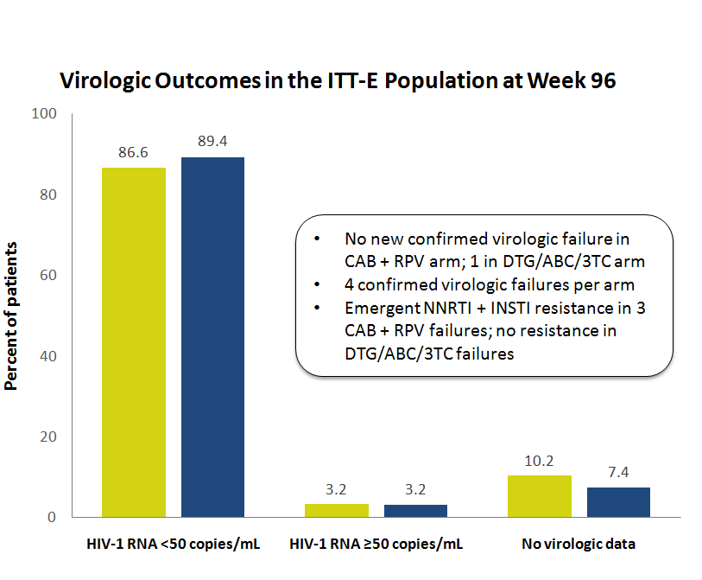
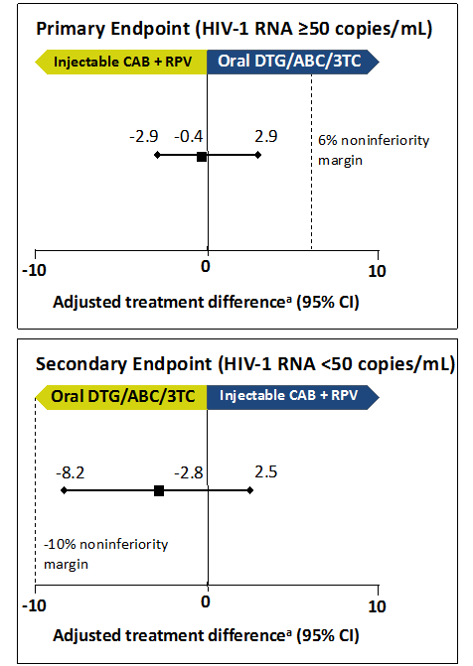
Long-acting CAB + RPV Is Noninferior to Oral DTG/ABC/3TC for Maintaining Viral Suppression
ªAdjusted for sex and baseline RNA
¹Orkin C et al. Conference on Retroviruses and Opportunistic Infections (CROI). 2020. Abstract 482. https://www.croiconference.org/abstract/long-acting-cabotegravir-rilpivirine-for-hiv-treatment-flair-week-96-results/
²Orkin C et al. NEJM. 2020;382:1124-1135.

Slide 63
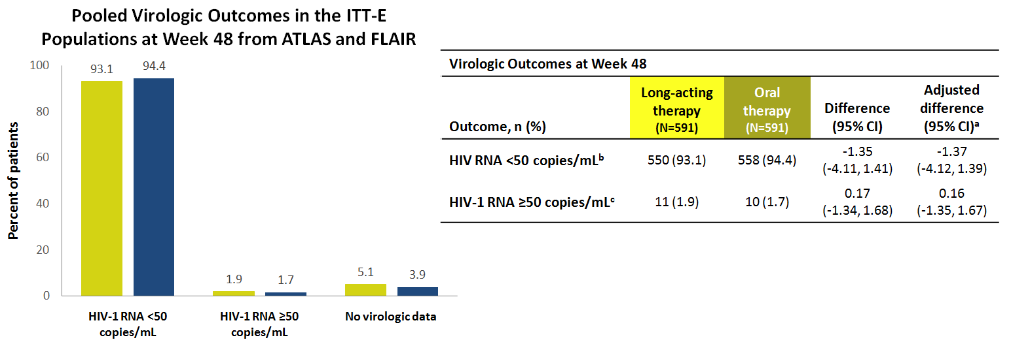
Combined Results from ATLAS and FLAIR Demonstrated That Monthly CAB + RPV Injections Were Noninferior to Oral Therapy
ªBased on Cochran-Mantel-Haenszel stratified analysis, adjusted for 10 strata
^{b}-10% noninferiority margin
^{c}4% noninferiority margin
Rizzardini G et al. J Acquir Immune Defic Syndr. 2020;85(4):498-506.

Slide 64
Promises and Challenges of Long-acting Injectable ART

Slide 65
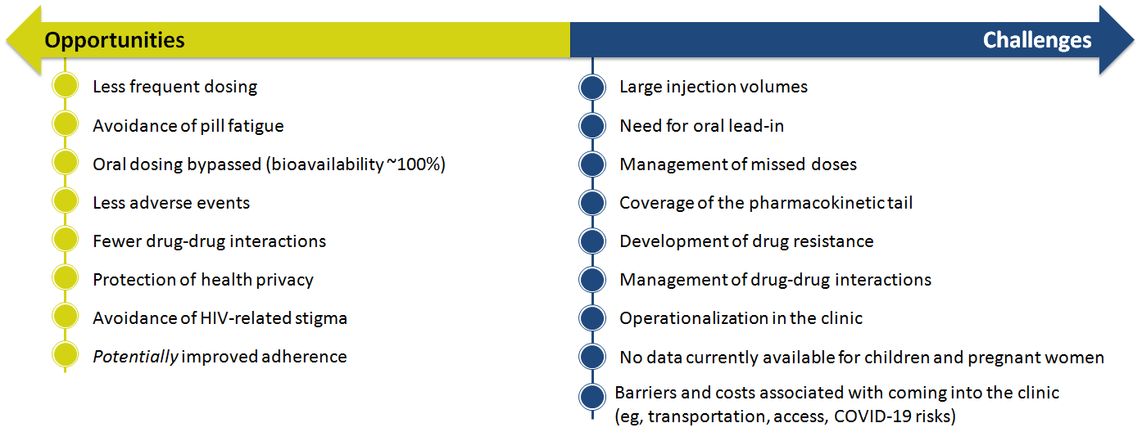
Long-acting Injectables Offer Several Opportunities and Challenges in HIV Care
Scarsi KK and Swindells S. J Int Assoc Provid AIDS Care. 2021;20:23259582211009011.

Slide 66
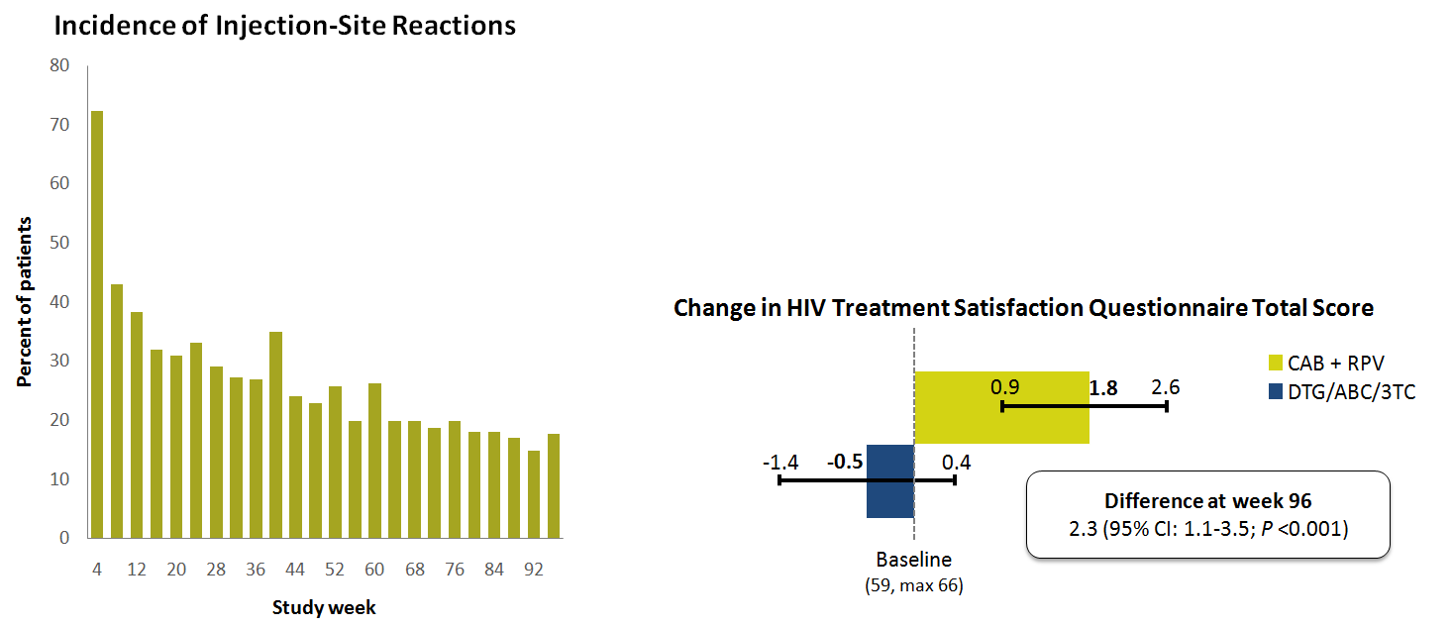
Injection-Site Reactions and Improved Patient-reported Outcomes in the FLAIR Trial
Most injection-site reactions (99%) were grade 1 or 2.
  89% resolved in ≤7 days (median, 3 days)
Long-acting injectable therapy was associated with significant improvements in HIV-related quality of life compared with oral DTG/ABC/3TC.
Orkin C et al. Conference on Retroviruses and Opportunistic Infections (CROI). 2020. Abstract 482. https://www.croiconference.org/abstract/long-acting-cabotegravir-rilpivirine-for-hiv-treatment-flair-week-96-results/

Slide 67
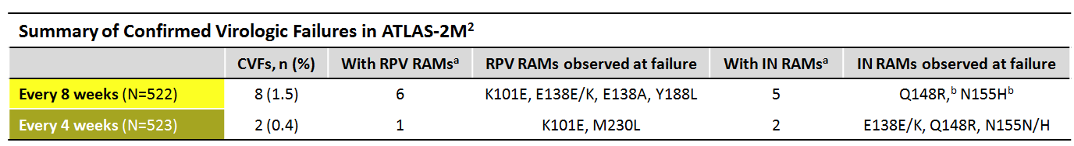
The Use of Long-acting Injectables in PLWH With Nonadherence Is Uncertain—More Data Are Needed
Long-acting injectables may help improve adherence by eliminating the need for daily pills, but it is unclear if they are appropriate in PLWH with nonadherence.¹
  Poor adherence can potentially cause prolonged periods of subtherapeutic drug levels if a dose is missed, which may lead to resistance.¹
Recommendations from the IAS-USA guidelines suggest that PLWH with poor adherence to treatment are unlikely to be good candidates for long-acting injectable therapy.¹
ª6/6 Q8W and 1/1 Q4W CVFs had RPV resistance (fold-change >2), and 3/5 Q8W and 1/2 Q4W CVFs had CAB resistance (fold-change >2.5); ^{b}Or mixture
CVF, confirmed virologic failure; RAM, resistance-associated mutation; Q8W, every 8 weeks; Q4W, every 4 weeks
¹Saag MS et al. JAMA. 2020;324(16):1651-1669.
²Overton ET et al. Conference on Retroviruses and Opportunistic Infections (CROI). 2020. Abstract 3334. https://www.natap.org/2020/CROI/croi_03.htm
Notes:
https://www.ncbi.nlm.nih.gov/pmc/articles/PMC4747082/
Wohl, David A 7/14/2021
Important point but we don't know that the resistance that occurred in the trial(s) were due to non-adherence. In many cases was not.
Jessica Martin 7/29/2021
Added a highlight on "may lead to resistance" and updated the title. This could be a good point for discussion. Alternatively, we can completely remove virologic failures from this slide since they are covered earlier.

Slide 68
Long-acting CAB + RPV Is Contraindicated With Select Drugs
Long-acting injectable CAB + RPV is contraindicated with:
  Anticonvulsants: Carbamazepine, oxcarbazepine, phenobarbital, and phenytoin
  Antimycobacterials: Rifabutin, rifampin, and rifapentine
  Systemic glucocorticoids: Dexamethasone (more than a single-dose treatment)
  Herbal products: St. John’s wort (Hypericum perforatum)
Co-administration of these drugs significantly decreases plasma concentrations of CAB and/or RPV due to UGT1A1 and/or cytochrome P450 CYP3A enzyme induction
  May reduce the virologic response
UGT, uridine diphosphate-glucuronosyl transferase
Food and Drug Administration (FDA). January 2021. Accessed June 7, 2021. https://www.accessdata.fda.gov/drugsatfda_docs/label/2021/212888s000lbl.pdf

Slide 69
Pearls and Pitfalls: Addressing Practical Challenges to Long-acting Injectable ART

Slide 70
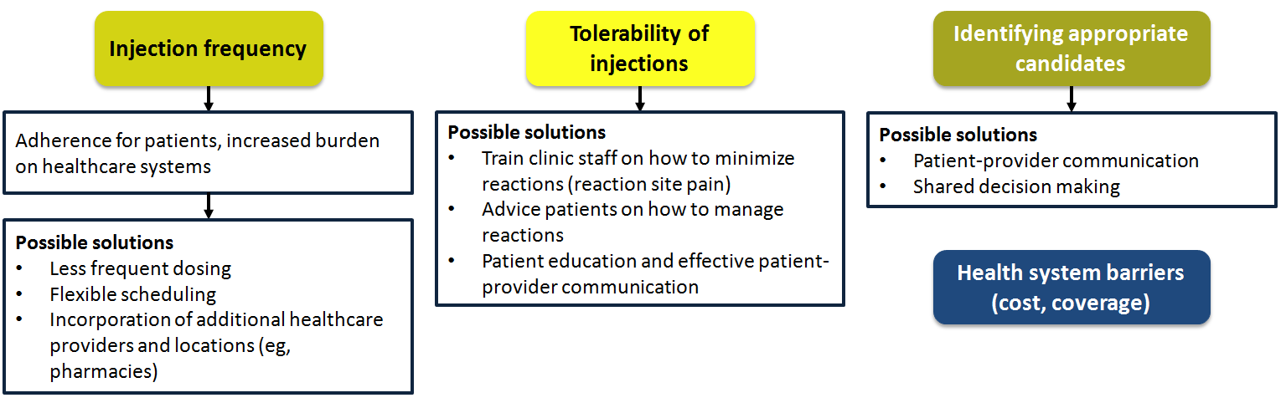
Logistical Barriers Will Need to be Addressed to Support the Use of Long-acting Injectables in HIV Treatment
Providers with long-acting injectable ART clinical trial experience suggest that the major barriers to real-world implementation are:
Mantsios A et al. BMC Health Serv Res. 2021;21(1):255.

Slide 71
Green Line
Optimizing Patient Outcomes: Selection of Patient-centered ART

Slide 72
ART Selection: Engaging in
Shared Decision Making

Slide 73
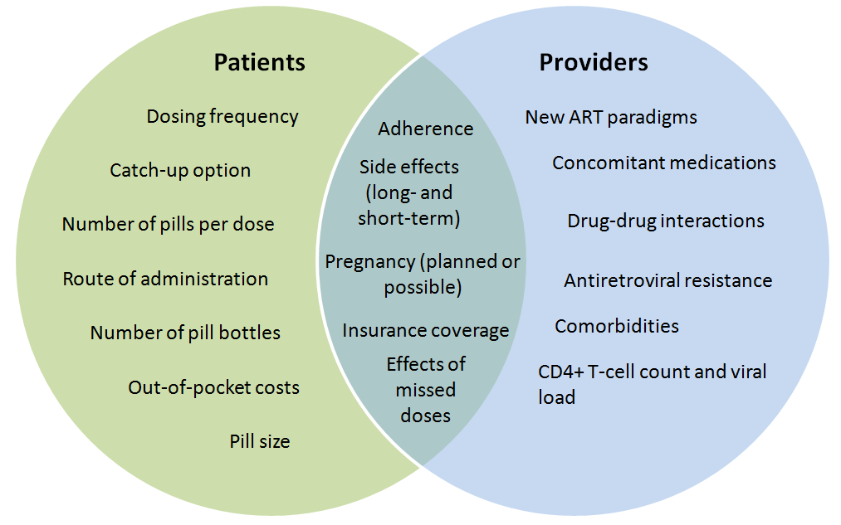
A Shared Decision-Making Approach to Treatment is Needed to Ensure Patient and Provider Concerns are Both Addressed
Yelverton V et al. AIDS Patient Care STDS. 2018;32(9):240-348.

Slide 74
Most PLWH Want to be Involved in Their Care but May Not Know How to Engage
Most PLWH are interested in being involved in decision-making related to their careª
  Especially newly diagnosed patients
However, many patients do not feel comfortable discussing concerns with their providers because:
  They do not feel that anything can be done
  Their provider never mentioned the issue
  They do not want to appear difficult
Among newly diagnosed patients, 73% reported that they wanted to be more involved in decisions regarding their treatment, but only 62% felt informed enough to be involved.
  One-third reported that their healthcare provider does not regularly ask them about concerns with their medications
ªAccording to a 2019 survey of 2389 PLWH in 25 countries
Okoli C et al. AIDS Behav. 2021;25(5):1384-1395.

Slide 75
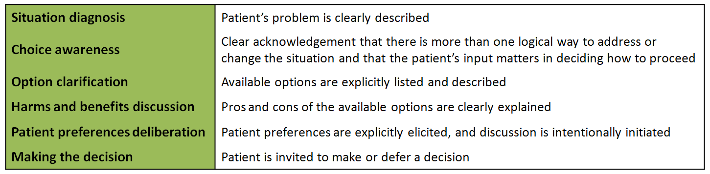
Effective Shared Decision-Making Requires Patient Education and Engagement
The key elements of shared decision-making are:
Shared decision-making aids can be employed to support discussions, but most do not include all 6 key elements
Wieringa TH et al. Syst Rev. 2019;8(1):121.

Slide 76
Animation:
Introduction to Weight Gain with ART Regimens

Slide 77
Introduction to Weight Gain with ART Regimens
Link to Annenberg HIV Weight Gain Video 3 091721.mp4

Slide 78
Barriers to Adherence and
Ways to Overcome Them

Slide 79
Efforts to Promote Linkage to Care Must Be Delivered With Both Sensitivity and Persistence
Linkage to care is defined as the completion of an outpatient appointment with a clinical provider with the expertise to treat HIV and prescribe ART
  Newly diagnosed PLWH should be linked to care within 30 days of diagnosis
Delays in linkage to care may be caused by:
  Insufficient socioeconomic resources
  Active substance use
  Mental health problems
  Stigma
  Disease severity (asymptomatic)
Active facilitation and maintaining a relationship with the patient can help improve linkage to care.
In the US, lower rates of linkage to care are observed among:
Young people
Black people
People with injection drug use
Department of Health and Human Services (DHHS). October 2017. Accessed June 8, 2021. https://clinicalinfo.hiv.gov/en/guidelines/adult-and-adolescent-arv/adherence-continuum-care

Slide 80
Retention in Care Is Important to Improve Survival Rates Among PLWH
Poor retention in care is associated with a greater risk for death and is associated with a variety of factors, including poor patient-provider relationships
Strategies to improve retention in care include:
  Case management and social outreach services
  Data-based approaches to identify patients who can be re-engaged with care
  Clinic-wide marketing to improve appointment attendance
  Flexible appointment scheduling and clinic hours
  Financial assistance programs
All clinic personnel play an important role in supporting the retention in care of PLWH by providing a positive patient experience and working collaboratively with patients to overcome barriers to care.
Department of Health and Human Services (DHHS). October 2017. Accessed June 8, 2021. https://clinicalinfo.hiv.gov/en/guidelines/adult-and-adolescent-arv/adherence-continuum-care

Slide 81
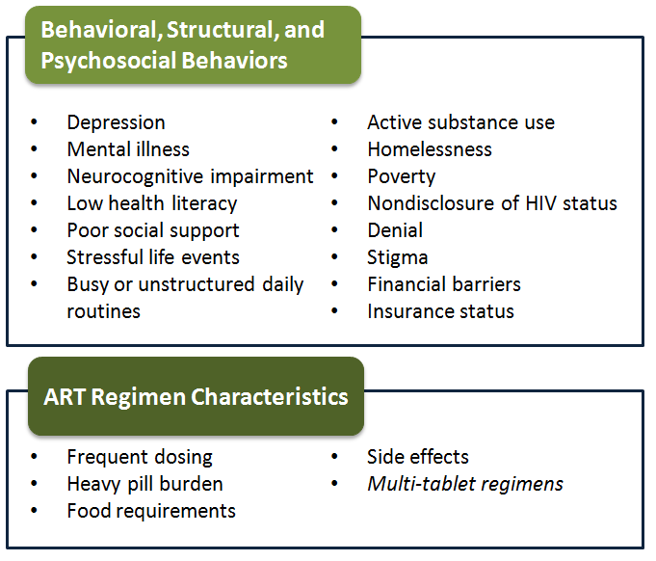
Adherence to ART Should be Regularly Assessed in a Constructive, Nonjudgmental Manner
Strategies to address nonadherence include:
Patient self-reporting: ask about adherence in a simple, nonjudgmental, routine, and structured format that normalizes suboptimal adherence
  Ask about the number of missed doses within a given period
Reviewing pharmacy records
Electronic measurement devices
  Bottle caps, dispensing systems
Pill counts are not recommended
Department of Health and Human Services (DHHS). October 2017. Accessed June 8, 2021. https://clinicalinfo.hiv.gov/en/guidelines/adult-and-adolescent-arv/adherence-continuum-care

Slide 82
Strategies to Improve ART Adherence Should Be Tailored to the Individual Needs of the Patient
Addressing nonadherence requires a multidisciplinary approach, time, and good patient-provider relationships.
Key components of strategies to improve treatment adherence may include:
  Patient education
  Social support (eg, transportation assistance, nurse case managers, substance abuse therapy)
  Payment assistance programs
  Counseling
  Development of a treatment plan that the patient can commit to (via shared decision making)
  Establishing a relationship built on trust and compassion
  Maintaining regular communication (eg, text reminders)
  Positive reinforcement
  Regular biologic monitoring (assess viral load at each visit)
Department of Health and Human Services (DHHS). October 2017. Accessed June 8, 2021. https://clinicalinfo.hiv.gov/en/guidelines/adult-and-adolescent-arv/adherence-continuum-care

Slide 83
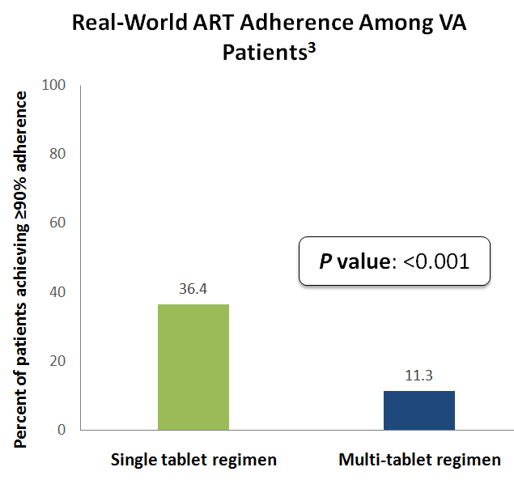
Treatment Simplification to Improve Adherence Is an Indication for Changing Treatment¹
Compared with those on multi-tablet regimens, PLWH treated with single tablet regimens are:^{2,a}
Real-world adherence to long-acting injectables has not yet been evaluated
63%
More likely to achieve adherence ≥95%
43%
More likely to achieve adherence ≥90%
ªAccording to a 2019 meta-analysis involving 29 studies
¹Department of Health and Human Services (DHHS). December 2019. Accessed May 28, 2021. https://clinicalinfo.hiv.gov/en/guidelines/adult-and-adolescent-arv/initiation-antiretroviral-therapy?view=full
²Altice F et al. Patient Prefer Adherence. 2019;13:475-490.
³Yager J et al. AIDS Patient Care STDS. 2017;31(9):370-376.
Notes:
https://www.sciencedirect.com/science/article/abs/pii/S0040595721000639?via%3Dihub

Slide 84
Optimizing Access and
Addressing Disparities

Slide 85
Support Services Can Be Engaged to Help Optimize Access to HIV Treatment
Recognizing and overcoming cost barriers
Connecting patients with resources
Flexible appointment scheduling and transportation
Counseling to overcome stigma, substance use disorder, or mental health issues
Addressing the unique needs of underserved populations
Department of Health and Human Services (DHHS). October 2017. Accessed June 8, 2021. https://clinicalinfo.hiv.gov/en/guidelines/adult-and-adolescent-arv/adherence-continuum-care

Slide 86
Blue Line
Case Studies: Patient Selection Criteria for New and Emerging ART Regimens

Slide 87
CASE STUDY 1: Treatment-naïve PWH

Slide 88
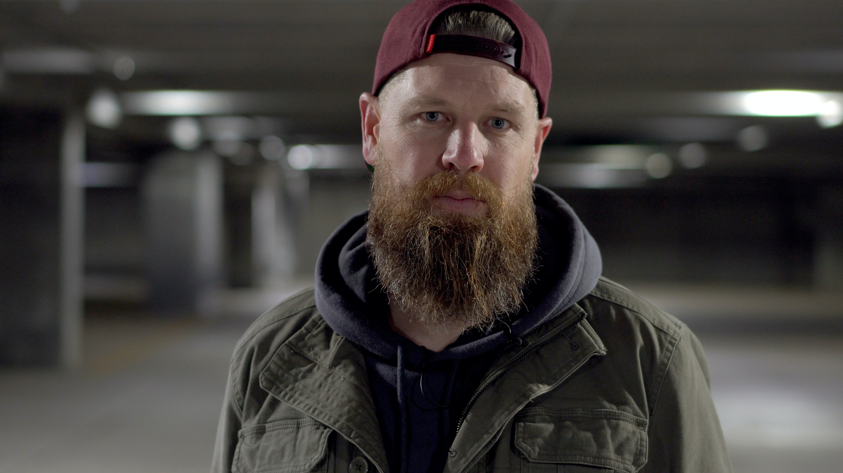
Case Study 1: Initiating Simple ART in a Treatment-naïve Adult With HIV
Kevin is a treatment-naïve 28-year-old white man who was recently diagnosed with HIV
He is currently experiencing housing instability due to substance use disorder (alcohol and crack cocaine)
He does not have any other underlying comorbidities but smokes cigarettes (1 pack/day)
Goal: Select a simple, durable regimen; adherence forgiveness

Slide 89
Case Study 1: Laboratory Evaluation
CD4+ cell count: 623 cells/µL
HIV RNA levels: 550,000 copies/mL
Other measures:
  HBV sAg positive; HBV viral load 11 IU/mL
  HCV Ab negative
  Creatinine 0.9 mg/dL
  ALT 43 mg/dL

Slide 90
Case Study 1: Treatment
Viral RNA >500,000 copies/mL and HBV+ status exclude DTG/3TC
  HLA status unknown, avoid DTG/ABC/3TC
Other considerations to facilitate discussion
  Viability of immediate start depends on clinic resources
  STR to improve adherence
After a shared decision-making discussion, Kevin is started on the STR BIC/TAF/FTC
Kevin is also provided resources on substance and alcohol use disorder counseling and connected with local housing resources

Slide 91
Case Study 1: Follow-up
Kevin missed his next follow-up appointment
A nurse was able to connect with him to reschedule the appointment
His HIV viral load after 6 weeks on treatment has been reduced to 102 copies/mL
HBV viral load undetectable
To improve follow-up adherence moving forward:
  Incorporate regular engagement and communication (through EMR portal, text reminders)
  Ensure Kevin has connected with social support services for SUD/AUD and housing support
  Recommend additional counseling, such as support groups for PLWH

Slide 92
CASE STUDY 2: Switching After Weight Gain

Slide 93
Case Study 2: Weight Gain in a Treatment-Experienced Adult
Rashida is a 62-year-old Black women who was diagnosed with HIV 12 years ago.
  Initially started on EVG/c/FTC/TDF (achieved viral suppression)
  Was recently switched to BIC/FTC/TAF to avoid issues related to pharmacologic booster and TDF
Following her treatment switch, Rashida is concerned that she has experienced significant weight gain (approximately 2 kg in 6 months)
Goal: Discuss weight effects of TDF and TAF as well as EVG/c and BIC
Notes:
Jessica Martin 9/29/2021
Image is stock from Adobe: 421200073.

Slide 94
Case Study 2: Laboratory Evaluations and Clinical History
CD4+ cell count: 540 cells/µL
HIV RNA levels: Viral load undetectable
Other measures:
  BMI 28.4 kg/m²
  Blood pressure 135/80 mmHg
  A1C 6.2%

Slide 95
Weight Change Following Switch From TDF to TAF May Be due to Weight-Suppressive Effects of TDF
Risk of Weight Gain ≥3% at 12 Months Since Switch to TAF
Baseline BMI overweight vs underweight/normal
0.80 (0.65, 0.98); P =0.035
Baseline BMI obese vs underweight/normal
0.72 (0.57, 0.91); P =0.006
CD4 <200 cells/mL
1.56 (1.12, 2.16); P =0.008
P value: 0.039
Age <50 years
1.15 (0.95, 1.39); P =0.161
Black vs White
1.10 (0.90, 1.35); P =0.362
Other race vs White
1.13 (0.85, 1.51); P =0.394
Female vs male
1.28 (1.02, 1.61); P =0.031
TDF to TAF vs ABC to TAF
1.38 (1.01, 1.88); P =0.043
0
1
2
3
ªAccording to a study of treatment switching in 970 treatment-experienced PLWH (828 TDF to TAF, 142 ABC to TAF)
Sax P et al. Open Forum Infectious Diseases. 2020;7(supp 1):S846-S847.
Notes:
Sax P et al. Open Forum Infectious Diseases. 2020;7(supp 1):S846-S847.

Slide 96
Case Study 2: Treatment
Discuss weight effects of TDF and TAF
  TDF as a weight suppressant, rather than TAF as a cause of weight gain
Removal of TDF is cause of weight gain rather than initiation of TAF
Consideration of other risk factors for weight gain
  Sex, baseline BMI, age

Slide 97
Case Study 2: Follow-up
After discussing the causes of weight effects associated with switching from TDF to TAF, Rashida agrees that a treatment switch is not needed
Counseling is provided on managing weight gain with treatment switch
  Lifestyle considerations: Diet, exercise, day-to-day activities

Slide 98
CASE STUDY 3: Overcoming Pill Fatigue

Slide 99

Case Study 3: Overcoming Pill Fatigue
Lucas is a 30-year-old Hispanic man who was diagnosed with HIV 5 years ago. At diagnosis, his viral load was 580,000 copies/mL and his CD4+ T cells were 170/mm³. He was started on DRV/r + TDF/FTC
He has been adherent to his ART regimen since he started it in 2013 with continuous HIV RNA < 50 copies/mL and CD4+ T cells of 650/mm³. His regimen was changed to DRV/c/TAF/FTC in 2019.
At his most recent visit, Lucas reports increasing difficulty with maintaining adherence to his daily regimen along with more common loose stools requiring diphenozylate/atropine.
While he still comes in regularly for check ups, he admits that he has been missing doses of his medication recently
Goal: Address pill fatigue, gastrointestinal adverse effects and improve adherence

Slide 100
Case Study 3: Laboratory Evaluations and Clinical History
CD4+ T cell count: 650 cells/µL
HIV RNA: 43 copies/mL
Other measures:
  Blood pressure 150/96 mmHg
  Creatinine 2.0 mg/dL
  Hgb A1c 6.7%
  TSH 4.7 mU/L
Hypertension currently managed with a thiazide diuretic
In discussions, Lucas also suggests that he believes that part of his problems with adherence may be related to symptoms of depression
  Depression developed over the last 6 months or so

Slide 101
Case Study 3: Treatment
Facilitate shared decision-making to promote treatment adherence
  Providing education on importance of adherence for maintenance of viral suppression
  Connecting Lucas with resources to manage his new onset depression (counseling, psychiatry consult)
Discuss options for ART regimen change to improve adherence and address side effects is an indication for treatment-switching
  BIC/TAF/FTC
  CAB/RPV- LA

Slide 102
Case Study 3: Follow-up
After discussing treatment options with Lucas, you decide together to initiate long-acting CAB/RPV injectable therapy after an oral lead-in
  Lucas is educated on the importance of adherence to maintain therapeutic doses
Using the EMR portal to promote adherence
  Sending monthly text reminders
Maintaining regular follow-up

Slide 103
CASE STUDY 4: Managing virologic resistance

Slide 104

Case Study 4: Managing Resistance in a Treatment-experienced Patient
Clara is a 43-year-old Black woman who was diagnosed with HIV 7 years ago.
She is currently treated with a “mega-HAART” including RAL + ATV/rtv + ETV + TAF/FTC due to difficulty with complex regimens.
She received a promotion at work last year that keeps her much busier, and she says that her treatment regimen has once again become too cumbersome
  While she tries to stay adherent, she notes that she has been missing more doses recently and would like a simpler ART regimen
Goal: Treatment simplification (if possible), management of resistance
HAART, highly active antiretroviral therapy

Slide 105
Case Study 4: Laboratory Evaluations and Clinical History
CD4+ T cell count: 350 cells/µL
HIV RNA:
  Current: 3000 copies/mL
  6 months ago: 900 copies/mL
  1 year ago: 280 copies/mL
Current and historic HIV genotype testing reveals the following resistance-associated mutations (RAMS):
  NRTI/NNRTI - M184V, M41L, K70R, L210W, K103N, Y181C
  PI - D30N, I50L, V82A
  InSTI - Q148H and N155H
IN, integrase

Slide 106
DTG-based Therapy Maintains Virologic Suppression in Treatment-experienced PLWH
The VIKING-3 trial examined the addition of DTG (50 mg BID) to current ART in adults with HIV RNA ≥500 copies/mL.
  20% with Q148ª +1 secondary mutation^{b}
  11% with Q148 + ≥2 secondary mutations
No Q148 : 79%
Q148 + 1: 58%
Q148 + ≥2: 24%
Change in HIV RNA Following Addition of DTG to Failing ART Regimen
Outcome | +DTG 50 mg BID (N=183)
Plasma HIV RNA level, log₁₀ copies/mL
Baseline, mean (SD) | 4.26 (0.93)
Change from baseline at day 8, mean (SD) | -1.43 (0.61)
P value | <0.001
95% CI | -1.52, -1.34
Castagna A et al. J Infect Dis. 2014;210(3):354-362.
ªN155H, Y143C/H/H, T66A, E92Q, or historical evidence
^{b}From G140A/C/S, E138A/K/T, or L74I
Notes:
Castagna A et al. J Infect Dis. 2014;210(3):354-362.

Slide 107
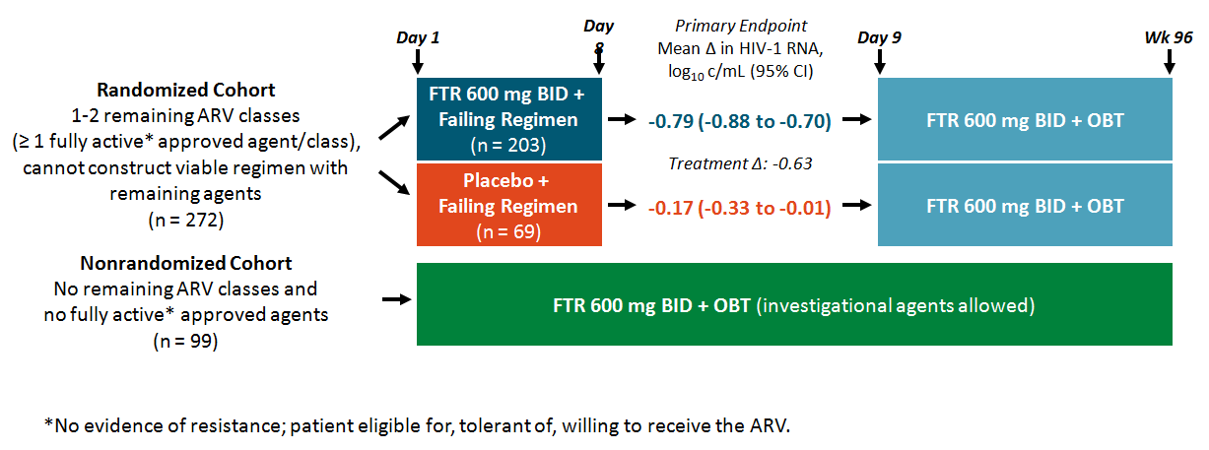
BRIGHTE: Fostemsavir in Heavily Treatment–Experienced Adults With Multidrug-Resistant HIV
Kozal. NEJM. 2020;382:1232. Pialoux. AIDS 2018. Abstr THPEB045.
ªN155H, Y143C/H/H, T66A, E92Q, or historical evidence
^{b}From G140A/C/S, E138A/K/T, or L74I

Slide 108

BRIGHTE: Virologic and Safety Outcomes Through 96 Wks
Lataillade. IAS 2019. Abstr MOAB0102.
ªN155H, Y143C/H/H, T66A, E92Q, or historical evidence
^{b}From G140A/C/S, E138A/K/T, or L74I

Slide 109

TMB-301: Ibalizumab in Pretreated Patients Infected With Multidrug-Resistant HIV
Emu. NEJM. 2018;379:645.
ªN155H, Y143C/H/H, T66A, E92Q, or historical evidence
^{b}From G140A/C/S, E138A/K/T, or L74I

Slide 110

TMB-301/-311: Virologic Outcomes Through 96 Wks
1Emu. NEJM. 2018;379:645. 2Emu. IDSA 2017. Abstr 1686. 3Emu. HIV Glasgow 2018. Abstr O345.
4Emu. CROI 2019. Abstr 485. 5. DeJesus. HIV Glasgow 2018. Abstr P064.
ªN155H, Y143C/H/H, T66A, E92Q, or historical evidence
^{b}From G140A/C/S, E138A/K/T, or L74I

Slide 111
Case Study 4: Treatment
Considerations with multi-class virologic resistance mutations
Discussion of treatment options to improve adherence and manage resistance to achieve virologic suppression
  Addition of twice-daily-dosed DTG (VIKING Study)
  Utilize existing ARVs with good activity
  Utilize ARV(s) with novel mechanism(s) of action
  Create dosing symmetry
After discussing options with Clara, she is switched to a DTG 50mg BID, DRV/c 600mg/100mg BID, FTR 600mg BID regimen (3 tablets BID)

Slide 112
Case Study 4: Follow-up
Clara returns for follow-up 3 months after switching treatment
  She reports that she is happy with her new regimen and that it has been easier to remember to take her medication
Her HIV RNA levels have dropped to <50 copies/mL
  She returns at 6 months for continued monitoring;
  her HIV RNA levels continued to be <50 copies/mL and
  her CD4+ T cells are now 550/mm³
Need for continued monitoring and regular follow up

