Slide 1
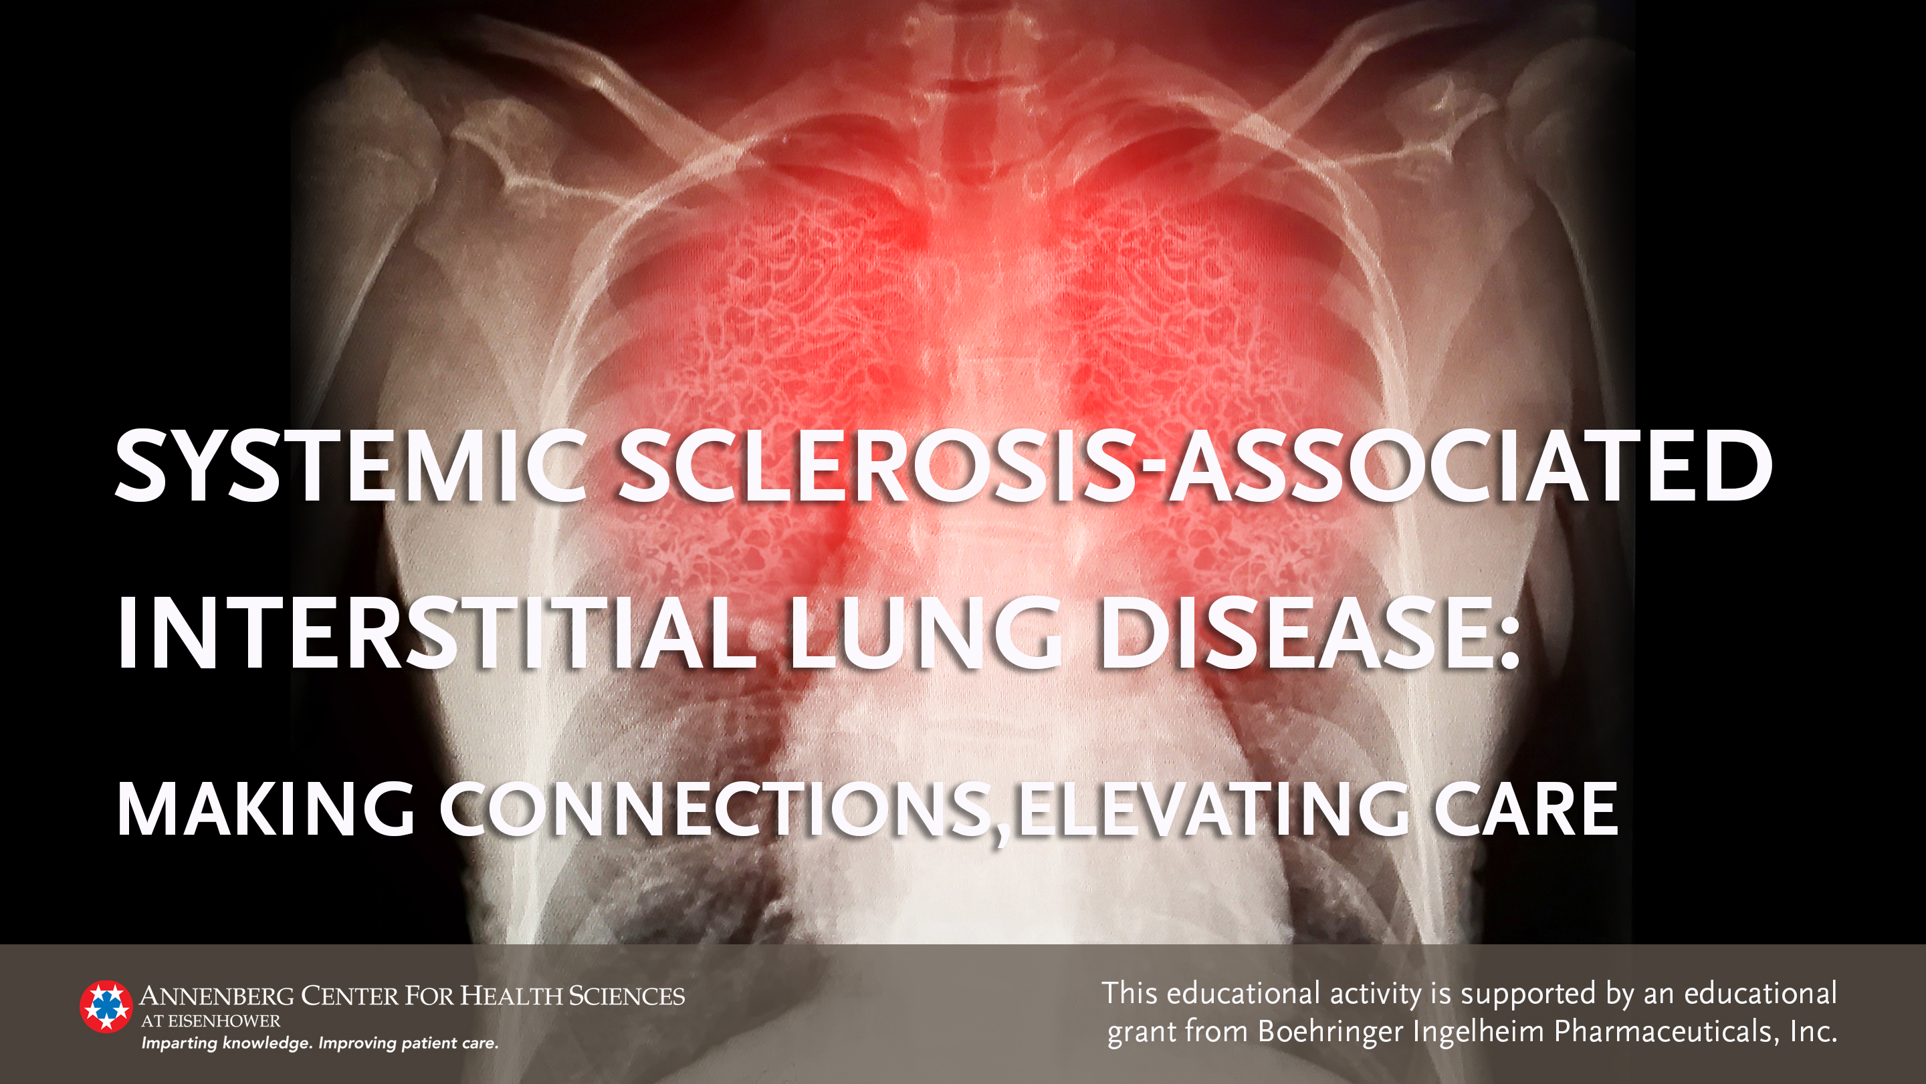

Slide 2
Faculty Presenters
Imre Noth, MD
Elizabeth Volkmann, MD
Professor of Medicine
Chief, Division of Pulmonary and Critical Care
University of Virginia
Charlottesville, Virginia
Associate Professor
Director, UCLA Scleroderma Program
Co-Director, CTD-ILD Program
Division of Rheumatology
Department of Medicine
University of California, Los Angeles

Slide 3
Faculty Disclosures
Imre Noth, MD
Research Support | Boehringer Ingelheim, Genentech
Consultant | Parion, Sanofi
Elizabeth Volkmann, MD
Research Support | Corbus, Forbis, Kadmon
Consultant | Boehringer Ingelheim

Slide 4
Learning Objectives
Recognize the burden associated with SSc-ILD requiring ongoing evaluation, monitoring, and management to minimize lung complications.
Identify the risk factors for SSc-ILD and its associated comorbidities; recognize the need to manage co-morbidities in patients with SSc-ILD.
Select appropriate treatment for patients with SSc-ILD.
Identify patients with SSc to screen for ILD.
Apply strategies for optimal clinician-patient communication and for education of patients with
SSc-ILD.
ILD, Interstitial Lung Disease; SSc, systemic sclerosis.
Notes:
EV: Nicely stated

Slide 5
Red Line
Prevalence, Patient Burden, and the Need for Screening
SSc Patients for ILD

Slide 6
Case Vignette
Highlights need for screening and further evaluation
A 48-yr-old female is referred to the rheumatologist by her primary care physician, where she was diagnosed with scleroderma or systemic sclerosis (SSc) but is asymptomatic for interstitial lung disease (ILD). She has not reported symptoms of breathlessness; however, with further evaluation she has stopped taking her Zumba class and prefers now to walk as her form of exercise.
ILD is the leading cause of death in SSc, so screening for ILD is essential—even in the absence of symptoms.
ILD, Interstitial Lung Disease; SSc, Systemic Sclerosis.
Fischer A, et al. Open Access Rheumatol. 2019;11:283-307.

Slide 7
Screening the Asymptomatic Patient
Clinicians often see ILD before a patient reports breathlessness.
To identify patients who should be screened for ILD, it is important to ask questions to evaluate the patient’s activities. This helps determine if the patient is modifying their lifestyle to avoid a feeling of breathlessness.
For example, ask your patients:
  Do you still walk up the stairs?
  What is your form of exercise?
  Do you still play 18 holes of golf, or do you now play 9?
  Are you still mowing the lawn?
ILD, Interstitial Lung Disease.

Slide 8
Epidemiology of Systemic Sclerosis¹
SSc is a rare, severe connective tissue disease
Affects multiple organ systems
ILD is a common manifestation
  30–40% develop clinically significant ILD, with a 10-year mortality up to 40%²
  Onset most often within 5 years of first non-Raynaud’s phenomenon symptom
Interstitial abnormalities evident in high-resolution CT (HRCT) of the chest
in up to 80% of patients with SSc²
Essentially a subclinical disease in most patients
Giacomelli R, et al. Rheumatol Int. 2017;37:853-863
Perelas A, et al. Lancet Respir Med. 2020;8:304-320.
Notes:
Giacomelli R, Liakouli V, Berardicurti O, et al. Interstitial lung disease in systemic sclerosis: current and future treatment. Rheumatol Int. 2017;37:853-863.
Perelas A, Silver RM, Arrossi AV, Highland KB. Systemic sclerosis-associated interstitial lung disease. Lancet Respir Med. 2020;8(3):304-320. doi: 10.1016/S2213-2600(19)30480-1.
Added last bullet-IN

Slide 9
Epidemiology of SSc & SSc-ILD
Affects ~2 per 10,000 individuals¹
Majority of SSc patients are women (>80%)¹
30–40% of patients with SSc show evidence of ILD²
Prevalence of ILD is ~96% among patients with SSc with abnormal PFT³
Histopathologic analysis of SSc-ILD^{3–5}
  Most common (78%) is NSIP
  Minority of patients (10–15%) is UIP
NSIP, nonspecific interstitial pneumonitis; PFT, pulmonary function test; UIP, usual interstitial pneumonia.
Pellar RE, et al. Semin Arthritis Rheum. 2017;46:767-774.
Perelas A, et al. Lancet Respir Med. 2020;8:304-320.
Volkmann ER, et al. Ann Am Thorac Soc. 2016;13:2045-2056.
Chowaniek M, et al. Reumatologia. 2018;56:249-254.
Khanna D, et al. Am J Respir Crit Care Med. 2020;201:650-660.
Notes:
EV: I would recommend being consistent with the reporting of ILD prevalence estimates, or giving a range, to avoid confusion and to send a consistent message (the majority of patients with SSc have ILD)
IN: Agree – first thing I noticed – either 30% from slide before or 40% here
VA revised: 30–40% show evidence of ILD; 40% have a 10-year mortality (Perelas A, et al. Lancet Respir Med. 2020;8:304-320.)

Slide 10
Epidemiology of SSc & SSc-ILD continued
Incidence and Prevalence Rates* | SSc | SSc-ILD
Crude incidence rates (per 100,000 person-years) | 16.4 | 1.2
Crude prevalence (per 100,000 people) | 24.4 | 6.9
Age- and sex-adjusted incidence rate (per 100,000 person-years) | 15.1 | 1.1
Adjusted prevalence (per 100,000 people) | 25.9 | 7.3
Mean age range | 59.2–59.9 years | 61.8–62.9 years
 | Similar patient characteristics
*Adults with medical claims between 2011 and 2016 for SSc or SSc-ILD with and without HRCT scans were identified.
HRCT, high-resolution computed tomography.
Fan Y, et al. J Manag Care Spec Pharm. 2020;26:1539-1547.

Slide 11
Identifying Who to Screen and Treat
Risk factors
Measurement of disease (extent on HRCT)
Longitudinal declines in PFTs
Mortality prediction models
Consider probability of progressive disease based on results of above criteria
HRCT, high-resolution computed tomography; PFT, Pulmonary function tests.
DeMizio DJ. Curr Opin Rheumatol. 2019;31:553-560.
Notes:
DeMizio DJ, Bernstein EJ. Detection and classification of systemic sclerosis-related interstitial lung disease: a review. Curr Opin Rheumatol. 2019;31:553-560.
EV: I think we want to have a dedicated slide on the importance of screening everyone with SSc with an HRCT. We could cite studies that have demonstrated that PFTs are inadequate screening tools (Bernstein EJ, Jaafar S, Assassi S, Domsic RT, Frech TM, Gordon JK, Broderick RJ, Hant FN, Hinchcliff ME, Shah AA, Shanmugam VK, Steen VD, Khanna D. Performance Characteristics of Pulmonary Function Tests for the Detection of Interstitial Lung Disease in Adults With Early Diffuse Cutaneous Systemic Sclerosis. Arthritis Rheumatol. 2020 Nov;72(11):1892-1896. doi: 10.1002/art.41415. Epub 2020 Sep 22. Erratum in: Arthritis Rheumatol. 2021 Apr;73(4):720. PMID: 32583956; PMCID: PMC7722107.)
VA added as next slide

Slide 12
HRCT Important Screening Tool
All patients with SSc should be screened with HRCT
PFTs alone are inadequate as a screening tool
  Suliman et al reveal high risk of missing significant SSc-related ILD when relying solely on PFTs
Study by Bernstein et al (n=212) show PFTs lack sensitivity for the detection of ILD in patients with SSc
  FVC <80% predicted had a sensitivity of 63%
  Combination FVC <80% predicted or DLCO <80% predicted improved sensitivity to 85%
DLCO, carbon monoxide diffusing capacity; FVC, forced vital capacity; HRCT, high-resolution computed tomography; NPV, negative predictive value; PFT, Pulmonary function tests.
Bernstein EJ, et al. Arthritis Rheumatol. 2020. 72:1892-1896; Suliman YA, et al. Arthritis Rheumatol. 2015;67:3256-61.
Notes:
EV: I think we want to have a dedicated slide on the importance of screening everyone with SSc with an HRCT. We could cite studies that have demonstrated that PFTs are inadequate screening tools (Bernstein EJ, Jaafar S, Assassi S, Domsic RT, Frech TM, Gordon JK, Broderick RJ, Hant FN, Hinchcliff ME, Shah AA, Shanmugam VK, Steen VD, Khanna D. Performance Characteristics of Pulmonary Function Tests for the Detection of Interstitial Lung Disease in Adults With Early Diffuse Cutaneous Systemic Sclerosis. Arthritis Rheumatol. 2020 Nov;72(11):1892-1896. doi: 10.1002/art.41415. Erratum in: Arthritis Rheumatol. 2021 Apr;73(4):720.)
VA: added study results from Bernstein et al.
an FVC < 80% predicted had a sensitivity of 63%
a TLC < 80% predicted had a sensitivity of 46%
a DLCO < 80% predicted had a sensitivity of 80%
The combination of FVC < 80% predicted or DLCO < 80% predicted improved the sensitivity to 85%.
Adding a TLC < 80% predicted to this combination did not further improve the sensitivity. <<see Table 3>>
Suliman YA, Dobrota R, Huscher D, Nguyen-Kim TD, Maurer B, Jordan S, et al. Pulmonary function tests: high rate of false-negative results in the early detection and screening of scleroderma-related interstitial lung disease. Arthritis Rheumatol. 2015;67:3256-61.

Slide 13
Patient Burden of Systemic Sclerosis
Heterogeneous clinical presentation complicates diagnosis and
treatment strategies
Carries significant patient burden of disease-related morbidity
Potential life-threatening complications
  Highest cause-specific mortality of all the connective tissue diseases
Lung involvement may occur in SSc with no skin involvement
ILD complicates SSc
  Early progression of ILD predicts mortality
Giacomelli R, et al. Rheumatol Int. 2017;37:853-863; Volkmann ER, et al. Ann Am Thorac Soc. 2016;13:2045-2056.
Notes:
Giacomelli R, Liakouli V, Berardicurti O, et al. Interstitial lung disease in systemic sclerosis: current and future treatment. Rheumatol Int. 2017;37:853-863.
Volkmann ER, Tashkin DP. Treatment of Systemic Sclerosis-related Interstitial Lung Disease: A Review of Existing and Emerging Therapies. Ann Am Thorac Soc. 2016;13(11):2045-2056. doi: 10.1513/AnnalsATS.201606-426FR.

Slide 14
Patient Burden with SSc-ILD
Greatest risk of development of ILD is 4–5 years after initial diagnosis of the SSc
#1 cause of death for SSc-ILD patients is respiratory failure from ILD
  3x greater risk mortality risk
Higher prevalence of comorbidities
Higher incidence of comorbid outcomes than patients with SSc alone
Fan Y, et al. J Manag Care Spec Pharm. 2020;26:1539-1547; Chowaniek M, et al. Reumatologia. 2018;56:249-254; Volkmann ER, et al. J Scleroderma Relat Disord. 2021;6:11-20.
Notes:
Additional ref: Volkmann ER, Fischer A. Update on Morbidity and Mortality in Systemic Sclerosis-Related Interstitial Lung Disease. J Scleroderma Relat Disord. 2021;6(1):11-20. doi:10.1177/2397198320915042
Fan Y, Bender S, Shi W, Zoz D. Incidence and prevalence of systemic sclerosis and systemic sclerosis with interstitial lung disease in the United States. J Manag Care Spec Pharm. 2020;26:1539-1547.
EV: I’m not sure what is meant by “longer disease duration.”
IN: Me too
VA: Those with SSc-ILD have longer time with their disease (vs SSc alone). ‘Longer disease duration’ was noted in Perelas A, et al. Lancet Respir Med. 2020;8:304-320 (pg 2). “SSc-ILD is also more common among patients with nailfold capillary abnormalities,3 digital ulcers, longer disease duration, and pulmonary hypertension on screening echocardiogram.”
I have removed from list.

Slide 15
Clinical Features of Systemic Sclerosis
Diffuse cutaneous skin involvement
Nailfold capillary abnormalities and digital ulcers
Pulmonary hypertension
Immunologic abnormalities
Vascular damage or vasculopathy
Extensive fibrosis of skin and internal organs
Subsequent atrophy of small arteries of the skin and internal organs that can result in irreversible damage
Barsotti S, et al. Clin Exp Rheumatol. 2019;37 Suppl 119:3-14; Perelas A, et al. Lancet Respir Med. 2020;8:304-320; Chowaniek M, et al. Reumatologia. 2018;56:249-254.
Notes:
Barsotti S, Orlandi M, Codullo V, et al. One year in review 2019: systemic sclerosis. Clin Exp Rheumatol. 2019;37 Suppl 119:3-14.
Perelas A, Silver RM, Arrossi AV, Highland KB. Systemic sclerosis-associated interstitial lung disease. Lancet Respir Med. 2020;8(3):304-320. doi: 10.1016/S2213-2600(19)30480-1.

Slide 16
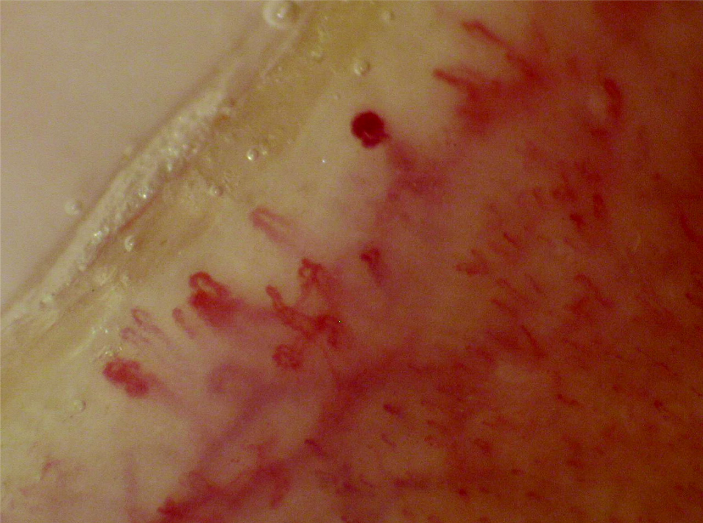
Nail bed changes in connective tissue disease

Slide 17
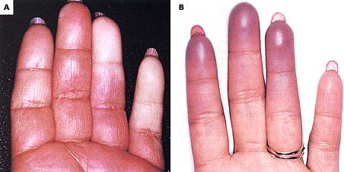
Raynaud’s Phenomenon in CTD
CTD, connective tissue disease.

Slide 18
Clinical Features of Systemic Sclerosis continued
Autoimmune connective tissue disease
Vascular damage, eg, Raynaud’s phenomenon
Rheumatologic conditions, eg, RA and myositis
Gastrointestinal bleeding
Esophageal disturbances reducing QoL
NSIP pattern on CT scan
May force progression of ILD
Interstitial pneumonia (minority of cases)
NSIP, Nonspecific interstitial pneumonia; QoL, quality of life; RA, rheumatoid arthritis.
Lin Y-T, et al. Arthritis Res Ther. 2019;21:301; Zhang XJ, et al. J Rheumatol. 2013;40:850-858.
Notes:
Lin Y-T, Chuang Y-S, Wang J-W, Wu P-H. High risk of gastrointestinal hemorrhage in patients with systemic sclerosis. Arthritis Res Ther. 2019;21:301.
Zhang XJ, Bonner A, Hudson M, Canadian Scleroderma Research Group; Baron M, Pope J. Association of gastroesophageal factors and worsening of forced vital capacity in systemic sclerosis. J Rheumatol. 2013;40:850-858.
EV: I’m not sure if symptoms is an appropriate header for this slide.
IN: maybe “features”
VA: Updated to ‘Features’

Slide 19
Symptoms SSc-ILD
Early SSc-ILD is often asymptomatic
  Difficult to diagnose at an early stage due to lack of specific symptoms
Fatigue
Exertional dyspnea
Dry cough
Perelas A, et al. Lancet Respir Med. 2020;8:304-320; Volkmann ER, et al. Ann Am Thorac Soc. 2016;13:2045-2056.
Notes:
IN: NSIP pattern and Interstitial pneumonia aren’t symptoms – they would go with features on previous slide
VA: Moved to Features on previous slide

Slide 20
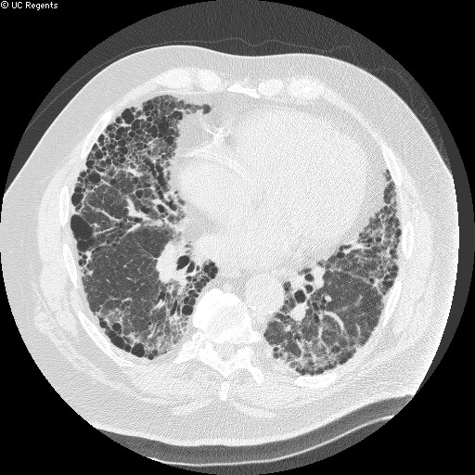
UIP:
Honeycombing
UIP, usual interstitial pneumonia.
Module: Basics of ILD: Principals of Common Physiology, Pathology & Clinical Features
Image courtesy of W. Richard Webb, MD.

Slide 21
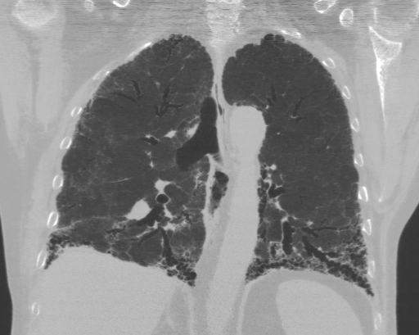
UIP
Coronal HRCT
Traction Bronchiectasis
Diffuse Honeycombing and interstitial alveolitis
Honeycombing
is predominantly subpleural and basilar
UIP, usual interstitial pneumonia.
Module: Idiopathic Pulmonary Fibrosis (IPF)
Notes:
The chest roentgenogram and HRCT typically show patchy, predominantly peripheral, subpleural, reticular opacities in the lower lung zones. There may also be a ground-glass opacities usually associated with traction bronchiectasis (a dilation of the airways) and subpleural honeycombing (cystic airspaces). Pulmonary function tests often reveal a restrictive pattern, a reduced DLCO, and arterial hypoxemia that is exaggerated or elicited by exercise.

Slide 22
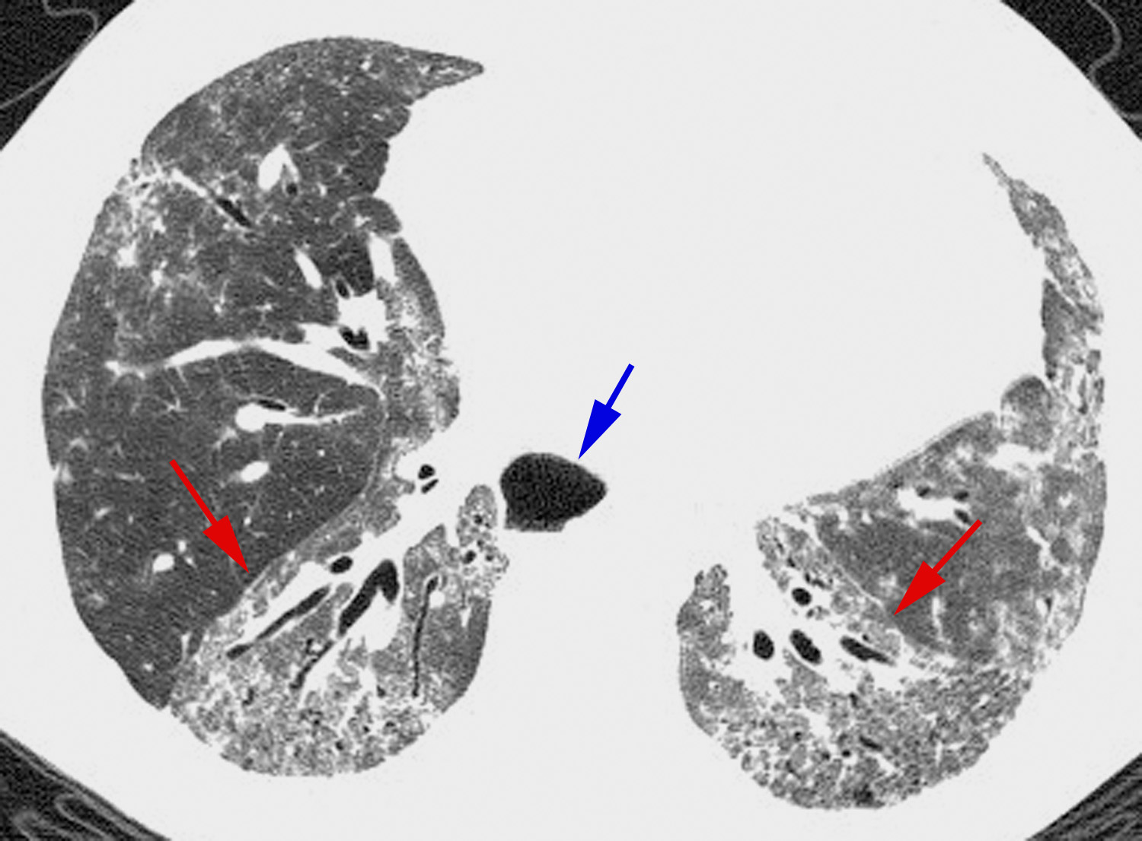
Scleroderma:
HRCT
HRCT, high-resolution computed tomography.
Module: Idiopathic Pulmonary Fibrosis (IPF)
Image courtesy of W. Richard Webb, MD.
Notes:
Scleroderma: HRCT
HRCT in a 34-year-old woman with scleroderma shows reticulation, traction bronchiectasis, and ground-glass opacity with a posterior, subpleural, and lower lobe predominance. No definite honeycombing is present. The major fissures are displaced posteriorly (red arrows) as a result of fibrosis and volume loss. These findings are consistent with fibrotic NSIP associated with scleroderma. IPF without honeycombing could have a similar appearance. Note that the esophagus is dilated (blue arrow), a finding typical of scleroderma.

Slide 23
Importance of Early Screening
Risk of ILD within 4–5 years of SSc onset
HRCT effective to identify ILD in patients with SSc
  Enables detection of mild lung abnormalities
  Note, HRCT associated with increase of radiation exposure (1.5–2.5 mSv per exam)
  Lung ultrasonography may be proposed as alternative to HRCT
ILD often suspected in the absence of clinical symptoms vs. fine bibasilar crackles revealed at lung auscultation
Early detection provides opportunity for early therapeutic intervention
to improve patient outcomes
HRCT, high-resolution computed tomography.
Fischer A, et al. Open Access Rheumatol. 2019;11:283-307; Chowaniek M, et al. Reumatologia. 2018;56:249-254; Bernstein EJ, et al. Arthritis Rheumatol. 2020;72:1892-1896.
Notes:
Fischer A, Patel NM, Volkmann ER. Interstitial lung disease in systemic sclerosis: focus on early detection and intervention. Open Access Rheumatol. 2019;11:283-307.
Chowaniec M, Skoczyńska M, Sokolik R, Wiland P. Interstitial lung disease in systemic sclerosis: challenges in early diagnosis and management. Reumatologia. 2018;56:249-254.
Bernstein EJ, Khanna D, Lederer DJ. Screening high-resolution computed tomography of the chest to detect interstitial lung disease in systemic sclerosis: a global survey of rheumatologists. Arthritis Rheumatol. 2018;70:971-972.
Bernstein EJ, Jaafar S, Assassi S, et al. Performance Characteristics of Pulmonary Function Tests for the Detection of Interstitial Lung Disease in Adults With Early Diffuse Cutaneous Systemic Sclerosis. Arthritis Rheumatol. 2020;72(11):1892-1896. doi: 10.1002/art.41415. Erratum in: Arthritis Rheumatol. 2021 Apr;73(4):720.

Slide 24
Orange Line
Risk Factors for SSc-ILD and Associated Comorbidities

Slide 25
Case Vignette
Address multi-systemic disease and comorbid conditions
A 58-yr-old African American male presents with progressive lung complications and reports recent numbness in toes and fingers.
His primary care physician is in a quandary about next steps based on presentation.

Slide 26
Risk Factors Associated with Progressive SSc-ILD
Demographic factors
African-American race
  socioeconomic disparities may underlie racial differences⁶
Male sex associated with increased mortality
Advanced age at presentation or diagnosis
Diffuse cutaneous disease
Degree of lung involvement on baseline HRCT imaging
Reduced DLCO and FVC (% predicted)
Presence of anti-Scl-70 or
anti–topoisomerase I antibody
Absence of anti-centromere antibodies
DLCO, carbon monoxide diffusing capacity; FVC, forced vital capacity; HRCT, high-resolution computed tomography.
Distler O, et al. Eur Respir J. 2020;55:1–12;
Cutolo M, et al. Expert Rev Clin Immunol. 2019;15:753-764.
Khanna D, et al. Am J Respir Crit Care Med. 2020;201:650-660.
Perelas A, et al. Lancet Respir Med. 2020;8:304-320.
Silver RM, et al. Curr Opin Rheumatol. 2012;24:642-8.
Volkmann ER, et al. J Scleroderma Relat Disord. 2021;6:11-20.
Notes:
VA added: Degree of lung involvement on baseline HRCT imaging, reduced DLCO, and reduced FVC
EV: I would remove “persistent Raynaud phenomenon.”
VA: Removed
IN: I’m a little lost – which genetic polymorphisms are you referencing?
VA: [Perelas et al 2020] “Most risk attributed to polymorphisms in the HLA region and in genes implicated in innate immunity, B-lymphocyte and T-lymphocyte activation and and signal transduction.”
IN: And images of rapid progression? or raynauds?
VA: Raynaud’s, which you have provide in earlier slide.
References:
Cutolo M, Soldano S, Smith V. Pathophysiology of systemic sclerosis: current understanding and new insights. Expert Rev Clin Immunol. 2019;15(7):753-764. doi: 10.1080/1744666X.2019.1614915.
Distler O, Assassi S, Cottin V, et al. Predictors of progression in systemic sclerosis patients with interstitial lung disease. Eur Respir J. 2020;55:1–12.
Khanna D, Tashkin DP, Denton CP, Renzoni EA, Desai SR, Varga J. Etiology, risk factors, and biomarkers in systemic sclerosis with interstitial lung disease. Am J Respir Crit Care Med. 2020;201:650-660.
Perelas A, Silver RM, Arrossi AV, Highland KB. Systemic sclerosis-associated interstitial lung disease. Lancet Respir Med. 2020;8(3):304-320. doi: 10.1016/S2213-2600(19)30480-1.
Silver RM, Bogatkevich G, Tourkina E, Nietert PJ, Hoffman S. Racial differences between blacks and whites with systemic sclerosis. Curr Opin Rheumatol. 2012;24(6):642-8. doi: 10.1097/BOR.0b013e328356d9dc.

Slide 27
Additional Factors Associated and to Identify SSc-ILD
Autoantibodies
Anti-topoisomerase I
Anti-neutrophil cytoplasmic antibody
Anticardiolipin
Anti-Ro52
Anti-NOR90
Anti-U11/U12
Anti-Th/To
Anti-polymyositis-scleroderma
Novel Biomarkers
Interleukin-6, interleukin-34
chemokine (C-X-C motif) ligand 4
chemokine (C-C motif) ligand 18
Carbohydrate antigen 15·3
Lysyl oxidase
Tenascin-C
Serum amyloid A
Surfactant protein D
Chitinase 1
Krebs von den Lungen-6
Cartilage oligomeric matrix protein
Perelas A, et al. Lancet Respir Med. 2020;8:304-32.

Slide 28
Multisystemic Disease, Multi-Organ Involvement
Skin—most common organ system affected in SSc
Gastrointestinal
Lungs
Cardiovascular
Kidneys
Musculoskeletal system
Fischer A, et al. Autoimmun Rev. 2017;16:1147-1154; Savarino E, et al. Am J Respir Crit Care Med. 2009;179:408-13.
Notes:
Fischer A, Zimovetz E, Ling C, Esser D, Schoof N. Humanistic and cost burden of systemic sclerosis: a review of the literature. Autoimmun Rev. 2017;16:1147-1154.
Savarino E, Bazzica M, Zentilin P, et al. Gastroesophageal reflux and pulmonary fibrosis in scleroderma: a study using pH-impedance monitoring. Am J Respir Crit Care Med. 2009;179(5):408-13. doi: 10.1164/rccm.200808-1359OC.

Slide 29
SSc Disease Course
“Renal crisis”
Diffuse
Cutaneous
Variant
Skin Thickness
Myocardial involvement
Pulmonary
hypertension
Intestinal lung disease
Skeletal myopathy
Tendon/bursal friction rubs; joint contractures
Malabsorption
Limited
Cutaneous
Variant
Raynaud’s phenomenon, digital ischemia
Pulmonary hypertension
Esophageal disease
Intestinal lung disease
Time from Disease Onset

Slide 30
Skin Involvement
Skin disorders are a common comorbid outcome of SSc-ILD
Cutaneous involvement varies:
 | dcSSc can evolve rapidly | lcSSc is slower, stable
 | skin thickening in the hands and feet | skin thickening confined to distal extremities
 | extends beyond elbows or knees | or only the fingers
 | often involves the trunk
Results in functional disability substantially contributing to pain, psychological distress, and body image dissatisfaction
dcSSc, diffuse cutaneous sclerosis; lcSSC, limited cutaneous sclerosis.
McMahan ZH, et al. Expert Opin Pharmacother. 2020;21:2041-2056.

Slide 31
Gastrointestinal Involvement
Increased, severe, and uncontrolled reflex
Requires appropriate management of GERD
GI symptoms are the most common disease features of SSc, impacting 90%
of patients
Can affect any region of GI tract—predominance observed in the upper digestive tract
  Primarily involves esophagus, small intestine, and rectum
GI symptoms exacerbated with ILD involvement
GERD, Gastroesophageal reflux disease.
Luquez-Mindiola A, et al. World J Clin Cases. 2021;9:6201-6217; Jaeger VK, et al. PLoS One. 2016;11:e0163894.
Notes:
Jaeger VK, Wirz EG, Allanore Y, et al; EUSTAR co-authors. Incidences and Risk Factors of Organ Manifestations in the Early Course of Systemic Sclerosis: A Longitudinal EUSTAR Study. PLoS One. 2016;11(10):e0163894. doi: 10.1371/journal.pone.0163894.
Luquez-Mindiola A, Atuesta AJ, Gómez-Aldana AJ. Gastrointestinal manifestations of systemic sclerosis: An updated review. World J Clin Cases. 2021;9(22):6201-6217. doi: 10.12998/wjcc.v9.i22.6201.

Slide 32
Lung Involvement
Lung fibrosis occurs in ~80% of patients with SSc
Most common pulmonary manifestations
  ILD (25–30%)
  PAH (10–12%)
ILD and PAH are leading cause of death
  Account for ~60% of SSc-associated mortality
  SSc-ILD mortality risk nearly three times greater than SSc patients
More rapid progression of disease
Connection between other organ involvement and lungs
PAH, Pulmonary arterial hypertension.
Fischer A, et al. Autoimmun Rev. 2017;16:1147-1154. Khanna D, et al. Lancet Respir Med. 2020;8:963-974.

Slide 33
Cardiac Involvement
Equal incidence in males and females for cardiac involvement
Older patients 2.1-fold higher incidence (95% CI 1.3–2.7)
Diffuse skin involvement 1.9-fold higher incidence
(95% CI 1.3–2.7)
anti-topoisomerase-I autoantibodies are risk factors for any cardiac involvement in patients with SSc
CI, confidence interval.
Jaeger VK, et al. PLoS One. 2016;11:e0163894.
Notes:
EV: We may want to mention cardiac arrhythmias as these can be fatal in patients with SSc cardiac involvement.
VA: added on next slide

Slide 34
Cardiac Involvement continued
Diastolic dysfunction most common
  No difference between sexes or autoantibody status
  3.5x (95% CI 2.1–5.9) higher in older than younger patients
  Frequency and time to develop diastolic dysfunction influenced by extent of skin involvement
  Diffuse patients having a 2.1-fold higher incidence
  (95% CI 1.3–3.4)
Cardiac arrhythmias can be fatal in patients with SSc cardiac involvement
Jaeger VK, et al. PLoS One. 2016;11:e0163894.
Notes:
EV: We may want to mention cardiac arrhythmias as these can be fatal in patients with SSc cardiac involvement.
VA: added

Slide 35
Renal Involvement
Administration of glucocorticoids in these patients can increase the risk of renal crisis
Incident leads with cardiac complications, pulmonary restriction (more rarely), followed by elevated systolic pressures of the pulmonary artery, and renal crisis
(Prior to advent of angiotensin converting enzyme inhibitors, renal disease was the greatest risk and worst prognostic sign)
Jaeger VK, et al. PLoS One. 2016;11:e0163894; Volkmann ER, et al. J Scleroderma Relat Disord. 2021;6:11-20.
Notes:
EV: I’m not sure what the second bullet point means. Renal crisis typically occurs in patients with early diffuse skin disease. In these types of patients the administration of glucocorticoids can increase the risk of renal crisis/
VA: adjusted first bullet to reflect this.

Slide 36
Musculoskeletal System
Arthritis
Joint contractures
Myopathy

Slide 37
Multidisciplinary Approach
Importance of co-management
Due to multi-organ involvement and complexity of SSc-ILD, interdisciplinary engagement is key to provide optimal care
For clinicians not in an academic setting, it is important to create a virtual multidisciplinary setting through phone calls, for example, within your clinical community or private practice
  Help make the connection accessible between disciplines to address comorbidities

Slide 38
Comorbidities Associated with SSc-ILD¹
Skin disorders
  eg, Raynaud’s Phenomenon²
GERD
  ~70 with Raynaud’s Phenomenon have GI symptoms³
Upper respiratory tract infections
Type 2 Diabetes Mellitus
COPD
Cardiac arrhythmia
Renal failure or insufficiency
PAH
UTI
Pneumonia
COPD, Chronic obstructive pulmonary disease; GERD, Gastroesophageal reflux disease; GI, gastrointestinal; PAH, Pulmonary arterial hypertension;
UTI, urinary tract infection.
Li Q, et al. Rheumatology (Oxford). 2021;60:1915-1925.
Herrick AL. J Scleroderma Relat Disord. 2019;4:89-101.
Jaeger VK, et al. PLoS One. 2016;11:e0163894.

Slide 39
Treating the Whole Patient
Co-management of patients with SSc-ILD addressing their comorbidities provides optimal care
Comorbidity prevalence increases for patients with SSc-ILD
There is a need for new, earlier management strategies

Slide 40
Blue Line
Current and Emerging Treatment for SSc-ILD

Slide 41
Practice Guidelines and Future Needs
Earlier treatment results in better patient outcomes
Practice guidelines (or lack thereof) and future needs
2013 ACR-EULAR guidelines are outdated
  Need for updating
ACR, American College of Rheumatology; EULAR, European Alliance of Associations for Rheumatology.

Slide 42
European Consensus
Goal to improve identification and treatment
Current Consensus Agreement Management Algorithms based on expert opinions
All patients with SSc should be screened for SSc-ILD using HRCT
HRCT is the primary tool for diagnosing ILD in SSc
PFTs support screening and diagnosis
Appropriate to treat all severe cases
No pharmacological treatment is an option for some patients
Follow-up assessments enable identification of disease progression
Progression pace and disease severity drive decisions to escalate treatment
Additional, post-European consensus:
  Stratify patients on basis of disease severity (subclinical vs clinical ILD)
  Tailor therapy based on risk progress and burden of disease
HRCT, high-resolution computed tomography; PFT, Pulmonary function tests.
Clarke J. Nat Rev Rheumatol. 2020;16:127; Distler O, et al. Expert Rev Clin Immunol. 2019;15:1-9; Hoffmann-Vold A-M, et al. Lancet Rheumatology. 2020;2:e71-83; Roofeh D, et al. Curr Opin Rheumatol. 2020;32:228-237.
Notes:
Roofeh D, Khanna D. Management of systemic sclerosis: the first five years. Curr Opin Rheumatol. 2020;32:228-237.

Slide 43
Whom to Treat Upfront
Not necessary for stable or non-progressing disease
  Mild disease is often clinically asymptomatic and stable
Consider duration of disease
  Less likely to treat stable patients vs. a patient early in the course of their disease
Aggressive disease progresses rapidly and can shorten life significantly
Treatment recommended for patients with extensive disease, considered:
  ILD ≥20% on HRCT, or
  10–30% and FVC <70% predicted
Treatment also considered for patients with limited ILD but have risk factors for progression, eg, Scl-70, males, etc.
FVC, forced vital capacity; HRCT, high-resolution computed tomography.
Bonhomme O, et al. Rheumatology (Oxford). 2019;58:1534-1546; Perelas A, et al. Lancet Respir Med. 2020;8:304-320.
Notes:
EV: Treatment should also be considered in patients with limited ILD but risk factors for progression (Scl-70, males, etc.).
VA: TY, added.

Slide 44
Efficacy and Safety of Traditional Therapies
 | Patients receiving IST at baseline | Patients receiving IST during follow-up
SSc | 13.6% | 8.2%
SSc-ILD | 23.4% | 12.7%
50% of patients received corticosteroids at baseline (limited evidence of efficacy)
Adverse events and long-term follow-up evidence is limited.
IST, Immunosuppressant therapies
Li Q, et al. Rheumatology (Oxford). 2021;60(4):1915-1925.

Slide 45
Current Treatment Strategies¹
First line—Immunosuppressant Therapies
First-line Therapy | Class of agent | Comments
Methotrexate (MTX) | immunosuppressant | Shown to improve skin score in early dcSSc; unclear benefits for lungs and other systems²
Cyclophosphamide (CYC) | alkylating agent | May slow progression of ILD; known toxicity—limits duration³
Mycophenolate mofetil (MMF) | immunosuppressant | Inhibitor of lymphocyte proliferation; safer, less-toxic alternative
Azathioprine (AZA) | immunosuppressant | May have adjuvant role in patients with more advanced disease or in those intolerant to CYC and MMF⁵
Combination therapy (MMF and CYC) |  | Consider for patients with a more inflammatory phenotype^{4,5} Consider with progressive disease or with evidence of substantial ground glass opacities and fibrotic changes⁵
dcSSc, diffuse cutaneous systemic sclerosis; IST, Immunosuppressant therapies.
Distler O, et al. Expert Rev Clin Immunol. 2019;15:1-9.
Kowal-Bielecka O, et al. Ann Rheum Dis. 2017;76:1327-1339.
Li Q, et al. Rheumatology (Oxford). 2021;60:1915-1925.
McMahan ZH, et al. Expert Opin Pharmacother. 2020;21:2041-2056.
Perelas A, et al. Lancet Respir Med. 2020;8:304-320.
Notes:
Distler O, Volkmann ER, Hoffmann-Vold AM, Maher TM. Current and future perspectives on management of systemic sclerosis-associated interstitial lung disease. Expert Rev Clin Immunol. 2019;15:1-9.
Kowal-Bielecka O, Fransen J, Avouac J et al. Update of EULAR recommendations for the treatment of systemic sclerosis. Ann Rheum Dis. 2017;76:1327-1339.
Li Q, Wallace L, Patnaik P, et al. Disease frequency, patient characteristics, comorbidity outcomes and immunosuppressive therapy in systemic sclerosis and systemic sclerosis-associated interstitial lung disease: a US cohort study. Rheumatology (Oxford). 2021;60(4):1915-1925. doi: 10.1093/rheumatology/keaa547.
McMahan ZH, Volkmann ER. An update on the pharmacotherapeutic options and treatment strategies for systemic sclerosis. Expert Opin Pharmacother. 2020;21(16):2041-2056. doi: 10.1080/14656566.2020.1793960.
Perelas A, Silver RM, Arrossi AV, Highland KB. Systemic sclerosis-associated interstitial lung disease. Lancet Respir Med. 2020;8(3):304-320. doi: 10.1016/S2213-2600(19)30480-1.

Slide 46
Cyclophosphamide: Scleroderma Lung Study I¹
FVC: 2.5%
DLCO: 1%
HAQ: 0.16 units
Mahler: 2.9 units
SF-36: no diff.
mRSS: 3.6 units
Cyclophosphamide
49.3% had improvement
Placebo
26.4% had improvement
25 20 15 10 5 5 10 15 20 25
DLCO, carbon monoxide diffusing capacity; FVC, forced vital capacity; HAQ, Health Assessment Questionnaire; mRSS, modified Rodnan Skin Score; SF-36, Medical Outcomes Study 36-item Short-Form General Health Survey.
Tashkin DP, et al. N Engl J Med. 2006;354:2655-2666.
Notes:
Tashkin DP, Elashoff R, Clements PJ, et al. Cyclophosphamide versus placebo in scleroderma lung disease. N Engl J Med. 2006;354(25):2655-66. doi: 10.1056/NEJMoa055120.

Slide 47
Effects of 1-Year Treatment With Cyclophosphamide at 2 Years¹
Placebo
Cyclophosphamide
Adjusted Predicted FVC, %
70
68
66
64
Placebo, N | 70 | 65 | 65 | 55 | 56 | 51 | 55
Cyclo, N | 67 | 64 | 66 | 57 | 52 | 51 | 54
P | .8053 | .0768 | .0400 | .3212 | .0107 | .4793 | .4223
6
9
12
15
18
21
24
Follow-Up Time, mo
FVC, forced vital capacity.
Tashkin DP et al. Am J Respir Crit Care Med. 2007;176:1026-1034.
Notes:
Tashkin DP, et al. Effects of 1-year treatment with cyclophosphamide on outcomes at 2 years in scleroderma lung disease. Am J Respir Crit Care Med. 2007;176(10):1026-34. doi: 10.1164/rccm.200702-326OC.
47

Slide 48
Scleroderma Lung Study II: Mycophenolate Versus Cyclophosphamide¹
72
Time to Premature Withdrawal From Study Medication or Treatment Failure by Treatment Arm
Cyclophosphamide
Mycophenolate
Predicted FVC, %
70
Cyclophosphamide
Mycophenolate
68
66
Mycophenolate
Cyclophosphamide
P = .019 (log-rank test)
64
0
3
6
9
12
15
18
21
24
Time, mo
Figures adapted from Tashkin DP et al. Lancet Respir Med. 2016;4:708-719.
Notes:
Tashkin DP, Roth MD, Clements PJ, et al; Sclerodema Lung Study II Investigators. Mycophenolate mofetil versus oral cyclophosphamide in scleroderma-related interstitial lung disease (SLS II): a randomised controlled, double-blind, parallel group trial. Lancet Respir Med. 2016;4(9):708-719. doi: 10.1016/S2213-2600(16)30152-7.
<<Figures 2A adapted>>

Slide 49
Mycophenolate and Cyclophosphamide: Improvement in Patient-Reported Shortness of Breath¹
Course of the Transitional Dyspnea Index (TDI) Score
Over 24 Months by Treatment Arm
Cyclophosphamide
Mycophenolate
TDI
Mean Baseline Dyspnea Index score for the entire Scleroderma Lung Study II cohort
Time, mo
ª A significant change from baseline within the mycophenolate arm at 12, 18, and 24 months.
^{b} A significant change from baseline within the cyclophosphamide arm at 12, 18, and 24 months.
Figure adapted from Volkmann ER et al. ACR Open Rheumatology. 2020;2:362-3.
Notes:
Volkmann ER, Tashkin DP, LeClair H, et al. Treatment With Mycophenolate and Cyclophosphamide Leads to Clinically Meaningful Improvements in Patient-Reported Outcomes in Scleroderma Lung Disease: Results of Scleroderma Lung Study II. ACR Open Rheumatol. 2020;2(6):362-370. doi: 10.1002/acr2.11125. <<Figure 2 redrawn>>

Slide 50
Targeted Treatment
Antifibrotic agent, nintedanib
Oral, targeted tyrosine kinase inhibitor; FDA approved 2019¹
Can be considered for first line among patients with a predominantly fibrotic pattern on chest CT²
SENSCIS trial (n=576) reduced rate of decline in FVC (>placebo grp)^{3,4}
  GI AEs more common than placebo grp
Combo therapy subgroup analysis
  Safety efficacy of nintedanib in patients who used MMF at baseline⁵
AE, adverse events; FVC, forced vital capacity; GI, gastrointestinal; MMF, mycophenolate mofetil.
Kuwana M, et al. Mod Rheumatol. 2020;30:225-231.
Perelas A, et al. Lancet Respir Med. 2020;8:304-320.
Distler O, et al. N Engl J Med. 2019;380:2518-2528.
Flaherty KR, et al. N Engl J Med. 2019; 381:1718-1727.
Highland KB, et al. Lancet Respir Med. 2021;9:96-106.
Notes:
Kuwana M, Azuma A. Nintedanib: New indication for systemic sclerosis-associated interstitial lung disease. Mod Rheumatol. 2020;30(2):225-231. doi: 10.1080/14397595.2019.1696505. Erratum in: Mod Rheumatol. 2019.
Distler O, Highland KB, Gahlemann M, et al; SENSCIS Trial Investigators. Nintedanib for Systemic Sclerosis-Associated Interstitial Lung Disease. N Engl J Med. 2019;380(26):2518-2528. doi: 10.1056/NEJMoa1903076.
Flaherty KR, Wells AU, Cottin V, et al. Nintedanib in progressive fibrosing interstitial lung diseases. N Engl J Med. 2019; 381:1718-1727.
Highland KB, Distler O, Kuwana M, et al; SENSCIS trial investigators. Efficacy and safety of nintedanib in patients with systemic sclerosis-associated interstitial lung disease treated with mycophenolate: a subgroup analysis of the SENSCIS trial. Lancet Respir Med. 2021;9(1):96-106. doi: 10.1016/S2213-2600(20)30330-1.

Slide 51
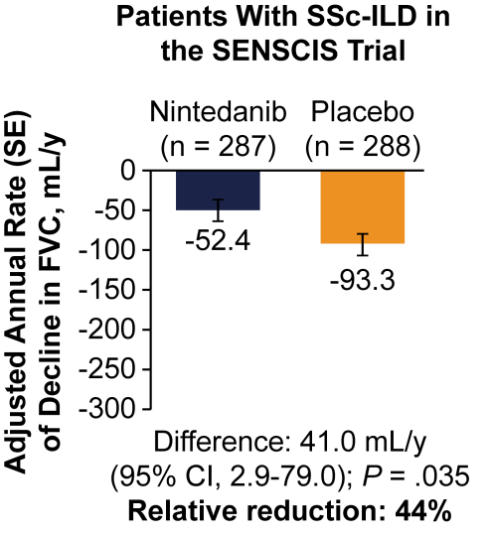
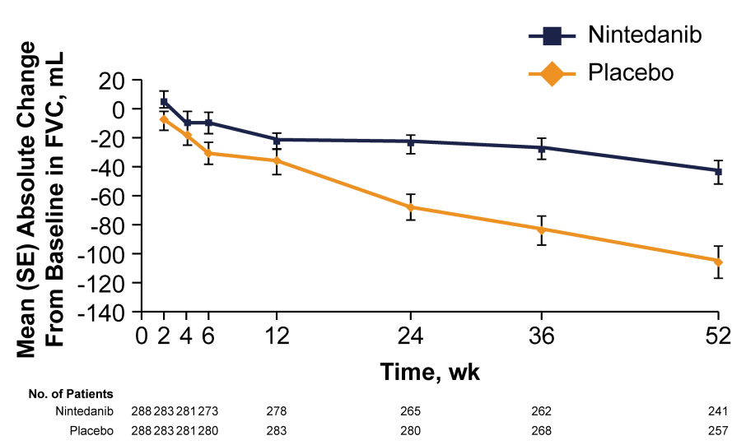
SENSCIS:
Results
Adjusted annual rate of decline in FVC was significantly lower in the nintedanib group vs placebo group
(-52.4 vs -93.3 mL/y)
Secondary: Adjusted mean change from baseline in mRSS at week 52 was -2.17 with nintedanib
vs -1.96 with placebo
Adjusted mean change from baseline in SGRQ total score at week 52 was 0.81 with nintedanib
vs -0.88 with placebo
FVC, forced vital capacity; mRSS, modified Rodnan Skin Score; SGRQ, St. George’s Respiratory Questionnaire .
Distler O, et al, SENSCIS Trial Investigators. N Engl J Med. 2019;380:2518-2528.
Figures adapted from Distler, et al. 2019.
Notes:
Distler O, Highland KB, Gahlemann M, et al; SENSCIS Trial Investigators. Nintedanib for Systemic Sclerosis-Associated Interstitial Lung Disease. N Engl J Med. 2019;380(26):2518-2528. doi: 10.1056/NEJMoa1903076.
<<Figures 2A and C>>

Slide 52
SENSCIS: Rate of Decline of FVC by
Mycophenolate Use at Baseline
Taking Mycophenolate at Baseline
Not Taking Mycophenolate at Baseline
Nintedanib
(n = 138)
Placebo
(n = 140)
Nintedanib
(n = 149)
Placebo
(n = 148)
Adjusted Rate (SE) of Decline
in FVC, mL/y
-40.2
-66.5
-63.9
-119.3
Difference: 26.3 mL/y
(95% CI, -27.9 to 80.6)
Relative reduction: 40%
Difference: 55.4 mL/y
(95% CI, 2.3 to 108.5)
Relative reduction: 46%
Treatment-by-time-by-subgroup interaction P = .45
CI, confidence interval; FVC, forced vital capacity.
Distler O, et al, SENSCIS Trial Investigators. N Engl J Med. 2019;380:2518-2528.
Figures adapted from Distler, et al. 2019.

Slide 53
Biological Agents—Studies Suggest Benefit
Rituximab
  Consider for refractory disease¹; not FDA approved for SSc-ILD
  Small RCT showed RTX may improve lung function in patients with SSc as a safe and effective alternative to CYC²
Tocilizumab, anti-interleukin-6 receptor antibody
  FDA approved 2021
  Khanna et al, phase 3 trial (n=210) assessed skin fibrosis and SSc-ILD^{3,4}
    Investigated safety and efficacy of tocilizumab in treatment of SSc
    Primary skin fibrosis endpoint not met
    Secondary endpoint of FVC% predicted tocilizumab might preserve lung function in people with early SSc-ILD and elevated acute-phase reactants
CYC, Cyclophosphamide; FVC, forced vital capacity; RCT, randomized clinical trial; RTX, Rituximab.
Perelas A, et al. Lancet Respir Med. 2020;8:304-320.
Sircar G, et al. Rheumatology (Oxford). 2018;57:2106-2113.
Khanna D, et al. Lancet Respir Med. 2020;8:963-974.
Roofeh D, et al. Curr Opin Rheumatol. 2020;32:228-237.
Notes:
Sircar G, Goswami RP, Sircar D, et al. Intravenous cyclophosphamide vs rituximab for the treatment of early diffuse scleroderma lung disease: open label, randomized, controlled trial. Rheumatology (Oxford). 2018;57:2106-2113.
Khanna D, Lin CJF, Furst DE, et al; focuSSced investigators. Tocilizumab in systemic sclerosis: a randomised, double-blind, placebo-controlled, phase 3 trial. Lancet Respir Med. 2020;8:963-974. doi: 10.1016/S2213-2600(20)30318-0.
Roofeh D, Khanna D. Management of systemic sclerosis: the first five years. Curr Opin Rheumatol. 2020;32:228-237.

Slide 54
Rituximab
Sometimes used as a second-line agent after MMF in progressive SSc-ILD; not FDA approved for SSc-ILD
Currently being studied in phase 3 trial versus CYC in treatment of CTD-ILD¹
Potential efficacy of RTX for treatment of SSc-ILD was evaluated in a small randomized trial comparing RTX plus “standard therapy” (eg, prednisone, CYC, and/or MMF) with standard therapy alone²
  Patients in the RTX group had significantly better FVC and DLCO at 1 year than the standard therapy-only group
CTD-ILD, Connective tissue disease-interstitial lung disease; CYC, Cyclophosphamide; DLCO, carbon monoxide diffusing capacity; FVC, forced vital capacity; MMF, Mycophenolate mofetil.
https://clinicaltrials.gov/ct2/show/NCT01862926.
Daoussis D et al. Rheumatology. 2010;49:271-280.
Notes:
Daoussis D, Liossis SN, Tsamandas AC, et al. Experience with rituximab in scleroderma: results from a 1-year, proof-of-principle study. Rheumatology (Oxford). 2010 Feb;49(2):271-80. doi: 10.1093/rheumatology/kep093.

Slide 55
Tocilizumab: Change from Baseline FVC compared with placebo in patients dcSSc and ILD¹
Entry Criteria
Diffuse SSc
Early disease (<5 years)
Increased inflammatory markers
Active disease
  duration ≤18 months
dcSSc, diffuse cutaneous systemic sclerosis; FVC, forced vital capacity.
1. Adapted from Khanna D, et al. Lancet Resp Med. 2020;8:963-974.
Notes:
Active disease defined as: disease duration 18 months or less; mRSS increase at least 3 units, or involvement of one new body area and mRSS increase at least 2 units, or involvement of two new body areas (each within the previous 6 months); and at least one tendon friction rub.
Reference:
Khanna D, Lin CJF, Furst DE, et al. Tocilizumab in systemic sclerosis: a randomised, double-blind, placebo-controlled, phase 3 trial. Lancet Respir Med. 2020;8(10):963-974. doi: 10.1016/S2213-2600(20)30318-0. Erratum in: Lancet Respir Med. 2020;8(10):e75. Erratum in: Lancet Respir Med. 2021;9(3):e29.

Slide 56
Autologous Hematopoietic Stem Cell Transplantation
Treatment for refractory cases
ASTIS Trial: Overall Survival¹
SCOT Trial: Overall Survival²
ITT Population
Transplantation
Transplantation
Survival, %
Cyclophosphamide
Survival, %
Cyclophosphamide
Time-varying HR P = .03
P = .05 by log-rank test
Time, y
Time, y
No. at Risk
Transplantation | 79 | 68 | 67 | 67 | 66 | 55 | 43 | 32 | 23 | 14 | 11
Cyclophosphamide | 77 | 70 | 64 | 60 | 57 | 40 | 34 | 25 | 18 | 12 | 6
No. at Risk
Transplantation | 36 | 33 | 31 | 30 | 30 | 25 | 9
Cyclophosphamide | 39 | 35 | 32 | 24 | 22 | 15 | 7
ASTIS, Autologous Stem Cell Transplantation International Scleroderma trial; HSCT, hematopoietic stem cell transplantation; ITT, Intention to treat; SCOT, Scleroderma: Cyclophosphamide or Transplantation trial.
Van Laar JM et al. JAMA. 2014;311:2490-2498.
Sullivan KM et al. N Engl J Med. 2018;378:35-47.
Notes:
van Laar JM, et al; EBMT/EULAR Scleroderma Study Group. Autologous hematopoietic stem cell transplantation vs intravenous pulse cyclophosphamide in diffuse cutaneous systemic sclerosis: a randomized clinical trial. JAMA. 2014;311(24):2490-8. doi: 10.1001/jama.2014.6368.
High-dose immunosuppressive therapy and autologous hematopoietic stem cell transplantation (HSCT)
Sullivan KM, et al; SCOT Study Investigators. Myeloablative Autologous Stem-Cell Transplantation for Severe Scleroderma. N Engl J Med. 2018;378(1):35-47. doi: 10.1056/nejmoa1703327. <<adapted from Figure 2D>>

Slide 57
Scleroderma Lung Study III—
Combining Pirfenidone With Mycophenolate
150 patients randomized to double-blind treatment
1º outcome
Pirfenidone, approved for IPF, has anti-inflammatory and antifibrotic properties.
~200 patients screened
75 patients: MMF + placebo
No Rx
0
18
1 month follow-up
1:1
vs
Off tx
-3
0
75 patients: MMF + PFD
Consent H&P
Blood tests
Spirometry
DLCO
If meet all other inc and exc, then HRCT
0
18
Follow-up about 2 weeks, monthly until 6 months, then every 3 months with CBC, metabolic panel with LFT, pregnancy test, H&P, drug reconciliation
AE and concomitant meds monitoring at 2, 4, 6 weeks, and then monthly through remainder of study and at 1-month post-study follow-up
Every 3 months: spirometry, DLCO-Hb, mRSS, BDI/TDI, SGRQ
Every 6 months: SHAQ, PROMIS-29, UCLA STC GIT, CRISS, LCQ
Biorepository sample at baseline, 12, and 18 months
HRCT at baseline and 18 months with quantitative image analysis
30-day washout if on tx but
≤3 months
Reject if all inc and exc not met
BDI, baseline dyspnea index; DLCO, carbon monoxide diffusing capacity; IPF, idiopathic pulmonary fibrosis; LCQ, Leicester Cough Questionnaire; LFT, liver function test; mRSS, modified Rodnan Skin Score; SHAQ, Scleroderma Health Assessment Questionnaire; TDI, transitional dyspnea index.
clinicaltrials.gov/ct2/show/NCT03221257. Perelas A, et al. Lancet Respir Med. 2020;8:304-320.

Slide 58
Green Line
Optimizing Clinician-Patient Communication and Patient Education
Faculty Case presentations that outline various issues and demonstrate how best to approach an ongoing and extensive conversation with the patient, regarding prognosis of disease.

Slide 59
As a pulmonologist, I encounter SSc-ILD in 2 ways
Referred from rheumatologist to help
  Assessment of involvement of the lungs
  Severity of lung function loss
  Use of antifibrotics on top of scleroderma therapies
De Novo diagnosis, I refer to rheum
  These tend to be subtle
  Often overlap syndrome
  Or involve positive serology without classically fitting a diagnosis (IPAF)
IPAF, Interstitial pneumonia with autoimmune features.

Slide 60
Referred from Rheum
Initial Presentation
CASE #1
CG is a 44-year-old female with pmh of asthma, hypothyroidism, PE, and anxiety who was recently diagnosed with CT-ILD and presents for a second opinion.
2005–2016 lived in an older house with mold and mildew
Has been having issues with dry cough, throat irritation, and dyspnea for at least 3 years. Notes that this has progressively worsened to where she wears home O₂.
Denies orthopnea, lower extremity edema, or productive sputum.
Was seen in 2018 where she was found to have
  restrictive PFTs;
  scattered GGOs on CT; and
  NSIP on VATS biopsy.
  +ANA and SCL 70 Pos
  Started on MMF/prednisone
ANA, antinuclear antibodies; CT, Computed tomography; CT-ILD, Connective tissue disease-associated interstitial lung disease; GGO, ground-glass opacity; MMF, mycophenolate mofetil; NSIP, nonspecific interstitial pneumonia; PE, pulmonary embolism; PFT, Pulmonary function test; PMH, past medical history; SCL, scleroderma; VATS, Video-assisted thoracoscopic surgery.

Slide 61
Medical and Family History
CASE #1
Medical History |  | Surgical History
Anemia | Hypertension | C section
Anxiety | Obstructive sleep apnea | s/p Choley
Asthma | Hx of pulmonary embolism | VATS
Depression | Scl with pulm involvement | Sinus surgery
Gall stones
 | Non/never smoked | Family History
 | Rare ETOH | Mother: arthritis, asthma, CAD, DM, RA, OSA, Lupus, COPD
Employment | Tax auditor
Pets | parakeet, dog
CAD, Coronary Artery Disease; DM, Diabetes mellitus;, OSA, obstructive sleep apnea; VATS, Video-assisted thoracoscopic surgery.

Slide 62
Physical Exam
CASE #1
There were no vitals taken for this visit.
There is no height or weight on file to calculate BMI.
Constitution: Pleasant, well appearing African American female. Oriented to person, place, and time. Appears well-developed and well-nourished. No distress. Able to speak in full sentences without accessory muscle use or SOB.
SOB, Shortness of breath.
Notes:
IN: able to speak in full sentences without….

Slide 63
Physical Exam continued
CASE #1
Mouth/Throat | Oropharynx is clear and moist. No oropharyngeal exudate.
Eyes | EOMI. No scleral icterus or conjunctival injection.
Neck | No JVD present. No cervical LAD.
Cardiovascular | Normal rate and regular rhythm. No murmurs. No pitting LE edema.
Pulmonary/Chest | Effort normal. Minimal crackles heard best at the lower lobes.
Abdominal | Soft. Normal bowel sounds. No distension and no mass. There is no tenderness.
Musculoskeletal | Clubbing present. No joint effusions or deformity.
Neurological | Alert and oriented to person, place, and time. 5/5 strength in UE, 5/5 strength in LE. Able to rise from chair without assistance or use of UE.
Skin | Skin is warm and dry. No erythema. No mechanic hands, no evidence of sclerodactyly.
Psychiatric | Normal mood and affect.
EOMI, extraocular movements intact; HENT, head, eyes, nose, and throat; JVD, jugular vein distention; LAD, left anterior descending artery; LE, lower extremity; UE, upper extremity.

Slide 64
Test Results
CASE #1
ECHO 5/29/19
Left ventricle: Systolic function was normal.
Ejection fraction was estimated in the range of 55% to 60%. There were no regional wall motion abnormalities.
CT 5/31/19 OSH Read
There are scattered areas of ground-glass opacities in the lungs, slightly more pronounced in the lung bases. There is mild changes of bronchiectasis in the lower lobes and right middle lobe. There are areas of slight reticulation/interlobular septal thickening in the right upper lobe. There is no significant air trapping. No adenopathy is identified. CT pattern is most consistent with non-IPF diagnosis. The findings are nonspecific but considerations include hypersensitivity pneumonitis or possibly NSIP. These findings have progressed when compared to 7/19/2016.
IPF, Idiopathic pulmonary fibrosis; NSIP, nonspecific interstitial pneumonia.

Slide 65
Test Results continued
CASE #1
Bronchoscopy/Biopsy Results:
VATS biopsy 8/3/18 (reviewed here)
  LUNG, right upper lobe biopsy:
    Interstitial pneumonia, favor cellular phase of NSIP
  LUNG, right middle lobe Wedge biopsy:
    Interstitial pneumonia, favor cellular phase of NSIP
  LUNG, right lower lobe Wedge biopsy:
    Interstitial pneumonia, favor cellular phase of NSIP
NSIP, nonspecific interstitial pneumonia; VATS, Video-assisted thoracoscopic surgery.

Slide 66
CT with NSIP pattern with GGO and some bronchiectasis—
no honeycombing
CASE #1
GGO, ground-glass opacities; NSIP, nonspecific interstitial pneumonia.
Notes:
IN: you may want to animate the cuts or put over two slides to demonstrate GGO features and absence of honeycombing
VA: Animated; pls LMK if this provides best display of these slides

Slide 67
Pulmonary Test Results
CASE #1
Pulmonary Function Tests (2/4/19)
FVC | 2.43/55%
FEV1 | 2.11/70%
TLC | 2.88/48%
DLCO | 8.7/29%
DLCO, carbon monoxide diffusing capacity; FEV1, forced expiratory volume over 1 second; FVC, forced vital capacity; TLC, total lung capacity.

Slide 68
This case addresses several issues
CASE #1
Diagnostic accuracy
  SCL70 positive
  Typical NSIP pattern on CT
    Did you really need a VATS? Probably not.
  Better prognosis than UIP pattern
  Multiple comorbidities to address
  Already treated with MMF and Prednisone
  What is the prognosis? What factors involved?
  What are other treatment options?
  We added nintedanib
MMF, Mycophenolate mofetil; NSIP, nonspecific interstitial pneumonia; SCL, scleroderma; UIP, Usual interstitial pneumonia; VATS, Video-assisted thoracoscopic surgery.

Slide 69
Interstitial Lung Disease Classification
CASE #1
Scleroderma ILD diagnosed w/CT, VATS Biopsy, and Inflammatory Serologies.
She has been on appropriate immunomodulatory therapy for her Scleroderma. Given the degree of desaturation in evaluating her imaging there may also be thrombotic and vascular components to her hypoxia. We will therefore start workup to evaluate for pulmonary hypertension and chronic thromboembolic disease (given previous VTE hx).
Otherwise, given recent updates in primary literature, the anti-fibrotic agent, nintedanib, may be an appropriate disease-slowing agent.
Can start nintedanib for scleroderma lung—awaiting script fill by Rheum
Has gained 15 lbs—advise wt loss
Allergic rhinitis—Fluticasone nasal spray

Slide 70
Medication Recommendations
CASE #1
Continue immunomodulator therapy (mycophenolate mofetil/Prednisone) as prescribed by rheumatologist
Labs: BNP
Imaging: TTE w/Bubble was negative
Medications managed by by rheumatologist
PJP prophylaxis: Sulfamethoxazole/trimethoprim
  Oxygen supplementation
As tolerated w/exertion and sleep
Vaccinations: In addition to yearly influenza vaccination, I recommend PCV13 followed by PPSV23 based on our current immunization record
Follow up with PFTs in 3 months
PFT, Pulmonary function test; PJP, pneumocystis jirovecii; TTE, transthoracic echocardiogram.

Slide 71
Optimizing Clinician Patient Communication and Education
Inform
  Encourage discussion over understanding of comorbidities and remaining concerns
Educate
  Provide patients information regarding pros and cons of immunomodulatory therapy and anti fibrotic therapy alone and together.
  Open discussion over the remainder of the work up and why monitoring is important
  Encourage them to ask questions and provide feedback along their journey
  Discussion about the importance of co-management with rheumatologist—management is not in isolation

Slide 72
Optimizing Clinician Patient Communication and Education continued
Empower
  Empower patients to participate in all their medical decisions
  Teach your patients what they should be looking for
    GI upset and other potential side effects
    Signs and symptoms of pulmonary hypertension
    Consider home oxygen monitoring
      Eg, Home oximeter (~$35)

Slide 73
Initial Presentation
CASE #2
KLA 78-yo female
PMHx of HTN, HLD, pAF (on AC)
Suspected ILD who presents to establish care at the ILD clinic.
Today she states her symptoms started about one year ago, in March 2020, presented with chest pain at rest; saw her PCP who referred her to Pulmonologist.
She endorses a dry cough, now more productive. She states the cough has significantly improved since her birds were removed (one year ago). In the past she has had other pets in addition to the birds, which included dogs, cats, gerbils, a rabbit and a snake (as a child).
She walks at least one mile and swims daily.
HLD, hypersensitivity lung disease; HTN, Hypertension; pAF, Paroxysmal atrial fibrillation; PMHx, past medical history.

Slide 74
Initial Presentation—PMHx continued
CASE #2
She has never smoked; does not vape; has not lived with any smokers.
No family history of autoimmune disease; her daughter has asthma.
She did not grow up on a farm.
She has never lived with anyone who worked as a miner or in a factory.
She has traveled in the past and has lived in Norway and spent a semester at sea. Has visited the Amazon rainforest. She has never worked for the military. For most of her life, she has lived in the Charlottesville area and worked as a physical therapist. She recently retired.

Slide 75
Medical and Family History
CASE #2
Medical and Surgery History |  | Family History
Afib | Appendectomy | Mother: Leukemia
DJD | Hip arthroplasty | Father: Alzheimer’s, Htn
Dyslipidemia | Lumbar Laminectomy
ILD
Employment | Physical Therapist (now retired)
Hobbies | Stained glass (~30–40 years ago; hobby for several years)
Pets | Had two birds (now removed since 2021; had for 20 years)
Travel | Norway, the Amazon, Semester at Sea (multiple countries)
DJD, degenerative joint disease; HTN, Hypertension.

Slide 76
CASE #2
Physical Examination
Vital signs stable
HENT
Mouth/Throat | Oropharynx is clear and moist. No oropharyngeal exudate.
Eyes | EOMI, No scleral icterus or conjunctival injection.
Neck | No JVD present. No cervical LAD.
Cardiovascular | Normal rate and regular rhythm. No murmurs. No LE edema
Pulmonary/Chest | Effort normal. No crackles.
Abdominal | Soft. Normal bowel sounds No distension and no mass. There is no tenderness.
Musculoskeletal | Clubbing absent. No joint effusions or deformity.
Neurological | Alert and oriented to person, place, and time. 5/5 strength in UE, 5/5 strength in LE. Able to rise from chair without assistance or use of UE.
Skin | Skin is warm and dry. No erythema. No mechanic hands, no evidence of sclerodactyly.
Psychiatric | Normal mood and affect.
EOMI, extraocular movements intact; HENT, Head, Ears, Nose, Throat; JVD, jugular vein distention; LAD, left anterior descending artery; LE, lower extremity;
UE, upper extremity.

Slide 77
CASE #2
Laboratory Analyses
SCL 100 + (there are more than SCL 70 cases)
Also, HP panel positive for birds (parrots/parakeets)
Chest CT w/o contrast from 5/26/2020
IMPRESSION:
Subpleural intralobular septal thickening symmetrically involving both lungs, with mild basilar predominance. No honeycombing or air trapping. The pattern of interstitial fibrosis is indeterminate for UIP.
Enlargement of the main pulmonary artery, as may be seen with pulmonary hypertension. Correlate with echocardiogram.
TTE from 9/30/2020
Left Ventricle: Normal left ventricular cavity size. Normal left ventricular wall thickness.
Left Ventricle Normal global left ventricular systolic function. No wall motion abnormalities. Normal diastolic function. Function: Ejection fraction is visually estimated at 65–70%.
HP, haptoglobin; SCL, Scleroderma; TEE, transesophageal echocardiogram; UIP, Usual interstitial pneumonia.

Slide 78
Pulmonary Function Testing
CASE #2
Date | FVC (L) | % | FEV1 (L) | % | DLCO | % | 6MW (m) | O₂ sat (start) | O₂ LPM (start) | O₂ sat (finish) | O₂ LPM (finish)
05/11/2021 | 2.24 | 83 | 1.79 | 87 | 14.43 | 73 | 332 | 97 | 0 | 96 | 0
Impression
Subpleural intralobular septal thickening symmetrically involving both lungs, with mild basilar predominance. No honeycombing or air trapping. The pattern of interstitial fibrosis is indeterminate for UIP.
Enlargement of the main pulmonary artery, as may be seen with pulmonary hypertension. Correlate with echocardiogram.
6MW, 6-min walk test; DLCO, carbon monoxide diffusing capacity; FVC, forced vital capacity; FEV1, forced expiratory volume over 1 second; LPM, liters per minute; sat, UIP, Usual interstitial pneumonia.

Slide 79
Initial Assessment
CASE #2
Thought it was HP
CT did not have air trapping—seems more unlikely now
SCL 100+
But PFTs are normal and have remained so
Result: not treating
CT, Computed tomography; HP, Hypersensitivity pneumonitis; PFT, Pulmonary function test; SCL, Scleroderma.

Slide 80
Optimizing Clinician Patient Communication and Education
Inform
  Encourage discussion over understanding Scleroderma phenotypes
  Potential for HP with SSc—this is not mutually exclusive
Educate
  Provide patients information regarding pros and cons of immunomodulatory therapy and anti-fibrotic therapy alone and together.
  Open discussion over decision to treat or not. This should be a shared decision-making process between provider and patient.
  Encourage your patients to ask questions and provide feedback along their journey.
  Discussion about the importance of co-management with rheumatologist—management is not in isolation.

Slide 81
Optimizing Clinician Patient Communication and Education continued
Empower
  Empower patients to participate in all their medical decisions
  Teach your patients what they should be looking for
    Disease symptoms manifestations, such as
      Shortness of breath
      Dyspnea on exertion

Slide 82
Progressive ILD in
Systemic Sclerosis
CASE #3
Initial Presentation of 47-year-old Hispanic Female
2011 | Raynaud’s phenomenon
2013 | Puffy hands; Positive ANA
 | Diagnosed with rheumatoid arthritis and started on methotrexate
2014 | Develops a dry cough—PCP thinks it’s due to GERD
2015 | Experiences fatigue and dyspnea after exercise—Patient feels she is out of shape
2016 | Decides to get a second opinion since she feels no better on methotrexate
ANA, antinuclear antibodies; GERD, Gastroesophageal Reflux Disease; PCP, primary care physician.

Slide 83
Physical Examination
CASE #3
2016 visit to referral center
Bibasilar crackles
Sclerodactyly
mRSS: 2
Positive nailfold capillary changes
mRSS, modified Rodnan Skin Score.

Slide 84
Laboratory Analyses
CASE #3
CBC, COMP normal
ESR 32 mm/hr, CRP 2.6 mg/L
CK, Aldolase normal
Positive for: ANA 1:640 homogeneous and nucleolar; PM-Scl Ab positive
Negative for Centromere, RNA polymerase III, RF, CCP
ANA, antinuclear antibodies; CCP, cyclic citrullinated peptide; CK, creatine kinase; COMP, cartilage oligomeric matrix protein; CRP, C-reactive protein; ESR, erythrocyte sedimentation rate; PM, polymyositis; RF, rheumatoid factor.

Slide 85
Initial Assessment
CASE #3
Date (11/2016) | Diagnosis of Limited Systemic Sclerosis
PFTs | FVC 2.54 (72%) | DLCO 13.7 (57%)
TTE | LVEF 60-65% | RVSP 26–31 mm Hg | Peak velocity of TR 2.57 m/s
High-Resolution Esophageal Impedance Manometry with Viscous Swallows |  | Small hiatal hernia | Absent contractility
DLCO, carbon monoxide diffusing capacity; FVC, forced vital capacity; LVEF, left ventricular ejection fraction; PFT, pulmonary function tests; RVSP, right ventricular systolic pressure; TR, tricuspid regurgitation; TTE, transthoracic echocardiogram.

Slide 86
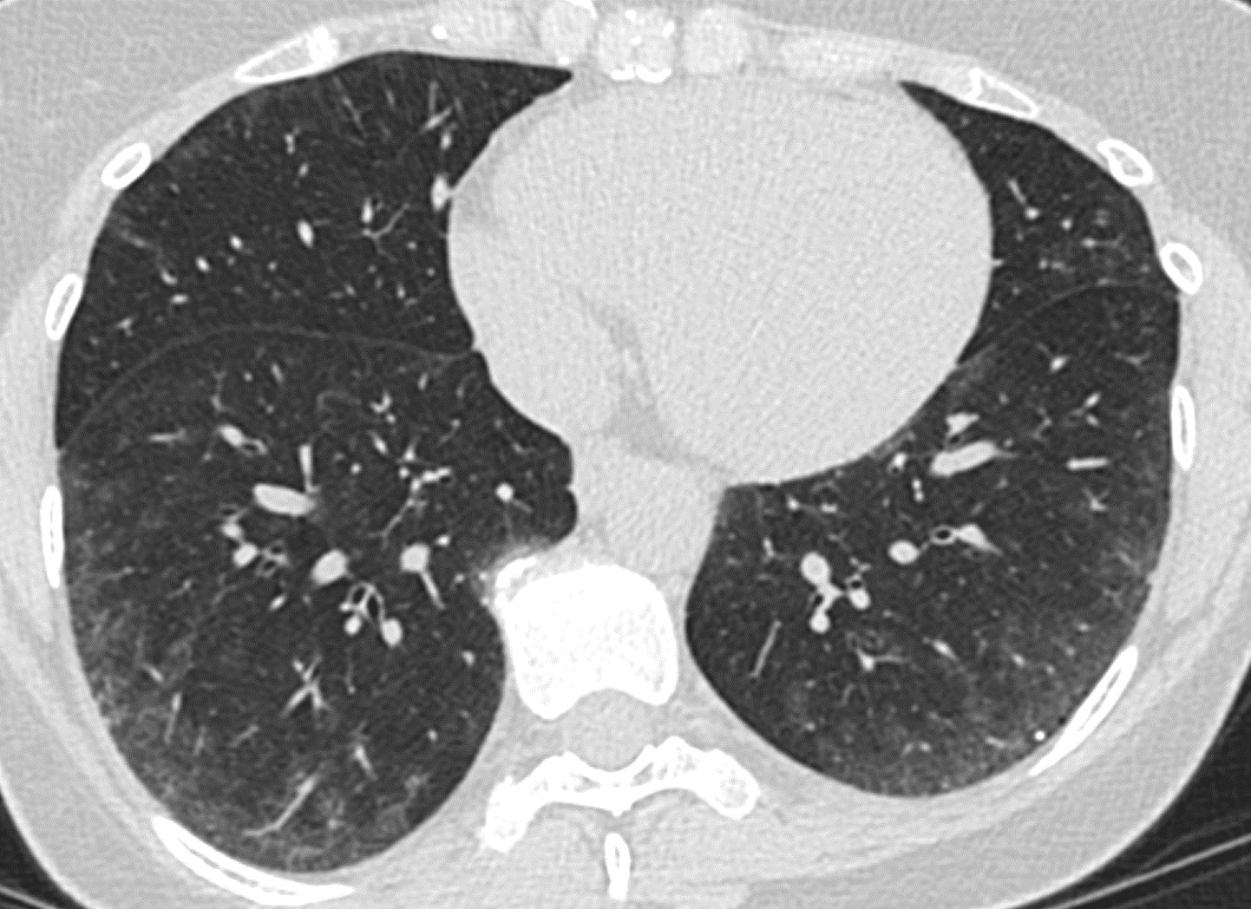
HRCT
Chest 2016
CASE #3

Slide 87
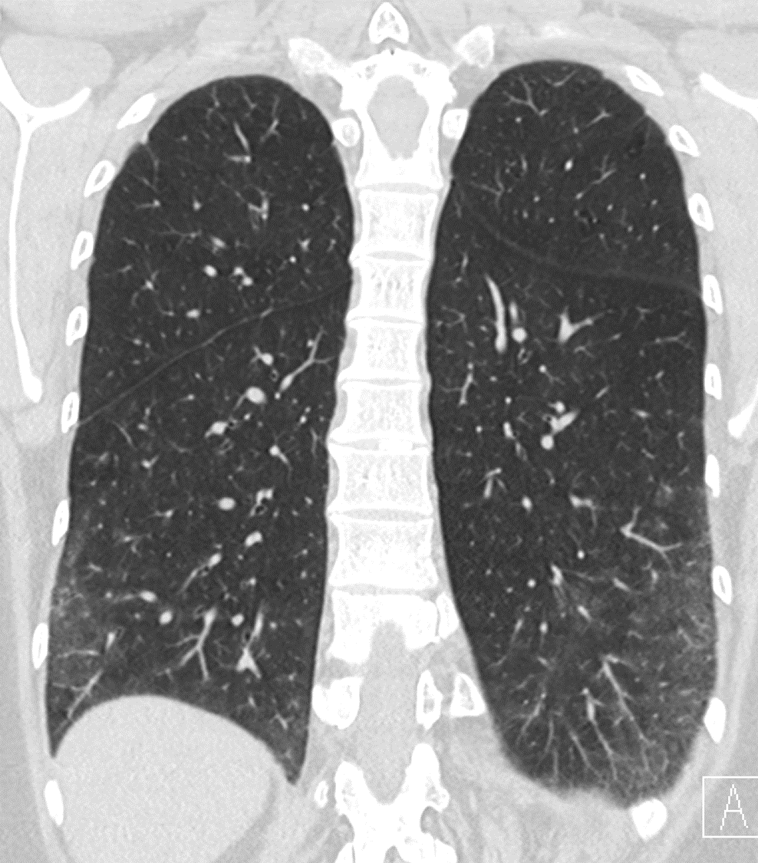
HRCT
Chest 2016
CASE #3

Slide 88
Evolution of SSc
CASE #3
2016–2017
Developed inflammatory myositis
Progressive dyspnea on exertion
Repeat HRCT demonstrated interval progression of ILD
HRCT, High-resolution computed tomography; ILD, Interstitial lung disease; SSc, Systemic sclerosis.

Slide 89
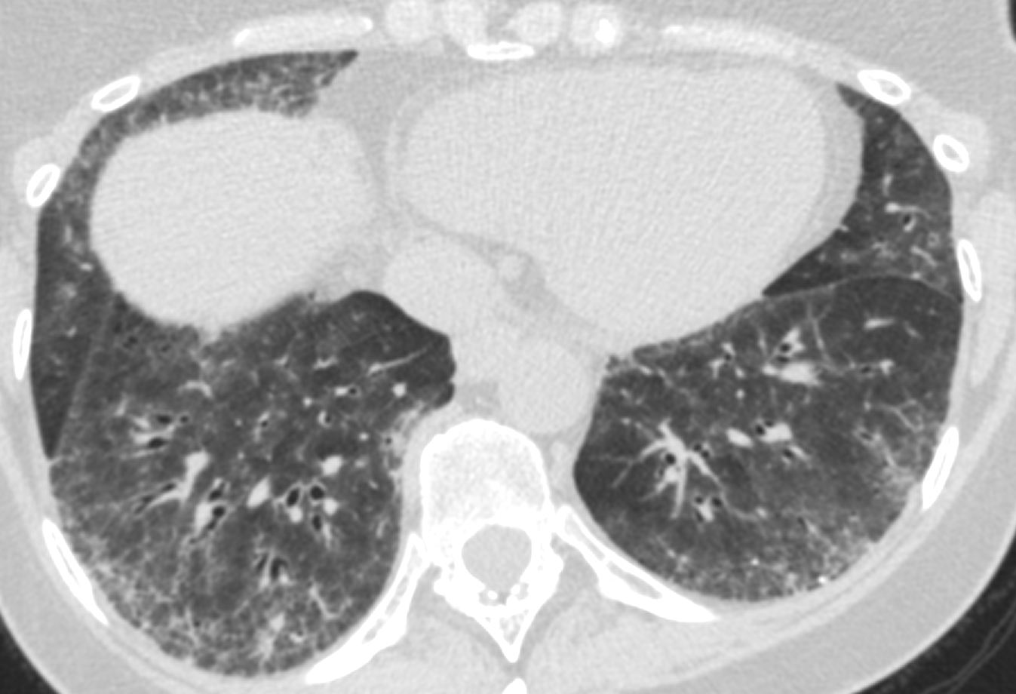
CASE #3
2016
2017

Slide 90

Evolution of ILD
Course of FVC, DLCO
Initiation of
Mycophenolate
Initiation of
Rituximab

Slide 91
Response to Therapy
Rituximab initiation led to complete resolution of myositis disease activity
Patient self-discontinued rituximab in early 2020 due to concerns of being on therapy during the pandemic
Following cessation of all immunosuppressive therapy, ILD progressed further

Slide 92
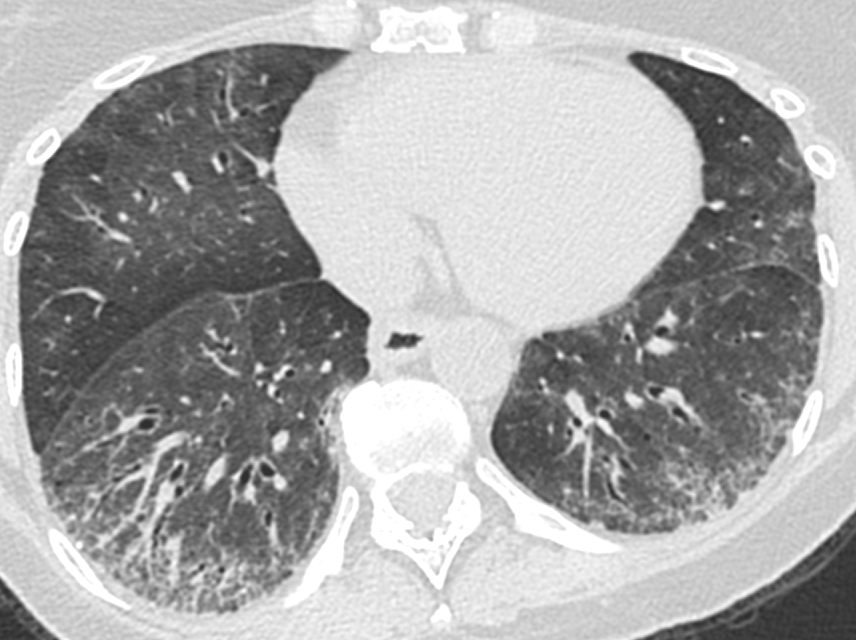
CASE #3
2018
2020

Slide 93
Evolution of ILD
Course of FVC, DLCO
Cessation of
Rituximab

Slide 94
Next Steps
CASE #3
Patient received mRNA BNT162b2 vaccine in 5/2021
Resumed rituximab in 6/2021
Introduced nintedanib to prevent further progression of ILD in 7/2021

Slide 95
Case Reflections
CASE #3
Consider early intervention for ILD when risk factors are present
Demographic Characteristics | Male sex, African American race, increased age
Disease-Related Features | Diffuse cutaneous disease, high mRSS at time of ILD diagnosis, shorter disease duration
PFTs | Moderate to severe restrictive physiology at diagnosis, decline in FVC and DLCO over 1–2 years
HRCT Extent | Increased extent of reticulations at time of ILD diagnosis
Serological Profiles | Scl-70 antibody, PM-Scl antibody
Biomarker Levels | KL-6, CCL-18, CRP
CCL-18, chemokine (C-C motif) ligand 18; CRP, C-reactive protein; DLCO, carbon monoxide diffusing capacity; FVC, Forced vital capacity; KL-6, Krebs von den Lungen 6; mRSS, modified Rodnan Skin Score; PFT, Pulmonary function tests; PM-Scl, polymyositis-scleroderma

Slide 96
Optimizing Clinician Patient Communication and Education
Inform
  Encourage an open dialogue with patients and their caregivers
Educate
  Provide patients information about their disease in a manner that is meaningful and understandable to them
  Encourage your patients to ask questions and provide feedback along their journey
Empower
  Empower patients to participate in all of their medical decisions
  Teach your patients about activities they can do (eg, breathing exercises, physical activity) to improve how they feel and function

Slide 97
Key Takeaways
ILD is the leading cause of death in SSc. Early screening is essential—even in the absence of symptoms.
SSc-ILD is difficult to diagnose at an early stage due to lack of specific symptoms; patients often asymptomatic.
Greatest risk of development of SSc-ILD is 4–5 years after the initial diagnosis of SSc. Early therapeutic interventions are essential.
Improved methods of phenotyping patients with SSc are needed to better anticipate who will develop progressive ILD and identify who will respond best to which therapies.

