Slide 1
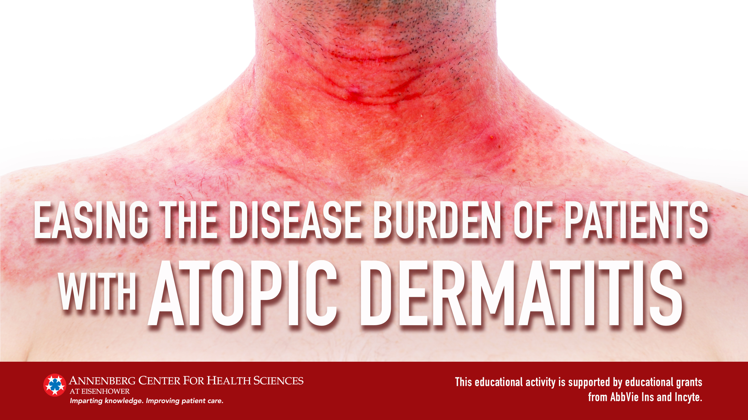

Slide 2
Unmet Needs in AD Care

Slide 3
AD Confers a Substantial Burden on Patients^{1,2}
Direct skin effects
Indirect effects
Mood & lifestyle
Scratching
Shame, embarrassment
Negative effect on relationships
ITCH
Open sores
Blood-stained clothing & bedding
Time lost to daily cleaning
DEPRESSION
ANXIETY
Disturbed sleep
Red, irritated skin
Negative self image
Itch is the most reported bothersome symptom for patients with AD¹
Patients with AD have high rates of depression, anxiety, and suicidal ideation²
Difficulty with attention, mood
Poor school & work performance
McCleary K. August 13, 2021. Accessed September 13, 2021. http://www.morethanskindeep-eczema.org/uploads/1/2/5/3/125377765/mtsd_report_-_digital_file.pdf.
Patel KR et al. J Am Acad Dermatol. 2019;80(2):402-410.

Slide 4
Differing Perceptions of Disease Burden Between Patients and Providers
About one-third of patients rate their AD severity differently from their clinicians
1 in 10 patients rated their AD as more severe than their clinicians, while 2 in 10 patients considered their disease to be less severe than their clinicians
Patients tended to focus more on their skin-related quality of life
Clinicians tended to focus more on sleep disturbance
Better patient-clinician communication and incorporation of quality-of-life measures may be important for management decision making
Wei W et al. Am J Clin Dermatol. 2017;18(6):825-835.

Slide 5
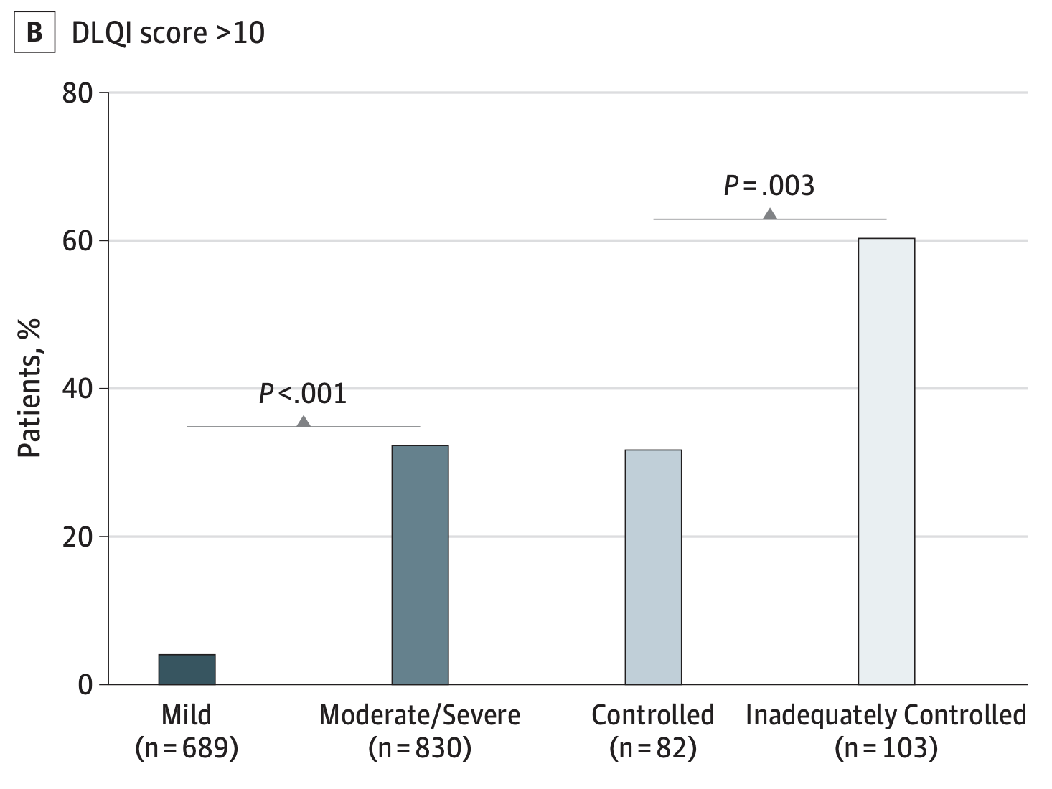
Inadequate Disease Control Is Common in Patients With AD and Leads to Poor Outcomes^{1,2}
59% of patients with AD have inadequate disease control²
  Rate of inadequate control increases with higher severity
Patients with inadequate control are at greater risk for:^{1,2}
  Depression and anxiety
  Stress
  Itch interfering with daily activities
  Sleep disturbances interfering with daily lives
Proportion of Patients With DLQI Score >10
(Very Large Quality of Life Effect)¹
Image courtesy of Simpson EL et al. JAMA Dermatol. 2018;154(8):903-912. CC-BY-NC-ND.
Simpson EL et al. JAMA Dermatol. 2018;154(8):903-912.
Wei W et al. J Dermatol. 2018;45(2):150-157.

Slide 6
There Is an Unmet Need for New Treatment Options in AD
Many patients with uncontrolled AD are currently receiving standard therapies
These data underscore the importance of guideline-adherent care and new treatment options
Wei W et al. J Dermatol. 2018;45(2):150-157.

Slide 7
Components of Basic AD Care

Slide 8


Tenets of Basic Skin Care for AD
Application of
moisturizers
Frequent and liberal use
Ideally inexpensive and free of additives, fragrances, perfumes, or other sensitizers
Bathing
Should be followed with moisturizer use
Use of fragrance-free, hypoallergenic nonsoap cleansers with neutral or low pH
Bleach baths for those with moderate or severe AD and signs of secondary bacterial infection
Eichenfield et al. J Am Acad Dermatol. 2014;71(1):116-132.

Slide 9

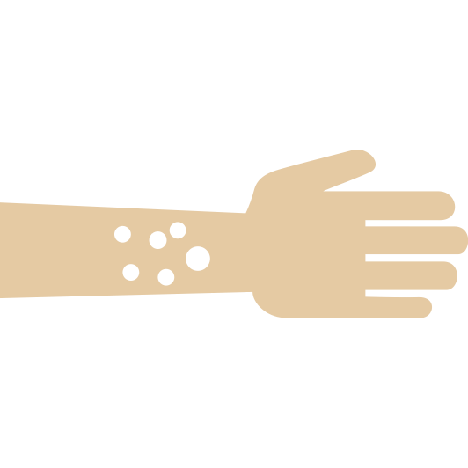

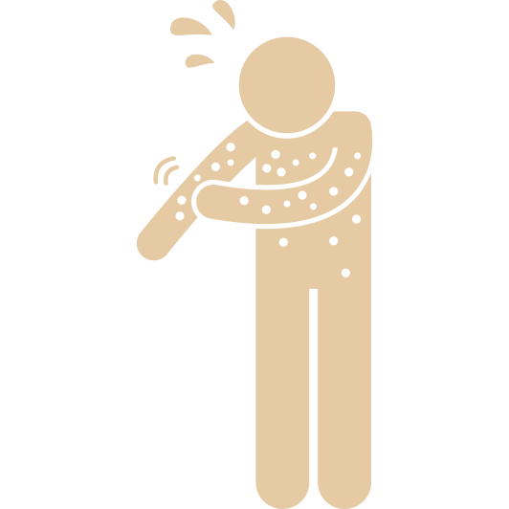


Topical Moisturizers Applied Frequently Can Improve AD Inflammation and Symptoms
Topical moisturizers address dry skin and transepidermal water loss
Several benefits of moisturizers have been identified in clinical trials
Benefits of Moisturizers
Increased skin hydration
Decreased erythema
Decreased lichenification
Decreased fissuring
Decreased use of topical corticosteroids
Decreased pruritus
Eichenfield et al. J Am Acad Dermatol. 2014;71(1):116-132.

Slide 10
Topical Corticosteroids Indicated for Relief After Failure of Good Skin Care and Moisturizers
Topical corticosteroids (TCS) are the main anti-inflammatory agents used in adults and children with AD
Recommended for patients with AD who have not responded to basic skin care
Recommendations for use:
  As maintenance on areas that regularly flare (1-2 times per week)
  As treatment for acute flares (daily until lesions are improved for up to 2-3 weeks at a time)
Eichenfield et al. J Am Acad Dermatol. 2014;71(1):116-132.

Slide 11
Adherence to Evidence-Based Guidelines

Slide 12
2014 AAD Guidelines Include Recommendations for Acute and Maintenance Treatment of Mild to Severe AD
Mild
Severe
Basic Management (all patients)
Skin care
Antiseptic measures
Trigger avoidance
Maintenance Topicals
Calcineurin inhibitors (tacrolimus or pimecrolimus) OR
Medium- and/or low-potency corticosteroids
Maintenance
Topical
Low-potency corticosteroids BID for up to 3 days beyond clearance
Topical
Medium-potency corticosteroids BID for up to 3 days beyond clearance
Oral antibiotic for secondary infection
Acute
Eichenfield et al. J Am Acad Dermatol. 2014;71(1):116-132.

Slide 13
Topical Therapies in 2014 AAD Clinical Guidelines
Topical corticosteroids (TCS)
Recommended for treatment of active inflammation or itch
May consider low-potency over-the-counter agents in some cases
Topical calcineurin inhibitors (TCI)
Recommended for treatment of itch when bathing, moisturizing, wet-wrap therapy, and/or TCS have not led to relief
Favored over TCS in delicate body areas (eg, face, groin)
Carry risk of skin atrophy with long-term use
No risk of atrophy but transient burning after application is common
Eichenfield et al. J Am Acad Dermatol. 2014;71(1):116-132.

Slide 14
Recommendations for Phototherapy in 2014 AAD Guidelines
UV light (UVA and/or UVB) can be used for acute flares or maintenance
  Requires 2 to 5 visits per week
Typically reserved for patients who have failed TCS and TCI
May be used in combination with TCS and moisturizers
Associated with short- and long-term adverse events (AEs), including itch, acute burns, and increased risk for skin cancer
UV, ultraviolet.
Sidbury R et al. J Am Acad Dermatol. 2014;71(2):327-349.

Slide 15
Adjunctive Systemic Therapies Included in 2014 AAD Guidelines
 | Cyclosporine A | Azathioprine | Methotrexate | Mycophenolate mofetil
Decrease in AD activity (%) | 40%-55% | 26%-37% | 42%-52% | 55%-68%
Time to response | 2-6 weeks | ≥12 weeks | 10-16 weeks | 8-12 weeks
Dosage | 150-300 mg/day | 1-3 mg/kg/day | 7.5-25 mg/week | 1.0-1.5 g oral BID
Selected AEs | Increased serum creatinine Increased blood pressure Infection | Leukopenia Increased liver enzymes GI symptoms | Bone marrow suppression Increased liver enzymes GI symptoms | Hematologic changes Genitourinary symptoms GI symptoms
Pediatric considerations | Weight-based dosing (3-6 mg/kg/day) | Dosing (1-4 mg/kg/day) | Dosing (0.2-0.7 mg/kg/week) | Dosing (30-50 mg/kg/day)
Sidbury R et al. J Am Acad Dermatol. 2014;71(2):327-349.
Wollenberg A et al. J Eur Acad Dermatol Venereol. 2018;32(5):657-682.

Slide 16
AD Therapies Approved After 2014 AAD Guidelines

Slide 17
Crisaborole: Approved in 2016 for AD
FDA-approved indication
Mechanism of action
Route of administration
Dosing
Mild-to-moderate AD in adults and children 3 months or older
PDE4 inhibition
Topical
Thin layer, twice daily
Safety
Application site pain
PDE4, phosphodiesterase 4.
Crisaborole ointment [prescribing information]. New York, NY; Pfizer: 2020.

Slide 18
Phase 3 AD-301 & AD-302: Crisaborole in
Mild-to-Moderate AD
P =.005
P <.001
P =.038
P <.001
Crisaborole Vehicle
ªSuccess defined as Investigator's Static Global Assessment (ISGA) score of 0 or 1 (clear or almost clear) with at least 2-grade improvement.
^{b}Improvement defined as score of 0 or 1 with ≥1-grade reduction from baseline.
Paller AS et al. J Am Acad Dermatol. 2016;75(3):494-503.e6.

Slide 19
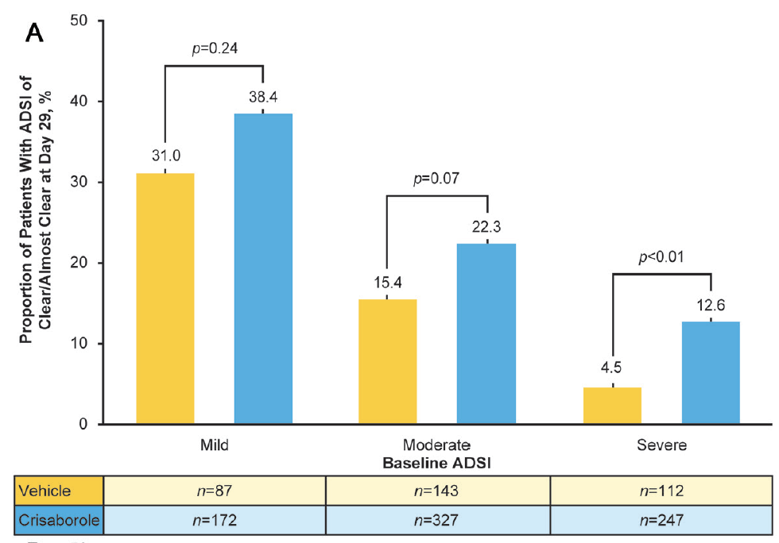
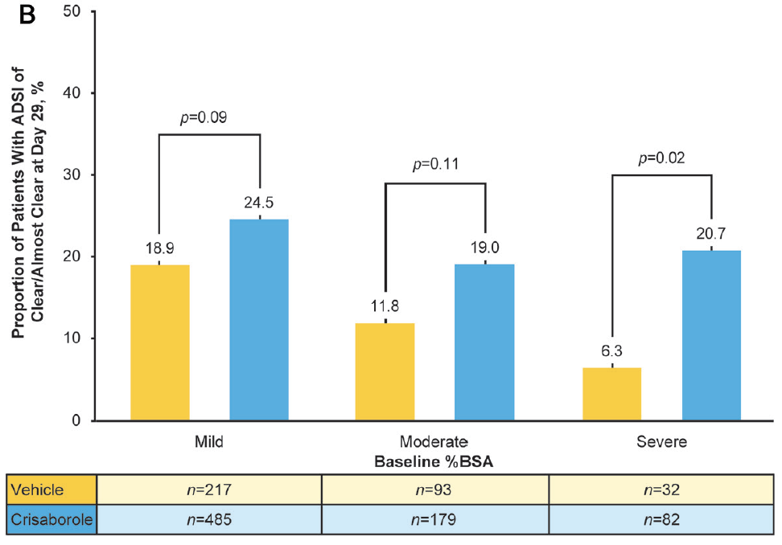
Post Hoc Analysis of AD-301 & AD-302 Suggests Crisaborole Effectiveness Across AD Severity
Response by Severity According to Baseline ADSI
Response by Severity According to Baseline BSA
Image courtesy of Silverberg JI et al. Acta Derm Venereol. 2020;100(13):adv00170. CC BY-NC 4.0.
Silverberg JI et al. Acta Derm Venereol. 2020;100(13):adv00170.

Slide 20
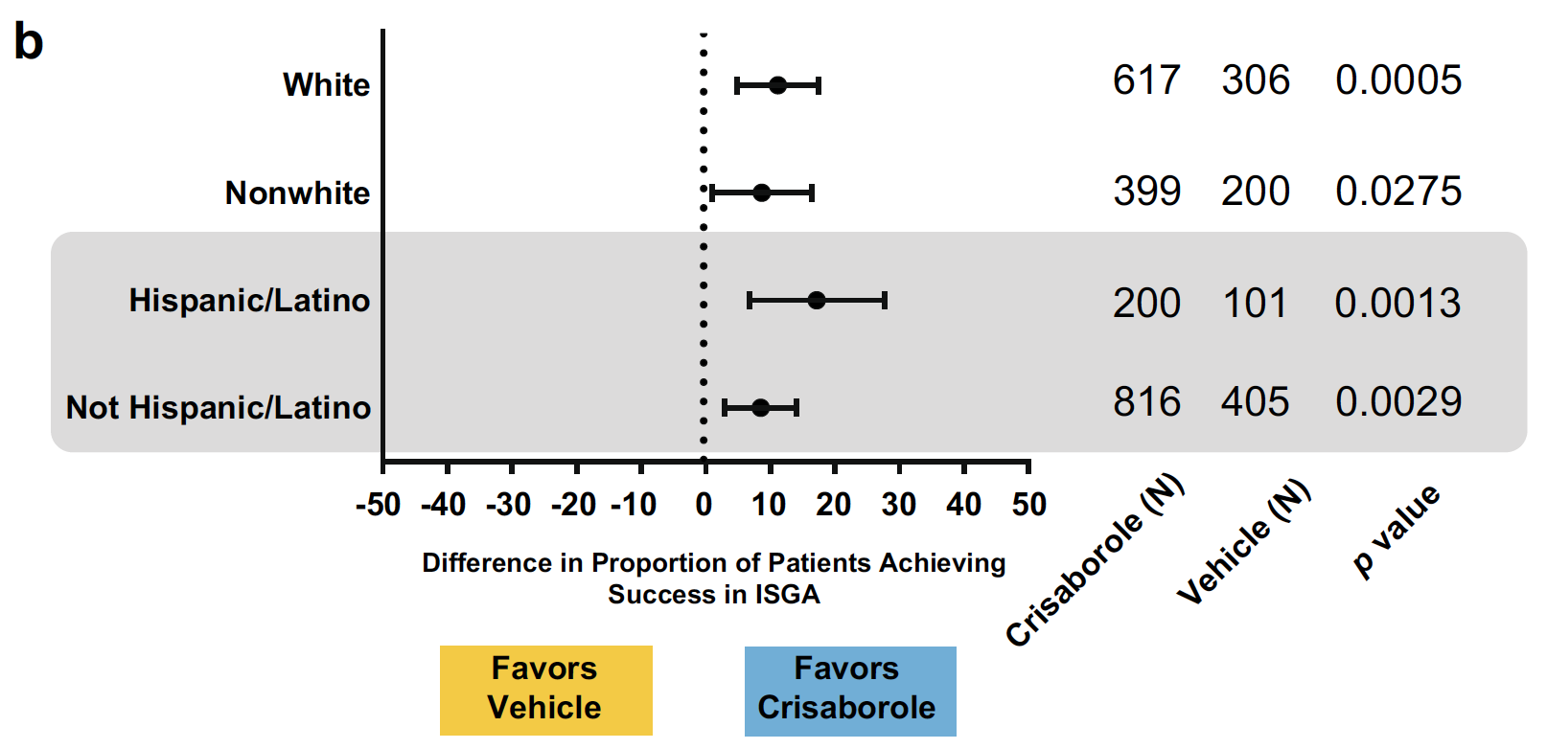
Post Hoc Analysis of AD-301 & AD-302 Suggests Crisaborole Effectiveness Across Racial/Ethnic Groups
Response by Race
Images courtesy of Callender VD et al. Am J Clin Dermatol. 2019;20(5):711-723. CC BY-NC 4.0.
Callender VD et al. Am J Clin Dermatol. 2019;20(5):711-723.

Slide 21
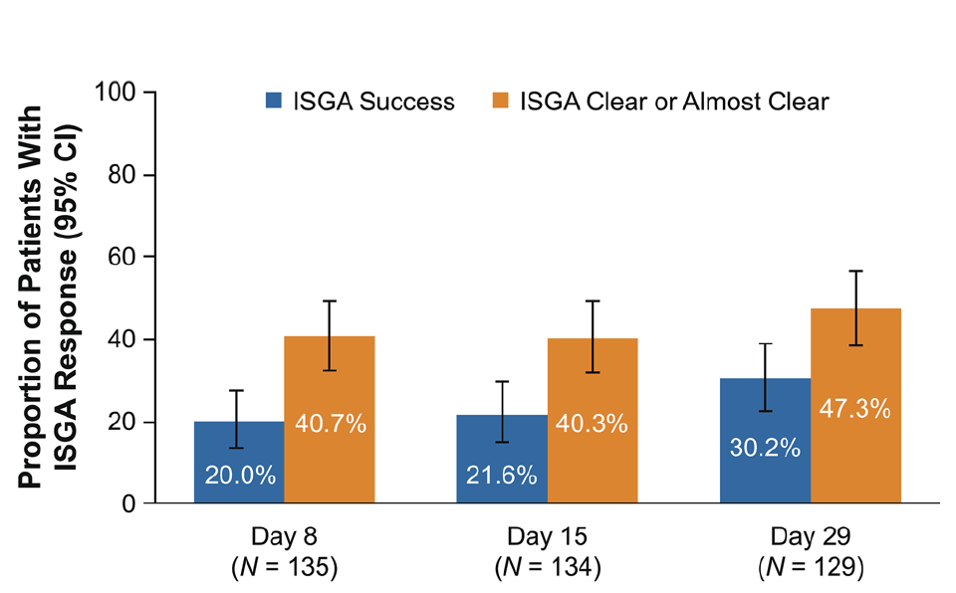
Phase 4 Open-Label Study: Crisaborole Effectiveness in Infants Aged 3 to 23 Months
ISGA Response With Crisaborole
Pharmacokinetics of crisaborole were comparable with those 2 years or older
No toxicity related to propylene glycol (eg, CNS toxicity, cardiac arrhythmia)
Images courtesy of Schlessinger J et al. Am J Clin Dermatol. 2020;21(2):275-284. CC BY-NC 4.0.
Schlessinger J et al. Am J Clin Dermatol. 2020;21(2):275-284.

Slide 22
Dupilumab: Approved in 2017 for AD
FDA-approved indication
Mechanism of action
Route of administration
Dosing
Moderate-to-severe AD inadequately controlled with topical therapies or when those therapies are not recommended in adults and children 6 years or older
IL-4 receptor antagonist
Subcutaneous
15-29 kg: 600-mg loading dose followed by 300-mg maintenance dose every 4 weeks;
30-59 kg: 400-mg loading dose followed by 200-mg maintenance dose every 2 weeks;
≥60 kg: 600-mg loading dose followed by 300-mg maintenance dose every 2 weeks
Safety
Injection site reactions
Conjunctivitis
Eye pruritus
Oral herpes
Dupilumab injection [prescribing information]. Tarrytown, NY; Regeneron: 2021.

Slide 23
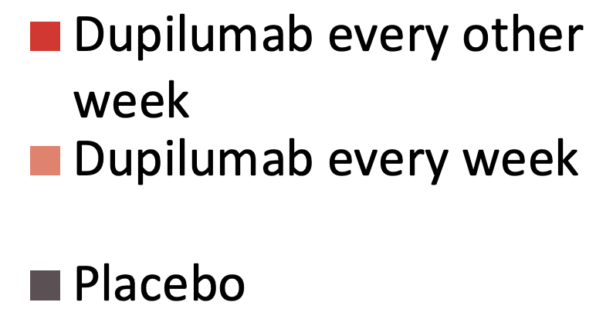
Phase 3 SOLO 1 & SOLO 2: Dupilumab in Moderate-to-Severe AD
P <.001 for all comparisons of dupilumab vs placebo
ªQualifying score defined as Investigator's Global Assessment (IGA) score of 0 or 1 (clear or almost clear) with at least 2-point improvement.
Simpson EL et al. N Engl J Med. 2016;375(24):2335-2348.

Slide 24
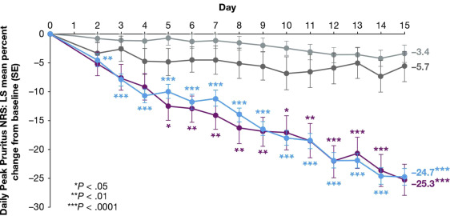
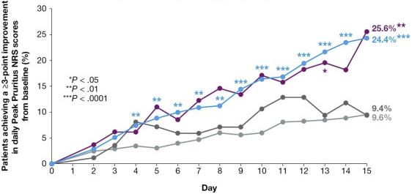
Post Hoc Analysis of Phase 3 Trials Reveals Early, Sustained Itch Relief With Dupilumab Treatment
Daily Peak Pruritus Improvement
Proportion Achieving ≥3 Point Improvement
— placebo (SOLO pooled) — dupilumab 300 mg every other week (SOLO pooled) — placebo (AD ADOL) — dupilumab 200-300 mg every other week
Images courtesy of Silverberg JI et al. J Am Acad Dermatol. 2020;82(6):1328-1336. CC BY-NC-ND 4.0.
Silverberg JI et al. J Am Acad Dermatol. 2020;82(6):1328-1336.

Slide 25
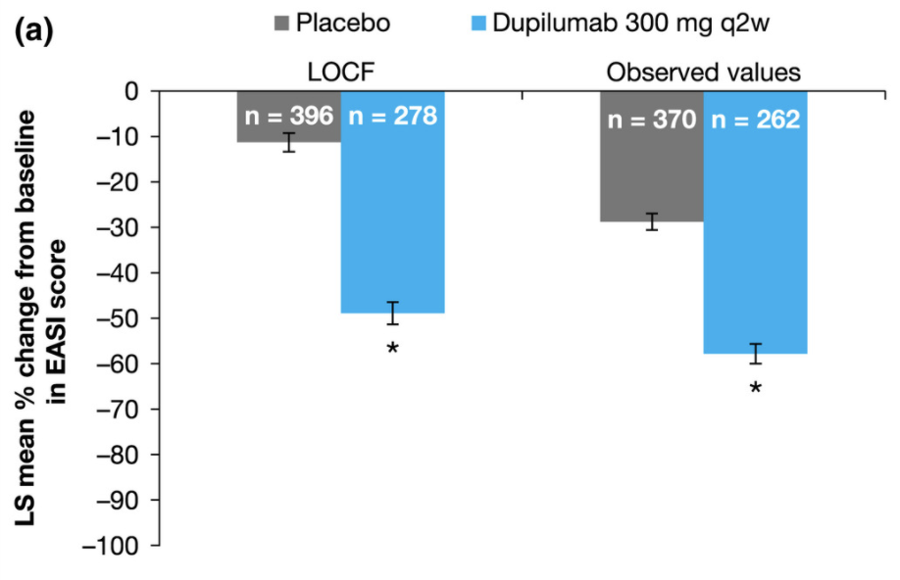
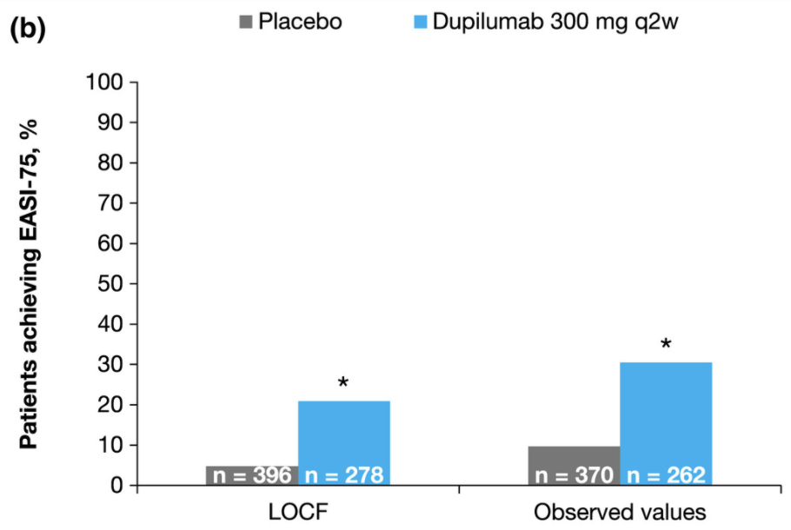
Post Hoc Analysis of Phase 3 Trials Reveals Important Clinical Benefits in Patients Without Clear Skin
Change in EASI Score in Patients With IGA >1
Achievement of EASI-75 in Patients With IGA >1
*P <.001
Images courtesy of Silverberg JI et al. Br J Dermatol. 2019;181(1):80-87. CC BY-NC 4.0.
Silverberg JI et al. Br J Dermatol. 2019;181(1):80-87.

Slide 26
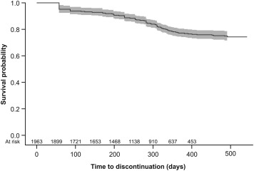
Real-World Data Support the Efficacy of Dupilumab, With High Rates of Patient Satisfaction
Persistence With Dupilumab
Real-world study of 1963 adults receiving dupilumab from insurance database
Dupilumab persistence:
  92% at 6 months
  77% at 12 months
Among those who discontinued, likelihood of re-initiation within 4 months was 79%
Image courtesy of Silverberg JI et al. Ann Allergy Asthma Immunol. 2021;126(1):40-45. CC BY-NC-ND 4.0.
Silverberg JI et al. Ann Allergy Asthma Immunol. 2021;126(1):40-45.

Slide 27

Despite the Approval of Novel Agents, AD Control Remains Suboptimal
Cross-sectional survey of 150 clinicians and 749 patients with moderate-to-severe AD
In 2018, the inadequate control rate was 42.3%
  Slight improvement since 2014, when the inadequate control rate was 58.7%
“Despite the introduction of novel therapies, the burden and impact of AD, the degree of patient- and physician-reported disease severity, and the lack of symptom control is still substantial.”
Vilsbøll AW et al. Dermatol Ther (Heidelb). 2021;11(2):475-486.

Slide 28
Emerging Therapies: Phase 3 Efficacy & Safety Data

Slide 29
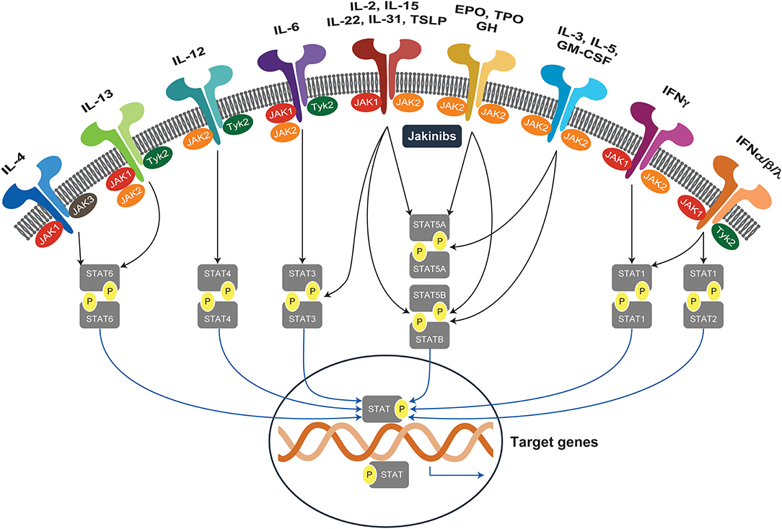
JAK-STAT Inhibitors: Mechanism of Action in AD
Many cytokines rely on downstream JAK-STAT signaling
  IL-4, IL-13, IL-31 (Th2 cytokines)
  IL-2 (Th22 cytokines)
JAK-STAT inhibition can be pan-JAK or specific to certain types
  JAK1-specific inhibitors: upadacitinib and abrocitinib
  JAK1/2-specific inhibitors: ruxolitinib and baricitinib
Image courtesy of Howell MD et al. Front Immunol. 2019;10:2342. CC BY 4.0.
Howell MD et al. Front Immunol. 2019;10:2342.

Slide 30
Pooled Data From Phase 3 BREEZE-AD1 & BREEZE-AD2: Oral Baricitinib Monotherapy^{1,a}
Results From Pooled BREEZE-AD1 and BREEZE-AD2 Trials²
Response at Wk 16 | Baricitinib 1 mg (n = 252) |  | Baricitinib 2 mg (n = 246) |  | Baricitinib 4 mg (n = 248) |  | Placebo (n = 493)
Atopic Comorbidity | Yes (n = 177) | No (n = 75) | Yes (n = 176) | No (n = 70) | Yes (n = 168) | No (n = 80) | Yes (n = 357) | No (n = 136)
EASI-50 response rate, %
Monotherapy | 20.3* | 26.7 | 29.0† | 28.6 | 32.7† | 41.3† | 11.5 | 19.9
With TCS rescue | 45.8 | 64.0 | 61.9† | 61.4 | 55.4† | 63.8 | 38.1 | 51.5
IGA (0, 1, 2) response rate, %
Monotherapy | 18.6* | 21.3 | 25.0† | 20.0 | 29.8† | 32.5‡ | 9.8 | 17.6
With TCS rescue | 36.2 | 46.7 | 48.9† | 52.9 | 50.6† | 45.0 | 31.7 | 44.1
Enrolled 1239 patients in total with moderate-to-severe AD and inadequate response to TCS¹
*P ≤ .01 vs placebo; †P ≤ .001 vs placebo; ‡P ≤ .05.
a. Rescue systemic or topical corticosteroids were allowed at investigator discretion.
1. Simpson EL et al. Br J Dermatol. 2020;183(2):242-255.
2. Wollenberg A et al. J Allergy Clin Immunol. 2020;142(2 supplement);AB190.

Slide 31
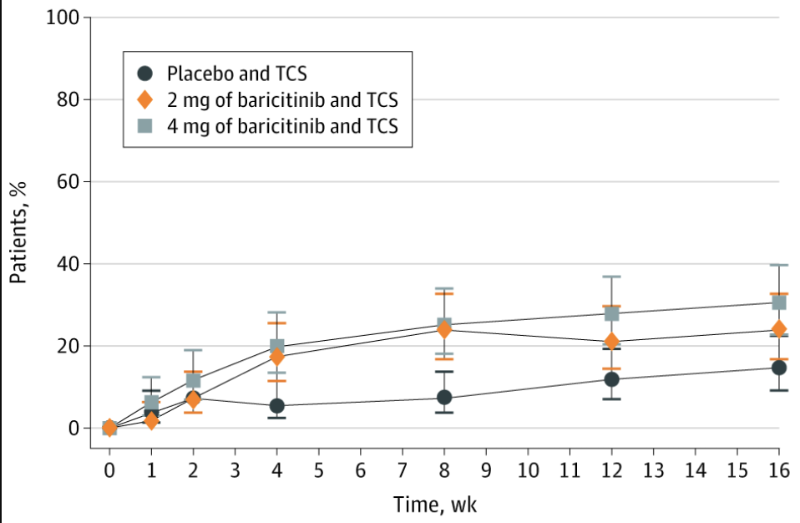
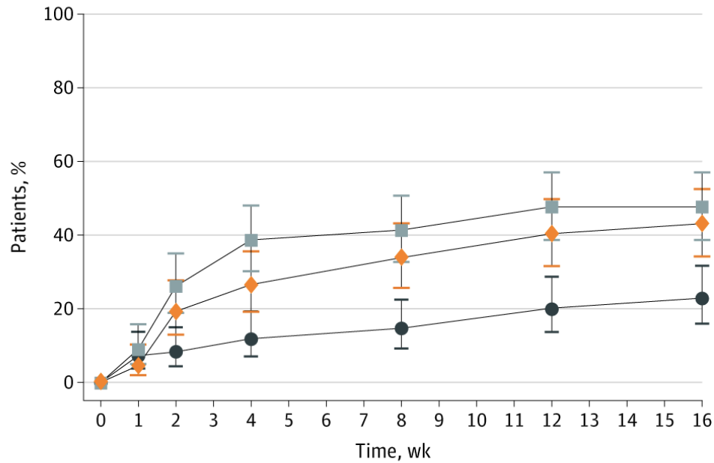
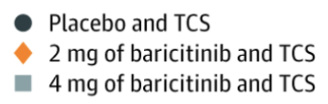
Phase 3 BREEZE-AD7: Oral Baricitinib Combined With Background Topical Corticosteroids
vIGA-AD Score of 0 or 1
EASI-75
Odds of improvement vs placebo at week 16
4 mg: 2.8 (95% CI, 1.4-5.6); P =.004
2 mg: 1.9 (95% CI, 0.9-3.9); P =.08
Enrolled 329 patients with moderate-to-severe AD receiving background TCS
vIGA-AD, validated Investigator Global Assessment for Atopic Dermatitis.
Images courtesy of Reich K et al. JAMA Dermatol. 2020;156(12):1333-1343. CC-BY-NC-ND.
Reich K et al. JAMA Dermatol. 2020;156(12):1333-1343.

Slide 32
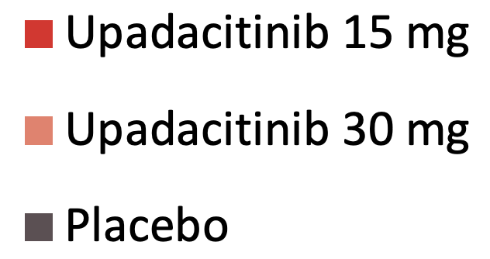
Phase 3 Measure Up 1 & 2: Oral Upadacitinib Monotherapy in Adolescents and Adults With Moderate to Severe AD
Enrolled 1683 patients with moderate-to-severe AD aged ≥12 years
P ≤.0001 for all comparisons of upadacitinib vs placebo
Guttman-Yassky E et al. Lancet. 2021;397(10290):2151-2168.

Slide 33
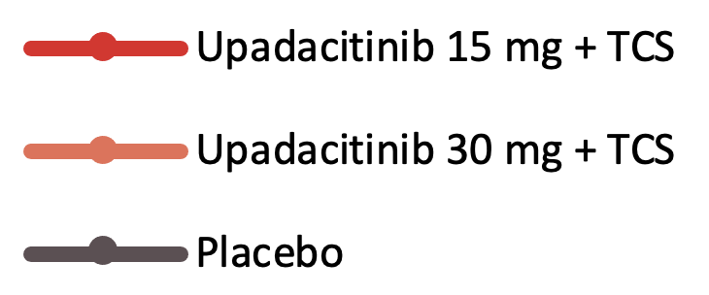
Phase 3 AD Up: Oral Upadacitinib Combined With TCS in Adolescents and Adults With Moderate to Severe AD
Enrolled 901 patients with moderate-to-severe AD aged ≥12 years
P <.01 for all comparisons of upadacitinib + TCS vs placebo + TCS
a. Defined as a vIGA-AD score of 0 or 1 (clear or almost clear) with at least a 2-grade improvement from baseline
Reich K et al. Lancet. 2021;397(10290):2169-2181.

Slide 34
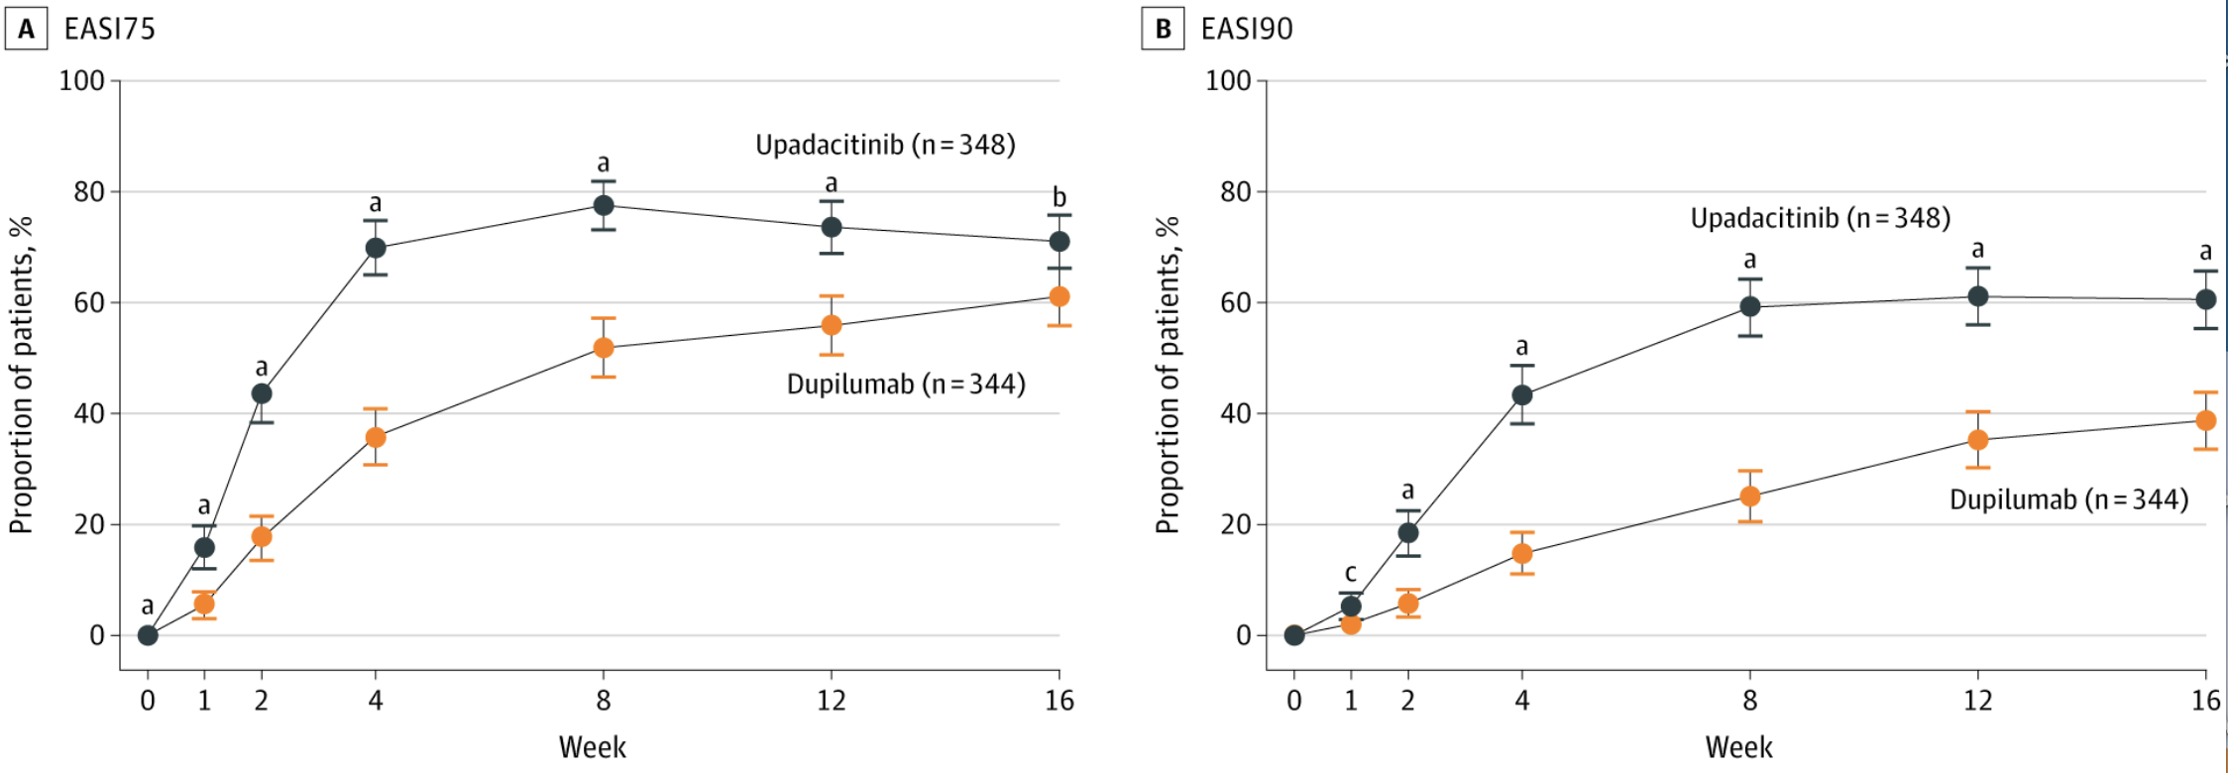
Phase 3 Heads Up: Oral Upadacitinib vs Dupilumab in Adults With Moderate to Severe AD
EASI-75 Response Rate
EASI-90 Response Rate
Enrolled 692 patients with moderate-to-severe AD aged ≥18 years
a, P ≤.001; b, P ≤.01; c, P ≤.05
Image courtesy of Blauvelt A et al. JAMA Dermatol. 2021;157(9):1047-1055. CC-BY-NC-ND.
Blauvelt A et al. JAMA Dermatol. 2021;157(9):1047-1055.

Slide 35
Phase 3 JADE MONO-1: Oral Abrocitinib Monotherapy in Adolescents and Adults With Moderate-to-Severe AD
IGA Response Rate
EASI-75
100
100
— Abrocitinib 200 mg
— Abrocitinib 100 mg
— Placebo
80
80
Enrolled 387 patients with moderate-to-severe AD aged ≥12 years
63%
60
60
44%
Percent with an IGA responseª
Percent with an EASI-75 response
40%
40
40
24%
20
20
12%
8%
0
2
8
12
0
0
4
0
2
4
8
12
Study week
Study week
a. Response defined as an Investigator Global Assessment response 0 or 1 (clear or almost clear) with a ≥2-grade improvement from baseline

Slide 36
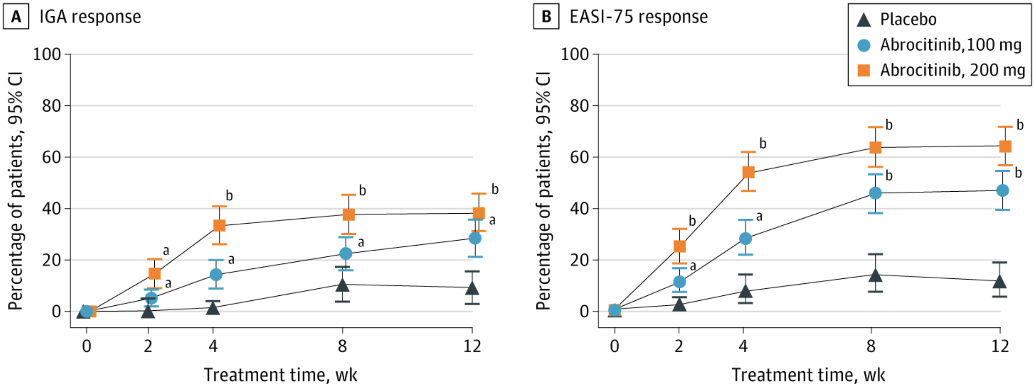
Phase 3 JADE MONO-2: Oral Abrocitinib Monotherapy in Adolescents and Adults With Moderate-to-Severe AD
IGA Response Rate
EASI-75 Response Rate
Enrolled 391 patients with moderate-to-severe AD aged ≥12 years
a, P <.05 vs placebo; b, P <.001 vs placebo.
Images courtesy of Silverberg JI et al. JAMA Dermatol. 2020;156(8):863-873. CC-BY-NC-ND.
Silverberg JI et al. JAMA Dermatol. 2020;156(8):863-873.

Slide 37
Phase 3 JADE COMPARE: Abrocitinib vs Dupilumab in Adults With Moderate-to-Severe AD
 | Abrocitinib, 200 mg (n = 226) | Abrocitinib, 100 mg (n = 238) | Dupilumab, 300 mg every other week (n = 242) | Placebo (n = 131)
Primary end points
IGA response (week 12), % | 48.4 | 36.6 | 36.5 | 14.0
Difference from placebo | 34.8 (P <.001) | 23.1 (P <.001) | 22.5 | NA
EASI-75 (week 12), % | 70.3 | 58.7 | 58.1 | 27.1
Difference from placebo | 43.2 (P <.001) | 31.9 (P <.001) | 30.9 | NA
Secondary end points
Itch response (week 2), % | 49.1 | 31.8 | 26.4 | 13.8
Difference from placebo | 34.9 (P <.001) | 17.9 (P <.001) | 12.5 | NA
Difference from dupilumab | 22.1 (P <.001) | 5.2 (P =.20) | NA | NA
IGA response (week 16), % | 47.5 | 34.8 | 38.8 | 12.9
Difference from placebo | 35.0 (P <.001) | 22.1 (P <.001) | 25.6 | NA
Difference from dupilumab | 9.4 | -3.5 | NA | NA
EASI-75 response (week 16), % | 71.0 | 60.3 | 65.5 | 30.6
Difference from placebo | 40.4 (P <.001) | 29.7 (P <.001) | 34.7 | NA
Difference from dupilumab | 5.5 | -5.1 | NA | NA
Bieber T et al. N Engl J Med. 2021;384(12):1101-1112.

Slide 38
Oral JAK-STAT Inhibitor Safety Considerations
In patients with AD, the most common AEs with JAK inhibitors include:¹
  Nasopharyngitis
  Upper respiratory tract infection
  Herpes zoster reactivation
  Nausea
  Diarrhea
JAK inhibitors already approved for use in rheumatoid arthritis have been associated with rare but serious AEs, resulting in FDA black box warnings^{1,2}
Black Box Warnings for Oral JAK Inhibitors²
Thrombosis
Malignancy
Serious infections
Tsai HR et al. J Pers Med. 2021;11(4):279.
FDA requires warnings about increased risk of serious heart-related events, cancer, blood clots, and death for JAK inhibitors that treat certain chronic inflammatory conditions. September 1, 2021. Accessed September 11, 2021. https://www.fda.gov/drugs/drug-safety-and-availability/fda-requires-warnings-about-increased-risk-serious-heart-related-events-cancer-blood-clots-and-death.

Slide 39
Phase 3 TRuE-AD1 & TruE-AD2: Ruxolitinib Cream vs Vehicle for the Treatment of Adults and Adolescents With AD
Enrolled 1249 patients with AD aged ≥12 years who had IGA of 2/3 and BSA of 3%-20%
Odds of success vs placebo at week 8
0.75%: 6.4 (95% CI, 3.6-11.9)
1.5%: 7.5 (95% CI, 4.2-14.0)
Application-site reactions were reported in 1.5% of patients
Longer-term studies are needed, but low bioavailability of topical ruxolitinib may reduce safety issues^{b}
P <.0001 for all comparisons of ruxolitinib vs vehicle
ªResponse defined as Investigator's Global Assessment (IGA) score of 0 or 1 (clear or almost clear) with at least 2-point improvement.
^{b}The 44-week safety extension study has been completed, but results are not yet published.
Papp K et al. J Am Acad Dermatol. 2021;85(4):863-872.

Slide 40
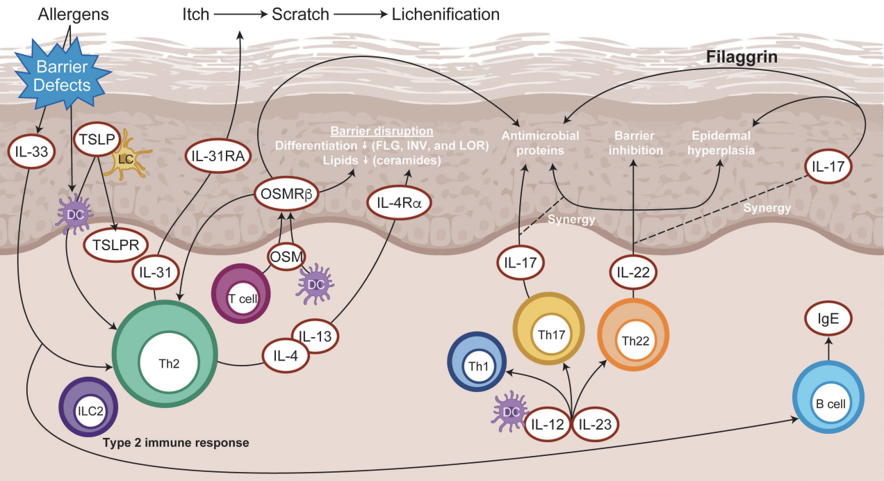
IL-13 Antagonists: Mechanism of Action in AD
AD lesions have overexpression of Th2 cytokines, including IL-13
IL-13 triggers several pathophysiologic mechanisms of AD:
  Inflammatory itch
  Disruption of skin barrier integrity
  Skin microbiome dysbiosis
Image courtesy of Howell MD et al. Front Immunol. 2019;10:2342. CC BY 4.0.
Howell MD et al. Front Immunol. 2019;10:2342.

Slide 41
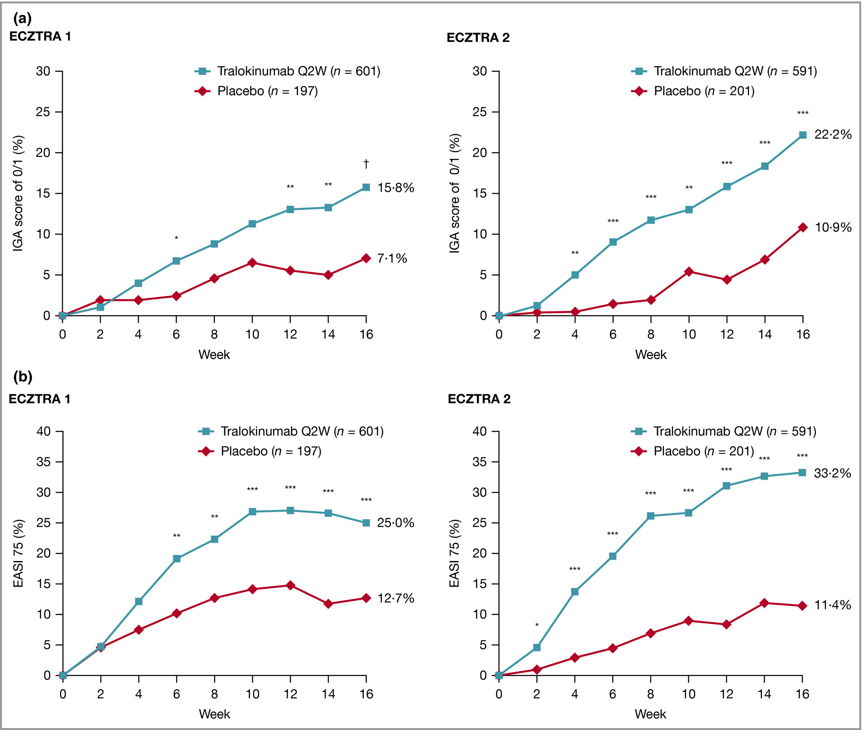
Phase 3 ECZTRA 1 and ECZTRA 2: Tralokinumab Monotherapy vs Placebo in Adults With Moderate-to-Severe AD
Enrolled 1596 patients with AD aged ≥18 years with moderate-to-severe AD
ECZTRA 1 (IGA 0 or 1)
ECZTRA 2 (IGA 0 or 1)
ECZTRA 1 (EASI-75)
ECZTRA 2 (EASI-75)
Upper respiratory tract infection and conjunctivitis were more frequent with tralokinumab than with placebo
*P <.05; **P <.01; *** P <.001; †P =.002.
Images courtesy of Wollenberg A et al. Br J Dermatol. 2021;184(3):437-449. CC BY-NC-ND 4.0.
Wollenberg A et al. Br J Dermatol. 2021;184(3):437-449.

Slide 42
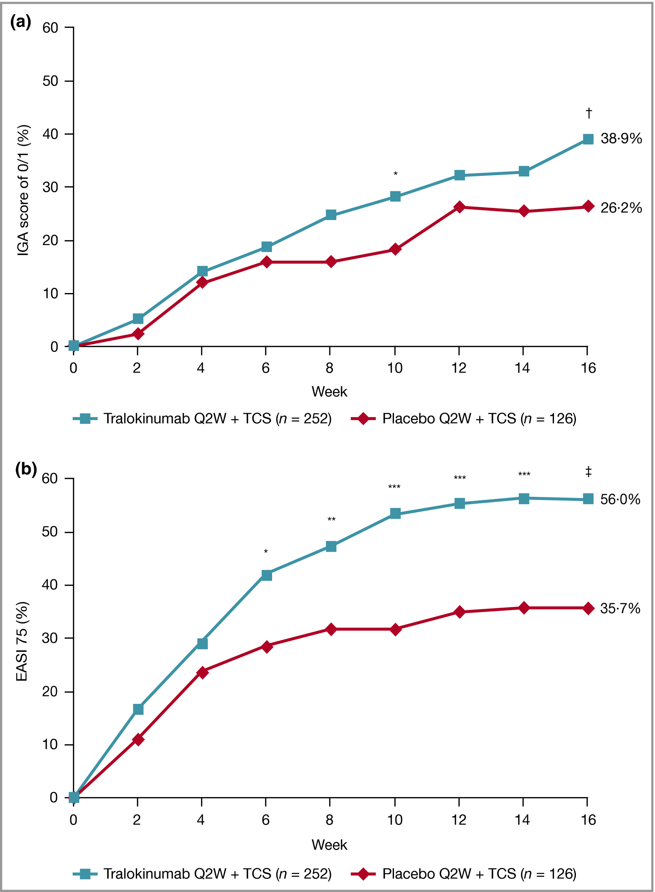
Phase 3 ECZTRA 3: Tralokinumab With Background TCS vs Placebo With Background TCS
IGA Score 0 or 1
EASI-75
Enrolled 380 patients with AD aged ≥18 years who had moderate-to-severe AD
*P <05; **P <.01; ***P <.001; model-based treatment difference: †P <.05; ‡P <.001.
Images courtesy of Silverberg JI et al. Br J Dermatol. 2021;184(3):450-463. CC BY-NC-ND 4.0.
Silverberg JI et al. Br J Dermatol. 2021;184(3):450-463.

Slide 43
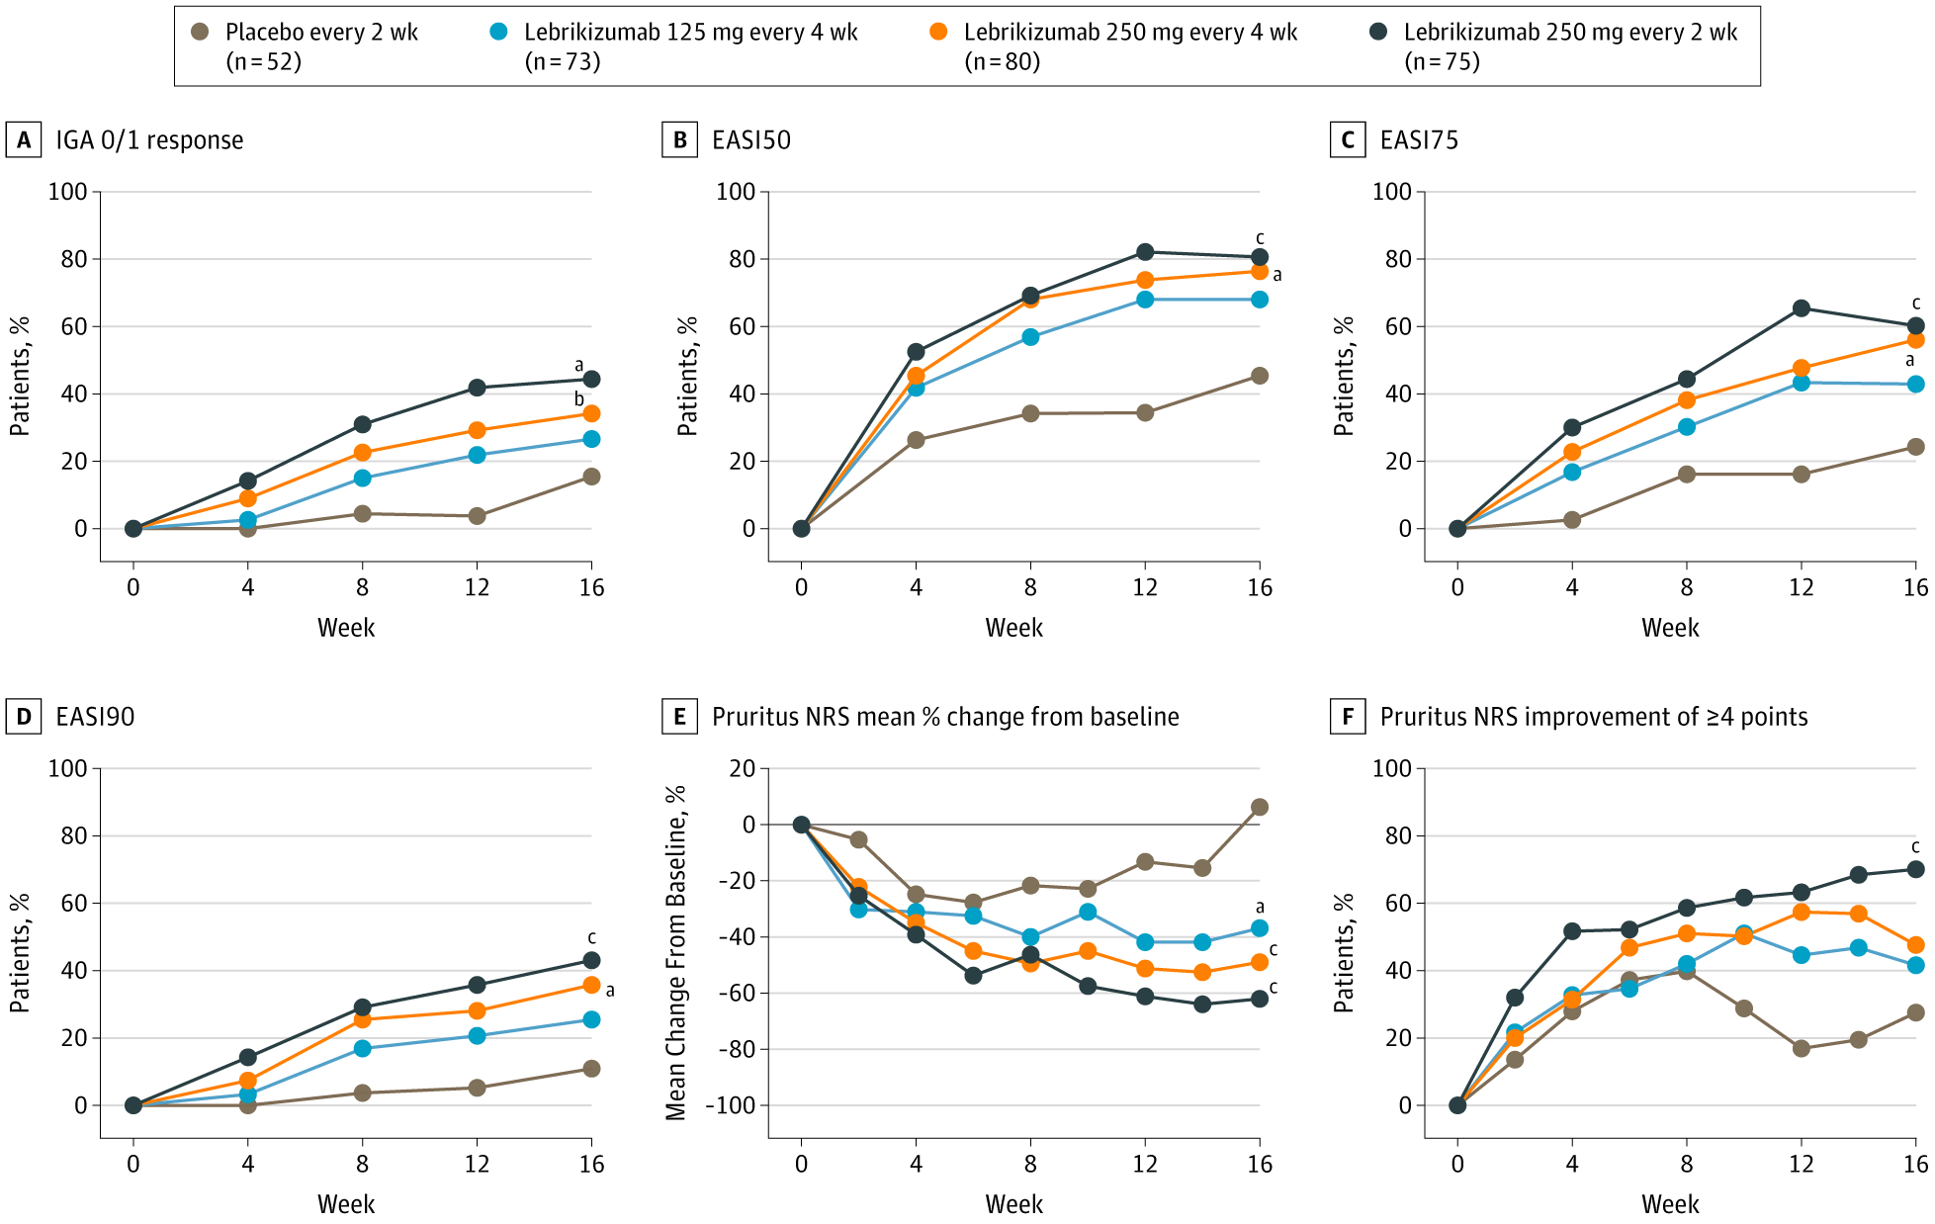
Phase 2b Trial: Lebrikizumab vs Placebo in Adults With Moderate-to-Severe AD¹
IGA 0/1 Response Rate
EASI-75 Response Rate
Enrolled 280 patients with AD aged ≥18 years who had moderate-to-severe AD
Treatment-emergent AEs included upper respiratory tract infection, injection site reactions, herpesvirus infections, and conjunctivitis
Phase 3 trials of lebrikizumab monotherapy (ADvocate 1 and ADvocate 2) met all primary and key secondary endpoints; full results expected in 2022²
a. P <.01; b, P <.05; c, P <.001.
Images courtesy of Guttman-Yassky E et al. JAMA Dermatol. 2020;156(4):411-420. CC-BY-NC-ND.
Guttman-Yassky E et al. JAMA Dermatol. 2020;156(4):411-420.
Lilly's lebrikizumab significantly improved skin clearance and itch in people with moderate-to-severe atopic dermatitis in two Phase 3 trials. August 16, 2021. Accessed September 14, 2021. https://www.prnewswire.com/news-releases/lillys-lebrikizumab-significantly-improved-skin-clearance-and-itch-in-people-with-moderate-to-severe-atopic-dermatitis-in-two-phase-3-trials-301355459.html.

Slide 44
IL-31 Antagonists: Mechanism of Action in AD
AD lesions have overexpression of Th2 cytokines, including IL-31¹
IL-31 triggers several pathophysiologic mechanisms of AD:^{1,2}
  Inflammatory itch
  Disruption of skin barrier function
  Proinflammatory signaling
Image courtesy of Howell MD et al. Front Immunol. 2019;10:2342. CC BY 4.0.
Howell MD et al. Front Immunol. 2019;10:2342.
Gibbs BF et al. Front Immunol. 2019;10:1383.

Slide 45
Phase 3 Trial: Nemolizumab vs Placebo in Adolescents and Adults With AD and Moderate-to-Severe Pruritus
 | Nemolizumab (n = 143) | Placebo (n = 72) | Treatment difference (95% CI)
Primary endpoint
Change in pruritus VAS at week 16, % | -42.8 | -21.4 | -21.5 (-30.2 to -12.7); P <.001
Secondary endpoints
Change in pruritus VAS at day 29, % | -34.4 | -15.3 | -19.3 (-26.6 to -11.9)
Change in EASI at week 16, % | -45.9 | -33.2 | -12.6 (-24.0 to -1.3)
Proportion with DLQI score ≤4 at week 16, % | 40 | 22 | 17 (2-31)
Proportion with decrease of ≥4 points in DLQI at week 16, % | 67 | 50 | 17 (3-31)
Proportion with ISI ≤7 at week 16, % | 55 | 21 | 33 (17-48)
Enrolled 215 Japanese patients with AD aged ≥14 years who had AD with moderate-to-severe pruritus
Common AEs included injection-site reactions and worsening of AD
DLQI, Dermatology Life Quality Index; ISI, Insomnia Severity Index; VAS, visual analog scale.
Kabashima K et al. N Engl J Med. 2020;383(2):141-150.

Slide 46
Key Takeaways
Moderate-to-severe AD is a debilitating disease, with itch as the most commonly reported bothersome symptom
There is an unmet need for novel emerging therapies for AD to improve rates of symptom control
Oral and topical JAK inhibitors have been shown to improve outcomes for patients with moderate-to-severe AD
Novel injectable antagonists of IL-13 or IL-31 have been shown to improve outcomes in patients with moderate-to-severe AD

