Slide 1


Slide 2
Epidemiology, Burden, Unmet Needs in Children and Adolescents

Slide 3
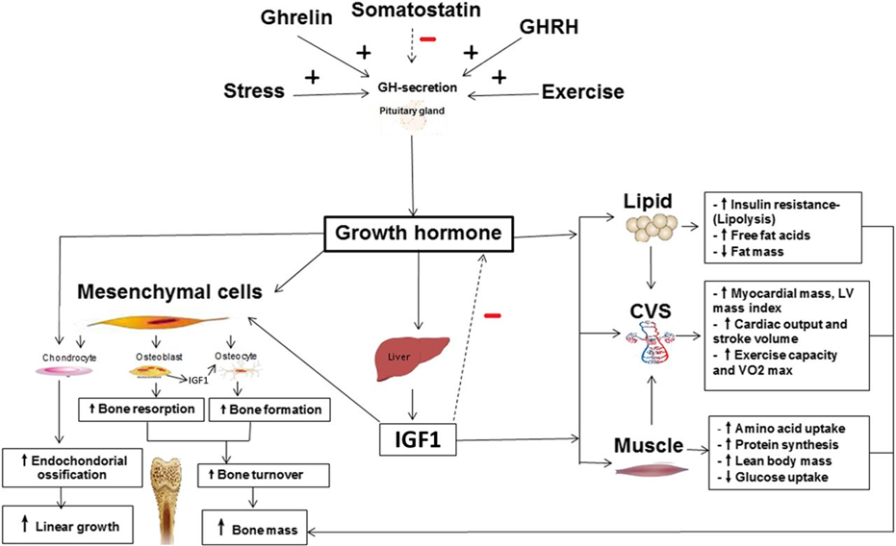
Physiology of Growth Hormone/IGF-I Axis

Slide 4
Growth Hormone Deficiency: Overview
Underrecognized and underdiagnosed
Characterized by inadequate physiological growth hormone (GH) secretion from the anterior pituitary gland
GH deficiency (GHD) in children: Growth rate consistently below the 3-5% for age
  Likely not underweight; if anything, ‘pudgy’
Prevalence of GHD in the general population is about one in 4,000 – 10,000^{1,2}
Consequences: growth retardation, short stature, maturation delays
GHD may not persist after achievement of adult height; about 50,000 adults have GHD and about 6000 new cases are diagnosed each year.³
Notes:
Cook DM, et al. American association of clinical endocrinologists medical guidelines for clinical practice for growth hormone use in growth hormone-deficient adults and transition patients—2009 update. Endocr Pract. 2009;15(suppl 2):1-2
J Clin Endocrinol Metab
. 2014 Apr;99(4):1204-12. doi: 10.1210/jc.2013-3438. Epub 2014 Jan 17.
Assessing the impact of growth hormone deficiency and treatment in adults: development of a new disease-specific measure
Meryl Brod 1, Lise Højbjerre, Johan Erpur Adalsteinsson, Michael Højby Rasmussen

Slide 5
Onset and Etiologies of GHD
Childhood/peripubertal¹
  Idiopathic isolated GHD: 80%
  Organic: 20%
    Isolated GHD or multiple pituitary hormone deficiencies
      Genetic defects in hypothalamic-pituitary axis
      Congenital malformations of
      hypothalamic-pituitary structures
      Acquired (trauma, tumor, or irradiation)
Adult^{2,3}
  Tumors: 75%
  Surgery/cranial irradiation: 4%
  Trauma/vascular injury: 6%
  Idiopathic: 10%
  Other (hypophysitis, infiltrative diseases): 5%
Allen DB. Pediatric Endocrinology. 4th ed. 2003
Cook DM. Growth Horm IGF Res. 1999;
Abs R, et al. Clin Endocrinol. 1999.
Notes:
As patients complete GH therapy for childhood GHD, clinical complications may continue, and the persistence of GHD needs to be redefined. Let us therefore review the etiologies of GHD in the pediatric and adult populations to identify potential clues for GHD persistence into adulthood:
During childhood (or the peripubertal years), most patients demonstrate an isolated GH deficiency of idiopathic origin. A smaller percentage (20%) of patients exhibit organic disease resulting in isolated GH or multiple pituitary deficiencies. These include genetic defects or congenital malformations of the hypothalamic-pituitary axis as well as acquired anomalies resulting from trauma, a central nervous system (CNS) tumor, or irradiation to the head.
In adults, GHD is most often associated with CNS tumors, cranial irradiation, and head trauma or vascular injury. However, 10% of patients have demonstrate no obvious etiology. Depending upon the severity of the underlying disease, the signs and symptoms may be more subtle and difficult to detect in the adult patient.
Allen DB. Pediatric Endocrinology. 4th ed. New York, NY: Marcel Dekker, Inc.; 2003.
Cook DM. Adult growth hormone deficiency syndrome: a personal approach to diagnosis, treatment and monitoring. Growth Horm IGF Res. 1999;9(suppl A):129-133.
Abs R, Bengtsson B-A, Hernberg-Stahl E, et al. GH replacement in 1034 growth hormone deficient adults: demographic and clinical characteristics, dosing and safety. Clin Endocrinol. 1999;50:703-713.

Slide 6
Clinical Manifestations
Children with GHD are usually normal size at birth
  May become hypoglycemic; males may have micropenis
May have delayed rates of development of facial bones, slow tooth eruptions, delayed lengthening of long bones, fine hair, poor nail growth
May have truncal obesity, high pitched voice, delayed closure of the sutures of the skull – and thus delayed closure of the fontanelles
  NOTE: many of these clinical features not apparent in children with idiopathic GHD
Growth rate consistently < 5% for age

Slide 7
Isolated GH Deficiency – Burden of Disease and Therapy
Quality of Life – is being short a burden? Controversial
  Yes – Peds QoL lower in children with shorter stature
  No - Cumulative Pediatric and Adult data do not support beliefs that shorter stature associated with lower psychosocial functioning as children or adults.
  Avail QOL studies have high degree of bias.
  Development of QoLISSY- Quality of Life in Short Stature Youth Questionnaire
Does GH improve quality of life?
  Yes – Using QoLISSY - Upon one year of therapy
Burden of therapy:
  Daily injections, frequent medical visits and blood draws, multiyear therapy, variable outcomes between patients.
  Many adolescent patients (and their parents) asking when can they discontinue GH
Bullinger et al. HormResPaediatr. 2009 72:74, Giesler et al. HormResPaediatr.. 2012 78:94
Sandberg DE PedClinNAmer. 2015 – 62: 963
Bullinger et al. Health Qual Life Outcomes
Briceno et al. JCEM. 2019 104: 2103

Slide 8
Safety considerations with GH Treatment
Safety issues with GH Treatment for GHD
  Intracranial hypertension
  Slipped capital femoral epiphysis (SCFE)
  Scoliosis progression
  Monitor for glucose metabolism
  Risk of neoplasia – controversial
  Arthralgias and edema are common in young adults/adults especially when higher doses are used

Slide 9
Diagnosis

Slide 10
Typical Growth Patterns
First 6 months of life: 16-17 cm
Second 6 months of life: ~8 cm
Second year of life: >10 cm
Third year of life: 8 cm
Fourth year: 7 cm
Years 4-10: average of 5-6 cm/year
A growth velocity of <5% for age (aka <4 cm/year in the 4-10 year old) should prompt evaluation.
Constitutional Delay of Growth and Puberty

Slide 11
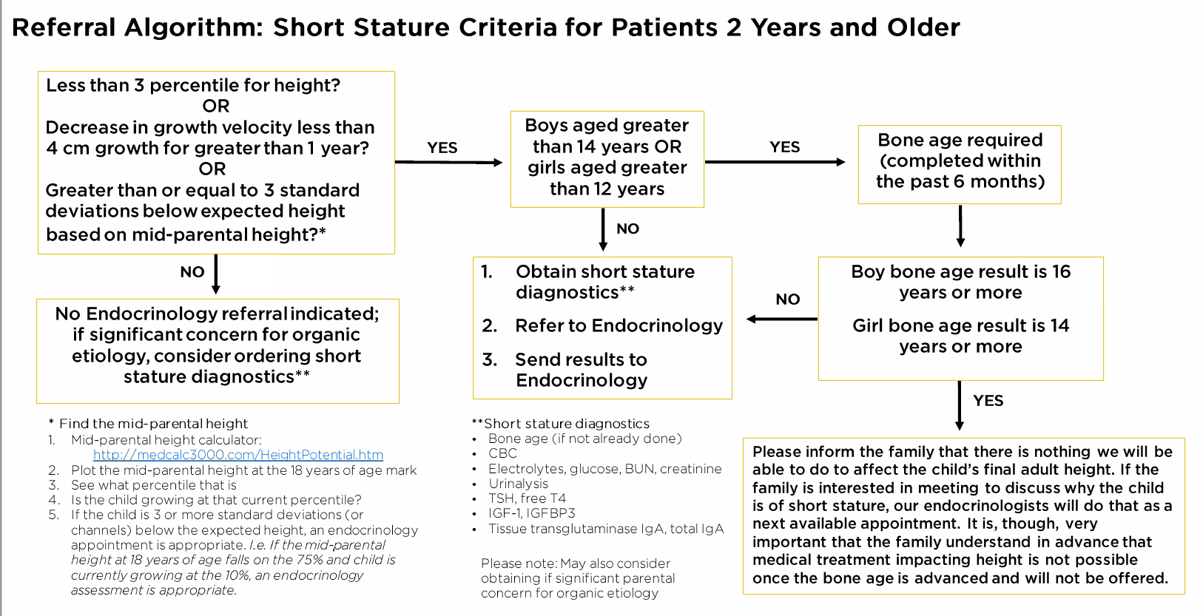

Slide 12
Growth Attenuation/Arrest (growth velocity < 4 cm/year)
Differential Diagnosis
Lab Eval
Endocrine disorders directly affecting GH/IGF secretion
  Pituitary diseases causing GH deficiency
Endocrine disorders indirectly affecting GH secretion
  Hypothyroidism
  Prolonged excess cortisol
    Endogenous – Cushing syndrome
    Exogenous – Corticosteroid treatment for inflammatory diseases
Non-Endocrine disorders indirectly affecting GH secretion
  Malnutrition
  Low calorie intake/Starvation
    Malabsorption
    Celiac disease
    Inflammatory bowel disease
  Chronic disease
Other disease causes of short stature
  Skeletal Disorders (eg, achondroplasia)
  Genetic Syndromes (eg, Trisomy 21)
  Chromosomal Abnormality (Turner Syndrome)
  IUGR→SGA
IGF-1, prolactin, free T4, morning cortisol
TSH, free T4
Salivary cortisol
Celiac panel
CMP with albumin
ESR/CRP
Bone age = Chronological Age
Consider skeletal Survey
Karyotype

Slide 13
Who should be evaluated for GH deficiency?
Pediatric Endocrine Society Guidelines
Establish diagnosis of GHD without GH provocative testing if patient meets all 3 criteria:
  Auxological criteria
  Hypothalamic-pituitary defect (eg, major congenital malformation, tumor, irradiation)
  Deficiency of at least 1 additional pituitary hormone
Do not rely on GH provocative testing as sole diagnostic criteria
NOTE: very low peak GH levels on provocative testing are consistent with severe GHD– however, threshold that distinguishes between ‘normal’ and partial GHD that would respond to GH treatment – not well established.
Owing to large discrepancies between labs, recommend that laboratories use somatropin standard IRP IS 98/574, 22k rhGH isoform

Slide 14
GH deficiency diagnosis
Growth Rate < 4 cm/year with IGF-1 z-score < -2, other causes excluded
Prepubertal with Age > 10 female or > 11 male
Assess other pituitary hormones (thyroxine, prolactin, cortisol)
normal
abnormal
MRI
no
normal
Sex steroid priming prior to stimulation testing
Growth Hormone Stimulation testing
abnormal
GH levels < 5
GH levels >5, < upper limits of normal
GH levels >5, > upper limits of normal, <10 ng/mL
GH levels >upper limits of normal, > 10 ng/mL
Tumor –appropriate management
Pituitary Structural abnormality – hormone replacement, including Growth Hormone
GH deficiency
Probable GH deficiency
No GH deficiency
Possible GH deficiency

Slide 15
Summary: Pearls and Pitfalls
Differential diagnosis of attenuated growth is broad and includes hormone and non-hormone causes
It can be difficult to distinguish between constitutional delay of growth and puberty and isolated partial (probable or possible) growth hormone deficiency
Cut-offs for GH deficiency using the GH stimulation test are open to interpretation

Slide 16
Pediatric Treatment Recommendations

Slide 17
Indications and Patient Selection
All daily somatropin products are FDA-approved for GH deficiency.
Significant variability in indications for non-GH deficient diagnoses among agents
Variabilities in dosing and dosing frequencies
Somatropin products not generally considered bioequivalent with one another (lack of head-to-head studies)
NOTE: selection of somatropin product is dictated by the insurance provider/payer, not the family or the physician

Slide 18
Treatment considerations: Efficacy for GH Deficiency
Growth hormone treatment with daily growth hormone injections generally leads to increase in height for persons who are GH deficient and whose growth plates have not fused
Efficacy of daily GH injections
  With treatment, achieved adult height SDS – Midparental Height (MPH) score is -0.8 to -0.4 SD depending upon study.
    Even with GH, children rarely achieve an adult height higher than MPH
    Those with a higher achieved adult height had a higher midparental height, height gain in first year of therapy, more years on GH, lower GH peak on diagnostic stimulation testing.

Slide 19
Treatment considerations: Safety – daily GH injections
Safety
  Intracranial Hypertension – 1 per 1000 patients
    Dose dependent; most likely to occur with treatment initiation or dose increases
    Reversible when stop GH
  SCFE – slipped capital femoral epiphysis – 1 per 10,000-20,000 patients
    Occurs on average 3 years after initiation; associated with rapid growth, obesity
  Scoliosis progression
  Increased diabetes risk in those with insulin resistance
  Long term risk of Cancer? Cardiovascular disease?
    Controversial – Some European studies suggest there is an increase in CV events for treated patients in their 30s and 40s, others no.

Slide 20
Shared decision making (SDM)
With patient/family – collaboration, goals, risk/benefit, ongoing support, promoting long term adherence
Importance of addressing psychosocial concerns during decision-making process
Means to facilitate adherence and consequences of poor adherence

Slide 21
Shared Decision Making:
AHRQ Model of Patient-Centered Care
Problem
  Lack of patient knowledge necessary for informed decision making
  Available evidence conflicting/confusing (eg, QOL data on short stature/effect of GH)
  Many medical decisions (preventive testing, diagnostic workups, treatment options) driven more by MD attitudes preferences than scientific evidence
  CORE PRINCIPLE of SDM: only preference driving diagnostic/treatment variations should be made by patient
Intervention: Basic Tenets
  Patients armed with balanced information relative to their particular situation can/will participate in the medical decision-making process by asking informed questions and expressing personal values/opinions about their conditions/treatment options
  Clinicians will respect patients’ goals/preferences and use them to guide recommendations and treatments

Slide 22
Implementing Shared Decision-Making SHARE
Seek your patient’s participation
  Communicate that a choice exists and invite to be involved in decision
Help your patient explore and compare treatment options
  Discuss benefits and harms (and unknowns) of each option
Assess your patient’s values and preferences
  Take into account what matters most
Reach a decision with your patient
  Decide together on the best option and arrange for follow-up
Evaluate your patient’s decision
  Support your patient so treatment decision has a positive impact on health outcomes

Slide 23
Treatment Dosing and Monitoring Daily GH injections
Dosing
  Starting dose 0.15-0.2 mg/kg/week (20-30 mcg/kg/day)
    Different GH (somatropin) brands have different recommendations for dosing
      0.16-0.3 mg/kg/week
  Subsequent dosing to titrate IGF-1 level in the upper ½ of normal range for age
    Minimum twice yearly – studies of this technique analyzed 3-4X yearly
    Wide range of mg/kg dosing among patients to keep IGF-1 in upper ½ of normal range
Every 3-6 mos
  IGF-1 level
  Height
  Weight
  Screen for side effects (headaches, knee, hip pain, polyuria)
  Consider screening for diabetes in those at high risk
Yearly
  Screen for other pituitary hormone deficiencies in those at high risk (consider free T4, cortisol)
  Bone age

Slide 24
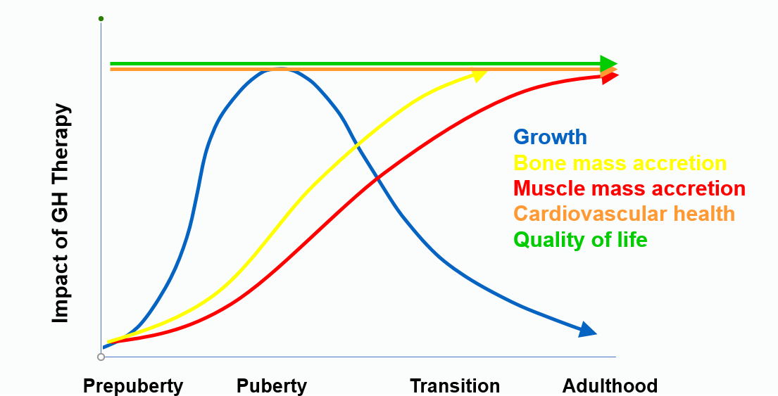
Outcomes of Growth Hormone Therapy: Beyond Height
Body composition
Bone Mass
  Accrual occurs until early 20s
  GH plays role in optimal accrual
Quality of life
Metabolic abnormalities
  Lean muscle mass
  Lipid profile

Slide 25
Duration of therapy
Transition: when linear growth done and re-evaluation for persistent GH deficiency is recommended
  Male: When growth rate less than 3 cm/year and bone age 17
  Female: When growth rate less than 3 cm/year and bone age 14
Retesting once these milestones achieved:
  Multiple pituitary hormone deficiency (>2 pituitary hormones deficiency)→ persistent GH deficiency is 100% chance → no repeat testing needed
  2 or fewer pituitary hormones (even with abnormal pituitary structure) → persistent GH deficiency 30-70% of patients → repeat testing needed
    IGF-1 level 1-3 months after GH held – If IGF-1 z-score < -2 → persistent GH deficiency. IF IGF-1 z-score > 0 likely not persistent GH deficiency
    Repeat GH stimulation testing (using adult protocols) recommended if IGF-1 level indeterminate

Slide 26
What Are the Common Challenges
to Transitioning a Patient?
Patient/Caregivers
Pediatric Endocrinologist
Adult Endocrinologist
  Lack of disease education/awareness
  Lack of expectations/preparation for managing disease as an adult
  Lack of treatment adherence
  No other treatment options besides injections
  High cost of treatment
  Patients may not be directed to the appropriate clinicians/pituitary centers to take over care
  Payers may not cover or dictate where patients will go for their testing
  Parental trust issues with adult endos
  Lack of education and/or communication with patients
  Lack of effective model for transferring patients
  Peds endos unwilling to “hand over” patients to adult endos
  Lack of education/awareness on the importance of treating adults with GHD
  Lack of long-term benefit data for GH replacement therapy
  Lack of knowledge of how to manage transition patients with certain conditions (eg, childhood cancer)
  Some pediatric and/or adult endocrinologists may not offer retesting after attainment of final height
Yuen KCJ, et al. Growth Horm IGF Res. 2021;56:101375.
Notes:
OBJECTIVE:
Seamless transition of endocrine patients from the paediatric to adult setting is still suboptimal,.
METHODS:
An expert panel meeting comprised of European paediatric and adult endocrinologists was convened to explore the current gaps in managing the healthcare of patients with endocrine diseases during transition from paediatric to adult care settings.
RESULTS:
While a consensus was reached that a team approach is best, discussions revealed that a 'one size fits all' model for transition is largely unsuccessful in these patients. They need more tailored care during adolescence to prevent complications like failure to achieve target adult height, reduced bone mineral density, morbid obesity, metabolic perturbations (obesity and body composition), inappropriate/inadequate puberty, compromised fertility, diminished quality of life and failure to adapt to the demands of adult life. Sometimes it is difficult for young people to detach emotionally from their paediatric endocrinologist and/or the abrupt change from an environment of parental responsibility to one of autonomy. Discussions about impending transition and healthcare autonomy should begin in early adolescence and continue throughout young adulthood to ensure seamless continuum of care and optimal treatment outcomes.
CONCLUSIONS:
Even amongst a group of healthcare professionals with a great interest in improving transition services for patients with endocrine diseases, there is still much work to be done to improve the quality of healthcare for transition patients.

Slide 27
Communication between pediatric endocrinologist and primary care
Expectation management
  Diagnosis/evaluation process
  Reasonable yearly gains (cm gained/year)
  Achievable height outcomes
GH may be needed after height achieved

Slide 28
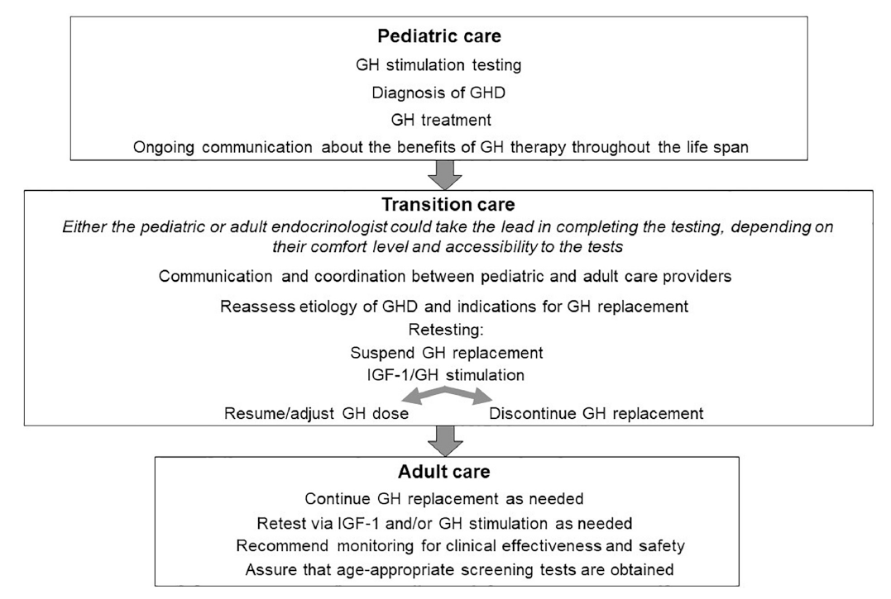
The ideal transition of childhood-onset GHD from pediatric to adult services
Yuen KCJ, et al. Growth Horm IGF Res. 2021;56:101375.

Slide 29
Summary: Pearls and Pitfalls
Daily growth hormone has a proven record for efficacy and safety in GHD patients
For optimal outcomes, GH treatment requires multiple years of therapy
Response to therapy varies among patients so discussions about outcomes is nuanced and can change upon response to therapy
Ensuring appropriate confirmatory testing and providing seamless GH replacement therapy for patients with persistent GHD is a challenge
A clearly structured transition protocol is vital to provide useful, practical guidance to clinicians and establish best practices when transitioning adolescents with persistent CO-GHD to adult care

Slide 30
Review of Available Recombinant Growth Hormone (somatropin) Treatments

Slide 31
Overview of Options
What factors to consider for treatment selection between approved products?
  Indications
  Frequency of administration
  Tolerability/Safety

Slide 32
Somatropin Products Available in the United States for Pediatric Growth Hormone Deficiency
 | Indications |  |  |  |  |  |  | Frequency of Administration
 | GHD | TS | ISS | PWS | SHOX | SGA | NS
Genotropin |  |  |  |  |  |  |  | 6-7 days/week
Humatrope |  |  |  |  |  |  |  | Daily
Lonapegsomatropin |  |  |  |  |  |  |  | Once weekly
Norditropin |  |  |  |  |  |  |  | 6-7 days/week
Nutropin |  |  |  |  |  |  |  | 6-7 days/week
Omnitrope |  |  |  |  |  |  |  | 6-7 days/week
Saizen |  |  |  |  |  |  |  | Either 3 alternate days, 6 days/week, or daily
GHD, growth hormone deficiency; TS, Turner syndrome; ISS, idiopathic short stature; PWS, Prader-Willi syndrome; SHOX, short stature homeobox-containing gene; SGA, small for gestational age; NS, Noonan syndrome

Slide 33
Why consider LAGH preparations?
Issues with daily GH injections
Inconvenient, painful and distressing
Lack of information/perceived effects
Nonadherence
Hypothesis: By decreasing injection frequency, LAGH preparations may improve quality of life and adherence, and thereby potentially improve clinical outcomes

Slide 34
What would make an “ideal” LAGH preparation?
Mode of delivery
Ideal frequency of injection (weekly, biweekly…?)
Small-bore needle
Entire dose in a small-volume single injection
User-friendly pen device to capture each dose administration
Efficacy
Not inferior to daily GH therapy
Safety
Side effect profile similar to daily GH
Maintains IGF-I in the physiologic range
No injection site reactions, lipodystrophy or pain
Does not induce neutralizing anti-GH antibodies
Does not cause iatrogenic acromegaly or other idiosyncratic side effects
Cost
Less costly or at least comparable to daily GH therapy

Slide 35
Lonapegsomatropin (TransCon ACP-001)
Indication: Growth Hormone deficiency in children
Dosed weekly (0.24 mg/kg/week)
Long-acting prodrug form of somatropin
Human growth hormone indicated for the treatment of pediatric patients 1 year and older who weigh at least 11.5 kg and have growth failure due to inadequate secretion of endogenous growth hormone (GH).

Slide 36
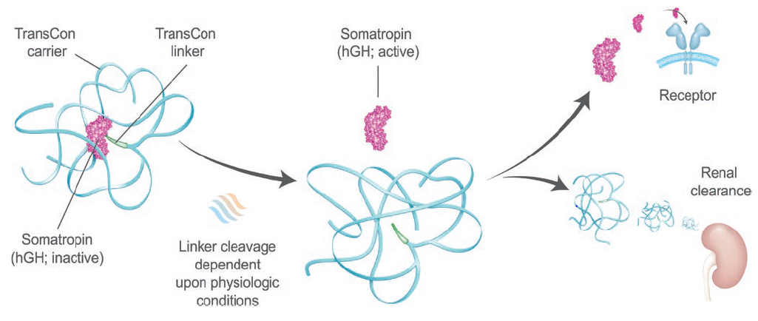
Lonapegsomatropin
Thornton PS, et al. J Clin Endocrinol Metab. 2021 Jul 17;dgab529. Online ahead of print.
Notes:
Lonapegsomatropin is a long-acting prodrug consisting of the parent drug, unmodified somatropin; an inert carrier; and a proprietary Transcon linker that temporarily binds the somatropin and carrier. The carrier has a shielding effect that minimizes renal excretion and receptor-mediated clearance.
Following autocleavage of the linker under physiologic conditions, lonapegsomatropin predictably releases somatropin within therapeutic levels over 1 week to allow the same tissue distribution and receptor activation as endogenous GH.
The carrier and linker are cleared primarily by renal filtration and to a minor extent by hepatobilary excretion

Slide 37
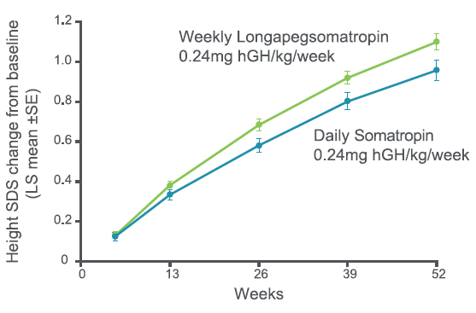
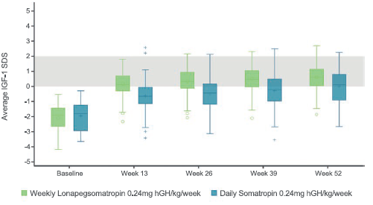
Phase 3 heiGHt trial in CGHD
Thornton PS, et al. J Clin Endocrinol Metab. 2021 Jul 17;dgab529. Online ahead of print.
Notes:
LS mean (SE) height SDS increased from baseline to week 52 by 1.10 (0.04) vs 0.96 (0.05) in the weekly lonapegsomatropin vs daily somatropin groups (P = 0.01).
Bone age/chronological age ratio, adverse events, tolerability, and immunogenicity were similar between groups.
The trial met its primary objective of noninferiority in AHV and further showed superiority of lonapegsomatropin compared to daily somatropin, with similar
safety, in treatment-naïve children with GHD.

Slide 38
Near-Term Long-Acting Growth Hormone Treatments
Review of Safety and Efficacy Data from Pivotal Trials

Slide 39
How do we make an injection of GH last longer?
Depot
Delay absorption from the subcutaneous space
  Incorporation into microspheres
Slow clearance from circulation
  Polyethylene glycol
    Permanent pegylation
    Reversible pegylation
  Fusion proteins
    Synthetic polypeptides
    Naturally occurring proteins
      Human chorionic gonadotropin (hCG)
      Albumin
      Immunoglobulin chains
  Modify binding to serum proteins
    Change binding to albumin
PEGylation
Prodrug
GH fusion proteins
Noncovalent albumin binding
Yuen KCJ, et al. Front Endocrinol (Lausanne). 2021 Feb 24;12:637209.

Slide 40
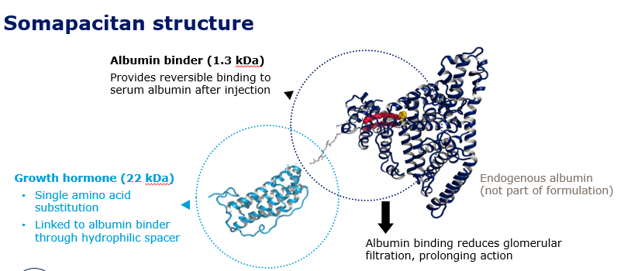
Somapacitan NNC0195-0092
Approved by the FDA in August 2020 with dosing every 7 days for use in AGHD; not yet marketed
Single-point mutation in GH, with albumin binding moiety attached (non-covalent albumin-binding properties)

Slide 41
Somapacitan vs Norditropin: REAL 3 study
 | Somapacitan 0.04 mg/kg/wk | Somapacitan 0.08 mg/kg/wk | Somapacitan 0.16 mg/kg/wk | Daily GH 0.034 mg/kg/d)
26 weeks: mean (SD) annualized HV | 8.0 (2.0) cm/yr | 10.9 (1.9) cm/yr | 12.9 (3.5) cm/yr | 11.4 (3.3) cm/yr
52 weeks: mean annualized HV | 7.8 cm/yr | 9.7 cm/yr | 11.50 cm/yr | 10.0 cm/yr
Mean (SD) IGF-1 SDS | -1.62 (0.86) | -1.09 (0.78) | 0.31 (1.06) | -0.40 (1.50)

Slide 42
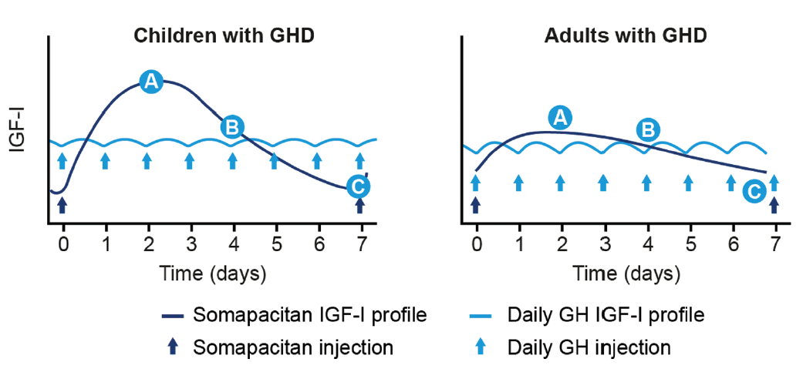
Measuring IGF-I levels using linear models while on LAGH preparations: it’s all about timing!
Juul Kildemoes R, et al. J Clin Endocrinol Metab. 2021;106(2):567-576.
Notes:
A pharmacokinetic/pharmacodynamic model was used to simulate IGF-I data in adults and children following weekly somapacitan treatment of GHD.
A = peak IGF-I levels around Day 2
B = weekly average IGF-I levels correspond to IGF-I level on Day 4
C = trough IGF-I levels prior to next dose
Linear models provided a simple and reliable tool to aid optimal monitoring of IGF-I by predicting mean and peak IGF-I levels based on an IGF-I sample following dosing of somapacitan.
Needs to be practical for the clinician!
Few physicians will appreciate the need to use complex formulas. The data presented suggest that—if blood sampling at defined time points is feasible (for the patient and the physician)—the use of samples taken on day 4 or 5 after administration is appropriate to get an estimate of mean IGF-I. In the clinical context, the 90% PI of ± 0.2 SDS seems acceptable for most situations. However, to give more flexibility regarding sampling time points, and to make dose adjustments in LAGH treatment as convenient as we know it from daily GH, the algorithms should be transferred to easy-to-use, electronic tools. Ideally, physicians should need to enter only the dose, weight, time point of sampling, and IGF-I to obtain the appropriate interpretation. We acknowledge this is not any easy task. Differences in IGF-I assays have to be taken into account, the device needs formal approval, and it needs to be adjusted for each individual LAGH product. However, with LAGH, timing is an art—and manufacturers need to help the artist!

Slide 43
Somatrogon (MOD 4023)
Long-acting recombinant human growth hormone: amino acid sequence of human growth hormone + 3 copies of carboxy-terminal peptide (CTP) of HCG.
Being developed as once-weekly treatment
https://clinicaltrials.gov/ct2/show/results/NCT02968004 https://clinicaltrials.gov/ct2/show/NCT03831880

Slide 44
Somatrogon: Phase 2 and 3 trials
12-month phase 2 trial: once weekly somatrogon (0.66 mg/kg/wk) vs daily genotropin (0.24 mg/kg/wk)
5-year open label extension
Phase 3 trials: n=224 Ss randomized 1:1 to somatrogon (0.66 mg/kg/wk; n=109) or qd genotropin (0.24 mg/kg/wk; n=115) X 12 months
Results: mean HV was 10.10 cm/yr somatrogon group vs 9.78 cm/yr in genotropin group.
Somatrogon was not inferior to genotropin
Well tolerated

Slide 45
Somatrogon: Phase 3 trial
Phase 3 trial: compared somatrogon (0.66 mg/kg/wk) administered once/week vs genotropin (0.025 mg/kg/day) administered subcutaneously once/day in 44 Japanese pGHD patients (aged 3-11 years) X 12 months.[Horikawa 2021]
LSM of Height velocity (HV) at 12 months:
  9.65 cm/year in somatrogon group (n=22) vs 7.87 cm/year in genotropin group (n=22); Point estimate treatment difference =1.79 cm/year (95A% CI 0.97, 2.60)
  Met primary endpoint; somatrogon not inferior to daily genotropin
  Well tolerated

Slide 46
Biomarkers of daily vs LAGH preparations: what are the differences?
Neither daily nor LAGH preparations mirror the “physiological” GH secretion
Daily vs LAGH preparations:
  Duration of GH exposure (hours per day vs days per week)
  Duration of exposure to high (peak) and low (trough) IGF-I levels
  Relationship between GH and IGF-I levels
  Tissue distribution of GH (if GH molecule is modified)

Slide 47
So which patients would benefit most from LAGH preparations?
Naïve-patients that are likely to be non-adherent
- patients already on many “other” injections
- patients unable to self-inject but willing to start or
remain on GH treatment
Patients already on daily GH injections but are non-adherent

Slide 48
Unanswered Questions with LAGH Products
  How to start and adjust LAGH dosing?
  When is the best time to measure IGF-I levels and is it the same for all LAGH preparations?
  Would LAGH cause tachyphylaxis and/or downregulation of GH receptors?
  Will the effects of LAGH preparations be durable with long-term use?
  Can LAGH preparations penetrate all tissues equally?
  Will there be long-term metabolic consequences?
  Are LAGH cost-effective?
  Will LAGH improve adherence and outcomes?
  Will the safety profile of LAGH be different to daily GH?
Notes:
There have been fewer than 1000 patients treated with LAGH, and the most frequent side effect of daily GH occurs in 1 in 1000 to 2000 patients, so safety profile unknown

Slide 49
Summary
Numerous LAGH preparations have been or are being developed but they all have different characteristics
Short-term studies demonstrate some LAGH preparations are noninferior to daily GH in efficacy and comparable safety profile
More “convenient” than daily GH injections
Although LAGH preparations has the promise to improve adherence and long-term outcomes, this still needs to be proven in large prospective clinical trials

Slide 50
Case Studies:
Putting It All Together

Slide 51
Case 1: 8-year old boy
8-year old boy on GH of 0.3 mg/kg/week (42 mcg/kg/day)
Parents recently divorced, with shared custody so supply must be transferred between households
Parent may forget to resupply/transfer GH pen between households, so often 2-3 days of GH missed every 2 weeks
Growth velocity has dropped from the 70% to the 20th percentile with corresponding height z-score drop from -2.3SD to -2.6SD

Slide 52
Case 1, continued
Both parents and child at clinic visit state desire to continue GH, but realities of coordinating delivery and care between households has limitations
His IGF-1 level fell from +1.7Sd to -0.4 SD once he had to move between household.
Goals of treatment:
Switching products:

Slide 53
Case 2: 11-year old girl
11-year old girl treated with GH at a dose of 0.25 mg/kg/week (35 mcg/kg/day).
Her growth velocity fell from the 80th percentile to 40% from her last clinic visit 6 months ago with corresponding height z-score fell from -1.4 to -1.9 SD
She is tanner 3 puberty, premenarchal.
Her IGF-1 z-score fell from +1.8SD to -0.7 SD.

Slide 54
Case 2, continued
At her last clinic visit, she triumphantly told you that she was doing injections herself. She prefers to do injections herself as they hurt less than when her parents do them.
She reports no missed doses.
  However: growth data and IGF-1 level suggest she is not getting the medicine
  Parents think they have to call for refills as often as before but can’t recall exactly.
Assessing treatment response
Shared decision making
Adherence barriers

Slide 55
Case 3: 15-year old female with idiopathic isolated GH deficiency
Treated with GH since age 6
Presentation:
- Delayed bone age < 3rd percentile for age
- Height and growth velocity < 3rd percentile
- MRI normal pituitary gland

Slide 56
Case 3, continued
Course:
- Puberty at 12.5 yrs of age
- Progressed normally
- 8 months ago, growth velocity decreased to 3.5 cm/yr
Currently:
- GH dose 0.033 mg/kg/day
- Height: 170 cm (mid-parental height: 175 cm)
- Growth velocity: 2.2 cm/yr
- Body weight: 68 kg (BMI: 23 kg/m²)
- Bone age 15 yrs

Slide 57
Psychosocial adaptation to Short Stature
Factors potentially affecting psychosocial adaptation among those with short stature
  Male gender
  The presence of a younger but taller sibling
  Being perceived and treated as younger than chronological age
  Lower intelligence
  Lower family socioeconomic status
  Acceptance into some peer group activities

Slide 58
Emotional burdens of GHD in children
Social Well-Being
Domain*
Emotional Well-Being
Domain*
Brod M, et al. Qual Life Res. 2017;26:1673.

Slide 59
Dealing with short stature as an adolescent
Treatment burden, adherence and persistence
Transition to child self-administering medication (without supervision)
Injection fatigue
Continued reassessment of expectations particularly as child approaches normal adult height range
Challenges of adherence of adolescents as they seek independence and become more active (school sports, school trips, after school activities, etc)

Slide 60
Nonadherence is more common in adolescents
Parents of children
(age 5–12)
Teens
(age 13–17)
Notes:
Source: Rosenfeld 2008, p149 Figure 3

Slide 61

Patient + Parent:
Following Through With Treatment
Years of daily injections
  Temperature-sensitive storage
  Child autonomy
  Adherence
  Brand switches from formulary preference changes
Treatment monitoring
  Visits to pediatric endocrinologist at least every 6 months
  Monitoring blood work (especially IGF-I)
  Serial bone age x-rays
Grimberg A, et al. Endocr Pract. 2012;18:307-316.

Slide 62
CONCLUSIONS and KEY TAKEAWAYS
Daily growth hormone has a proven record for efficacy and safety in GHD patients
There may be multiple barriers to daily GH therapy
Nonadherence with daily GH therapy can contribute to poor growth and possible long-term bone and cardiovascular health
Long-acting GH preparations holds the promise of improving treatment adherence and outcomes

Slide 63
Identifying Potentially Modifiable Factors Associated with Treatment Nonadherence in Pediatric Growth Hormone Deficiency: A Systematic Review
Included 6 observational studies of children treated with GH
  Children had any indication for GH
  Adherence measured by either self-report or returned/unused vials on a specific device
Rates of nonadherence: 7% to 70%
Identified 22 different factors that contribute to nonadherence.
  Physical capability
  Uncomfortableness with the injection or pain on the injection
  Concerns about inadequate training on injection,
  Discomfort, dissatisfaction with efficacy so want to discontinue injections
  Lifestyle disruptions
Graham S, Weinman J, Auyeung V. Horm Res Paediatr. 2018;90:221-227.

