Slide 1
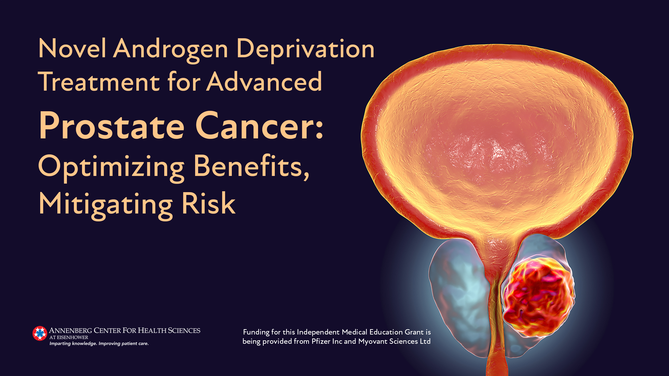

Slide 2
Module 1
Androgen Deprivation Therapy: Clinical Differences

Slide 3
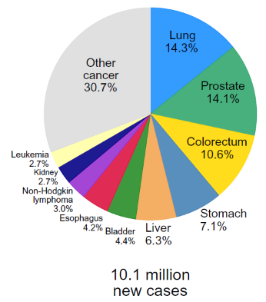
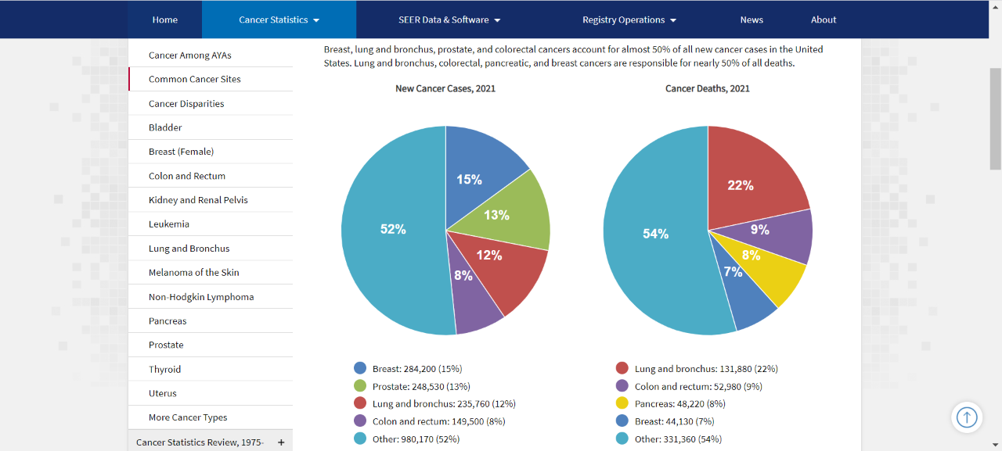
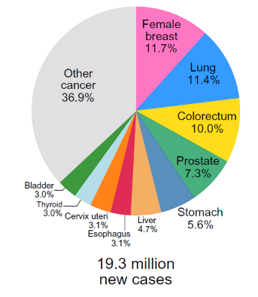
Prostate cancer (PCa) is one of the most-commonly diagnosed cancers worldwide and in the United States
Global Cancer Incidence in 2020¹
Estimated New Cancer Cases in the United States in 2021²
Both Sexes
Males
1.9 million new cases
estimated
1. Sung H, et al. CA Cancer J Clin. 2021;71(3):209-249.
2. NCI SEER Program. Common Cancer Sites - Cancer Stat Facts. https://seer.cancer.gov/statfacts/html/common.html . Published 2021. Accessed September 12, 2021.

Slide 4
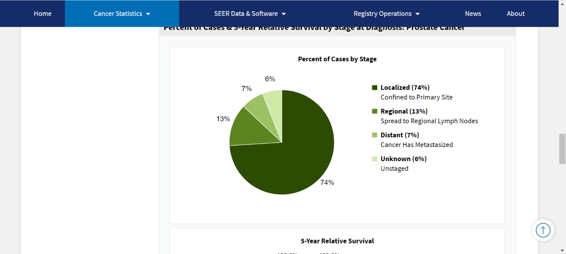
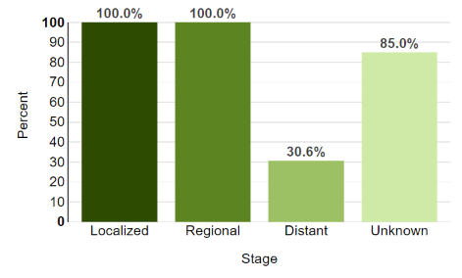
5-Year relative survival of patients with advanced/metastatic PCa is 30.6%
Majority of PCa cases are localized or regional at diagnosis; 6% are advanced/metastatic at diagnosis
Considered curable when diagnosed at a localized stage, 5-year relative survival of patients with metastatic PCa drops dramatically
NCI SEER Program. Common Cancer Sites - Cancer Stat Facts. https://seer.cancer.gov/statfacts/html/common.html . Published 2021. Accessed September 12, 2021.

Slide 5
PCa develops through various stages
Localized Disease
Biochemical Failure
(PSA ↑ After Local Therapy)
Castration-Resistant PCa (CRPC)
Metastatic CRPC
(mCRPC)
Treatment-Refractory mCRPC
Metastatic
Hormone-Naïve/
Castration-Sensitive PCa (mHSPC/mCSPC)
Teo MY, et al. Annu Rev Med. 2019;70:479-499.

Slide 6
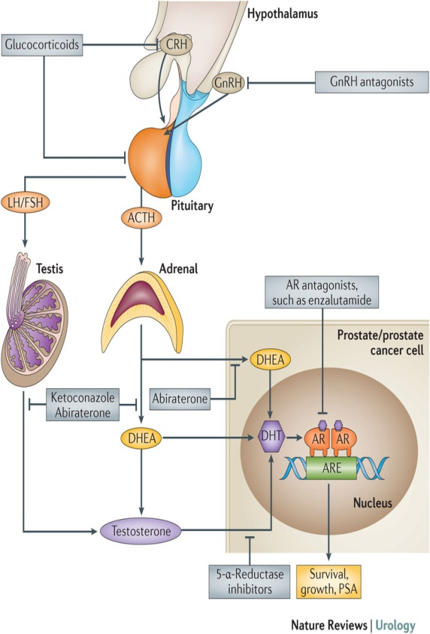
De Novo Metastatic PCa
  mHSPC incidence is:¹⁻⁵
  ~3% in US and rising;
  ~6% across Europe
  ~4%-10% in Latin America
  ~60% in Asia-Pacific
Historically, androgen deprivation therapy (ADT)
has been the standard of care⁶
Progression to metastatic disease largely driven by reactivation of androgen receptor (AR) signaling⁶
Narayanan S et al. Nat Rev Urol. 2016;13:47-60, with permission from Nature Publishing Group.
1. Weiner AB et al. Prostate Cancer Prostatic Dis. 2016;19:395-397. 2. Buzzoni C et al. Eur Urol. 2015;68:885-890. 3. Chen R et al. Asian J Urol. 2014;1:15-29. 4. Ito K. Nat Rev Urol. 2014;11:15-29. 5. Nardi AC. Int Braz J Urol. 2012;38:155-166. 6. Yamaoka M et al. Clin Cancer Res. 2010;16:4319-4324.

Slide 7
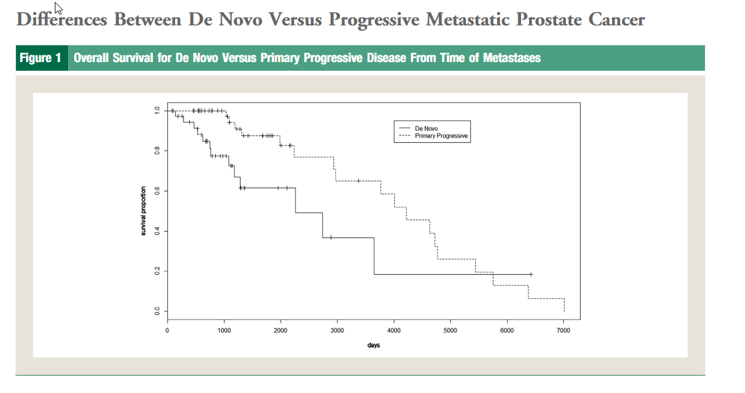
Differences between de novo vs progressive metastatic PCa
Finianos A, et al. [published online ahead of print, 2017 Aug 31]. Clin Genitourin Cancer. 2017;S1558-7673(17)30247-1.

Slide 8
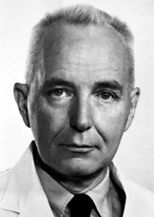
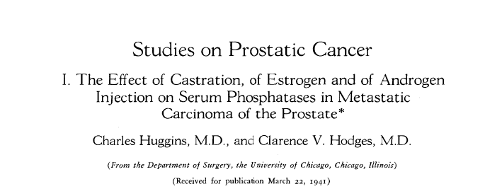
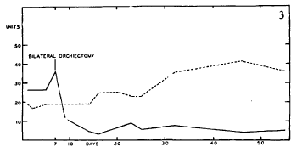
Historical Perspective: Androgens and PCa
Pca is androgen dependent
AR highly expressed on PCa cells and directly stimulates growth and survival
Androgen deprivation is the primary therapy for metastatic disease
Notes:
Need to highlight that this is a key piece of the history of our specialty, led to Nobel for Huggins
Prostatic acid phosphatase and Alk phosphatse measured

Slide 9
Advanced PCa management is based on disease states¹⁻³
Metastatic Hormone-Sensitive/
Castration-Sensitive PCa (mCSPC)
Primary ADT
High-volume/high-risk diseaseª
  ADT + docetaxel^{b} or
  ADT + AAP^{c}
Metastatic CRPC
(mCRPC)
Clinically Localized Disease
Nonmetastatic Hormone-Sensitive PCa (HSPC/CSPC)
Active surveillance
Radiation ± ADT
Radical prostatectomy
Salvage focal treatment
Observation
Intermittent ADT
Chemotherapy
Targeted therapy with PARP inhibitor
  Olaparib
  Rucaparib
Immunotherapy
  Sipuleucel
  Pembrolizumab
Nonmetastatic Castration-Resistant PCa (CRPC)
ADT to maintain castrate T levels
AR-axis targeted therapy
ªCastrate levels of testosterone. ^{b}High-volume disease in chemotherapy candidate. ^{c}High-risk disease, in chemotherapy-ineligible patient/refusal of chemotherapy.
ADT, androgen deprivation therapy; AR, androgen receptor; AAP; abiraterone acetate and prednisone/prednisolone; PARP, poly (ADP-ribose) polymerase.
1. Schaeffer E, et al. NCCN Clinical Practice Guidelines in Oncology. Prostate Cancer. Version 2.2021. https://www.nccn.org/professionals/physician_gls/pdf/prostate.pdf. Published February 17, 2021. Accessed September 18,2021. 2. Initial Management of Noncastrate Advanced, Recurrent or Metastatic Prostate Cancer Algorithm. ASCO Guidelines. https://www.asco.org/sites/new-www.asco.org/files/content-files/advocacy-and-policy/documents/2021-Mgmt-Noncastrate-Prostate-Algorithm.pdf. Published 2021. Accessed September 18, 2021. 3. Malone S, et al. [published online ahead of print, 2019 Apr 26]. Can Urol Assoc J. 2019;14(2):50-60.
Notes:
Need to highlight that this is a key piece of the history of our specialty, led to Nobel for Huggins
Prostatic acid phosphatase and Alk phosphatse measured

Slide 10
GnRH agonists and antagonists are approved for ADT^{1,2}
GnRH Agonists
GnRH Antagonists
Both GnRH agonists and antagonists block the hypothalamic–pituitary–gonadal feedback system
GnRH agonists downregulate GnRH receptors in the pituitary leading to reduced T and LH release
GnRH antagonists directly inhibit GnRH receptors in the anterior pituitary gland leading to:
  Immediate and reversible LH and FSH suppression
  And, thereby, suppression of T and DHT levels
GnRH agonist/antagonist binding to GnRH receptors activates the receptor-coupled Gαi/cAMP pathway, promoting antiproliferative/proapoptotic/ antimetastatic pathways
GnRH Receptor
Binding
Activation
Inhibition
Gαi/cAMP
Upregulated
p-JNK; p-p38; P53
Caspase 8, 3
Actin remodeling
Downregulated
AR
EGFR; PI3K/AKT
ERK1/2; IGF-1R
PCa cell growth, survival, and metastasis
AR, androgen receptor; DHT, dihydrotestosterone; EGFR, epidermal growth factor receptor; ERK, extracellular signal-regulated kinase; FSH, follicle-stimulating hormone; GnRH, gonadotropin releasing hormone; JNK, Janus kinase; LH, luteinizing hormone; PI3K, phosphoinsoitol-3 kinase; T, testosterone
1. Van Poppel H and Abrahamsson PA. Int J Urol. 2020;27(10):830-837.
2. Fontana F, et al. Int J Mol Sci. 2020;21(24):9511. Published 2020 Dec 14.

Slide 11
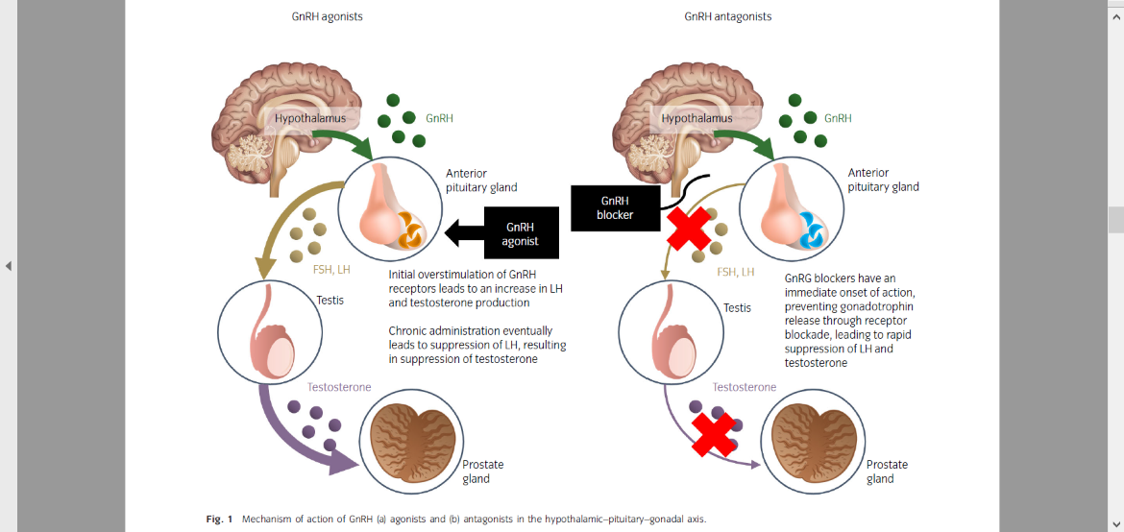
GnRH agonists and antagonists act through different MOAs¹⁻⁵
GnRH Agonists
GnRH Agonists | GnRH Antagonists
Both suppress serum T to castrate levels
Downregulate GnRH-R in the pituitary gland | Directly inhibit GnRH-R in anterior pituitary
Initially, stimulate GnRH-R, resulting in initial increase in LH, FSH, T and DHT | Immediate and reversible suppression of LH, FSH, and then, T and DHT
Hot flushes, reduced libido, and erectile dysfunction (due to reduced T and estrogen levels) occur at similar rates
Associated with lower rates of injection site reactions | Associated with higher rates of injection site reactions
No significant difference in PSA progression
Associated with higher musculoskeletal and CV* events, and overall mortality | Associated with fewer musculoskeletal and CV* events, and overall mortality
GnRH Antagonists
*Relative differences in CV risk between GnRH agonists and antagonists noted in retrospective cohort studies and meta-analyses of randomized clinical trial data.^{4,5}
CV, cardiovascular; DHT, dihydrotestosterone; FSH, follicle-stimulating hormone; GnRH, gonadotropin releasing hormone; GnRH-R, GnRH receptor; LH, luteinizing hormone; PSA, prostate-specific antigen; T, testosterone.
1. Van Poppel H, Abrahamsson PA. Int J Urol. 2020;27(10):830-837. 2. Fontana F, et al. Int J Mol Sci. 2020;21(24):9511. Published 2020 Dec 14. 3. Abufaraj M, et al. Eur Urol. 2021;79(1):44-53. 4. Challa AA, et al. Curr Treat Options Oncol. 2021;22(6):47. 5. Hu JR, et al. Arterioscler Thromb Vasc Biol. 2020;40(3):e55-e64.

Slide 12
Module 2
Current State of Care in Advanced PCa

Slide 13
Prognosis and therapeutic choice in mHSPC is based on disease features¹⁻⁴
Incidence of metastatic HSPC has been increasing since 2013, likely due to improved imaging sensitivity and changes in PSA screening guidelines
The therapeutic landscape of advanced PCa (APC) is evolving rapidly
Key considerations that can impact the prognosis and/or therapeutic choice in metastatic HSPC include:
  Disease characterized as recurrence after initial local therapy for localized PCa or as de novo metastatic disease
  Extent of disease (high- vs low-volume)
  Site of metastases and burden (visceral metastases/nodal disease)
  Symptom burden/ quality of life (QoL) effects
  Patient preferences
  Genetic testing results
1. Lowrance WT, et al. J Urol. 2021;205(1):14-21. 2. Sheng IY, et al. Drugs Context. 2021;10:2020-10-2. 3. Francini E, et al. Prostate. 2018;78(12):889-895. 4. Cattrini C, et al. Cancers (Basel). 2019;11(9):1355.

Slide 14
Although ADT is the foundation of mHSPC management, response may be short-lived, with progression to CRPC¹⁻³
ADT is the treatment of choice for mHSPC
ADT monotherapy yields:
  Median failure-free survival (FFS) of 11 months
  Median overall survival (OS) of 42 months
Treatment response to ADT monotherapy:
  Is short-lived
  Progresses to CRPC in most patients
While ADT alone may be appropriate for a subset of patients (asymptomatic disease with a life expectancy ≤5 years), treatment intensification is important for mHSPC management
1. Sheng IY, et al. Drugs Context. 2021;10:2020-10-2. 2. Kim TJ, et al. Biomolecules. 2021;11(4):492. 3. James ND, et al. Eur Urol. 2015;67(6):1028-1038.

Slide 15
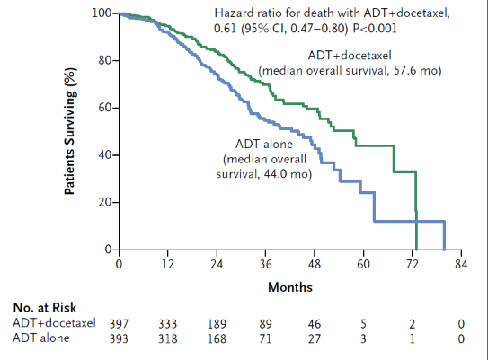
Treatment Intensification Approaches Extend Survival in APC Patients
Median OS with ADT vs ADT + Docetaxel
Figure adapted from Sweeney et al (2015).
Median duration of follow-up was 28.9 months
among all patients in the CHAARTED study comparing ADT alone and ADT plus docetaxel in patients with mHSPC.
Sweeney CJ, et al. N Engl J Med. 2015;373(8):737-746

Slide 16
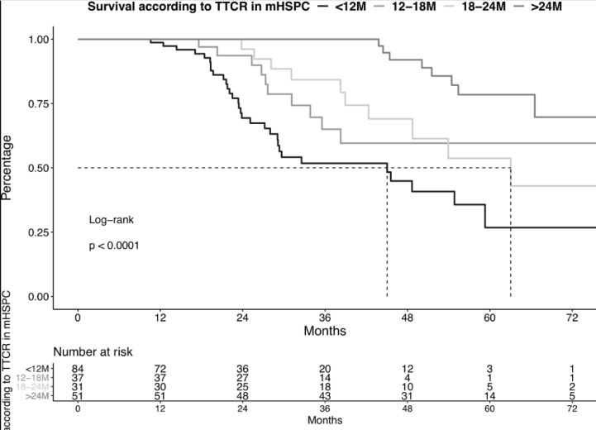
TTCR <12 months confers an OS disadvantage in mHSPC¹
Castrate-resistant disease: defined typically as castrate
serum T levels (≤50 ng/dL) and disease progression
For patients with mHSPC, patients with TTCR <12 months are at highest risk of overall mortality, while those with TTCR >24 months had longest OS¹
ADT combination therapies for mHSPC can potentially²
  Delay the development of CRPC
  Improve QoL and OS
Impact of TTCR on OS
Figure adapted from Wenzel et al (2021).¹
TTCR, time to castration-resistance
1. Wenzel M, et al. Front Oncol. 2021;11:659135. 2. Kyriakopoulos CE, et al. J Clin Oncol. 2018;36(11):1080-1087.

Slide 17
Summary of Pivotal Trials of Treatment Intensification in mHSPC:
Docetaxel
Trial | N | Treatment | Median OS (months) | Median time to CRPC
TRIAL |  |  |  | Overall | bPFS |  | cPFS | FFS
GETUG-AFU¹ | 192 | D + ADT vs ADT | 58.9 vs 54.2 (HR 1.01, p=0.955) | NR | 22.9 vs 12.9 (HR 0.72, p=0.005) |  | 23.5 vs 15.4 (HR 0.75, p=0.015) | NR
CHAARTED² | 790 | D + ADT vs ADT | 57.6 vs 44.0 (HR 0.61; p<0.001) | 20.2 versus 11.7 (HR 0.61, p<0.001) | NR |  | 33.0 versus 19.8 (HR 0.61, p<0.001) | NR
STAMPEDE³ (Arms A, C, & E) | 2962 (ITT) 1817 (M1) | ADT vs D + ADT vs D + ZA + ADT | ITT: 71 vs 81 (HR 0.78, p=0.006) vs 76 (HR 0.82, p=0.022) M1: 45 vs 60 (HR 0.76, p=0.005) vs 55 (HR 0.79, p=0.015) | NR | NR |  | NR | ITT: 20 vs 37 (HR 0.62, p=0.413 × 10^{–13}) vs 36 (HR 0.62, p=0.134 × 10^{–12}) M1: HR 0.61, p=0.283 × 10^{–10}
Addition of docetaxel to ADT improves median OS by about 18 months
AAP, abiraterone acetate with prednisone; ADT, androgen deprivation therapy; Apa, apalutamide; bPFS, biochemical progression-free survival; cPFS, clinical progression-free survival; D, docetaxel; Enza, enzalutamide; FFS, failure-free survival; HR, hazard ratio; mCRPC, metastatic castration-resistant prostate cancer; mHSPC, metastatic hormone-sensitive prostate cancer; ITT, intent-to-treat population; M1, metastatic population;; NE, not estimable; NR, not reported; OS, overall survival; rPFS, radiographic progression-free survival; ZA, zolendronic acid.
1. Gravis G, et al. Lancet Oncol. 2013;14(2):149-158. 2. Sweeney CJ, et al. N Engl J Med. 2015;373(8):737-746. 3. James ND, et al. Lancet. 2016;387(10024):1163-1177.

Slide 18
Summary of Pivotal Trials of Treatment Intensification in mHSPC:
AR Antagonists
Trial | N | Treatment | Median OS (months) | Median time to CRPC
TRIAL |  |  |  | Overall | bPFS | cPFS | rPFS | FFS
LATITIUDE¹ | 1199 | AAP + ADT vs ADT | NE vs 34.7 (HR 0.62, p<0.001) | NR | 33.2 vs 7.4 (HR 0.30, p<0.001) | Pain: NR vs 16.6 (HR 0.70, p<0.001) | 33.0 vs 14.8 (HR 0.47, p<0.001) | NR
STAMPEDE² (Arm G) | 1917 1002 (M1) | AAP + ADT vs ADT | At 3 years ITT: 83% vs 76% (HR 0.63, p<0.001) M1: HR 0.61 (95% CI 0.49–0.75) | ITT: 3-year PFS 80% vs 62% (HR 0.40, p<0.001) | (0.26–0.37) | ITT Symptomatic skeletal event: HR, 0.46; p<0.001 | NR | At 3 years ITT: 75% vs 45% (HR 0.29, p<0.001) M1: HR 0.31 (95%CI 0.26–0.37)
ARCHES³ | 1150 | Enza + ADT vs ADT | NE vs NE (HR 0.81, p=0.3361) | NE vs 13.8 (HR 0.28, p<0.001) | NE vs NE (HR 0.19, p<0.001) | Pain: HR 0.82, p=0.0322 | NE vs 19.0 (HR 0.39, p<0.001) | NR
TITAN⁴ | 1052 | Apa + ADT vs ADT | NE vs NE (HR 0.67, p=0.005) | NR | NE vs 12.9 HR 0.26 (95% CI 0.21–0.32) | Pain: HR 0.83, p=0.12 | NE vs 22.1 (HR 0.48, p<0.001) | NR
ENZAMET⁵ | 1125 | Enza + ADT vs ADT |  | At 3 years: 80% vs 72% | 67% vs 37% HR, 0.39; p<0.001 | 68% vs 41% HR,, 0.40; p<0.001 |  | NR
AAP, abiraterone acetate with prednisone; ADT, androgen deprivation therapy; Apa, apalutamide; AR, androgen receptor; bPFS, biochemical progression-free survival; cPFS, clinical progression-free survival; D, docetaxel; Enza, enzalutamide; FFS, failure-free survival; HR, hazard ratio; mCRPC, metastatic castration-resistant prostate cancer; mHSPC, metastatic hormone-sensitive prostate cancer; ITT, intent-to-treat population; M1, metastatic population;; NE, not estimable; NR, not reported; OS, overall survival; rPFS, radiographic progression-free survival; ZA, zolendronic acid.
1. Fizazi K, et al. N Engl J Med. 2017;377(4):352-360. 2. James ND, et al. N Engl J Med. 2017;377(4):338-351. 3. Armstrong AJ, et al. J Clin Oncol. 2019;37(32):2974-2986. 4. Chi KN, et al. N Engl J Med. 2019;381(1):13-24. 5. Davis ID, et al. N Engl J Med. 2019;381(2):121-131.

Slide 19
Optimal patient selection is a critical component of treatment decision-making, given the availability of multiple options¹⁻⁵
Multiple ADT+ options are now available for management of mHSPC
However, data from randomized adequately-powered prospective head-to-head comparative clinical studies of these options are not available
In the absence of such comparisons, key considerations that can impact the prognosis and/or therapeutic choice in mHSPC include:
  Recurrent disease after initial local therapy for localized PCa or de novo metastatic disease
  Extent of disease (high- vs low-volume)
  Site of metastases and burden
  Symptom burden/ QoL effects
  Genetic testing results
  Patient characteristics (comorbid illness) and preferences
1. Lowrance WT, et al. J Urol. 2021;205(1):14-21. 2. Sheng IY, et al. Drugs Context. 2021;10:2020-10-2. 3. Francini E, et al. Prostate. 2018;78(12):889-895. 4. Cattrini C, et al. Cancers (Basel). 2019;11(9):1355. 5. Damodaran S, et al. J Urol. 2019;201(5):876-885

Slide 20
ADT monotherapy/intensification options in mHSPC need to be individualized¹⁻⁷
Although upfront ADT intensification with docetaxel or AR axis-targeted therapy has been shown to provide OS benefits in patient subsets, treatment selection for individual patients remains challenging
Example of Individualized Approach to ADT Intensification¹
mHSPC
ADT, BSC
Patient Group: Elderly, Fragile, Limited Life Expectancy
Clinical and Molecular Profiling
ADT + PARP Inhibitor/Platinum-Based Therapy
Patient Group: Harboring DNA Damage Repair Mutations
Patient Group:
Low-volume, Low-Risk, Favorable Response to ADT
ADT + AR Axis-Targeted Agents/Docetaxel
Patient Group: Others
ADT
Patient Group: Life Expectancy <10 years
ADT ± AR Axis-Targeted Agents/Docetaxel ± RPx/RT
Patient Group: Life Expectancy ≥10 years
Figure adapted from Harada K et al (2021).¹
ADT, androgen deprivation therapy; AR, androgen receptor; BSC, best supportive care; mHSPC, metastatic hormone-sensitive prostate cancer; PARP, poly (ADP-ribose) polymerase; RPx, radical prostatectomy; RT, radiation therapy.
1. Harada K, et al. Onco Targets Ther. 2021;14:2967-2974. 2. Sathianathen NJ, et al. Eur Urol. 2020;77(3):365-372. 3. Wallis CJD, et al. Eur Urol. 2018;73(6):834-844. 4. Chen J, et al. Front Oncol. 2020;10:519388. 5. Kessel A, et al. Cancer Treat Res Commun. 2021;28:100384. 6. Sheng IY, et al. Drugs Context. 2021;10:2020-10-2. 7. Hofmann MR, et al. Urology. 2021;155:165-171.

Slide 21
ADT intensification is underutilized in real-world practice¹⁻⁴
Despite evidence for improved outcomes with ADT intensification approaches in subsets of patients with mCSPC, ADT intensification – with docetaxel, androgen blockade, or novel hormonal therapies such as the adrenal biosynthesis inhibitor AA or AR inhibitors – is underutilized in real-world practice
  A population-based study of men aged ≥66 years diagnosed with de novo mCSPC between 2014-2019 showed that only a small proportion (12.7%) of patients received intensified treatment¹
  An analysis of Veterans Health Administration (VHA) claims data reported that most mCSPC patients who initiated treatment between 2014 and 2018 were treated with ADT only²
1. Wallis CJD, et al. J Clin Onc. 2021; 39, (6_suppl):50. 2. Freedland SJ, et al. J Clin Onc. 2021; 39, (15_suppl):5073. 3. Freedland SJ, et al. J Clin Onc. 2021; 39, (6_suppl):46. 4. OncLive. ADT Monotherapy in mCSPC. https://www.onclive.com/view/adt-monotherapy-in-mcspc. Published September 7, 2021. Accessed September 22, 2021.

Slide 22
A phase 3 trial with a 2x2 factorial design in men with de novo high-risk mCSPC: Overall survival with abiraterone acetate plus prednisone in PEACE-1^{1,2}
Inclusion criteria:
mCSPC
Distant metastatic disease^{b}
On-study requirement of continuous ADT
ADT ≤3 months permitted
Stratification:
ECOG PS 0 vs 1–2
Site of metastases (LN vs bone vs viscera)
Castration type (Orch vs GnRH agonist vs GnRH antagonist)
SOC^{c} (N=296)
SOC + AA^{d} (N=292)
Primary Endpoint
rPFS
OS
R
1:1:1:1
SOC + RT (N=293)
SOC +RT +AA^{d} (N=292)
ªInternational, multicenter, prospective, randomized trial conducted in 7 countries by the Prostate Cancer Consortium in Europe (PEACE) Consortium; started accruing in 2013.
^{b}Based on presence of ≥1 lesion on bone scan and/or CT scan.
^{c}SOC was initially ADT alone; from 10/2015 to 2017 was SOC arm was ADT +docetaxel per investigator’s discretion; from 2017, accrual restricted to ADT + docetaxel as SOC.
^{d}AA (1000mg/day; 4 tablets of 250 mg [PO] per day) along with prednisone (5mg bid).
AA, abiraterone acetate; CT, computed tomography; LN, lymph node; rPFS, radiologic progression-free survival; RT, radiotherapy; OS, overall survival; SOC, standard of care.
1. Fizazi K, et al. J Clin Onc. 2021;39, (15_suppl):5000. 2. Fizazi K. A phase III trial with a 2x2 factorial design in men with de novo metastatic castration-sensitive prostate cancer: Overall survival with abiraterone acetate plus prednisone in PEACE-1. Oral presentation at: European Society of Medical Oncology; September 16-21, 2021; Virtual Congress. Abstract LBA5_PR.

Slide 23
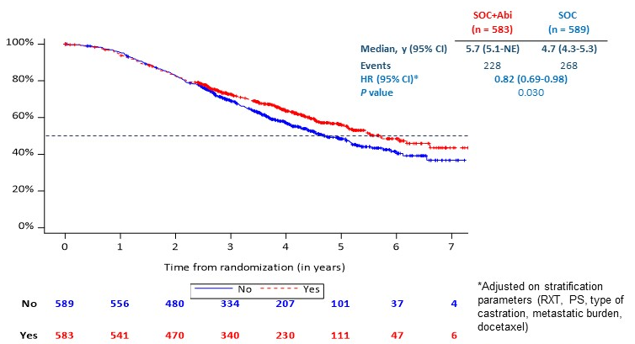
Upfront ADT + Docetaxel + AA Triplet Regimen Improves rPFS in De Novo mCSPC^{1,2}
In first analysis, adding AA to ADT + docetaxel significantly improved rPFS (HR: 0.50 (0.40-0.62), p<0.0001¹
AA addition improved OS²
  In overall population (HR, 0.83; 95% CI, 0.69-0.99, p=0.034; median OS, 5.7 vs 4.7 years)
  In ADT+docetaxel population (HR, 0.75, 95% CI: 0.59-0.96, p=0.021; median OS, NR vs 4.4 years)
Overall Survival
Image kindly provided by Karim Fizaz, University of Paris-Saclay in Villejuif, France.
AA, abiraterone acetate; CI, confidence interval; ESMO, European Society of Medical Oncology; HR, hazard ratio; NE, not estimable; rPFS, radiologic progression-free survival; RT, radiotherapy; OS, overall survival; SOC, standard of care.
1. Fizazi K, et al. J Clin Onc. 2021;39, (15_suppl):5000. 2. Fizazi K. A phase III trial with a 2x2 factorial design in men with de novo metastatic castration-sensitive prostate cancer: Overall survival with abiraterone acetate plus prednisone in PEACE-1. Oral presentation at: European Society of Medical Oncology; September 16-21, 2021; Virtual Congress. Abstract LBA5_PR.

Slide 24
Selected Ongoing Trials of ADT Combinations in mHSPC
NCT | Phase | N | Treatment | Primary end point | Status
NCT02799602 | III | 1300 | Daro + ADT + D vs ADT + D | OS | Recruiting
NCT03436654 | II | 76 | ADT + Apa vs ADT + Apa + AAP | pCR and MRD | Recruiting
NCT02867020 | II | 126 | ADT+ Apa vs Apa vs Apa + AAP | Number of patients with undetectable PSA at week 25 | Recruiting
NCT01957436 | III | 1173 | ADT + D (arm A) vs ADT + AA/P + D (arm B) vs arm A + RT (arm C) vs arm B + RT (arm D) | OS and PFS | Active, not recruiting
NCT03940235 | II | 150 | SBRT vs SBRT + ADT | PFS | Recruiting
NCT 03934840 | III | 61 | ADT + carboplatin + cabazitaxel × 6 cycles followed by ADT + AAP | Percentage of patients with PSA or radiographic progression at 1 year | Recruiting
AAP, abiraterone acetate with prednisone; ADT, androgen deprivation therapy; Apa, apalutamide; AR, androgen receptor; D, docetaxel; Daro, darolutamide; Enza, enzalutamide; mHSPC, metastatic hormone-sensitive prostate cancer; MRD, minimal residual disease; OS, overall survival; pCR, pathologic complete response; PFS, progression-free survival; PSA, prostate-specific antigen; ;SBRT, stereotactic body radiation therapy.

Slide 25
Key Principles in Guideline-Directed mCSPC Management¹⁻⁴
ADT is the backbone of mCSPC management
Staging and prognosis is predicated on clinical and disease characteristics
Therapeutics options, including potential clinical trial enrollment, to be discussed with patients in the context of a multidisciplinary team
ADT initiation is recommended, alone, or in combination with:²
  Preferred Regimens:
  Apalutamide (category 1)
  Abiraterone (category 1)
  Docetaxel 75 mg/m² for 6 cycles (category 1)
  Enzalutamide (category 1)
  External beam radiation therapy to the primary tumor for low-volume M1
1. Lowrance WT, et al. J Urol. 2021;205(1):14-21. 2. . Schaeffer E, et al. NCCN Clinical Practice Guidelines in Oncology. Prostate Cancer. Version 2.2021. https://www.nccn.org/professionals/physician_gls/pdf/prostate.pdf. Published February 17, 2021. Accessed September 18,2021. 3. Malone S, et al. Can Urol Assoc J. 2019;14(2):50-60. 4. Cornford P, et al. Eur Urol. 2021;79(2):263-282.

Slide 26
Understanding of the adverse events (AEs) with ADT is critical
While ADT is integral to long-term disease control in PCa management, the drop in serum T levels is associated with AEs that can have QoL impacts¹⁻¹⁰
AEs/toxicities associated with ADT include:
  Metabolic effects²
  Musculoskeletal effects³
  Cognitive and neuropsychiatric effects^{4,5}
  Sexual function⁶
  Cardiovascular morbidity/risk⁷⁻¹⁰
Major AEs Associated with ADT¹
Symptom | Notes
Hot flushes | Very common; can be mitigated using medications such as venlafaxine or gabapentin
Osteoporosis | Very common; estimated annual fracture risk of 1%−3%; Calcium/vitamin D supplements
Fatigue | Very common; regular exercise may be beneficial; occurs independent of anemia or depression
Metabolic syndrome | Common; weight gain seen within 1 year of ADT initiation; insulin resistance, dyslipidemia, and sarcopenic obesity reported
Erectile dysfunction | Common; both erectile dysfunction and reduced libido can have significant QoL impacts; sexual health counseling referral may be beneficial
Cardiovascular disease | Unresolved; conflicting data from meta-analyses and observational studies; include primary and secondary CVD prevention measures
Thromboembolic disease | Unresolved; meta-analyses show association between VTE and ongoing ADT use, but tobacco use and acute hospitalization may be confounding factors
Table adapted from Patil and Bernard (2018).¹
1. Patil T and Bernard B. Oncology (Williston Park). 2018; 32(9):470-4, CV3. 2. Tzortzis V, et al. Hormones (Athens). 2017;16(2):115-123. 3. Bargiota A, et al. J BUON. 2020;25(3):1286-1294. 4. Gunlusoy B, et al. Urology. 2017;103:167-172. 5. Siebert AL, et al. Eur Urol Focus. 2020;6(6):1170-1179. 6. Corona G, et al. Int J Impot Res. 2021;33(4):439-447. 7. Challa AA, et al. Curr Treat Options Oncol. 2021;22(6):47. 8. Hu JR, et al. Arterioscler Thromb Vasc Biol. 2020;40(3):e55-e64. 9. Muniyan S, et al. Biochim Biophys Acta Rev Cancer. 2020;1874(1):188383. 10. Lopes RD, et al. Lopes RD, et al. Circulation. 2021;10.1161/CIRCULATIONAHA.121.056810.

Slide 27
Metabolic Complications Associated with ADT¹⁻²
Androgens are key drivers of body composition in men
Metabolic complications associated with ADT include:
  Weight gain (median weight gain of 1 to 2 kg after 1 year of treatment with ADT)
  Insulin resistance (and potential development or exacerbation of pre-existing diabetes)
  Dyslipidemia and increased risk for metabolic syndrome; downstream risk of increased cardiovascular complications
  Loss of lean muscle mass and sarcopenic obesity (and associated fall risk)
1. Patil T and Bernard B. Oncology (Williston Park). 2018; 32(9):470-4, CV3. 2. Tzortzis V, et al. Hormones (Athens). 2017;16(2):115-123.

Slide 28
Strategies for Managing Metabolic Complications¹⁻²
  Review the risk of metabolic complications with patients
  Referral to dietician
  Application of formal/structured exercise programs
  Assessment of fall risk, especially in frail patients
  Risk-adapted diabetes screening and management as per American Diabetes Association guidelines
1. Patil T, Bernard B. Oncology (Williston Park). 2018; 32(9):470-4, CV3. 2. Tzortzis V, et al. Hormones (Athens). 2017;16(2):115-123.

Slide 29
Impact of ADT on Muscle Tissue¹⁻²
The precise mechanism of ADT-mediated adverse effects on muscle tissue has not yet been delineated; however, many factors may contribute:
  Dysregulation of factors that activate anabolic pathways and activation of negative regulators of muscle mass development
  T suppression-mediated reduction in maximum specific force in type I muscle fibers and loss of calcium-sensitivity
  Impact on other cells, such as fibroblasts, within skeletal muscles, which alters muscle regeneration
1. Patil T, Bernard B. Oncology (Williston Park). 2018; 32(9):470-4, CV3. 2. Tzortzis V, et al. Hormones (Athens). 2017;16(2):115-123.

Slide 30
Impact of ADT on Skeletal Tissue¹⁻²
Sex steroids play an important role in bone remodeling
  T stimulates osteoblast proliferation and inhibits apoptosis of osteoblasts and osteoclasts
  Aromatase converts T to estradiol, which regulates bone mineralization
  ADT-mediated T suppression and resulting estradiol reduction affects bone mineralization, increasing fracture risk
1. Patil T, Bernard B. Oncology (Williston Park). 2018; 32(9):470-4, CV3. 2. Tzortzis V, et al. Hormones (Athens). 2017;16(2):115-123.

Slide 31
Muscle-Related AEs Associated with ADT¹⁻²
Muscle-related AEs associated with ADT include:
  Lean body mass reduction (1%-4%; mainly from upper/lower limbs) and increase in fat mass (10%-20%) within first 12 months of ADT
  Decline in muscle strength and endurance (mainly upper limbs) within first 6 months of treatment
  Effects on muscle tissue is non-uniform across various muscle groups; for instance, ADT is associated with significantly greater increases in intramuscular fat within the gluteus maximus, but no significant change in gluteus medius and calf muscle volume at 12 months, compared to controls
1. Patil T, Bernard B. Oncology (Williston Park). 2018; 32(9):470-4, CV3. 2. Tzortzis V, et al. Hormones (Athens). 2017;16(2):115-123.

Slide 32
Skeletal AEs Associated with ADT¹⁻²
Skeletal AEs associated with ADT include:
  Decline in bone mass density (BMD), with a maximum decrease of 5%-10% within the first year
  Annual bone loss of 2%-8% for the lumbar spine and 1.8%-6.5% for the femoral neck
  Increased risk for osteoporotic fractures; around 1 in 5 men receiving ADT experience an osteoporotic fracture within the first 5 years of treatment
1. Patil T, Bernard B. Oncology (Williston Park). 2018; 32(9):470-4, CV3. 2. Tzortzis V, et al. Hormones (Athens). 2017;16(2):115-123.

Slide 33
Preventive Approaches for Managing ADT-Associated Musculoskeletal AEs¹⁻³
Muscle Health
Supervised resistance and aerobic exercises, 3-5 times/week for 12-24 weeks
Lifestyle modifications
Bone health
Supervised resistance exercises
Lifestyle modifications (eg, smoking cessation, decreasing alcohol intake)
Calcium and vitamin D supplementation
DEXA scan at baseline (within 6 months of initiating ADT) and at least once every 2 years for follow‐up; evaluate fracture risk using the FRAX calculator
Bisphosphonates/RANK-L inhibitors when needed
1. Bargiota A, et al. J BUON. 2020;25(3):1286-1294. 2. Schaeffer E, et al. NCCN Clinical Practice Guidelines in Oncology. Prostate Cancer. Version 2.2021. https://www.nccn.org/professionals/physician_gls/pdf/prostate.pdf. Published February 17, 2021. Accessed September 18,2021. 3. Shore ND, et al. Prostate. 2020;80(6):527-544.

Slide 34
Neuropsychiatric Effects Associated with ADT¹⁻⁴
Studies suggest an association between ADT and depression and/or cognitive dysfunction
  However, depression is common in men with cancer and
  The impact of ADT on cognitive dysfunction is unclear
In the NCCN guidelines, the potential link between ADT and depression and cognitive function are noted²
1. Patil T, Bernard B. Oncology (Williston Park). 2018; 32(9):470-4, CV3. 2. Schaeffer E, et al. NCCN Clinical Practice Guidelines in Oncology. Prostate Cancer. Version 2.2021. https://www.nccn.org/professionals/physician_gls/pdf/prostate.pdf. Published February 17, 2021. Accessed September 18, 2021. 3. Shore ND, et al. Prostate. 2020;80(6):527-544. 4. Izard JP, Siemens DR. Eur Urol Focus. 2020;6(6):1162-1164.

Slide 35
Managing ADT-Associated Neuropsychiatric Effects¹⁻⁴
Specific guidelines or standardized tools for evaluation or intervention of patients receiving ADT for these effects are currently not available
  It is important for clinicians and patients to be aware/informed of the risk of depression
  Routine discussions of mental health concerns, including depression and/or memory issues, should be considered for men receiving ADT
  Annual referral for neurocognitive assessment is recommended for patients ≥70 years who have been on ADT for ≥2 years
1. Patil T, Bernard B. Oncology (Williston Park). 2018; 32(9):470-4, CV3. 2. Schaeffer E, et al. NCCN Clinical Practice Guidelines in Oncology. Prostate Cancer. Version 2.2021. https://www.nccn.org/professionals/physician_gls/pdf/prostate.pdf. Published February 17, 2021. Accessed September 18,2021. 3. Shore ND, et al. Prostate. 2020;80(6):527-544. 4. Izard JP, Siemens DR. Eur Urol Focus. 2020;6(6):1162-1164.

Slide 36
Effects of ADT on Sexual Function
Loss of libido and erectile dysfunction (ED) are major sexual health concerns associated with ADT
  Degree of ED while on ADT is affected by pretreatment sexual function and libido changes
  In patients previously able to attain an erection, pharmacological, mechanical, or other interventions may be considered based on patient characteristics and preferences
  As sexual function is impacted by physiology and psycho-emotional issues, referral to psychology or counseling services with a focus on sexual health may be considered for the patient and their partners
Patil T, Bernard B. Oncology (Williston Park). 2018; 32(9):470-4, CV3. 2.

Slide 37
ADT-Associated Vasomotor Symptoms^{1,2}
Vasomotor symptoms, primarily hot flashes, are reported in up to 90% of men on ADT
Agents in use for treatment of hot flashes in men receiving ADT are associated with side effects
Medication | Common doses used for hot flashes | Common AEs
Megestrol acetate (Megace) | 20 mg PO qd | Weight gain, CV risk (DVT/PE), cost
Venlafaxine (Effexor; Effexor XR) | 75 mg PO qd | Feelings of being activated/jittery if not titrated properly Suicidal ideation Withdrawal issues
Paroxetine (Paxil) | ⋯ | Weight gain, loss of libido, suicidal ideation, withdrawal issues
Clonidine (Catapres; Kapvay) | ⋯ | ⋯
Gabapentin (Neurontin) | ⋯ | Drowsiness, dyspepsia
Medroxyprogesterone (Depo‐Provera; Provera) | 150 mg IM | Increased risk of thrombotic issues
Table adapted from Shore ND, et al. Prostate. 2020;80(6):527-544.
CV, cardiovascular; DVT, deep vein thrombosis; IM, intramuscular; PE, pulmonary embolus; PO, per os; qd, once daily.
Patil T, Bernard B. Oncology (Williston Park). 2018; 32(9):470-4, CV3. 2. Shore ND, et al. Prostate. 2020;80(6):527-544.

Slide 38
ADT-Related Side Effects and Strategies to Mitigate Them
Key Takeaways
Weight gain/risk of metabolic syndrome
  Caloric control/structured exercise programs
Bone health issues
  Vitamin D/calcium supplementation/structured exercise programs
Fatigue and muscle mass loss
  Structured exercise programs
Impact on libido/sexual health issues
  Pharmacological, mechanical, or other interventions may be considered for ED; Sexual health counseling
Hot flashes
  Pharmacological approaches can be considered
Cardiovascular morbidity?

Slide 39
ADT-Associated CV Morbidity
Retrospective analysis of pooled data from randomized controlled trials (RCTs) have also attempted to clarify the potential differences in CVD risk profiles of the 2 different classes of ADT − GnRH agonists and antagonists¹⁻³
Recently published data from the first RCT comparing the relative cardiovascular safety of GnRH agonists (leuprolide) to antagonists (degarelix), the PRONOUNCE study, showed no difference in MACE between patients treated with these 2 classes of ADT⁴
In the HERO study, which compared the GnRH agonist leuprolide to the oral GnRH antagonist relugolix, the incidence of MACE was lower with the antagonist than with the agonist⁵
CVD, cardiovascular disease; MACE, major adverse cardiovascular event (composite of death, myocardial infarction, or stroke) through 12 months; NCCN, National Comprehensive Cancer Network.
1. Challa AA, et al. Curr Treat Options Oncol. 2021;22(6):47. 2. Hu JR, et al. Arterioscler Thromb Vasc Biol. 2020;40(3):e55-e64. 3. Abufaraj M, et al. Eur Urol. 2021;79(1):44-53. 4. Lopes RD, et al. Circulation. 2021;10.1161/CIRCULATIONAHA.121.056810. 5. Shore ND, et al. N Engl J Med. 2020;382(23):2187-2196.

Slide 40
PRONOUNCE- First Prospective Study Comparing the ASCVD Risk Profiles of GnRH Agonists and Antagonistsª
Inclusion criteria:
Men with histologically confirmed adenocarcinoma of the prostate
Concomitant ASCVD^{b}
Scheduled for ≥12 months of ADT
Degarelix^{d}
N =
Primary Endpoint
Time to first adjudicated MACE^{f}
R^{c}
1:1
Leuprolide^{e}
N =
ªInternational, multicenter, prospective, randomized, open-label trial with blinded endpoint adjudication conducted at 113 sites in 12 countries.
^{b}ASCVD was defined as prior history of MI; previous percutaneous or surgical revascularization of the carotid, coronary, iliac, femoral, or popliteal arteries; previous documentation of a stenosis of >50% in these vessels by angiography or carotid ultrasound; or peripheral artery disease with a diminished ankle-brachial pressure index <0.9.
^{c}Randomization was stratified by baseline age (<75 or ≥75 years) and region (North America or other) in fixed blocks of 4.
^{d}Patients received a 240 mg subcutaneous starting dose of degarelix followed by 11 maintenance doses of 80 mg injections every 28 days.
^{e}Patients received a 22.5-mg intramuscular injection of leuprolide followed by 3 similar injections every 84 days.
^{f}Composite of all-cause death, MI, or stroke through 12 months.
ASCVD, atherosclerotic cardiovascular disease; MACE, major adverse cardiovascular event; MI, myocardial infarction.
Lopes RD, et al. Circulation. 2021;10.1161/CIRCULATIONAHA.121.056810.

Slide 41
PRONOUNCE: Summary of Findings
Baseline characteristics were balanced between the study groups
  Median age was 73 years
  49.8% had localized prostate cancer
  26.3% had locally advanced disease
  20.4% had metastatic disease
MACE occurred in
  15 (5.5%) patients assigned to degarelix and
  11 (4.1%) assigned to leuprolide (HR, 1.28, 95% CI 0.59–2.79; p=0.53)
No difference in MACE at 1 year with degarelix and leuprolide
Study terminated prematurely due to smaller than planned enrollment numbers
Lopes RD, et al. Circulation. 2021;10.1161/CIRCULATIONAHA.121.056810. 8.

Slide 42
Mr. G (Case 1)
68-year-old male, last seen by a physician when he was 16 years old
Presents to local ER with 6 months of progressive back pain and lower urinary tract symptoms, he notes a 25-lb weight loss and worsening fatigue (ECOG
PS 1)
In the ER, hgb 9.8, creatinine 2.5, glucose 324, Alk phos 724
Rock hard prostate on exam, PSA 123, Foley placed, creatinine improved
TRUS bx: high volume Gleason 4 + 4 (grade group 4) PCa
CT/bone scan obtained
ALK phos, alkaline phosphatase; CT, compute dtomography; ECOG, Eastern Cooperative Oncology Group; ER, emergency room; hgb, hemoglobin; PS, performance status; PSA, prostate-specific antigen; TRUS bx; transrectal ultrasound biopsy.

Slide 43
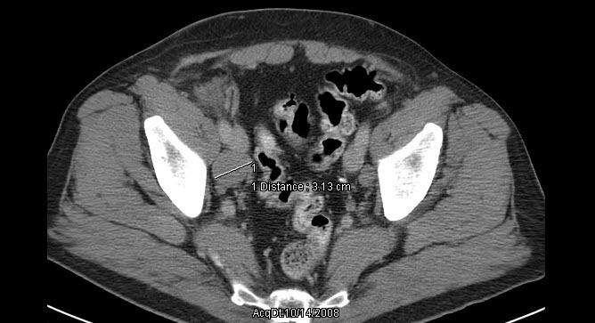
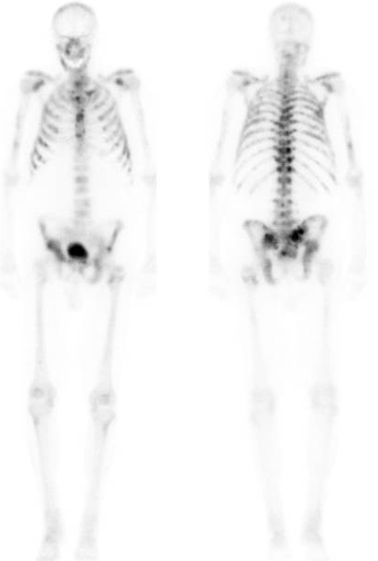
Mr. G: Imaging Results
Abdominal and Pelvic CT
Bone Scan
Evidence of pelvic adenopathy
Extensive disease in spine, ribs, and pelvis

Slide 44
Current State of PCa Care
Key Takeaways
Key considerations for prognosis and/or therapeutic choice in mHSPC include – recurrent disease after initial local therapy or de novo metastatic disease; extent of disease; site of metastases and burden; symptom burden/ QoL effects; genetic testing results; and patient preferences
While ADT alone may be appropriate for some patients, treatment intensification based on ADT with docetaxel or AR-axis targeted therapies are important for upfront management of mHSPC
Choice of ADT intensification needs to be individualized based on patient-, disease-, and treatment-related factors

Slide 45
Current State of PCa Care
Key Takeaways (continued)
Understanding and management of ADT-associated AEs are critical components of the treatment plan
ADT-associated toxicities/AEs include metabolic, musculoskeletal, and cognitive and neuropsychiatric, and sexual function effects
ADT-associated cardiovascular morbidity/risk remains an unresolved issue requiring further studies
Differences between the cardiovascular morbidity/risk profiles of GnRH agonists and antagonists are need to be compared in head-to-head studies, such as the PRONOUNCE trial

Slide 46
Module 3
Exploring Optimal Therapeutic Options

Slide 47
Summary of GnRH Agonists for PCa Management
Drug | Indication(s) | Formulation and Dosing | Contraindications
Goserelin | Locally advanced and metastatic PCa | Injection into the abdominal wall (10.8 mg every 12 weeks) | Depression, diabetes, hypertension, metabolic bone disease, risk of spinal cord compression, risk of ureteral obstruction
Triptorelin | Advanced PCa | Intramuscular injection (3 mg every 4 weeks, 11.25 mg every 3 months, 3.75 mg every 4 weeks or 22.5 mg every 6 months) | Depression, metabolic bone disease
Histrelin | Advanced PCa | Subcutaneous implant containing 50 mg of histrelin acetate | Diabetes, high cholesterol, high blood pressure, chronic heart failure, smoking, depression
Leuprolide | Locally advanced (in conjunction with RT in HR patients) and metastatic PCa | Subcutaneous or intramuscular injection (3.75 mg every month or 11.25 mg every 3 months) | Diabetes, family history of osteoporosis, metabolic bone disease, risk of spinal cord compression, risk of ureteric obstruction
Buserelin | Advanced PCa | Subcutaneous injection (500 μg every 8 h for 7 days) followed by 200 μg intranasal 6 times a day | Depression, diabetes, hypertension, patients with metabolic bone disease
†Some of the treatments within this table might have a country or regional approval status only, but are included for completeness.
RT, radiation therapy.
Table adapted from Van Poppel H, Abrahamsson PA. Int J Urol. 2020;27(10):830-837.

Slide 48
Summary of GnRH Antagonists for PCa Management
Drug | Indication(s) | Formulation and Dosing | Contraindications
Abarelix | Advanced PCa | Intramuscular injection (100 mg on days 1, 15, 29 and then every 4 weeks) | Patients with a known hypersensitivity to any of the components in abarelix, congenital QT prolongations, patients taking class IA or class III antiarrhythmic medications
Degarelix | Advanced hormone-dependent PCa | Two subcutaneous injections of 120 mg followed by an injection into the abdominal region of 80 mg every 4 weeks | Patients with prior hypersensitivity reactions to degarelix, diabetes, susceptibility to QT-interval prolongation
Relugolix*,§ | Advanced PCa | A loading dose of 360 mg on the first day of treatment followed by 120 mg taken orally once daily, at approximately the same time each day | None noted
*Relugolix gained FDA approval for treatment of advanced PCa in December 18, 2020, based on data from the HERO study.¹
§Please refer to link to prescribing information for further details.
Table adapted from Van Poppel H, Abrahamsson PA. Int J Urol. 2020;27(10):830-837.

Slide 49
Summary of Oncologic Outcomes with GnRH Agonists and Antagonists
GnRH agonists and antagonists gained approval for Pca indications based on their ability to induce T suppression
Overall, GnRH agonists and antagonists appear equally effective in patients with advanced PCa¹
  For instance, in a phase 3 study, both GnRH agonist (abarelix) and antagonist (leuprolide) were equally effective in reducing serum PSA and maintaining castrate T levels²
  Meta-analyses demonstrate:^{3,4}
    No significant difference in PSA progression between GnRH antagonists and agonists
    Associations of GnRH antagonists with lower mortality rates than agonists
1. Schaeffer E, et al. NCCN Clinical Practice Guidelines in Oncology. Prostate Cancer. Version 2.2021. https://www.nccn.org/professionals/physician_gls/pdf/prostate.pdf. Published February 17, 2021. Accessed September 18,2021. 2. Trachtenberg J, et al. J Urol. 2002;167(4):1670-1674. 3. Abufaraj M, et al. Eur Urol. 2021;79(1):44-53. 4. Hosseini SA, et al. Med J Islam Repub Iran. 2016;30:317.

Slide 50
Summary of Oncologic Outcomes with GnRH Agonists and Antagonists (continued)
In patients presenting with symptomatic metastatic hormone-naïve disease, antagonists may offer potential clinical benefits over agonists¹
Orchiectomy may be safer than an GnRH agonist¹
  Orchiectomy associated with lower risk of fracture, PAD, and cardiac-related complications³
  Risk for diabetes, DVT, PE, and cognitive disorders similar for orchiectomy and GRH agonists³
DVT, deep vein thrombosis; PAD, peripheral arterial disease; PE, pulmonary embolism.
1. Clinton TN, et al. Expert Opin Pharmacother. 2017;18(8):825-832. 2. Schaeffer E, et al. NCCN Clinical Practice Guidelines in Oncology. Prostate Cancer. Version 2.2021. https://www.nccn.org/professionals/physician_gls/pdf/prostate.pdf. Published February 17, 2021. Accessed September 18,2021. 3. Kolinsky M, de Bono JS. Eur Urol. 2016;69(5):841-843.

Slide 51
Summary of AEs/Toxicities with GnRH Agonists and
Antagonists¹⁻³
To date, GnRH agonists are a common therapeutic option for ADT in Pca
There are mechanistic differences between the GnRH agonists and antagonists
GnRH agonists, compared to antagonists, are associated with:
Lower impact on libido
Lower incidence of hot flushes, ED, back pain, weight gain, and constipation
Lower injection site reactions
GnRH antagonists, compared with agonists, are associated with:
Significantly lower overall mortality
Lower CV events? (based on data from trials with short follow-up duration)
CV, cardiovascular; ED, erectile dysfunction.
1. . Van Poppel H, Abrahamsson PA. Int J Urol. 2020;27(10):830-837. 2. Abufaraj M, et al. Eur Urol. 2021;79(1):44-53. 3. Sciarra A, et al. Front Endocrinol (Lausanne). 2021;12:695170. 4. Ma C, et al. Minerva Urol Nephrol. 2021;73(3):276-282

Slide 52
HERO: A Phase 3 Study Comparing Relugolix to Leuprolide
Eligibility Crieria | No.ª | Treatment Arms | Primary Endpoint | Follow-up duration
CSPC including: Biochemical or clinical relapse following definitive treatment Newly diagnosed mCSPC Advanced localized disease unlikely to be cured by RT or surgery Prior ADT allowed if <18 months and discontinued >3 months | 931 | Relugolix (120 mg oral daily); n=622 Or Leuprolide (22.5 mg subcutaneous every 3 months); n=308 | Sustained castration rate 96.70% with relugolix vs 88.80% with leuprolide; difference of 7.9% (4.1 to 11.8; P <0.001 for superiority) | 48 weeks
ªNumber of patients enrolled in the study
CI, confidence interval; CV, cardiovascular; HR, hazard ratio.
Shore ND, et al. N Engl J Med. 2020;382(23):2187-2196.

Slide 53
HERO: Summary of Findings
Secondary endpoints:
Cumulative probability of castration on day 4 (relugolix vs leuprolide; 56.0% vs 0%) and on day 15 (98.7% vs 12.0%)
T suppression to profound castrate levels (<20 ng per deciliter) on day 15 (78.4% vs 1.0%)
Confirmed PSA response at day 15 79.4% vs 19.8% (p<0.001)
All key secondary end points showed superiority of relugolix over leuprolide (p<0.001)
Summary of AEs:
Hot flash was the most common AE in both groups (54.3% vs 51.6%)
Diarrhea higher with relugolix than leuprolide (12.2% vs 6.8%)
Fatal events reported in 1.1% vs 2.9%
MACE after 48 weeks of treatment was 2.9% (exact 95% CI, 1.7 to 4.5) vs 6.2% (exact 95% CI, 3.8 to 9.5)
Incidence rates were consistent with a 54% lower risk (hazard ratio, 0.46; 95% CI, 0.24 to 0.88) of MACE with relugolix than leuprolide
Shore ND, et al. N Engl J Med. 2020;382(23):2187-2196.

Slide 54
Oral Relugolix Approved for Treatment of APC Patients
Relugolix is the first and only oral GnRH antagonist approved by the US FDA for the treatment of patients with APC
Approval was based on data from the HERO study
  Relugolix induced rapid and sustained castration superior to that induced with leuprolide
  Difference in proportion of patients with castration through 48 weeks was 7.9%; 95% CI, 4.1 to 11.8; P<0.001
  Proportion of patients with castrate T levels on day 4 was 56.0% with relugolix and 0% with leuprolide
  Incidence of MACE was 2.9% in the relugolix group, compared to 6.2% in the leuprolide group (HR, 0.46; 95% CI, 0.24 to 0.88)
  In the subgroup of patients with a reported medical history of MACE, MACE incidence was 3.6% vs 17.6%
CI, confidence interval; CV, cardiovascular; HR, hazard ratio.
Shore ND, et al. N Engl J Med. 2020;382(23):2187-2196.

Slide 55
Exploring Optimal Therapeutic Options
Key Takeaways
GnRH agonists and agonists, which are currently approved for ADT, act through different MOAs
Overall, GnRH agonists and antagonists appear equally effective in patients with advanced Pca
Based on key differences in their clinical effects and safety profiles, choice of class of agent for ADT needs to be individualized
Additional considerations for optimizing therapeutic options include disease features, patient characteristics and preferences, and treatment-related factors
The first oral GnRH antagonist, relugolix, was approved for treatment of advanced Pca late last year
The issue of CV morbidity and mortality with ADT, and differences between agonists and antagonists, continues to be an important area of investigation in Pca management

Slide 56
Mr. N (Case 2)
59-year-old male, positive family history of PCa, screening PSA 6.6, prostate exam unremarkable
TRUS bx: Gleason 4+3=7 (grade group 3)
Robotic-assisted laparoscopic radical prostatectomy
  Gleason 4+3=7 (grade group 3)
PSA 3 months post op, undetectable
PSA 18 months 0.35
PSA 19 months 0.69
Recovered continence, potent with meds, ECOG PS 0, hypertensive on 2 medications, elevated lipids on medications
ECOG, Eastern Cooperative Oncology Group; PS, performance status; PSA, prostate-specific antigen; TRUS bx; transrectal ultrasound biopsy.

Slide 57
Module 4:
Patient Preferences: Preserving Wellbeing and Optimizing Treatment

Slide 58
Mr. T (Case 3)
77-year-old with recently diagnosed high volume Gleason 4+4 (Grade Group 4), iPSA 38 relocates into your community
Bone scan/CT imaging without evidence of metastatic disease
PMH s/p MI x 2, cardiac defibrillator in place, hypertension (3 medications), T2DM, hyperlipidemia (2 medications)
ECOG PS 1-2
Newly married, wants to be aggressive with regards disease management
CT, computed tomography; ECOG, Eastern Cooperative Oncology Group; MI, myocardial infarction; PMH, past medical history; PS, performance status; PSA, prostate-specific antigen; T2DM, type 2 diabetes mellitus; TRUS bx; transrectal ultrasound biopsy.

Slide 59
END

