Slide 1
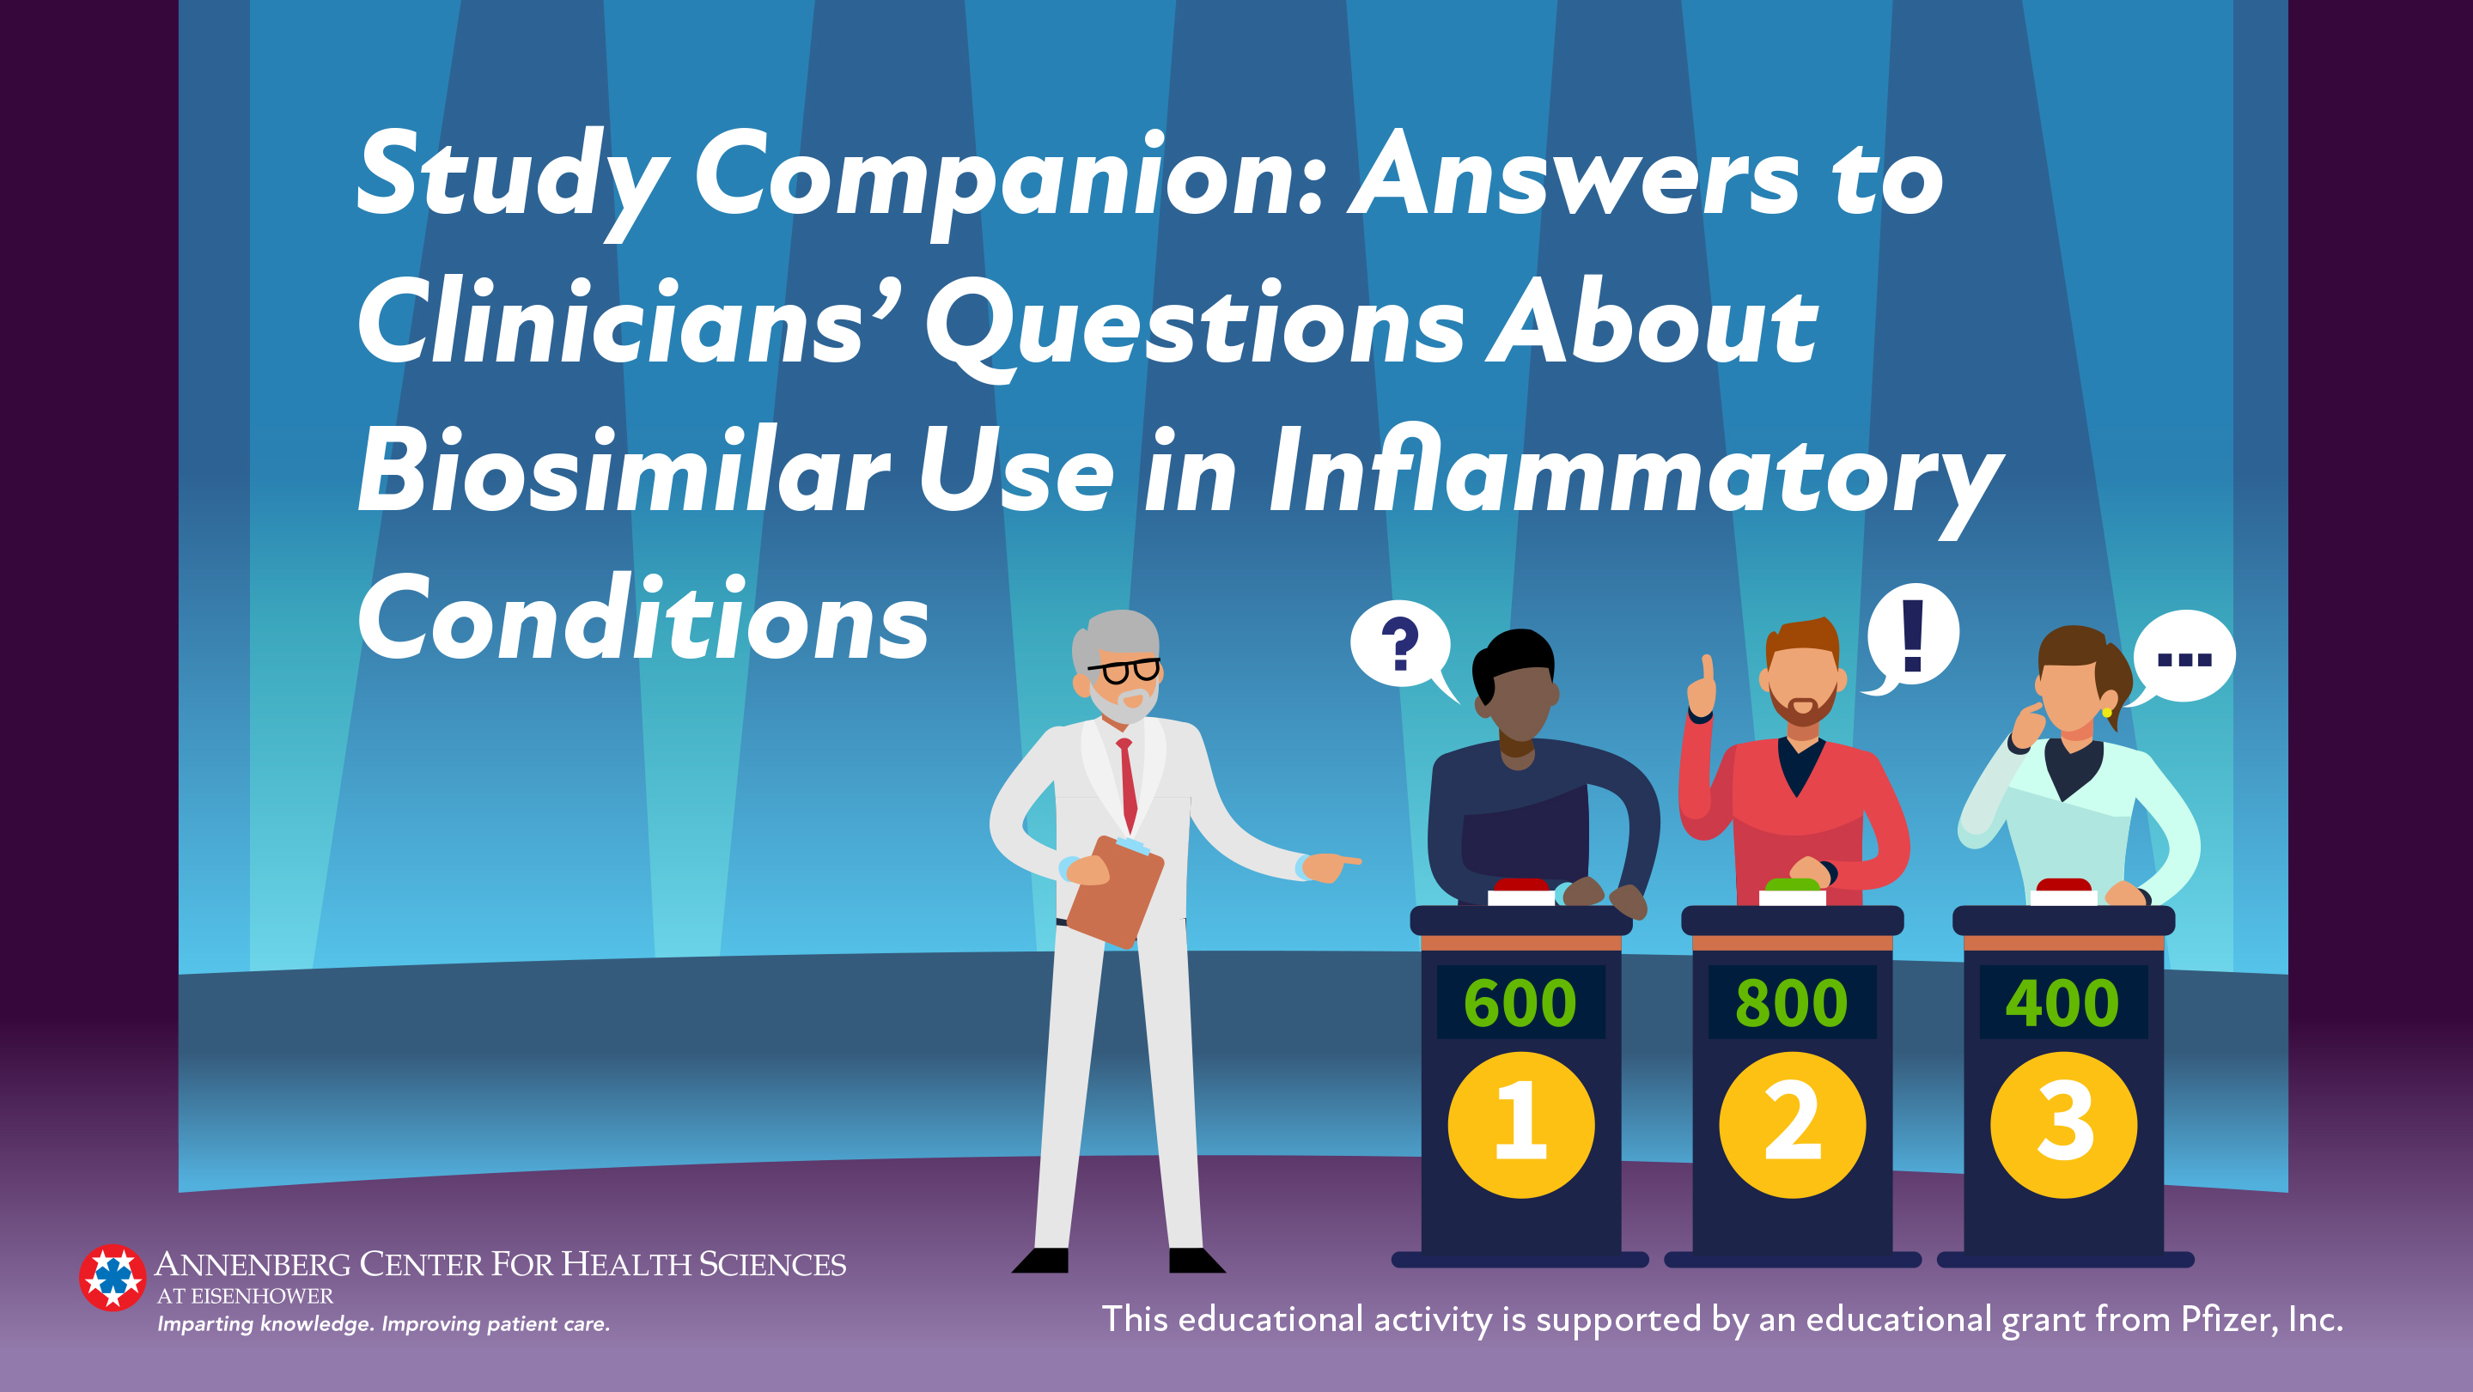

Slide 2
Category 1: Defining Terms

Slide 3
Clue: A biologic product with no clinically meaningful differences from its reference product
What is…
A biosimilar

Slide 4
A biosimilar is a biological product that:^{1,2}
  Is highly similar to the RP notwithstanding minor differences in clinically inactive components; and
  Has no clinically meaningful differences from the FDA-approved RP in terms of safety, purity, potency.
Biosimilars are:
  Approved through a specific regulatory pathway that involves analytical and clinical assessments to assess function, safety, pharmacokinetics, and immunogenicity relative to the RP.
  Not intended to improve on the performance of the RP and thus, are not second-generation biologics.
RP, reference product

Slide 5
Clue: The FDA-approved biologic product against which a biosimilar is evaluated
What is a…
Reference product

Slide 6
A reference product is:
  The biological product licensed by the FDA against which a biosimilar is evaluated.^{1,3}
    Approval was based on an extensive development program that includes phase 3 clinical trials to establish its safety and efficacy.
  Often referred to as the originator or innovator product.⁴
A proposed biosimilar is evaluated in comparison to the RP to ensure that it is highly similar and has no clinically meaningful differences.
A biosimilar may be a cost-saving alternative to the RP.
RP, reference product

Slide 7
Clue: The addition of this to the nonproprietary name of the reference product is required to identify biosimilar products
What is…
A 4-letter suffix

Slide 8
The RP and biosimilar share a proper name (ie, the core or nonproprietary name assigned to the RP when it was approved)
  Related biologics are differentiated by the addition of a unique 4-letter suffix.⁵⁻⁷
  The primary purpose of this naming convention is to promote patient safety by ensuring a mechanism to accurately dispense and monitor biologic products.⁵
Example: -rzaa is appended to the proper name for the risankizumab RP, risankizumab-rzaa
  If a risankizumab biosimilar is approved, it will have a unique 4-letter suffix.
Exception:
  Some biologics were approved before this naming convention was established, so that some RPs were not assigned their own suffix.⁶
RP, reference product

Slide 9
Clue: The largest difference between a biosimilar and its reference product that is clinically acceptable
What is the…
Equivalence margin

Slide 10
Equivalence margin defined as:
  Largest difference between a biosimilar candidate and its RP that is clinically acceptable.⁸
The endpoints for studies designed to establish equivalence of a biosimilar candidate and its RP are chosen to demonstrate that the proposed biosimilar is neither inferior nor superior to the RP in terms of each endpoint.¹
In clinical trials of biosimilars approved to treat inflammatory diseases, equivalence margins were established for clinical endpoints such as the percentage who achieve American College of Rheumatology 20 (ACR20) or Psoriasis Area and Severity Index 75 (PASI75).⁹
RP, reference product

Slide 11
Equivalence Margins in Clinical Trials of Rheumatology Biosimilars
Compound | Biosimilar | Study Size (N) | Endpoint | Equivalence Margin
Etanercept | Etanercept-ykro (SB4) | 596 | ACR20 responders | -15 to +15
 | Etanercept-szzs | 531 | PASI75 responders | -18 to +18
Infliximab | Infliximab-dyyb | 606 | ACR20 responders | -15 to +15
 | Infliximab-abda (SB2) | 584 | ACR20 responders | -15 to +15
Adalimumab | Adalimumab-atto (ABP 501) | 526 | ACR20 responders (risk ratio) | 0.738 to 1.355
 | Adalimumab-bwwd (SB5) | 544 | ACR20 responders | -15 to +15
 | Adalimumab-adbm | 645 | ACR20 responders (at week 12) | -12 to +15
Mielke J, et al. Br J Clin Pharmacol. 2018;84(7):1415-1431.

Slide 12
Equivalence margins also may be established for nonclinical endpoints such as PK parameters.
  For example, AUC and C_{max} for US-sourced adalimumab, European-sourced adalimumab, and an adalimumab biosimilar candidate (SB5/adalimumab-bwwd) were compared in a PK study in healthy volunteers.¹⁰
AUC, area under the concentration-time curve; C_{max}, maximum concentration; PK, pharmacokinetic

Slide 13
Comparison of Primary PK Parameters Between an Adalimumab Biosimilar and Adalimumab Reference Products
Comparison | PK parameter | Ratio | 90% CI
Adalimumab-bwwd vs EU-ADL | AUC_{inf} | 0.990 | 0.885; 1.108
 | AUC_{last} | 1.027 | 0.915; 1.153
 | C_{max} | 0.957 | 0.870; 1.054
Adalimumab-bwwd vs US-ADL | AUC_{inf} | 1.001 | 0.890; 1.126
 | AUC_{last} | 1.025 | 0.911; 1.153
 | C_{max} | 0.972 | 0.881; 1.073
EU-ADL vs US-ADL | AUC_{inf} | 1.011 | 0.904; 1.131
 | AUC_{last} | 0.998 | 0.887; 1.122
 | C_{max} | 1.016 | 0.920; 1.121
AUC_{inf}, area under the concentration-time curve from time zero to infinity; AUC_{last}, area under the concentration-time curve from time zero to the last quantifiable concentration; C_{max}, maximum concentration; EU-ADL, European-sourced adalimumab reference product; PK, pharmacokinetic; US-ADL, US-sourced adalimumab reference product.
Shin D, et al. Ann Rheum Dis. 2015;74:459-460.

Slide 14
In the study by Shin et al, the equivalence margin for the 90% confidence intervals for pairwise ratios of mean AUC and C_{max} was within the predefined limit of 0.8 and 1.25, establishing PK equivalence of adalimumab‑bwwd to reference adalimumab.
A later clinical trial of patients with moderate-to-severe RA showed the ACR20 response rate was 72.4% for adalimumab-bwwd compared to 72.2% for the adalimumab RP.¹¹ The 95% confidence intervals for this difference of 0.2%,
(-7.83% to 8.13%) fell within the predefined equivalence margin of -15% to +15%, confirming clinical equivalence of the biosimilar to its RP.
AUC, area under the concentration-time curve; C_{max}, maximum concentration; RA, rheumatoid arthritis; RP, reference product

Slide 15
Clue: They may be substituted for a prescribed biologic without intervention from the prescribing physician
What is a…
Biosimilars that have been approved by the FDA as “interchangeable”

Slide 16

What is a…
Biosimilars that have been approved by the FDA as “interchangeable”

Slide 17
Category 2: Differences in Dollars or Design

Slide 18
Clue: This increased after the introduction of a second biosimilar to the Norwegian market in 2016
What is…
The number of patients treated with infliximab

Slide 19
Ferrario et al studied total expenditures and number of doses of infliximab from 2008 (when only the branded RP was available in Norway) to 2014 when 1 infliximab biosimilar was introduced, and then until 2016 when a second biosimilar entered the Norwegian market.¹⁴
In 2015, total spending for infliximab increased and the number of patients treated also increased.
By 2016, the price per dose of infliximab RP remained relatively unchanged, while infliximab biosimilars were discounted to 40% to 60% of the cost of the infliximab RP.
This resulted in sales of infliximab biosimilars surpassing those of infliximab RP and a decrease in total spending for infliximab despite an increase in the number of patients being treated with infliximab.^{14,15}
RP, reference product

Slide 20
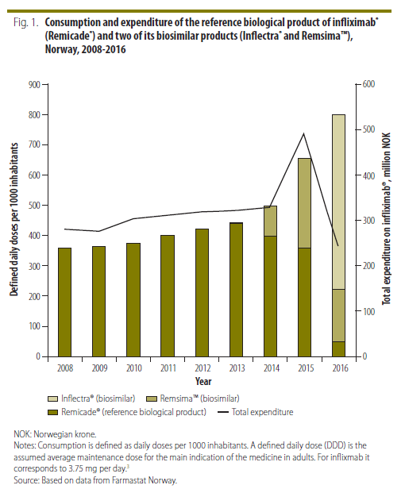
Consumption and Expenditure of Infliximab Reference Product and Two Biosimilars
NOK, Norwegian krone.
Consumption is defined as daily doses per 1000 inhabitants. A defined daily dose is the assumed average maintenance dose for the main indication of the medicine in adults (3.75 mg/d for infliximab).
Ferrario A, et al. Bull World Health Organ. 2017;95(10):720-722.

Slide 21
In the US, biologics account for 25% of Rx drug costs but less than 1% of all Rx.¹⁶
In Norway and Italy, where more biosimilars have been introduced into the market, price competition from biosimilars has driven down the cost of biologics and resulted in lower health care expenditures.^{14,15,17}
In the US, a short-acting filgrastim biosimilar had a 24% market share within 4 months of approval and an AWP 15% lower than that of filgrastim RP.¹⁸
  If accepted, uptake of biosimilars in the US market could result in an estimated savings of $66 billion over the next decade.¹⁹
Experience in Norway suggests that introduction of lower-priced biosimilars can increase patient access.^{14,15} Hopson et al identified an association between out-of-pocket costs for antirheumatic drugs and the rate of Rx abandonment.²⁰ Required copayments for biologics may be 20% to 35%.¹⁹
AWP, average wholesale price; RP, reference product; Rx, prescription

Slide 22
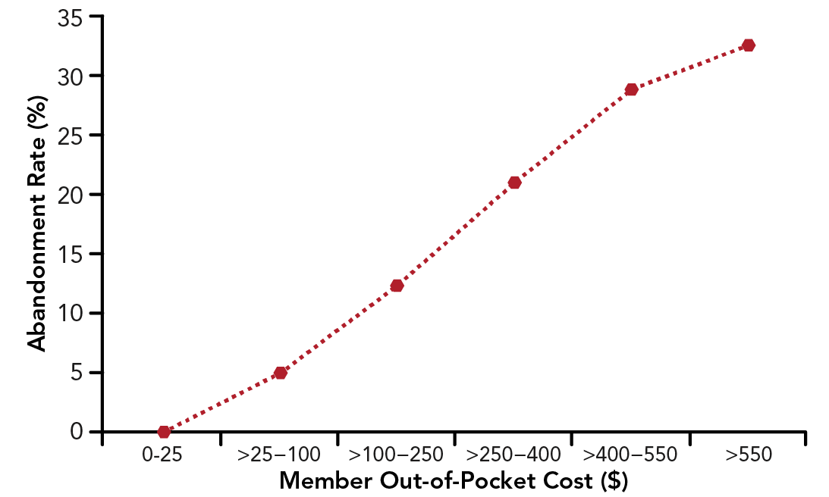
Rate of Prescription Abandonment by Out-of-Pocket Cost
Medicare Advantage and Prescription Drug plan for biologic disease-modifying antirheumatic drug therapy for 864 patients with rheumatoid arthritis from July 2007 to December 2012.
Hopson S, et al. J Manag Care Spec Pharm. 2016;22(2):122-130.

Slide 23
Clue: The variability in quality attributes of a biologic that arises over its lifecycle
What is…
Biologic drift

Slide 24
Biologics are large, complex macromolecules produced in living cells.
  Small molecules are synthesized by in vitro chemical reactions.²¹
While production of biologics begins with a known gene sequence, manufacture is an inherently variable process.²¹⁻²⁴
  As a result, no 2 batches of a biologic that are manufactured in the same way would be expected to be structurally identical. There may be differences in quality attributes—the molecular or product characteristics, such as posttranslational modifications—that contribute to the identity, potency, and stability of the biologic.^{1,22}
  Biologic drift is the variability in quality attributes that arise over the lifecycle of a biologic.²¹
The FDA has considered drift as process drift, or the variation in quality attributes that arise as a result of postapproval changes in the manufacturing process for any biologic.²²

Slide 25
Changes in Manufacturing Process After Regulatory Approval
Schneider CK. Ann Rheum Dis. 2013;72(3):315-318.

Slide 26
Changes in manufacturing processes are common, and the FDA has established a comparability exercise to ensure that changes in manufacturing process do not affect the quality, safety, or efficacy of a biologic.²²
  After making a manufacturing change, manufacturers are required to assess relevant quality attributes to establish that the resulting biologic is highly similar to the prechange product to the extent that any difference(s) would not have an adverse impact on safety or efficacy.²²
Quality attributes (eg, glycosylation and N- and C-terminal structure) of the etanercept RP were investigated from batches manufactured from 2007 to 2010.²¹
  Glycosylation profile of etanercept found to be highly uniform until 2009, when some batches appeared that had a different glycosylation profile (thought to be due to a manufacturing change).
  This study demonstrates that biologics evolve over time, and that the biologic in use today is not identical to the biologic that was approved because of biologic drift and/or process drift.²⁵
RP, reference product

Slide 27
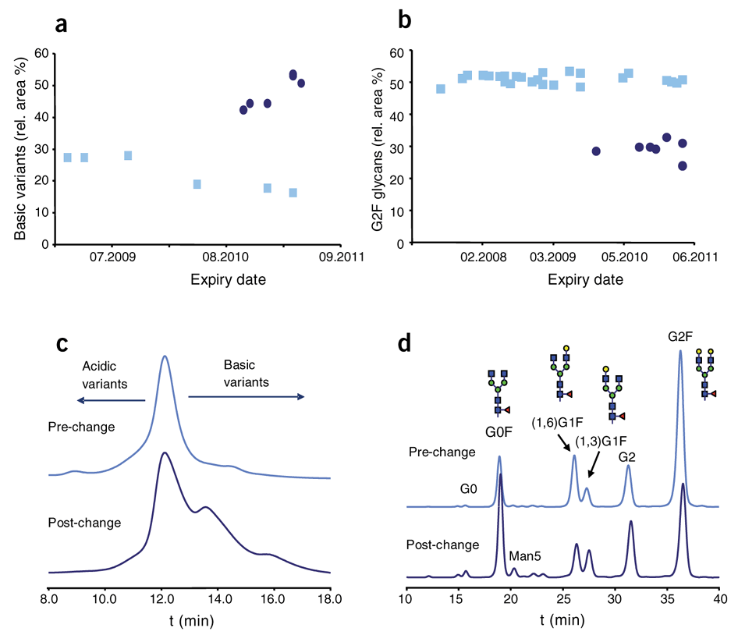
Batch-to-Batch Variability With Enbrel®
Relative amounts of basic variants of the prechange
(n = 6) and the postchange
(n = 6) batches as measured by cation exchange chromatography.
Relative amount of the G2F glycan of the prechange
(n = 25) and the postchange (n = 9) batches.
Exemplary cation exchange chromatograms.
Exemplary glycan mapping chromatograms.
Schiestl T, et al. Nat Biotechnol. 2011;29(4):310-312. Used by permission from Springer Nature, Nature Biotechnology, Copyright 2011.

Slide 28
Clue: Studies that are considered the foundation for development of a biosimilar
What are…
Analytical studies

Slide 29
Section 351(k) of the Public Health Service Act delineates the abbreviated licensure pathway for biosimilars.
  Pathway does not require the full complement of preclinical and clinical data required for new biologics licensed under the “stand-alone” section 351(a) approval pathway.
For biosimilars, the FDA considers analytical characterization to be the foundation of the approval pathway.^{1,26}

Slide 30


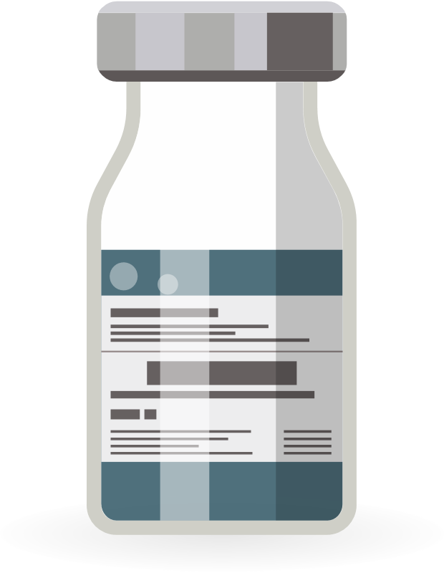
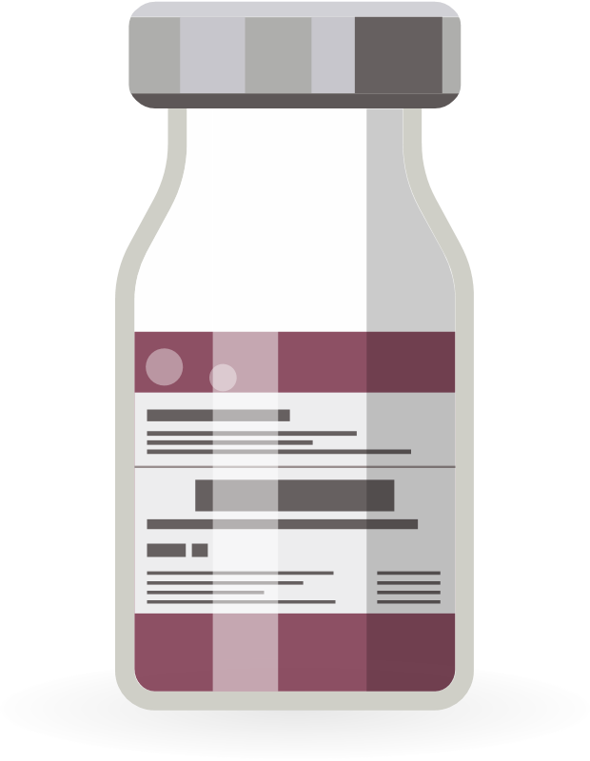
Biosimilar Pathway Represents a Paradigm Shift From Standard Originator Registration Pathway
Originator Pathway [§351(a)]
Biosimilar Pathway [§351(k)]
Conducted in sensitive patient population with sensitive
endpoints. Designed to detect a difference, if there is one.
Clinical Studies
Clinical
Studies
Clinical Pharmacology
Clinical
Pharmacology
Preclinical
Preclinical
Analytical
Analytical
Schneider CK, et al. Nat Biotechnol. 2012;30(12):1179-1185.
Kozlowski S, et al. N Engl J Med. 2011;365(5):385-388.
US Food and Drug Administration. Accessed April 7, 2022. https://www.fda.gov/media/109573/download

Slide 31
Minor variations in the molecular composition of a biologic are expected.
Analytical phase of development includes structural and functional studies to demonstrate that the variations between the biosimilar and RP are:^{1,27}
  Minor.
  Affect only clinically inactive components.
  Would not be expected to result in a clinically meaningful difference.
Subsequent animal toxicity studies and clinical studies:
  Depend on the findings from the analytical studies.
  Designed to address any residual uncertainty of biosimilarity to the RP.^{1,27}
Clinical studies of the biosimilar are designed to:
  Address any remaining uncertainty that the biosimilar is highly similar to the RP with respect to its safety, purity, and potency.
  Establish that there is no clinically meaningful difference between the biosimilar and the RP.
RP, reference product

Slide 32
The analytical phase may include:
  Structural and functional characterization of the biosimilar.
  Identification of clinically active components and impurities.
  A study of the RP’s heterogeneity, impurities, and critical characteristics.
  An evaluation of the manufacturing process.
  An evaluation of the biosimilar’s stability.
RP, reference product

Slide 33
Clue: The development of a biosimilar may directly use some (but not all) of this from the reference product
What is…
Information included in the package insert

Slide 34
The label or PI for a biosimilar must incorporate data and information from its RP label.^{6,28}
  Premise lies in the definition of biosimilarity—ie, that there are no clinically meaningful differences between the biosimilar and the RP in terms of safety, purity, and potency.²⁸
  Consequently, the established safety and efficacy described in the PI for the RP contains the essential scientific information needed to prescribe the biosimilar.²⁸
Clinical studies used to demonstrate biosimilarity are not typically described in the biosimilar label since these studies are not designed to independently support safety or efficacy²⁸; including them could lead to an inaccurate comparison of the risk-benefit profile for biosimilars.
  Exception is that clinical data for the biosimilar may be included, if needed, to inform its safe and effective use.
PI, package insert; RP, reference product

Slide 35
Biosimilar label also includes a statement in the HIGHLIGHTS section which indicates the compound is biosimilar to the RP, with a footnote that defines biosimilarity.²⁸
Biosimilar is identified by its proprietary name and nonproprietary name with its unique suffix when discussing information specific to the biosimilar, such as in the:
  INDICATIONS AND USAGE, DOSAGE AND ADMINISTRATION, DESCRIPTION, HOW SUPPLIED/STORAGE AND HANDLING, BOXED WARNING, CONTRAINDICATIONS, WARNINGS AND PRECAUTIONS, and DRUG INTERACTIONS sections.
The INDICATIONS AND USAGE section is specific for the licensed indications for the biosimilar, which may not include all the indications for the RP.
The American College of Rheumatology supports labeling that clearly indicates:
  Which biosimilars are interchangeable with their RP.
  For which indication(s) the biosimilar products is (are) approved.
  Whether the data supporting the approved indication(s) are derived from studies of the biosimilar or the RP.⁴
RP, reference product

Slide 36
Clue: Pharmacovigilance is needed to identify rare adverse events or safety issues for these
What are….
All drugs, including biologics and biosimilars

Slide 37
Pharmacovigilance: detection, assessment, understanding, and prevention of adverse effects of other drug-related problems.²⁹
Pharmacovigilance is needed for all biologics, ie, both biosimilars and their RPs, because clinical trials are inadequate to identify uncommon adverse events.³⁰
Postapproval pharmacovigilance remains important:
  To identify unexpected, rare adverse events, that are not identified in clinical trials, for both biosimilars and their RPs.
  Regardless of how long the product has been on the market.³¹
The naming convention for biologics and biosimilars is designed to facilitate pharmacovigilance efforts.
Biosimilars cannot be approved for an indication for which the RP is not approved, but may be approved for indications, without a clinical trial, by extrapolation.
RP, reference product

Slide 38
Pharmacovigilance: Tips for Practice
Be aware of which biosimilar product is being prescribed, dispensed, and used
Contribute to local pharmacovigilance efforts (registries)
Encourage transparency in drug characterization
Prescribe using the proper name or trade name with suffix
Monitor long-term safety (pharmacovigilance)





Dörner T, et al. Ann Rheum Dis. 2016;75(6):974-982

Slide 39
Category 3: Development

Slide 40
Clue: Here you can find a list of FDA-approved biologics, biosimilars, and interchangeable biosimilars
What is the…
Purple Book

Slide 41
Purple Book is an online, searchable database of biologic products approved by the FDA, including biosimilar and interchangeable biologic products.³²
Searching the Purple Book (available at https://purplebooksearch.fda.gov/) for a biologic returns a list of biosimilar, interchangeable, and RPs, with links to their product labels.
RP, reference product

Slide 42
Clue: An exact copy of a drug
What is…
A generic drug

Slide 43
Generic drug is an exact copy of a branded small-molecule drug.^{3,33}
  Structure can be completely defined and entirely reproduced.¹
A generic drug must:
  Meet be shown to be bioequivalent to the branded drug.
  Consist of the same active ingredient(s) as the branded drug.³
Biosimilar is not a generic nor is it identical to the RP.
  Must meet the standard of being highly similar to its RP, with any differences having no clinically meaningful effect on safety and efficacy.
Both generics and biosimilars undergo abbreviated, but different, approval processes to demonstrate bioequivalence or biosimilarity, respectively.
  Process does not require an independent demonstration of safety and efficacy.
Separate batches of a biologic, whether a biosimilar or an RP, are not necessarily identical since their manufacture is an inherently variable process that may result in minor differences in quality attributes.
RP, reference product

Slide 44
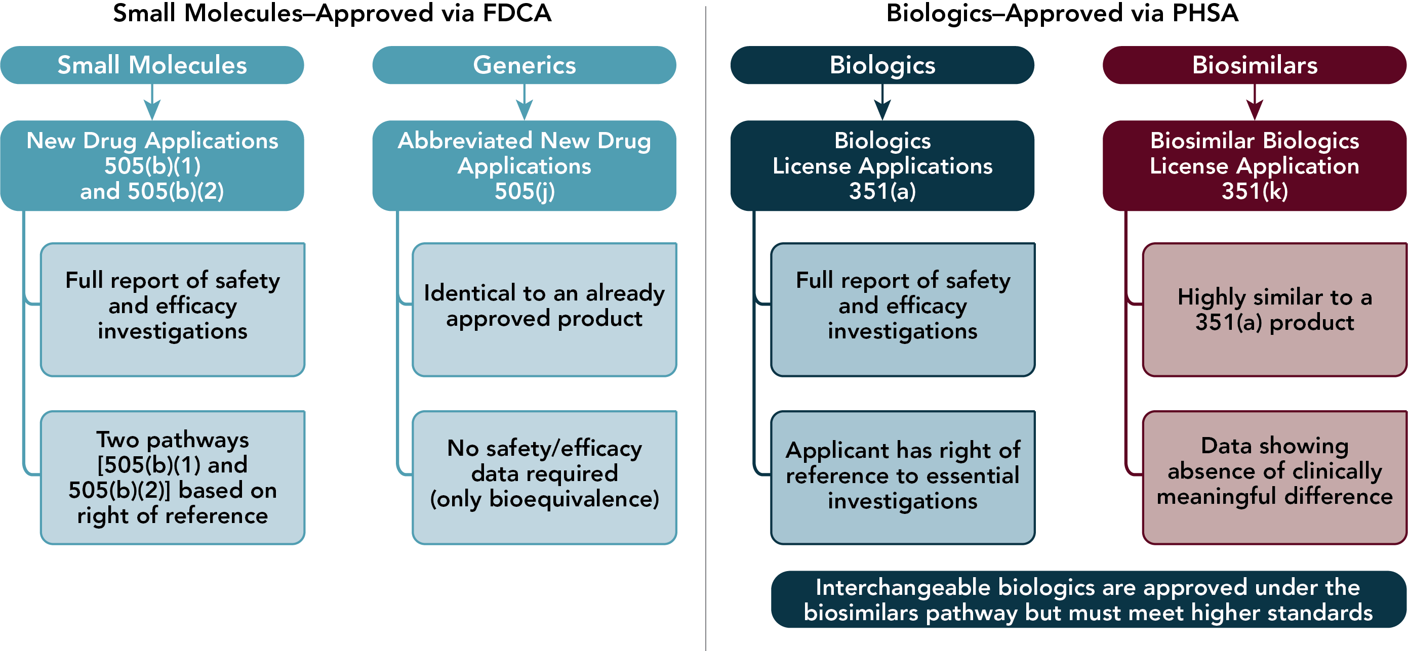
US Regulatory Pathways for Small-Molecule Drugs and Biologics
FDCA, Food, Drug, and Cosmetic Act; BPCI, Biologics Price Competition and Innovation; PHSA, Public Health Service Act.
For historical reasons, some biologic products are currently approved under the FDCA. Beginning 2020, all biologic products are approved under the PHSA.
Li EC, et al. J Manag Care Spec Pharm. 2015;21(7):532-539.

Slide 45
Clue: A biosimilar must be this when compared to its reference product
What is…
Highly similar

Slide 46
Biosimilar must be highly similar to its RP, notwithstanding minor differences in clinically inactive components.
Biosimilars are not expected to be identical to the RP with respect to the molecular structure.
A biosimilar need not have been proven to be interchangeable with its RP.
  Interchangeability is a higher standard that requires the conduct of additional clinical studies to demonstrate no significant difference in PK parameters, efficacy, or safety in patients who are treated with repeated switches between the biosimilar and its RP, compared to those treated with the RP alone and without switching.¹²
The clinical phase of the biosimilar approval process is designed to verify that there are no clinically meaningful differences in safety or efficacy between the biosimilar and its RP.²⁶
PK, pharmacokinetic; RP, reference product

Slide 47
Clue: The approach taken by regulators when reviewing data to support designation of biosimilarity
What is…
Totality of the evidence

Slide 48

What is…
Totality of the evidence

Slide 49
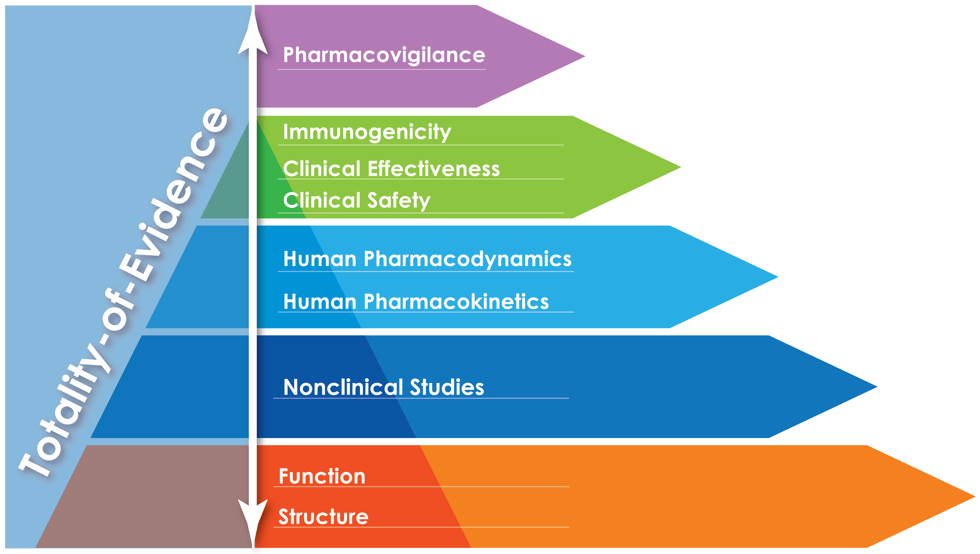
Totality-of-Evidence Approach
US Food and Drug Administration. Published April 2015. Accessed April 7, 2022. www.fda.gov/downloads/Drugs/GuidanceComplianceRegulatoryInformation/Guidances/UCM291128.pdf

Slide 50
Clue: The approach to development of biosimilars that is based on structural analysis of the reference product
What is…
Reverse engineering

Slide 51
Biosimilar development starts with protein synthesis from a gene that encodes the amino acid sequence of the RP.
  Expression vector and remaining production and purification steps for the RP are proprietary and known only to the RP manufacturer.
Each biosimilar manufacturer has to develop its own cell line to express the biosimilar, and fermentation conditions, purification protocols, and packaging.
  These steps are not trivial since they can affect posttranslational modifications and higher order structure of the biosimilar.^{1,34}
To develop a biosimilar, manufacturers analyze its RP extensively and reverse engineer a manufacturing process which can produce a biosimilar that is highly similar to its RP.
  Critical quality attributes (ie, the molecular and product characteristics, such as posttranslational modifications and functional activity, that define the identity, potency, and safety of a biologic) must be identified so that they can be replicated by the manufacturing process.^{21,22}
Throughout development, the critical quality attributes of the biosimilar candidate are compared to those of its RP to inform modification of the manufacturing process so that the biosimilar meets the standard of being highly similar to its RP without clinically meaningful differences.
RP, reference product

Slide 52
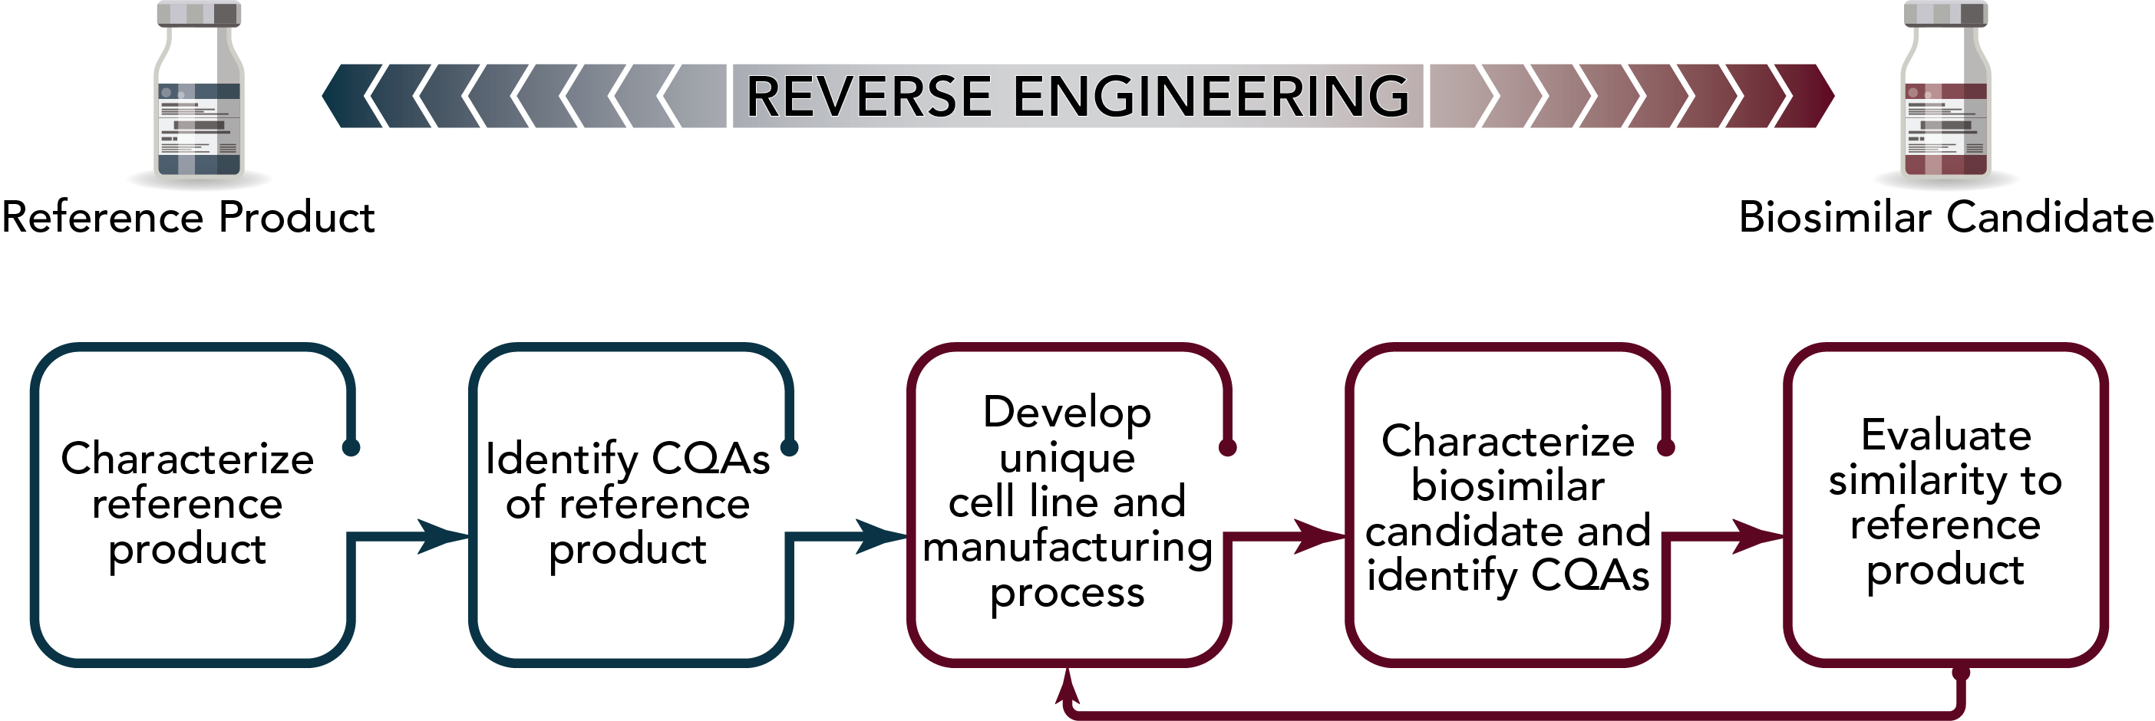
Biosimilars Are Reverse Engineered
CQA, critical quality attribute.
US Food and Drug Administration. Published April 2015. Accessed April 7, 2022. www.fda.gov/downloads/Drugs/GuidanceComplianceRegulatoryInformation/Guidances/UCM291128.pdf
US Food and Drug Administration. Published April 2015. Accessed April 7, 2022. www.fda.gov/downloads/Drugs/GuidanceComplianceRegulatoryInformation/Guidances/UCM291134.pdf

Slide 53
Category 4: Delivery to the Clinic

Slide 54
Clue: The regulatory approach that may be used to approve a biosimilar for indications for which its reference product is approved without conducting additional clinical trials
What is…
Extrapolation of indications

Slide 55
Extrapolation of indications:
  Regulatory approach to approve a biosimilar for indications other than those for which it was studied during clinical development, but for which the RP has already been approved.
  Does not assume that a biosimilar is safe and effective across indications.
    Biosimilar manufacturer must provide a scientific justification for extrapolation to indications not tested during the clinical program.^{1,35}
Clinical testing for a biosimilar is designed to demonstrate the absence of clinically meaningful differences, not to demonstrate efficacy.
  FDA guidance directs manufacturers to choose an indication that would be adequately sensitive to detect a difference.^{1,36}
The scientific justification for extrapolation to other indications should address whether:¹
    Mechanism of action is similar for each condition;
    PK and PD are comparable in the different patient populations; and
    Toxicity and immunogenicity are similar in the different patient populations.
PD, pharmacodynamic; PK, pharmacokinetic; RP, reference product

Slide 56
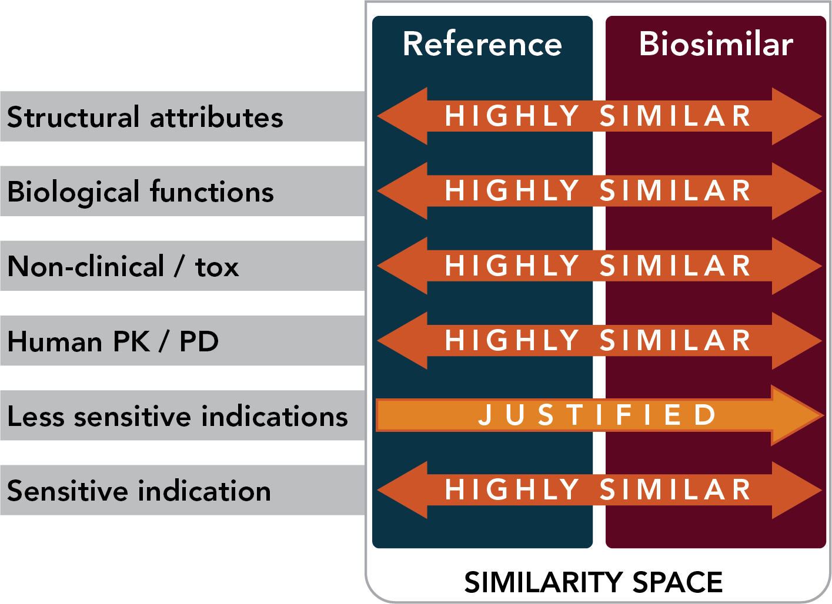
Extrapolation and FDA-Labeled Indications
FDA-approved indications for biosimilars do not require a clinical trial for each indication.
Extrapolation is scientifically justified based on specifications of the product made by biosimilar manufacturer relative to product made by reference product manufacturer.
Totality of the evidence (including physiochemical, functional, PK/PD studies) informs the appropriate indications.
PD, pharmacodynamic; PK, pharmacokinetic
US Food and Drug Administration. Published April 2015. Accessed April 7, 2022.
www.fda.gov/downloads/Drugs/GuidanceComplianceRegulatoryInformation/Guidances/UCM291128.pdf

Slide 57
Totality of the evidence may support extrapolation to other indications if:
  Biosimilarity can be established using analytical and functional studies; and
  No clinically meaningful differences are identified in clinical testing in a patient population selected for its sensitivity to identify a difference in efficacy or safety.
This process is analogous to that used for approval of changes in manufacture of biologics.³⁵
Extrapolation has been used to approve biosimilars for the same indications as the corresponding RP, except under 2 circumstances:³⁷
  RP was granted a new indication after the biosimilar was approved; or
  RP had been granted market exclusivity for an indication.
RP, reference product

Slide 58
Clue: The property of a biologic to induce an immune response that may neutralize the protein and reduce therapeutic efficacy
What is…
Immunogenicity

Slide 59
Immunogenicity is the property of a protein to induce an immune response that may neutralize the protein and reduce its therapeutic efficacy.
Immune responses to a biologic can affect both its safety and efficacy.¹
Comparative clinical studies to assess the immunogenicity of a biosimilar are expected to be included in the process to demonstrate biosimilarity.
  Immunogenicity is assessed in comparative PK/PD clinical studies.
Goal of the clinical immunogenicity assessment is to identify differences between a biosimilar and its RP in the incidence and severity of immune reactions.
The extent of these studies—which include both premarketing clinical trials and postmarketing surveillance—depends on the expected incidence and severity of immune reactions, and the degree of analytical similarity of the biosimilar to its RP.
Differences between a biosimilar and its RP in post-translational modifications or other clinically inactive aspects could contribute to differences in immunogenicity.³⁸
PD, pharmacodynamic; PK, pharmacokinetic; RP, reference product

Slide 60
Immunogenicity: Infliximab Reference Product vs CT-P13 Biosimilar
1. Park W, et al. Ann Rheum Dis. 2013;72:1605-1612. 2. Park W, et al. Arthritis Res Ther. 2016;18:25.
3. Yoo DH, et al. Ann Rheum Dis. 2013;72:1613-1620. 4. Yoo DH, et al. Arthritis Res Ther. 2016;18:82.

Slide 61
Clue: The negative responses to a biosimilar that are not related to its pharmacologic properties
What is…
The nocebo effect

Slide 62
“Nocebo” effect refers to the perceived increase in adverse events or negative responses to a medication that are not due to its biological properties.³⁹
Both patients and healthcare providers may have concerns about the efficacy and safety of biosimilars. These concerns:
  Have been a barrier to the acceptance of biosimilars in both Europe and US.
  Are rooted in misconceptions about biosimilars (eg, that they are second- or third-line treatments, can only be used in treatment-naïve patients, or are less effective or more immunogenic than their RPs).⁴⁰
  Have resulted in an increase in biosimilar discontinuation in the absence of objective evidence of disease worsening in some biosimilar trials.
Patients with these concerns have expressed unwillingness to switch to a biosimilar, even if their out-of-pocket costs might be lower.^{41,42}
Countering the nocebo effect requires shared decision making and positive communication about biosimilars.
RP, reference product

Slide 63
Checklist for an Informed Patient About Biosimilars
 | Use of biologic therapies in the specific disease |  | Access to treatment
 | Definition of a biosimilar |  | Insurance coverage and out-of-pocket cost
 | Totality of evidence required of a biosimilar |  | Services available to support patient
 | Efficacy similar to innovator biologic |  | Clinical trials including standard biosimilar trial design
 | Delivery/Administration of the agent |  | Manufacturer identity
 | Device use (if applicable)
Jacobs I, et al. Patient Prefer Adherence. 2016;10:937-948.

Slide 64
Clue: A structured process to engage the patient in evaluating treatment options and selecting treatment
What is…
Shared decision making

Slide 65

What is…
Shared decision making

Slide 66
Clue: A patient who is not responding to treatment with a biologic, or who experienced an allergic reaction to it
What is…
A patient who should not be switched to its biosimilar

Slide 67

What is…
A patient who should not be switched to its biosimilar

Slide 68
Clinical Settings for Biosimilar Use
Initiate biosimilar |  | Switch from reference product to biosimilar
Biologic-naïve patients warranting treatment Patients treated with anti-TNF and stopped due to remission or reasons not related to adverse events or primary/secondary loss of response Not for patients with allergic reactions, primary treatment failure, or loss of response due to antibodies to reference product |  | Patients in remission Referred to as ‘non-medical switching’
Switch from biosimilar to reference product |  | Switch from biosimilar to biosimilar
Switched from biosimilar to reference product Switched from reference product to biosimilar back to reference product May be driven by cost or patient request |  | May be driven by cost or payor preference
Bhat S, et al. Dig Dis Sci. 2021;66(8):2513-2532.

Slide 69
References
1. US Food and Drug Administration. Scientific considerations in demonstrating biosimilarity to a reference product: guidance for industry. http://www.fda.gov/downloads/Drugs/GuidanceComplianceRegulatoryInformation/Guidances/UCM291128.pdf (2015, accessed December 15, 2021).
2. Woodcock J, Griffin J, Behrman R, et al. The FDA's assessment of follow-on protein products: a historical perspective. Nat Rev Drug Discov. 2007;6(6):437-442.
3. US Food and Drug Administration. Biological Product Definitions. https://www.fda.gov/files/drugs/published/Biological-Product-Definitions.pdf
(accessed December 15, 2021).
4. American College of Rheumatology. Biosimilars Position Statement. https://www.rheumatology.org/Practice-Quality/Administrative-Support/Position-Statements (February 2021, accessed December 16, 2021).
5. US Food and Drug Administration. Nonproprietary Naming of Biological Products: Guidance for Industry. https://www.fda.gov/media/93218/download
(2017, accessed December 15, 2021).

Slide 70
References (continued)
6. US Food and Drug Administration. Nonproprietary Naming of Biological Products Update: Guidance for Industry. https://www.fda.gov/media/121316/download
(2019, accessed December 15, 2021).
7. Peters GL, Hennessey EK. Naming of biological products. US Pharm. 2020;45(6)33-36.
8. Lee H. Equivalence margin of the biosimilar product. J Korean Soc Clin Pharmacol Ther. 2012;20:17-33.
9. Mielke J, Jilma B, Jones B, Koenig F. An update on the clinical evidence that supports biosimilar approvals in Europe. Br J Clin Pharmacol. 2018;84(7):1415-1431.
10. Shin D, Kim Y, Kim HS, Fuhr R, Körnicke T. FRI0110 A phase I pharmacokinetic study comparing SB5, an adalimumab biosimilar, and adalimumab reference product (Humira®) in healthy subjects. Ann Rheum Dis. 2015;74:459-460.
11. Weinblatt ME, Baranauskaite A, Niebrzydowski J, et al. Phase III randomized study of SB5, an adalimumab biosimilar, versus reference adalimumab in patients with moderate-to-severe rheumatoid arthritis. Arthritis Rheumatol. 2018;70(1):40-48.

Slide 71
References (continued)
12. US Food and Drug Administration. Interchangeable Biological Products. https://www.fda.gov/media/151094/download. (accessed December 15, 2021).
13. US Food and Drug Administration. Prescribing Interchangeable Products. https://www.fda.gov/media/108107/download. (accessed December 15, 2021).
14. Ferrario A, Humbert T, Kanavos P, Pedersen HB. Strategic procurement and international collaboration to improve access to medicines. Bull World Health Organ. 2017;95(10):720-722.
15. Dalen D, Strom S, Locatelli M. Biosimilar bidding in centralized tenders in Norway. Nordic Journal of Health Economics. 2021.
16. Sarpatwari A, Avorn J, Kesselheim AS. Progress and hurdles for follow-on biologics. N Engl J Med. 2015;372(25):2380-2382.
17. Curto S, Ghislandi S, van de Vooren K, Duranti S, Garattini L. Regional tenders on biosimilars in Italy: an empirical analysis of awarded prices. Health Policy. 2014;116(2-3):182-187.
18. McBride A, Balu S, Campbell K, Bikkina M, MacDonald K, Abraham I. Expanded access to cancer treatments from conversion to neutropenia prophylaxis with biosimilar filgrastim-sndz. Future Oncol. 2017;13(25):2285-2295.

Slide 72
References (continued)
19. Mulcahy AW, Predmore Z, Mattke S. The Cost Savings Potential of Biosimilar Drugs in the United States. Santa Monica, CA: RAND Corporation; 2014.
20. Hopson S, Saverno K, Liu LZ, et al. Impact of out-of-pocket costs on prescription fills among new initiators of biologic therapies for rheumatoid arthritis. J Manag Care Spec Pharm. 2016;22(2):122-130.
21. Schiestl M, Stangler T, Torella C, Cepeljnik T, Toll H, Grau R. Acceptable changes in quality attributes of glycosylated biopharmaceuticals. Nat Biotechnol. 2011;29(4):310-312.
22. US Food and Drug Administration. Quality Considerations in Demonstrating Biosimilarity of a Therapeutic Protein Product to a Reference Product. https://www.fda.gov/regulatory-information/search-fda-guidance-documents/quality-considerations-demonstrating-biosimilarity-therapeutic-protein-product-reference-product
(accessed December 15, 2021).
23. Liu HF, Ma J, Winter C, Bayer R. Recovery and purification process development for monoclonal antibody production. MAbs. 2010;2(5):480-499.

Slide 73
References (continued)
24. Li F, Vijayasankaran N, Shen AY, Kiss R, Amanullah A. Cell culture processes for monoclonal antibody production. MAbs. 2010;2(5):466-479.
25. Mehr SR, Zimmerman MP. Is a Biologic Produced 15 Years Ago a Biosimilar of Itself Today? Am Health Drug Benefits. 2016;9(9):515-518.
26. US Food and Drug Administration. Biosimilar Regulatory Review and Approval. https://www.fda.gov/media/151061/download (accessed December 15, 2021).
27. US Food and Drug Administration. Overview of the Regulatory Framework and FDA’s Guidance for the Development and Approval of Biosimilar and Interchangeable Products in the US. https://www.fda.gov/media/109573/download (accessed January 1, 2022).
28. US Food and Drug Administration. Labeling for Biosimilar Products: Guidance for Industry. Available at https://www.fda.gov/media/96894/download#:~:text=The%20labeling%20for%20the%20biosimilar,for%20those%20conditions%20of%20use. Accessed September 22, 2021.
29. World Health Organization. The importance of pharmacovigilance (2002). Available at https://www.who.int/publications/i/item/10665-42493. Accessed January 5, 2022.
30. Dorner T, Strand V, Cornes P, et al. The changing landscape of biosimilars in rheumatology. Ann Rheum Dis. 2016;75(6):974-982

Slide 74
References (continued)
31. US Food and Drug Administration. An Introduction to Drug Safety Surveillance and the FDA Adverse Event Reporting System (2018). Available at https://www.fda.gov/files/about%20fda/published/Drug-Safety-Surveillance-and-the-FDA-Adverse-Event-Reporting-System-%28PDF---1.31MB%29.pdf. Accessed January 5, 2022.
32. US Food and Drug Administration. Purple Book: Lists of Licensed Biological Products with Reference Product Exclusivity and Biosimilarity or Interchangeability Evaluations. Available at https://www.fda.gov/drugs/therapeutic-biologics-applications-bla/purple-book-lists-licensed-biological-products-reference-product-exclusivity-and-biosimilarity-or. Accessed January 5, 2022.
33. Li E, Ramanan S, Green L. Pharmacist substitution of biological products: Issues and considerations. J Manag Care Spec Pharm. 2015;21(7):532-539.
34. Socinski MA, Curigliano G, Jacobs I, Gumbiner B, MacDonald J, Thomas D. Clinical considerations for the development of biosimilars in oncology. MAbs. 2015;7(2):286-293.
35. Cohen HP. BIOSIMILAR DEVELOPMENT - Approval of Biosimilar Medicines Through Totality of the Evidence. Retrieved from https://drug-dev.com/biosimilar-development-approval-of-biosimilar-medicines-through-totality-of-the-evidence/. Accessed January 6, 2022.

Slide 75
References (continued)
36. Tesser JR, Furst DE, Jacobs I. Biosimilars and the extrapolation of indications for inflammatory conditions. Biologics. 2017;11:5-11.
37. Hung A, Vu Q, Mostovoy L. A systematic review of U.S. biosimilar approvals: What evidence does the FDA require and how are manufacturers responding? J Manag Care Spec Pharm. 2017;23(12):1234-1244.
38. Weise M, Bielsky MC, De Smet K, et al. Biosimilars: what clinicians should know. Blood. 2012;120(26):5111-5117.
39. Bhat S, Limdi JK, Cross RK, Farraye FA. Does similarity breed contempt? A review of the use of biosimilars in inflammatory bowel disease. Dig Dis Sci. 2021;66(8):2513-2532.
40. Leonard E, Wascovich M, Oskouei S, Gurz P, Carpenter D. Factors affecting health care provider knowledge and acceptance of biosimilar medicines: A systematic review. J Manag Care Spec Pharm. 2019;25(1):102-112.
41. Peyrin-Biroulet L, Lonnfors S, Avedano L, Danese S. Changes in inflammatory bowel disease patients' perspectives on biosimilars: A follow-up survey. United European Gastroenterol J. 2019;7(10):1345-1352.

Slide 76
References (continued)
41. Peyrin-Biroulet L, Lonnfors S, Avedano L, Danese S. Changes in inflammatory bowel disease patients' perspectives on biosimilars: A follow-up survey. United European Gastroenterol J. 2019;7(10):1345-1352.
42. Teeple A, Ellis LA, Huff L, et al. Physician attitudes about non-medical switching to biosimilars: results from an online physician survey in the United States. Curr Med Res Opin. 2019;35(4):611-617.
43. Teeple A, Ginsburg S, Howard L, et al. Patient attitudes about non-medical switching to biosimilars: results from an online patient survey in the United States. Curr Med Res Opin. 2019;35(4):603-609.
44. Jacobs I, Singh E, Sewell KL, Al-Sabbagh A, Shane LG. Patient attitudes and understanding about biosimilars: an international cross-sectional survey. Patient Prefer Adherence. 2016;10:937-948.
45. Colloca L, Panaccione R, Murphy TK. The clinical implications of nocebo effects for biosimilar therapy. Front Pharmacol. 2019;10:1372.
46. Pouillon L, Socha M, Demore B, et al. The nocebo effect: a clinical challenge in the era of biosimilars. Expert Rev Clin Immunol. 2018;14(9):739-749.

