Slide 1
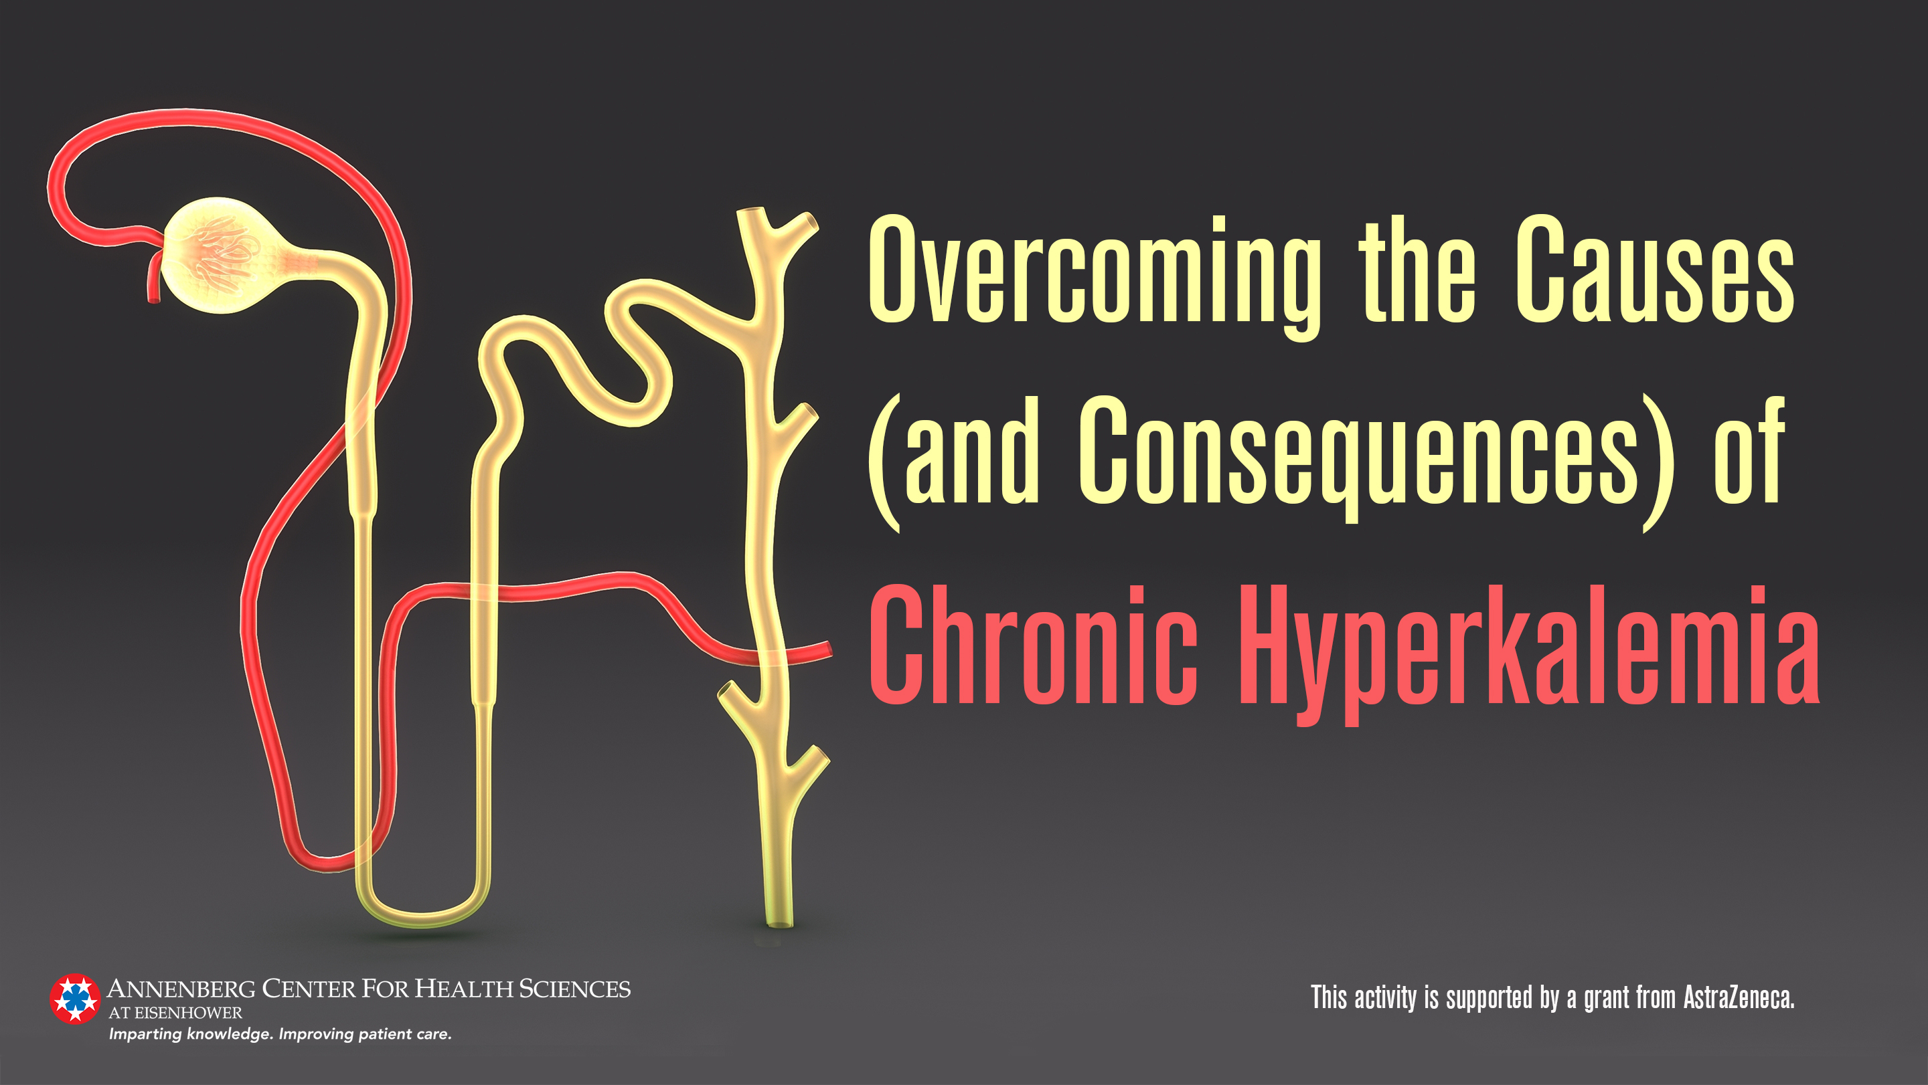

Slide 2
Presenters
Biff F. Palmer, MD
Robert Toto, MD
Professor of Internal Medicine
UT Southwestern Medical Center
Dallas, Texas
Associate Dean
Clinical and Translational Research
Director, Center for Translational Medicine
UT Southwestern Medical Center
Dallas, Texas

Slide 3
Disclosures
Biff F. Palmer, MD
 | No relevant financial relationships to disclose
Robert Toto, MD
Consultant | Amgen, Akebia, AstraZeneca, Bayer, Boehringer-Ingelheim, Novo Nordisk, Reata, ViFor, Medscape

Slide 4
Learning Objectives
List the common causes of hyperkalemia
Describe the clinical benefits of renin-angiotensin-aldosterone system inhibitor (RAASi) therapy in patients with chronic kidney disease and heart failure
Compare and contrast patiromer and sodium zirconium cyclosilicate for the treatment of chronic hyperkalemia, including safety and efficacy data
Identify opportunities to treat patients with potassium-binding agents, in accordance with the latest guidance, to help optimize the use of RAASi therapy

Slide 5
Outline
Case presentation
Pathophysiology discussion
Acute treatment of case
Discharge planning: Now what?
  Restart RAASi
  Start potassium binder
New emerging Rx data
  Chronic trials, mention ESRD study
  What next with the case for chronic management, drug Rx, case coordination

Slide 6
Case Study: Meni
A 64 yo man presents with new onset weakness
Medical history
  T2DM, HTN, stage 3b CKD
  MI 6 mos ago complicated by HFrEF (EF 35%)
  Had been taking
    Lisinopril 10 mg/d
    Metoprolol succinate 50 mg/d
    Insulin
    Furosemide 20 mg twice daily until 1 week ago, when he was started on spironolactone 25 mg/d by his cardiologist

Slide 7
Case Study: Meni
(continued)
Two days ago, he noticed generalized weakness which has worsened over the last
24 hours
A basic metabolic profile obtained by his PCP shows
  Na⁺ 139 mEq/L
  K⁺ 6.8 mEq/L
  Cl⁻ 107 mEq/L
  HCO₃⁻ 18 mEq/L
  SCr 2.0 mg/dL
  Glucose 184 mg/dL
The patient is instructed to go to the emergency department

Slide 8
Distribution of Total Body K⁺
K⁺ Gradient Sets Cell Voltage
Intracellular fluid
3,500 mEq (140-150 mEq/L)
Muscle: 2,700 mEq
Liver: 250 mEq
Erythrocytes: 250 mEq
Bone: 300 mEq
Extracellular fluid
70 mEq (3.5-5.5 mEq/L)

Slide 9
Regulation of K⁺ Homeostasis
Intake
100 mEq
Cell Shift
ICF
3,500 mEq
(140-150 mEq/L)
ECF
70 mEq
(3.5-5.5 mEq/L)
Renal excretion
90 mEq
GI excretion
10 mEq
ECF, extracellular fluid; ICF, intracellular fluid

Slide 10
Epidemiology of Hyperkalemia
Prevalence as high as 40%-65% in patients with CKD
Even in specialized CKD clinics, the prevalence is as high
as 55%
Annual mortality rate 25%
CKD, chronic kidney disease
Einhorn LM, et al. Arch Intern Med. 2009;169:1156-1162.
Hayes J, et al. Nephron Clin Pract. 2012;120:c8-c16.
Sarafidis PA, et al. Clin J Am Soc Nephrol. 2012;7:1234-1241.
Fitch K, et al. Am Health Drug Benefits. 2017;10(4):202-210.

Slide 11
Mortality Rate Within 1 Day of a Hyperkalemia Event
1-day mortality rate 6 to 17 times higher in patients with K⁺ ≥5.5 mEq/L than in those with K⁺ <5.5 mEq/L
1-Day Mortality Rate (%)
Serum Potassium (mEq/L) | <5.5 | >5.5 and <6.0 | >6.0
Ratio compared to <5.5 | 1.0 | 6.2 | 16.7
Number of records | 2,037,163 | 44,907 | 21,352
Einhorn LM, et al. Arch Intern Med. 2009;169:1156-1162.

Slide 12
Differential Diagnosis of Hyperkalemia
Pseudohyperkalemia
Excess K⁺ intake
Cell shifts
Impaired renal excretion
  Only cause of sustained hyperkalemia
  Primary decrease in mineralocorticoid activity

Slide 13
Impaired Renal K⁺ Excretion
Primary decrease in mineralocorticoid activity
Primary decrease in distal Na⁺ delivery
  Decompensated heart failure
  Oliguric acute renal failure
  Acute glomerulonephritis
Abnormal cortical collecting duct
  Drugs
  Tubulointerstitial nephritis
  Urinary obstruction

Slide 14
Change in PRA and Aldosterone With Na⁺ Restriction in Young vs Elderly
Plasma Renin Activity (ng/100 mL/3h)
Plasma Aldosterone (ng/100 mL)
Na⁺ Intake (mEq/24h)
Na⁺ Intake (mEq/24h)
F, furosemide; PRA, plasma renin activity
Weidmann P, et al. Kidney Int. 1975;8:325-333.

Slide 15
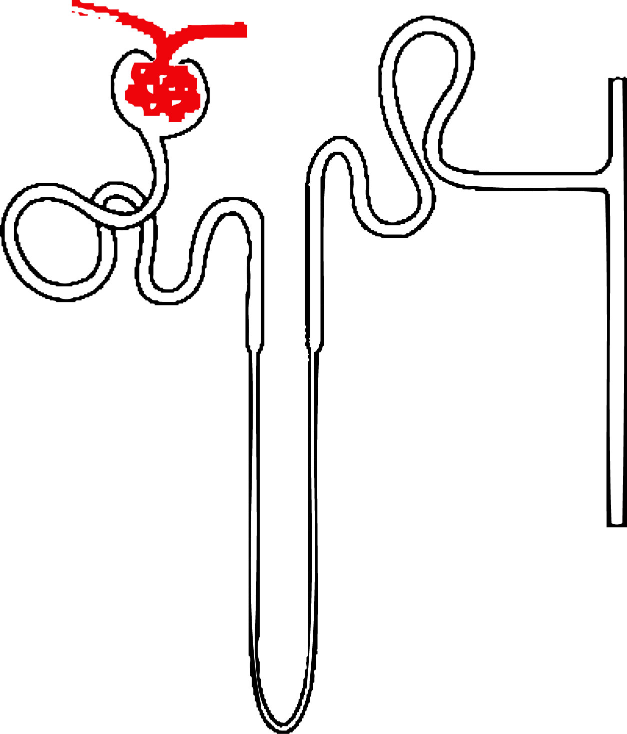
Primary Decrease in Mineralocorticoid Activity
ANGIOTENSIN
RECEPTOR BLOCKERS
Angiotensin I
Angiotensin II
ANGIOTENSIN-
CONVERTING ENZYME
INHIBITORS
Aldosterone
DIRECT RENIN
INHIBITOR
IMPAIRED
ALDOSTERONE
METABOLISM
Adrenal Disease
Heparin
Ketoconazole
Adrenal
Gland
Afferent Arteriole
Renin
SODIUM CHANNEL
BLOCKERS
Amiloride
Triamterene
Trimethoprim
Pentamidine
Juxtaglomerular
cells
Collecting Duct
(principal cell)
IMPAIRED RELEASE OF RENIN
NSAIDs
Beta Blockers
Cyclosporine, Tacrolimus
Diabetes
Elderly
Na⁺
Na⁺
LUMEN
K⁺
K⁺
ALDOSTERONE
RECEPTOR
BLOCKERS
Spironolactone
Eplerenone
Finerenone
*Available only as a combination product
Palmer BF. N Engl J Med. 2004;351:585-592.

Slide 16
Clinical Consequences of Hyperkalemia
Cardiac toxicity
Muscle weakness
Impaired renal acidification

Slide 17
Poor Sensitivity and Specificity of ECG as Diagnostic Test for Hyperkalemia
In 127 patients with serum K⁺ between 6-9.3 mEq/L, only 46% of ECGs noted to have changes¹
In 90 cases, only 24 noted to have characteristic T-wave changes
as read by a cardiologist²
Only 1/14 who presented with arrhythmias or arrest had strict criteria²
ECG, electrocardiogram
1. Acker CG, et al. Arch Intern Med. 1998;158:917-924.
2. Montague BT, et al. Clin J Am Soc Nephrol. 2008;3:324-330.

Slide 18
Management of Hyperkalemia
Review medications
Dietary K⁺ counseling
Effective diuretic therapy
  Loop diuretics when estimated glomerular filtration rate <30mL/min/1.73 m²
    Use furosemide twice daily
NaHCO₃ tablets (650-mg tablet, 8 mEq)
Decrease or discontinue renin-angiotensin-aldosterone system blocker
Palmer BF, et al. N Engl J Med. 2015;373(6):548-559.
Palmer BF. Am J Kidney Dis. 2010;56(2):387-393.
Palmer BF. N Engl J Med. 2004;351(6):585–592.

Slide 19
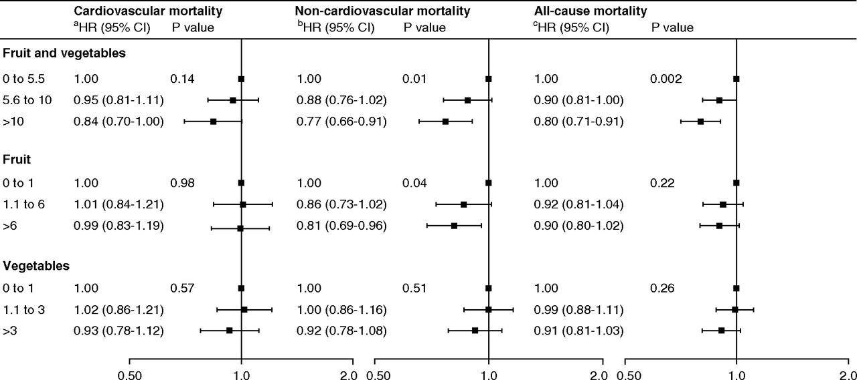
Higher Intake of Fruits and Vegetables Associated With Lower All-Cause Mortality
9757 patients across European and South American countries in the: Dietary Intake,
Death and Hospitalization in Adults with ESKD Treated with Hemodialysis Study
Saglimbene VM, et al. Clin J Am Soc Nephrol. 2019;14(2):250-260
Notes:
Adjusted mortality hazard ratios (HRs) (95% CIs) by tertiles of fruit and vegetable intake (servings per week) showing an association between higher combined intake of fruit and vegetables and lower all-cause mortality largely driven by noncardiovascular causes. HR estimates for one serving per week increase of combined fruit and vegetable intake are 0.99 (95% CI, 0.98 to 1.00; P=0.05), 0.99 (95% CI, 0.98 to 0.99; P=0.001), and 0.99 (95% CI, 0.98 to 0.99; P≤0.001) for cardiovascular, noncardiovascular, and all-cause mortality, respectively. HR estimates for one serving per week increase of fruit intake are 0.99 (95% CI, 0.97 to 1.00; P=0.13), 0.99 (95% CI, 0.97 to 1.00; P=0.03), and 0.99 (95% CI, 0.98 to 1.00; P=0.01) for cardiovascular, noncardiovascular, and all-cause mortality, respectively. HR estimates for one serving per week increase of vegetable intake are 1.00 (95% CI, 0.98 to 1.02; P=0.63), 0.99 (95% CI, 0.97 to 1.00; P=0.12), and 0.99 (95% CI, 0.98 to 1.00; P=0.13) for cardiovascular, noncardiovascular, and all-cause mortality, respectively. All analyses are adjusted for country (random effect), age, sex, smoking (current or former versus never), daily physical activity, myocardial infarction, vascular access type (fistula versus graft/catheter), body mass index (categories according to World Health Organization), albumin (tertiles), Charlson Comorbidity Index score (quartiles), hemoglobin, and energy intake (1000 kcal/d increase). Analyses for fruit are adjusted for vegetables and vice versa. ªAdditionally adjusted for education (secondary versus none/primary), diabetes, phosphorus, and calcium. ^{b}Additionally adjusted for underlying kidney disease and being waitlisted for transplant. ^{c}Additionally adjusted for education (secondary versus none/primary), life partner, underlying kidney disease, being waitlisted for transplant, phosphorus, calcium, time on dialysis, and Kt/V.

Slide 20
Dietary K⁺ Restriction: A Catch-22 of Managing Diseases That Benefit From K⁺-Enriched Foods
Encourage K⁺-enriched
foods and accept risk of
hyperkalemia?
Restrict K⁺-enriched
foods that have health
benefits?
CATCH-22
Palmer BF, et al. Kidney360. 2020;1(1):65-71.

Slide 21
Clinical Guidelines Recommend RAASi Therapy for Treatment of Acute and Chronic Heart Failure
2016 ESC guidelines for the diagnosis and treatment of acute and chronic HF
Intervention | Recommendation
ACEi | Class I | Recommended in addition to a β-blocker, for symptomatic patients with HFrEF
 | Class I | Recommended in patients with asymptomatic LV systolic dysfunction
 | Class IIa | Recommended in patients with stable CAD
ARBs | Class I | Recommended to symptomatic patients with HF unable to tolerate an ACEi (patients should also receive a β-blocker and an MRA)
Aldosterone blockade | Class I | Recommended for patients with HFrEF, who remain symptomatic despite treatment with an ACEi and a β-blocker
Class recommendation I = recommended/indicated; Class recommendation IIa = should be considered
ACEi, angiotensin-converting enzyme inhibitor; ARB, angiotensin receptor blocker; CAD, coronary artery disease; ESC, European Society of Cardiology; HF, heart failure; HFrEF, heart failure with reduced ejection fraction; LV, left ventricular; MRA, mineralocorticoid receptor antagonist; RAASi, renin-angiotensin-aldosterone system inhibitor
Ponikowski P, et al. Eur Heart J. 2016;18(8)::891-975.

Slide 22

KDIGO Recommends RAASi Therapy for Managing Patients With CKD
ND-CKD patients without diabetes mellitus
We recommend that an ARB or ACEi be used in adults without diabetes with
ND-CKD and urine albumin excretion >300 mg per 24 hours (or equivalent) in whom treatment with BP-lowering drugs is indicated (1B)
ND-CKD patients with diabetes mellitus
We recommend that an ARB or ACEi be used in adults with diabetes and ND-CKD with urine albumin excretion >300 mg per 24 hours (or equivalent) (1B)
ACEi, angiotensin-converting enzyme inhibitor; ARB, angiotensin receptor blocker; BP, blood pressure; ND-CKD, non-dialysis chronic kidney disease; RAASi, renin-angiotensin-aldosterone system inhibitor
KDIGO. Kidney Int Suppl (2011). 2012;2(5):347-381.

Slide 23
Hyperkalemia vs RAASi: The Catch-22 of Managing Diseases That Benefit From RAASi Therapy!
Prescribe RAASi and Accept Presence of Hyperkalemia?
Avoid/Discontinue
Proven RAASi
Therapies?
CATCH-22
RAASi, renin-angiotensin-aldosterone system inhibitor.

Slide 24
Suboptimal Dosing of RAAS Inhibitor Therapy: Doubling of Mortality Across Patient Subtypes
Hyperkalemia among patients on ≥1 RAAS inhibitor prescription in a retrospective study over a 5-year period
(data include any in-hospital services and office and outpatient care)
Maximum doseª
Sub-maximum doseª
Discontinuedª
CKD stages 3–4
(N=43,288 total patients
across dose categories)
Heart failure
(N=20,529 total patients
across dose categories)
Diabetes
(N=79,087 total patients
across dose categories)
Total population
(N=201,655 total patients
across dose categories)
Mortality rate by prior RAAS inhibitor dose
ªIn those receiving maximum doses of RAAS inhibitor therapy; inclusion criteria required 12 months of data prior to the index date
CKD, chronic kidney disease; RAAS, renin–angiotensin–aldosterone system
Epstein M, et al. Am J Manag Care. 2015;21(11 Suppl):S212-S220.

Slide 25
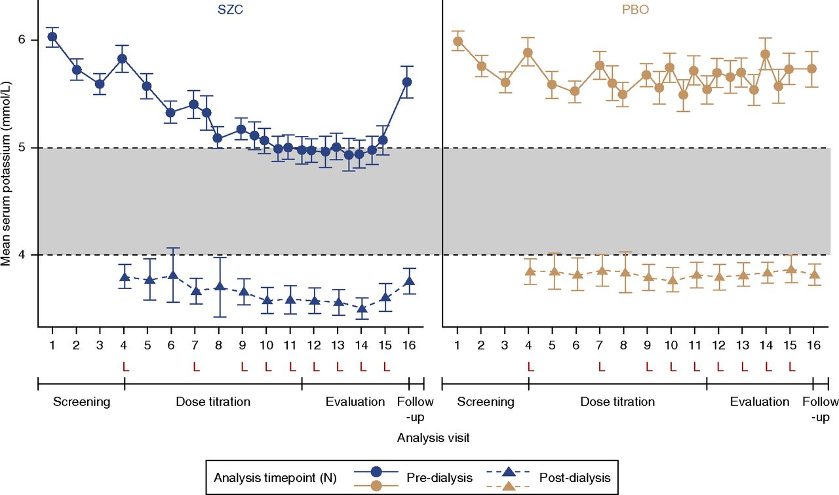
Mean Pre- and Post-dialysis Serum K⁺ Values Were Lower With Sodium Zirconium Cyclosilicate Than With Placebo
N= 196; 41% of 97 on sodium zirconium cyclosilicate responded vs 1% of 99 on placebo
Fishbane S, et al. J Am Soc Nephrol. 2019;30(9)1723-1733.
Notes:
Mean pre- and postdialysis sK⁺ values were lower with SZC than with PBO both at the end of the titration period and during the evaluation period. Postdialysis measurements after the short interdialytic interval were obtained only for some of the patients, because these were scheduled according to an earlier version of the study protocol. Dashed horizontal lines represent the upper and lower limits of normal predialysis sK⁺. Error bars indicate 2×SD of the mean. Predialysis mean (SD) sK⁺ was comparable between treatment groups at randomization (visit 4): SZC, 5.8 (0.6) mmol/L; PBO, 5.9 (0.6) mmol/L. Postdialysis mean (SD) sK⁺ at randomization was also comparable in each treatment group: SZC, 3.8 (0.6) mmol/L; PBO, 3.9 (0.6) mmol/L. L, visit after the long interdialytic interval.

Slide 26
Summary
Hyperkalemia is common in patients with CKD and in those with conditions that disrupt the renin-angiotensin-aldosterone system
  It is a long-term concern
Hyperkalemic events are associated with worse outcomes
  Cardiac events
  Muscle weakness
  Impaired acidification
Strategies to limit development of hyperkalemia would be useful clinically

Slide 27
Case Study (continued)
Meni is admitted to the hospital and is treated with
  1 amp D50W
  10 units insulin
  10 mg of nebulized albuterol
6 hours later → K⁺ 5.1 mEq/L
Lisinopril and spironolactone are discontinued
How should this patient be managed once ready for discharge?
D50W, 50% dextrose in water

Slide 28
Continuing Care for Patients With Chronic Hyperkalemia
If hospitalized for hyperkalemia, begin transition to outpatient early
Patient education
  Treatment, diet adherence
  Symptom recognition
  Action plan
Health care team
  Physicians: hospitalist, cardiologist, nephrologist, general internist/primary care
  Nurse, NP, PA, pharmacist, case manager

Slide 29
The Continuum of Hyperkalemia
Acute treatment may be needed for unrecognized chronic hyperkalemia
Signs/symptoms should be closely monitored following an episode of acute hyperkalemia
  Do not discharge until hyperkalemia has resolved
Hospitalist will need to decide if
  Current medications can be continued
  Disease-modifying treatment needs to be initiated
Patient recognition of signs/symptoms is important
Coordinated care is essential

Slide 30
Hyperkalemia vs RAASi: The Catch-22 of Managing Diseases That Benefit From RAASi Therapy!
Prescribe RAASi and Accept Presence of Hyperkalemia?
Avoid/Discontinue
Proven RAASi
Therapies?
CATCH-22
RAASi, renin-angiotensin-aldosterone system inhibitor

Slide 31
RAASi Promotes Kidney-Saving and Life-Saving Benefits in Patients With CKD, Heart Failure, or Diabetes Mellitus
CKD, chronic kidney disease; RAASi, renin-angiotensin-aldosterone system inhibitor

Slide 32
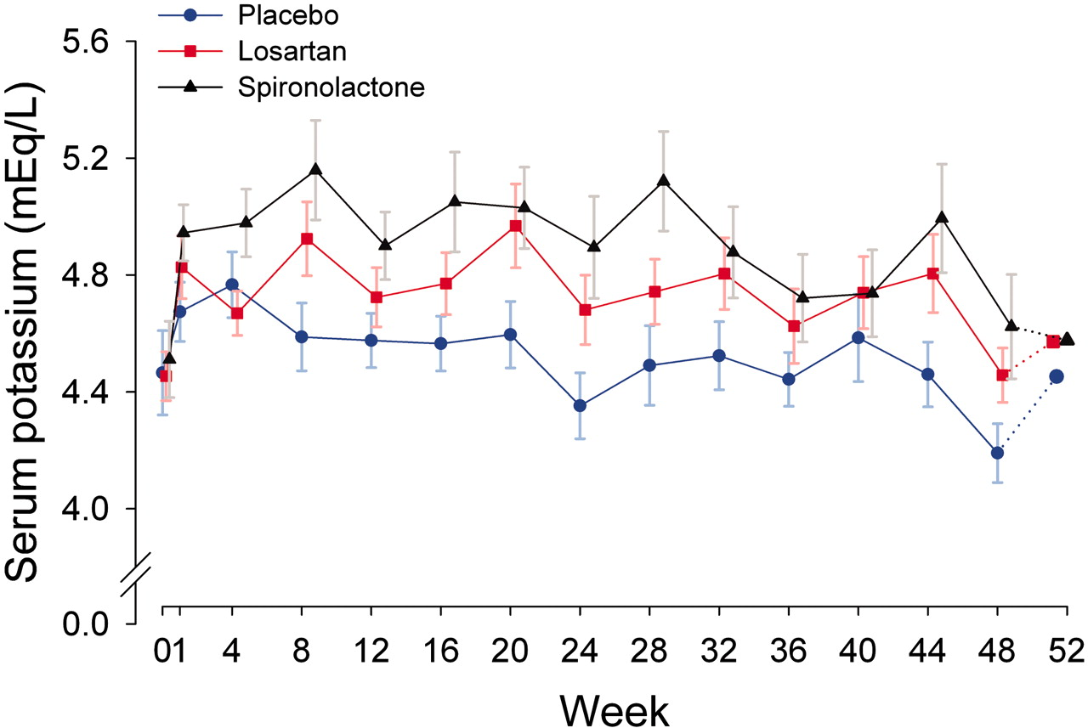
Mean Serum K⁺ Concentration Was Significantly Higher With MRA vs ARB
(n = 27)
100 mg once daily (n = 26)
25 mg once daily (n = 27)
Hyperkalemia (serum K⁺ >6.0 mEq/L) occurred at least once in 2, 10, and 14 subjects in the placebo, ARB, and MRA groups, respectively (MRA (spironolactone) vs placebo, P<.001; ARB (losartan) vs placebo, P=.009). ARB, angiotensin receptor blocker; MRA, mineralocorticoid receptor antagonist
Mehdi UF, et al. J Am Soc Nephrol. 2009;20(12):2641-2650.

Slide 33
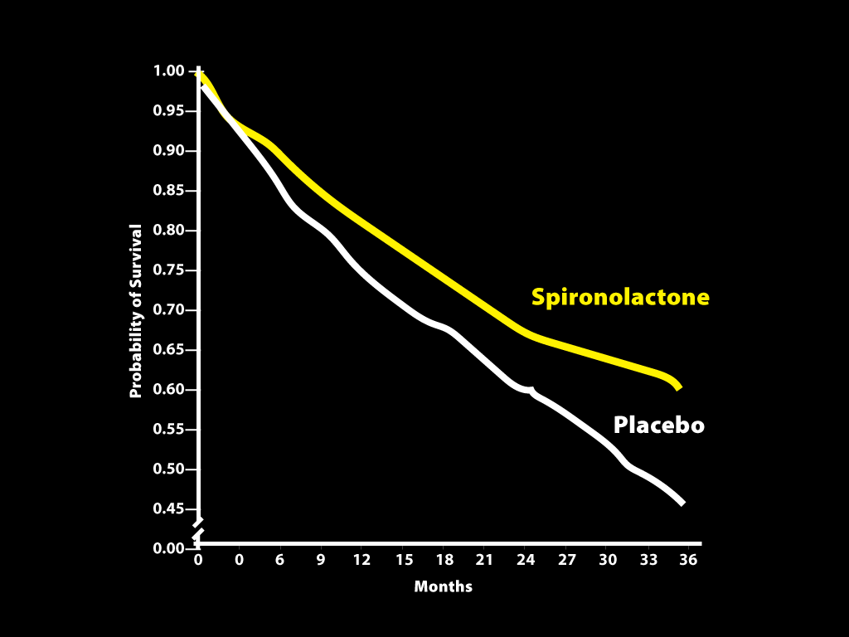
RALES/EMPHASIS-HF: MRAs Improved Survival in Patients With Heart Failure
MRAs, mineralocorticoid receptor antagonists
Pitt B, et al. N Engl J Med. 1999;341(10):709-717.

Slide 34
Hospitalizations for Hyperkalemia Spiked in Patients With Heart Failure After Publication of RALES
Rate of hospital admission for hyperkalemia among patients
recently hospitalized for heart failure who were receiving ACEi
14
Online release
of RALES
12
10
8
Rate of Admission for
Hyperkalemia (per 1,000 patients)
6
4
2
0
1994
1995
1996
1997
1998
1999
2000
2001
Study Year
The yellow lines and 95% CIs beginning in 1999 represent the projected rates of hospital admissions for hyperkalemia
ACEi, angiotensin converting enzyme inhibitor
Juurlink DN, et al. N Engl J Med. 2004;351(6):543-551.

Slide 35
Hyperkalemia Is a Leading Reason for Not Starting RAASi and the Major Reason for Discontinuation of RAASi in CKD
279 patients with CKD followed for a mean of 22 months
At baseline:
  Mean eGFR 33.3 mL/min/1.73 m²
  Mean serum K⁺ 4.73 mEq/L
CKD, chronic kidney disease; eGFR, estimated glomerular filtration rate; RAASi, renin-angiotensin-aldosterone system inhibitor
Yildirim T, et al. Ren Fail. 2012;34(9):1095-1099.

Slide 36
Hyperkalemia Is a Major Reason for Discontinuation of MRA in Heart Failure
134 patients with HF followed in a Portuguese HF clinic
Spironolactone used in patients with SCr ≤2.5 mg/dL and K+ ≤5 mEq/L
25% of patients withdrew from spironolactone therapy (19/76)
Reason for spironolactone suspension (%)
% of Patients
Discontinuation of MRA
Severe hyperkalemia (≥6 mEq/L) occurred in 7 patients who withdrew from spironolactone therapy (9.2%)
HF, heart failure; MRA, mineralocorticoid receptor antagonist; SCr, serum creatinine

Slide 37
Distribution of RAASi Dose Levels by Comorbidity
RAASi, renin-angiotensin-aldosterone system inhibitor
Epstein M, et al. Am J Manag Care. 2015;21:S212-S220.

Slide 38
Current Guidelines Tend to Lessen the Use of Full Recommended Doses of Renin-Angiotensin-Aldosterone System Inhibitors Because of Concerns Related to Hyperkalemia

Slide 39
Hyperkalemia Prevents Use of Guideline-Recommended RAASi Therapy to Delay Progression to ESRD
Kidney Disease Outcomes Quality Initiative, Guideline 11: Use of ACEis and ARBs in CKD
In general, highest tolerated dose of RAASi (ACEi or ARB) is recommended
If hyperkalemia develops
  Reduce dose of ACEi or ARB and/or
  Discontinue ACEi or ARB
ACEi, angiotensin-converting enzyme inhibitor; ARB, angiotensin receptor blocker; CKD, chronic kidney disease; ESRD, end-stage renal disease;
RAASi, renin-angiotensin-aldosterone system inhibitor
KDOQI. https://kdigo.org/wp-content/uploads/2017/02/KDIGO_2012_CKD_GL.pdf

Slide 40
Sodium Polystyrene Sulfonate:
Limited Data to Substantiate Efficacy
Approved in 1958, before well-controlled studies were required¹
Indicated for the treatment of hyperkalemia²
“…no convincing evidence that SPS increases fecal K⁺ losses in
experimental animals or humans and no evidence that adding sorbitol to the resin increases its effectiveness...”¹
There is concern that SPS may not be effective without osmotically active amounts of sorbitol^{3,4}
SPS, sodium polystyrene sulfonate
Sterns RH, et al. J Am Soc Nephrol. 2010;21(5):733-735.
Kayexalate [package insert]. Bridgewater, NJ: sanofi-aventis U.S. LLC; 2009.
Kamel KS, et al. Nephrol Dial Transplant. 2012;27(12):4294-4297.
Gruy-Kapral C, et al. J Am Soc Nephrol. 1998;9(10):1924-1930.

Slide 41
Randomized Clinical Trial of Sodium Polystyrene Sulfonate for the Treatment of Mild Hyperkalemia in CKD
P<.001
P=.07
CKD, chronic kidney disease; SPS, sodium polystyrene sulfonate
LePage L, et al. Clin J Am Soc Nephrol. 2015;10(12):2136-2142.

Slide 42
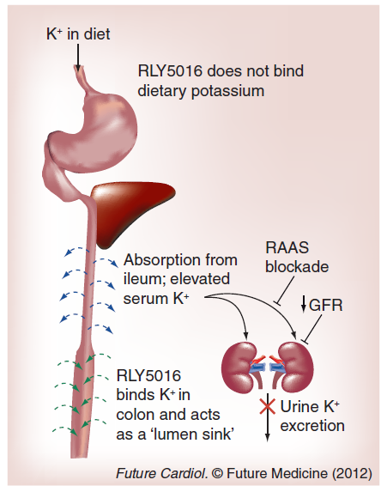
Patiromer Is a Polymer That Binds Potassium in the Colon
Hyperkalemia
  Hyperkalemia is most commonly caused by chronic kidney disease, or the use of RAASi that limit urinary K⁺ excretion and increase serum K⁺ level
Patiromer (RLY5016)
  Nonabsorbed K⁺ binding polymer
  Binds K⁺ in colon (not dietary K⁺)
  Acts as a “sink” to increase colonic K⁺ excretion
GFR, glomerular filtration rate; RAASi, renin-angiotensin-aldosterone system inhibitor
Buysse JM, et al. Future Cardiol. 2012;8(1):17-28.

Slide 43
Patiromer in Patients With Kidney Disease and Hyperkalemia Receiving RAAS Inhibitors
Patients with CKD on RAAS inhibitors (n=243) with hyperkalemia
(5.1 to <6.5 mEq/L) at baseline
Phase 1 (treatment phase)
  Treatment with patiromer for 4 weeks
    4.2 g twice daily if K⁺ 5.1 to <5.5 mEq/L
    8.4 g twice daily if K⁺ 5.5 to <6.5 mEq/L
Phase 2 (withdrawal phase):
  Eligible patients (n=107) were those with baseline K⁺ of 5.5 to 6.4 mEq/L in whom the K⁺ level decreased to 3.8 to 5.0 mEq/L
  Randomized to continue patiromer (at same dose) or switch to placebo for 8 weeks
CKD, chronic kidney disease; RAAS, renin-angiotensin-aldosterone system
Weir MR, et al. N Engl J Med. 2015;372:211-221.

Slide 44
Patiromer Phase 3 Trial (Opal-HK)– Phase 1 Results
  Phase 1 Primary Efficacy Endpoint:
  Mean Change from Baseline to Phase 1 Week 4
  (All Subjects)
All
Subjects
−1.01
P<0.001
Dose
Group 1
−0.65
Dose
Group 2
−1.23
BL
Day 3
Week 1
Week 2
Week 3
Week 4
Weir MR, et al. N Engl J Med. 2015;372:211-221.

Slide 45
Pivotal Phase 3 Trial (Opal-HK)– Phase 2 Results
Primary Efficacy Endpoint: Difference Between Groups in the Median Change in Serum Potassium From Phase 2 Baseline to Phase 2 Week 4*
∆ = 0.72 mEq/L
P<0.001
Estimated Median Change from Phase 2 Baseline in Serum Potassium (mEq/L)
Estimated Median Change from Phase 2 Baseline
Placebo
Patiromer
0.72 mEq/L
0.00 mEq/L
*Or earlier time point if subject first had serum potassium <3.8 mEq/L or ≥5.5 mEq/L
Weir MR, et al. N Engl J Med. 2015;372:211-221.

Slide 46
Time to First Recurrent Hyperkalemia Event
During Phase 2
Weeks 1-4*
Recurrent Hyperkalemia
= Serum Potassium ≥5.5 mEq/L
Weeks 5-8
Recurrent Hyperkalemia
= Serum Potassium ≥5.1 mEq/L
1.0
0.9
0.8
0.7
Placebo
Proportion With Recurrent Hyperkalemia
0.6
0.5
0.4
0.3
0.2
Patiromer
0.1
0.0
Study Week
AW4/BBL
BW1
BW2
BW3
BW4
BW5
BW6
BW7
BW8
Subjects without recurrent hyperkalemia at any time before, and at, the study visit and still on study drug
Placebo
52
46
38
31
29
23
16
12
4
Patiromer
55
53
48
47
44
39
38
38
29
* Phase 2 Weeks 1-4 = Primary Efficacy Outcome Period
Weir MR, et al. N Engl J Med. 2015;372:211-221.

Slide 47
Primary Efficacy Endpoint in the Randomized Withdrawal Phase, According to Subgroup
Weir MR, et al. N Engl J Med. 2015;372:211-221.

Slide 48
Adverse Events During the Initial Treatment Phase and Through the Safety Follow-up Period* for That Phase
Adverse Event | No. of Patients (%)
≥1 Adverse event | 114 (47)
Constipation | 26 (11)
Diarrhea | 8 (3)
Hypomagnesemia | 8 (3)
Nausea | 8 (3)
Anemia | 7 (3)
Chronic renal failure | 7 (3)
≥1 Serious adverse event | 3 (1)
*1-2 weeks after discontinuation of study drug
Weir MR, et al. N Engl J Med. 2015;372:211-221.

Slide 49
Adverse Events During the Randomized Withdrawal Phase and Through the Safety Follow-up Period* for That Phase
Adverse Event | Placebo (n=52) | Patiromer (n=55)
≥1 Adverse event | 26 (50) | 26 (47)
Headache | 4 (8) | 2 (4)
Supraventricular extrasystoles | 1 (2) | 2 (4)
Constipation | 0 | 2 (4)
Diarrhea | 0 | 2 (4)
Nausea | 0 | 2 (4)
≥1 Serious adverse event | 1 (2) | 0
*1-2 weeks after discontinuation of study drug; Data are presented as number of patients (%).
Weir MR, et al. N Engl J Med. 2015;372:211-221.

Slide 50
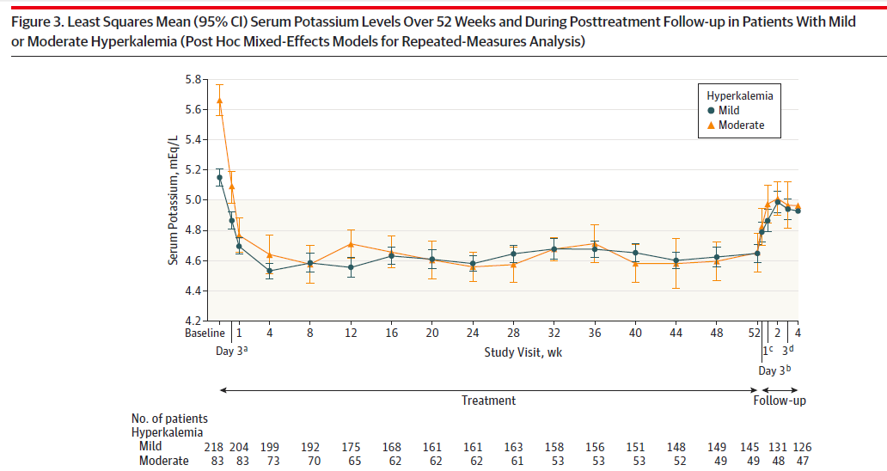
Effect of Patiromer on Serum Potassium Level: AMETHYST-DN (52 weeks)
Drug
Withdrawal
Bakris G, et al. JAMA. 2015;314(2):151-161.

Slide 51
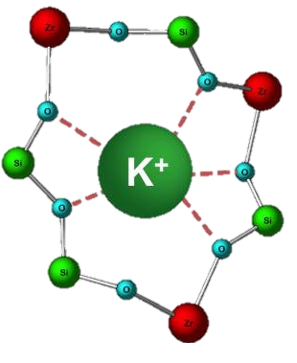
Sodium Zirconium Cyclosilicate: A Novel, Selective K⁺ Binding Agent
Sodium Zirconium Cyclosilicate Properties
Microporous zirconium silicate compound Insoluble, highly stable 9.3x more K⁺ binding capacity than sodium polystyrene sulfonate (Kayexalate®) >125x more selective for K⁺ than sodium polystyrene sulfonate
Average Width of Micropore
Opening 3Å

Slide 52
HARMONIZE Trial
Multicenter, randomized, double-blind, placebo-controlled, phase 3 trial evaluating sodium zirconium cyclosilicate 3 times daily in an initial 48-hour open-label phase (N=258)
Patients (n=237) achieving normokalemia (3.5-5.0 mEq/L) were randomized to once-daily treatment for 28 days with
  Sodium zirconium cyclosilicate
    5 g (n=45)
    10 g (n=51), or
    15 g (n=56) or
  Placebo (n=85)
Kosiborod M, et al. JAMA. 2014;312(21):2223-2233.

Slide 53
HARMONIZE Trial (continued)
In the open-label phase:
  Congestive heart failure: 36.4%
  Diabetes mellitus: 65.9%
  RAASi therapy: 69.8%
RAASi, renin-angiotensin aldosterone inhibitor
Kosiborod M, et al. JAMA. 2014;312(21):2223-2233.

Slide 54
HARMONIZE Trial: Serum Potassium Levels During the Open-Label Phase (48 hours) by Demographics
Kosiborod M, et al. JAMA. 2014;312(21):2223-2233.

Slide 55
HARMONIZE Trial: Serum Potassium Levels During the Randomized Phase (Days 8–29) According to Study Group
Kosiborod M, et al. JAMA. 2014;312(21):2223-2233.

Slide 56
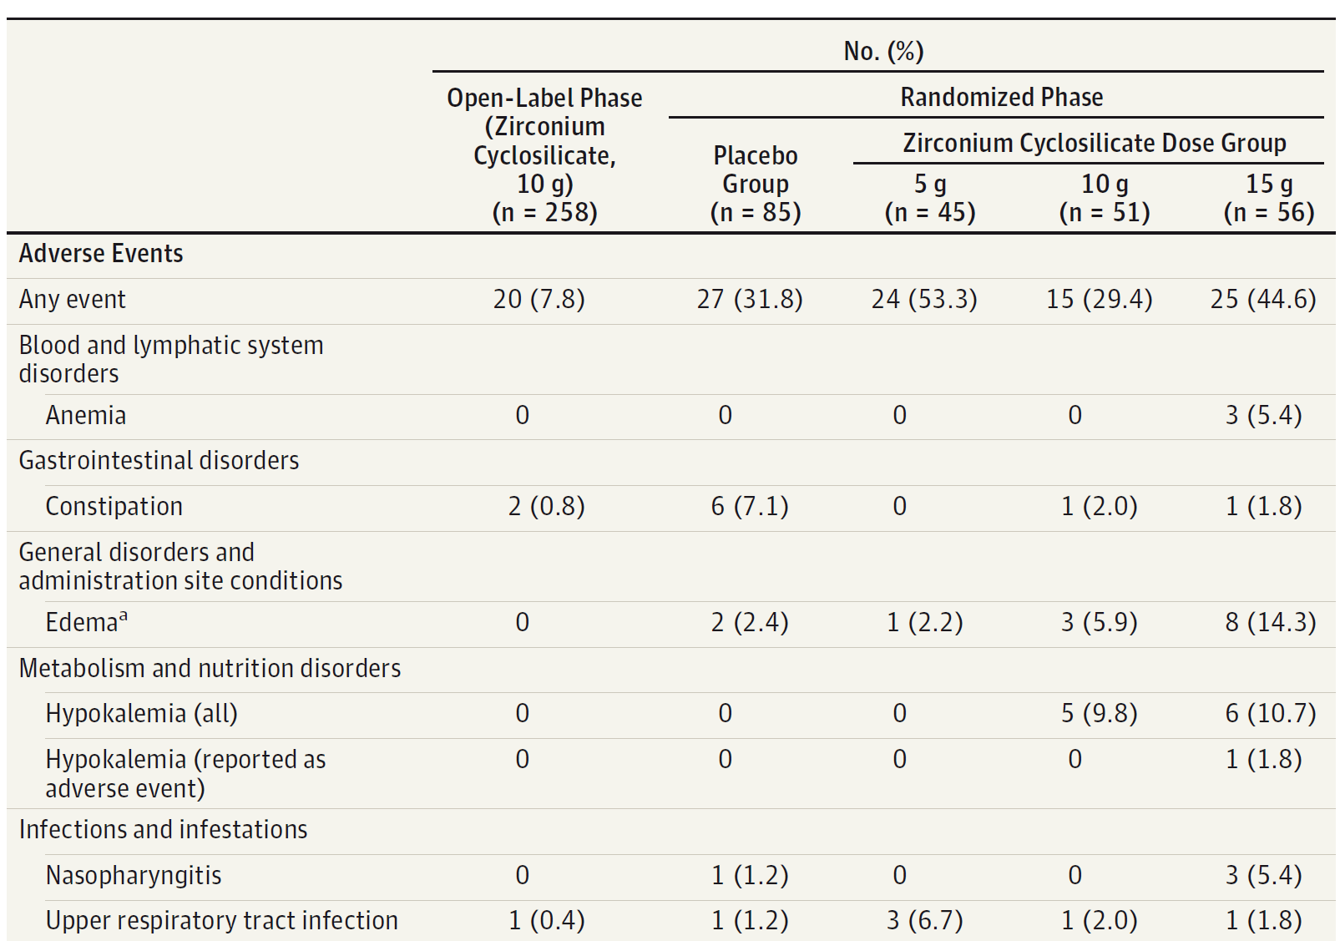
HARMONIZE Trial: Adverse Events Occurring in ≥5% of Patients in Any Group
Kosiborod M, et al. JAMA. 2014;312(21):2223-2233.

Slide 57
Sodium Zirconium Cyclosilicate in Hyperkalemia
Multicenter, double-blind phase 3 trial of patients (N=754) with hyperkalemia
Phase 1
  Patients randomly assigned to receive thrice-daily treatment for 48 hours with:
    Sodium zirconium cyclosilicate (1.25 g, 2.5 g, 5 g, or 10 g) or
    Placebo
Phase 2
  Patients achieving normokalemia (3.5-4.9 mEq/L) (N=543) were randomly assigned to
  once-daily treatment from days 3 through 11 with:
    Sodium zirconium cyclosilicate (1.25 g, 2.5 g, 5 g, or 10 g) or
    Placebo
Packham DK, et al. N Engl J Med. 2015;372(3):222-231.

Slide 58
Potassium Levels With Sodium Zirconium Cyclosilicate 10 g Once-Daily During Phase 2
Packham DK, et al. N Engl J Med. 2015;372(3):222-231.

Slide 59
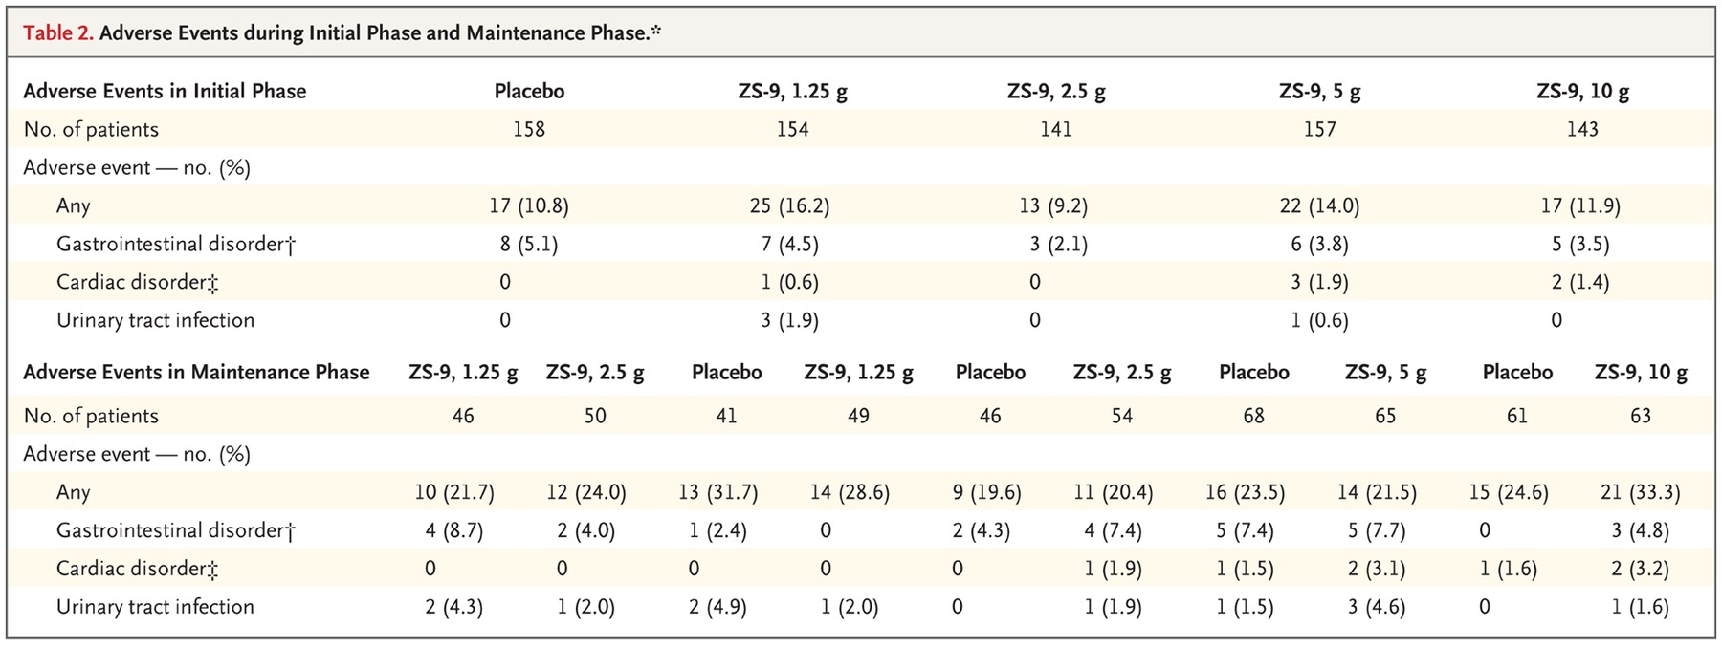
Adverse Events During Initial Phase and Maintenance Phase
Packham DK, et al. N Engl J Med. 2015;372(3):222-231.

Slide 60
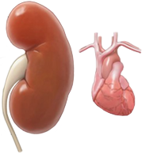
FIDELIO-DKD: Study Design
13,911 patients enrolled
5743 patients randomized
2.6 years median follow-up
Finerenone 10 or 20 mg QD*
Post-treatment follow-up
Run-in
(4–16 weeks)
Screening
R
Placebo
Post-treatment follow-up
N=5734
Hierarchical endpoints
1. Kidney composite
2. CV composite
3.
Death from any cause
Time to kidney failure, sustained ≥40% decrease in eGFR from BL, or renal death
Time to CV death, non-fatal MI, non-fatal stroke or hospitalization for HF
4.
Hospitalization for any cause
5.
Change in UACR
6.
Second kidney composite
*10 mg if screening eGFR <60 mL/min/1.73 m² and 20 mg if >60 mL/min/1.73 m², uptitration encouraged from month 1 if serum potassium <4.8 mEq/L and eGFR stable
Bakris GL, et al. N Engl J Med. 2020;383(23):2219-2229.
Bakris GL, et al. N Engl J Med. 2020;383:2219-2229.

Slide 61
FIDELIO-DKD: Primary Endpoint
Kidney Failure*, Sustained >40% Decrease in eGFR from BL, or Renal Death
40
HR = 0.82 (95% CI, 0.73–0.93)
P= 0.001
Placebo (600/2841)
Finerenone (504/2833)
30
Cumulative incidence (%)
20
10
0
0
6
12
18
24
30
36
42
48
Time to first event (mos)
No. at risk
Placebo 2841 2586 1758 792 82
Finerenone 2833 2607 1808 787 83
*ESKD or eGRF <15 mL/min/1.73 m²
Bakris GL, et al. N Engl J Med. 2020;383(23):2219-2229.

Slide 62
FIDELIO-DKD: Key Secondary Endpoint
CV Death, Non-Fatal MI, Non-Fatal Stroke, or Hospitalization for HF
25
HR = 0.86 (95% CI 0.75–0.99)
P= .0339
Placebo (420/2841)
20
Finerenone (367/2833)
15
Cumulative incidence (%)
10
5
0
0
6
12
18
24
30
36
42
48
Months since randomization
No. at risk
Placebo 2841 2653 1969 951 115
Finerenone 2833 2688 2017 984 111
Bakris GL, et al. N Engl J Med. 2020;383(23):2219-2229.

Slide 63
FIDELIO-DKD: Change in Serum Potassium Over Time
5.4
0.25*
0.24*
0.21*
0.21*
0.20*
5.2
5.0
4.8
Mean serum K⁺ at BL:
Finerenone: 4.4 ± 0.5
Placebo: 4.4 ± 0.5
4.6
Mean serum K⁺ (mmol/L)
4.4
4.2
4.0
3.8
0.02*
0.04*
0.05*
0.07*
0.07*
3.6
0
4
8
12
16
20
24
28
32
36
40
44
Months since randomization
Maximum mean difference in serum potassium between groups: 0.23 mmol/L at month 4
*Mean change from baseline
Bakris GL, et al. N Engl J Med. 2020;383(23):2219-2229.

Slide 64
Strategies to Mitigate Hyperkalemia
Dietary potassium restriction
Avoid drugs that can cause or potentiate hyperkalemia
  NSAIDs
  K⁺-sparing diuretics
  Calcineurin inhibitors
  Other
Concomitant use of potassium binders such as patiromer, sodium zirconium cyclosilicate, sodium polystyrene sulfonate
NSAIDs = non-steroidal anti-inflammatory drugs

Slide 65
Case Study (continued)
Outcome of patient in hospital
Patient SCr returns to baseline, repeat K⁺ 4.5 mEq/L
Discharge medications include carvedilol, torsemide, amlodipine, insulin, restricted potassium diet
Coordinated care with PCP with follow-up 1 week post-discharge
  Repeat SCr stable, K⁺ 4.3 mEq/L
  Restart lisinopril 20 mg/d
Repeat levels in 2 weeks; if K⁺ increased, consider diet counseling, oral
K⁺ binding agent
Restart spironolactone when K⁺ stable
PCP, primary care provider; SCr, serum creatinine

Slide 66
Tips for Good Team Care
Healthcare team members and patient must share the same goal
Education provided to the patient must be consistent among healthcare team members
Good communication is essential
  Among healthcare team members
  Between patient and healthcare team members
The patient must know how to communicate with the healthcare team

