Slide 1
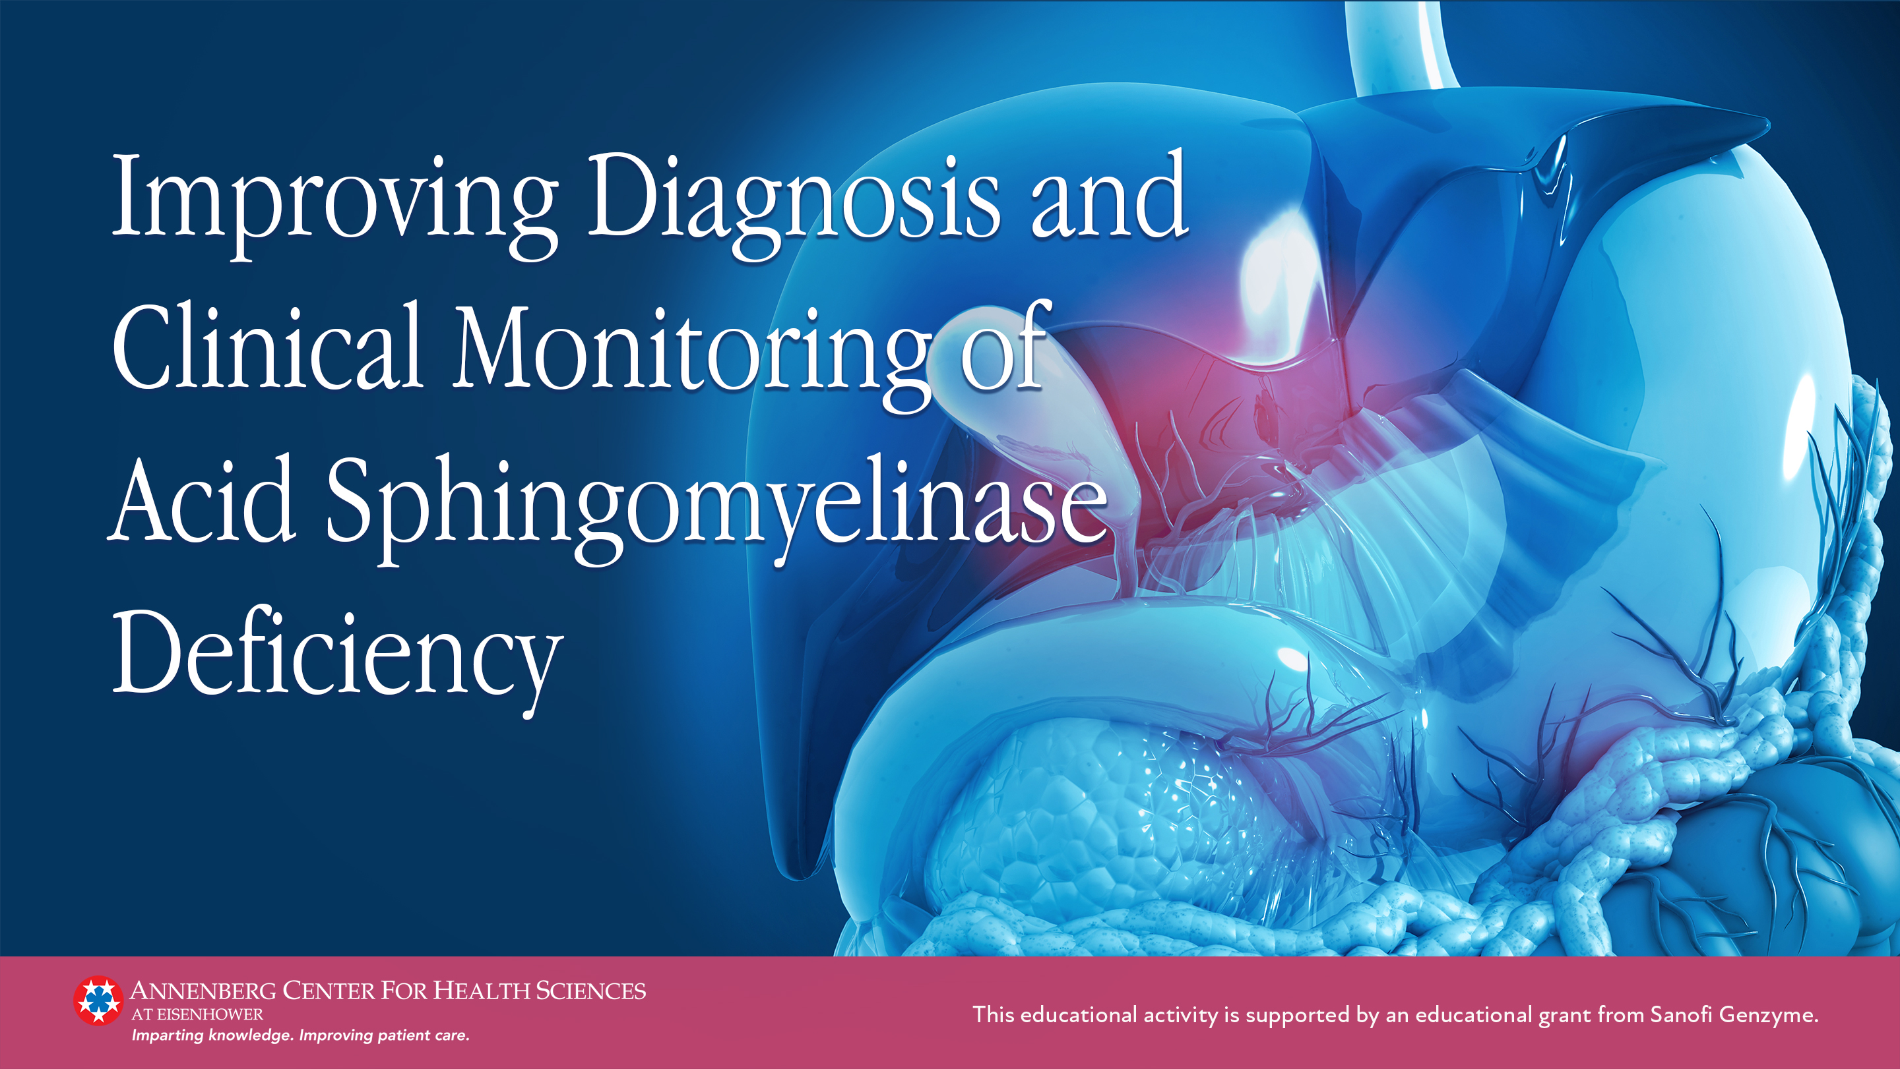

Slide 2
Defining ASMD

Slide 3
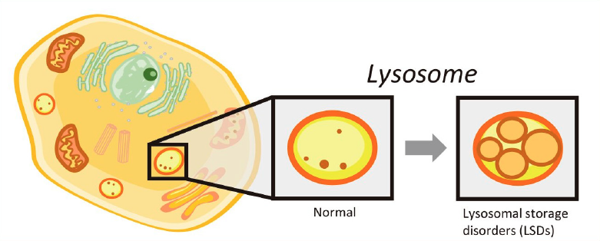
Overview of Lysosomal Storage Disorders
Lysosomes are cellular organelles that are responsible for catabolism of sphingolipids, oligosaccharides, mucopolysaccharides, and various other molecules
Deficiency of specific lysosomal enzymes result in ~70 relatively rare monogenic lysosomal storage disorders
Lysosome
Normal
LSDs
lysosomal enzymes break down substances, which are then recycled
lysosomal enzyme deficiencies lead to accumulation of materials
Image courtesy of Mashima R , et al. Int J Mol Sci. 2020;21(8):2704. CC BY 4.0.
LSD, lysosomal storage disorder.
Mashima R et al. Int J Mol Sci. 2020;21(8):2704.
Platt FM et al. Nat Rev Dis Primers. 2018;4(1):27.

Slide 4
Overview of Acid Sphingomyelinase Deficiency
Autosomal recessive disorder caused by mutations in the SMPD1 gene, which leads to deficiency of acid sphingomyelinase (ASM)
Acid sphingomyelinase is necessary for the metabolism of sphingomyelin, a lipid found in cell membranes
  In ASMD sphingomyelin accumulated in alveolar macrophages, bone marrow, lymph nodes, tissue macrophages in the liver and spleen and, in severe cases, neurons
Commonly known as Niemann-Pick disease (NPD) types A and B
National Organization for Rare Disorders (NORD). 2019. Accessed March 7, 2022. https://rarediseases.org/rare-diseases/acid-sphingomyelinase-deficiency/
McGovern MM et al. Genet Med. 2017;19(9):967-974.

Slide 5
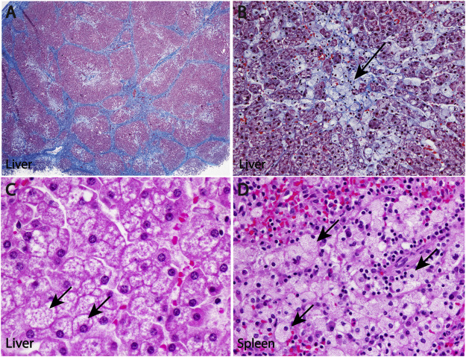
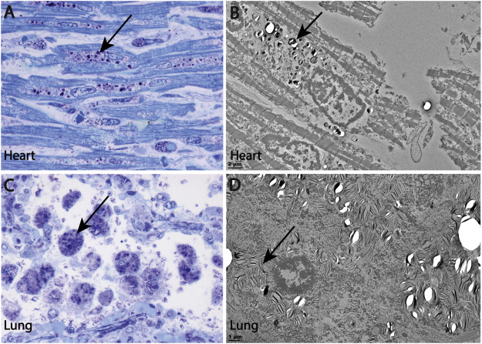
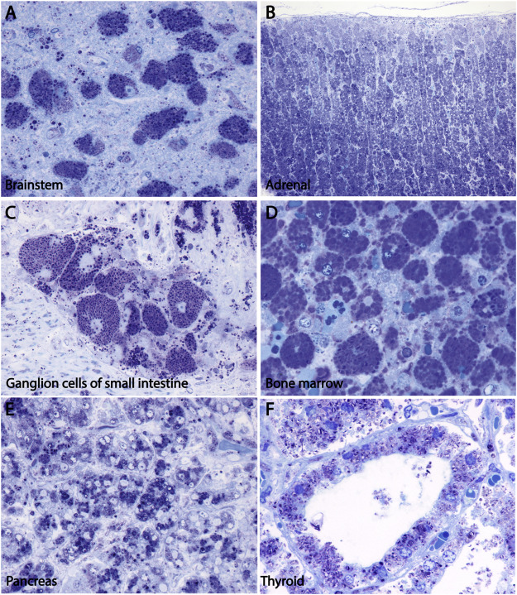
Sphingomyelin Storage Across Organ Systems
(NPD Type A)
Liver
Spleen
Lung
Heart
Brainstem
Bone marrow
Images courtesy of Thurberg BL. Mol Genet Metab Rep. 2020;24:100626. CC BY-NC-ND 4.0.

Slide 6
Classification of ASMD
 | Type A or Infantile Neurovisceral ASMD¹⁻³ | Type A/B or Chronic Neurovisceral ASMD^{1,2,4} | Type B or Chronic Visceral ASMD^{1,2,4,5} (most common)
Severity | Most severe (life-threatening) | Moderate severity | Least severe
Rate of symptom progression | Rapid | Variable | Variable, slower
First appearance of symptoms | Early infancy | Infancy to childhood | Infancy to adulthood
Organ involvement | Multiorgan involvement, including neurodegeneration | Variable multiorgan involvement, typically including neurodegeneration | Variable multiorgan involvement, with limited or no neurodegeneration
Life expectancy | Childhood (mean, 2.3 years) | Childhood to mid-adulthood (mean, 10.3 years) | Childhood to late adulthood (mean, 32.9 years)
McGovern MM et al. Orphanet J Rare Dis. 2017;12(1):41.
McGovern MM et al. Genet Med. 2017;19(9):967-974.
McGovern MM et al. Neurology. 2006;66(2):228-232.
Cassiman D et al. Mol Genet Metab. 2016;118(3):200-213.
Cox GF et al. JIMD Rep. 2018;41:119-129.

Slide 7
Epidemiology of and Risk Factors for ASMD
Precise estimate of incidence difficult due to frequent underdiagnosis or misdiagnosis
  Estimated at 0.5 cases per 100,000 live births
NPD type A highest frequency in Ashkenazi Jewish community
  Carrier frequency of ~1%
  Estimated 2 to 3 cases per 100,000 live births
NPD types A/B and B are panethnic
McGovern MM et al. Orphanet J Rare Dis. 2017;12(1):41.
NORD. 2019. Accessed March 7, 2022. https://rarediseases.org/rare-diseases/acid-sphingomyelinase-deficiency/

Slide 8





ASMD and SPMD1 Alteration Inheritance
If parents are carriers, each child has a 25% chance of being born with ASMD
More than 100 pathogenic SMPD1 variants have been identified
  Type of variant may influence
  ASMD severity
Two copies of loss-of-function SMPD1 alleles result in ASMD
25% ASMD
50%
unaffected carriers
25%
noncarrier
McGovern MM et al. Orphanet J Rare Dis. 2017;12(1):41.

Slide 9
Guidelines for the Diagnosis of ASMD

Slide 10
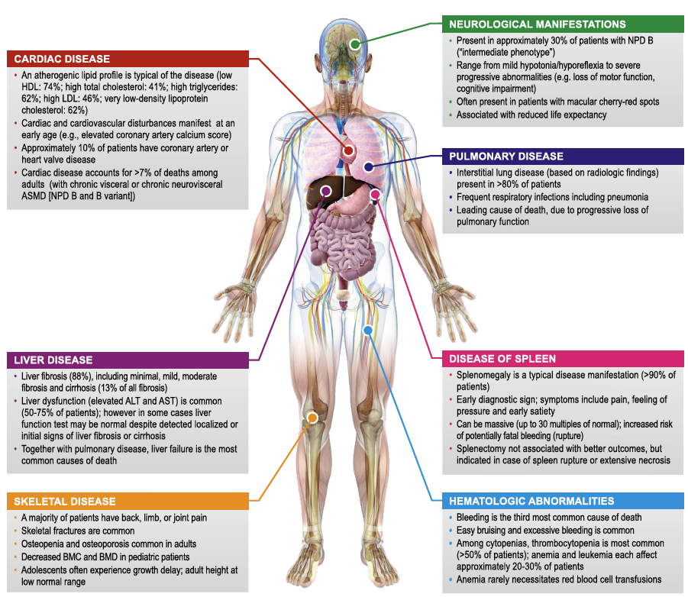
Signs and Symptoms of ASMD…
Vary by genotype
Are highly heterogeneous
Span multiple organ systems
leukopenia each affect
Image courtesy of McGovern MM et al. Orphanet J Rare Dis. 2017;12(1):41. CC BY 4.0.

Slide 11
Manifestations and Natural History of NPD Type A
NPD type A is a relatively homogenous phenotype with the following natural history:^{1,2}
  2 to 4 months: Hepatosplenomegaly
  Onset <10 months: Rapid, progressive neurodegeneration
  ~12 months: Irritability and severe sleep disturbance
  21-27 months: Death
Developmental Age vs Chronologic Age (n = 10)¹
30
— Adaptive behavior skills
— Expressive language
— Gross motor
— Fine motor
25
20
15
Developmental age
10
5
0
2
4
6
8
10
12
14
16
18
02
22
24
Chronologic age, months
McGovern MM et al. Neurology. 2006;66(2):228-232.
Hollak CE et al. Mol Genet Metab. 2012;107(3):526-533.

Slide 12
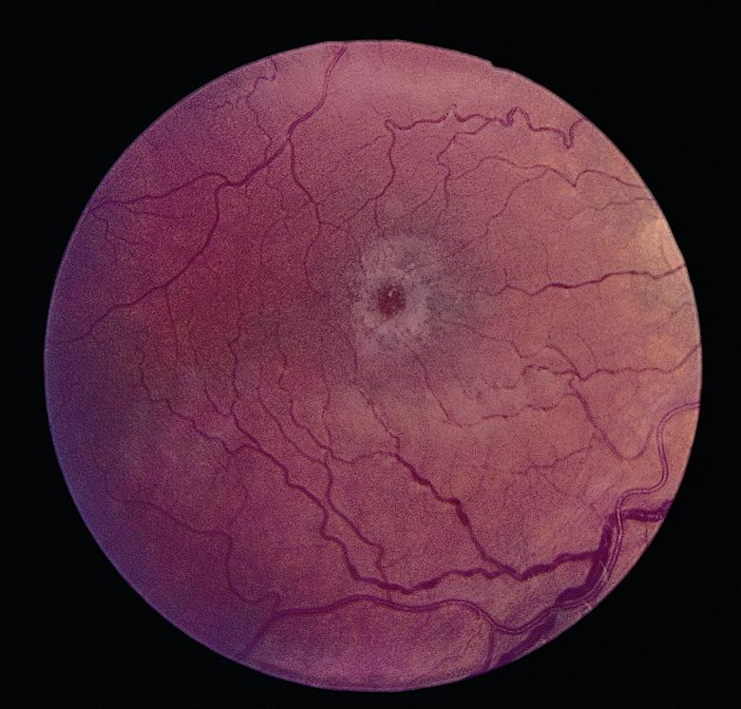
ASMD Ophthalmologic Findings
Retinal changes with NPD:
  White ring of lipid-laden neurons encircling red, ganglion cell–free fovea
  Appears as macular halo or cherry-red macula
For NPD type A, fundus examination typically reveals retinal changes at time of diagnosis
  May also occur with NPD type A/B
NPD Retinal Changes
Image © 2022 American Academy of Ophthalmology. https://www.aao.org/image/niemannpick-disease-2.
McGovern MM et al. Orphanet J Rare Dis. 2017;12(1):41.

Slide 13
Manifestations and Natural History of NPD Type B: Initial Presentation
NPD type B is a phenotypically heterogeneous disorder
Most common initial presentation is hepatomegaly and splenomegaly
Other common findings and complaints:
  Bleeding
  Dyspnea
  Pulmonary infections
  Joint and/or limb pain
  Bruising
  Headaches
  Bone fractures
  Diarrhea
McGovern MM et al. Orphanet J Rare Dis. 2017;12(1):41.
Wasserstein MP et al. Pediatrics. 2004;114(6):e672-e677.

Slide 14
NPD Type B Laboratory Abnormalities
 | Abnormal values at initial visit (%) | Abnormal values at final visit (%)
Hematologic
White blood cells | 3% | 34%
Hemoglobin | 27% | 19%
Platelets | 39% | 54%
Lipids
Total cholesterol | 71% | 78%
LDL cholesterol | 67% | 81%
HDL cholesterol | 88% | 88%
Triglycerides | 83% | 68%
Lung function
FEV₁ | 37% | 44%
FVC | 41% | 30%
FEV₁/FVC | 40% | 52%
DLCO | 69% | 75%
TLC | 19% | 14%
Liver function
ALT | 75% | 68%
AST | 65% | 69%
Total bilirubin | 10% | 17%
Wasserstein MP et al. Pediatrics. 2004;114(6):e672-e677.

Slide 15
Manifestations and Natural History of NPD Type A/B
NPD type A/B (also called B variant) is a phenotypically heterogeneous disorder
Somatic features similar to those in NPD type B
May present with cherry red macula
Common neurologic manifestations include ataxia, gross motor delays, and learning disabilities
Presentation more severe than type B and less severe than type A
McGovern MM et al. Orphanet J Rare Dis. 2017;12(1):41.
McGovern MM et al. Genet Med. 2017;19(9):967-974.

Slide 16
Diagnosis of ASMD Presenting in Infancy or Childhood
Splenomegaly ± hepatomegaly
Rule out other causes?
Infection
Malignancy
Other LSDs
Liver disease
CHF
Hematologic disease
≥1 features suggestive of ASMD?
Cherry red maculae
Developmental delay
Hypotonia
Low HDL-C
No
Yes
Equivocal
Repeat enzyme assay (use fibroblasts, MS/MS)
ASM enzyme activity
Low
SMPD1 gene sequencing
Low
Known genotype/phenotype correlations
Infantile neurovisceral ASMD
Chronic neurovisceral ASMD
Chronic Visceral ASMD
McGovern MM et al. Genet Med. 2017;19(9):967-974.

Slide 17
Diagnosis of ASMD Presenting After Childhood
Splenomegaly ± hepatomegaly
Rule out other causes?
Infection
Malignancy
Other LSDs
Liver disease
CHF
Hematologic disease
≥1 features suggestive of ASMD?
Low HDL-C
Interstitial lung disease
Pathologic fractures
No
Yes
Equivocal
Repeat enzyme assay (use fibroblasts, MS/MS)
ASM enzyme activity
Low
SMPD1 gene sequencing
Low
Chronic Visceral ASMD
McGovern MM et al. Genet Med. 2017;19(9):967-974.

Slide 18
ASM Enzymatic Assay for ASMD
Assessment of ASM activity is required for a diagnosis
  Other clinical and laboratory testing may be confirmatory but cannot substitute for enzymatic testing
ASM testing can be performed on several tissues:
  Isolated peripheral blood leukocytes
  Dried blood spots
  Skin fibroblasts
Low levels of ASM activity confirm ASMD diagnosis
McGovern MM et al. Genet Med. 2017;19(9):967-974.

Slide 19
ASM Enzymatic Testing: Best Practices
Tandem mass spectrometry (MS/MS) is the preferred method
  Allows for multiplexing analysis of enzyme activities (eg, Gaucher disease, glucocerebrosidase activity), which decreases costs and improves speed
Compared with fluorometric measurements, tandem mass spectrometry…
  Has higher specificity (fewer false positives, specifically for those with
  Q292K mutations)
  Does not require radiochemicals
Although several types of samples can be used, most laboratories require whole blood
McGovern MM et al. Genet Med. 2017;19(9):967-974.

Slide 20
SMPD1 Sequencing: Role in ASMD Evaluation
>180 pathogenic SMPD1 mutations identified
General genotype-phenotype associations:
  Frameshift mutations typically result in little or no residual ASM activity
  (more severe disease)
  Missense and in-frame deletions typically result in >5% residual ASM activity
  (less severe disease)
Specific genotype-phenotype associations:
  R610del is most common mutation (found in North African populations) and is associated with attenuated NPD type B phenotype
  R496L, L302P, and fsP330 account for most NPD type A in Ashkenazi Jewish population
  A359D accounts for most cases of NPD type B in Chile and have high rates of clinically significant liver disease
  Q292K is associated with neurologic involvement
McGovern MM et al. Orphanet J Rare Dis. 2017;12(1):41.

Slide 21
Differential Diagnosis of ASMD
Clinical features overlap with Gaucher disease
  Parallel enzymatic testing for ASMD (ASM enzyme assay) and Gaucher disease
  (β-glucosidase enzyme assay) recommended
Other potential causes of hepatosplenomegaly:
  Other LSDs, including hexosaminidase A deficiency, Sandhoff disease, NPD type C, Wolman disease, the mucopolysaccharidoses, and the oligosaccharidoses
  Some infectious diseases, hematologic malignancies, and other genetic disorders, including familial hemophagocytic lymphohistiocytosis and glycogen storage diseases
Other potential causes of interstitial lung disease:
  Environmental exposures, connective tissue diseases, and infections
Wasserstein MP, Schuchman EH. February 25, 2021. Accessed March 7, 2022. https://www.ncbi.nlm.nih.gov/books/NBK1370/

Slide 22
Clinical Management and Treatment Monitoring
Part 1

Slide 23
Initial Evaluations and Consultations After Diagnosis of NPD A
Ophthalmologic examination (if not yet performed)
Comprehensive neurologic evaluation
Compete blood count
Serum chemistries, including liver function tests
Dietary consultation
Occupational and physical therapy evaluations
Consultation with a medical geneticist and/or genetic counselor
Wasserstein MP, Schuchman EH. February 25, 2021. Accessed March 7, 2022. https://www.ncbi.nlm.nih.gov/books/NBK1370/
McGovern MM et al. Orphanet J Rare Dis. 2017;12(1):41.

Slide 24
Management of NPD A
No definitive treatment
Physical and occupational therapy
Feeding tube for nutrition
Sedatives for irritability and sleep disturbance (which can impact entire family), as indicated
Family counseling and early involvement of palliative care team
Wasserstein MP, Schuchman EH. February 25, 2021. Accessed March 7, 2022. https://www.ncbi.nlm.nih.gov/books/NBK1370/

Slide 25
Initial Evaluations and Consultations After Diagnosis of NPD A/B or B
Chest radiograph to determine the extent of interstitial lung disease
Pulmonary function testing, including assessment of DLCO in those old enough to cooperate
Bone age in children younger than 18 years
Ophthalmologic examination
Neurologic examination
Baseline laboratory studies (eg, complete blood count, fasting lipid profile, serum chemistries, liver function tests)
Consultation with a medical geneticist and/or genetic counselor
Wasserstein MP, Schuchman EH. February 25, 2021. Accessed March 7, 2022. https://www.ncbi.nlm.nih.gov/books/NBK1370/
McGovern MM et al. Orphanet J Rare Dis. 2017;12(1):41.

Slide 26
Management of NPD A/B and B
No definitive treatment
Primarily based on organ system–directed management
Goal is to lessen impact of symptoms through both treatment and lifestyle interventions
NOTE: bone marrow transplantation and total lung lavage confer minimal benefit with high risk and should not be considered as standard treatment^{2,3}
Wasserstein M et al. Mol Genet Metab. 2019;126(2):98-105.
Uyan ZS et al. Pediatr Pulmonol. 2005;40(2):169-172.
Mercati O et al. Eur J Paediatr Neurol. 2017;21(6):907-911.

Slide 27
Burden of Living With ASMD
Health
Frequent hospitalizations
Need for home health care
Physical
Reduced energy levels
Psychosocial
Stress of financial costs
Feelings of social isolation
Ongoing need for medications and/or medical devices
Difficulty fulfilling work and school obligations
Need for mobility aids
Negative effect on relationships (both patients and caregivers)
Pokrzywinski R et al. Sci Rep. 2021;11(1):20972.
Cox GF et al. JIMD Rep. 2018;41:119-129.

Slide 28
Role of Clinical Trials and Discussions With Patients and Caregivers
Clinical trials for rare diseases can be challenging to implement
Reluctance among patients and caregivers to participate can further delay development
Key points when discussing trial:
  Describe best current treatment option and then present clinical trial
  Explain differences between trial drug and current treatment
  Reiterate multiple times that participation is voluntary
  Use diagrams to show differences in trial groups
  Elicit and thoroughly answer questions
Tingley K et al. Orphanet J Rare Dis. 2021;16(1):26.
National Institutes of Health (NIH). September 17, 2015. March 8, 2022. https://www.nih.gov/health-information/nih-clinical-research-trials-you/talking-your-patient-about-clinical-trial

Slide 29
Clinical Management and Treatment Monitoring
Part 2

Slide 30
Ongoing Surveillance for NPD A/B and B
System/Concern | Evaluation | Frequency
Growth/Nutrition | Measurement of growth parameters Evaluation of nutritional status & safety of oral intake | At each visit
Cardiac | Electrocardiogram | Annually
 | Echocardiogram | Every 2-4 years
Liver function | Serum chemistries including liver transaminases (ALT, AST), albumin, & clotting factors | At least annually
Hematologic | Assessment for fatigue, abdominal pain, & increase in bleeding Platelet count
Hepatosplenomegaly | Radiologic measurements of liver & spleen size | At baseline & as needed
Pulmonary | Assessment for shortness of breath | At each visit
 | Pulmonary function testing | Annually
 | Chest radiograph | Every 2-4 years
Neurologic | Assessment of neurologic function & frequency of headaches | At least annually
Developmental | Monitoring developmental progress & educational needs Evaluation of occupational and physical therapy needs | At each visit
Hyperlipidemia | Fasting lipid profile | At least annually
Musculoskeletal | Assessment for extremity pain | At each visit
 | Bone density assessment (DEXA) | Every 2-4 years
Family support | Assessment for any change in social, domestic, or school- or work-related activities | At each visit
Wasserstein MP, Schuchman EH. February 25, 2021. Accessed March 7, 2022. https://www.ncbi.nlm.nih.gov/books/NBK1370/

Slide 31
Ongoing Management of Liver Disease
Major cause of morbidity and mortality
Lifestyle modifications for patients with liver disease
  Counseling regarding alcohol use
  Diet modification in consultation with registered dietitian
Prophylactic treatment with beta blockers to prevent variceal bleeding in patients with severe fibrosis
Liver transplantation has been utilized in some patients with ASMD
Wasserstein M et al. Mol Genet Metab. 2019;126(2):98-105.

Slide 32
Liver Transplantation for ASMD (NPD Type B)
Height z Score
Can stably restore liver function
Has been shown to improve hematologic and lipid parameters
Has been shown to improve pulmonary function and resolve interstitial lung disease
May lead to catch-up growth
Neurologic delays typically maintained
0
-1
Height z score
-2
-3
-4
0
20
40
After LT, months
Serum LDL
Predicted FEV₁
5
100
4
90
3
LDL (mmol/L)
%
80
2
1
70
0
P = .02
P = .07
Before
LT
After
LT
60
Before
LT
After
LT
Liu Y et al. Liver Transpl. 2019;25(8):1233-1240.

Slide 33
Managing Splenomegaly
No satisfactory treatments
Counseling to reduce or use caution in contact sports to decrease trauma to the spleen
Splenectomy generally not recommended due to risk for pulmonary disease exacerbation
If necessary due to massive splenomegaly or pressure symptoms, splenectomy should be limited to partial splenectomy or partial splenic arterial embolization
Wasserstein M et al. Mol Genet Metab. 2019;126(2):98-105.

Slide 34
Ongoing Management of Common Metabolic and Cardiovascular Symptoms
Lifestyle modifications to decrease cardiovascular risk
  Diet modification in consultation with registered dietitian
  Physical activity in consultation with physical therapist
Lipid-lowering therapy for dyslipidemia based on current guidelines
  Statin use may require more frequent assessment of liver function
Valvular insufficiency may require pharmacotherapy according to current guidelines
Wasserstein M et al. Mol Genet Metab. 2019;126(2):98-105.

Slide 35
Management of Lung Dysfunction
Lifestyle modification counseling
  Avoid first- and second-hand exposure to tobacco smoke
  Avoid use of electronic cigarettes
Supplemental oxygen or bronchodilators may improve dyspnea
Pulmonary infections are common and should be managed according to guidelines for the general population
Wasserstein M et al. Mol Genet Metab. 2019;126(2):98-105.

Slide 36
Improving Growth in ASMD
Standard counseling regarding lifestyle for skeletal loss:
  Dietary modifications, including vitamin D and calcium intake
  Weight-bearing exercise to slow or prevent bone loss
Bisphosphonates not recommended, as they inhibit ASM activity
Physical therapy may help musculoskeletal pain
Wasserstein M et al. Mol Genet Metab. 2019;126(2):98-105.

Slide 37
Emerging Therapies: Efficacy and Safety Data from Phase 3 Trials

Slide 38
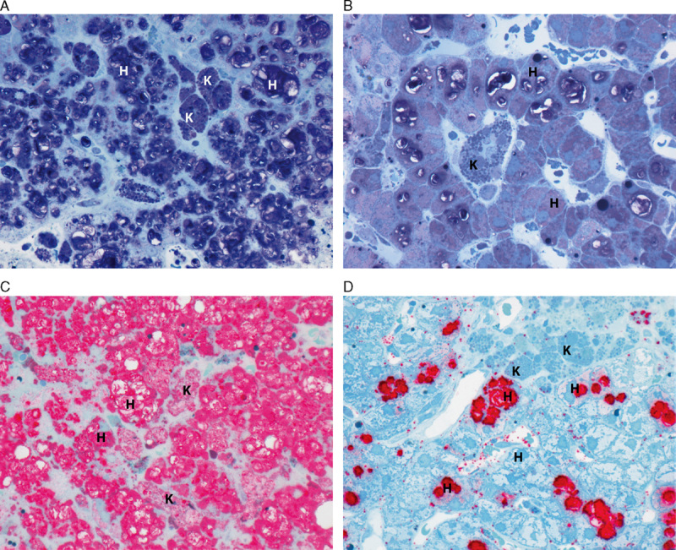
Enzyme Replacement Therapy With Olipudase Alfa
Olipudase alfa is a recombinant human acid sphingomyelinase
Developed for use in patients with nonneurologic ASMD
Has been shown to reduce sphingomyelin levels
Effect of Olipudase Alfa on Sphingomyelin in Liver Samples
Pretreatment
Posttreatment
Toluidene blue stain
Lysenin affinity stain
Thurberg BL e al. Am J Surg Pathol. 2016;40(9):1232-1242.

Slide 39
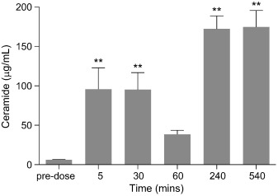
Olipudase Alfa Dose Titration
Ceramide Levels After Administration of 20 mg/kg Olipudase Alfa in ASMD Mouse Model
Doses up to 3 mg/kg have been shown to reduce sphingomyelin in tissues
Higher doses (≥10 mg/kg) were associated with severe toxicity in mouse models
  Believed to be caused by rapid catabolism of sphingomyelin leading to build-up of catabolites (ceramides)
**P < .01
Image courtesy of Murray JM et al. Mol Genet Metab. 2015;114(2):217-225. CC BY-NC-ND 3.0.
Murray JM et al. Mol Genet Metab. 2015;114(2):217-225.

Slide 40
Phase 2 ASCEND Clinical Trial: Study Design
Inclusion criteria:
Adults aged 18-65 years
Spleen volume ≥6 multiples of normal
DLCO 21%-80% of predicted value
Preserved liver function
No history of organ transplant
Key end points:
Safety
Spleen and liver volumes
Pulmonary function
Hematologic parameters
Bone density
Patient-reported outcomes
IV olipudase alfa
every 2 weeks
started at 0.1 mg/kg and
titrated to 3 mg/kg
n = 5
long- term follow up
Wasserstein MP et al. Mol Genet Metab. 2015;116(1-2):88-97.

Slide 41
Phase 2 ASCEND Clinical Trial: Baseline Demographics
 | Mean | Range
Age (years)
Symptom onset | 4.2 | 0-12
Diagnosis | 7.2 | 2-12
First olipudase alfa injection | 32.6 | 22-47
ASM activity in leukocytes (% of normal) | 17.8% | 12%-29%
Spleen volume (MN) | 12.77 | 7.41-17.92
Liver volume (MN) | 1.74 | 1.21-2.23
MN, multiples of normal.
Wasserstein MP et al. Mol Genet Metab. 2015;116(1-2):88-97.

Slide 42
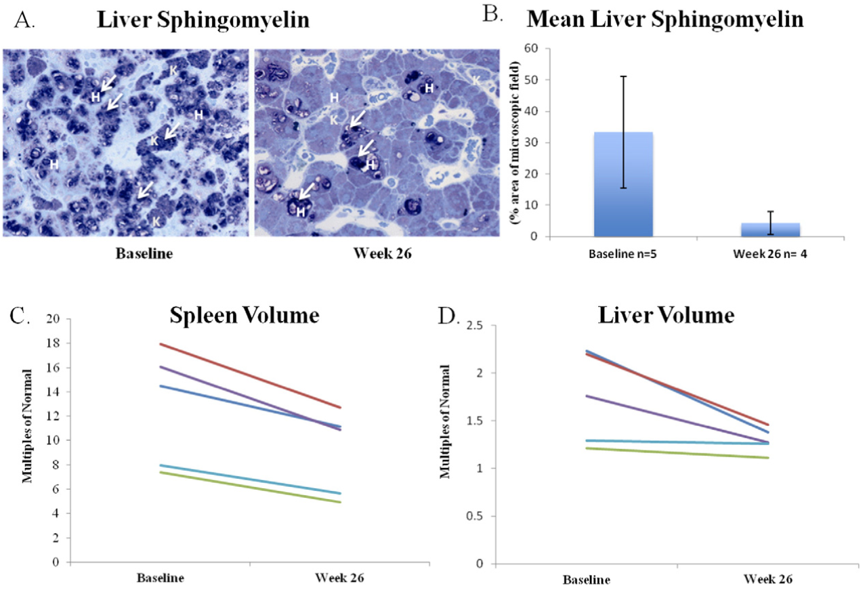
Phase 2 ASCEND Clinical Trial: 26-Week Efficacy Results
Mean Liver Sphingomyelin Levels
Liver Sphingomyelin
Sphingomyelin cleared from Kupffer cells (K) and confined to hepatocytes (H) by week 26
Spleen Volume
Liver Volume
Image courtesy of Wasserstein MP et al. Mol Genet Metab. 2015;116(1-2):88-97. CC BY-NC-ND 4.0.

Slide 43
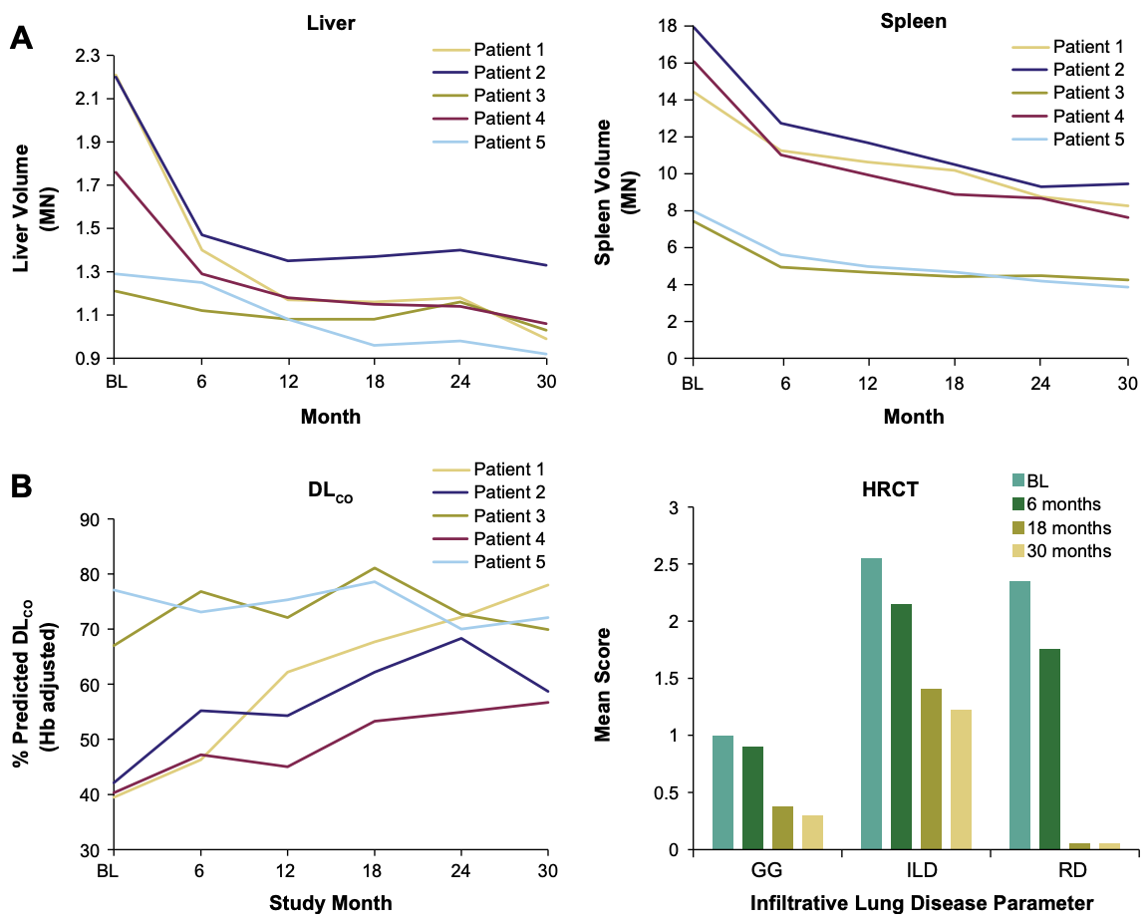
Phase 2 ASCEND Clinical Trial: 30-Month Efficacy Results
Liver Volume
Spleen Volume
DLCO
HRCT
HRCT, high-resolution computed tomography.
Image courtesy of Wasserstein MP et al. J Inherit Metab Dis. 2018;41(5):829-838. CC BY 4.0.

Slide 44
Phase 2 ASCEND Clinical Trial: 42-Month Efficacy Results
Olipudase alfa was also shown to improve lipid profiles for up to
42 months of treatment
Progressive reductions in proatherogenic lipid markers:
  Total cholesterol (4 out of 5 patients)
  LDL cholesterol (4 out of 5)
  VLDL cholesterol (5 out of 5)
  Triglycerides (5 out of 5)
Progressive improvements in antiatherogenic lipid markers:
  HDL cholesterol (5 out of 5)
  apolipoprotein A-I (5 out of 5)
Thurberg BL et al. Mol Genet Metab. 2020;131(1-2):245-252.

Slide 45
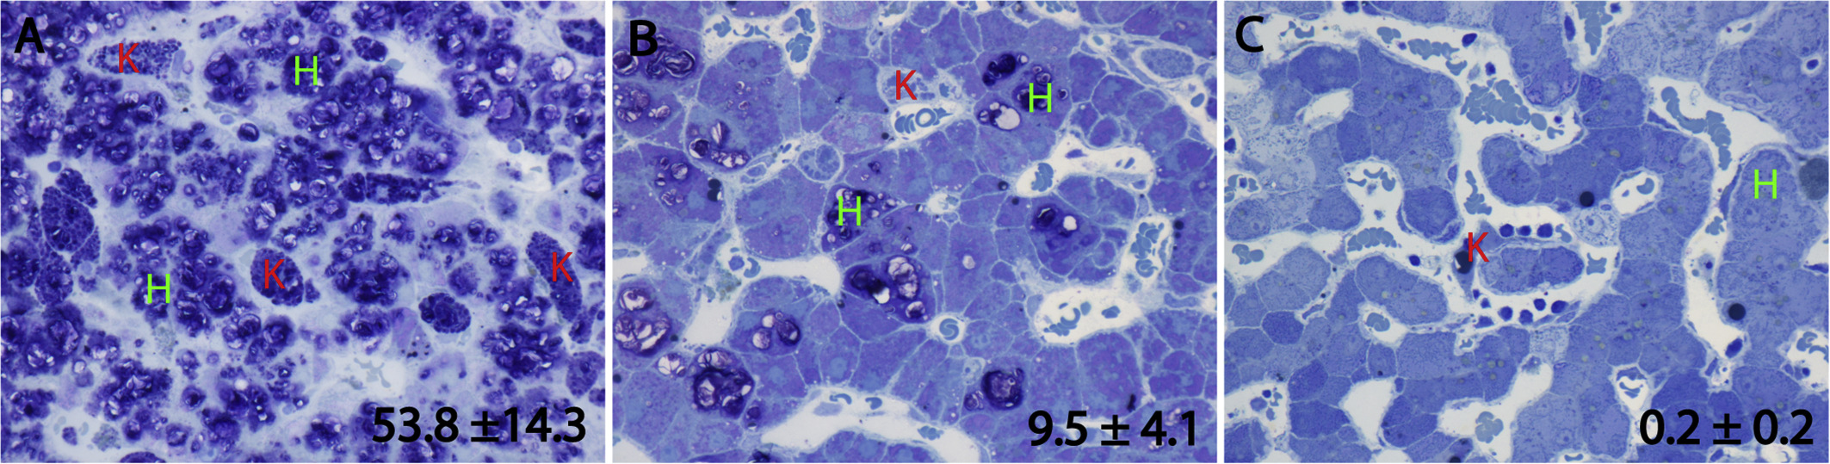
Phase 2 ASCEND Clinical Trial: 42-Month Efficacy Results
Sphingomyelin was progressively cleared from Kupffer cells and then hepatocytes
Baseline
6 Months
42 Months
Image courtesy of Thurberg BL et al. Mol Genet Metab. 2020;131(1-2):245-252. CC BY 4.0.

Slide 46
Phase 2 ASCEND Clinical Trial: Safety
All patients experienced mild treatment-emergent adverse events (TEAEs)
No patients experienced severe TEAEs
Most common TEAEs:
  Headache (100%)
  Nausea (100%)
  Abdominal pain (100%)
  Arthralgia (80%)
  Fatigue (60%)
Thurberg BL et al. Mol Genet Metab. 2020;131(1-2):245-252.

Slide 47
Phase 1/2 ASCEND-Peds Clinical Trial: Study Design
Inclusion criteria:
Aged <18 years
Spleen volume ≥5 multiples of normal
Height Z-scores ≤-1
Mean platelet counts ≥60 x 10⁹/L
Preserved liver function
No acute or rapidly progressive neurologic symptoms
Key end points:
Safety
Spleen and liver volumes
Liver function
Lung anatomy and function
Lipid levels
Platelet counts
Growth
IV olipudase alfa
every 2 weeks
started at 0.03 mg/kg and titrated to 3 mg/kg
n = 20
long- term follow up
Diaz GA et al. Genet Med. 2021;23(8):1543-1550.

Slide 48
Phase 1/2 ASCEND-Peds Clinical Trial: Baseline Demographics
 | Adolescent (12-17 y) (n = 4) | Child (6-11 y) (n = 9) | Infant/early child (<6 y) (n = 7) | Overall (n = 20)
Age (years)
Symptom onset | 1.4 | 1.6 | 1.2 | 1.4
Diagnosis | 2.1 | 3.4 | 1.6 | 2.5
Enrollment | 14.8 | 8.7 | 3.4 | 8.0
ASM activity in leukocytes (nmol/h/mg) | 0.21 | 0.13 | 0.10 | 0.14
Severe splenomegaly (>15 MN) | 25.0% | 55.6% | 85.7% | 60.0%
Diaz GA et al. Genet Med. 2021;23(8):1543-1550.

Slide 49
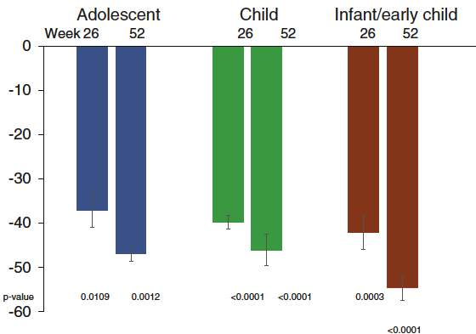
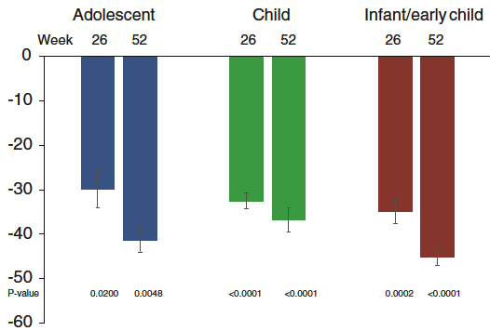
Phase 1/2 ASCEND-Peds Clinical Trial: Spleen and Liver Outcomes
Spleen Volume
Liver Volume
Change from baseline (%)
Images courtesy of Diaz GA et al. Genet Med. 2021;23(8):1543-1550. CC BY 4.0.

Slide 50
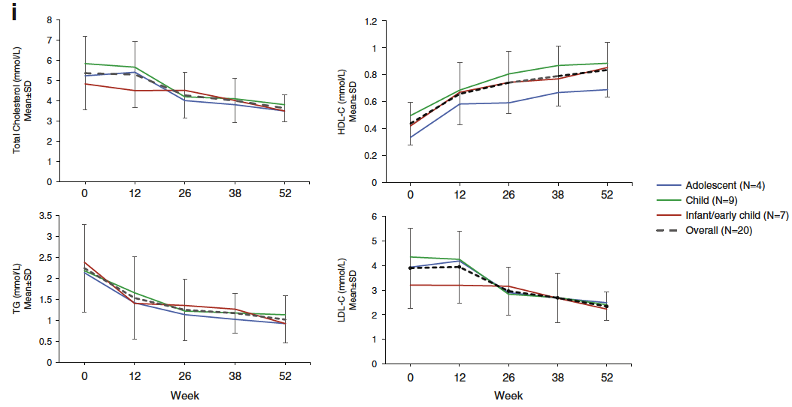
Phase 1/2 ASCEND-Peds Clinical Trial: Lipids Outcomes
Total Cholesterol
HDL Cholesterol
Triglycerides
LDL Cholesterol
Images courtesy of Diaz GA et al. Genet Med. 2021;23(8):1543-1550. CC BY 4.0.

Slide 51
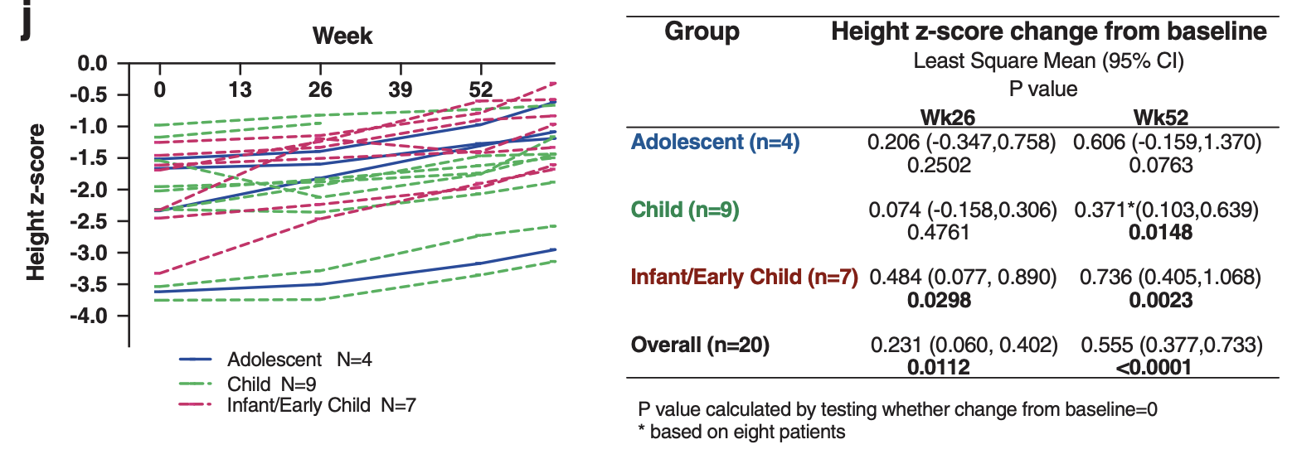
Phase 1/2 ASCEND-Peds Clinical Trial: Growth Outcomes
Images courtesy of Diaz GA et al. Genet Med. 2021;23(8):1543-1550. CC BY 4.0.

Slide 52
Phase 1/2 ASCEND-Peds Clinical Trial: Safety Outcomes
All patients experienced at least one TEAE, which were mostly mild (88%)
  One patient had a serious treatment-related TEAE (anaphylaxis) but successfully continued treatment after desensitization
Common TEAEs included fever, cough, vomiting, nasopharyngitis, diarrhea, headache, nausea, rhinitis, oropharyngeal pain, ear pain, and rhinorrhea
Of the TEAEs considered related to treatment, most were injection reactions (eg, itching, fever, and vomiting)
Diaz GA et al. Genet Med. 2021;23(8):1543-1550.

Slide 53
Phase 2/3 ASCEND Clinical Trial: Study Design
Inclusion criteria:
Adults aged ≥18 years
DLCO ≤70% of predicted normal value
Spleen volume ≥6 multiples of normal
Splenomegaly-related score ≥5
Mean platelet counts ≥60 × 10⁹/L
Preserved liver function
Key end points:
Change in % predicted DLCO (primary)
Spleen volume with SRS in the US (primary)
Liver volume
Platelet counts
Patient-reported outcomes
Safety
Placebo
n = 36
IV olipudase alfa
every 2 weeks
started at 0.1 mg/kg and
titrated to 3 mg/kg
Wasserstein M et al. Genet Med. 2022;S1098-3600(22)00716-X.

Slide 54
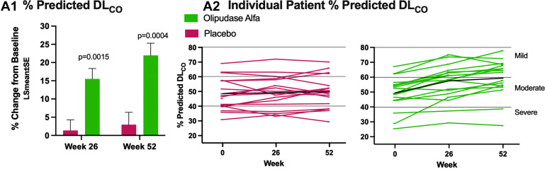
Phase 2/3 ASCEND Clinical Trial: Pulmonary Outcomes
Image courtesy of Wasserstein M et al. Genet Med. 2022;S1098-3600(22)00716-X. CC BY-NC-ND 4.0.
Wasserstein M et al. Genet Med. 2022;S1098-3600(22)00716-X.

Slide 55
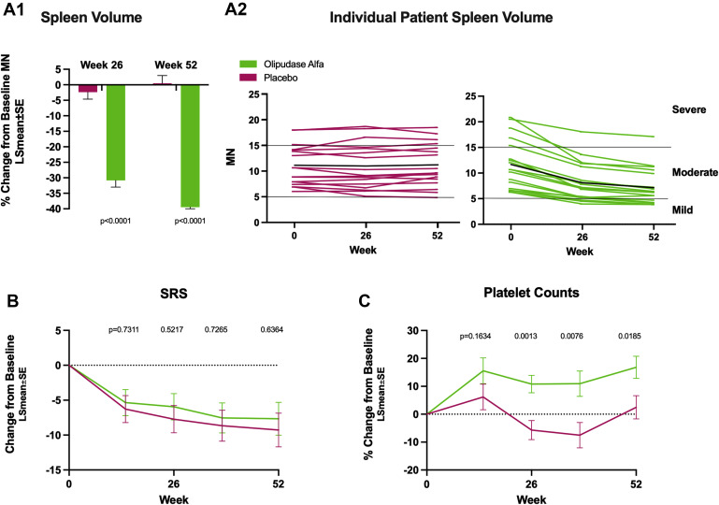
Phase 2/3 ASCEND Clinical Trial: Pulmonary Outcomes
Image courtesy of Wasserstein M et al. Genet Med. 2022;S1098-3600(22)00716-X. CC BY-NC-ND 4.0.
Wasserstein M et al. Genet Med. 2022;S1098-3600(22)00716-X.

Slide 56
Phase 2/3 ASCEND Clinical Trial: Safety
AEs occurred at similar rates in the olipudase alfa (242) and placebo (267) groups
Headache, nasopharyngitis, arthralgia, upper respiratory tract infection, and cough were the most common AES
Most AEs were mild, and none led to permanent treatment discontinuation or study withdrawal
Wasserstein M et al. Genet Med. 2022;S1098-3600(22)00716-X.

Slide 57
Preclinical Investigational Treatments for ASMD
Gene therapy with an adeno-associated viral vector (AAV9) to deliver human ASM1
  Currently in preliminary studies in animal models
Inhibition of fatty acid amide hydrolase (FAAH) to reduce degradation of the endocannabinoid system2
  Currently in preliminary studies in mouse models and in vitro studies
Samaranch L et al. Sci Transl Med. 2019;11(506):eaat3738.
Bartoll A et al. EMBO Mol Med. 2020;12(11):e11776.

Slide 58
Summary
ASMD (NPD A, B, and A/B) comprises a group of potentially life-threatening disorders caused by deficiency in ASM and accumulation of sphingomyelin
ASMD is caused by mutations in the SMPD1 gene
Common presenting symptoms include hepatosplenomegaly, but NPD B and A/B are highly heterogeneous disorders
Olipudase alfa is an investigational treatment that has been shown to safely reduce liver and spleen volume, lipid levels, and other signs and symptoms of ASMD

