Slide 1
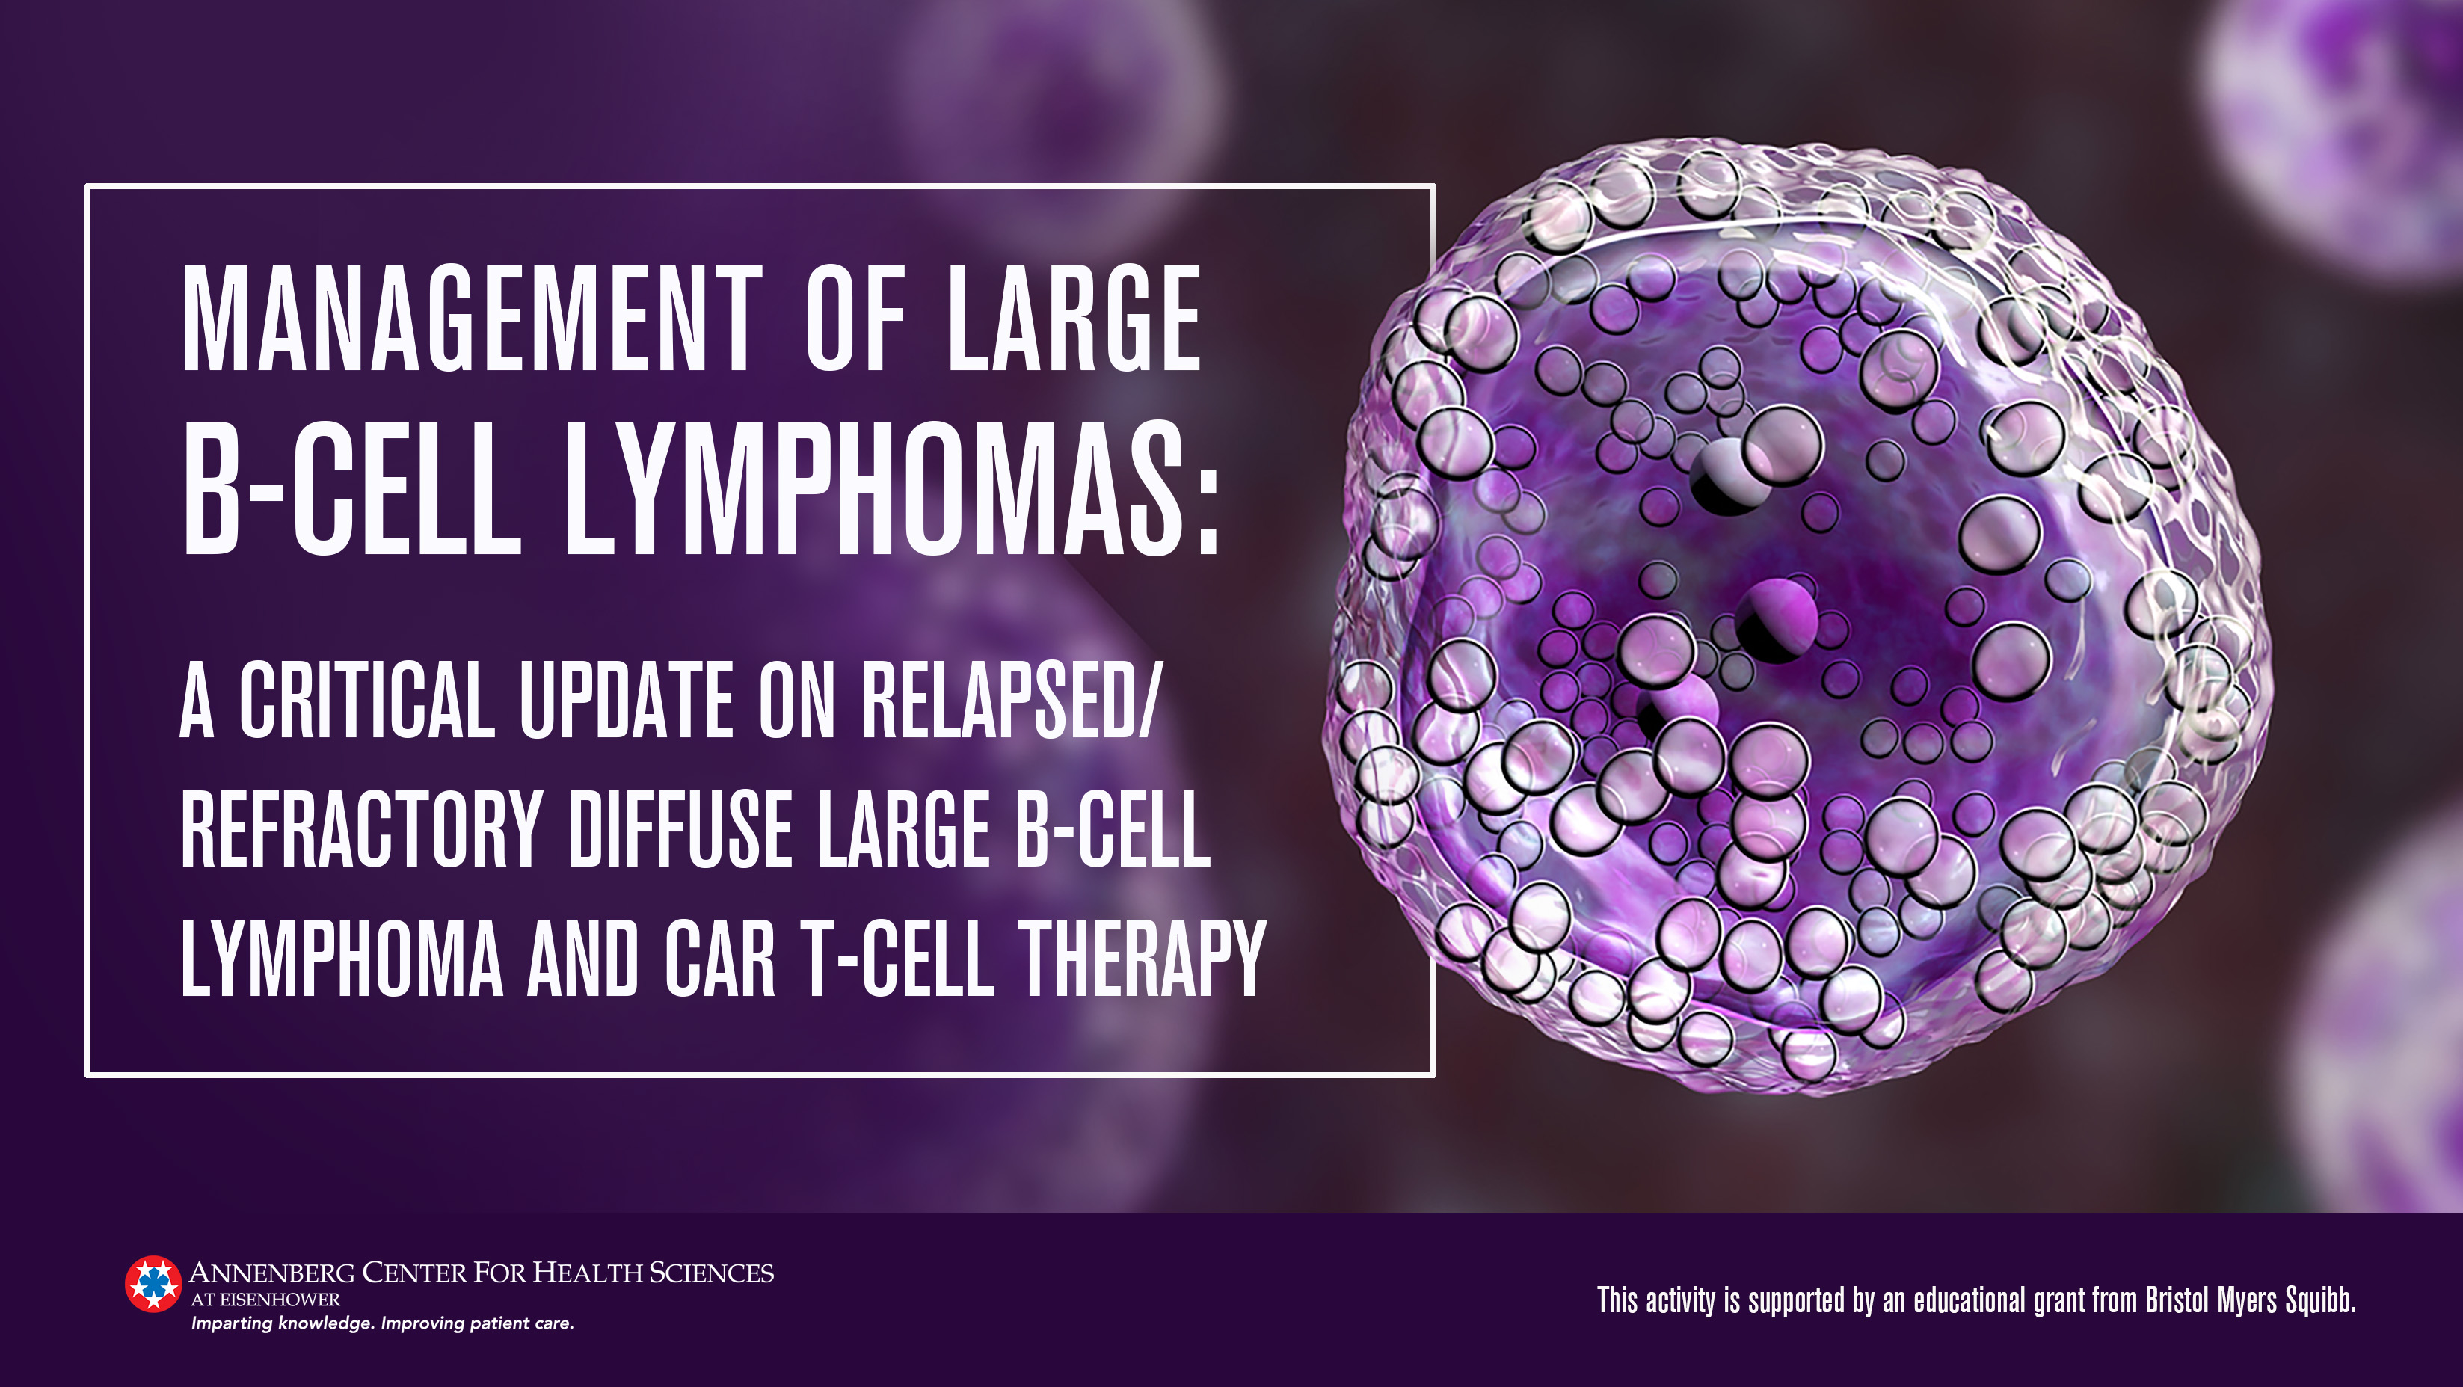

Slide 2
Jeremy Abramson, MD
Director, Lymphoma Program
Jon and Jo Ann Hagler Chair in Lymphoma
Massachusetts General Hospital Cancer Center
Associate Professor of Medicine
Harvard Medical School
Boston, Massachusetts

Slide 3
Faculty Disclosures
Advisory Board: AbbVie, Century Therapeutics, Lilly, Mustang Bio, Regeneron
Consultant: AstraZeneca, BeiGene, Bluebird Bio, Bristol Myers Squibb, Epizyme, Genentech, Genmab, Incyte, Kite Pharma, Kymera, MorphoSys, Ono Pharma

Slide 4
Objectives
Review the disease state, clinical and molecular heterogeneity, and unmet needs, including the clinical and healthcare resource burden of large B-cell lymphomas (LBCL)
Describe the mechanism of action and appraise available clinical safety and efficacy data and indications for new agents for the treatment of LBCL, especially R/R LBCL, to select optimal treatments
Integrate approaches for identifying patients eligible for chimeric antigen receptor T-cell (CAR T-cell) therapy and applying suitable bridging therapies
Incorporate approaches for identifying, monitoring, and managing therapy-associated toxicities and AEs, including CAR T-cell–associated toxicities, for patients with LBCL

Slide 5
Module 1
Disease Burden and Overview of Large B-Cell Lymphomas

Slide 6
Non-Hodgkin Lymphomas (NHL)
Most common lymphoid neoplasm²
B-cell lymphomas: predominant subtype of NHL^{1,3}
  ~30-40% are diffuse large B-cell lymphoma (DLBCL)
  Most common hematologic malignancy
  Aggressive: median survival of weeks to months if not treated
*
*CLL/SLL: chronic lymphocytic leukemia/small lymphocytic lymphoma
1. Padala SA, et al. StatPearls, Published 2021. Accessed Feb 10, 2022. https://www.ncbi.nlm.nih.gov/books/NBK557796.
2. National Comprehensive Cancer Network. B-Cell Lymphomas. Version 1.2022. Published March 2, 2022. Accessed March 7, 2022. https://www.nccn.org/professionals/physician_gls/pdf/b-cell.pdf. 3. Maurizio M, et al. Crit Rev Oncol Hematol. 2013;87(2):146-71.

Slide 7
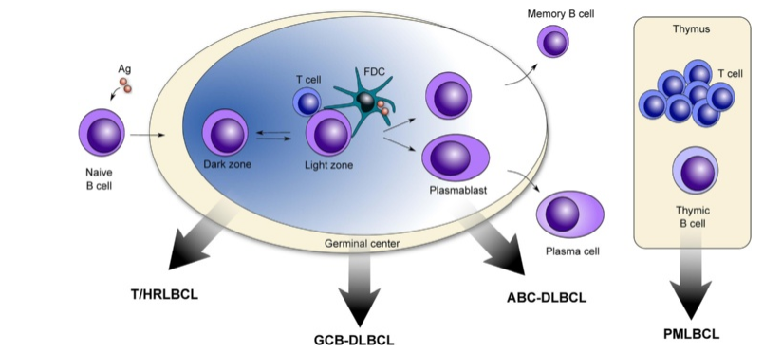
Molecular Subtypes Large-B-Cell Lymphoma^{1,2}
T/HRLBCL: T-cell/histocyte-rich large B-cell lymphoma; GCB: Germinal center B-cell; ABC: Activated B-cell-like; PMLBCL: Primary mediastinal (thymic) large B-cell lymphoma
1. Camicia R, et al. Molecular Cancer. 2015;14:207. Figure used under approved terms of Creative Commons License http://creativecommons.org/licenses/by/4.0/.
2. Lenz G, et al. N Engl J Med. 2008;359:2313-2323.

Slide 8
Clinical Features at Diagnosis¹⁻⁶
Median age 60s
Male 55%
Approximately half of patients present with advanced stage
B symptoms ~40%
Elevated LDH ~40%
Any extranodal involvement 40-70%
Bone marrow involvement 10-20%
CNS involvement <1% (~3% during entire course of disease)
LDH, lactate dehydrogenase; CNS, central nervous system
1. NCI SEER Program. Common Cancer Sites - Cancer Stat Facts. Published 2021. Accessed February 12, 2022. https://seer.cancer.gov/statfacts/html/dlbcl.html. 2. Maurizio M, et al. Crit Rev Oncol Hematol. 2013;87(2):146-71. 3. Padala SA, et al. StatPearls, Published 2021. Accessed Feb 10, 2022. https://www.ncbi.nlm.nih.gov/books/NBK557796. 4. Conlan MG, et al. J Clin Oncol. 1990;8(7):63-72. 5. Gouveia GR, et al. Rev Bras Hematol Hemoter. 2012;34:447-451. 6. Zhou Z, et al. Blood. 2014;123(6):837-842.

Slide 9
Enhanced International Prognostic Index (NCCN-IPI) in Aggressive NHL
NCCN-IPI
Age (years)
> 40 to < 60 | > 60 to < 75 | > 75
1 | 2 | 3
Risk Group
Low (L) | 0-1
Low-intermediate (L-I) | 2-3
High-intermediate (H-I) | 4-5
High (H) | > 6
NCCN-IPI
LDH, normalized
>1 to < 3 | >3 | Stage III-IV disease | Extranodal disease | Performance status > 2
1 | 2 | 1 | 1 | 1
Zhou Z, et al. Blood. 2014; 123(6):837-842

Slide 10
Clinical/Economic Burden of LBCL
Large portion of patients require additional therapy post 1st-line treatment¹
Progressively shorter duration of treatment for subsequent cycles¹
Strong economic burden¹
$164,631 per-patient-per-year for R/R patients¹
Drug cost continues to be one of most significant contributors to overall cost burden in LBCL²
Large unmet need to reduce burden for patients → Can novel therapies close this gap?
R/R, relapsed/refractory
1. Yang X, et al. Oncologist. 2021;26(5):e817-e826. 2. Harkins RA, et al. Expert Rev Pharmacoecon Outcomes Res. 2019;19(6):645-661.

Slide 11
Module 2
Treatment of Large B-Cell Lymphoma: MOA and Clinical Efficacy Data of Novel Therapies

Slide 12
Summary of the Current DLBCL Treatment Landscape
1st Line
Chemoimmunotherapy
± ISRT
(R-CHOP, R-EPOCH)
Relapsed/Refractory
Transplant Eligible
Transplant Ineligible
CAR T-cells (axi-cel or liso-cel for early progressors)
2nd Line
R-ICE
R-DHAP
R-GDP
CR
BEAM-ASCT
R-Chemo (i.e. R-GemOx)
Tafasitamab + Lenalidomide
Polatuzumab + BR
Relapsed/Refractory
Recent therapeutic advances
3rd Line+
Alternative chemoimmunotherapy
Allogeneic transplant
CAR T-cells
Tafasitamab + Lenalidomide
Polatuzumab + BR (US)
Loncastuximab tesirine
Selinexor
Pembro-lizumab (PMBCL)
Ibrutinib (non-GCB)
CR, Complete Response; ASCT, autologous stem-cell transplant; ISRT, involved-site radiation therapy
National Comprehensive Cancer Network. B-Cell Lymphomas. Version 1.2022. Published March 2, 2022. Accessed March 7, 2022. https://www.nccn.org/professionals/physician_gls/pdf/b-cell.pdf.

Slide 13
Novel Agents for DLBCL¹⁻⁸
Class | Agent | MOA/Target | Indication
Monoclonal antibody¹ | Tafasitamab-cxix¹ | CD19 directed antibody | 2nd-line in combo with lenalidomide (non-transplant eligible) ¥ R/R DLBCL (> 2 lines) ¥
Antibody-drug conjugates (ADCs)^{2,3} | Polatuzumab vedotin² | CD79b antibody + MMAE payload | R/R DLBCL (> 2 lines) +BR¥ 2nd-line (non-transplant eligible)*
 | Loncastuximab tesirine³ | CD19 antibody + PBD payload | R/R LBCL (> 2 lines) ¥
Chimeric antigen receptor (CAR-T)⁴⁻⁶ | Axicabtagene Ciloleucel⁴ | antiCD19-CD28-CD3z | R/R LBCL (> 2 lines of therapy)
 | Tisagenlecleucel⁵ | antiCD19-41BB-CD3z
 | Lisocabtagene Maraleucel⁶ | antiCD19-41BB-CD3z
Oral agents⁷⁻⁸ | Ibrutinib⁷ | Bruton’s tyrosine kinase (BTK) inhibitor | 2nd-line+ non-GCB DLBCL (non-transplant eligible)*
Nuclear export inhibitor⁸ | Selinexor⁸ | Oral Selective Inhibitor of nuclear export (SINE) | R/R DLBCL (> 2 lines)¥
*Off-label (ibrutinib is FDA approved for mantle cell and marginal zone lymphomas) ¥Accelerated approval
MMAE, monomethyl auristatin E; PBD, pyrrolobenzodiazepine
1. MONJUVI (prescribing information). Boston, MA. Morphosys US INC. June 2021. 2. POLIVY (prescribing information). San Francisco, CA. Genentech, Inc. Sept 2020. 3. ZYNLONTA (prescribing information). Murray Hill, NJ. ADC Therapeutics. Sept 2021. 4. YESCARTA (prescribing information). Santa Monica, CA. Kite Pharma, Inc. Jan 2022. 5. KYMRIAH (prescribing information). East Hanover, NJ. Novartis Pharmaceuticals. Aug 2021. 6. BREYANZI (prescribing information). Bothel, WA. Bristol-Myers Squibb. February 2021. 7. IMBRUVICA (prescribing information). Horsham, PA. Janssen Biotech, Inc. Dec 2020. 8. XPOVIO (prescribing information). Newton, MA. Karyopharm Therapeutics, Inc. Aug 2021.

Slide 14
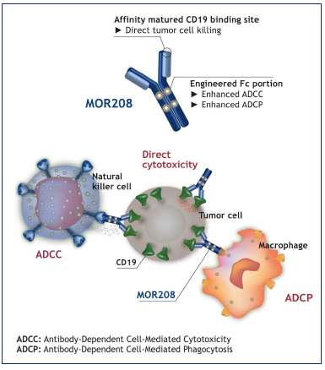
L-MIND: Tafasitamab + Len in R/R DLBCL
Phase 2 Study
R/R DLBCL
N = 81
Len 25 mg/d PO, d1-21 for ≤12 28-day cycles
Taf 12 mg/kg/wk IV C1-3 (q4w; d1,8,15,22)
(+ loading dose C1D4) and C4-12 (q4w; d1,15)
Taf
12 mg/kg (d1,15)
until PD
Len
Eligibility Criteria
ECOG PS 0-2
1-3 prior regimens (including at least 1 anti-CD20)
Ineligible for HDCT and ASCT
Excluded primary refractory disease
If progression-free after 12 cycles
activation
Baseline Characteristics | Patients (N=81)
Median (range) age, y | 72 (62-76)
IPI 3-5, n (%) | 41 (51)
Median (range) no. prior therapies | 2 (1-4)
Refractory to previous line, n (%) | 36 (44)
antiproliferation
Len
ECOG, Eastern Cooperative Oncology Group; PS, performance status; PD, progressive disease

Slide 15
L-MIND Results With 3 Years Follow-Up
ORR 58%
CRR 40%
Median DOR: 43.9 mos
Median PFS: 11.6 mos
Median OS: 33.5 mos
Remaining questions:
Can we give before an anti-CD19 CAR?
Will it work post CAR failure?
Better than rituximab post anti-CD19 CAR?
ORR, overall response rate; CRR, complete response rate; DOR, duration of response; PFS, progression free survival; OS, overall survival
Duell J, et al. Haematologica. 2021;106(9):2417-2426.

Slide 16
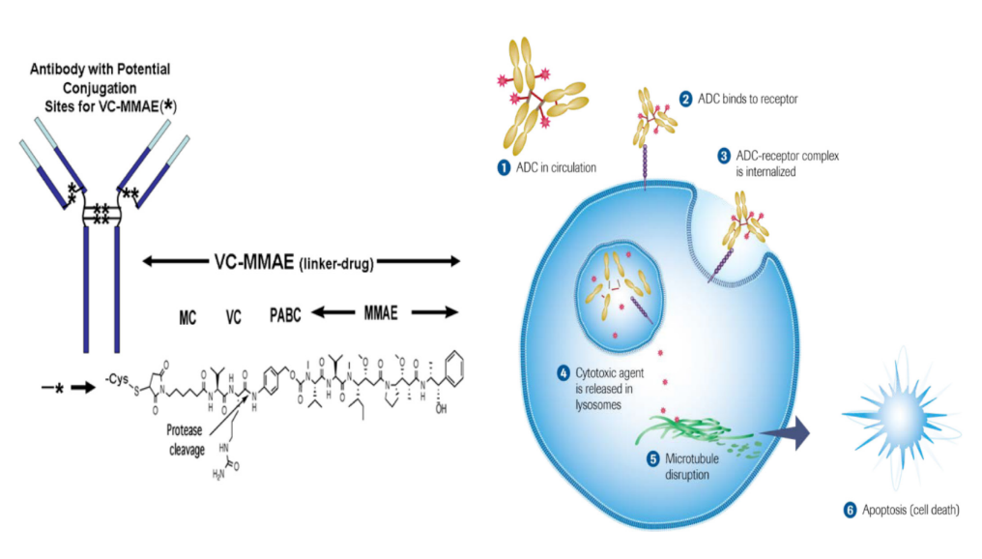
Polatuzumab Vedotin Plus BR for Relapsed/Refractory DLBCL
Polatuzumab vedotin
  Antibody-drug conjugate (ADC) targeting CD79b
  The toxic payload is monomethyl auristatin E (MMAE)
Phase 2 randomized trial of BR vs Pola-BR
CD79b is ubiquitously expressed on DLBCL cells
Polatuzumab vedotin
Binds to CD79b and is then internalized
R/R DLBCL
N=80
21-day cycles x 6 cycles
- Bendamustine (90 mg/m² IV x 2 days); - Rituximab (375 mg/m² IV x 1 day); - ± Pola (1.8 mg/kg IV x 1 day)
BR
Pola-BR
Apoptosis
Microtubule
disruption
Sehn LH, et al. J Clin Oncol. 2020;38(2):155-165.
Palanca-Wessels MC, et al. Blood. 2013;122(21):4400.

Slide 17
Pola-BR vs BR
Baseline Characteristics | BR (N=40) | Pola-BR (N=40)
Median age | 71 (30-84) | 67 (33-86)
IPI ≥3 | 29 (73%) | 22 (55%)
Median prior treatment | 2 (1-5) | 2 (1-7)
Prior BMT | 6 (15%) | 9 (23%)
Progression Free Survival
Overall Survival
Pola-BR: 7.6 mos
BR: 2 mos
Pola-BR: 12.4 mos
BR: 4.7 mos
RESPONSE | BR (N=40) | Pola-BR (N=40)
ORR (%) | 17.5 | 45.0
CRR (%) | 17.5 | 40.0
BMT, bone marrow transplant; ORR, overall response rate; CRR, complete response rate
Consider in:
Non-transplant/ non-CAR patient 2nd-line+
Bridging therapy prior to CAR (caution w/benda)
Post CAR T-cell failure
Sehn LH, et al. J Clin Oncol. 2020;38(2):155-165.

Slide 18
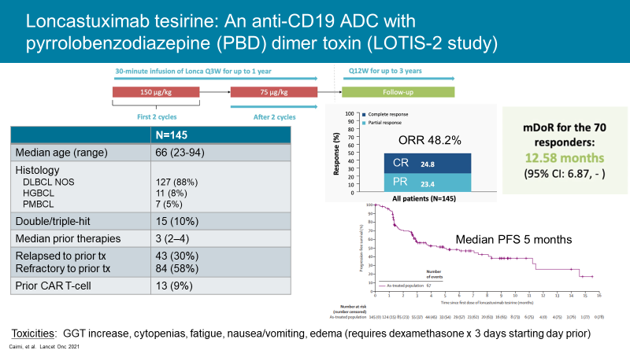
Loncastuximab tesirine: An anti-CD19 ADC with pyrrolobenzodiazepine (PBD) dimer toxin (LOTIS-2 study)
Baseline Characteristics (N=145)
Median age (range) | 66 (56-71)
Histology DLBCL NOS HGBCL PMBCL | 127 (88%) 11 (8%) 7 (5%)
Double/triple-hit | 15 (10%)
Median prior therapies | 3 (2–4)
Relapsed to prior treatment Refractory to prior treatment | 43 (30%) 84 (58%)
Prior CAR T-cell | 13 (9%)
Results
ORR: 48.2%
CR: 24%
DOR: 12.58 mos
PFS: 5 mos
NOS, not otherwise specified; HGBCL, high-grade B-cell lymphoma
Caimi PF, et al. Lancet Oncol. 2021;22:790-800.

Slide 19
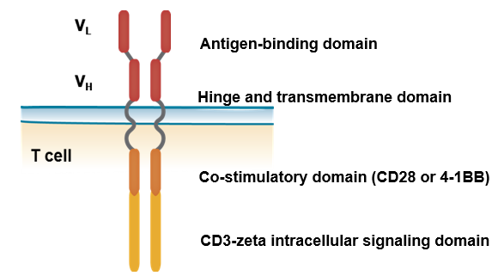
Chimeric Antigen Receptor (CAR) T-cell Therapy¹⁻⁴
Pros | Cons
Single infusion^{1,2} No need for immune suppression or risk of GvHD² | Potential cost³ Supportive care management/ transitions of care involvement⁴
GvHD, graft vs. host disease
Confer direct antigen specificity to an autologous cytotoxic T-cell¹
Living drug¹
1. Feins S, et al. Am J Hematol. 2019;94:S3-S9
2. Sanber K, et al. Br J Haematol. 2021;195(5):660-668.
3. Ramos CA, et al. Annu Rev Med. 2016;67:165-183.
4. Sterner RC, et al. Blood Cancer J. 2021;11(4):69.

Slide 20
ZUMA-1: PFS and OS of patients with R/R DLBCL receiving axicabtagene ciloleucel
Baseline Characteristics | Phase 1 and 2 (N = 108)
Median age (range), y | 58 (23–76)
Age ≥ 65 y, n (%) | 27 (25)
≥ 3 prior therapies, n (%) | 76 (70)
Refractory (no response to prior treatment or relapse <1y from ASCT) | 108 (100%)
Refractory to 2nd- or later-line therapy, n (%) | 80 (74)
Best response as PD to last therapy, n (%) | 70 (65)
Relapse post ASCT, n (%) | 25 (23)
Progression Free Survival
Median of 5.9 mos
42% at 2 y
Overall Survival
NR at time of data collection
51% alive at 2 y
ORR: 74%
CRR: 54%
NR, not reached
Locke FL, et al. Lancet Oncol. 2019;20(1):31-42.

Slide 21
JULIET: PFS and OS of patients with R/R DLBCL receiving tisagenlecleucel^{1,2}
Long-Term Follow-Up Data²
Baseline Characteristics¹ | Patients (N = 111)
Median age (range), y | 56 (22–76)
Double-/triple-hit lymphoma, % | 27
Number of prior lines of therapy, %
2 | 44
3 | 31
4–6 | 21
Refractory to last therapy, % | 55
Prior ASCT, % | 49
Progression Free Survival
Median of 2.9 mos
~30% at 2 y
Overall Survival
Median of 11.1 mos
ORR¹: 52%
CRR²: 40%
1. Schuster SJ, et al. N Engl J Med. 2019;380(1):45-56.
2. Schuster SJ, et al. Lancet Oncol. 2021; 22(10):1403-1415.

Slide 22
TRANSCEND-NHL-001 trial: liso-cel in multiply R/R aggressive B-NHL^{1,2}
Characteristic* | Patients (N = 270)
Age, median (range), y² | 63 (18–86)
Median prior lines, n (range)² | 3 (1–8)
CNS involvement, n (%)¹ | 7 (3)
Chemo-refractory, n (range)^{1,2} | 181 (67)
Prior HSCT, n (%)² | 99 (36)
Progression Free Survival
Median of 6.8 mos
41% at 2 y
Overall Survival
Median of 27.3 mos
51% alive at 2 y
ORR²: 73%
CRR²: 53%
2-yr DOR²: 50%
1. Abramson JS, et al. Lancet. 2020;396(10254):839-852
2. Abramson JS, et al. Blood. 2021;138(Suppl 1):2840.

Slide 23
Selinexor: An XPO1 inhibitor
SADAL study in DLBCL (n=127)
  Open label phase 2
  2-5 prior lines of treatment
  ≥60 days from last treatment if PR or CR, otherwise ≥98 days (!)
  60 mg po twice weekly
  Median prior treatments = 2 (range 1-6)
Overall response | Complete response | Partial response
28% | 12% | 17%
Median PFS: 2.6 mos
Median DOR: 9.3 mos
XPO1, Exportin 1 gene

Slide 24
Emerging Treatments and Paradigm Shifts on the Horizon
Pola-R-CHP
First line
CAR-T
Second line
Bispecific Agents in R/R

Slide 25
POLARIX trial:
Substituting polatuzumab vedotin for vincristine in R-CHOP
Patients
Previously untreated DLBCL
Age 18–80 y
IPI 2-5
ECOG PS 0–2
R 1:1
6 Cycles: Pola-R-CHP
2 additional cycles of rituximab
6 Cycles: R-CHOP
2 additional cycles of rituximab
Primary endpoint: Investigator-assessed PFS
Tilly H, et al. N Engl J Med. 2022;386(4):351-363.

Slide 26
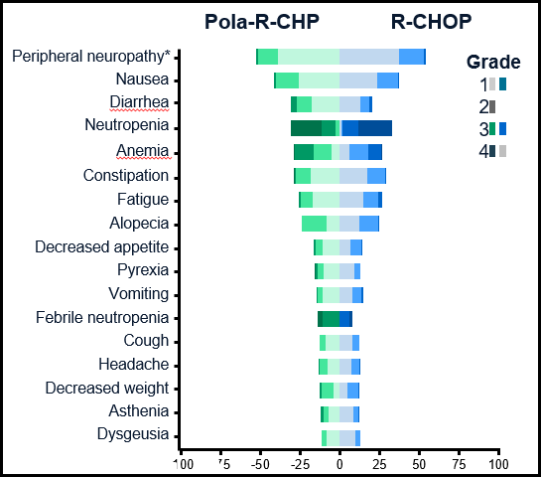
Primary endpoint: Progression-free survival
Pola-RCHP improves PFS
Without excess toxicity
HR 0.73 (P<0.02)
95% CI: 0.57, 0.95
2 year PFS:
76.7% with Pola-R-CHP vs
70.2% with R-CHOP (∆=6.5%)
Tilly H, et al. N Engl J Med. 2022;386(4):351-363.

Slide 27
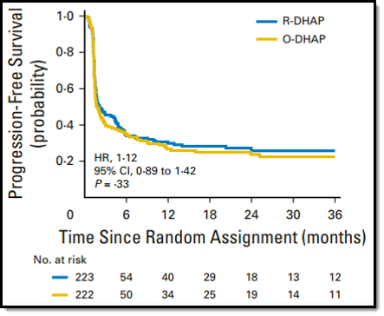
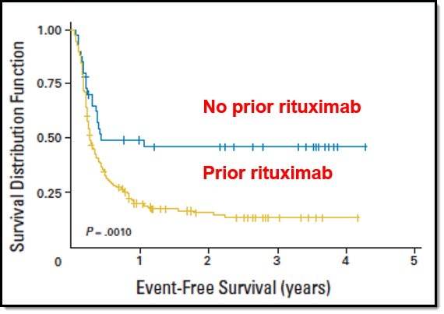
Should high dose chemo and ASCT remain SOC in 2nd line?
2nd line chemo/ASCT (rituximab vs ofatumumab) ORCHARRD trial¹
2nd line chemo/ASCT in CORAL trial for patients progressing within 1 year²
No prior rituximab
Prior rituximab
1. Van Imhoff GW, et al. J Clin Oncol. 2017;35(5):544-551; fig 3a, pg. 548; Permission granted for us by Wolters Kluwer Health, Inc.; License 5311480207022.
2. Gisselbrecht C, et al. J Clin Oncol. 2010;28:4184-4190; Permission granted for us by Wolters Kluwer Health, Inc.; License 5311481177554.

Slide 28
ZUMA-7: Axi-cel vs SOC in 2nd line large B-cell lymphoma¹
ZUMA-7 Phase 3 Trial | Axi-Cel (N = 180) | Chemo+ ASCT (N=179)
Median age (range), y | 58 (21-80) | 60 (26-81)
Age ≥ 65 y, n (%) | 51 (28) | 58 (32)
IPI 2 or 3, n (%) | 82 (46) | 79 (44)
GCB, n (%) | 109 (61) | 99 (55)
Relapse at < 12 mos, n (%) | 47 (26) | 48 (27)
Primary Refractory, n (%) | 133 (74) | 131 (73)
DHL/THL, % | 31 (17) | 25 (14)
Median follow-up: 24.9 mos
Event-free Survival
Median 8.3 vs. 2.0 mos
HR 0.40 (0.31 – 0.51)
Overall Survival
Median NR vs. 35.1 mos
HR 0.73 (0.53 – 1.01)
GCB, germinal center B-cell like subtype; DHL/THL, double hit/triple hit lymphoma
Axi-cel now NCCN category 1 for 2nd line early progressors (Relapse < 12 mos or primary refractory)²
1. Locke FL, et al. N Engl J Med. 2022;386(7):640-654.
2. National Comprehensive Cancer Network. B-Cell Lymphomas. Version 1.2022. Published March 2, 2022. Accessed March 7, 2022. https://www.nccn.org/professionals/physician_gls/pdf/b-cell.pdf.

Slide 29
TRANSFORM: Liso-cel vs SOC in 2nd line large B-cell lymphoma
TRANSFORM Phase 3 Trial | Liso-Cel (N = 92) | Chemo+ ASCT (N=92)
Median age (range), y | 60 (20-74) | 58 (26-74)
NHL type DLBCL, n (%) | 60 (65) | 57 (62)
IPI 2 or 3, n (%) | 36 (39) | 37 (40)
Relapse at < 12 mos, n (%) | 25 (27) | 24 (26)
Primary Refractory, n (%) | 67 (73) | 68 (74)
DHL/THL, n (%) | 22 (24) | 21 (23)
Median follow-up: 6.2 mos
Event-free Survival
Median 10.1 vs 2.3 mos
HR 0.35 (0.23 – 0.53)
Overall Survival
Median NR vs 16.4 mos
HR 0.51 (0.26 – 1.00)
Kamdar M, et al. Blood. 2021;138(Suppl 1):91.

Slide 30
BELINDA: Tisa-cel vs SOC in 2nd line large B-cell lymphoma
BELINDA Phase 3 Trial | Tisa-Cel (N = 162) | Chemo+ ASCT (N=160)
Median age (range), y | 59.5 (19-79) | 58 (19-77)
Age > 65 y, n (%) | 54 (33.3) | 46 (28.8)
IPI > 2, n (%) | 106 (65.4) | 92 (57.5)
GCB, n (%) | 46 (28.4) | 63 (39.4)
Relapse at < 12 mos, n (%) | 55 (33.9) | 53 (33)
Primary Refractory, n (%) | 107 (66) | 107 (66.9)
DHL/THL, n (%) | 32 (19.8) | 19 (11.9)
Event Free Survival
Tisagenlecleucel arm (N=162):
3.0 mos (95% CI, 2.9-4.2)
SOC arm (N=160):
3.0 mos (95% CI, 3.0-3.5)
Median follow-up: 10 mos
EFS was not significantly different between treatment arms
Stratified unadjusted HR: 1.07 (95% CI, 0.82-1.40, p=0.69)
Bishop MR, et al. N Engl J Med. 2021;386(7):629-639.

Slide 31
 | ZUMA-7¹ | TRANSFORM² | BELINDA³
N | 359 | 184 | 322
% pts proceeded to CAR-T vs ASCT | 94% vs 36% | 97% vs 46% | 96% vs 32% 2ND PCT regimen in 54% of SOC
Median time from registration to CAR | 29 days | 34 days | 52 days
Bridging therapy | Steroids only allowed (36%) | 1 cycle of chemo allowed (63%) | >1 cycle of chemo allowed (83%, 48% >1 cycle)
Crossover | Not allowed | Allowed (51%) | Allowed (51%)
Median follow up | 25 mos | 6.2 mos | 10 mos
Median EFS | 8.3 m vs 2 m | 10.1 m vs 2.3 m | 3 m vs 3 m
Hazard ratio | 0.39 (P<0.0001) | 0.34 (P< 0.0001) | 1.07 (P=0.69)
CR rate | 65% vs 32% | 66% vs 39% | 28% vs 28%
Grade >=3 CRS / NE | 6% / 21% | 1% / 4% | 5% / 3%
PCT, platinum-based immunochemotherapy; CRS, cytokine release syndrome; NE, neurologic events
1. Locke FL, et al. N Engl J Med. 2022;386(7):640-654.
2. Kamdar M, et al. Blood. 2021;138(Suppl 1):91.
3. Bishop MR, et al. N Engl J Med. 2021;386(7):629-639.

Slide 32
Evolution of 2nd line therapy and beyond
Relapsed/refractory DLBCL
Fit for high dose therapy
Unfit for high dose therapy
Early relapse/
Fit for CAR
Unfit for CAR/ ?late relapse
?Late relapse
Early relapse
2nd line therapy
(personalized to the patient)
2nd line therapy
(personalized to the patient)
Chemo + ASCT?
CAR T-cells
(liso-cel or axi-cel)
Relapse
3rd+ line treatment

Slide 33
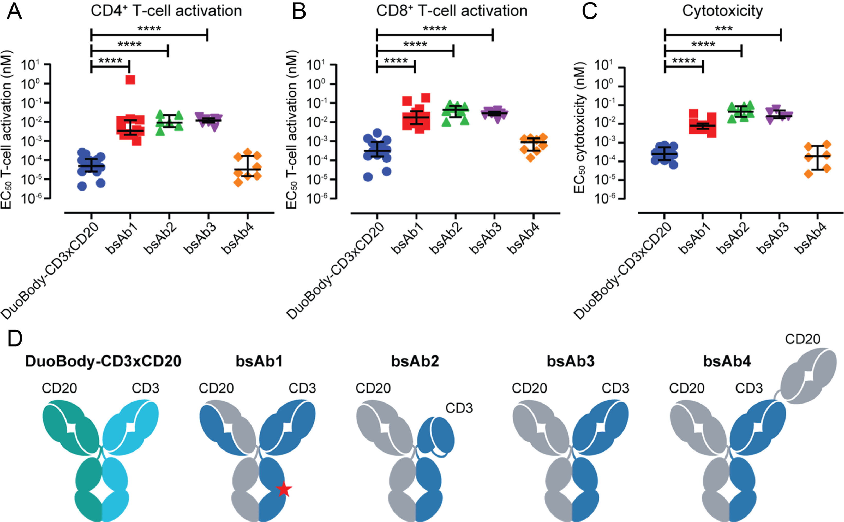
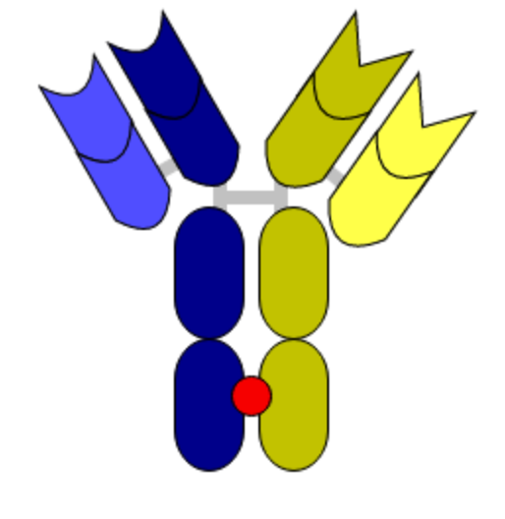
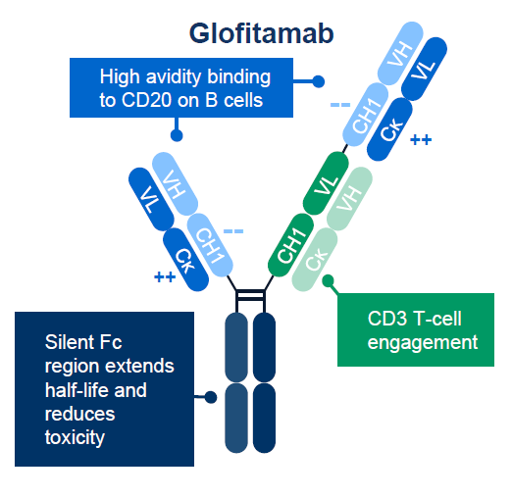
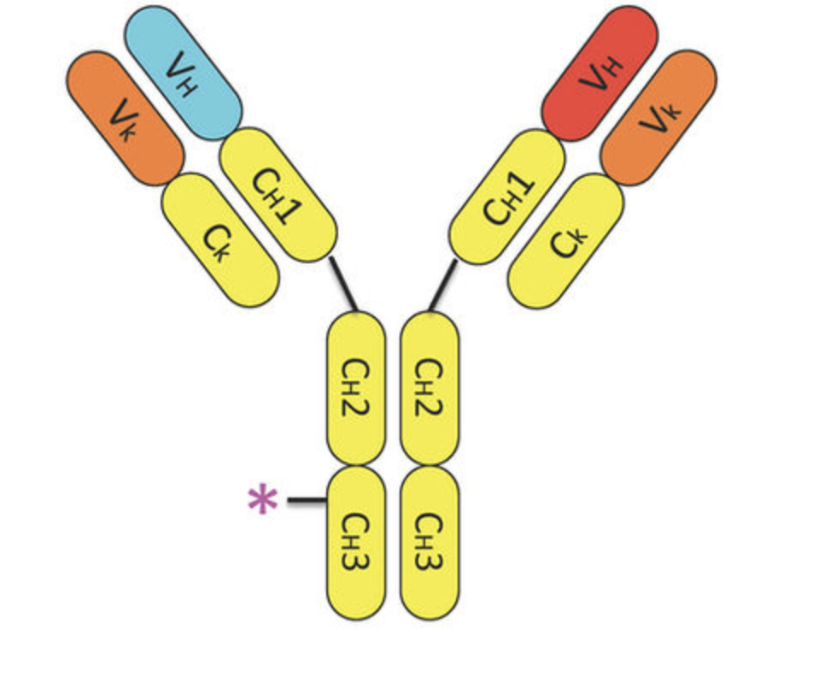
Emerging Bispecific Antibodies in Large B-Cell Lymphomas
Epcoritamab¹ | Mosunetuzumab² | Glofitamab³ | Odronextamab
DuoBody- CD3 x CD20 BsAb SC | CD3 x CD20 Knobs-in-hole Fc BsAb IV/SC | CD3 (Fab) x CD20 (Fab x2) Fc BsAb IV | CD3 x CD20 Common LC Fc BsAb IV
1. Hutchings M, et al. Lancet. 2021;398(10306):1157-1169.
2. Budde LE, et al. J Clin Oncol. 2022;40(5):481-491.
3. Minson A, et al. Leuk Lymphoma. 2021;62(13):3098-3108.
4. Zhu M, et al. Clin Transl Sci. 2022;15(4):954-966.

Slide 34
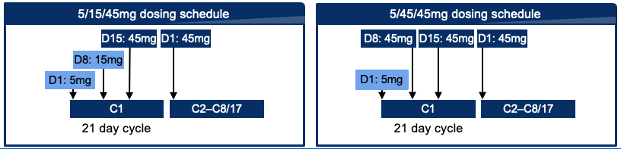
Phase 1/2 Study of SC Mosunetuzumab in Relapsed/
Refractory B-Cell NHL
N (%) unless stated | 5/15/45mg N=39 | 5/45/45mg N=27 | Overall N=66
Median age, y (range) | 68 (46–88) | 64 (41–78) | 68 (41–88)
NHL subtype
DLBCL | 18 (46.2) | 17 (63.0) | 35 (53.0)
trFL | 4 (10.3) | 8 (29.6) | 12 (18.2)
FL Gr 1–3a | 12 (30.8) | 0 | 12 (18.2)
MCL | 2 (5.1) | 1 (3.7) | 3 (4.5)
FL Gr 3b | 1 (2.6) | 0 | 1 (1.5)
trMZL /trWM | 2 (5.1) | 0 | 2 (3.0)
Median number of prior lines of therapy, n (range) | 3 (1–9) | 4 (2–8) | 3.5 (1–9)
Refractory to any prior anti-CD20 | 34 (87.2) | 24 (88.9) | 58 (87.9)
N (%) | aNHL N=51 | iNHL N=11 | Overall N=62
ORR | 15 (29.4) | 9 (81.8) | 24 (38.7)
CR | 9 (17.6) | 7 (63.6) | 16 (25.8)
16/16 (100%) CRs are ongoing at data cut-off
CRS
N (%) of patients with ≥1 AE | 5/15/45mg N=39 | 5/45/45mg N=27
Any Gr CRS | 16 (41.0) | 4 (14.8)
Gr 1 | 13 (33.3) | 3 (11.1)
Gr 2 | 3 (7.7) | 1 (3.7)
tr, transformed; MZL, marginal zone lymphoma; WM, Waldenstrom macroglobulinemia; FL, follicular lymphoma; aNHL, aggressive non-Hodgkin’s lymphoma; iNHL, indolent non-Hodgkin’s lymphoma
Bartlett N, et al. Blood. 2021;138(Suppl 1):3573.

Slide 35
Glofitamab in Relapsed/Refractory NHL
Treatment: Obinutuzumab 1000 mg followed 7 days later by glofitamab by step-up dosing followed by fixed dosing at increasing dose levels every 3 weeks for 12 cycles
Baseline characteristics | Patients (N = 258)
Age, median (range), y | 64 (22–86)
Median prior lines, n (range) | 3 (1–12)
Aggressive B-NHL, n (%) DLBCL, n=98 Mantle cell, n=26 Transformed follicular, n=31 Transformed CLL, n=11 | 183 (71%)
Indolent B-NHL, n (%) All grade 1-2 follicular | 75 (29%)
 | aNHL, all doses N=175 | aNHL RP2D N=14 | iNHL, all doses N=75
ORR, n (%) | 94 (54%) | 11 (79%) | 61 (81%)
CRR, n (%) | 69 (39%) | 10 (71%) | 52 (69%)
RP2D, recommended phase 2 study dose
Dickinson MJ, et al. Blood. 2021;138(Suppl 1):2478.

Slide 36
Module 3
Principles of Chimeric Antigen Receptor T-Cell (CAR-T) Therapy in Large B-Cell Lymphoma: Patient Selection Strategies

Slide 37
Patient Evaluation for CAR-T
Adequate number of T-cells for collection
No active, uncontrolled infections
Adequate performance status (PS) 0 or 2 and organ function
Absence of clinically relevant comorbidities
Adequate caregiver support
Ability to travel to treatment center within appropriate radius travel time
Logistical considerations
Clinical considerations
Johnson PC, et al. Leuk Lymphoma. 2020;61(11)3561-2567.

Slide 38
Patients ineligible for ASCT/those who do not qualify for CAR-T clinical trial may still be CAR-T candidates^{1,2}
Characteristics | Real World Post-Approval Experience³⁻⁵
Cellular therapy | Axi-cel³ | Axi-cel⁴ | Tisa-cel⁵
n | 91 | 274 | 63
Median age (range) | 64 (21-80) | 60 (21-83) | 65 (18-81)
ECOG PS 0-1 | 90% | 81% | 82%
High risk IPI (> 3) | 46% | 55% | NR
Bridging therapy | 40% | NR | NR
Prior ASCT | 27% | 33% | 21%
Ineligible for pivotal trial | 60% | 43% | NR
Outcomes
ORR | 71% | 81% | 66%
CR | 44% | 57% | 42%
>Grade 3 CRS | 16% | 7% | <5%
> Grade 3 neurotoxicity | 39% | 33% | 4%
ZUMA-1⁶ | JULIET (Tisa-cel)⁷
Axi-cel | Tisa-cel
108 | 111
59 (23-76) | 56 (22-76)
100% | 100%
44% | NR
0% | 92%
23% | 49%
NA | NA
Outcomes
83% | 52%
58% | 40%
13% | 23%
28% | 12%
1. Johnson PC, et al. Leuk Lymphoma. 2020;61(11)3561-2567. 2. Cahill KE, et al. Leuk Lymphoma. 2020;61(41):799-807. 3. Jacobson CA, et al. Blood. 2018;132(Suppl):92. 4. Nastoupil LJ, et al. Blood. 2018;132(Suppl):91. 5. Pasquini MC, et al. Blood. 2019;134(Suppl 1):764. 6. Neelapu SS, et al. N Engl J Med. 2017;377(26):2531-44. 7. Schuster SJ, et al. N Engl J Med. 2019;380(1):45-56.

Slide 39
Considerations for CAR-T Selection
Turnaround during manufacturing¹
Bridging for symptomatic/progressive disease
Referral to center for CAR-T/ clinical trial as appropriate⁴
Early referral is optimal (immediately after 1st treatment failure before salvage therapy initiation)
Future considerations: Potential to identify responders?⁵
CR at 3-month follow-up →3x higher frequency of CD8 T-cell memory signatures
cf(DNA) sequencing
CD8 T-cell exhaustion associated with poor molecular response
Axi-cel: 17 days
Tisa-cel & Liso cel: ~24 days
Radiation^{2,3}
Polatuzumab vedotin⁴
Molecular response at 7-days post infusion associated with significant clinical response
cf, cell free
1. Johnson PC, et al. Leuk Lymphoma. 2020;61(11)3561-2567. 2. Pinnix CC, et al. Blood Adv. 2020;4(13):2871-2883. 3. Sim AJ, et al. Int J Radiat Oncol Biol Phys. 2019;105(5):1012-1021. 4. Dimou M, et al. Hematol Oncol. 2021;39(3):336-348. 4. Cahill KE, et al. Leuk Lymphoma. 2020;61(41):799-807. 5. Deng Q, et al. Nat Med. 2020;26(12):1878-1887.

Slide 40
Module 4
Management of Adverse Effects Associated With Novel Therapies

Slide 41
Notable CAR T-cell toxicities
Cytokine Release Syndrome (CRS)
Neurological toxicity
CAR T-cell associated Encephalopathy Syndrome (CRES)
Immune Effector Cell Associated Neurotoxicity Syndrome (ICANS)
Prolonged cytopenias
B-cell aplasia
Hypogammaglobulinemia
Thompson JA, et al. NCCN Clinical Practice Guidelines in Oncology. Management of Immunotherapy-Related Toxicities. Version 1.2022. Published February 28, 2022. Accessed 2/28/2022. https://www.nccn.org/professionals/physician_gls/pdf/immunotherapy.pdf

Slide 42
Toxicity of 3 Major CAR T-cell Products for Relapsed/Refractory DLBCL¹⁻³
 | Axicabtagene Ciloleucel¹ | Tisagenlecleucel² | Lisocabtagene Maraleucel³
Construct | antiCD19-CD28-CD3z | antiCD19-41BB-CD3z | antiCD19-41BB-CD3z
n | 101 | 111 | 269
Any CRS Median time to onset | 93% 2 days | 58% 3 days | 42% 5 days
≥ Gr 3 CRS† | 13% | 23% | 2%
Any neurotoxicity | 64% | 21% | 30%
≥ Gr 3 neurotoxicity | 28% | 12% | 10%
Tocilizumab use | 43% | 14% | 20%
Steroid use | 27% | 10% | 21%
  * Caveats in cross trial comparisons: Different eligibility criteria, phase of study, dose levels
  †CRS toxicity grading scales differ across studies. Axi-Cel and Liso-cel used Lee criteria. Tisa-cel used Penn criteria
1. Neelapu SS, et al. N Engl J Med. 2017;377(26):2531-44. 2. Schuster SJ, et al. N Engl J Med. 2019;380(1):45-56. 3. Abramson JS, et al. Lancet. 2020;396(10254):839-852.

Slide 43
CRS Management
CRS Grade§ | Treatment Recommendation | Additional Supportive Care
Grade 1 Fever (> 38°C) | Supportive care Consider tocilizumab for persistent symptoms | Maintenance fluids Empiric antibiotics Consider colony stimulating factor
Grade 2 Fever with hypotension (not requiring vasopressors) | Tocilizumab 8 mg/kg IV over 1 hour Repeat in 8 hours if no improvement* Max 4 total doses | IV fluids Consider steroids for refractory hypotension after 1-2 doses of tocilizumab
Grade 3 Fever with hypotension requiring a vasopressor | Tocilizumab as per Grade 2 plus dexamethasone 10 mg IV every 6 hours | Transfer to ICU Supplemental oxygen Vasopressors as needed
Grade 4 Fever with hypotension requiring multiple vasopressors | Tocilizumab as per grade 2 Dexamethasone 10 mg IV every 6 hours If refractory, consider methylprednisolone 1000 mg/day IV | ICU care Mechanical ventilation as needed Vasopressors as needed Symptom management of organ toxicities
§Lee criteria
IL-6, interleukin-6
*May consider alternative IL-6 antagonists if repeat doses needed (anakinra/siltuximab)
Thompson JA, et al. NCCN Clinical Practice Guidelines in Oncology. Management of Immunotherapy-Related Toxicities. Version 1.2022. Published February 28, 2022. Accessed February 28, 2022. https://www.nccn.org/professionals/physician_gls/pdf/immunotherapy.pdf

Slide 44
Neurotoxicity Management^{1,2}
Grade¹ | Management Recommendations²
1 | Supportive care, IV fluids Withhold oral intake Management of agitation Neurology consult; papilledema assessment, lumbar puncture, MRI, EEG If associated with CRS, consider anti-IL-6 therapy with tocilizumab
2 | Dexamethasone 10 mg IV q6h or methylprednisolone 1 mg/kg q 12h if refractory to anti-IL-6 therapy, or for ICANS without concurrent CRS Consider transfer to ICU
3 | Transfer to ICU Corticosteroids, continue until grade 1 then taper
4 | Consider mechanical ventilation Seizure management High dose corticosteroids Management of increased ICP and papilledema
§CTCAE for neurotoxicity
ICP, intracranial pressure; MRI, magnetic resonance imaging; EEG, electroencephalography
1. Lee DW, et al. Biol Blood Marrow Transplant. 2019;25:625-638. 2. Thompson JA, et al. NCCN Clinical Practice Guidelines in Oncology. Management of Immunotherapy-Related Toxicities. Version 1.2022. Published February 28, 2022. Accessed February 28, 2022. https://www.nccn.org/professionals/physician_gls/pdf/immunotherapy.pdf

Slide 45
Novel Therapy Toxicities
Agent | Toxicity Any > Gr 3 |  |  | Management
Polatuzumab vedotin¹ CD79b antibody drug conjugate (MMAE payload) | Peripheral neuropathy | 40% | 0% | Premedicate with APAP/diphenhydramine PJP and HSV prophylaxis required when combined with bendamustine
 | GI toxicities | 56% | 6.6%
 | Infusion reactions | 18% | 2.2%
 | Myelosuppression | 49% | 42%
 | Infections (pneumonia/URTI) | 35% | 16%
Loncastuximab tesirine² CD19 antibody drug conjugate (PBD payload) | Fluid retention/edema | 28% | 3% | Corticosteroid prophylaxis w/ dexamethasone x 3 days (start day before therapy)
 | AST elevation | 41% | <1%
 | Dermatological toxicities | 52% | 4%
Selinexor³ Oral nuclear export inhibitor | Myelosuppression | 58% | 31% | Supportive care management Early intervention Use of Neurokinin-1 antagonists and/or olanzapine for additional N/V prevention
 | GI toxicities (Nausea/diarrhea) | 94% | 9%
AST, aspartate transferase; URTI, upper respiratory tract infection; PJP, pneumocystis jiroveci pneumonia; HSV, herpes simplex virus
1. POLIVY (prescribing information). San Francisco, CA: Genentech, Inc; Sept 2020.
2. ZYNLONTA (prescribing information). Murray Hill, NJ: ADC Therapeutics.; Sept 2021.
3. XPOVIO (prescribing information). Newton, MA: Karyopharm Therapeutics, Inc; Aug 2021.

Slide 46
Patient Case
72 yo woman with type 2 diabetes and hypertension presents with diffuse large B-cell lymphoma. ECOG PS: 1. Scr: 1.7
Stage III, non-GCB subtype, with co-expression of MYC and BCL2 (no translocation of MYC, BCL2 or BCL6)
1st-line treatment: R-CHOP → CR achieved → Relapsed 8 mos later
Relapse involving lymph nodes, spleen, and liver
2nd-line: non-transplant eligible → received 2 cycles of R-GemOx
No response
Treatment considerations for next line of therapy?
Sequencing?
Toxicity management?

Slide 47
Summary: Rapidly evolving face of R/R DLBCL therapy
DLBCL is a clinically and biologically heterogeneous disease which is treated with curative intent for most patients
Landscape is constantly evolving as evidenced by recent novel therapy approvals for R/R LBCL
CAR T-cells → treatment of choice in 3rd line and beyond DLBCL for eligible patients
2nd line therapy is personalized to the patient
Available 3rd line+ options in post-CAR or for non-CAR eligible patients include:
Frontline treatment: Polatuzumab with R-CHP may be on the horizon
Bispecific anti-CD20 monoclonal antibodies will emerge as appealing off the shelf immunotherapies
Appropriate supportive care and toxicity management can enhance utilization and treatment outcomes with novel therapies
Chemoimmunotherapy +/- ASCT, tafasitamab-lenalidomide or polatuzumab-BR
Tafasitamab-lenalidomide, polatuzumab-BR, loncastuximab tesirine, and Selinexor
Poised to move into 2nd line for primary refractory and early progressing patients
Subset-specific options also include pembrolizumab in PMBCL, ibrutinib or lenalidomide in non-GCB DLBCL

