Slide 1
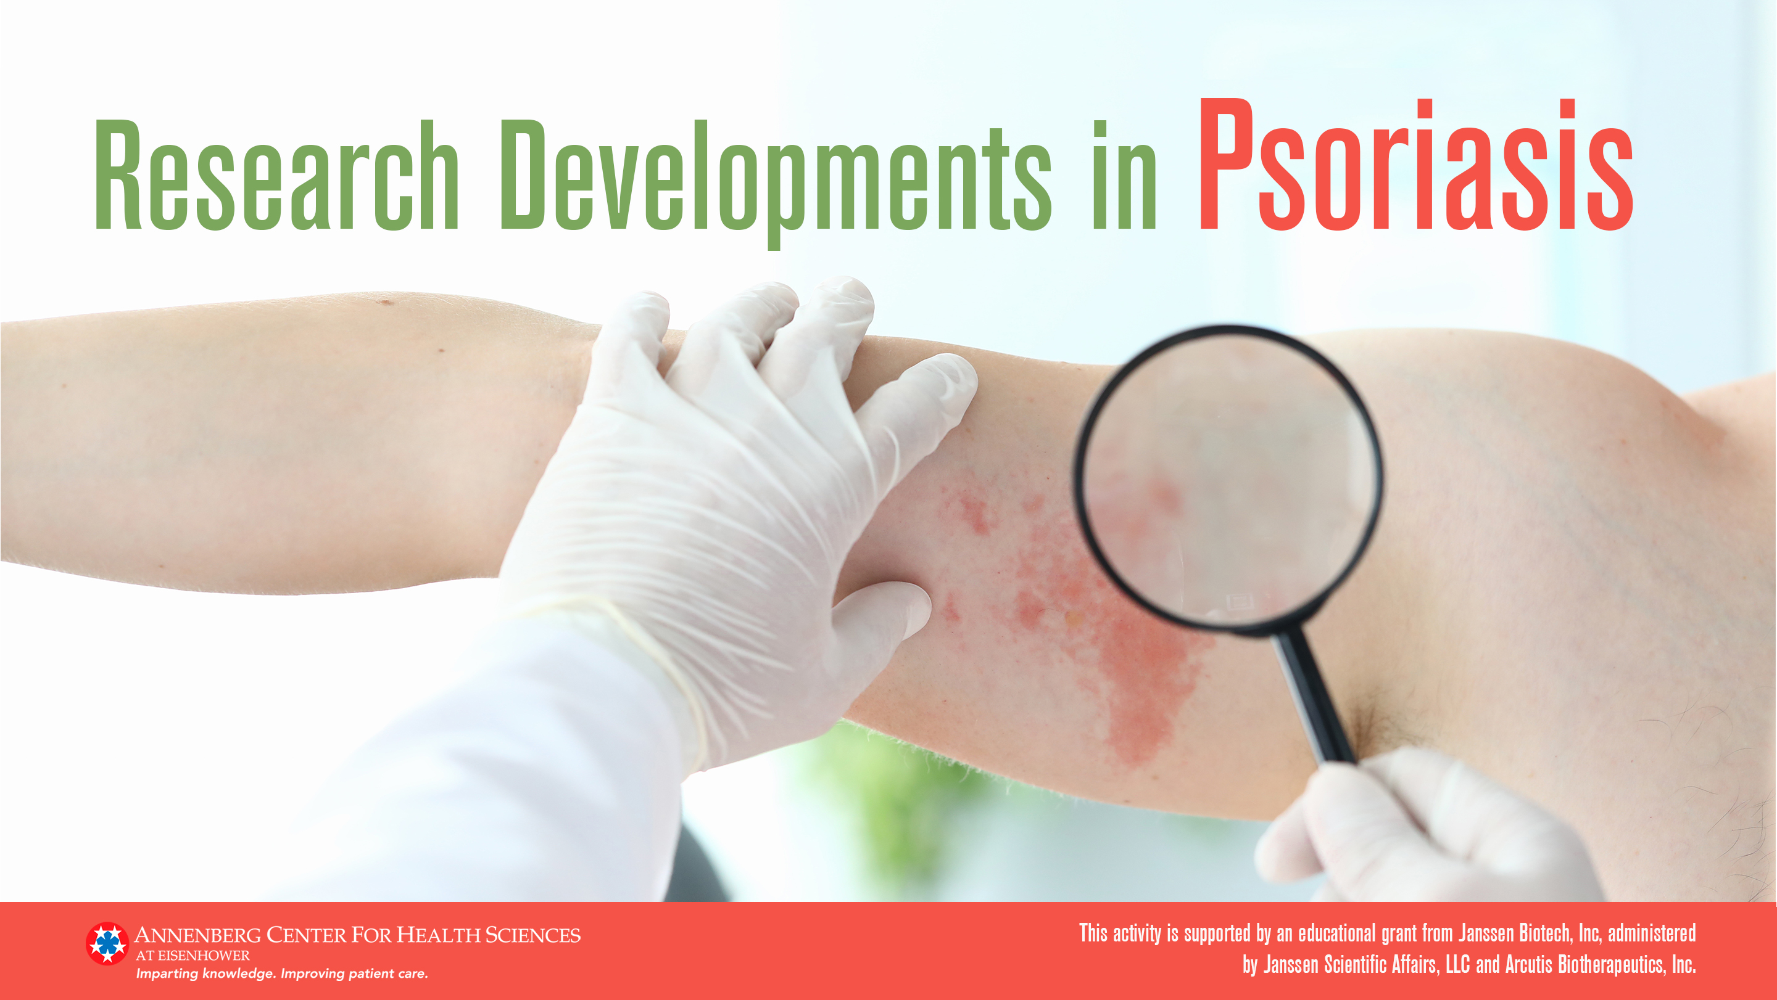

Slide 2
Complete Skin Clearance for Patients With Moderate to Severe Plaque Psoriasis: The Relationship Between Improvements in Psoriasis Area and Severity Index and Health-Related Quality of Life
Andrew Blauvelt and Colleagues
2022 AAD Annual Meeting
https://eposters.aad.org/abstracts/33884

Slide 3
Skin Clearance and Quality of Life
Multiple drugs have good data for skin clearance
Skin clearance has not been directly correlated with quality of life
Should clinicians push for complete skin clearance?
Complete Skin Clearance for Patients With Moderate to Severe Plaque Psoriasis: The Relationship Between Improvements in Psoriasis Area and Severity Index and Health-Related Quality of Life: Andrew Blauvelt

Slide 4
Skin Clearance and Quality of Life
Methods
  Data pooled from phase 3 bimekizumab trials
  Bimekizumab was compared to ustekinumab, adalimumab, secukinumab, and placebo
  Psoriasis Area and Severity Index (PASI) used to measure skin clearance
  Dermatology Life Quality Index (DLQI) of 0 or 1 indicated no impact of psoriasis on the patient’s quality of life
  Mixed-effects logistic regression model used to assess the relationship between the measurements
Complete Skin Clearance for Patients With Moderate to Severe Plaque Psoriasis: The Relationship Between Improvements in Psoriasis Area and Severity Index and Health-Related Quality of Life: Andrew Blauvelt

Slide 5
Skin Clearance and Quality of Life
Key Findings
  There was an incremental increase in the percent of patients with a DLQI 0/1 as the percent of PASI improvement increased:
    100% PASI improvement = 85.5% (95% CI 83.3-87.4%) of patients achieving DLQI 0/1
    95% PASI improvement = 78.6% (75.9-81%)
    90% PASI improvement = 69.5% (66.5-72.3%)
    75% PASI improvement = 35.4% (32.3-38.5%)
    50% PASI improvement = 4.8%
  Itchy/sore/painful skin, embarrassment and clothing limitations impacted quality of life more than other DLQI items
  Residual skin disease may still negatively impact quality of life
Complete Skin Clearance for Patients With Moderate to Severe Plaque Psoriasis: The Relationship Between Improvements in Psoriasis Area and Severity Index and Health-Related Quality of Life: Andrew Blauvelt

Slide 6
Skin Clearance and Quality of Life
Faculty Comments
  Complete clearance is now a realistic expectation
  While the study showed statistical significance, is it clinically significant?
  Find out if complete clearance is important for the patient
Complete Skin Clearance for Patients With Moderate to Severe Plaque Psoriasis: The Relationship Between Improvements in Psoriasis Area and Severity Index and Health-Related Quality of Life: Andrew Blauvelt

Slide 7
Skin Clearance and Quality of Life
Primary Author Comment
  “Using a large group of pooled psoriasis patients participating in phase 3 trials of bimekizumab, we show that quality of life is most improved when response to a biologic drug is complete clearance (PASI 100). And, each level of skin improvement is associated with better quality of life. For examples, PASI 90 response improves quality of life more than PASI 75, PASI 95 more than PASI 90, and PASI 100 more than PASI 95. Even when skin is completely clear, some patients will still say psoriasis affects their quality of life. The two top complaints for those who are completely clear of lesions are 1) painful, sore, itchy skin and 2) embarrassment because of their skin.”
Complete Skin Clearance for Patients With Moderate to Severe Plaque Psoriasis: The Relationship Between Improvements in Psoriasis Area and Severity Index and Health-Related Quality of Life: Andrew Blauvelt

Slide 8
Malignancy Rates Through 5 Years of Follow-up in Guselkumab-treated Patients With Moderate to Severe Psoriasis: Results from the VOYAGE 1 and 2 Trials and Comparisons to General Populations
Andrew Blauvelt and Colleagues
2022 AAD Annual Meeting
https://eposters.aad.org/abstracts/31256

Slide 9
Malignancy Rates With Guselkumab
Psoriasis and other immune-related diseases can be associated with an increased risk of malignancy
Inhibition of IL-23, in theory, may affect tumor growth rate
Empirical effects on cancer from psoriasis therapy in humans is not well defined
Malignancy Rates Through 5 Years of Follow-up in Guselkumab-treated Patients with Moderate to Severe Psoriasis: Results from the VOYAGE 1 and 2 Trials and Comparisons to General Populations: Andrew Blauvelt

Slide 10
Malignancy Rates With Guselkumab
Methods
  Voyage 1 and 2 participants divided into 3 groups
    Participants randomized to guselkumab (GUS) at baseline and those originally randomized to placebo but then transferred to GUS at week 16 (n=1221)
    Participants randomized to adalimumab at baseline and then transferred to GUS at or after week 28 (n=500)
    Combined participants from the groups above (n=1721)
  Psoriasis Longitudinal Assessment and Registry (PSOLAR) used to represent the general psoriasis population requiring systemic therapy
  Surveillance, Epidemiology and End Results (SEER) database used for the general US Population
  Overall rates of malignancy excluding nonmelanoma skin cancer (NMSC) were compared with rates from PSOLAR
  Standardized incidence ratios (SIRs) were used to compare malignancy rates between the GUS groups and the SEER group
Malignancy Rates Through 5 Years of Follow-up in Guselkumab-treated Patients with Moderate to Severe Psoriasis: Results from the VOYAGE 1 and 2 Trials and Comparisons to General Populations: Andrew Blauvelt

Slide 11
Malignancy Rates With Guselkumab
Key Findings:
  The rate of non-NMSC cancer in the GUS group was 0.45/100PY compared to 0.68/100PY in PSOLAR.
  The rate of cancer was similar between the GUS group and the SEER group with a SIR of 0.93 (95% CI 0.64-1.31). SIR is the ratio of observed vs expected number of patients with malignancy
  There was year-to-year variability in malignancy rates over time without a clear increasing trend
  Most reported cancers were breast, colorectal, melanoma, and prostate
    Rates for the above were similar to the general US population
Malignancy Rates Through 5 Years of Follow-up in Guselkumab-treated Patients with Moderate to Severe Psoriasis: Results from the VOYAGE 1 and 2 Trials and Comparisons to General Populations: Andrew Blauvelt

Slide 12
Malignancy Rates With Guselkumab
Faculty Commentary:
  There is always a worry of increased infection and malignancy when blocking aspects of immune function
  This study supports the notion that there is not an increased risk of malignancy with IL23 blockade
  Safety and efficacy of IL-23 blockers like guselkumab is excellent
  IL-23 blockers will continue to be a favored treatment for psoriasis
Malignancy Rates Through 5 Years of Follow-up in Guselkumab-treated Patients with Moderate to Severe Psoriasis: Results from the VOYAGE 1 and 2 Trials and Comparisons to General Populations: Andrew Blauvelt

Slide 13
Malignancy Rates With Guselkumab
Primary Author Comment :
  “Long-term safety of biologics is important. Here, we examined cancer types and cancer rates over the course of 5 years in psoriasis patients receiving guselkumab, an IL-23 blocker. Cancers occurred, yes, but the types of cancers and the rates at which they occurred in this large cohort were not different than what would be expected from cancer types and rates in healthy individuals, patients with psoriasis, and psoriasis patients on other types of long-term systemic medications. In other words, there were no clear cancer “signals” in psoriasis patients receiving guselkumab over the course of 5 years.”
Malignancy Rates Through 5 Years of Follow-up in Guselkumab-treated Patients with Moderate to Severe Psoriasis: Results from the VOYAGE 1 and 2 Trials and Comparisons to General Populations: Andrew Blauvelt

Slide 14
Pooled Efficacy and Safety Results from the DERMIS-1 and DERMIS-2 Phase 3 Trials of Once-Daily Roflumilast Cream 0.3% for Treatment of Chronic Plaque Psoriasis
Mark Lebwohl and Colleagues
2022 AAD Annual Meeting
https://eposters.aad.org/abstracts/31865

Slide 15
Efficacy and Safety of Topical Roflumilast
Topical agents are considered first line for mild-moderate psoriasis
Many current topical treatments have safety concerns with long term use
No new topical treatment approved in the last 20 years
Pooled Efficacy and Safety Results from the DERMIS-1 and DERMIS-2 Phase 3 Trials of Once-Daily Roflumilast Cream 0.3% for Treatment of Chronic Plaque Psoriasis: Mark Lebwohl

Slide 16
Efficacy and Safety of Topical Roflumilast
Methods
  Data from the 8-week, phase 3, randomized, double-blind vehicle-controlled DERMIS-1 and DERMIS-2 trials
  Patients received either once-daily roflumilast 0.3% cream or a vehicle cream
  Inclusion criteria were age >2 years, disease duration ≥ 6 months for adults or 3 months for children, Investigator’s Global Assessment (IGA) ≥ mild severity, psoriasis covering 2-20% of body surface area, and Psoriasis Area and Severity Index (PASI) ≥ 2
  Primary endpoint was IGA success at week 8 and secondary endpoints included Intertriginous-IGA (I-IGA), PASI-75 and Worst Itch Numeric Rating Scale (WI-NRS)
  IGA success was defined as clear or almost clear with 2-grade or better improvement from baseline
  Safety and tolerability endpoints included rates of application-site adverse events, treatment-related adverse events, and discontinuation due to adverse events
Pooled Efficacy and Safety Results from the DERMIS-1 and DERMIS-2 Phase 3 Trials of Once-Daily Roflumilast Cream 0.3% for Treatment of Chronic Plaque Psoriasis: Mark Lebwohl

Slide 17
Efficacy and Safety of Topical Roflumilast
Key Findings:
  39.9% of patients in the roflumilast group achieved IGA success compared to 6.5% for the vehicle (P<0.0001)
  69.7% of patients in the roflumilast group achieved I-IGA success compared to 16.1% in the vehicle group (P<0.01)
  40.3% of patients in the roflumilast group achieved a 75% reduction in PASI scores compared to 6.5% in the vehicle group (P<0.0001)
  68.5% of patients in the roflumilast group achieved at least a 4-point improvement with WI-NRS scores compared to 31.3% in the vehicle group (P<0.0001)
  There was a low incidence of adverse events with no significant difference between the roflumilast and vehicle groups. The rates of treatment-related adverse events were 4.0% and 3.6% in the roflumilast and vehicle groups
Pooled Efficacy and Safety Results from the DERMIS-1 and DERMIS-2 Phase 3 Trials of Once-Daily Roflumilast Cream 0.3% for Treatment of Chronic Plaque Psoriasis: Mark Lebwohl

Slide 18
Efficacy and Safety of Topical Roflumilast
Faculty Comments:
  There is a large unmet need in the large percentage of patients with limited disease
  Many patients fail topical treatments by not applying them as directed
  This study shows that roflumilast is safe and effective – but it does not show if patients will use it as directed
  Real-world experience will show if patients will use this new topical treatment better than the current treatments
Pooled Efficacy and Safety Results from the DERMIS-1 and DERMIS-2 Phase 3 Trials of Once-Daily Roflumilast Cream 0.3% for Treatment of Chronic Plaque Psoriasis: Mark Lebwohl

Slide 19
Efficacy and Safety of Topical Roflumilast
Lead Author Comment:
  “Roflumilast is a nonsteroid that works by blocking PDE-4. It is effective for psoriasis and is safe and effective for intertriginous psoriasis.”
Pooled Efficacy and Safety Results from the DERMIS-1 and DERMIS-2 Phase 3 Trials of Once-Daily Roflumilast Cream 0.3% for Treatment of Chronic Plaque Psoriasis: Mark Lebwohl

