Slide 1


Slide 2
Red Flags for Diagnosing MS: Neurologic
Abnormal calcification on CT scans
Cerebral venous sinus thrombosis
Cortical infarcts
Extrapyramidal features
Headaches or meningismus
Hypothalamic disturbance
Lacunar infarcts
Large and infiltrating brainstem lesions
Meningeal enhancement (though small leptomeningeal enhancement has been described in MS)
Multiple cranial neuropathies or polyradiculopathy
Persistent (> 8 weeks) gadolinium-enhancement and continued enlargement of lesions
Persistently mono-focal manifestations
Predominance of lesions at the cortical/subcortical junction
Selective involvement of the anterior temporal and inferior frontal lobe
Simultaneous enhancement of all lesions
T1-hyperintensity of the pulvinar
T2-hyperintensity in the dentate nuclei
Miller DH, et al. Mult Scler. 2008;14(9):1157-1174.

Slide 3
Red Flags for Diagnosing MS: Other
Cardiologic
  Cardiac disease
  Myopathy
Dermatologic
  Livedo reticularis
  Rash
  Tendon xanthomas
Endocrinologic
  Diabetes insipidus
Gastrointestinal
  Mucosal ulcers
Ophthalmologic
  Retinopathy
Pulmonary
Renal
Rheumatologic
  Amyotrophy
  Arthritis, polyarthralgia, myalgia
  Bone lesions
Other
  Increased serum lactate level
Miller DH, et al. Mult Scler. 2008;14(9):1157-1174.

Slide 4
Importance of Detecting MS Mimics Early
Treating an MS mimic appropriately may avoid significant morbidity or mortality that may occur in the absence of appropriate treatment
Minimizing overdiagnosis of MS:
  Decreases or eliminates the potentially pernicious impact on patient’s psyche, social situation, employment, and finances
  Avoids the side effects and safety issues of DMDs
  Avoids the use of costly medications and the expense of laboratory monitoring
Singhal D, et al. Future Neurol. 2012;7(5):547-555.

Slide 5
Overdiagnosis of MS
Study of 4 academic centers (U VT, OHSU, WU, Mayo)
110 patients incorrectly diagnosed
  24% of misdiagnoses were by a neurologist with fellowship training or practice with MS focus
  32% of misdiagnoses were by a neurologist without fellowship training
Most common diagnoses: migraine; fibromyalgia; nonspecific symptoms with abnormal MRI; conversion disorder; NMOSD
Duration of Misdiagnosis
Cumulative Exposure to Immunomodulatory Therapy
Solomon A, et al. Neurology. 2016;87:1393-1399.

Slide 6
Dictums for Diagnosing MS
Uncommon manifestations of common disorders are far more common than common manifestations of uncommon conditions
It is important to remain open-minded and question one’s diagnosis when there are atypical features of the disease
Multiple sclerosis can manifest in a wide variety of fashions, but so do its mimickers
MS remains a clinical diagnosis. Careful history, physical examination, and ancillary studies are fundamental to diagnosing MS
A careful and comprehensive review of systems and general physical examination rather than ancillary studies may correctly suggest an MS mimicker
  Specific tests for these disorders are often simply confirmatory
  Features that suggest an alternative diagnosis include fever, skin rash, arthralgias, and headache
Avoid an overreliance on MRI interpretations
Singhal D, et al. Future Neurol. 2012;7(5):547-555.

Slide 7
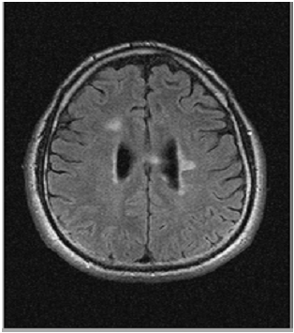
Melinda S.
20-yo woman with 2 days of blurry vision in her left eye associated with painful eye movements
Visual exam
  Left central scotoma
  L APD normal acuity
  Rest of neurological exam unremarkable
Diagnosed with acute optic neuritis
  Treated with 3 days of IV steroids
Further work up by MRI revealed 3 nonenhancing lesions in the brain
  LP showed OCB⁺, blood workup negative

Slide 8
Prominent Features
Relapsing-Remitting MS
Fatigue
Numbness
Vision problems
Spasticity/Stiffness
Bowel/Bladder problems
Cognitive decline
Progressive MS
Relapsing-Remitting MS
+
Worsening walking/mobility

Slide 9
Prognostic Factors
 | Good | Poor
Race | Caucasian | Black
Age at diagnosis | young (<35 years) | older (≥35 years)
Gender | female | male
Smoker | no | yes
Subtype | relapsing | progressive
First attack | optic neuritis, sensory, unifocal | motor, cerebellar, sphincter, multifocal
Recovery | complete | incomplete
Attack rate | low | high (≥2 in 1 year)
Disability at 5 years | no | yes
MRI lesions | cerebral | brainstem, cord
Lesion load | low | high
Enhancement | absent | present

Slide 10
Progressive Disease Definition
Active disease over N time (eg, 1 year)
Clinical
  Steadily increasing, objectively documented neurological dysfunction/disability without unequivocal recovery (fluctuations and phases of stability may occur)
Imaging (MRI)
  No standardized imaging measures of disease progression are established
  Increasing number and volume of T1 hypo-intense lesions, brain volume loss, and changes in MTI and DTI are being explored

Slide 11
Jeremy R.
52-yo African American male with 2-year history of progressive exercise intolerance, exacerbated in warm weather
  Notes difficulty walking his dog and going up the stairs in his home
  Also reports attention and memory problems, urgency incontinence and fatigue
Social history significant for smoking (20-pack years)
MRI
  Confirms areas of white matter lesions in the periventricular region and in the spinal cord
CSF
  6 oligoclonal bands

Slide 12
Clinical Course Ontology
SPMS
CIS
RRMS
RR or Benign
RIS
Active
PPMS
Purely Progressive

Slide 13
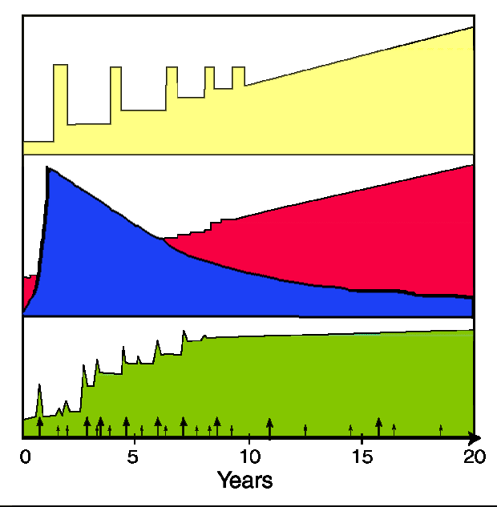
New: Concept of MS Biology – parallel, overlapping, dynamic, and interactions
Clinical Course
Underlying Biologies
Relapsing biology: focal, perivenular inflammatory demyelination
Progressive biology: chronic inflammation, neuronal degeneration
Degenerative
Inflammatory
Disability

Slide 14

Multiple Sclerosis
A lifelong, complex, heterogenous, inflammatory and
neurodegenerative disease
Motor
Sensory
Balance and Coordination
Cognition
Physical Fatigue
Mental Fatigue
Vision
Speech
Chronic Pain
Incontinence
Disability
Mobility
Uncertainty
Unpredictability
Financial Concerns
Depression
Loss of Independence
Fear
Lifelong Illness
Notes:
4:40 – 6:35

Slide 15
Comprehensive Care
Complexity of the therapeutic landscape dictates a multidisciplinary team to deliver comprehensive care
Multiple issues addressed by various team members
Empowerment for patients, families, care team
Improves communication with care team, adherence to treatment, continuity of care, QOL
Comprehensive care team may be able to identify breakthrough disease early
Notes:
18:15 – 20:00

Slide 16
Diagnostic and Therapeutic Issues
Treatment Plan
  Adjusting to new diagnosis
    Denial vs acceptance
    Anxiety and depression
    Unpredictability
  Adjustment to treatment
    Which DMT? Side effect profiles, comorbidities, lifestyle
    Research and clinical trial enrollment opportunities
  Symptomatic Treatment
    Pain, paresthesias
    Fatigue
    Depression
Notes:
12:45 – 16:05
16

Slide 17
Initiating Treatment—Real-World Considerations
Disease factors
  Frequency and severity of relapses
  Duration since MS onset
  Lesion burden on MRI
  Lesion location
  Residual deficits/EDSS
Access factors
  Formulary restrictions
  Out-of-pocket costs
Patient factors
  Potency/safety preference
  Risk tolerability
  Monitoring requirements
  Route of administration
  Age
  Future pregnancy
  Comorbidities
  Impairment impacting monitoring or adherence
  Ethnicity
Kalincik T, et al. Brain. 2017;140:2426-2443.
Wingerchuk DM, et al. BMJ 2016;354:i3518.
Rush CA, et al. Nat Rev Neurol .2015;11:379-389.
Rae-Grant A, et al. Neurology. 2018;90:777-788.

Slide 18
Assessing Therapy—Factors to Consider
Changes on physical exam
Relapses
Progression
MRI
Side effects
Other measures: fatigue, cognition, depression, etc
Therapeutic risks vs benefits assessment
  Multiple available pharmacological therapies
  Several other therapeutic options in late-stage development
Patient perceptions and perspectives
Notes:
1:05:13 – 1:12:26

Slide 19
Monitoring Disease: MRI Guidelines
CIS (follow-up)
  High risk: MR study with gadolinium at 6 to 12 months after diagnosis
  Low risk: MR study with gadolinium at 12 to 24 months after diagnosis
Established MS
  If no recent prior imaging available (eg, in cases of new patient referrals)
  Postpartum to establish new baseline
  Before starting or switching DMT
  ~6 to 12 months after switching DMT (to establish new baseline on therapy)
  Every 1 to 2 years during unchanged DMT to assess for subclinical disease
  In cases of unexpected clinical deterioration or to reassess original diagnosis
  Gadolinium is helpful but not essential—new T2-lesions can be identified on
  well-performed standardized MR imaging (unless T2-lesion burden is high)
Consortium of MS Centers. February 2018. Accessed June 6, 2022. https://cdn.ymaws.com/mscare.site-ym.com/resource/collection/9C5F19B9-3489-48B0-A54B-623A1ECEE07B/2018MRIGuidelines_booklet_with_final_changes_0522.pdf

Slide 20
Defining Treatment Failure/Breakthrough Disease:
2018 AAN Guideline
Treatment failure in MS management is difficult to define
  Most patients are not completely free of disease activity during therapy
  Disease activity may occur shortly after DMT initiation and before DMT is fully effective
Many clinicians obtain repeat MR imaging 3 to 6 months after a DMT is started to establish a new baseline
Optimal timing for monitoring disease activity remains uncertain
  Clinicians should consider treatment failure and switching DMTs when patients experience one of the following:
    ≥1 relapses
    ≥2 unequivocally new MR lesions
    Increased disability on neurologic examination over 1 year of therapy
Rae-Grant A, et al. Neurology. 2018;90(17):777-788.

Slide 21
Treatment of Relapsing MS
FDA Approvals 1993-2022
Ocrelizumab
(Ocrevus®)
Ponesimod (PonvoryTM)
SC/IM Injectable Therapy
GA 20 mg QD
(Glatopa®)
Siponimod
(Mayzent®)
IV Infusion Therapy
Oral Therapy
Cladribine
(Mavenclad®)
Alemtuzumab (Lemtrada®)
Diroximel Fumarate
(Vumerity®)
IFN-beta-1b (Betaseron®)
PEG-IFN-beta-1a (Plegridy®)
Natalizumab (Tysabri®)
IFN-beta-1a (Avonex®)
Ozanimod
(Zeposia®)
GA 40 mg TIW (Copaxone®)
IFN-beta-1b (Extavia®)
GA 20 mg/d (Copaxone®)
Ofatumumab
(Kesimpta®)
Fingolimod (Gilenya™)
Dimethyl Fumarate (Tecfidera®)
Dimethyl Fumarate (Mylan®)
Mitoxantrone (Novantrone®)
Teriflunomide (Aubagio®)
IFN-beta-1a (Rebif®)
Monomethyl fumarate (Bafiertam™)
1993
1996
2000
2002
2004
2009
2010
2011
2012
2013
2014
2015
2017
2019
2020
2021
2022
GA = glatiramer acetate; IFN = interferon
Wingerchuk DM, et al. BMJ. 2016;354:13518.
FDA. http://www.accessdata.fda.gov/scripts/cder/daf/. Accessed April 2022.

Slide 22
Summary of MS Therapies by Mechanism of Action
Immunomodulation | Cell Migration Inhibition / Lymphocyte-Sequestering | Lymphocyte-Depleting | Remyelination
Fumarates | Natalizumab | Alemtuzumab | Multiple investigational products in clinical development
Glatiramer acetate | Sphingosine 1-phosphate agonists* | Cladribine
Interferon β |  | Ocrelizumab
Teriflunomide |  | Ofatumumab
*Examples include fingolimod, siponimod, ozanimod, ponesimod
Gohil K. PT. 2015;40:33-35.

Slide 23
Fumarates (Dimethyl fumarate, Diroximel fumarate, Monomethyl fumarate)
Pros
  Moderate to high effectiveness
  Strong safety record
  Oral medication
Cons
  Twice daily dosing
  Tolerability issues
    GI symptoms (lower with diroximel fumarate)
    Flushing
  Safety
    7 PML cases with DMF, as of December 2021

Slide 24
Fumarates: Safety/Tolerability
GI: abdominal pain, nausea, emesis, and diarrhea (transient)
Flushing (transient), mitigated by taking with meals, ASA prior
Proteinuria
Rash/pruritus
Lymphopenia
  Few PML case reports in MS patients post marketing
  Lymphopenia in 4%–5% in clinical trials; 2.2% <500/mm³ for >6 mos
  If ALC <800/mm³ in 1st year, risk of ALC <500/mm³ for >6 mos = 11%
  Persistent lymphopenia up to >30 mos, associated with duration exposure
  No association of lymphopenia with efficacy or infections
Elevated transaminases in 6% in clinical trials
ALC, absolute lymphocyte count; ASA, aspirin; mos, months
Gold R, et al. N Engl J Med. 2012;367:1098-1107. Fox RJ, et al. N Engl J Med. 2012;367:1087-1097. Ermis U, et al. N Engl J Med. 2013;368:1657-1658. 57-1658. van Oosten BW, et al. N Engl J Med. 2013;368:1658-1659. Sweetser MT, et al. N Engl J Med. 2013;368:1659-1661. Fox RJ, et al. Neurol Clin Pract. 2016;6:220-229. Khatri BO, et al. Mult Scler Relat Disord. 2017;18:60-64.

Slide 25
Monomethyl Fumarate
Dimethyl and diroximel fumarates are prodrugs and require metabolic conversion to the active metabolite monomethyl fumarate (MMF).
FDA approval based on clinical trials of efficacy and safety, as well as bioequivalence studies
  MMF (380 mg/day) is bioequivalent to DMF (480 mg/day) or DRF (462 mg/day)
Clinical trial data from dimethyl fumarates studies
There are no alcohol or dietary restrictions

Slide 26
Sphingosine-1 Phosphate Receptor Modulators
Pros
  Moderate to high efficacy
  Once-daily oral medication
Cons
  Serious and atypical infections
    PML (rare)
    Cryptococcal infection including meningitis (rare)
    Herpes infections
  Bradycardia including cardiovascular deaths
  Macular edema
  Baseline evaluation and monitoring requirements
  Risk of rebound activity after withdrawal

Slide 27
Fingolimod: Safety
Potential adverse effects
Cardiovascular
  First dose observation 6 hours
  Caution regarding use in patients with CVD, prolonged QTc, or concomitant meds with potential to cause cardiac arrhythmia or decrease in BP
  ECG at end of observation; new heart block, arrhythmia, or symptomatic bradycardia requires further observation
Macular edema
  ↑Risk w/ diabetes or uveitis
Hepatotoxicity
Infections:
  Respiratory tract
  Herpetic—must have VZV immunity
  PML
  Cryptococcus
Avoid live virus vaccinations
Pulmonary effects: reductions FEV1 and DLCO
Subsequent increase in BP/hypertension
Rebound following discontinuation
Cardiac contraindications
Recent (within 6 months)
  Myocardial infarction
  Unstable angina
  Cerebral vascular accident, transient ischemic attack
  Decompensated heart failure requiring hospitalization or Class III/IV heart failure
History of Mobitz type II second-degree or third-degree AV block or sick sinus syndrome, unless patient has pacemaker
Baseline QTc ≥500 ms
Treatment with class Ia or class III antiarrhythmic drugs
AV, atrioventricular; BP, blood pressure; CVD, cardiovascular disease; DLCO, diffusion lung capacity for carbon monoxide; ECG, electrocardiogram; FEV, forced expiratory volume; PML, progressive multifocal leukoencephalopathy; VZV, varicella zoster virus
Fingolimod (Gilenya®) (www.pharma.us.novartis.com/sites/www.pharma.us.norvartis.com/files.gilenya.pdf ).
Comi G, et al. Lancet. 2017;389:1347-1356.
FDA 2012 safety announcement (www.fda.gov/Drugs/DrugSafety/ucm303192.htm ).
Hatcher SE, et al. JAMA Neurol. 2016;73:790-794.
Notes:
From: Kappos L et al. Engl J Med. 2010;362:387-401. In FREEDOMS, n= 429 0.5mg dose and n= 431 placebo (also higher 1.25mg dose in that study). Note- no LOWER dose has been studied – might work. No dose effect observed with 1.25 vs 0.5mg.
Cohen JA et al NEJM 2010
Note, 0.5mg dose also lowered risk of disability progression c/w pbo
FREEDOMS II older age group mean age 40 -41, mean EDSS 2.4-2.5. Higher BMI than FREEDOMS I.
ARR  48% over 24 months, 0.5mg vs PBO. (0.4 in PBO, 0.21 in 0.5mg group)
33% proportion of brain volume loss at 24months ; 17% in confirmed disability progression (NS); AE’s: Herpes zoster: 2.5% vs 0.8%, basal cell skin cancer: 2.8% vs 0.6%, HTN (8.9% vs 3.1%). No deaths
The FREEDOMS II study was a two year study of oral fingolimod versus placebo. This study differed from the FREEDOMS I trial in that the mean age of the enrolled subjects was older (40-41), and the subjects in this study had high body mass indices. In the FREEDOMS II study, the annualized relapse rate was reduced by 47.5% versus placebo for the approved 0.5 mg daily dose (it was 54% for the FREEDOMS I trial).
FREEDOMS: mean age ~ 37, mean EDSS 2.3-2.4
30% disability progression (3 month confirmed)
30% less reduction in MRI brain volumes
89.7% (0.5mg) vs. 65% (placebo) free of Gd+ lesions at 24mon

Slide 28
Second-Generation S1P-Receptor Modulators
Proposed to offer refinements on fingolimod
  Not prodrugs
  Shorter half-lives
  More selective S1P subgroup binding
  Fewer cardiac issues (avoid first dose monitoring)
Three products have completed phase 3 trials and are approved for relapsing forms of MS

Slide 29
S1P-Receptor Modulators
 | Fingolimod | Siponimod | Ozanimod | Ponesimod
Dose | 0.5 mg | 2 mg | 1 mg | 20 mg
t_{½} | 6-9 days | 30 (26-37) hours | 20-22 hours; metabolites 10 days | 32 hours
Washout | 1-2 months | 7 days | Metabolites ~50 days | ~6 days
Receptor targets | 1,3,4,5 | 1,5 | 1,5 | 1
Pro Drug | Yes | No | No | No
 |  | +SPMS phase 3 (EXPAND) | +RRMS phase 3 trials vs IM IFNβ-1a (SUNBEAM, RADIANCE) | +RR phase 3 (OPTIMUM) vs teriflunomide

Slide 30
Comparison of S1P Receptor Modulators
Prior to initiation of therapy
  Genetic testing only for siponimod
  Ophthalmological evaluations only recommended for patients with history of diabetes mellitus or uveitis in patients starting ozanimod; for all with others
Initiation of therapy
  First dose observation with fingolimod; seldom for all others
  Titration: 5 days for siponimod; 7 days for ozanimod; 14 days for ponesimod
Return of normal lymphocyte counts
  Longer for fingolimod and ozanimod
  Shorter for siponimod and ponesimod

Slide 31
Teriflunomide
MOA: immunomodulation
Pros
  Moderate effectiveness
  Once a day oral medication
  Only drug with statistically significant reduction in disability progression
  in 2 trials
  Extensive good safety record of leflunomide
Cons
  Moderate effectiveness
  Need for liver monitoring monthly x6
  Mild hair loss
  Pregnancy Category X
  Need for accelerated elimination protocol

Slide 32
Teriflunomide: Safety/Tolerability
GI: nausea, diarrhea
Alopecia, transient
Hepatotoxicity—ALT
Teratogenic in animal models
Slow clearance from body requires enhanced elimination procedure with to remove drug
Peripheral neuropathy
Transient acute renal failure/ increased uric acid clearance
Hyperkalemia
Hypertension
Safety Issues from leflunomide experience in rheumatoid arthritis incorporated in teriflunomide PI:
  Opportunistic infections: TB screening prior to use
  Fulminant Hepatotoxicity (black box): monthly LFTs for first 6 months
  Leukopenia
    Rare agranulocytosis
    Thrombocytopenia
    Pancytopenia
  Severe cutaneous reactions (SJS, TEN)
  Interstitial lung disease
ALT, alanine aminotransferase; GI, gastrointestinal; LFT, liver function test; PI, prescribing information; RA, rheumatoid arthritis; SJS, Stevens-Johnson syndrome; TB, tuberculosis; TEN, toxic epidermal necrolysis
O’Connor P et al. N Engl J Med. 2011;365:1293-1303. Teriflunomide (Aubagio®) PI (http://products.sanofi.us/aubagio/aubagio.pdf)

Slide 33
Cladribine
Intracellular accumulation of metabolite 2-chlorodeoxyadenosine,triphosphate disrupts cell metabolism, inhibits DNA synthesis, and causes apoptosis
Selective effect on lymphocytes due to limited adenosine deaminase activity
Prolonged effect on T lymphocytes, transient effect on B lymphocytes
Annual courses of 3.5 mg/kg given over 5 days in 2 successive months for
2 years
Reduced ARR by 57.6% vs PBO (0.14 vs 0.33, P<0.0001), increased % relapse free (79.7% vs 60.9%), and decreased % with 3-month confirmed disability progression by 33%
Adverse events: lymphopenia, increased infections, herpes zoster
Efficacy maintained in 2-year placebo extension
Approved for MS in US for RRMS and SPMS
Giovannoni G, et al. N Engl J Med. 2010;362:416-426. Giovannoni G, et al. Mult Scler. 2017;Epub ahead of print. Stuve O. ECTRIMS, 2017, poster 667 (https://onlinelibrary.ectrims-congress.eu/ectrims/2017/ACTRIMS-ECTRIMS2017/200322/olaf.stuve.effects.of.cladribine.tablets.on.cd42B.t. cell.subsets.in.the.html).

Slide 34
Anti-CD20 Monoclonal Antibodies
Ofatumumab
  May be used in adults for treatment of relapsing forms of MS, including clinically isolated syndrome, relapsing-remitting disease, and active secondary progressive disease
  versus
Ocrelizumab
  May be used in adults for treatment of relapsing forms of MS and primary progressive multiple sclerosis

Slide 35
Ocrelizumab (Anti-CD20 Monoclonal Ab)
MOA: Anti-CD20 Monoclonal Ab
Administered through IV dosing, initially as a split first dose, separated by 2 weeks, followed by every 6-month dosing
Safety Considerations
Infusion reactions in 34%–40%, most frequent and severe with early infusions but could occur at any infusion
Infection rates similar in ocrelizumab and IFNβ-1a groups
  Serious infections with ocrelizumab less frequent
Infection rates more common than with placebo in ORATORIO
  URI and nasopharyngitis most common
  No opportunistic infections in the 3 studies
Malignancies numerically more common with ocrelizumab
  0.4 vs 0.2/100 patient-years for comparators across all trials
  OPERA I/II: 4 compared to 2 with IFNβ, 5 additional during open label
  ORATORIO: 11 (2.3%) with ocrelizumab vs 2 (0.8%) with placebo; 2 additional cases during open-label extension
Herpetic infections
URI, upper respiratory (tract) infection
Hauser SL, et al. N Engl J Med. 2017;376:221-234.
Montalban X, et al. N Engl J Med. 2017;376:209-220.

Slide 36
Alemtuzumab
MOA: Lymphocyte depleting
Risk-management program
  Certified infusion centers and prescribers
  Monthly CBC, UA for 48 months following last infusion
  Thyroid tests every 3 months for 48 months following last infusion
  Annual dermatologic exams
Safety considerations
Infusion reactions
Infections
  Antiviral prophylaxis for HSV/VZV with each treatment cycle
Secondary autoimmunity
  47.7% (UK Cambridge cohort 1999–2012)
  Thyroid disease most common
  Immune thrombocytopenia
  Rare cases of antiglomerular basement- membrane disease
? increased risk of malignancies
  Thyroid
  Melanoma
  Lymphoproliferative disorders
11/29/18 FDA Press Release
  Rare, but serious risk of stroke and blood vessel wall tears
  13 cases in 5 years (12 reported symptoms w/in 1 day of drug)
  Added to boxed warnings
HSV, herpes simplex virus; CBC, complete blood count; UA, urinalysis
Alemtuzumab (Lemtrada®) PI (http://products.sanofi.us/Lemtrada/Lemtrada.pdf).
Tuohy O, et al. J Neurol Neurosurg Psychiatry. 2015;86:208-215.

Slide 37
Natalizumab
MOA: Cell migration inhibition/lymphocyte sequestering
Pros
  Intravenous infusion every 4 weeks
  Highly effective
  Well tolerated
Cons
  Progressive multifocal leukoencephalopathy (PML)
  Must be given in a TOUCH-certified center

Slide 38
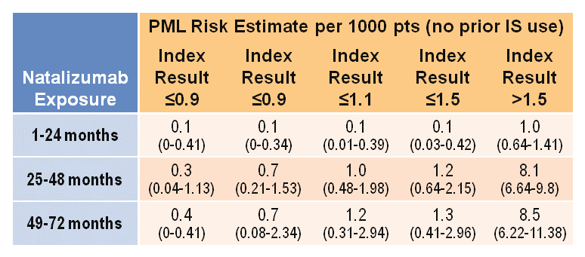
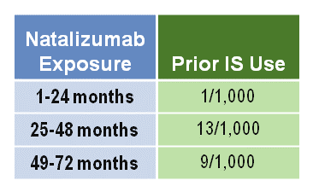
JCV Antibody Status and Risk for PML
Negative
JCV Antibody Status
<1/1000*
Positive
Natalizumab Exposure | Prior IS Use
1-24 months | 1/1,000
25-48 months | 13/1,000
49-72 months | 9/1,000
*Calculation based on 2 cases of JCV antibody-negative PML in patients exposed for ≥1 month of therapy as of September 3, 2013. IS, immunosuppressant
Natalizumab Prescribing Information. www.tysabri.com/en_US/tysb/site/pdfs/TYSABRI-pi.pdf. Accessed: April 7, 2014.

Slide 39
Natalizumab: Safety
Hypersensitivity reactions
Rare hepatotoxicity
PML > 800 confirmed cases
  JCV Ab test = biomarker for risk stratification
    Duration of therapy
    Prior immune suppressive therapy irrespective of duration of Rx or remoteness of exposure
    Potential for seroconversion requires periodic testing
    Quantitative index may offer further value in risk stratification
  Clinical and MRI monitoring for emergent PML required while on therapy
    Increased rate of MRI surveillance and clinical evaluation if JCV Ab+
    Clinical evaluation every 3 months
CNS herpes virus infections
Polman CH, et al. N Engl J Med. 2006;354:899-910. Kappos L, et al. Lancet Neurol. 2011;10:745-758. Bloomgren G, et al. N Engl J Med. 2012;366:1870-1880. Clifford DB, et al. Lancet Neurol. 2010;9:438-446. Miravalle A, et al. Arch Neurol. 2011;68:186-191. Traboulsee A, et al. AJNR Am J Neuroradiol. 2016;37:394-401. Natalizumab (Tysabri®) PI (www.tysabrihcp.com/content/dam/commercial/multiple-sclerosis/tysabri/en_us/pdfs/tysabri_prescribing_information.pdf)

Slide 40
Summary of MS Therapies by Efficacy
Efficacy
Modest | Moderate | High
Interferons | Sphingosine-1-phosphate receptor modulators | Natalizumab
Glatiramer acetate | Fumarates | Anti-CD20s (B cell depletors)
Teriflunomide | Cladribine | Alemtuzumab

Slide 41
DMT Considerations
No clear guidelines on what to start first/treatment sequencing, making patient preference extremely important. Other considerations include if the patient has:
Highly Active MS
Access Issues
JC Virus Ab⁺
PPMS
  Alemtuzumab
  Sphingosine-1 receptor modulators
  Natalizumab
  Anti-CD20 monoclonal antibodies eg ocrelizumab crelizumab
  Manufacturer patient-access programs
  National/ government organizations
  Options include cladribine, off-label use of less expensive drugs
  Natalizumab
    If JCV antibody index is >0.9, consider whether benefit outweighs PML risk
  Offer ocrelizumab
Rae-Grant A, et al. Neurology. 2018;90:777-788.

Slide 42
Clinical Trials in Progressive MS
Agent | Mechanism of Action | Phase | MS Subtype | Study | 1° End Point Met?
Fingolimod | Non-selective S1P receptor modulator | III | PPMS | INFORMS | No
Natalizumab | Inhibits leukocyte trafficking across the BBB | III | SPMS | ASCEND | No
Opicinumab | Prevents LINGO-1 from suppressing myelination | II | RRMS, SPMS | SYNERGY | No
Ocrelizumab | Depletes CD20 B cells | III | PPMS | ORATORIO | Yes
Biotin (MD1003) | Cofactor for decarboxylase enzymes involved in myelin synthesis | III | RRMS, SPMS | MS-SPI | No
Siponimod | Selective S1P-1 and -5 receptor modulator | III | SPMS | EXPAND | Yes, but…
Laquinimod | Modulates cytokines and reduces leukocyte migration into CNS | II | PPMS | ARPEGGIO | No
Simvastatin | ?Anti-inflammatory | III | SPMS | MS-Stat 2 | Ongoing

Slide 43
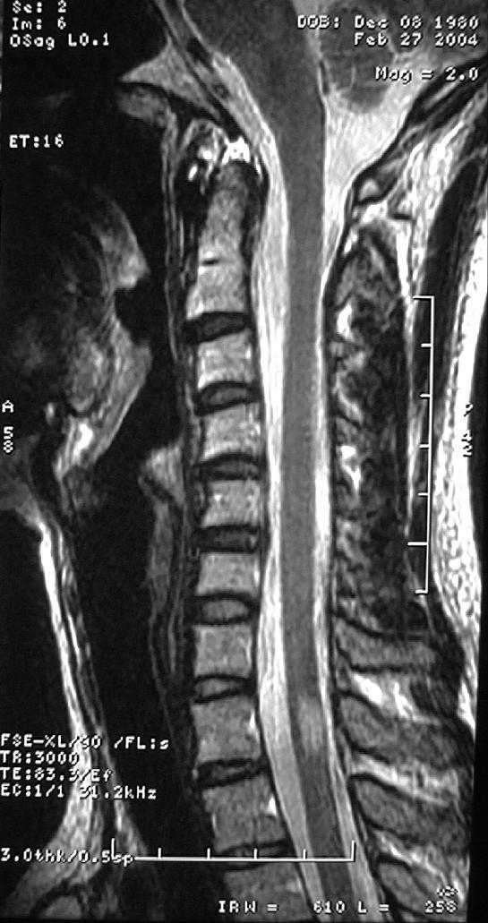
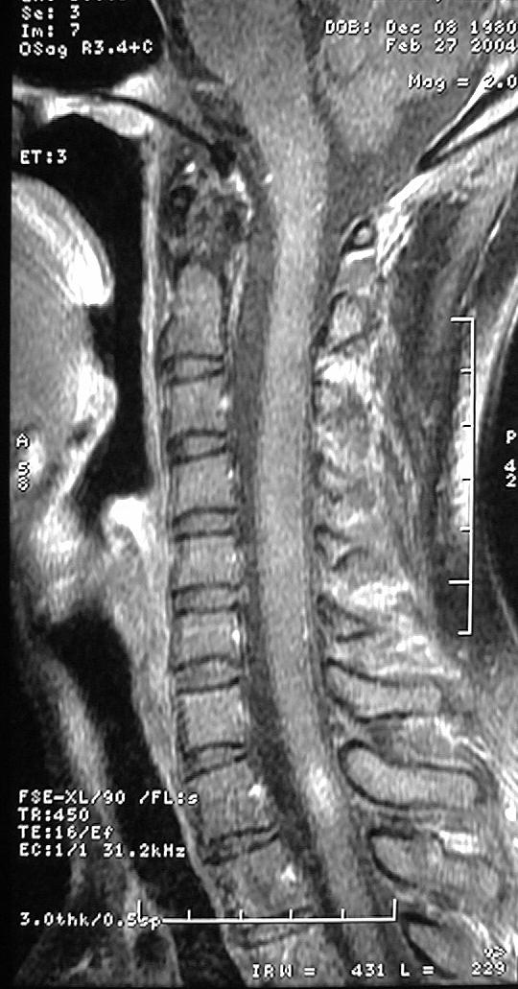
Wellness/Health Maintenance Program
30-year-old African American man developed difficulty walking
  Neuro exam reveals an ataxic gait
  MRI revealed 14 nonenhancing lesions, and 4 Gad⁺ lesions in the brain and 1 spinal cord
  Treated with IV steroids
  LP showed OCB⁺, blood workup negative

Slide 44
Wellness/Health Maintenance Program
Increasing evidence that health maintenance changes/improves CNS reserve, function, and repair
This can be considered a complement to DMTs
Components involve
  High-normal vitamin D levels; vitamin B12 >400 pg/mL
  Regular aerobic exercise, weight loss
  No smoking, limited alcohol and salt, healthy diet
  Regular mental and social stimulation
  Good sleep hygiene, stress management
  Watch blood pressure, lipids, and hemoglobin A1C; monitor bone density, prostate, and other health issues

Slide 45
Melinda S.
20-year-old woman with 2 days of blurry vision in her left eye associated with painful eye movements
Visual exam
  Left central scotoma
  L APD normal acuity
  Rest of neurological exam unremarkable
Diagnosed with acute optic neuritis
  Treated with 3 days of IV steroids
Further work up by MRI revealed 3 nonenhancing lesions in the brain
  LP showed OCB⁺, blood workup negative

Slide 46
Jeremy R.
52-year-old African American male with 2-year history of progressive exercise intolerance, exacerbated in warm weather
  Notes difficulty walking his dog and going up the stairs in his home
  Also reports attention and memory problems, urgency incontinence and fatigue
Social history significant for smoking (20-pack years)
MRI
  Confirms areas of lesions in the brain
CSF
  6 oligoclonal bands

