Slide 2
Epidemiology and Pathophysiology of Food Allergy
Red line

Slide 3
Epidemiology and Increasing Prevalence of Food Allergy

Slide 4



Prevalence of Food Allergies in the United States
~32 million people in the US have food allergies^{1,2}
~26 million US adults¹
(10.8%)
~5.6 million children²
(7.6%)
1. Gupta RS et al. JAMA Netw Open. 2019;2(1):e185630. 2. Gupta RS et al. Pediatrics. 2018;142(6):e20181235.

Slide 5
Rising Rates of Food Allergy Among Children
Incidence of Peanut Allergy Among
4- to 17-Year-Olds in the US, 2001-2017¹
Pediatric Food-Related Anaphylaxis
ED Visits, 2005-2014²
173% increase in food-related anaphylaxis ED visits
ED, emergency department.
1. Lieberman J et al. Ann Allergy Asthma Immunol. 2018;121(5 Supplement):S13. 2. Motosue MS et al. Pediatr Allergy Immunol. 2018;29(5):538-544.

Slide 6
Risk Factors for Food Allergy: Genetic and Environmental Determinants
Prenatal
Genetic factors
Epigenetic modifications
Perinatal
Gut microbiota
Antibiotic use
Postnatal
Maternal diet during lactation
Duration of breastfeeding
Family history
Parent country of birth
Maternal diet during pregnancy
Maternal folate level
Route of delivery
Cutaneous exposure to food allergens
Timing of introduction of food allergens
Age at first introduction of solids
Diversity of solid diet
Animal exposure
Vitamin D level
Atopic dermatitis
Tobacco smoke exposure
1. Stallings VA, Oria MP, eds. Finding a Path to Safety in Food Allergy. National Academies Press. 2017. https://nap.nationalacademies.org/read/23658/chapter/7.
Notes:
Animal exposure-suggest moving to postnatal, also add vit D level, presence of atopic dermatitis, tobacco smoke exposure

Slide 7
Common Food Triggers

Slide 8
Common Food Allergens
About 90% of food allergies in the US are caused by the following 8 allergens¹⁻³:
  Milk
    ~2.5% of children younger than 3 have cow’s milk allergy
    Most will eventually outgrow it
  Egg
    ~2% of children are allergic to eggs
    Most will eventually outgrow it
  Peanut
    ~2%-5% of children are allergic to peanuts
    Most will continue to be allergic in adulthood
  Soy
    ~0.4% of children are allergic to soy
    Most will eventually outgrow it
  Wheat
    ~1% of children are allergic to wheat
    About two-thirds will outgrow it
  Tree nut
    ~2% of children are allergic to tree nuts
    Most will continue to be allergic into adulthood
  Shellfish
    ~2% of the population is allergic to shellfish
    Most experience their first allergic reaction as adults
  Fish
    ~1% of the population is allergic to fish
    About half experience their first allergic reaction as adults
1. NIAID-Sponsored Expert Panel. J Allergy Clin Immunol. 2010;126(6 Suppl):S1–S58. 2. Sampson HA et al. J Allergy Clin Immunol. 2014;134(5):1016-1025. 3. FARE. Common allergens. Accessed October 3, 2022. https://www.foodallergy.org/living-food-allergies/food-allergy-essentials/common-allergens

Slide 9
Common Food Allergens (Continued)
Recently in the US, sesame has been identified as a major allergen and was the ninth allergen added by the FDA to food labeling requirements^{1,2}
  About 0.5% of the population self-reported sesame allergy
  About 0.2% of the population met symptomatic criteria for IgE-mediated sesame allergy
Declaration requirements started on January 2, 2023
1. Warren CM et al. JAMA Netw Open. 2019;2(8):e199144. 2. US FDA. Food allergies. Accessed October 3, 2022. https://www.fda.gov/food/food-labeling-nutrition/food-allergies.
Notes:
will be declared on labels as of Jan 2, 2023

Slide 10
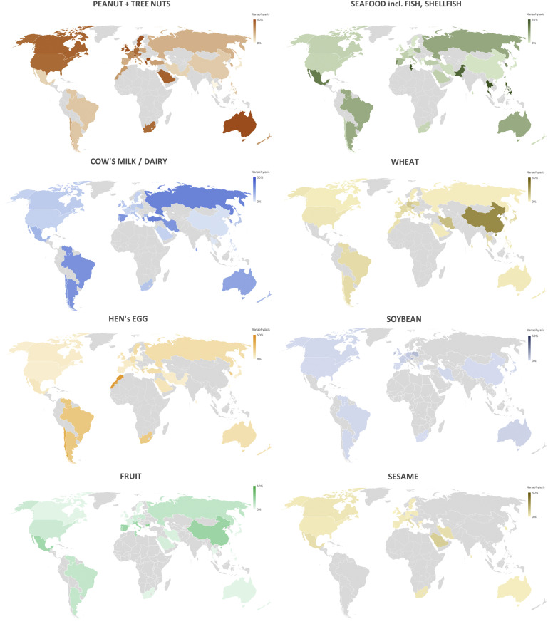
Common Food Allergens
(Continued)
Rates of Anaphylaxis for Individual Allergens
Due to differing patterns of food consumption, common allergens can vary by geography and culture¹
For example, in Europe, common food allergens include celery, mustard, and stone fruits, among others¹
Sampson HA et al. J Allergy Clin Immunol. 2014;134(5):1016-1025.
Image courtesy of Baseggio Conrado A et al. J Allergy Clin Immunol. 2021;148(6):1515-1525.e3. CC BY 4.0.
Notes:
It might be fun to show a map

Slide 11
Inflammatory Pathways Involved in Food Allergy

Slide 12
Normal Physiologic Response to Ingested Antigens:
Oral Tolerance
Oral tolerance is usually the default response to ingested antigens; when the process of oral tolerance is disrupted, food allergies can occur
Mechanisms of oral tolerance in the intestinal mucosa:
  Induction of IL-10–producing dendritic cells
  Suppression of Th2 cells
  Generation of regulatory T cells (Tregs)
  Suppression of effector T-cell migration to tissues
  Decreased B-cell production of IgE
  Increased B-cell production of IgA and IgG4
  Suppression of basophil, eosinophil, and mast cell activation
Th2, T helper type 2.
Sampson HA et al. J Allergy Clin Immunol. 2018;141(1):11-19.
Notes:
I have reordered for better flow

Slide 13
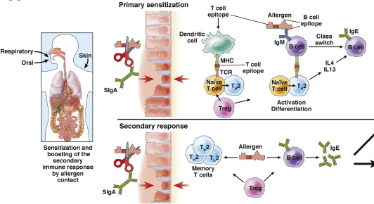
Immune Tolerance vs Allergic Sensitization
Allergic sensitization can occur in the intestines, mouth, skin, and respiratory tract.¹
Allergen-specific Th2 cells produce cytokines that promote IgE production. Allergen-specific IgE is produced by B cells and is a hallmark of allergic sensitization.^{1,2}
Image courtesy of Valenta R et al. Gastroenterology. 2015;148(6):1120-31.e4. CC BY 4.0.
1. Sampson HA et al. J Allergy Clin Immunol. 2018;141(1):11-19. 2. Valenta R et al. Gastroenterology. 2015;148(6):1120-31.e4.

Slide 14
The Skin Barrier and Allergic Sensitization
Skin barrier disruption may contribute to food allergy through transcutaneous sensitization¹⁻³
Evidence supporting transcutaneous food allergen sensitization^{1,2}:
  Allergic reactions to foods can occur without prior oral ingestion
  Earlier oral exposures to foods are associated with tolerance
  Food allergy is more common in people with atopic dermatitis and correlates with atopic dermatitis severity
  Peanut allergy is associated with household—and not individual—peanut consumption
1. Izadi N et al. Children (Basel). 2015;2(3):382–402. 2. Martin PE et al. Clin Exp Allergy. 2015;45(1):255-264. 3. Lack G. J Allergy Clin Immunol. 2012;129(5):1187-1197.
Notes:
better reference would be one of Gideon Lack papers in JACI

Slide 15
Risks of Food Allergy

Slide 16
Serious and Life-Threatening Reactions to Food Allergens
Up to 50% of people diagnosed with food allergy are considered at high risk for anaphylaxis¹
1 out of 2
Over the last several decades, food allergen–induced anaphylaxis requiring an ED visit or hospitalization has increased substantially^{2,3}
Every 3 minutes, a food allergy reaction requires an ED visit³
Without immediate treatment, anaphylactic food allergy reactions can be fatal^{2,3}
1. Arizona Department of Health Services. Arizona Resource Guide for Supporting Children With Life-Threatening Food Allergies. Accessed October 3, 2022. https://www.azdhs.gov/documents/prevention/azwic/food-allergies-resource-guide.pdf. 2. Motosue MS et al. Pediatr Allergy Immunol. 2018;29(5):538-544. 3. FARE. Facts and statistics. Accessed October 3, 2022. https://www.foodallergy.org/resources/facts-and-statistics.

Slide 17
Food Allergies and Nutritional Deficiencies
Food allergies can limit growth and development¹⁻⁴
Growth impairment in patients with food allergy has been correlated with elimination diets and inadequate nutrient intake^{1,4}
Below-average weight and height can persist into childhood, particularly for patients with milk allergies⁴
1. Christie L, et al. J Am Diet Assoc. 2002;102(11):1648-1651. 2. Hobbs CB, et al. J Allergy Clin Immunol Pract. 2015;3(1):133–134.e1. 3. Robbins KA, et al. J Allergy Clin Immunol. 2014;134(6):1466–1468.e6. 4. Mehta H, et al. J Pediatr. 2014;165(4):842-848.

Slide 18
Economic Burden of Food Allergy
Annual Costs of Food Allergy in the US
On average, childhood food allergies cost US families more than $4000 per child annually, totaling up to $25 billion in costs to families per year.
1. Gupta R et al. JAMA Pediatr. 2013;167:1026-1031.

Slide 19
Psychosocial and Emotional Burdens of Food Allergy

Slide 20
Food Allergies: Simultaneously Over- and Underdiagnosed

Slide 21
Food Allergy Overdiagnosis and Adverse Consequences
Overdiagnosis is “the phenomenon of turning a healthy individual into a patient with a disease on the basis of a clinical test or examination finding when they are not likely to suffer any of the consequences of the condition.”¹
Overdiagnosis of food allergy can lead to several adverse outcomes^{1,2}:
  Patient and/or caregiver anxiety and stress
  Unnecessary elimination diets, leading to malnutrition
  Special arrangements for child care, summer camps, and after-school care
  Overuse of treatments and medical resources
Nonetheless, overdiagnosis of food allergy (both self-diagnosis and clinician diagnosis) remains an ongoing issue.³
1. Abrams EM et al. J Allergy Clin Immunol Pract. 2021;9(11):3911-3917. 2. Westwell-Roper C et al. Pediatr Allergy Immunol. 2022;33(1):e13695.3. Sicherer SH et al. Pediatrics. 2017;140(2):e20170194.
Notes:
also special arrangements fod child care, summer camps, afetr school etc

Slide 22
Underdiagnosis in Underprivileged Populations
Compared with White children, Black and Asian children have 1.8- and 1.4-fold higher rates of food allergy, respectively
The prevalence of food allergy is increasing most rapidly among Non-Hispanic Black adults (2.1% increase per decade)
And yet, rates of clinician-diagnosed food allergy are lower in public schools with more Black and lower-income children than in private schools with more White and higher-income children (7.4% vs 17.5%)
  Even among Black children with a history of severe food reaction, about one-half had never received a clinician diagnosis
Davis CM et al. J Allergy Clin Immunol. 2021;147(5):1579-1593.

Slide 23
Social Determinants of Health Likely Contributing to Disparities in Food Allergy Diagnosis
Food insecurity and lack of varied diet
Lack of access to specialty care (geographic regions, transportation barriers)
Cultural and language barriers
Lack of insurance or underinsurance
Discrimination, stress, and HCP bias
Warren CM et al. J Allergy Clin Immunol Pract. 2021;9(1):110-118.
Notes:
I added “likely”these are speculative not evidence based

Slide 24
Clinical Features and Diagnosis of Food Allergy
Orange line

Slide 25
Clinical Presentation of Food Allergy

Slide 26




Symptoms of IgE-Mediated Food Allergy Reactions
Ocular: Pruritus, conjunctival erythema, tearing, periorbital edema
Upper respiratory: Nasal congestion, pruritus, rhinorrhea, sneezing, laryngeal edema, hoarseness, dry staccato cough
Oral: Angioedema of the lips, tongue, or palate; oral pruritus; tongue swelling
Cardiovascular: Tachycardia (occasionally bradycardia in anaphylaxis), hypotension, dizziness, fainting, loss of consciousness
Lower respiratory: Cough, chest tightness, dyspnea, wheezing, intercostal retractions, accessory muscle use
Gastrointestinal: Nausea, abdominal pain, reflux, vomiting, diarrhea, irritability and food refusal with weight loss
Cutaneous: Erythema, pruritus, urticaria, morbilliform eruption, angioedema, eczematous rash
Other: Uterine contractions, sense of “impending doom”
Yawn BP, Fenton MJ. Am Fam Physician. 2012;86(1):43-50.

Slide 27
Differentiating IgE- and Non-IgE-Mediated Food Allergy Presentation^{1,2}
 | IgE-mediated food allergy | Mixed IgE or non-IgE–mediated food allergy
Typical organ systems involved in symptom presentation | Symptoms across broad range of organs, including oral, respiratory, cardiovascular, cutaneous, and GI | Symptoms usually isolated to GI system (nausea, vomiting, diarrhea, stomach cramps)
Timing after oral intake | Usually seconds to minutes (within 2 hours) | Usually hours to days
Severity | May proceed to anaphylaxis | Variable, life-threatening is rare but can occur (eg, FPIES)
Pathogenesis | Type 1 immune hypersensitivity (IgE-mediated) | Type 3 or 4 immune hypersensitivity
Examples | Peanuts, tree nuts, seafood, milk | Eosinophilic esophagitis, food protein-induced enterocolitis syndrome
GI, gastrointestinal.
1. Wrobel JP et al. Aust Fam Physician. 2008;37(4):222-226. 2. Ruffner MA, Spergel JM. Ann Allergy Asthma Immunol. 2016;117(5):452–454.

Slide 28
Diagnosing Food Allergy (NIAID and AAAAI/ACAAI Guidelines)

Slide 29
Medical History for Food Allergy
Medical history to include:
  Symptoms associated with various types of food reactions
  Timing between food ingestion and symptom onset
  Route of food exposure
  Amount of food ingested
  Form of food (eg, raw vs cooked)
  Epidemiologic factors and potential triggers
  Presence of cofactors, including exercise, febrile illness, alcohol, drugs, and ASA or NSAID use
Neither the medical history nor physical examination is diagnostic of food allergy; however, important information can be obtained that can aid in the identification of potential allergens and types of food reactions.
ASA, acetylsalicylic acid; NSAID, nonsteroidal anti-inflammatory drug.
1. Boyce et al, J Allergy Clin Immunol 2010;126(6):1105-1118. 2. Sampson HA et al. J Allergy Clin Immunol. 2014;134(5):1016-1025.
Notes:
I would split into 2 slides: history also should include route of food exposure, amount of food ingested, form of food: raw vs baked/cooked, presence of cofactors: exercise, febrile illness, alcohol, drugs: ASA, NSAIDS
On Phys Exam slide I suggest adding pictures to illustrate

Slide 30
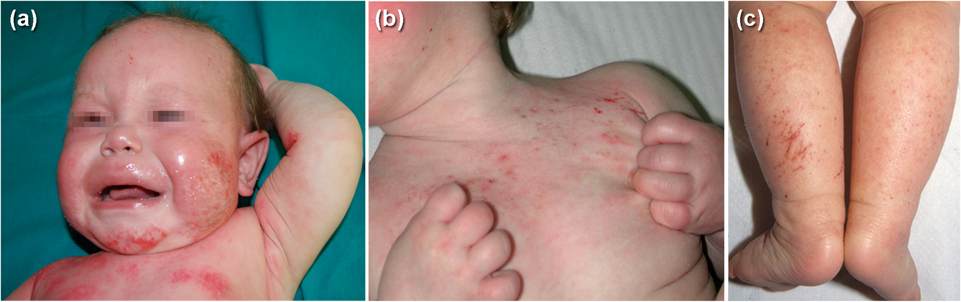
Physical Examination for Food Allergy
Pediatric Atopic Dermatitis
Physical examination to assess for:
  Evidence of other atopic diseases (eg, asthma, allergic rhinitis, atopic dermatitis)
  Evidence of non-IgE-mediated food reaction (eg, failure to thrive or autoimmune diseases)
1. Boyce et al, J Allergy Clin Immunol 2010;126(6):1105-1118. 2. Sampson HA et al. J Allergy Clin Immunol. 2014;134(5):1016-1025.
Images courtesy of El Hachem M et al. Ital J Pediatr. 2020;46(1):11. CC BY 4.0.
Notes:
I would split into 2 slides: history also should include route of food exposure, amount of food ingested, form of food: raw vs baked/cooked, presence of cofactors: exercise, febrile illness, alcohol, drugs: ASA, NSAIDS
On Phys Exam slide I suggest adding pictures to illustrate

Slide 31
IgE Testing for Food Allergy
Self-reported symptoms have a low positive predictive value, underscoring the need for laboratory allergy testing
for specific suspected triggers.¹
Guideline-recommended food allergy testing options^{1,2}:
  Skin prick tests (SPTs): allergens in a liquid are lanced into the skin to evaluate the level of activating IgE antibodies in the dermal mast cells
  Serum IgE testing (also called immunoassays): blood samples are tested for allergen-specific IgE antibody levels
1. Sampson HA et al. J Allergy Clin Immunol. 2014;134(5):1016-1025. 2. Muthupalaniappen L, Jamil A. Malays Fam Physician. 2021;16(2):19-26.

Slide 32
Oral Food Challenge
Oral food challenges may be considered to determine the appropriateness of elimination diet, to assess for tolerance, or to confirm findings of medical history and/or laboratory testing.
Must be performed under direct supervision of clinician prepared to treat an anaphylactic reaction
Should be preceded by an elimination diet
Oral food challenges can be:
  Open (unmasked, unblinded)—most cost effective, but may be influenced by patient anxiety or fears
  Single-blind
  Double-blind, placebo-controlled-gold standard in food allergy diagnosis
Sampson HA et al. J Allergy Clin Immunol. 2014;134(5):1016-1025.

Slide 33
Avoiding Inappropriate Testing for Food Allergy

Slide 34
Food Panel Testing
Test for food allergy should be specific to a patient’s medical history and should not be performed using large panels of food allergens.
Positive results to tolerated foods are common
  For example, 8% of people have positive SPT or serum IgE results for peanut even though only about 1% of people are clinically allergic
Panels can lead to clinically irrelevant positive results and overdiagnosis, which can in turn promote unnecessary stress and dietary avoidance
Sicherer SH, Wood RA. Pediatrics. 2012;129(1):193-197.

Slide 35
IgG or IgG4 Antibody Testing
Tests that evaluate for large panels of IgG and IgE antibodies are often marketed as diagnostic of food allergies and sensitivities
IgG testing is not a validated diagnostic tool for food allergy
IgG (specifically IgG4) may be a marker of food exposure and tolerance
1. American Academy of Allergy, Asthma & Immunology (AAAAI). Position Statement. May 2010. Accessed October 4, 2022. https://www.aaaai.org/Aaaai/media/Media-Library-PDFs/Tools%20for%20the%20Public/Conditions%20Library/Library%20-%20Allergies/eacci-igg4-2010.pdf. 2. Lavine E. CMAJ. 2012;184(6):666-668.

Slide 36
Serum Antibody Allergy Testing
Key issues with serum antibody allergy tests identified by the American Academy of Allergy, Asthma & Immunology:
  Diagnosis of food allergy in the absence of a medical history and possible food challenge testing is inappropriate
  Serum antibody levels cannot diagnose food allergy
  Overinterpretation of results may lead to unnecessary and potentially nutritionally inadequate elimination diets
  Test marketing oversimplifies the interpretation of results
  Misinterpretation of results could lead to serious food reactions when clinical sensitivity is present despite presumed negative results
American Academy of Allergy, Asthma & Immunology (AAAAI). Position Statement. May 2010. Accessed October 4, 2022. https://www.aaaai.org/Aaaai/media/Media-Library-PDFs/Tools%20for%20the%20Public/Conditions%20Library/Library%20-%20Allergies/eacci-igg4-2010.pdf.

Slide 37
Intradermal Testing
Involves injection of a small amount of allergen directly into the skin
Not recommended for food allergy
Highly sensitive and, as such, is associated with a risk of severe allergic reaction
Associated with higher rates of false positives than SPTs
1. Muthupalaniappen L, Jamil A. Malays Fam Physician. 2021;16(2):19-26. 2. Sampson HA et al. J Allergy Clin Immunol. 2014;134(5):1016-1025.

Slide 38
Atopy Patch Testing
Involves the topical application of a solution containing the food allergen and assessment for reaction
Lack of standardization for the testing process and cutoffs makes test result interpretation challenging
Therefore, atopy patch testing is not recommended for routine clinical use
1. Sicherer SH, Wood RA. Pediatrics. 2012;129(1):193-197. 2. Sampson HA et al. J Allergy Clin Immunol. 2014;134(5):1016-1025.

Slide 39
Safe Food Challenge Testing

Slide 40
Oral Food Challenge Safety
When an oral food challenge is being considered, referral to an allergist/immunologist is recommended
Challenges can be performed in the allergist/immunologist’s office as long as staff are prepared to assess for and treat allergic reactions and anaphylaxis
Procedures for rapid access to emergency medical services should be in place
Bird JA et al. J Allergy Clin Immunol Pract. 2020;8(1):75-90.e17.

Slide 41
AAAAI Recommendations for Oral Food Challenge
Example Dosing Options for Food Challenge
4-dose protocol
6-dose protocol
  Dose 1 = 1/12th total serving
  Dose 2 = 1/6th total serving
  Dose 3 = 1/4 total serving
  Dose 4 = 1/2 total serving
  Dose 1 = 1% total dose
  Dose 2 = 4% total dose
  Dose 3 = 10% total dose
  Dose 4 = 20% total dose
  Dose 5 = 30% total dose
  Dose 6 = 35% total dose
Bird JA et al. J Allergy Clin Immunol Pract. 2020;8(1):75-90.e17.
Notes:
The diagram shows Practal food chalelnge protocol that is usually used in research and totally different from the examples on the left. I suggest splitting into 2 slides, one showing the tyoical clinical protocol, second with the research protocol

Slide 42
AAAAI Recommendations for Oral Food Challenge:
Research Protocol
Example Dosing Protocol With Objective Reaction After Ingestion of 100-mg Dose
Dose
(mg)
1
3
10
30
100
300
1000
3000
Cumulative
tolerated dose
(44 mg)
Single highest tolerated dose
(30 mg)
Eliciting or reactive dose
(100 mg)
Cumulative reactive dose
(144 mg)
Bird JA et al. J Allergy Clin Immunol Pract. 2020;8(1):75-90.e17.
Notes:
The diagram shows Practal food chalelnge protocol that is usually used in research and totally different from the examples on the left. I suggest splitting into 2 slides, one showing the tyoical clinical protocol, second with the research protocol

Slide 43
Psychosocial Considerations for Food Challenge
Ingesting a food avoided or considered dangerous by a patient can lead to stress and anxiety
This can lead to difficulty differentiating subjective symptoms due to overlap between anxiety and food allergy reaction symptoms (eg, accelerated heart rate, mouth/throat pruritus)
Recommendations for providers:
  Assess patient readiness for a food challenge
  Consider referral to or consultation with mental health support during food challenge preparation and, if available, during food challenge itself
  For children, have parents discuss food challenges using terms they can understand
  For children, avoid using terms such as “pass” or “fail” to prevent self-blame
Bird JA et al. J Allergy Clin Immunol Pract. 2020;8(1):75-90.e17.

Slide 44
Case Study 1: James

Slide 45
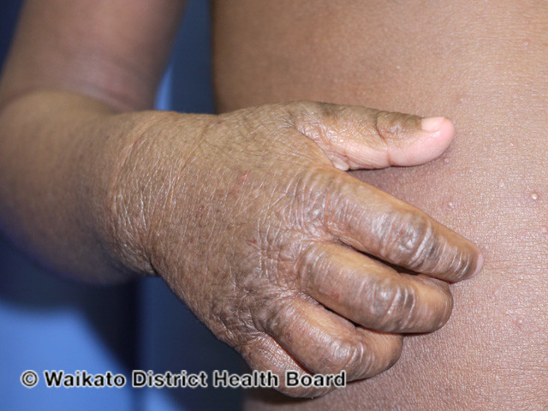

James: 6-Month-Old Infant
Parents of a 6-month-old present for follow-up of atopic dermatitis diagnosis 2 weeks prior
Parents report use of topical emollient after baths and topical steroids as recommended
Atopic dermatitis has not improved
Top image courtesy of DermNet. https://dermnetnz.org/topics/atopic-dermatitis. CC BY-NC-ND 3.0.

Slide 46

James: 6-Month-Old Infant
Additional symptoms reported by the parents include GI upset (colic, vomiting, general fussiness)
The patient is in the 25th height-for-weight percentile
His growth has recently plateaued
Top image courtesy of DermNet. https://dermnetnz.org/topics/atopic-dermatitis. CC BY-NC-ND 3.0.

Slide 47
James: 6-Month-Old Infant
Medical history reveals worsening symptoms, particularly after introduction of yogurt in the diet
Solid foods and formula were introduced 1 month prior; partial breastfeeding is ongoing
Recommended testing:
  Skin prick test
Top image courtesy of DermNet. https://dermnetnz.org/topics/atopic-dermatitis. CC BY-NC-ND 3.0.
Notes:
Consider using a Black baby with eczema picture here

Slide 48
James: 6-Month-Old Infant
SPT results are positive for cow’s milk (8-mm wheal)
Next step:
  Counseling to remove dairy from James’ diet
  Recommendation for alternatives to cow’s milk formula
  Referral to nutritionist
Top image courtesy of DermNet. https://dermnetnz.org/topics/atopic-dermatitis. CC BY-NC-ND 3.0.
Notes:
I changed spt to 8 mm; with spt of 3 mm we would recommend a better skin care regime and an oral milk challenge

Slide 49
Case Study 2: Isabelle

Slide 50

Victoria: 2-Year-Old Toddler
Parents of a 2-year-old girl present for evaluation of acute urticaria on arm
They note that the symptoms started 2 days ago and hives are still present
They suspect allergy to tree nuts, as she ate walnuts for the first time 3 days ago
Notes:
Image free to use from Pixabay: https://pixabay.com/de/photos/asien-china-m%C3%A4dchen-lachen-1202527/
it would be nice to have more diverse paptients, eg Asian

Slide 51

Victoria: 2-Year-Old Toddler
Medical history reveals that she only had the walnuts 1 time, 2 days ago and has not had any since
The rash has come and gone over the last 2 days and responds to antihistamines
Differential diagnosis:
  Contact dermatitis
  Insect bite
Notes:
I think a more common scenario is that of a child who presents with several days of true hives ( rash comes and goes, responds to antihistamines)

Slide 52
Food Allergy and nutrition
Silver line

Slide 53
Changes in Food Allergy Prevention Recommendations

Slide 54





Shifting Food Allergy Prevention Rationale
American Academy of Pediatrics Guidelines on Preventing Food Allergy
2000¹
2008²
2015
2019³
Wait to introduce allergenic foods:
No evidence for delaying introduction of allergenic foods:
No evidence for delaying introduction of allergenic foods:
Milk: 1 year
Milk, eggs, tree nuts, and fish: 4-6 months
Milk, eggs, nuts, and fish: 4-6 months
Eggs: 2 years
LEAP study
Early introduction of peanuts may be beneficial for infants at high risk for allergy:
Nuts and fish: 3 years
Peanuts: 4-6 months
1. Zeiger RS. Pediatrics. 2003;111(6 Pt 3):1662-1671. 2. Greer FR et al. Pediatrics. 2008;121(1):183-191. 3. Greer FR et al. 2019;143(4). pii:e20190281.

Slide 55
LEAP Study: Avoidance vs Consumption of Peanuts in Infants Aged
4-11 Months at High Risk for Peanut Allergy
Primary and Secondary Prevention of Allergies at 60 Months
P = .004
LEAP enrolled patients with severe eczema, egg allergy, or both, and stratified outcomes based on peanut SPT results.
P < .001
P < .001
Du Toit G et al. N Engl J Med. 2015;372(9):803-813.

Slide 56
EAT Study: Early vs Standard Introduction of Cow’s Milk, Peanut, Cooked Egg, Sesame, Whitefish, and Wheat
P = .32
P = .01
P = .03
Enrolled 1303 infants aged 3 months who were exclusively breast fed
No significant difference in food allergy between groups by intention-to-treat analysis
Adherence was lower for early feeding group (42.8%) than for standard feeding group (92.9%)
Significant reduction in peanut and egg allergy in per-protocol analysis
One or More Foods
P = .11
P = .003
P = .003
Peanut
P = .17
P = .009
P = .02
Egg
Perkin MR, et al. J Allergy Clin Immunol. 2016;137(5):1477–1486.e8.
Notes:
I would ass that PP analysis showed significant reduction in peanut and egg allergy in infants ingesting at least 2 g of peanut or egg protein per week.

Slide 57
Current Recommendations for Food Allergy Prevention

Slide 58
2017 NIAID Addendum Guideline Recommendations
Severe eczema
AND/OR
Egg allergy
Peanut sIgE
Peanut SPT
<0.35 kU_{A}/L
≥0.35 kU_{A}/L
0-2 mm
3-8 mm
>8 mm
Refer to specialist for consultation and evaluation
Risk of reaction varies from moderate to high
Risk of reaction low
Risk of reaction low
Probably allergic
Introduce peanut at home
OR
Supervised feeding in the office
Peanut avoidance recommended; refer to specialist for consultation and evaluation
NIAID-Sponsored Expert Panel. Addendum Guidelines for the Prevention of Peanut Allergy in the United States. 2017. Accessed October 4, 2022. https://www.niaid.nih.gov/sites/default/files/addendum-peanut-allergy-prevention-guidelines.pdf.

Slide 59
2021 Consensus Approach to the Primary Prevention of Food Allergy Through Nutrition (AAAAI, ACAAI and CSACI)
Key recommendations
Infants with severe eczema are at highest risk for food allergy
Regardless of risk of peanut allergy, introduce peanuts at around 6 months of age (not before 4 months)
Regardless of risk of egg allergy, introduce egg at around 6 months of age (not before 4 months)
Do not purposefully delay introduction of other allergenic foods
Feed a diverse diet, which may prevent food allergy
Do not use hydrolyzed formulas to prevent food allergy
Do not recommend maternal exclusion of common allergens to prevent food allergy
Fleischer DM et al. J Allergy Clin Immunol Pract. 2021;9(1):22-43 e24.

Slide 60
Optimizing Nutrition in Patients with Food Allergy

Slide 61
Avoiding Unnecessary Elimination Diets
Avoiding unnecessary elimination diets is the first step to optimizing nutrition in people with food allergies. Elimination diets can place children at risk for poor growth and nutritional deficiency.^{1,2}
ªNecessary elimination diet was one in which cow’s milk allergy was confirmed with a double-blind placebo-controlled food challenge. Unnecessary elimination diet was one in which a double-blind placebo-controlled trial confirmed tolerance of cow’s milk and cow’s milk was successfully reintroduced.
1. Sinagra JL, et al. Pediatr Dermatol. 2007;24(1):1-6. 2. Dambacher WM, et al. Nutr J. 2013;12:22.

Slide 62
Food Substitutions for Common Allergens
Allergen | Lost nutrients | Suggested alternatives (if not allergic)
Milk | Protein, fat, calcium, riboflavin, phosphorous, vitamins A, D, B12 | Meat, fish, poultry, legumes, eggs, fortified milk substitutes, calcium-fortified foods or drinks
Eggs | Protein, iron, biotin, folacin, riboflavin, vitamins A, D, E, B12, selenium | Meats, fish, poultry, legumes, dairy, leafy greens, enriched grains
Soy | Protein, thiamin, riboflavin, iron, calcium, zinc, vitamin B6 | Meats, fish, poultry, legumes, eggs, dairy, fruit, vegetables, leafy greens, enriched grains
Wheat | Thiamin, niacin, riboflavin, folate, iron, fiber | Meats (iron), whole and fortified alternate grain products (oats, buckwheat, amaranth, millet, quinoa, teff, sorghum), seeds, legumes
Peanuts and tree nuts | Protein, vitamins, minerals | Meats, fish, poultry, eggs, dairy, fruit, vegetables, enriched grains, seeds
Fish and shellfish | Protein, PUFA (fatty fish) iodine, B12, A, E | Meats, poultry, eggs, fruit, vegetables, enriched grains, seeds, marine algae and seaweed
Asthma and Allergy Foundation of America. Reviewed March 2013. Accessed October 4, 2022. https://www.kidswithfoodallergies.org/page/replacing-lost-nutrients.aspx.

Slide 63
Maintaining Optimal Nutrition in Patients With Food Allergy
Consider referral to a registered dietitian
Encourage a diverse and balanced diet
For infants, encourage breastfeeding and adequate maternal nutrition, eg, adequate replacement of the eliminated foods, vit. D, calcium
Identify and mitigate factors associated with high nutritional risk (eg, multiple food allergies, feeding difficulties or delays, lack of financial resources for specialty formulas)
1. Allen L. Adv Nutr. 2012;3:362-369. 2. Fleischer DM et al. J Allergy Clin Immunol Pract. 2021;9(1):22-43 e24. 3. Groetch M, et al. J Allergy Clin Immunol Pract. 2013;1(4):323-331.

Slide 64
Current Food Allergy Treatment Approaches
Blue line

Slide 65
Overarching Treatment Principles

Slide 66
Standard of Care: Targeted Allergen Elimination Diet
Elimination diet should be specific to known or strongly suspected allergens
2-4 weeks diagnostic elimination diet should be followed by a supervised reintroduction (rechallenge) unless recent anaphylaxis, severe FPIES or diagnosis of EoE
Limit elimination diets to relevant foods only
  Consider the potential risk for cross-reactive foods
Discuss common exposure routes (generally ingestion, although some patients may react to skin contact or inhalation)
Provide education about preparing foods and reading food allergen labels
Sampson HA et al. J Allergy Clin Immunol. 2014;134(5):1016-1025.

Slide 67
Anaphylaxis Awareness and Treatment
Review signs and symptoms of anaphylaxis to promote prompt recognition
  Delays in recognition and treatment can lead to adverse outcomes
Discuss action steps for the treatment of anaphylaxis
Provide written treatment plan
Ensure that patients have access to self-injectable epinephrine
Instruct patients on the proper use of epinephrine (teach-back method) and the potential need for repeat dosing
Sampson HA et al. J Allergy Clin Immunol. 2014;134(5):1016-1025.

Slide 68
Allergen Immunotherapy
Allergen immunotherapy is a novel treatment option that can be considered for selected patients with IgE-mediated food allergy
Food allergen immunotherapy is a process whereby desensitization can be induced through oral (OIT), sublingual (SLIT) or epicutaneous (EPIT) exposure to allergens at regular intervals and increasing dosages
Currently, the only FDA-approved allergy immunotherapy option is an oral immunotherapy (OIT) for peanut allergy (age 4-17 years)
Research protocols are also available for egg, cow’s milk, wheat OIT, as well as for peanut SLIT and EPIT

Slide 69
Introduction to Allergen Immunotherapy

Slide 70
Goals of Allergen Immunotherapy
Modify the immune response to increase the threshold at which a person has an allergic reaction
Decrease the risk for anaphylaxis during accidental exposure
Decrease the need for burdensome lifestyle modifications, which can improve quality of life
Reduce anxiety about accidental exposures
1. Muraro A et al. World Allergy Organ J. 2022;15(9):100687. 2. Feuille E, Nowak-Wegrzyn A. Allergy Asthma Immunol Res. 2018;10(3):189-206.

Slide 71
2022 GA²LEN Guidelines: OIT Indications and Contraindications
Indications (must meet all of the following)
IgE-mediated systemic allergic reactions after ingestion and/or positive oral food challenge
Evidence of allergic sensitization (positive SPT and/or serum IgE)
Primary food allergy (ie, not pollen food allergy syndrome due to cross-reactivity)
Low likelihood of spontaneous resolution of food allergy
Patients and/or caregivers understand effectiveness, adverse effects, logistics, and potentially lifelong duration of therapy
Patients and/or caregivers are motivated, adherent, and capable of administering emergency treatment (including IM epinephrine)
Previous severe reactions to allergen or impaired quality of life due to burden
Willingness to incorporate allergen into diet
Stable living and family situation
GA²LEN, Global Allergy and Asthma European Network.
Muraro A et al. World Allergy Organ J. 2022;15(9):100687.

Slide 72
2022 GA²LEN Guidelines: OIT Contraindications
Contraindications (absolute)
Inadequate adherence to therapy and/or safety recommendations
Uncontrolled or severe asthma
Active malignancy
Active systemic autoimmune disorder
Systemic immunosuppressive therapy
Untreated/uncontrolled active EoE and other eosinophilic GI disorders
Initiation during pregnancy
Contraindications (relative)
Severe systemic conditions (eg, CVD)
Systemic autoimmune disorders in remission or organ-specific autoimmune disorders
Uncontrolled atopic dermatitis
Uncontrolled chronic urticaria
Use of beta-blockers or ACE inhibitors
Systemic mastocytosis
Ongoing updosing with other immunotherapy
Chronic GI symptoms of uncertain etiology
Unable to consume study product (eg, vomiting, taste problems, allergy to vehicle)
Psychological disorder or eating disorder
Muraro A et al. World Allergy Organ J. 2022;15(9):100687.

Slide 73
Desensitization vs Tolerance
Desensitization
A temporary increase in threshold exposure to a food allergen
Tolerance
A permanent state of allergen
nonresponsiveness
  Induced and maintained by frequent exposure to allergen
  Primary outcome measured in most food allergen immunotherapy studies
  Maintained even after sustained nonexposure to allergen
  Ultimate goal of food allergen immunotherapy but generally not attained
  Sustained unresponsiveness can be used as surrogate
Feuille E, Nowak-Wegrzyn A. Allergy Asthma Immunol Res. 2018;10(3):189-206.

Slide 74
Mechanism of Action of OIT
Early initiation
Late initiation
Consolidation
↑ Th2 cells
↓Treg cells
↑ mast cells, eosinophils, basophils
↑ B-cell production of IgE
Th2 cell exhaustion
↑ Treg cells
↑ B-cell production of IgG4
↓ mast cells, eosinophils, basophils
↑ B-cell production of IgG4
↑ Treg cells and Treg signaling
OIT drives desensitization through chronic stimulation and exhaustion of allergen-specific Th2 cells, leading to subsequent shifts in IgE/IgG4 ratios.
OIT Process
Kulis MD et al. J Allergy Clin Immunol. 2017;141(2):491-498.

Slide 75
OIT Process for Food Allergies
Updosing phase
(every ~2 weeks)
Maintenance phase
(daily)
Initial dose escalation
Day 1
About 6-9 months
Months or years
OIT is generally an extended process performed over months or years
Ongoing exposure is typically required to maintain sensitization
Asthma and Allergy Foundation of America. OIT for Food Allergies. October 2021. Accessed October 4, 2022. https://www.kidswithfoodallergies.org/food-allergy-treatment-oral-immunotherapy-oit.

Slide 76
Safety and Efficacy of OIT for Single-Food Allergies

Slide 77
Efficacy of OIT
Highly effective for induction of desensitization while on therapy
May not always decrease the rate of allergic reactions in the real-world setting
Desensitization more common than short-term sustained unresponsiveness
Development of sustained unresponsiveness may be dependent on age of OIT initiation and allergy severity (greater effectiveness at younger ages)
Muraro A et al. World Allergy Organ J. 2022;15(9):100687.

Slide 78
Systematic Review of Allergen Immunotherapy: Efficacy
In a systematic review and meta-analysis of 36 trials that included 2126 patients (mostly children), the efficacy and safety of OIT was assessed
While on therapy, OIT was shown to increase tolerance for the following food allergens:
  Peanut (relative risk [RR], 9.9; high certainty)
  Cow’s milk (RR, 5.7; moderate certainty)
  Hen’s egg (RR, 8.9; moderate certainty)
Number needed to treat to increase the tolerance to a single dose of 300 to 1000 mg peanut protein was 2
de Silva D et al. Allergy. 2022;77(6):1852-1862.

Slide 79
Systematic Review of Allergen Immunotherapy: Safety
In a systematic review and meta-analysis of 36 trials that included 2126 patients (mostly children), the efficacy and safety of OIT was assessed¹
OIT did not increase adverse reactions (RR, 1.1)
OIT did not increase severe adverse reactions (RR, 1.6)
OIT may increase mild adverse reactions to cow’s milk (RR, 3.9)
OIT may increase mild adverse reactions to hen’s egg allergy (RR, 7.0)
NOTE: some studies exclude extremely allergic patients; safety in these populations may be less certain²
1. de Silva D et al. Allergy. 2022;77(6):1852-1862. 2. Muraro A et al. World Allergy Organ J. 2022;15(9):100687.

Slide 80
Peanut (Arachis hypogaea) Allergen Powder-dnfp Clinical Trials

Slide 81
PALISADE Study: Peanut (Arachis hypogaea) Allergen Powder-dnfp (PTAH)
Double-blind, placebo-controlled phase 3 trial that enrolled patients 4-55 years of age with peanut allergy
The primary efficacy endpoint was the proportion of patients 4-17 years who could ingest 600 mg of peanut with only mild symptoms after 24 weeks of treatment
Vickery BP et al. N Engl J Med. 2018;379(21):1991-2001.

Slide 82
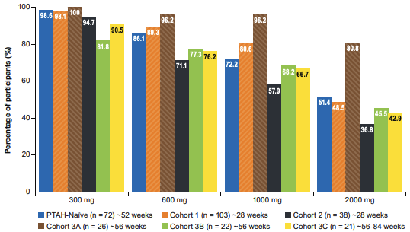
ARC004: Open-Label Follow-on to PALISADE
Desensitization Rates at Exit Food Challenge
Participants in the active arm of PALISADE who tolerated ≥300 mg peanut protein could continue daily or nondaily dosing
Participants in the placebo arm could initiate PTAH and were updosed to 300 mg/day before initiating maintenance dosing
NOTE: Hatches indicate daily dosing cohorts
Image courtesy of Vickery BP et al. J Allergy Clin Immunol Pract. 2021;9(5):1879-1889.e14. CC BY-NC-ND 4.0.
Vickery BP et al. J Allergy Clin Immunol Pract. 2021;9(5):1879-1889.e14.

Slide 83
PTAH Safety in Clinical Trials
In the initial dose-escalation and increasing-dose phases of PALISADE…¹
  Common adverse events with PTAH included abdominal pain, vomiting, oral pruritus, nausea, and oral paresthesia
  Systemic allergic reactions were reported in up to 8.5% of patients treated with PTAH
  Severe reactions were reported in 4.3% of patients treated with PTAH
In the maintenance dosing phase of PALISADE and ARC004…^{1,2}
  Adverse events were lower in the daily dosing cohorts than in the nondaily-dosing cohorts
  GI and respiratory adverse reactions were most common
  Severe adverse reactions occurred in less than 3% of patients
1. Vickery BP et al. N Engl J Med. 2018;379(21):1991-2001. 2. Vickery BP et al. J Allergy Clin Immunol Pract. 2021;9(5):1879-1889.e14.

Slide 84
Peanut (Arachis hypogaea) Allergen Powder-dnfp Prescribing

Slide 85
PTAH Dosing: Three Phases
Initial dose escalation
  Administered on a single day in a health setting
  Dose escalation using 5 dose levels (0.5-6 mg)
  Each dose separated by observation period of 20-30 minutes
  Patients who tolerate ≥3 mg of PTAH should begin updosing the next day
Updosing
  Consists of 11 dose levels, beginning at 3 mg
  Dose levels are administered for 2 weeks; each new level is administered under supervision
Maintenance
  Continue at 300 mg daily
  Necessary to maintain efficacy
Palforzia [Peanut (Arachis hypogaea) Allergen Powder-dnfp] [prescribing information]. Brisbane, CA: Aimmune Therapeutics; 2020.

Slide 86
GA²LEN-Recommended Safety Requirements for OIT Prescribing
Staff trained and experienced in the use of food allergy immunotherapy, including a prescribing clinician and nurse experienced in food allergy diagnosis as well as recognition and management of allergic reactions, including anaphylaxis
Ability and preparedness to provide appropriate treatment and observation according to the severity of any allergic reaction
  May include transfer to another facility
Emergency equipment and treatments for medical emergencies, including severe anaphylaxis
Implementation of a standardized, evidence-based protocol, with use of licensed pharmaceutical products when indicated
Muraro A et al. World Allergy Organ J. 2022;15(9):100687.

Slide 87
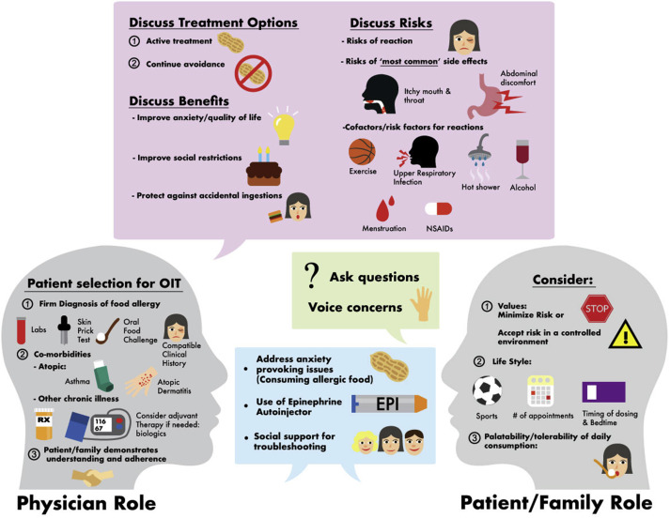
Key Components of Shared Decision Making for OIT
Image courtesy of Chinthrajah RS et al. World Allergy Organ J. 2020;13(8):100455. CC BY-NC-ND 4.0.

Slide 88
Case Study 3: Julian

Slide 89

Julian: 13-Year-Old Boy
Julian, a 13-year-old boy, is referred to your practice after a recent severe anaphylactic reaction to peanuts at his school
Julian recently joined a traveling soccer team, and his parents are concerned that there may be more potential for accidental exposure
Notes:
Image free to use from Pexels: https://www.pexels.com/photo/boy-in-white-v-neck-shirt-969373/

Slide 90

Julian: 13-Year-Old Boy
Julian has a documented history of peanut allergy
  Positive SPT conducted 3 years ago
Julian and his family follow a strict avoidance diet
In addition to recent severe allergic reaction, he has had 2 other instances of accidental exposure requiring epinephrine treatment

Slide 91
Julian: 13-Year-Old Boy
Julian has no other atopic conditions
Julian’s family asks about immunotherapy
Would Julian be considered eligible for OIT based on the information you have thus far?

Slide 92
Julian: 13-Year-Old Boy
Considerations for discussion with Julian’s family:
  Goals of OIT
  Effectiveness of OIT
  Risks of OIT
  Need for frequent clinic visits over the next year
  Need for lifelong treatment
  Costs of treatment

Slide 93
Anaphylaxis and Food Allergy Management in School Settings
Yellow line

Slide 94
Food Allergies at School: Reducing Risk of Allergen Exposure

Slide 95
Protections for Students With Food Allergy
Children with food allergy are protected under the ADA and ADAA to allow access to education in the least restrictive environments
The 2011 Food Allergy and Anaphylaxis Management Act (FAAMA) led to the development of voluntary guidelines for food allergy and anaphylaxis management for schools
Food allergy guidelines and requirements vary by state, county, and school district
Between 16% and 18% of children with food allergy have had food allergy reactions at school
Wang J et al. J Allergy Clin Immunol Pract. 2018;6(2):427-435.

Slide 96
Role of the Allergist in Communicating Diagnosis and Risks
Discussion with family and caregivers about food allergy care
Development of a written allergy and anaphylaxis emergency plan
  Focus on common causes of exposure (ie, ingestion)
  Develop in collaboration with student and family
  Provide to the school
Prescriptions for epinephrine
Collaboration on creating school plans for effective avoidance
Communication with the school team, as needed
Wang J et al. J Allergy Clin Immunol Pract. 2018;6(2):427-435.

Slide 97
Allergen Avoidance at School
Most reactions in schools result from oral ingestion. Severe reactions from cutaneous or inhaled exposures are uncommon.
Sharing foods or eating and drinking utensils should be avoided
Hidden allergens may be found in school supplies, such as for art or science projects (eg, paint, play dough)
Food allergens can be removed from surfaces with standard cleaning methods
Designated peanut-free lunch tables can reduce the risk of severe allergic reaction (especially in younger children)
Allergen exposures can occur anywhere in the school—not just the lunchroom
Wang J et al. J Allergy Clin Immunol Pract. 2018;6(2):427-435.

Slide 98
COVID-19 and Food Allergen Accommodations
COVID-19 has changed CDC recommendations for food in classrooms
  In 2020, the CDC recommended that snacks and lunches should be eaten in the classroom to avoid mixing of students
  In 2021, the CDC stopped recommending that all food be eaten in the classroom and left this up to schools to determine
Food in the classroom may have adverse effects on students with allergies:
  Sharing of snacks and other foods outside of mealtimes
  Heightened anxiety regarding spills and accidental exposure
  Relaxation of food separation protocols
Jobrack J. Back to School With Food Allergies in Pandemic Times? Accessed October 5, 2022. https://www.allergicliving.com/2021/08/05/back-to-school-with-food-allergies-in-pandemic-times-start-talking/.

Slide 99
Food Allergies at School: Emergency Plans

Slide 100
Food Allergy Emergency Plans
Emergency plans are individualized, written documents using simple lay terms to describe guidance regarding recognition and treatment of anaphylaxis
Components of an emergency plan:
  Demographic and allergy history
  Signs and symptoms of allergic reaction
  Instructions for treatment and appropriate dosages
NOTE: even when an emergency plan is provided, school staff need training regarding the appropriate management of allergic reactions beyond the scope of an individualized plan.
Wang J et al. J Allergy Clin Immunol Pract. 2018;6(2):427-435.

Slide 101
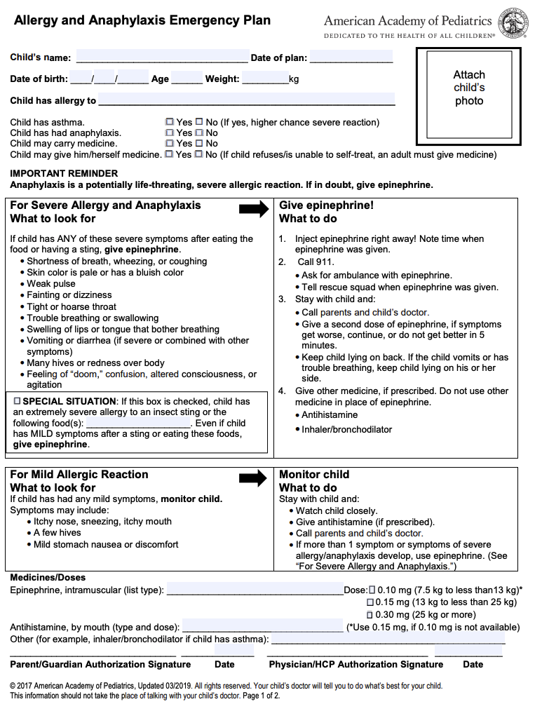
Emergency Plan Forms
AAP Emergency Plan
Emergency plan templates are available from the AAP, AAAAI, and FARE
In addition to individualized information, all emergency plans should…
  Emphasize the importance of immediate administration of epinephrine in case of anaphylactic allergic reaction
  Review the need to call emergency medical services
  Discuss other medications that can be considered for mild reactions
Wang J et al. J Allergy Clin Immunol Pract. 2018;6(2):427-435.

Slide 102
Anaphylaxis: Appropriate Use of Epinephrine

Slide 103
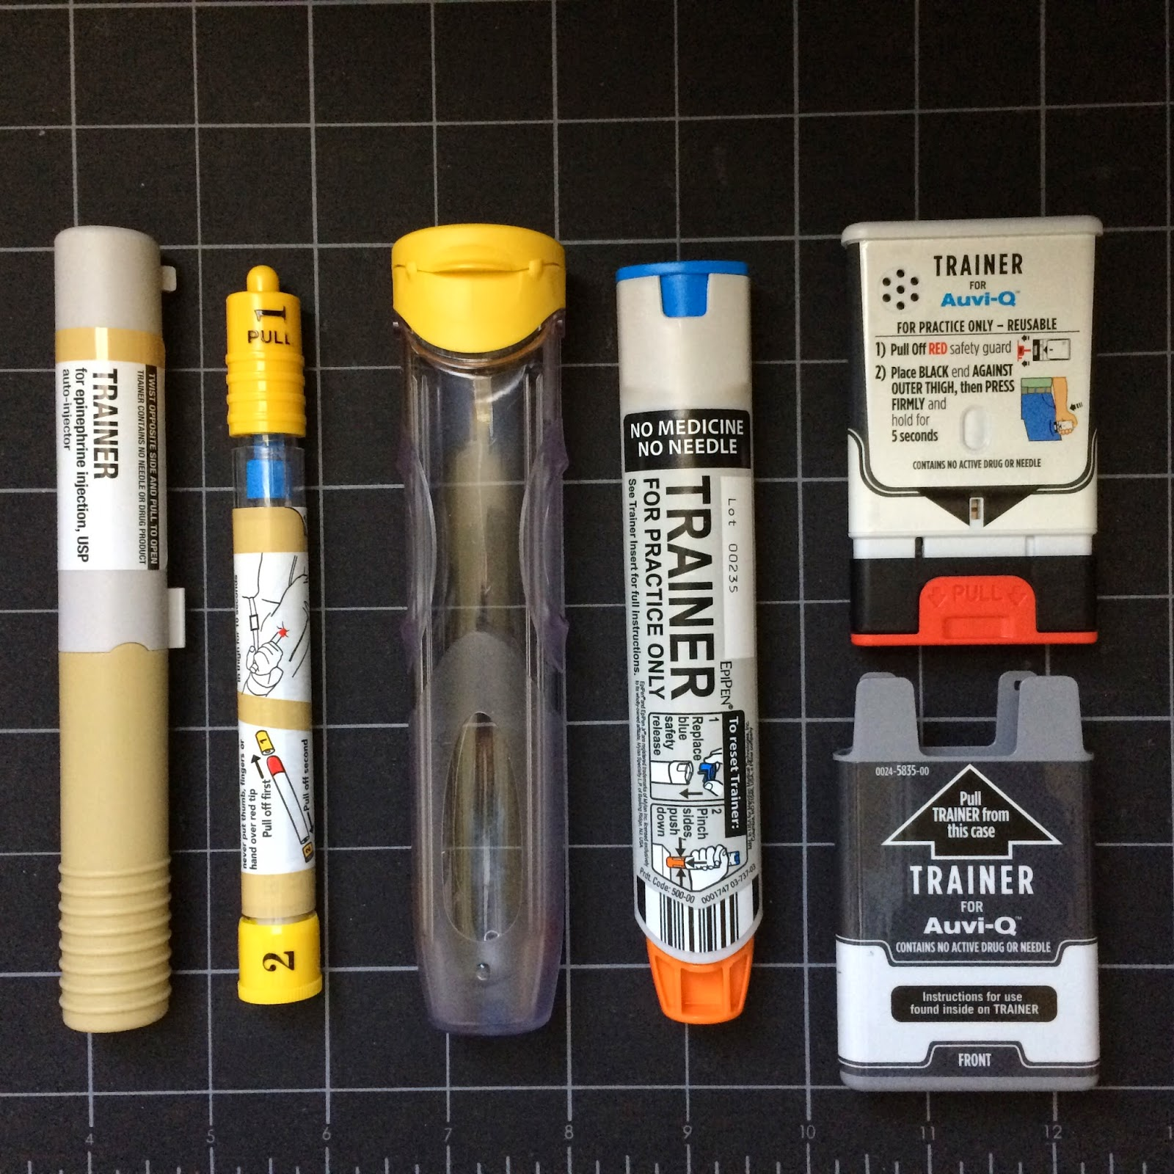
Types of Injectable Epinephrine
Several different epinephrine devices, including autoinjectors and prefilled syringes, are available
Each device has different instructions; family and caregivers should understand instructions for their prescribed device
  Instruct families to monitor expiration dates
In some states, epinephrine devices can be substituted by pharmacists, and patients should be advised to check which device they were given and to review instructions
Asthma and Allergy Foundation of America. Epinephrine is the first-line of treatment for severe allergic reactions. March 2022. Accessed October 5, 2022. https://www.kidswithfoodallergies.org/epinephrine-and-anaphylaxis-food-allergy/#eai.
Image courtesy of Backyard Bee Hive Blog. https://www.303beekeeper.com/2015/04/vit-report-2-years-post-anaphylaxis.html. CC BY-NC-SA 3.0.
Notes:
don’t forget to monitor expiration date

Slide 104
Access to Epinephrine at School
Nearly all states have epinephrine stocking laws allowing nonstudent-specific epinephrine in schools; only a subset of states require epinephrine stocking in schools¹
Stay up-to-date with local epinephrine stocking and self-carry laws
Ensure students and families have emergency medications to provide to schools
Ensure school personnel are available to administer epinephrine if needed (eg, nurses, trained staff, all staff, etc)
1. Asthma and Allergy Foundation of America. Epinephrine in Schools. Accessed October 5, 2022. https://www.aafa.org/epinephrine-stocking-in-schools/. 2. Wang J et al. J Allergy Clin Immunol Pract. 2018;6(2):427-435.

Slide 105
Barriers to Epinephrine Access in Underserved Populations
Several barriers to optimal food allergy emergency care have been identified in underserved populations^{1,2}:
  Lack of access to personal epinephrine and undesignated epinephrine
  Limited education among school staff in recognizing and managing anaphylaxis
  Lack of access to allergist care and limited training for primary care providers
Undesignated epinephrine autoinjectors are less likely to be available in schools serving lower–socioeconomic status (SES) communities¹
  High-SES schools had 6-times more epinephrine autoinjectors than low-SES schools
1. Shah SS et al. J Allergy Clin Immunol Pract. 2014;2(3):288-93.e1. 2. Stephen ED et al. Ann Allergy Asthma Immunol. 2022;129(4):405-406.

Slide 106
Case Study 4: Casey

Slide 107

Casey: 12-Year-Old Girl
Casey is a 12-year-old girl with a history of multiple allergies (peanut, soy, egg, wheat)
In the past year, she has had 2 allergic episodes at school (both to peanut), 1 of which required epinephrine treatment
She is underweight
Notes:
Image free to use from Pexels: https://www.pexels.com/photo/happy-cute-small-girl-in-glasses-sitting-on-table-in-light-living-room-3755494/

Slide 108

Casey: 12-Year-Old Girl
She has had a positive SPT for peanut and soy 6 years ago
Egg and wheat are self-reported allergies based on parent reports of symptoms after ingestion
What are the next steps for Casey?

Slide 109
Casey: 12-Year-Old Girl
Recommend SPT for egg, wheat, and soy to assess for sensitization
SPT results are positive for soy but negative for egg and wheat
Consider oral food challenge for soy, egg, and wheat

Slide 110
Casey: 12-Year-Old Girl
Oral food challenge reveals:
  Sensitization to soy at 2 g
  Tolerance to egg and wheat
Recommend against avoidance of egg and wheat
Referral to nutritionist for development of balanced elimination diet
Develop avoidance and emergency plans for school

Slide 111
Emerging Food Allergy Treatments
Green line

Slide 112
Unmet Needs in Food Allergy and Emerging Treatments

Slide 113
Unmet Needs With Current Food Allergy Therapy
Risk for allergic reactions from OIT
Taste aversion to OIT
Variable rates of sustained unresponsiveness after discontinuation of OIT (requirement for lifelong treatment)
Approved OIT product does not address patients with multiple food allergies
Albuhairi S, Rachid R. Immunol Allergy Clin North Am. 2021;41(2):271-283.

Slide 114
Biologics for Food Allergy
Biologics have been suggested as an alternative future treatment option for modifying the allergic response
Potential benefits of biologics for food allergy
  Ability to treat multiple food allergies and comorbid allergic conditions (asthma, allergic rhinitis)
  Potential efficacy in older populations
  Better adherence due to less frequent treatment than OIT
  May decrease the risk of adverse reactions relative to OIT
Albuhairi S, Rachid R. Immunol Allergy Clin North Am. 2021;41(2):271-283.

Slide 115
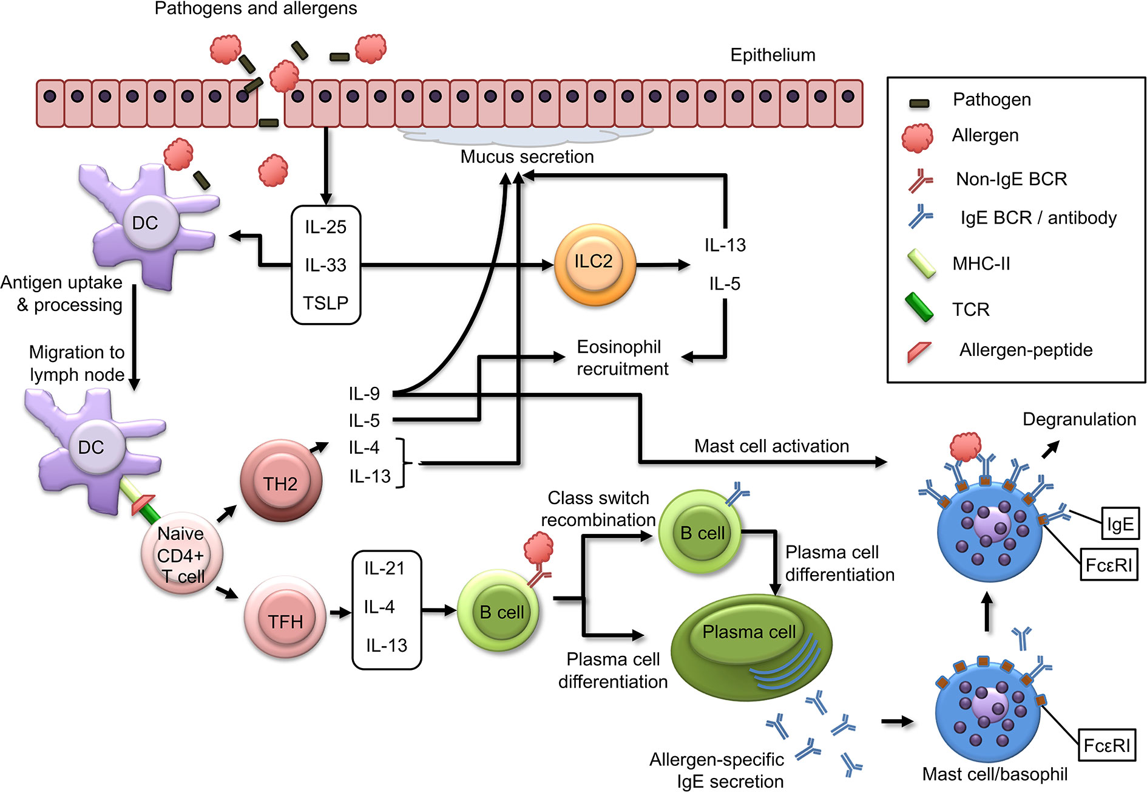
Biologics Currently Under Investigation
Biologics have been developed to target key inflammatory mediators that are responsible for food allergen reactions
Emerging biologics for food allergy:
  IgE: omalizumab, ligelizumab
  IL-4Rɑ: dupilumab
  IL-33: etokimab
  TSLP: tezepelumab
Etokimab
Dupilumab
Omalizumab
Ligelizumab
Sampath V et al. Allergy. 2020;75(6):1316-1326.
Image, with modification, courtesy of Schoos AM et al. Front Immunol. 2020;11:568598. CC BY 4.0.

Slide 116
Omalizumab: Early Evidence in Food Allergy

Slide 117
Omalizumab: Anti-IgE Monoclonal Antibody Under Investigation for Food Allergy
Omalizumab is an anti-IgE monoclonal antibody currently approved for the treatment of allergic asthma, nasal polyps, and chronic spontaneous urticaria¹
Omalizumab is being evaluated both as a monotherapy and in conjunction with OIT²
Dupilumab
Omalizumab
Ligelizumab
1. Xolair (omalizumab) [prescribing information]. South San Francisco, CA: Genentech; 2021. 2. Sampath V et al. Allergy. 2020;75(6):1316-1326.

Slide 118
Anti-IgE Omalizumab Monotherapy: Phase 2 Data
Placebo |  |  | Omalizumab treatment
Participant number | Peanut flour tolerance week 1 (mg) | Peanut flour tolerance week 24 (mg) | Participant number | Peanut flour tolerance week 1 (mg) | Peanut flour tolerance week 24 (mg)
1702 | 5 | 50 | 1506 | <5 | 1000
1107 | 15 | 50 | 1503 | 15 | 250
1419 | 15 | 50 | 1101 | 15 | 500
1502 | 50 | 50 | 1002 | 15 | 500
1601 | 100 | 1000 | 1202 | 15 | 8000
 |  |  | 1410 | 50 | 50
 |  |  | 1402 | 50 | 500
 |  |  | 1501 | 100 | 1000
 |  |  | 1106 | 100 | 1500
Increase from baseline for placebo: 4-times
Increase from baseline for omalizumab: 81-times
Note: the study was terminated early due to severe anaphylactic reactions during the initial food challenge
1. Sampson HA et al. J Allergy Clin Immunol. 2011;127(5):1309-10.e1.

Slide 119
Real-World and Post Hoc Support for Omalizumab Monotherapy
Real-World Study of Omalizumab in Patients With Asthma and Food Allergy¹
Post Hoc Analysis of STELLAIR Study in Patients With Allergic Comorbidities²
Add-on treatment with omalizumab in 15 patients with severe asthma and either multiple food allergy or failed prior OIT to 1 food
Omalizumab was initiated 2-3 days after first food challenge
After 4 months of treatment, desensitization was reported for 70% of tested foods
Additional efficacy data:
  Accidental food reactions decreased
  Asthma control improved
  Eliciting doses for food allergens increased
  Patient and parent quality of life improved
STELLAIR evaluated omalizumab in adults and children with severe allergic asthma
Patients with 3 or more allergic comorbidities, including food allergy, had better responses to omalizumab
After 12 months, food allergies were improved in 38.7% of patients
1. Fiocchi A et al. J Allergy Clin Immunol Pract. 2019;7(6):1901-1909. 2. Just J et al. J Asthma Allergy. 2021;14:1129-1138.

Slide 120
Adjuvant Omalizumab to OIT: Pilot Studies
Omalizumab may promote oral desensitization in patients with peanut allergy receiving OIT^{1,2}
In pilot studies, between 82% and 100% of patients were rapidly desensitized to peanut protein^{1,2}
With omalizumab, patients may be able to tolerate higher doses of peanut protein in shorter periods of time^{1,2}
  In 1 study, patients were able to reach a maintenance dose of peanut protein of 4000 mg within 8 weeks²
Omalizumab may reduce the risk for serious allergic reactions from OIT²
1. Nadeau KC et al. J Allergy Clin Immunol. 2011;127(6):1622-1624. 2. Schneider LC et al. J Allergy Clin Immunol. 2013;132(6):1368-1374.

Slide 121
Adjuvant Omalizumab to OIT: Randomized Controlled Trial
Enrolled 37 participants to receive omalizumab or placebo for 12 weeks, followed by peanut OIT
  OIT involved 1-day desensitization of up to 250 mg, followed by weekly increases up to maintenance dose of 2000 mg
Median peanut dose tolerated at initial desensitization was 250 mg for omalizumab vs 22.5 mg for placebo
Reaction rates during final food challenge were not significantly different between groups despite higher peanut doses in omalizumab group
MacGinnitie AJ et al. J Allergy Clin Immunol. 2017;139(3):873-881.
Notes:
Double check reaction rates or severity of symptoms were not different

Slide 122
Omalizumab: Ongoing Phase 2 and 3 Studies (BOOM and OUtMATCH)

Slide 123
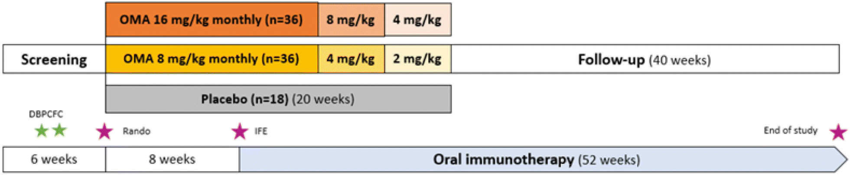
Adjuvant Omalizumab: Ongoing Phase 2 BOOM Trial
Key inclusion criteria
6-25 years of age
IgE-mediated allergy with ≥6-mm wheal on SPT and ≥15-kU/L sIgE to ≥3 foods
Positive DBPCFC with eliciting dose ≤300 mg
No severe asthma or EoE
Primary endpoint
First successful attempt to escalate to 1500 mg of food allergen protein (no systemic or local reactions requiring treatment)
DBPCFC, double-blind placebo-controlled food challenge; IFE, initial food escalation; OMA, omalizumab.
Image courtesy of Langlois A et al. Allergy Asthma Clin Immunol. 2020;16:25. CC BY 4.0.

Slide 124
Monotherapy or Adjuvant Omalizumab: OUtMATCH Trial
OUtMATCH is a multistage clinical trial with 2 parts enrolling patients aged 1 to 55 years with allergy to peanut and at least 2 other foods (milk, egg, wheat, cashew, hazelnut, and/or walnut)
STAGE
1
efficacy of omalizumab for the treatment of multiple food allergies
comparison of the efficacy of omalizumab monotherapy vs omalizumab-facilitated multiallergen OIT
long-term efficacy and safety of these treatments, including the use of dietary forms of food allergens to induce or maintain desensitization
STAGE
2
STAGE
3
Wood RA et al. J Allergy Clin Immunol Global. 2022. Preprint online.

Slide 125
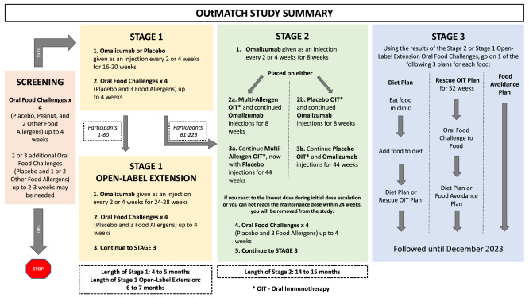
Monotherapy or Adjuvant Omalizumab: OUtMATCH Trial
OUtMATCH: a Multistage Phase 3 Study
Image courtesy of Wood RA et al. J Allergy Clin Immunol Global. 2022. Preprint online. CC BY-NC-ND 4.0.

Slide 126
Ligelizumab: Ongoing Studies in Food Allergy

Slide 127
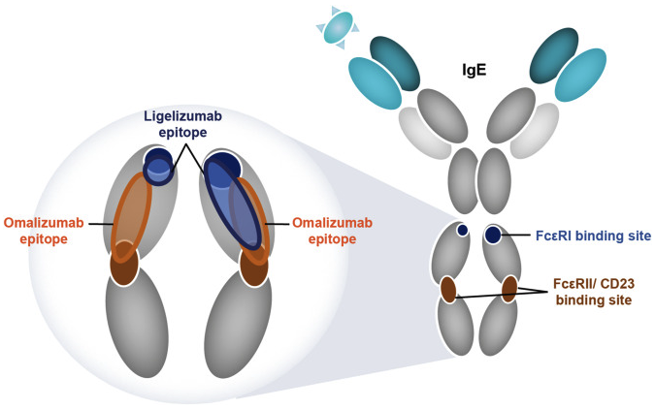
Ligelizumab: a Next-Generation Anti-IgE Antibody
~88-fold greater affinity for human IgE than omalizumab
Epitopes are distinct between ligelizumab omalizumab
  Associated with different IgE inhibition profiles
  Ligelizumab blocks binding of free IgE to FcεRI
Image courtesy of Wood RA et al. World Allergy Organ J. 2022;15(9):100690. CC BY 4.0.

Slide 128
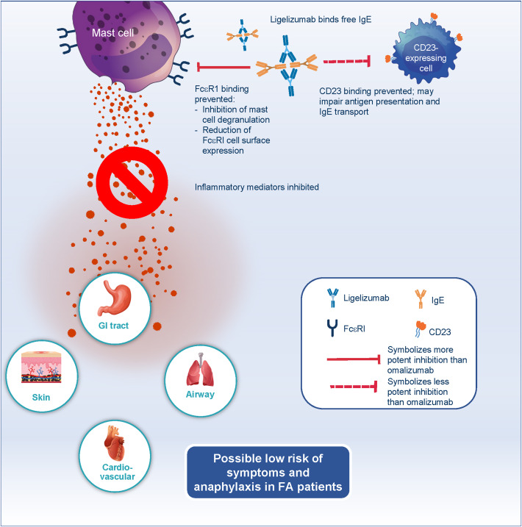
Ligelizumab Binding and Mechanisms
Ligelizumab inhibition and decreased IgE binding leads to the reduction of FcεRI receptors
This may ultimately reduce allergen-induced activation of mast cells and basophils, decreasing the release of proinflammatory molecules
Also blocks IgE/CD23 signaling, which may affect antigen presentation and IgE transport
Image courtesy of Wood RA et al. World Allergy Organ J. 2022;15(9):100690. CC BY 4.0.

Slide 129
Ligelizumab: Early Evidence in Allergy SPTs
In pharmacokinetic and pharmacodynamic studies of patients with atopic conditions (n = 73), ligelizumab reduced free IgE and basophil receptor expression relative to omalizumab¹
  SPT wheal sizes to aeroallergens were reduced by more than 95% at 6 weeks post treatment
In patients with allergic asthma (n = 37), ligelizumab was associated with reductions in aeroallergen SPT wheal size relative to omalizumab²
  Reductions were dose- and time-dependent
1. Arm JP et al. Clin Exp Allergy. 2014;44(11):1371-1385. 2. Gauvreau GM et al. J Allergy Clin Immunol. 2016;138(4):1051-1059.

Slide 130
Ligelizumab Phase 3 Trial (NCT04984876)
Ligelizumab 240 mg
52 weeks
Key inclusion criteria
6-55 years of age
History of peanut allergy
Positive SPT ≥4 mm to peanut
Positive peanut-specific serum IgE (≥0.35 kU_{A}/L)
Positive peanu DBPCSC
Total IgE ≤2000 IU/mL
No uncontrolled asthma
Ligelizumab 120 mg
52 weeks
Primary endpoint
Proportion of patients able to tolerate ≥600-mg dose (1044-mg cumulative dose) peanut protein without dose-limiting symptoms at week 12
Placebo
8 weeks
Ligelizumab 120 mg
44 weeks
Placebo
8 weeks
Ligelizumab 240 mg
44 weeks
Placebo
16 weeks
Ligelizumab 120 or 240 mg
36 weeks
ClinicalTrials.gov. Efficacy and Safety of QGE031 (Ligelizumab) in Patients With Peanut Allergy. Updated October 4, 2022. Accessed October 5, 2022. https://clinicaltrials.gov/ct2/show/NCT04984876.

Slide 131
Dupilumab: Early Evidence in Food Allergy

Slide 132
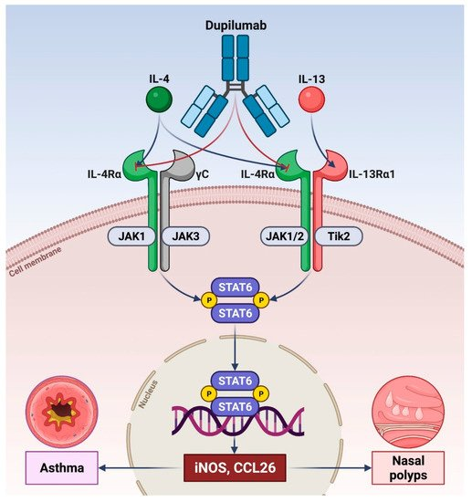
Dupilumab: Inhibitor of IL-4 and IL-13 Signaling
Dual Blockade With Dupilumab
Dupilumab targets the receptor IL-4Rɑ, which decreases Th2 inflammatory signaling^{1,2}
Current indications for dupilumab include atopic dermatitis, asthma, chronic rhinosinusitis, and eosinophilic esophagitis¹
  Approved for those as young as 6 months
Investigation into dupilumab for food allergy is ongoing
Image courtesy of Pelaia C et al. Vaccines. 2022;10(6):974. CC BY 4.0.
Dupixent (dupilumab) [prescribing information]. Tarrytown, NY: Regeneron; 2022. 2. Pelaia C et al. Vaccines. 2022;10(6):974.

Slide 133
Dupilumab Efficacy in Adolescents With Atopic Dermatitis
In a phase 3 clinical trial of patients with moderate to severe atopic dermatitis (n = 251), dupilumab was compared with placebo
Dupilumab improved comorbid allergic conditions, including asthma, allergic rhinitis, and food allergen sensitivity
After 16 weeks of treatment every 2 weeks (n = 77), dupilumab significantly reduced allergen-specific IgE concentrations
Simpson EL et al. JAMA Dermatol. 2020;156(1):44-56.
Notes:
dupi is now approved down to age 6 months for AD! it is also approved for asthma, eosinophilic esophagitis, chronic rhinosinusitis with polyposis

Slide 134
Adjuvant Dupilumab to OIT: Clinical Trials
Dupilumab as an adjunct to PTAH (NCT03682770)¹
  Evaluating dupilumab vs placebo as an adjunct to PTAH after updosing in patients with peanut allergy
  Primary outcome is the proportion of patients who tolerate 2044-mg cumulative dose of peanut protein after updosing
  Study is completed but results have not been posted
Dupilumab as an adjunct to milk OIT (NCT04148352)²
  Evaluating dupilumab vs placebo run-in and maintenance with milk OIT in patients aged 4 to 50 years with cow’s milk allergy
  Primary outcome is the proportion of patients who tolerate 2044-mg cumulative dose of milk protein
1. ClinicalTrials.gov. Study in Pediatric Subjects With Peanut Allergy to Evaluate Efficacy and Safety of Dupilumab as Adjunct to AR101 (Peanut Oral Immunotherapy). Updated November 1, 2021. Accessed October 5, 2022. https://clinicaltrials.gov/ct2/show/NCT03682770. 2. ClinicalTrials.gov. Dupilumab and Milk OIT for the Treatment of Cow's Milk Allergy. Updated November 1, 2021. Accessed October 5, 2022. https://clinicaltrials.gov/ct2/show/NCT04148352.

Slide 135
Dupilumab Monotherapy Clinical Trial (NCT03793608)
Evaluating dupilumab monotherapy in patients aged 6- to 17-years-old with peanut allergy
Primary outcome is patients who tolerate 444-mg cumulative peanut protein treatment after 24 weeks of treatment
Study is completed but results have not been posted
1. ClinicalTrials.gov. Study in Pediatric Subjects With Peanut Allergy to Evaluate Efficacy and Safety of Dupilumab as Adjunct to AR101 (Peanut Oral Immunotherapy). Updated November 1, 2021. Accessed October 5, 2022. https://clinicaltrials.gov/ct2/show/NCT03682770. 2. ClinicalTrials.gov. Dupilumab and Milk OIT for the Treatment of Cow's Milk Allergy. Updated November 1, 2021. Accessed October 5, 2022. https://clinicaltrials.gov/ct2/show/NCT04148352.

Slide 136
Next-Generation Peptide Immunotherapy

Slide 137
PVX108: Next-Generation Allergen Immunotherapy
PVX108 contains a mixture of peptides that can be recognized by T cells but do not contain allergens that trigger reactions
  Administered by intradermal injection
Exposure to noninflammatory peptide mixtures may reduce the amount of allergen-specific T cells
Compared with currently available OIT options, PVX108 may offer the following advantages:
  Reduced risk of activating basophils and mast cells
  No need for supervised dose escalation or daily administration
  Targets the underlying disease, potentially providing long-term effects
Aravix. PVX108: A next generation immunotherapy for the treatment of peanut allergy. Accessed October 5, 2022. https://www.aravax.com.au/our-product.

Slide 138
PVX108 Clinical Trial Program
In blood samples from people with peanut allergy, PVX108 did not induce basophil reactivity¹
Evaluated in a phase 1 study of 66 adults with peanut allergy¹
  2:1 randomization to PVX108 or placebo
  Adverse events were mostly mild or moderate
A phase 2 clinical trial program for PVX108 is planned²
1. Prickett SR et al. J Allergy Clin Immunol. 2019;143(2):AB431. 2. Aravax Pty Ltd announces opening of IND for Phase 2 clinical trials of PVX108, a next-generation immunotherapy for the treatment of peanut allergy. March 4, 2022. Accessed October 5, 2022. https://www.prnewswire.com/news-releases/aravax-pty-ltd-announces-opening-of-ind-for-phase-2-clinical-trials-of-pvx108-a-next-generation-immunotherapy-for-the-treatment-of-peanut-allergy-301495585.html.

