Slide 1


Slide 2
SLE Overview
Diane Kamen, MD

Slide 3
SLE Incidence is Higher in Women vs Men
Data collected from 2002-2009 from Michigan, Georgia, New York, and California SLE registries
Izmirly PM, et al. Lupus Sci Med. 2021;8:e000614.

Slide 4
SLE Incidence: Racial Differences
Moe SR, et al. Ann Rheum Dis. 2022;81:1050-1051.

Slide 5
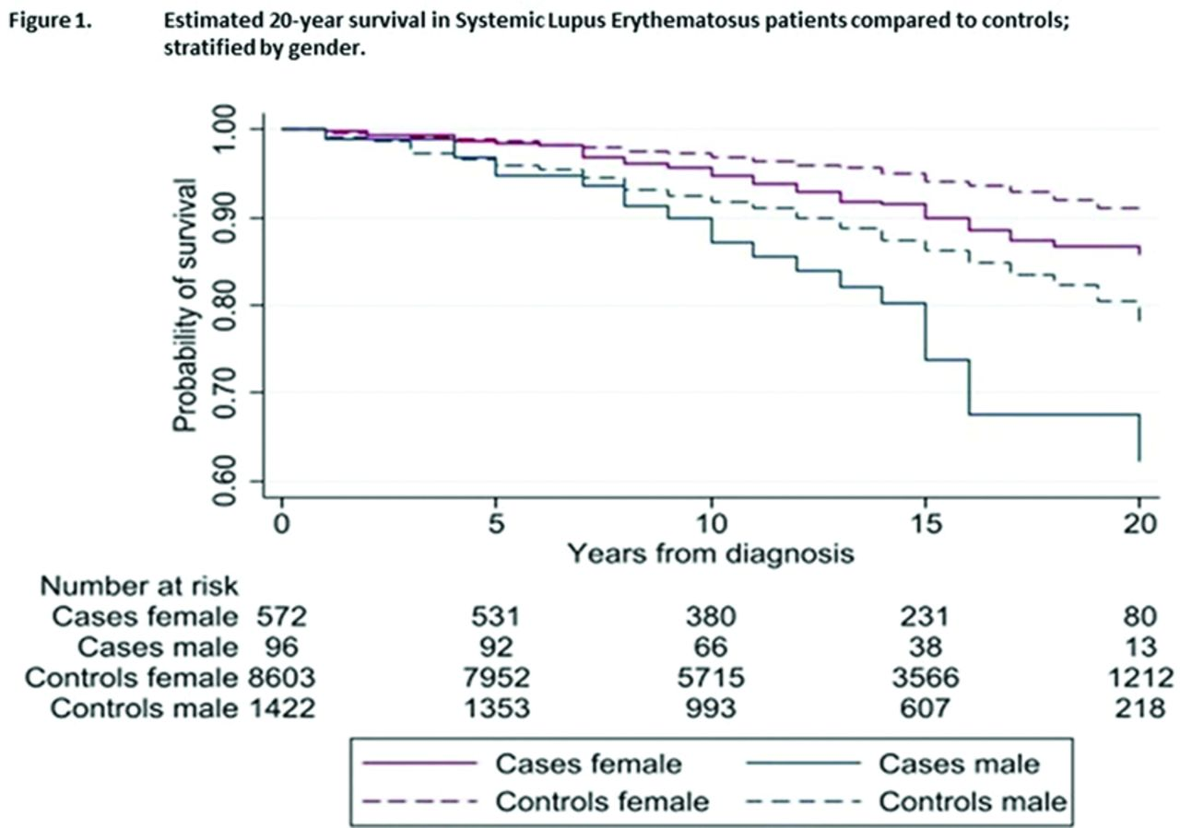
SLE Reduces Survival and Men Are at Greater Mortality Risk
Female
Male
Moe SR, et al. Ann Rheum Dis. 2022;81(Suppl 1):1050-1051.
Notes:
[no audio / slide only ]

Slide 6
Cumulative Mortality Is Higher in Black Patients With SLE (Georgia Lupus Registry, 2002-2016)
Characteristic | Standardized Mortality Ratio (95% CI) | Age at Death (years, incident deaths)
Overall | 3.12 (2.83-3.44) | N/A
Black | 3.34 (3.00-3.72) | 51.8 ± 15.9*
White | 2.43 (1.94-3.04) | 64.4 ± 18.9*
Black Female | 3.38 (3.01-3.79) | N/A
White Female | 2.36 (1.84-3.02) | N/A
*P<0.001, Black vs White
Lim SS, et al. MMWR Morb Mortal Wkly Rep. 2019;68:419-422.

Slide 7
Social Determinants of Health in Lupus
Lupus may be underdiagnosed in areas with fewer rheumatologists
  Some estimates from Medicaid data show a trend toward lower prevalence in areas with fewer practicing rheumatologists
Socioeconomic status (SES) has less of an effect once lupus is diagnosed
  Result of increasing standardization of care in lupus and “treat-to-target” mentality in rheumatology?
  Nonsignificant trend toward higher prevalence of lupus in low SES groups
  No difference in prevalence of lupus nephritis between SES groups
  No difference between prescriptions for different SES groups
Women are at greater risk for lupus, but men are disproportionately affected by LN
  Incidence and severity of lupus nephritis is higher in men
  Lupus may be diagnosed later because of the relatively low prevalence in men
  By the time LN is diagnosed, men have more significant renal disease and laboratory abnormalities
Schwartzman-Morris J, Putterman C. Clin Dev Immunol. 2012; doi: 10.1155/2012/604892. Feldman CH, Hiraki LT, Liu J, et al. Arth Rheum. 2013;65:753-763. Bankole A, Ford S, Wong F, et al. Lupus Science & Medicine. 2017;4:doi:10.1136/lupus-2017-000215.399.

Slide 8
Severe SLE Manifestations Are More Common in Racial and Ethnic Minorities
 | Non-Hispanic Blackª | Hispanicª | Asian/Pacific Islanderª
Mucocutaneous | NS | NS | NS
Serositis | NS | NS | NS
Cardiovascular | NS | NS | NS
Pulmonary | NS | NS | NS
Gastrointestinal | NS | NS | NS
Renal | 1.74 (1.4-2.16)^{b} | 1.35 (1.05-1.74)^{c} | 1.68 (1.38-2.05)^{b}
Musculoskeletal | 1.35 (1.05-1.74)^{c} | NS | NS
Neurologic | 1.49 (1.12-1.98)^{c} | NS | NS
Hematologic | 1.09 (1.04-1.15)^{b} | NS | 1.07 (1.01-1.13)^{c}
Serologic | NS | NS | NS
ªNon-Hispanic White reference population; ^{b}P<0.05; ^{c}P<0.0001
Maningding E, et al. Arthritis Care Res (Hoboken). 2020;72:622-629.

Slide 9
Lupus in Adolescent Populations
Between 5000-10,000 patients with childhood SLE
Similar demographic patterns as in adults
  More common in females
  Higher incidence in Asian, African, Native American, and Hispanic/Latino populations
Rare before 5 years of age
More aggressive disease course and earlier renal and cardiac damage
10%-20% of all SLE cases present in childhood
Tucker LB, et al. Br J Rheumatol. 1995; 34:866-872. Cooper GS, et al. Lupus 2002;11:161-167. Hersh AO, et al. Arth Rheum. 2009;61:13-20. Brunner HI, et al. Arth Rheum. 2008;58:556-562.

Slide 10
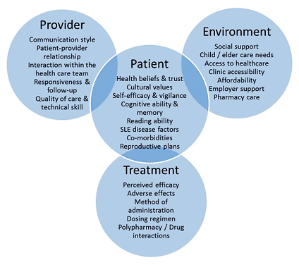
Disengagement From the Healthcare System
Notes:
14:29.0 So, I like this figure or this diagram because it shows how the patient is central to a lot of external factors that end up influencing to a great degree how much access they’re going to have to care, how well they’re going to do with being able to get their medications, take their medications, make it to follow-up appointments.

Slide 11
Overview: Key Points
Lupus can be seen throughout the population
Black patients
  Higher risk
  Younger age
  More severe disease
Men
  Especially Black men
  Higher risk for lupus nephritis
  May need more aggressive treatment
Kidney disease is common, but other organ involvement can be the presenting symptom

Slide 12
Diagnosis
Anca Askanase, MD
Notes:
28:03.6 I’m Anca Askanase, I’m a rheumatologist in New York City at Columbia University. I’m the Director of the Lupus Center here and my life’s passion has been taking care of people with lupus and better understanding, doing research into outcomes, novel therapeutics and shedding more light into health disparities in people with lupus.

Slide 13
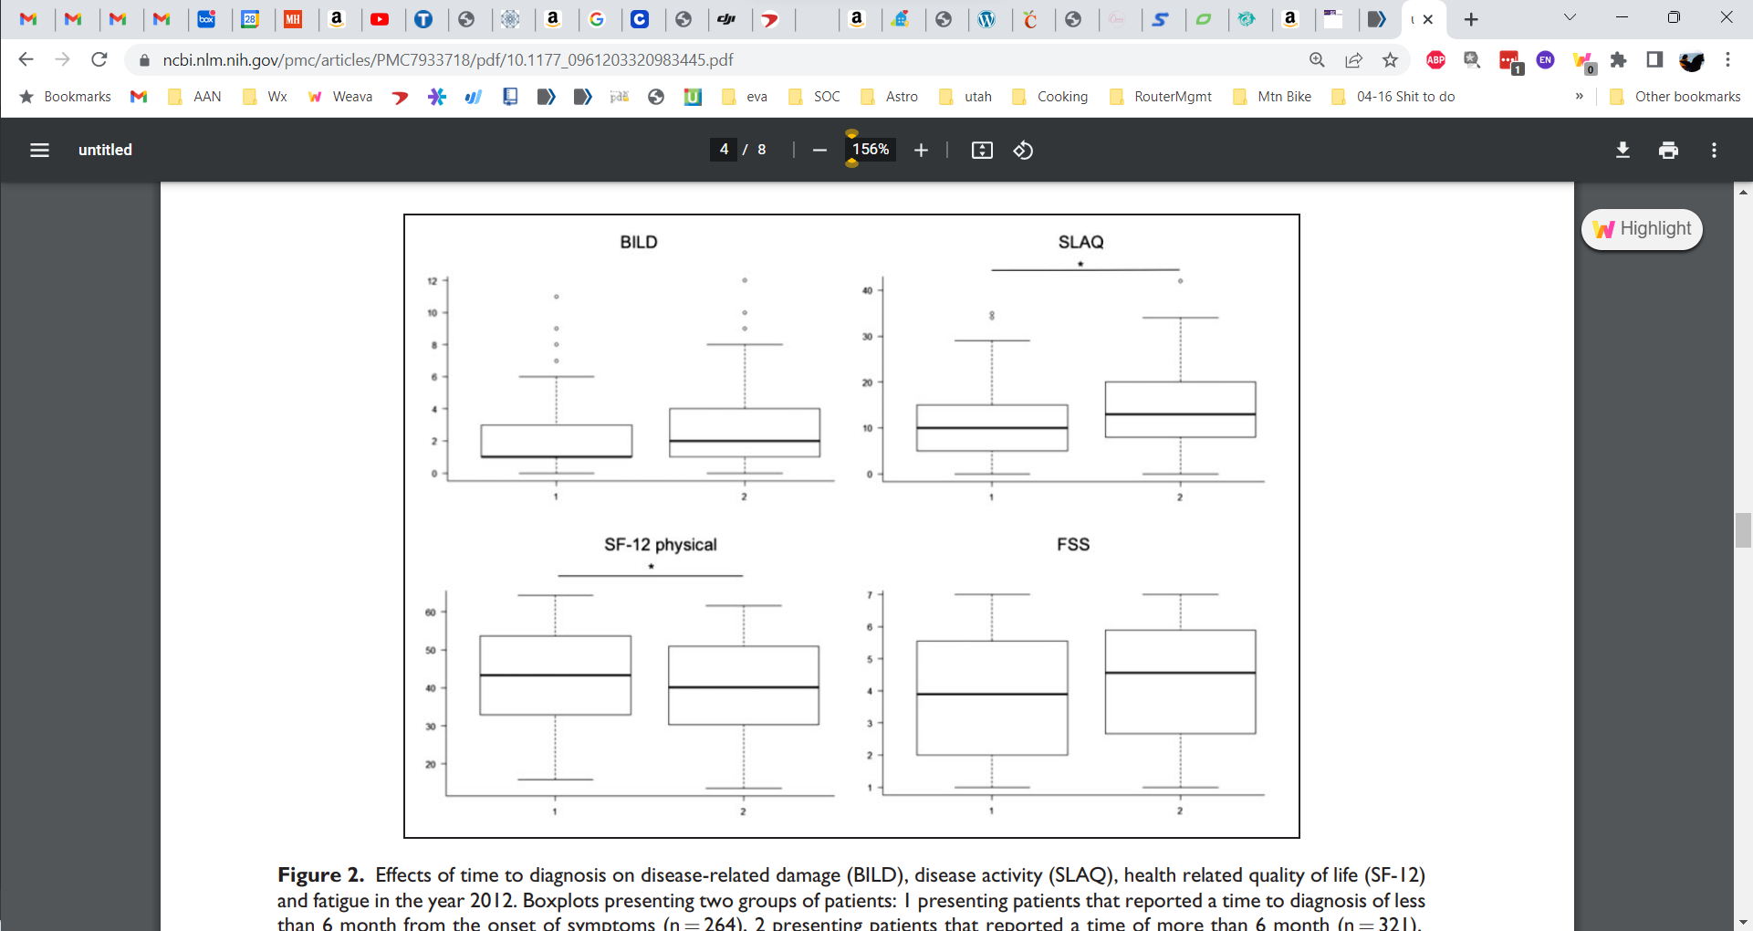
Longer Time to Diagnosis Negatively Affects Outcomes: German LuLa Cohort
P <0.05
BILD Score
SLAQ Score
<6 months
>6 months
<6 months
>6 months
Time to Diagnosis From Symptom Onset
Time to Diagnosis From Symptom Onset
Reproduced without modification from Kernder A, et al. Lupus. 2021;30:431-438 under the terms of the Creative Commons License (CC BY 4.0).

Slide 14
Organ Damage Accrues Over Time, Even When Disease Activity Is Decreasing
Disease Activity
Mean Total SLEDAI-2k
Irreversible Damage
Mean SDI Score
Years in Registry
Urowitz MB, et al. Arthritis Care Res. 2012;64:132-137.

Slide 15
Cumulative Corticosteroid Use Is Associated With an Increased Rate of Organ Damage
% Patients with SDI≥1
20
Cumulative steroid dose
Mean daily prednisone dose (mg)
10
Daily oral steroid dose
0
12
24
36
IQR, interquartile range; PDN, prednisone
Piga M, et al. Rheumatology (Oxford). 2020;59:2272-2281.
Notes:
29:37.0 … the big reason for this increase in damage is the cumulative steroid dose. So, we use steroids to quench disease activity. Over time, the cumulative steroid dose increases and damage parallels that increase in cumulative steroid dose.

Slide 16
ACR (1997) Revised Criteria for Classification of SLE
Skin Criteria
Butterfly rash Discoid rash | Sun sensitivity Oral ulcerations
Systemic Criteria
Arthritis Serositis | Kidney disorder Neurological disorder
Laboratory Criteria
Blood abnormalities | Positive ANA blood test
Immunologic disorder Antiphospholipid antibodies, lupus anticoagulant, anti-DNA, false-positive syphilis test, positive anti-Sm
4 of 11 needed for a diagnosis
Hochberg MC. Arthritis Rheum. 1997;40:1725. Tan EM, et al. Arthritis Rheum. 1982;25:1271-1277.

Slide 17
2012 SLICC Revision of the ACR Classification Criteria
Summary of Clinical Criteria
Acute/subacute cutaneous lupus Chronic cutaneous lupus Oral/Nasal ulcers Nonscarring alopecia
Inflammatory synovitis OR tender joints with morning stiffness Serositis Proteinuria or red blood cell casts Neurologic symptoms
Hemolytic anemia Leukopenia OR Lymphopenia Thrombocytopenia
Summary of Immunologic Criteria
ANA above laboratory reference range Anti-dsDNA above laboratory reference range Anti-Sm Antiphospholipid antibody Low complement Direct Coombs’ test without hemolytic anemia
SLICC, Systemic Lupus International Collaborating Clinics
Petri M, et al. Arthritis Rheum. 2012;64:2677-2686.

Slide 18
Proposed ACR/EULAR Classification Criteria
ANA≥1:80 AND Score ≥10 points across 22 domains
Clinical Domain | Criteria | Weight
Constitutional domain | Fever | 2
Cutaneous domain | Non scarring alopecia | 2
 | Oral ulcers | 2
 | Subacute cutaneous or discoid lupus | 4
 | Acute cutanous lupus | 6
Arthritis domain | Synovitis >=2 joints or tenderness>=2 joints and >=30 minutes of morning stiffness | 6
Neurological domain | Delirium | 2
 | Psychosis | 3
 | Seizure | 5
Serositis domain | Pleural of pericardial effusion | 5
 | Acute pericarditis | 6
Hematological domain | Leukopenia | 3
 | Thrombocytopenia | 4
 | Autoimmune hemolysis | 4
Renal domain | Proteinuria>0.5g/24 hours | 4
 | Class II or V Lupus nephritis | 8
 | Class III or IV Lupus nephritis | 10
Immunological Domain | Criteria | Weight
Antiphospholipid antibody domain | Anti-Cardiolipin IgG or Anti-Beta2 GP IgG or Lupus anticoagulant | 2
Complement Protein domain | Low C3 or Low C4 | 3
 | Low C3 and Low C4 | 4
SLE specific antibody domain | Anti-dsDNA | 6
 | Anti-Smith | 6
Aringer M, et al. Ann Rheum Dis. 2019;78:1151–1159.

Slide 19
Review of Proposed New Classification Criteria
Classification criteria are for clinical trials and research but help guide clinical practice and can influence therapeutic options
Advances in criteria have improved their sensitivity and specificity, allowing for earlier diagnosis
1997 ACR Criteria
2012 SLICC Criteria
ACR / EULAR 2018
Sensitivity | 84.63% | 96.81% | 98.00%
Specificity | 95.20% | 90.00% | 96.40%
Aringer M, et al. Ann Rheum Dis. 2019;78:1151–1159.

Slide 20
Incomplete SLE
Patients have clinical signs of SLE
Do not meet classification criteria
May have serious organ involvement
Up to 55% progress and later meet classification criteria
Lambers WM, et al. Arthritis Care Res. 2020;72:607-614.

Slide 21
Proposed Definition of Incomplete SLE
Required ANA at titer ≥1:80
And ≥1 of the following criteria (as specified in SLICC criteria) Acute or subacute cutaneous lupus Chronic cutaneous lupus Oral or nasal ulcers Alopecia Synovitis Serositis Neurologic manifestation Renal manifestation
Or 2 of the following criteria Hematologic manifestations (as specified in SLICC criteria) Immunologic features (as specified in SLICC criteria) Positive family history of autoimmune rheumatic disease (first- or second-degree relative with autoimmune rheumatic disease)
And does not meet ACR 1997 criteria and/or SLICC 2012 criteria for SLE
Reproduced without modification from Lambers WM, et al. Arthritis Care Res. 2020;72:607-614 under the Creative Commons NonCommercial-NoDerivatives 4.0 International (CC BY-NC-ND 4.0) license.

Slide 22
Monitoring
Diane Kamen, MD

Slide 23
Regular Monitoring to Assess SLE Symptoms and Organ Involvement Is Needed
Disease Activity Tools
  SLEDAI, BILAG, PGA, LLDAS
Composite Indices
  SRI, BICLA
Disease Damage
  SLICC DAMAGE INDEX, LDIQ
Quality of Life
  SF-36, LupusPRO, Lupus Impact Tracker (LIT), Lupus QoL, PROMIS
Flare Indices
  SLEDAI flare index, BILAG flare
Organ Specific Endpoints
  CLASI, Nephritis

Slide 24
Goal: Prevent Damage
Organ damage predicts long-term prognosis for patients with SLE
30%-50% of organ damage occurs in first 5 years
Most common manifestations:
  Cardiovascular
  Neuropsychiatric
  Musculoskeletal
  Renal
80% of damage attributable to corticosteroid use
  Damage is dose-dependent
Urowitz MB, et al. Arthritis Care Res. 2022;74:1822-1828.

Slide 25
Glucocorticoids Are Associated With Damage in SLE
SLICC meta-analysis of 49 publications
  16224 patients, 90.9% female with a mean age 35 years old
  Disease duration 37.1 months
  Mean follow-up 104.9 months
Use of glucocorticoids associated with
  Overall cardiovascular events
  Osteoporosis with fractures
  Osteonecrosis
Did not assess infection risk
Other cohort studies have reported association with overall damage (Hopkins and Asia-Pacific cohorts)
Maximize the efficacy of glucocorticoids to minimize their harms
Ugarte-Gil MF, et al. Lupus Sci Med. 2021;8:e000590. Apostolopoulos D, et al. Lancet Rheumatology 2020;2:e24-30. Thamer M, et al. J Rheumatol. 2009;36:560-564.

Slide 26
Effect of Prednisone on Organ Damage
Prednisone Average Dose | Hazard Ratio
> 0-6 mg/day | 1.16
> 6-12 mg/day | 1.50
>12-18 mg/day | 1.64
> 18 mg/day | 2.51
Thamer M, et al. J Rheumatol. 2009;36:560–564.

Slide 27
Prednisone Itself Increases the Risk of Cardiovascular Events
Prednisone Use | Observed Number of CVEs | Rate (Events/1000 Person-Years) | Age-Adjusted Rate Ratios (95% CI) | P Value
Never taken | 22 | 13.3 | 1.0 (reference group)
Currently Taking
1-9 mg/d | 32 | 12.3 | 1.3 (0.8, 2.0) | 0.31
10-19 mg/d | 31 | 20.2 | 2.4 (1.5, 3.8) | 0.0002
≥20 mg/d | 25 | 35.4 | 5.1 (3.1, 8.4) | <0.0001
Cumulative Past Dose
<3650 mgª | 14 | 9.9 | 0.8 (0.4, 1.6) | 0.56
3650-10,950 mg^{b} | 26 | 13.8 | 1.2 (0.7, 2.2) | 0.49
10,950-36,499 mg^{c} | 41 | 12.8 | 1.1 (0.6, 1.8) | 0.83
36,500+^{d} | 30 | 25.3 | 2.2 (1.2, 3.7) | 0.0066
ª3650 mg equals 10 mg/day for 1 year, or an equivalent cumulative exposure; ^{b}1-3 years with 10 mg/day or an equivalent cumulative exposure; ^{c}3-10 years with 10 mg/day or an equivalent cumulative exposure; ^{d}10+ years with 10 mg/day or an equivalent cumulative exposure; CVE=cardiovascular events.
Magder LS, Petri M. Am J Epidemol. 2012;176:708-719.

Slide 28
Attributable Risk for Cataracts and Osteoporosis Due to Steroid Exposure
Cumulative Steroid Dose (grams) | Cataracts, Exposed Cases (n) | Adjusted OR | Attributable Risk | Osteoporosis Exposed Cases (n) | Adjusted OR | Attributable Risk
0 | 24 | 1.000 | 0.711 | 22 | 1.000 | 0.540
>0 to <3.65 | 44 | 4.401 |  | 31 | 1.234
≥3.65 to <18.25 | 40 | 9.688 |  | 45 | 6.632
≥18.25 | 24 | 586.187 |  | 20 | 58.164
Reproduced without modification from Davidson JE, et al. Lupus Sci Med. 2018;5:e000237 under the terms of Creative Commons NonCommercial 4.0 International (CC BY-NC 4.0) license.

Slide 29
EULAR Quality Indicators in SLE Care
EULAR management recommendations, updated in 2019, developed into 44 QIs
18 selected as “most feasible” – checklist includes:
  Screening-diagnostic QIs (eg, labs every 3-6 months, stratification for CVD risk)
  Treatment QIs (eg, add ACE-I or ARB for proteinuria)
  Monitoring QIs (eg, use SLEDAI and PGA at each visit, monitor SLICC/ACR damage annually)
ACE-I, angiotensin-converting enzyme inhibitor; ARB, angiotensin receptor blocker; CVD, cardiovascular disease; PGA, Physician Global Assessment; QIs, quality indicators; SLICC/ACR, Systemic Lupus International Collaborating Clinics/American College of Rheumatology
Fanouriakis A, et al. Ann Rheum Dis. 2019;78:736-745. Chavatza K, et al. Ann Rheum Dis. 2021;80:1175-1182.

Slide 30
Suggested Plan for Assessing and Monitoring
Assess at Each Visit BILAG or SLEDAI* Full blood count Erythrocyte sedimentation rate C-reactive protein Urea, creatinine, electrolytes | Liver function Double-stranded DNA titer C3/C4 Urinalysis Blood pressure
Annual Assessments SF-36 SLICC/ACR
Annual monitoring for patients with suspected or known renal disease Cr-EDTA glomerular filtration rate
Monitoring for patients with known osteoporosis DXA bone density scan to monitor treatment response (adjust interval based on severity)
*Faculty recommend SLEDAI as a more practical alternative to BILAG for an objective measurement of disease activity
Fernando MMA, et al. Ann Rheum. Dis 2005;64:524-527.

Slide 31
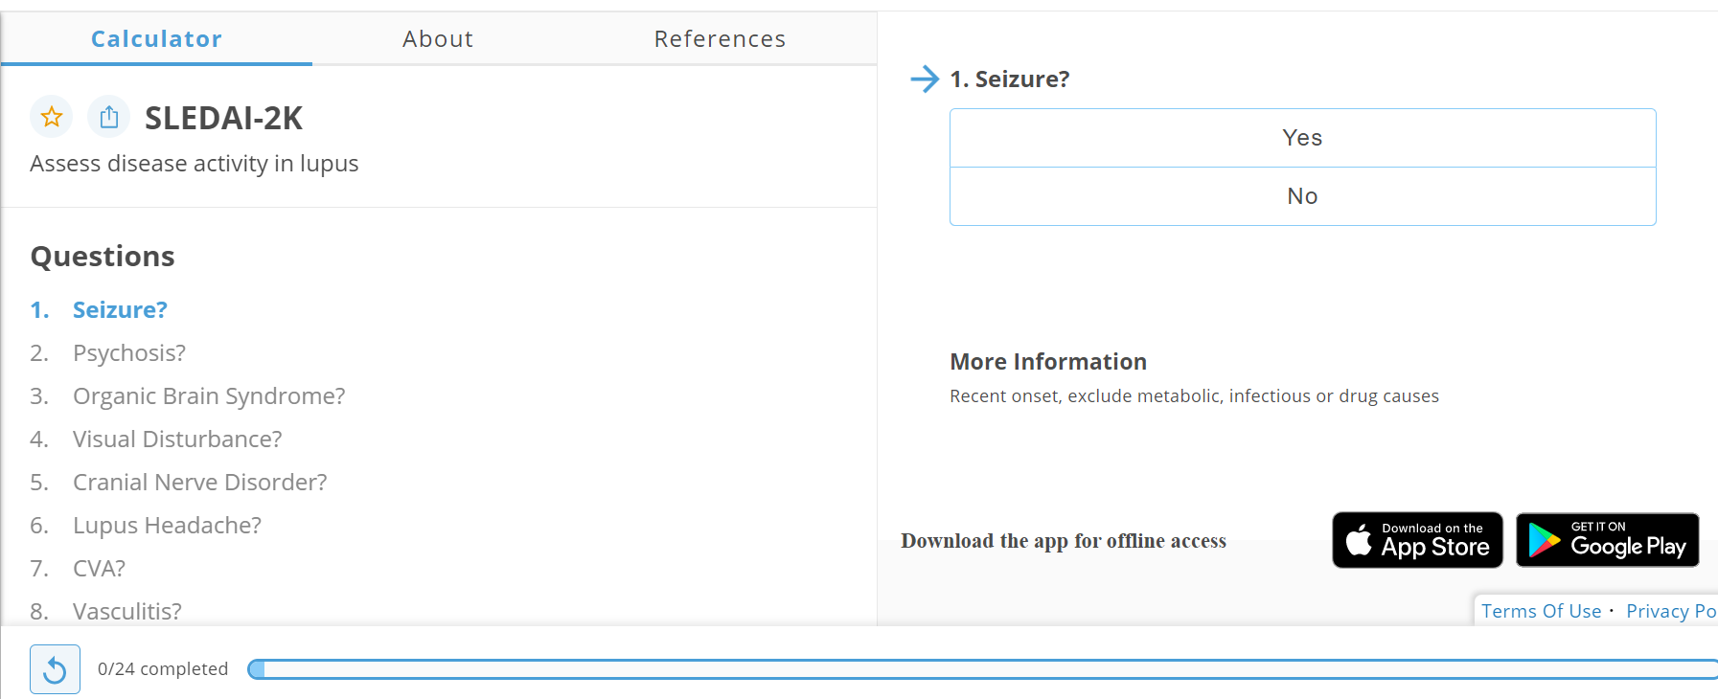
SLEDAI Disease Activity Calculator
Available at https://qxmd.com/calculate/calculator_335/sledai-2k

Slide 32
Shortcomings of the SELENA-SLEDAI
Devised in 1992 and never intended for use in clinical trials
24 items with a maximum score of 105
Not sensitive to change in joints, blood counts
No subjectivity
Weighted against laboratory tests (6 points)
Heavily weighted towards CNS and kidneys (56 CNS, 24 kidneys).
Lupus headache does not exist.
Ignores pulmonary hypertension, TTP, hemolytic anemia, interstitial lung disease
Validated for clinical activity, but a poor measure of change in activity

Slide 33
Patient Reported Outcomes (PROs)
Examples include SSC, SLEQOL, Lupus QOL Index, L-QOL, LupusPRO, Lupus Impact Tracker, RAPID3
Patient-reported outcomes
  Don’t always align with other measures of disease activity
  Best used in combination
2005 FDA Lupus Guidance Document for new treatments reiterated in 2010
  If a clinical trial can demonstrate IMPROVEMENT in Patient Reported Outcomes, a drug can be approved for use in SLE, even if clinical improvements are not demonstrated
Grootscholten C, et al. Qual Life Res. 2003;12:635-644. Leong KP, et al. Rheumatology. 2005;44:1267-1276 ; Pincus T, et al. Rheum Dis Clin North Am. 2009;35:773-778. McElhone K, et al. Arthr Care Res. 2007;57:972-979.

Slide 34
Vitamin D Deficiency
High prevalence in SLE because of sun avoidance and photoprotection, renal insufficiency, and treatment side effects (eg, steroids, antimalarials, and calcineurin inhibitors)
Can be a risk factor for SLE onset and disease activity
Can also be related to bone disease, cardiovascular disease, and renal disease
Hassanalilou T, et al. Auto Immun Highlights. 201;9:1. doi: 10.1007/s13317-017-0101-x. Amital H, et al. Ann Rheum Dis. 2010;69:1155–1157. Attar SM, Siddiqui AM. Oman Med J. 2013;28:42–47. Mok C, et al. Lupus. 2012;21:36–42.

Slide 35
Increasing 25-Hydroxy Vitamin D Helps Disease Activity and Urine Protein/CR
Model allowing slope to differ before and after 40 ng/mL
Disease Measure | Slope over range of 0-40 ng/mL (95% CI) | P-value | Slope over range of ≥40 ng/mL (95% CI) | P-value
Physician’s Global Assessment | –0.04 (–0.08, –0.01) | 0.026 | 0.01 (–0.02, 0.04) | 0.50
SELENA-SLEDAI | –0.22 (–0.41, –0.02) | 0.032 | 0.12 (–0.01, 0.24) | 0.065
Log Urinary Protein/Creatinine | –0.03 (–0.05, –0.02) | 0.0004 | –0.01 (–0.01, 0.00) | 0.24
CR, creatinine; SELENA-SLEDAI, Safety of Estrogens in Lupus Erythematosus National Assessment version of the Systemic Lupus Erythematosus Disease Activity Index.
Petri M, et al. Arthritis Rheum. 2013;65:1865-1871.

Slide 36
Section Summary
Disease monitoring can be overwhelming
  Use quality measures as a guide for what to monitor
  Don’t overlook patient reported outcomes, activities of daily living, and quality of life
  Engage other healthcare providers (eg, case managers or nurses), or use technology, to reduce the burden of monitoring
Monitoring frequency
  No defined guidelines
  Increase monitoring frequency in patients who are in a high-risk demographic group
Monitoring includes
  Lupus-specific risk factors such as bone health and cardiovascular health
  Routine health maintenance monitoring for traditional risk factors (eg, hyperlipidemia and hypertension)

Slide 37
Treatment
Anca Askanase, MD

Slide 38
Discordance in SLE Treatment Goals:
Clinical Measures vs Quality of Life
Physician Focus
Patient Point of View
Objective measures of disease activity
Improving long-term outcomes
Reducing disease activity and damage
Subjective symptoms or personal impacts of disease
How they feel today
Improving quality of life
Bennett JK et al. Patient Educ Couns. 2011;85:53–59. Pisetsky DS, et al. Arthritis Care Res. 2019;71(6):735-741. Choi ST, et al. Clin Exp Rheumatol. 2012;30:664-672.

Slide 39
Understanding Differences Between Lupus Type 1 vs Type 2 May Facilitate Communication and Decision-Making
Type 1
Type 2
Inflammatory, immune-mediated etiology
Severity varies with disease activity, parallels lab biomarkers
Responds to conventional immunosuppressants
Examples: nephritis, inflammatory arthritis, cutaneous rash, mucocutaneous ulcers, alopecia, vasculitis, cytopenias
Noninflammatory etiology
Often persistent and chronic
Usually does not respond to conventional immunosuppressants
Examples: fatigue, widespread or diffuse pain, cognitive dysfunction, sleep disturbances, depression or anxiety, brain fog
Note: Patients can have both type 1 and type 2 manifestations in varying extents
Pisetsky DS, et al. Arthritis Care Res. 2019;71(6):735-741.

Slide 40
Overarching Strategy to Address Pain and Fatigue in SLE
Differential diagnosis
Identify the etiology and individualize interventions for SLE pain and fatigue
Use validated instruments to assess patient
Identify contributing factors
Treat with targeted interventions
Fatigue Measures
FSS, FACIT-F, MFI
Pain due to Disease Activity
SLEDAI
Nondisease Activity Associated Pain
2011 ACR Fibromyalgia Criteria
Disease Activity
Inflammation?
Specific Causes
Anemia, fibromyalgia, neuropathic pain
Psychological Factors
Depression, anxiety, stress
Non-SLE Causes
Reduce Disease Activity
Pharmacologic interventions for SLE
Treat Specific Causes
Psychological or Social Interventions
Lifestyle Changes
FSS, Fatigue Severity Scale; FACIT-F, Functional Assessment of Chronic Illness Therapy-Fatigue; MFI, Multidimensional Fatigue Inventory; SLEDAI, Systemic Lupus Erythematosus Disease Activity Index
Kawka L, et al. J Clin Med. 2021;10:3996. Lampa J. Best Pract Res Clin Rheumatol. 2019;33:101439. Pisetsky DS, et al. Rheum Dis Clin North Am. 2021;47:215-228.

Slide 41
EULAR: SLE Treatment Goals
Treatment Goals
Long-Term Survival
Reduce Steroid-Associated Toxicity
Prevent Organ Damage
Optimize Health-Related QoL
QOL, quality of life
Fanouriakis A, et al. Ann Rheum Dis. 2019;78:736-745.

Slide 42
Treating to Target in Lupus: LLDAS
Lupus Low Disease Activity State Domains and Items
Disease activity
SLEDAI-2K ≤4, with no activity in major organ systems (renal, CNS, cardiopulmonary, vasculitis, fever) and no hemolytic anemia or gastrointestinal activity
No new features of lupus disease activity compared with the previous assessment
SELENA-SLEDAI physician global assessment (PGA, scale 0-3) ≤1
Immunosuppressive medications
Current prednisolone (or equivalent) dose ≤7.5 mg/day
Well tolerated standard maintenance doses of immunosuppressive drugs and approved biological agents, excluding investigational drugs
Franklyn K, et al. Ann Rheum Dis. 2016;75:1615-1621.

Slide 43
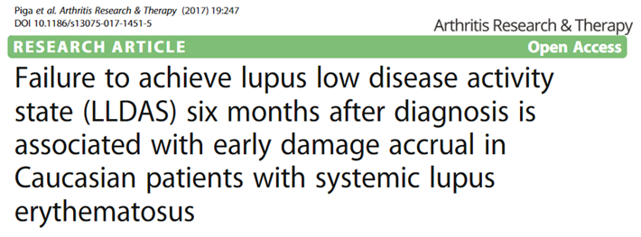
Patients with SDI ≥1 (n=19)
Odds Ratio
5.0 (1.5 – 16.6)
P = 0.009
No LLDAS at 18 months
Patients with SDI=0 (n=84)
Achieving LLDAS lowers risk of damage accumulation
Prednisone use ≥7.5 mg was the most common reason for not attaining LLDAS
Piga M, et al. Arthritis Res Ther. 2017;19:247. doi:10.1186/s13075-017-1415-5

Slide 44

 | Patients with LLDAS-50 (n=69) | Patients without LLDAS-50 (n=137)
Reduction in mortality | 0.31 (95% CI 0.16 – 0.62, P<0.01)
Reduction in risk of severe damage | 0.37 (95% CI 0.19 – 0.73, P<0.01)
Patients who spent >50% of their follow-up time in LLDAS (LLDAS-50)
  Had a lower risk of mortality
  Had a lower risk of developing severe SDI damage
Sharma C, et al. Arthritis Care Res. 2020;72:447-451.

Slide 45
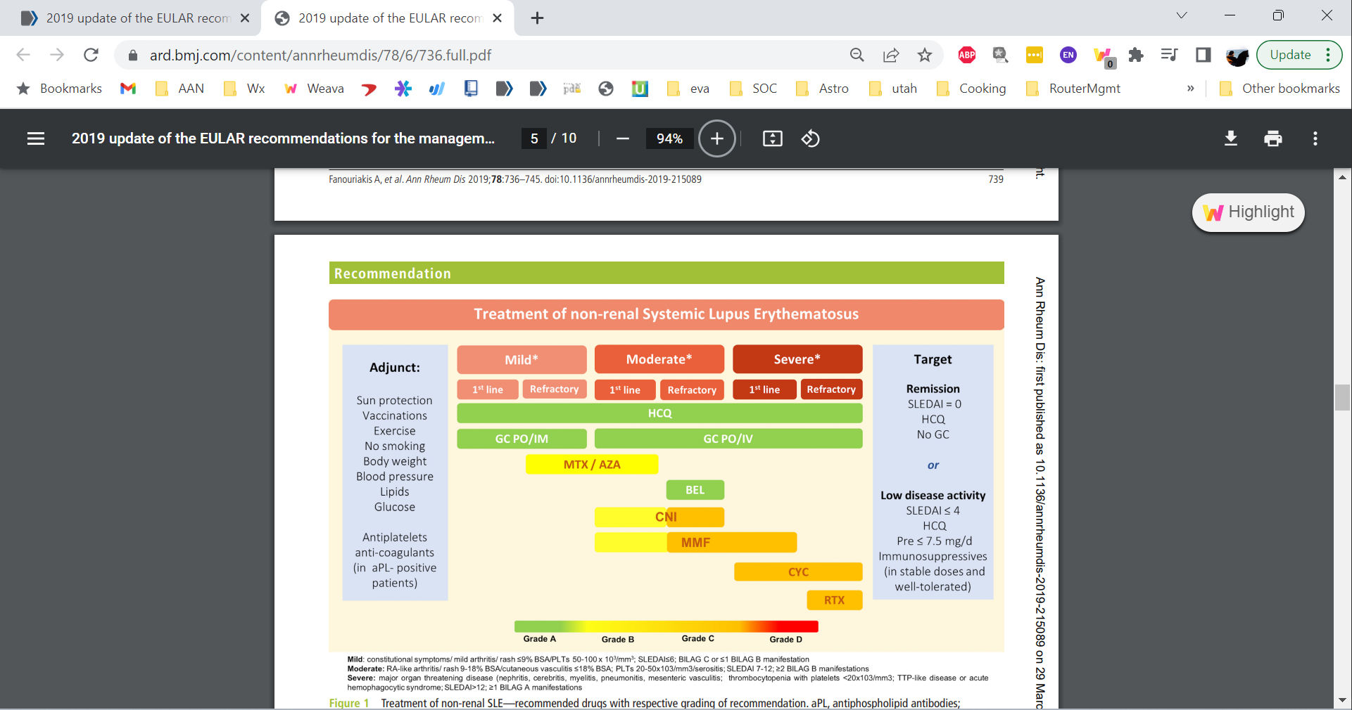
EULAR: Treatment Targets
Target
Remission
SLEDAI = 0
HCQ
No GC
or
Low Disease Activity
SLEDAI ≤ 4
HCQ
Pred ≤ 7.5 mg/d
Immunosuppressives (stable dose, well-tolerated)
GC, glucocorticoids; HCQ, hydroxychloroquine; Pred, prednisone.
Fanouriakis A, et al. Ann Rheum Dis. 2019;78:736-745.

Slide 46
EULAR: Treatment of Nonrenal SLE
Target
Remission
SLEDAI = 0
HCQ
No GC
or
Low Disease Activity
SLEDAI ≤ 4
HCQ
Pred ≤ 7.5 mg/d
Immunosuppressives (stable dose, well-tolerated)
AZA, azathioprine; BEL, belimumab; CNI, calcineurin inhibitors; CYC, cyclophosphamide; GC, glucocorticoid; HCQ, hydroxychloroquine; IM, intramuscular; MMF, mycophenolate mofetil; MTX, methotrexate; RTX, rituximab.
Fanouriakis A, et al. Ann Rheum Dis. 2019;78:736-745.

Slide 47
EULAR: Treatment of Nonrenal SLE After Anifrolumab Approval
Target
Remission
SLEDAI = 0
HCQ
No GC
ANI*
or
Low Disease Activity
SLEDAI ≤ 4
HCQ
Pred ≤ 7.5 mg/d
Immunosuppressives (stable dose, well-tolerated)
ANI*
*Anifrolumab was not approved at the time the EULAR guidelines were published
ANI, anifrolumab
Fanouriakis A, et al. Ann Rheum Dis. 2019;78:736-745.

Slide 48
EULAR: Adjunct Treatment
Target
Remission
SLEDAI = 0
HCQ
No GC
or
Low Disease Activity
SLEDAI ≤ 4
HCQ
Pred ≤ 7.5 mg/d
Immunosuppressives (stable dose, well-tolerated)
aPL, antiphospholipid antibodies;.
Fanouriakis A, et al. Ann Rheum Dis. 2019;78:736-745.

Slide 49
Using Antimalarials for Lupus
After 6-12 weeks, anti-inflammatory and sun protective
80% response rate for non-organ-threatening disease and cutaneous lupus
Decreases flare rate and risk for organ dissemination
Antiplatelet effects
Lipid lowering effects
No serious toxicity if appropriately monitored
Can be used in pregnancy and lactation
Ruiz-Irastorza G, et al. Ann Rheum Dis. 2010;69:20. Akhavan PS, et al. J Rheumatol. 2013;40:831-841.

Slide 50
Hydroxychloroquine Therapy
Effective in early, mild disease
Increases the probability of survival
Associated with fewer thromboembolic events
Decreases damage scores at 5 years
Broder A, et al. J Rheumatol. 2013;40:30-33. Zheng ZH, et al. Lupus. 2012;21:1049-1056.

Slide 51
Methotrexate for Moderate to Severe SLE
Most commonly prescribed disease-modifying drug for rheumatoid arthritis
Not FDA-approved for SLE
Use in patients who
  Cannot tolerate or do not respond to HCQ
  Need continued steroid treatment for disease control
  Have disease activity that could be responsive to methotrexate (eg, arthritis, skin manifestations, possibly serositis)
Sakthiswary R, et al. Lupus. 2014;23:225-235.

Slide 52
Mycophenolate and Azathioprine
Mycophenolate
  Primarily used for renal involvement
  Can be used in moderate to severe lupus for organ-threatening or non-organ-threatening disease
Azathioprine
  Used for nephritis
  Can be used for hematologic, musculoskeletal, or dermatologic involvement
  Can be steroid sparing

Slide 53
Treating Specific Manifestations
Specific agents for cutaneous subsets
  Retinoids, antileprosy drugs, topical pimecrolimus or tacrolimus
Immune thrombocytopenia (ITP)
  Danazol, intravenous immunoglobulin (IVIg), splenectomy, rituximab
CNS
  Intrathecal methotrexate, cyclophosphamide, rituximab
Antiphospholipid antibody syndrome (APS)
  Warfarin, heparin, platelet antagonists
Raynaud’s
  Calcium channel blockers, phosphodiesterase inhibitors, nitrates
Pulmonary hypertension
  Prostaglandins, phosphodiesterase inhibitors, endothelin blockers

Slide 54
In Phase 3 Trials, More Patients Treated With Belimumab Achieved LLDAS
P=0.04
P=0.02
Patients who achieved LLDAS (%)
Oon S, et al. Ann Rheum Dis. 2019;78:629-633.

Slide 55
Steroid Use in Belimumab Phase 3 Trials
Post-hoc analysis of 2 randomized trials
Steroid dose-adjustment based on disease activity allowed
Belimumab treatment led to smaller increase in cumulative corticosteroid dose (cumulative change, left)
  Patients who could decrease their steroid dose had larger decreases (cumulative decrease, middle)
  Patients who needed a dose increase required smaller increases (cumulative increase, right)
†
*
**
*P<0.0001; **P=0.0165; †P=0.0005
Modified from van Vollenhoven, et al. Arthritis Rheum. 2016;68:2184-2192 under Creative Commons License (CC BY-NC 4.0).

Slide 56
Anifrolumab: More Patients Achieved LLDAS or DORIS Remission vs Standard of Care
Combined, post-hoc analysis of phase 3 TULIP trials: standard of care ± anifrolumab
LLDAS required steroid dose ≤7.5 mg/day; DORIS remission required steroid dose ≤5 mg/day
*
% Patients
% Patients
*
*P<0.01
Morand EF, et al. Ann Rheum Dis. 2023;82:639-645.

Slide 57
EULAR: LN Treatment Goals
Increase Long-Term Survival
Prevent Disease Flares
Improve Disease-Related QoL
Preserve Kidney Function
Prevent Organ Damage
Manage Comorbidities
QOL, quality of life
Fanouriakis A, et al. Ann Rheum Dis. 2020;79:713-723.

Slide 58
ACR Guidelines for Monitoring Activity of Lupus Nephritis
Recommended Monitoring of Lupus Nephritis*
 | BP | UA | Protein:CR | Serum CR | C3/C4 Levels | Anti-DNA
Active nephritis at onset of treatment |  |  |  |  | †
Previous active nephritis, none currently
Pregnant with active GN at onset of treatment
Pregnant with previous nephritis, none currently
No prior or current nephritis
*Values are the monthly intervals suggested as the minimum frequency at which the indicated laboratory tests should be measured in the SLE scenarios shown in the left-hand column. †Opinion of the authors based on a study published after the Task Force Panel had voted.
Every month
Every 2 months
Every 3 months
Every 6 months
See patients with active lupus nephritis monthly to monitor their progress and to respond quickly to changes in disease activity (renal or nonrenal)
For patients who have never had lupus nephritis, monitoring is based on disease activity
BP, blood pressure; CR, creatinine; GN, glomerulonephritis; UA, urinalysis.
Hahn BH, et al. Arthritis Care Res. 2012;64:797-808. Grootscholten C, et al. Kidney Int. 2006;70:732-742.

Slide 59
Lupus Nephritis Monitoring
Perform kidney biopsy in patient with SLE and new:
Proteinuria >500 mg/d
Nephritic urine sediment (especially if combined with evidence of proteinuria
Decreased kidney function attributable to SLE
Parikh SV, et al. Am J Kidney Dis. 2020;76:265-281.

Slide 60
Lupus Nephritis Treatment Algorithm
Biopsy Findings
Non-proliferative LN
- Class II
- Class V
Proliferative LN
-Class III/IV (chronic)
Proliferative LN
-Class III/IV (active or active + chronic)
-Mixed Class III or IV + V
Non-proliferative LN
-Class V
Non-LN Kidney Disease*
-Immunosuppression to treat extra-renal disease only
-Kidney protective measures**
-Immunosuppression to treat extra-renal disease only
-Kidney protective measures**
-Immunosuppression to treat LN
-Kidney protective measures**
-Immunosuppression to treat LN
-Kidney protective measures**
-Treatment varies according to condition
*Lupus podocytopathy, thrombotic microangiopathy, interstitial nephritis, cryoglobulinemic glomerulonephritis, acute tubular necrosis
**ACE-I or ARB; BP<125/75 mmHg; moderate sodium- and protein-restricted diet; correction of metabolic abnormalities
Parikh SV, et al. Am J Kidney Dis. 2020;76:265-281.

Slide 61
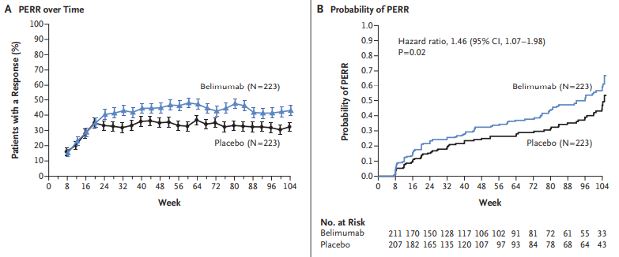
Belimumab Treatment Improved Renal Symptoms
Primary Efficacy Renal Responses Over Time
Probability of Sustained PERR
Primary efficacy response: ratio of urinary protein to creatinine ≤0.7, eGFR no worse than 20% below value before pre-flare value or ≥60 ml/min/1.73 m², and no use of rescue therapy
Patients were treated with standard therapy alone (mycophenolate mofetil or cyclophosphamide–azathioprine) or belimumab plus standard therapy
PERR, Primary Efficacy Renal Responses
From The New England Journal of Medicine, Furie R, Rovin BH, Houssiau F, et al. Two-year, randomized, controlled trial of belimumab in lupus nephritis, volume 383, pages 1117-1128. Copyright ©2020 Massachusetts Medical Society. Reprinted with permission from Massachusetts Medical Society.

Slide 62
Voclosporin Treatment Improved Renal Symptoms
*
*
*
*
*P<0.05 vs placebo
Complete Renal Response: UPCR≤0.5 mg/mg, eGFR≥60 mL/min (or no decrease more than 20% from baseline), no SLE/LN rescue medication, and no more than 10 mg prednisone equivalent per day on weeks 44-52
All patients were treated with standard therapy that included mycophenolate mofetil and steroids. After initial IV steroid treatment, patients were tapered from 20-25 mg/day prednisone to 2.5 mg/day by week 16.
*P<0.05 vs placebo
eGFR, estimated glomerular filtration rate; UPCR, urine protein creatinine ratio
Rovin BH, et al. Lancet. 2021;397:2070-2080.

Slide 63
Outlook on Future SLE Treatments
Anca Askanase, MD

Slide 64
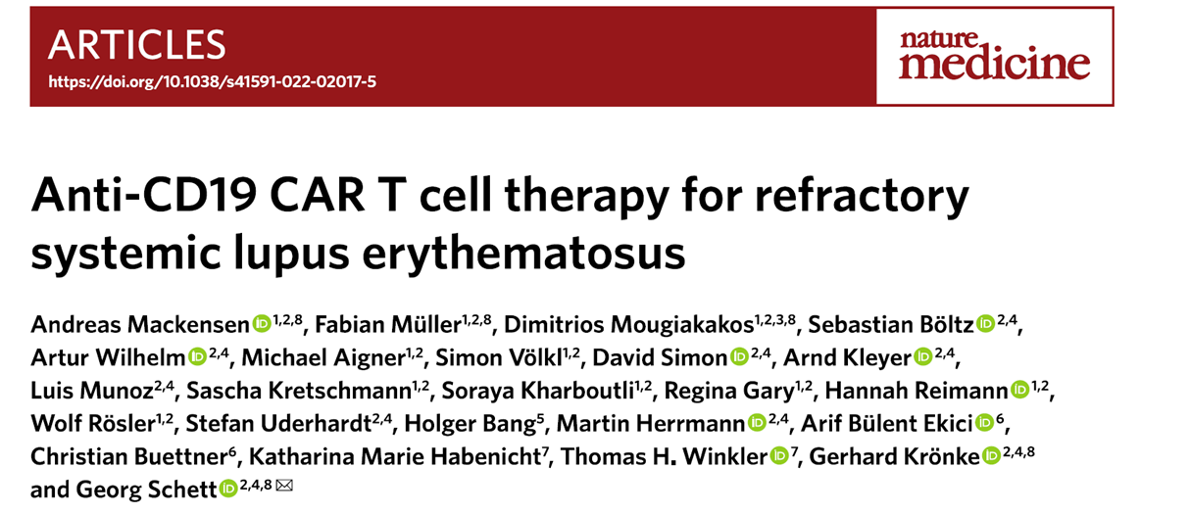
Anti-CD19 CAR T cells caused deep depletion of B cells
In patients with SLE (N=5), led to improvement in clinical symptoms and normalization of laboratory parameters
All patients met DORIS remission criteria after 3 months
Mackensen A, et al. Nat Medicine. 2022;28:2124-2132.

Slide 65
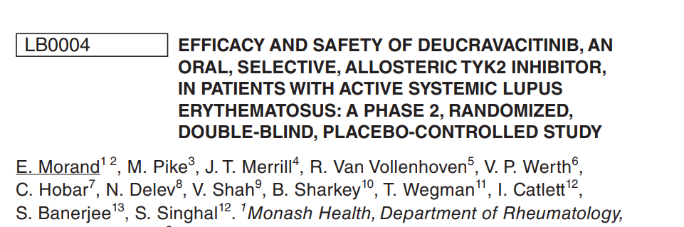
TYK2 is a tyrosine kinase that mediates signaling for Type I interferons, IL-23, and IL-12
Deucravacitinib is an oral TYK2 inhibitor
Patients received standard of care ± deucravacitinib
  Steroid tapering to 7.5 mg/day from weeks 8-20 was required
Primary endpoint: SRI(4) response
  Statistically significant difference between placebo and all deucravacitinib doses at week 32, and response sustained to week 48 (N=363)
Morand E, et al. Ann Rheum Dis. 2022;81:209.

Slide 66
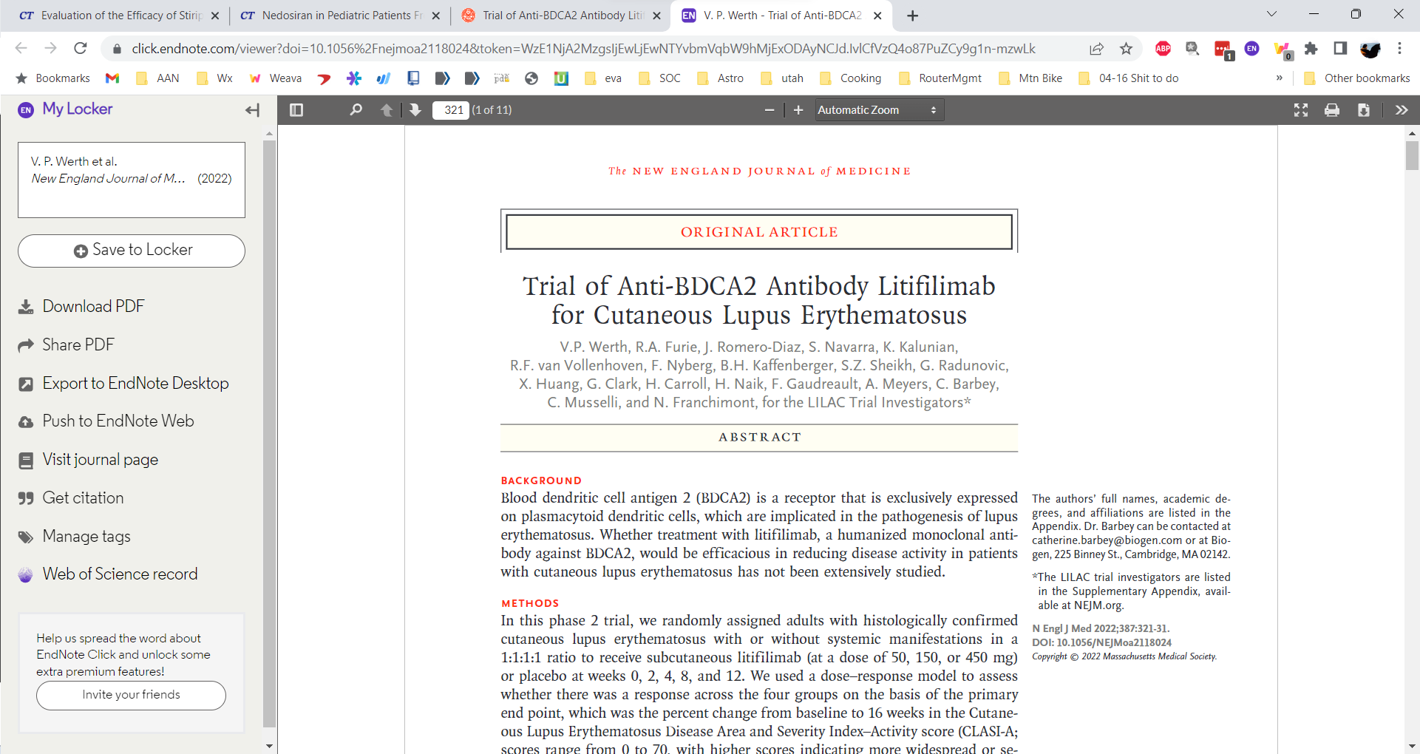
Blood dendritic cell antigen 2 (BDCA2) expressed exclusively on plasmacytoid dendritic cells
Randomized, placebo-controlled, phase 2 dose-response trial
Primary endpoint: Cutaneous Lupus Erythematosus Disease Area and Severity Index-Activity score (CLASI-A)
Werth VP, et al. N Engl J Med. 2022;387:321-331.

Slide 67
Multidisciplinary Management
Diane Kamen, MD

Slide 68
The SLE Patient Team
Primary care providers
  Coordinate healthcare maintenance
  Essential member of patient team
Specialists to address specific patient needs
  Reproductive health, dermatology, nephrology, cardiology, neurology, ophthalmology, sleep medicine, others…
Case managers and patient navigators to overcome barriers to care
Social workers to assist with insurance, work accommodations, assistance programs
Specialty pharmacists (PharmDs) assist with insurance authorizations, medication assistance programs, toxicity monitoring
Occupational therapists, hand therapists, and physical therapists
Dietitians
Clinical research team
Notes:
[no audio / slide only ]

Slide 69
Minorities Are Underrepresented in Clinical Trials
 | Percent of Prevalent Cases | Representation in Clinical Trials
White/Caucasian | ~33% | 51%
Black | 43% | 14%
Hispanic/LatinX | 16% | 21%
Asian | 13% | 10%
Falasinnu T, et al. Curr Rheumatol Rep. 2018;20:20

Slide 70
Patient Barriers to Clinical Trial Participation
Barrier | Examples
Access | No rheumatologists who know about clinical trials Difficult transportation to clinic
Opportunity | Lack awareness of clinical trials Lack of referral
Mistrust | History of exploitation Fear of deportation
Health literacy | Lack of disease education Dislike and misunderstanding of clinical trial protocols Beliefs about clinical trial value and benefits
Cultural | Lack of friendly patient-provider relationship
Sheikh SZ, et al. J Clin Med. 2019;8:1245. doi: 10.3390/jcm8081245.
Notes:
[no audio / slide only ]

Slide 71
Case Study 1
Anca Askanase, MD

Slide 72
Case 1
A 25-year-old African American woman presented to the clinic 2 weeks ago with shortness of breath, chest pain, and lower extremity edema
On examination, she had evidence of alopecia, mild bilateral knee arthralgia and swelling, and malar rash
In the ED, her blood pressure was 150/90 mmHg
  Also noted fluid overload, arthritis, alopecia, and rash, leading to suspect systemic illness
Blood work significant for
  Positive for anti-ANA, anti-dsDNA, anti-Smith
  C3 and C4 below normal range
Urinalysis significant for
  Elevated protein and RBCs with casts

Slide 73
Initial Evaluation
Every patient with clinical evidence of active, previously untreated LN should undergo a renal biopsy (unless strongly contraindicated)
Clinical findings of LN are nonspecific (may be found in other forms of renal injury)
Recommended therapeutic strategies are based on knowing ISN/RPS classification on biopsy
ISN/RPS, International Society of Nephrology/Renal Pathology Society
Hahn BH, et al. Arthritis Care Res (Hoboken). 2012;64:797-808. Parikh SV, et al. Semin Nephrol. 2015;35:465-477. Bajema IM, et al. Kidney Int. 2018:93:789-796.

Slide 74
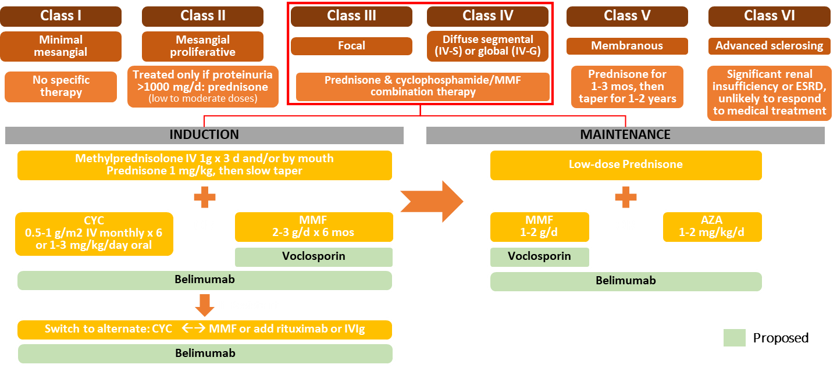
2012 ACR Guidelines for Lupus Nephritis
AZA, azathioprine; CYC, cyclophosphamide; ESRD, end-stage renal disease; IVIg, IV immunoglobulin;MMF, mycophenolate mofetil.
Hahn BH, et al. Arthritis Care Res (Hoboken). 2012;64. Appel GB, et al. J Am Soc Nephrol. 2009;20:1103-1112. Parikh SV, et al. J Am Soc Nephrol. 2016;27:2929-2939.

Slide 75
Case 1: Selecting Treatment
During the follow-up from acute care, the patient says that she and her husband have been considering having a child

Slide 76
Pregnancy With SLE is High-Risk
SLE should be stable and inactive for >6 months before attempting pregnancy
  Medication review is critical: Continue hydroxychloroquine, stop mycophenolate
Higher risk of pregnancy loss with active SLE or with antiphospholipid antibodies
Few circumstances where pregnancy is absolutely contraindicated
The 3 Ps are all increased with SLE:
  Preterm birth
  Pre-eclampsia
  Premature rupture of membranes
Utilize LupusPregnancy.org and ReproRheum.duke.edu with your patients
Petri M. Best Pract Clin Obstet Gynaecol. 2020;64:24-30. Lateef A, et al. Rheum Dis Clin North Am. 2017;43:215-226.

Slide 77
Case Study 2
Diane Kamen, MD

Slide 78
Case 2
A 48-year-old woman with an 18-year history of SLE is presenting for a regular appointment
  Mother of 2 teenage children, works full time as a dental assistant
  Functional history: patient describes worsening of her lupus symptoms
    Pain in fingers, especially in the winter, causing some functional disability
    Hip pain causing difficulty walking
Treatment history
  Heavy steroid use before switching to methotrexate and belimumab 12 years ago
  18-year history of hydroxychloroquine with no ocular adverse events

