Slide 1


Slide 2
Module 1: Diagnosis
Identify appropriate tests and support decision-making in the diagnosis of PBC
James Boyer, MD

Slide 3
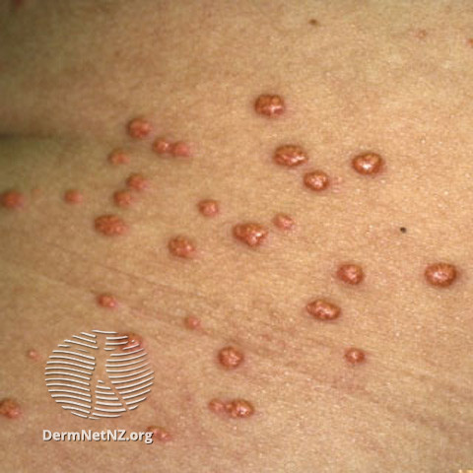
Background and Presentation
Chronic, cholestatic disease
Cholestasis → Cirrhosis → Liver failure
Asymptomatic vs Symptomatic Presentation
  Fatigue and pruritus
Associated symptoms:
  Dry eyes and mouth, fluid in ankles and abdomen, fatty deposits in skin around the eyes, jaundice
Associated Disorders:
  Sjogren’s, hypothyroidism, celiac disease, rheumatoid arthritis, cholesterol gallstones
Lindor KD, et al. Hepatology. 2019;69(1):394-419.
Image: https://dermnetnz.org/topics/xanthoma

Slide 4
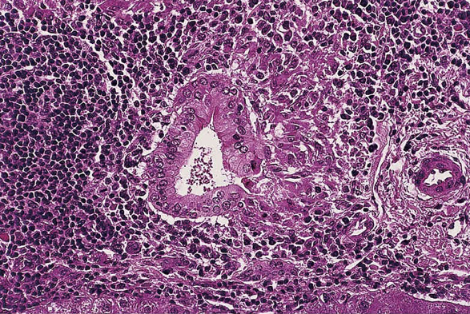
Diagnostic Criteria
Presence of at least 2 of the following:
  Biochemical evidence of cholestasis with elevated alkaline phosphatase
  Antimitochondrial antibody (AMA)
  Histopathologic evidence of nonsuppurative cholangitis and bile duct destruction
For AMA negative PBC
  Anti-SP100
  Anti-GP210
Lindor KD, et al. Hepatology. 2019;69(1):394-419.
Courtesy James Boyer, MD.

Slide 5
Laboratory Evaluations
Tests and Serologies | Typical Pattern
Alkaline phosphatase | Typically elevated
Alanine aminotransferase | Mild elevation may be present
Aspartate aminotransferase | Mild elevation may be present
Bilirubin | Elevated as disease progresses
AMA | Positive in 95% of cases
Antinuclear antibody (ANA) | Positive in half of cases
Smooth muscle antibody | Positive in half of cases
Immunoglobulin M | May be elevated
Lindor KD, et al. Hepatology. 2019;69(1):394-419.
Kaplan MM, et al. N Engl J Med. 2005;353:1261‐1273.

Slide 6
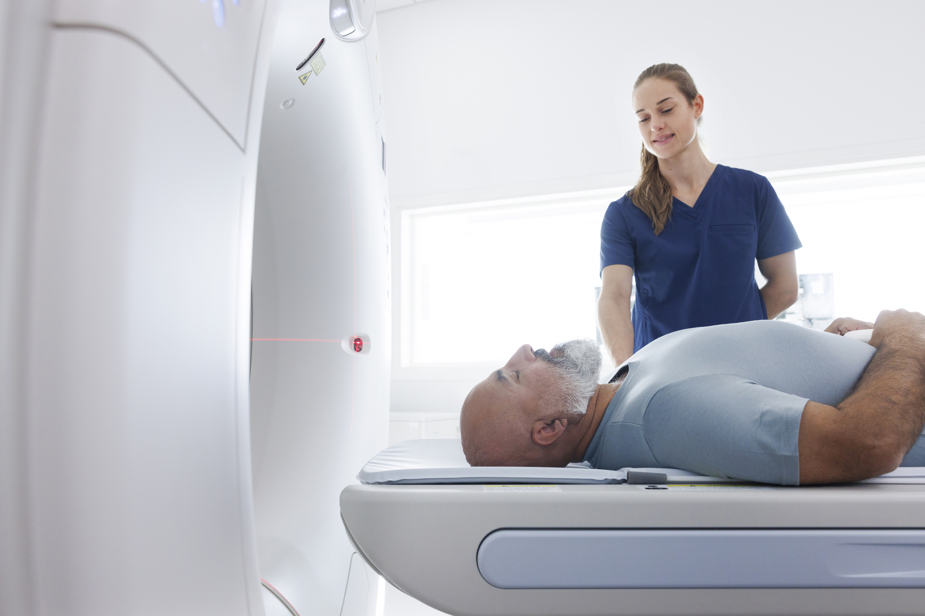
Imaging Modalities
Ultrasound
Magnetic resonance imaging
Transient elastography
FibroScan®
Corpechot C, et al. Hepatology 2012;56:198‐208.
Joshita S, et al. J Gastroenterol Hepatol. 2020;35(7):1208-1214.
Lindor KD, et al. Hepatology. 2019;69(1):394-419.
Notes:
End with role of imaging in diagnosis and the value of these modalities. When to use which.
Ask and answer the question: what is the value of each of these imaging modalities?
-Ultrasound is often the first imaging modality used as patients with PBC often present with abdominal pain with the development of gallstones. Imaging can be used to rule out other diagnoses and extrahepatic biliary obstructions. Fibroscan can be used to measure liver stiffness as a non-invasive measure for staging of PBC.
Ask and answer the question: for who is obtaining a liver biopsy most and least important?
-Use of liver biopsy is not uniform, but may be important for cases of unclear diagnosis such as possible autoimmune hepatitis, for staging of disease, or for those with inadequate response to ursodiol.
Ask and answer the question: given the advances of imaging modalities, will they ever replace liver biopsy or what role will liver biopsy maintain?
End with: What is the threshold for referral to GI/Hepatology?

Slide 7
Module 2:
Prognosis in
Primary Biliary Cholangitis
Seth Sclair, MD
Medical Director, Liver Transplant Program
University Hospitals Cleveland Medical Center
Associate Professor of Medicine
Case Western Reserve University, School of Medicine

Slide 8
Natural History of PBC – Pre UDCA
Mild disease presentation
  Approximately half of patients are asymptomatic
  Most common – fatigue and pruritus
Variable course
  36% - 89% become symptomatic over time (over follow-up of 4.5 – 17.8y)
  Asymptomatic at diagnosis: median survival of 16 years
    Remain asymptomatic → stable course
    Become symptomatic → progressive disease
      Median time to symptoms: 2 – 4.2 years
  Symptomatic at diagnosis
    Median survival diminished: ranging from 5 – 8 years
Springer J, et al. AJG. 1999; 94(1):47-53.
Lindor KD, et al. Hepatology. 2019;69(1):394-419.
Roll J, et al. NEJM. 1983; 308(1):1-7.

Slide 9
Natural History of PBC – Pre UDCA
Asymptomatic vs Symptomatic PBC
Variable Course of PBC
Springer J, et al. AJG. 1999; 94(1):47-53.
Lindor KD, et al. Hepatology. 2019;69(1):394-419.
Roll J, et al. NEJM. 1983; 308(1):1-7.

Slide 10
Natural History of PBC – Pre UDCA
Fibrosis Stage at Diagnosis
Clinical Predictors of Prognosis
Early studies have shown:
  Presence of bridging fibrosis and cirrhosis at diagnosis
  Bilirubin levels > 5.0 mg/dL at diagnosis
Roll J, et al. NEJM. 1983; 308(1):1-7.

Slide 11
PBC and Disease Progression: Pre-UDCA
Histologic Progression
  Median time to extensive fibrosis (≥ F3): 2 years
  At 4 years:
    Stable/remain in early stage PBC: 29%
    50% of were diagnosed with cirrhosis over time (who did not have fibrosis at baseline).
    Histologic stage progression: 1 stage/1.5 years of follow-up
Clinical Progression
  Development of decompensation (ascites, HE, variceal bleeding, hyperbilirubinemia)
    5 year: 15% – 25% (Cohorts that comprised of 50% cirrhotic patients at entry)
  Development of esophageal varices and bleeding
    31% develop EV over 5.6 y (28% cirrhotic at baseline)
    Diminished survival following the development of varices (3 year survival of 59%)
Lindor KD, et al. Hepatology. 2019;69(1):394-419.

Slide 12
Impact of Ursodiol: Improving PBC Outcomes
Ursodiol changes the course of PBC
  Improves biochemical indices
  Delays histologic progression
  Improves survival without transplantation
Risk of fibrosis progression/year
  URSO 7% vs Placebo 34%
Risk of development of varices at 4y:
  URSO 16% vs Placebo 58%
Perez CFM, et al. Hepatology. 2018;67(5):1920-1930.
Lindor KD, et al. Hepatology. 2019;69(1):394-419.
Corpechot C, et al. Hepatology. 2000;32(6):1196-1199.

Slide 13
Medical Approaches to PBC: UDCA
Survival Free of Transplantation (Combined Data)
Probability of Survival %
1.0
UDCA
Placebo → UDCA
0.5
0
24
48
Months
UDCA
273
236
116
Placebo → UDCA
275
220
87
Poupon RE, et al. Gastroenterology. 1997; 113:884-890.

Slide 14
Effect of UDCA on Mortality and Liver Transplantation Risk
Long-term UDCA reduces death
and OLT^{1,2}
UDCA normalizes survival rates when given at early stages of PBC³
However, survival in patients with late-stage disease is reduced³
Endpoint | RR (95% CI) | P value
Death or OLT¹ | 0.32 (0.14−0.74) | .005
OLT-free survival² | 1.92 (1.30−2.82) | <.001
CI, confidence interval; OLT, orthotopic liver transplantation; RR, relative risk.
Poupon RE, et al. N Engl J Med. 1994;330:1342-1347.
Poupon RE, et al. Gastroenterology. 1997;113:884-890.
Corpechot C, et al. Gastroenterology. 2005;128:297-303.

Slide 15
Prognostic Models in PBC
Bilirubin
Bilirubin level remains the best predictor of survival in all PBC prognostic models.
UK-PBC Risk Score² (2015)
Prognostic index comprising baseline albumin and platelet count, plus bilirubin, ALT or AST, and ALP after 1 year UDCA (derived/validated > 3000 patients)
www.uk-pbc.com/resources/tools/riskcalculator
GLOBE Score³
(2015)
Prognostic index comprising baseline age, and bilirubin, ALP, albumin,
and platelet count after 1 year UDCA (derived/validated > 4000 patients)
www. globalpbc.com/globe
APRI, AST/platelet ratio index.
Trivedi PJ, et al. J Hepatol. 2014;60:1249-1258.
Carbone M, et al. Hepatology. 2016;63(3):930-950.
Lammers WJ, et al. Gastroenterology. 2015;149(7):1804-1812.

Slide 16
GLOBE Score – Transplant-Free Survival Threshold
Transplant-Free Survival Rates for Patients With GLOBE Score >0.30
Transplant-Free Survival Rates for Patients With GLOBE Score ≤0.30
Derivation cohort
Lammers WJ, et al. Gastroenterology. 2015;149(7):1804-1812.

