Slide 1
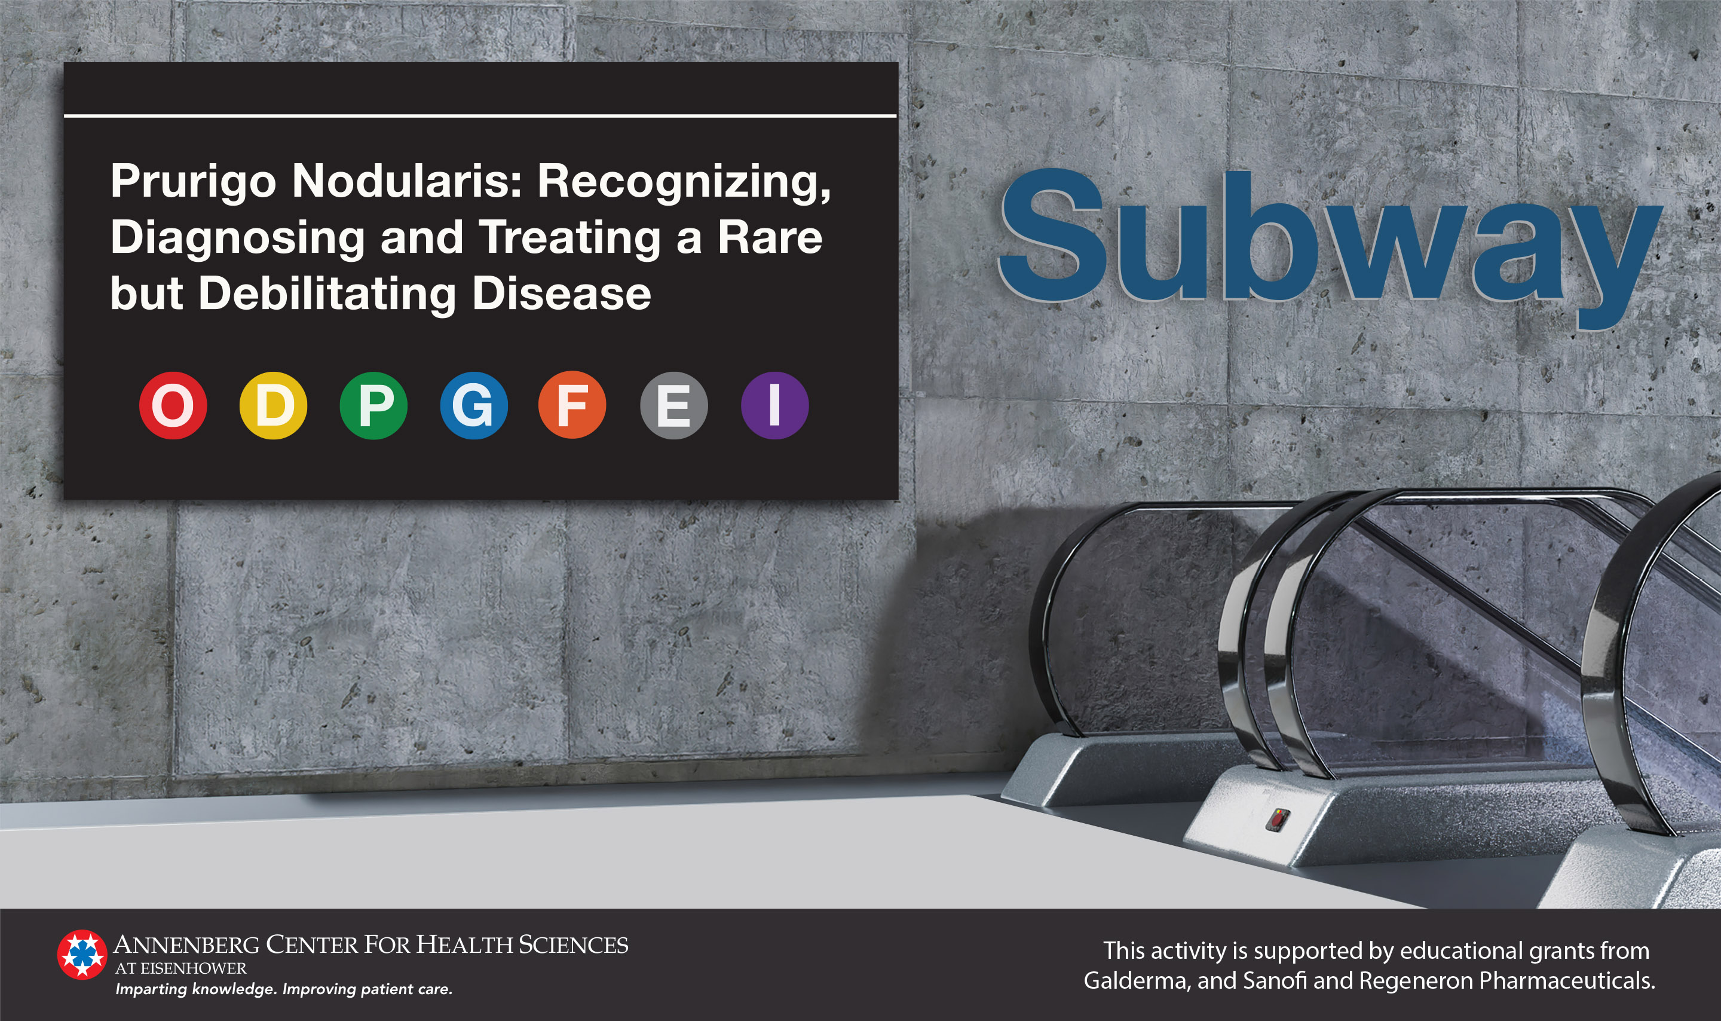

Slide 2
Objectives
Distinguish the unique signs and symptoms of Prurigo Nodularis (PN) in various skin types
Explain the pathophysiology of PN and the role of IL-4, IL-13, IL-31, and other mediators in itch, inflammation, epithelial dysregulation, and fibrosis
Recognize the burden of PN on quality of life, including sleep disturbances and psychiatric comorbidities
Employ evidence-based strategies for treating patients with PN
Describe the safety and efficacy of emerging treatments for PN

Slide 3
Definitions¹⁻²
Prurigo introduced over 200 years ago by Robert Willian as a term to describe itchy papules
  Prurigo is often used without clear criteria to name multiple conditions
  Historically, other terms have been added to further differentiate the itch such as prurigo mitis, prurigo pigmentosa and prurigo nodularis (PN)
PN is defined as an uncommon, chronic inflammatory skin disorder characterized by the presence of chronic pruritus and multiple firm, symmetrically distributed, pruritic nodules that have a profound, negative impact on quality of life
Tsianakas A, et al. Curr Probl Dermatol. 2016:50:94-101.
Elmariah S, et al. J Am Acad Dermatol. 2021;84(3):747-760.

Slide 4
Classification
In the US, PN includes other variants such as papular, plaque or umbilicated due to the similar clinical picture
  In Europe, PN is a sub type of chronic prurigo
ICD-10 lists PN as a distinct disease (L28.1)
  Previously, PN was grouped with other pruritic conditions
Avoid using prurigo to describe other conditions
  eg, “Pruriginous atopic dermatitis”
Elmariah S, et al. J Am Acad Dermatol. 2021;84(3):747-760.

Slide 5
Epidemiology and Demographics¹⁻⁴
Estimated prevalence of 72 per 100,000 people in the US using ICD-10 data
  This is likely an underestimation due to a general lack of disease awareness and negative stigma
PN is more common in older adults (median age=66), but can manifest at any age
  Patients usually are first diagnosed between the ages of 51 and 65 years
African American patients are 3.4 times more likely to experience PN compared to White patients
Five percent of persons with HIV suffer from PN
1. Huang A, et al. J Eur Acad Dermatol Venereol. 2018;32(7):1059-1065. 2. Iking A, et al. J Eur Acad Dermatol Venereol. 2013;27(5):550-557. 3. Boozalis E, et al. J Am Acad Dermatol. 2018;79(4):714-719. 4. Magand F, et al. Trans R Soc Trop Med Hyg. 2011;105(7):401-404.

Slide 6
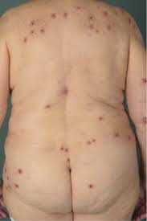
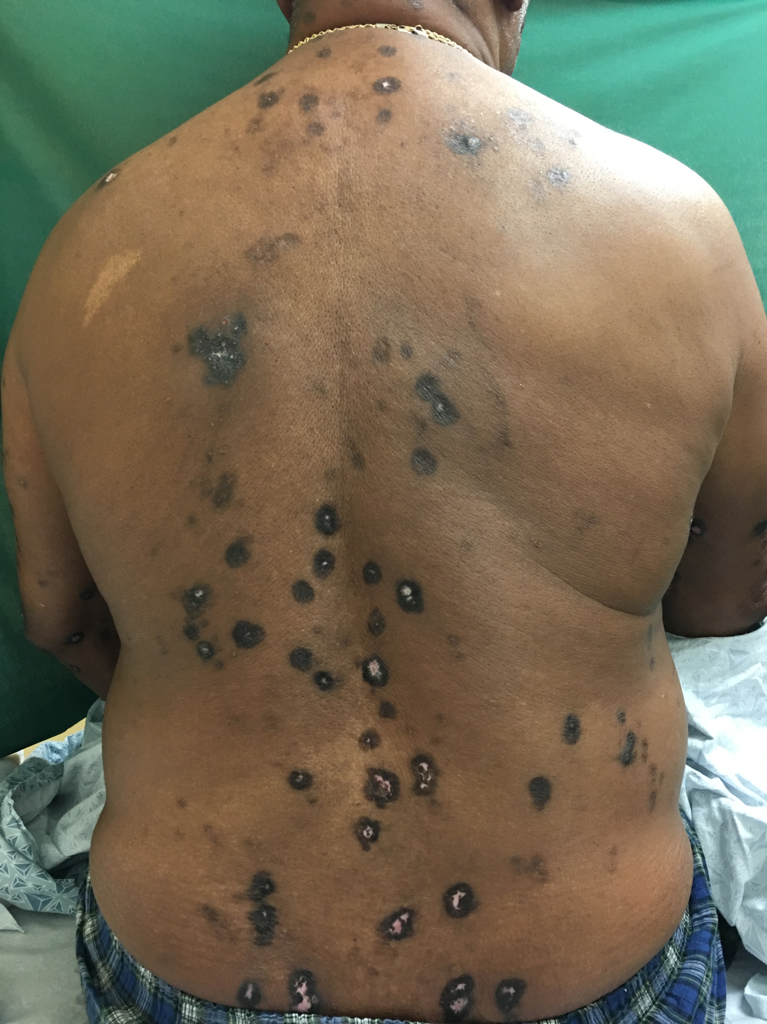
Disease Manifestations¹⁻³
Nodules
  Firm and dome shaped
  Size varies from a couple millimeters to several centimeters
  Commonly distributed symmetrically on the extensor surfaces of the legs, trunk and arms but absent from the palms, soles and face
  Also seen on the abdomen, sacrum and the back in a butterfly shape
1
2
Williams K, et al. Expert Rev Clin Pharmacol. 2021;14(1):67-77. 2. Huang A, et al. J Invest Dermatol. 2020;140(2):480-483 e4. 3. Kwatra S. NEJM. 2020;382(8):757-758.
Image 1: courtesy of Lindsay Strowd, MD. , Image 2 : Reprint from Stander H, et al. Diagnostic and treatment algorithm for
chronic nodular prurigo. J Am Acad Dermatol. 2020;82(2):460-468 , with permission from Elsevier.

Slide 7
Disease Manifestations¹⁻³
Pruritus
  Severe
    Highest dermatologic itch intensity despite patients using the highest number of medications to treat⁴
  May be sporadic, paroxysmal or continuous
  Made worse by heat, sweating or irritation from clothing
  Cause of pruritus is often unknown
1. Williams K, et al. Expert Rev Clin Pharmacol. 2021;14(1):67-77. 2. Huang A, et al. J Invest Dermatol. 2020;140(2):480-483 e4. 3. Kwatra S. NEJM. 2020;382(8):757-758. 4. Steinke S, et al. J Am Acad Dermatol. 2018;79(3):457-463.

Slide 8
Associated Conditions¹⁻²
About half of persons with PN have a history of atopic dermatitis
Five percent of persons with HIV also suffer from PN
Persons with PN have a high incidence of diabetes, chronic renal failure, cardiovascular disease and hepatitis C
Persons with PN also suffer from anxiety, depression and emotional stress
1. Iking A, et al. J Eur Acad Dermatol Venereol. 2013;27(5):550-7. 2. Boozalis E, et al. J Am Acad Dermatol. 2018;79(4):714-719.

Slide 9
Initial Diagnosis and Referral
Diagnosis based upon patient history and physical exam
Symptomatic treatment can begin while awaiting further workup
All patients should be referred to a dermatology specialist
Elmariah S, et al. J Am Acad Dermatol. 2021;84(3):747-760.

Slide 10
Initial Diagnosis and Referral
Core Findings Essential for Diagnosis:
Firm, Nodular Lesions
Excoriated, hyperkeratotic and pruritic
Vary in size, location, color and quantity
Pruritus ≥6 weeks
Continuous, sporadic or paroxysmal
Severe
Repetition
Scratching
Picking
Elmariah S, et al. J Am Acad Dermatol. 2021;84(3):747-760.

Slide 11
Initial Diagnosis and Referral
Additional Findings:
  Symmetrical distribution of nodules on areas of the body accessible to scratching
  Lesions absent on the face, palms and soles
  Other lesions due to scratching or picking
  Burning, stinging or painful sensations in addition to pruritus
Elmariah S, et al. J Am Acad Dermatol. 2021;84(3):747-760.

Slide 12
Overview of Diagnostic Evaluation by
Dermatology
Confirm PN diagnosis
Look for treatable causes of pruritus
  Majority of PN has no identifiable cause
Rule out diseases that can mimic PN
Screen for associated conditions
Qualify and quantify disease burden using patient questionnaires and validated tools
Elmariah S, et al. J Am Acad Dermatol. 2021;84(3):747-760.

Slide 13
Patient History¹⁻³
Dermatologic History
  Onset, location and duration of pruritus
  Pruritic intensity, quality, and triggering factors
  Appearance and evolution of lesions
  Other household members affected
  Contact with animals
  Methods used to relieve itch
Medical history
  Family history
  Current medications
  Illicit drug use
  Atopic predisposition
  Patient’s theory of causality
Comorbidities
  Diabetes
  Chronic kidney disease
  Iron deficiency
  HIV
  Hepatobiliary disease
  Lymphoma or other types of cancer
  Neurologic disorders
  Psychological disorders
1. Elmariah S, et al. J Am Acad Dermatol. 2021;84(3):747-760. 2. Stander H, et al. J Am Acad Dermatol. 2020;82(2):460-468 3. Kwon C, et al. Medicines (Basel). 2019;6(4):E97.

Slide 14
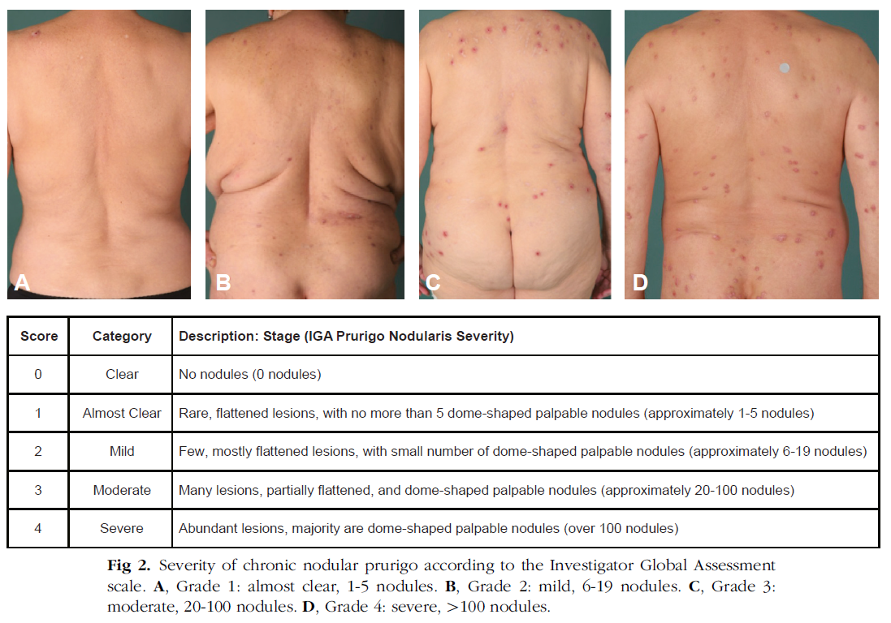
Patient Exam¹⁻³
1
2
3
4
Number and firmness of lesions
Look for signs of other skin diseases
  Atopic dermatitis
  Bullous pemphigoid
  Cutaneous T-cell lymphoma
Palpate liver, spleen and lymph nodes
Score/Grade | Category | Number of nodules | Description
0 | Clear | 0 | No nodules
1 | Almost Clear | 1-5 | Rare, flattened lesions, no more than 5 dome-shaped palpable nodules
2 | Mild | 6-19 | Few, mostly flattened lesions, with small number of dome-shaped palpable nodules
3 | Moderate | 20-100 | Many lesions, partially flattened, and dome-shaped palpable nodules
4 | Severe | >100 | Abundant lesions, majority are dome-shaped palpable nodules
1. Elmariah S, et al. J Am Acad Dermatol. 2021;84(3):747-760. 2. Stander H, et al. J Am Acad Dermatol. 2020;82(2):460-468, with permission from Elsevier. 3. Kwon C, et al. Medicines (Basel). 2019;6(4):E97.

Slide 15
Laboratory Assessment¹⁻³
Biopsy
Blood Tests
Consider if there are associated blisters or if pruritus started from inflamed skin
  Hematoxylin-eosin staining for histology
  Direct immunofluorescence for auto-immune diseases
  Intraepidermal nerve fiber density for possible neuropathy
Complete blood cell count with differential
Hemoglobin A1c
Glomerular filtration rate
Creatinine
Liver function tests
Thyroid tests
HIV screening
Hepatitis panel
Radiology
Consider to rule out neuropathy, systemic disease or malignancy
1. Elmariah S, et al. J Am Acad Dermatol. 2021;84(3):747-760. 2. Stander H, et al. J Am Acad Dermatol. 2020;82(2):460-468 3. Kwon C, et al. Medicines (Basel). 2019;6(4):E97.

Slide 16
Rule Out Similar Diseases¹⁻³
Skin scraping to rule out scabies or fungal infections
Direct immunofluorescence to identify autoimmune blistering conditions
Dermoscopy and histopathology to differentiate between hypertrophic lichen planus or lichen amyloidosis and PN
Skin biopsy with hematoxylin-eosin staining to rule out allergic or inflammatory conditions
Psychiatric evaluation to identify any skin-picking syndromes
1. Elmariah S, et al. J Am Acad Dermatol. 2021;84(3):747-760. 2. Stander H, et al. J Am Acad Dermatol. 2020;82(2):460-468 3. Kwon C, et al. Medicines (Basel). 2019;6(4):E97.

Slide 17
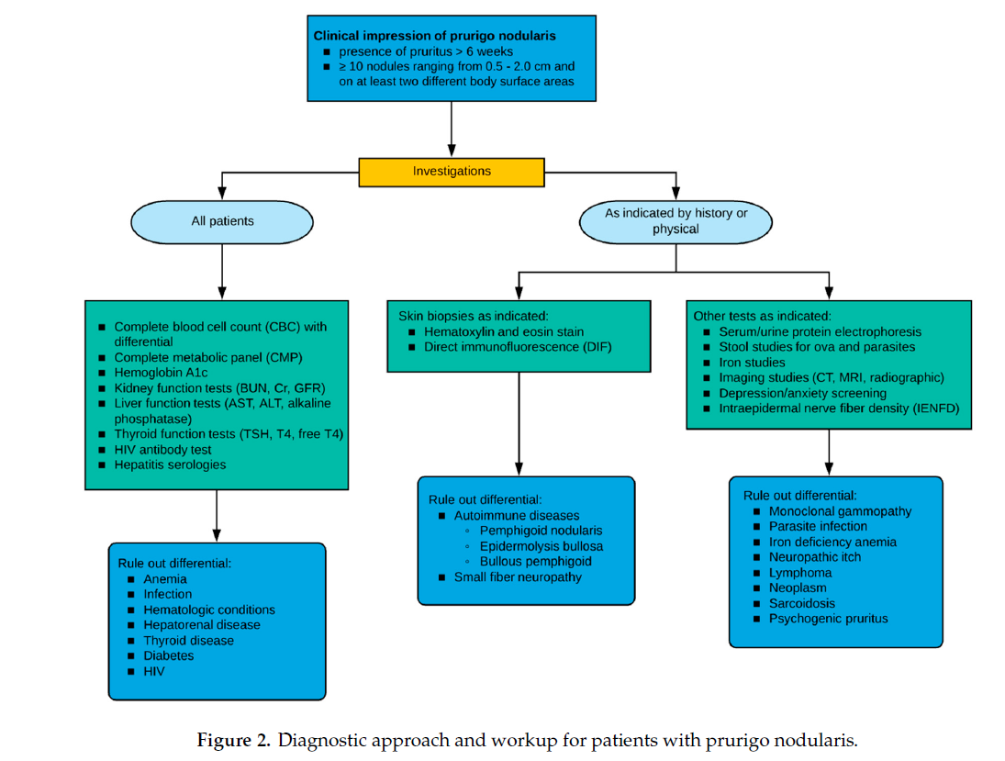
Summary of Workup
Kwon C, et al. Medicines (Basel). 2019;6(4):E97. Used under terms of the Creative Commons Attribution (CC BY) license.

Slide 18
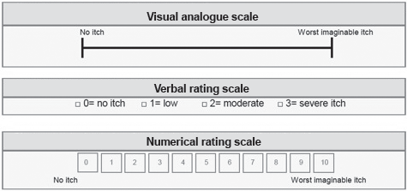
Rate Disease Burden and Intensity¹⁻²
VAS is more sensitive for itch intensity than the NRS or the verbal rating scale VRS although all three showed high reliability and validity
NRS, numerical rating scale; VAS, visual analogue scale; VRS, verbal rating scale
1. Quan N, et al. Acta Derm Venereol. 2012;92:502-507 Used under terms of Creative Commons (CC-BY-NC 4.0 license). 2. Stander H, et al. J Am Acad Dermatol. 2020;82(2):460-468

Slide 19
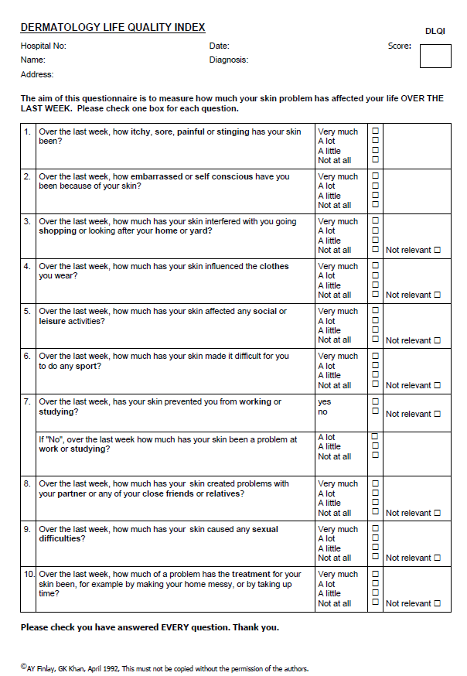
Quality of Life Survey¹⁻²
Dermatology Life Quality Index (DLQI) is a validated tool for many dermatological conditions
Assess the impact of PN on:
  Mental health
  Activities of daily living
  Employment
  Relationships
  Treatment burden
Scored between 0 and 30 with higher numbers correlating with a lower quality of life
1. Stander H, et al. J Am Acad Dermatol. 2020;82(2):460-468 2. Finlay A, et al. Clin Exp Dermatol. 1994;19:210-216.

Slide 20
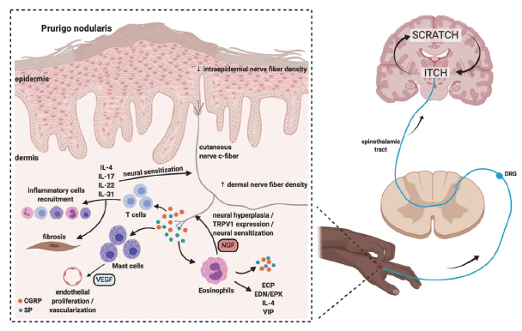
Itch-Scratch Cycle¹⁻³
Self-perpetuating cycle seen in many forms of pruritus where scratching potentiates the factors that lead to increased itch
The lack of nodules where patients cannot reach highlights the importance of scratching in the pathogenesis
Involves an altered neural and immune response with cross-talk between the 2 systems
The increased growth factors lead to endothelial cell growth and nodule formation
SP, substance P; CGRP, calcitonin-related gene peptide; IL, Interleukin; NGF, nerve growth factor; VEGF, vascular endothelial growth factor; DRG, dorsal root ganglia; TRPV1, transient receptor potential vanilloid 1; ECP, Eosinophilic cationic protein; EDN/EPX, eosinophil-derived neurotoxin/eosinophil protein X; VIP, vasoactive intestinal polypeptide
1. Williams K, et al. Expert Rev Clin Pharmacol. 2021;14(1):67-77, reprinted by permission of the publisher (Taylor & Francis Ltd, http://www.tandfonline.com ). 2. Choi J, et al. Semin Immunopathol. 2018;40(3):249-259. 3. Garcovich S, et al. Vaccines (Basel). 2021;9(3):303.

Slide 21
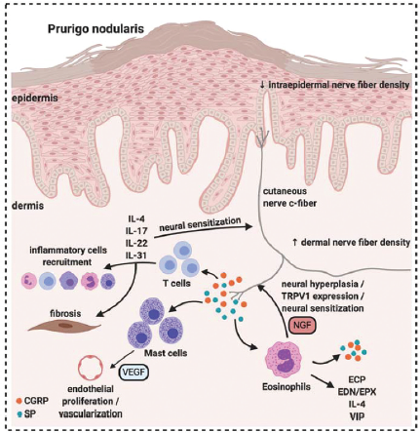
Immune Factors¹⁻³
PN skin contains dense infiltrates of eosinophils, T lymphocytes and mast cells
These release many proinflammatory cytokines
There is interaction with the neuronal pathway by eosinophils releasing SP and NGF
ECP and EDN/EPX are also increased in the upper dermis of PN lesions leading to increased inflammation
Note the general lack of histamine
SP, substance P; CGRP, calcitonin-related gene peptide; IL, Interleukin; NGF, nerve growth factor; VEGF, vascular endothelial growth factor; DRG, dorsal root ganglia; TRPV1, transient receptor potential vanilloid 1; ECP, Eosinophilic cationic protein; EDN/EPX, eosinophil-derived neurotoxin/eosinophil protein X; VIP, vasoactive intestinal polypeptide
1. Williams K, et al. Expert Rev Clin Pharmacol. 2021;14(1):67-77, reprinted by permission of the publisher (Taylor & Francis Ltd, http://www.tandfonline.com ). 2. Johansson O, et al. Arch Dermatol Res. 2000;292(8):371-378. 3. Garcovich S, et al. Vaccines (Basel). 2021;9(3):303.

Slide 22
Role of Interleukins¹⁻³
Increased IL-31 expression has been associated with many pruritic skin diseases and is increased in the skin of PN patients
IL-31 induces itch through neural sensitization by activating receptors IL-31 receptor alpha (IL-31RA) and Oncostatin M receptor beta (OSMRβ)
IL-4,IL-13 are proinflammatory cytokines released by type 2 T helper(Th2) cells that can induce itch, erythema and increase fibrosis
IL-4 may augment IL-31 receptor sensitivity
SP, substance P; CGRP, calcitonin-related gene peptide; IL, Interleukin; NGF, nerve growth factor; VEGF, vascular endothelial growth factor; DRG, dorsal root ganglia; TRPV1, transient receptor potential vanilloid 1; ECP, Eosinophilic cationic protein; EDN/EPX, eosinophil-derived neurotoxin/eosinophil protein X; VIP, vasoactive intestinal polypeptide
1. Williams K, et al. Expert Rev Clin Pharmacol. 2021;14(1):67-77, reprinted by permission of the publisher (Taylor & Francis Ltd, http://www.tandfonline.com ). 2. Hashimoto T, et al. Exp Dermatol. 2021;30(6):804-810. 3. Zhong W, et al. Acta Derm Venereol. 2019;99:579-586

Slide 23
Role of Substance P and Calcitonin-Related Gene Peptide¹⁻³
Increased density of SP nerve fibers
  SP is responsible for allergic sensitization, mast cell degranulation and other proinflammatory effects
  SP triggers mast cells to release VEGF which leads to endothelial growth
CGRP expression is also increased
  CGRP stimulates mast cells and eosinophils
  CGRP can also induce a Th2 response
SP, substance P; CGRP, calcitonin-related gene peptide; IL, Interleukin; NGF, nerve growth factor; VEGF, vascular endothelial growth factor; DRG, dorsal root ganglia; TRPV1, transient receptor potential vanilloid 1; ECP, Eosinophilic cationic protein; EDN/EPX, eosinophil-derived neurotoxin/eosinophil protein X; VIP, vasoactive intestinal polypeptide
1. Williams K, et al. Expert Rev Clin Pharmacol. 2021;14(1):67-77, reprinted by permission of the publisher (Taylor & Francis Ltd, http://www.tandfonline.com ). 2. Choi J, et al. Semin Immunopathol. 2018;40(3):249-259. 3. Liang Y, et al. J Cutan Pathol. 2000;27(7):359-366

Slide 24
Role of Vanilloid
Receptor Subtype 1¹⁻⁴
Vanilloid receptor subtype 1 is also known as TRPV1 or the capsaicin receptor and is a nonselective channel found in sensory nerve fibers and immune cells
NGF activates tyrosine kinase receptor type 1 (TRK1) which then increases the expression of TRPV1 on nerve fibers which causes release of SP and CGRP potentiating the itch cycle
IL-31 induced itch may come from activating IL-31RA on the cutaneous TRPV1 sensory nerve
SP, substance P; CGRP, calcitonin-related gene peptide; IL, Interleukin; NGF, nerve growth factor; VEGF, vascular endothelial growth factor; DRG, dorsal root ganglia; TRPV1, transient receptor potential vanilloid 1; ECP, Eosinophilic cationic protein; EDN/EPX, eosinophil-derived neurotoxin/eosinophil protein X; VIP, vasoactive intestinal polypeptide
1. Williams K, et al. Expert Rev Clin Pharmacol. 2021;14(1):67-77, reprinted by permission of the publisher (Taylor & Francis Ltd, http://www.tandfonline.com ). 2. Choi J, et al. Semin Immunopathol. 2018;40(3):249-259. 3. Cevikbas F, et al. J Allergy Clin Immunol. 2014;133(2):448-460. 4. Xiao T, et al. Front Pharmacol. 2023;14:1-9.

Slide 25
Goals and Factors to Consider
Goals
Considerations
Address the neural and immunologic components
Reduce pruritus
Interrupt the itch-scratch cycle
Heal the lesions
Dupilumab is the only FDA-approved therapy for PN
Treatment should be based on clinical judgement rather than a strict stepwise approach
Consider age, comorbidities, severity of PN, quality of life and adverse effects of treatment
Treatment data is from small clinical trials, case reports or observational studies
1. Elmariah S, et al. J Am Acad Dermatol. 2021;84(3):747-760. 2. Stander S, et al. Itch. 2020;5(4):1-13.

Slide 26
US 2021 Expert Panel Consensus
Tier 1 – Topical Therapies
Immunologic
  Topical corticosteroids
    First line
  Topical calcineurin inhibitors
    Use if corticosteroids are unsuccessful or if long term application is needed
  Topical calcipotriol
  Intralesional corticosteroid injections
    Use for up to 10 lesions
    Can use with or without cryotherapy
Neural
  Topical capsaicin
    Short term efficacy
    Adverse events (AEs) include application-site reactions such as burning, redness and itching
  Topical ketamine combined with lidocaine or amitriptyline
    Needs to be compounded
    Limited efficacy
    Application-site reactions such as burning, redness and itching
1. Elmariah S, et al. J Am Acad Dermatol. 2021;84(3):747-760.

Slide 27
US 2021 Expert Panel Consensus
Tier 2 – Widespread Skin Directed or Systemic Therapies
Immunologic
  Methotrexate
    Retrospective data showed an improvement in the number of lesions and pruritus
    AEs- nausea, fatigue, anemia and elevated liver transaminases
  Cyclosporine
    Limited data
Phototherapy
  Includes narrowband ultraviolet B and psoralen plus ultraviolet A (PUVA)
  Treats neural and immunologic components
  Small trials showed improvement in pruritus
  AEs – generally mild and include burning sensation, erythema, blistering and hyperpigmentation
Neural
  Gabapentin or pregabalin
    Start with low doses
    AEs - sedation, dizziness and headache
  Serotonin and norepinephrine reuptake inhibitors (SNRI), selective serotonin reuptake inhibitors (SSRI) or tricyclic antidepressants (TCA)
    Start with SNRI first followed by SSRI then a TCA
  Neurokinin-1 receptor antagonist
    Limited conflicting data
    Serlopitant failed to show benefit in phase 3 trials
1. Elmariah S, et al. J Am Acad Dermatol. 2021;84(3):747-760.

Slide 28
US 2021 Expert Panel Consensus
Tier 3 – Less Tolerable, Less Well-Established or Experimental Therapies
Immunologic
  Dupilumab
    Approved by FDA for PN after release of these guidelines
  Azathioprine
    Limited data
    Short-term efficacy
    AEs – nausea, diarrhea and epigastric pain
  Nemolizumab
    In phase 3 trials
    Received breakthrough therapy designation from the FDA for treatment of pruritus in patients with PN
Neural
  κ-opioid receptor/μ-opioid receptor agonists/antagonists
    Limited data with naltrexone or butorphanol
    AEs – dizziness, headache, nausea, somnolence
  Thalidomide
    Poor safety profile
    Need higher doses
1. Elmariah S, et al. J Am Acad Dermatol. 2021;84(3):747-760.

Slide 29
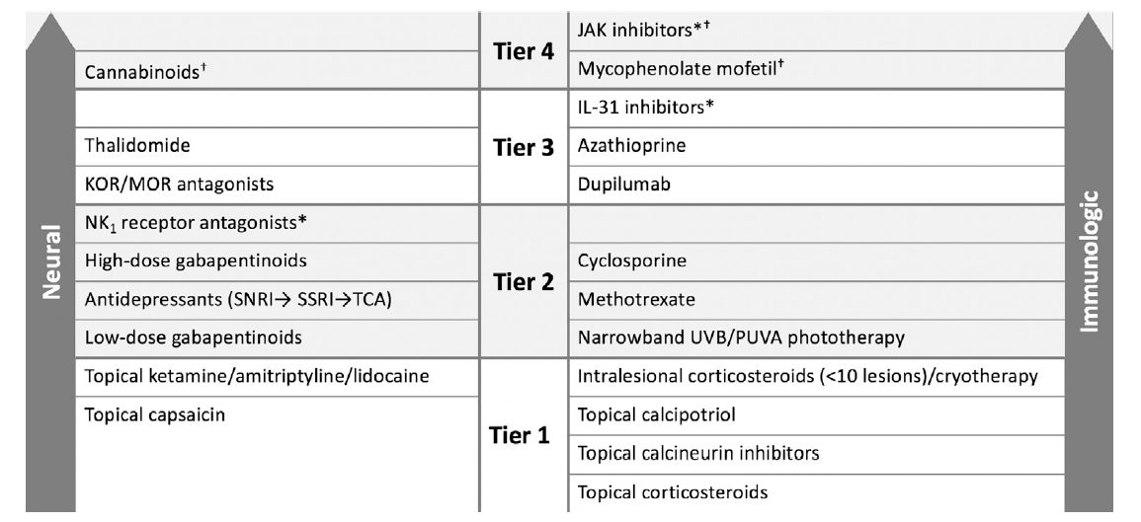
US 2021 Expert Panel Consensus
Tier 3 – Treatment Ladder
IL-31, Interleukin 31
JAK, Janus Kinase
KOR, κ-opioid receptor
MOR, μ-opioid receptor
NK₁, Neurokinin 1
PUVA, psoralen plus ultraviolet A
SNRI, serotonin and norepinephrine reuptake inhibitor
SSRI, selective serotonin reuptake inhibitor
TCA, tricyclic antidepressant
UVB, ultraviolet B
*Investigational therapies
†Therapies that have been helpful in chronic pruritus but currently lack data in PN
**Therapy may cross over between neural and immunologic
1. Elmariah S, et al. J Am Acad Dermatol. 2021;84(3):747-760.

Slide 30
International Forum on the Study of Itch Guidelines
In general, these guidelines agree with the US 2021 Expert Panel Consensus
Recommend emollients as supportive care for everyone
Recommend antihistamines for no longer than 4 weeks as monotherapy
Strong consensus recommendation for the use of nemolizumab
Stander S, et al. Itch. 2020;5(4):1-13.

Slide 31
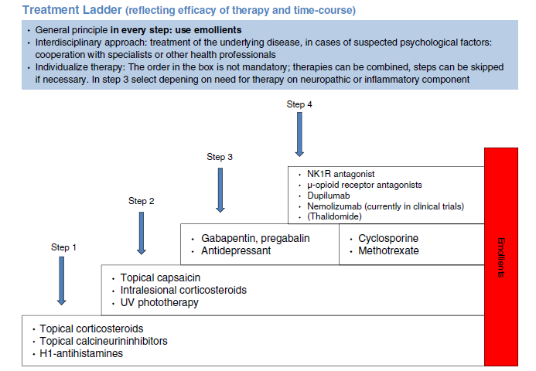
International Forum on the Study of Itch Guidelines
General principle in every step: use emollients
Interdisciplinary approach: treatment of the underlying disease, in cases of suspected psychological factors: cooperation with specialists or other health professionals
Individualize therapy: The order in the box is not mandatory; therapies can be combined, steps can be skipped if necessary. In step 3 depending on need for therapy on neuropathic or inflammatory component
Stander S, et al. Itch. 2020;5(4):1-13. Used under terms of a Creative Commons license (CC BY-NC-ND 4.0).

Slide 32
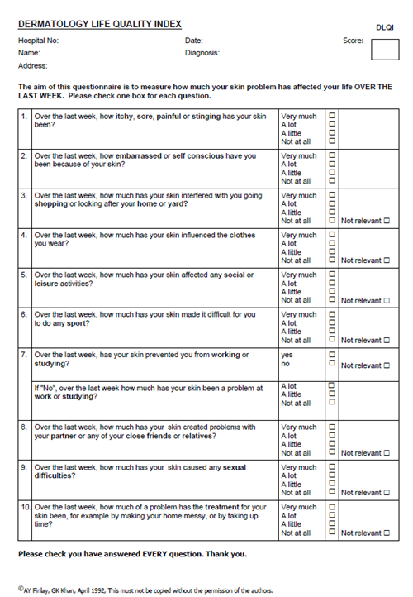
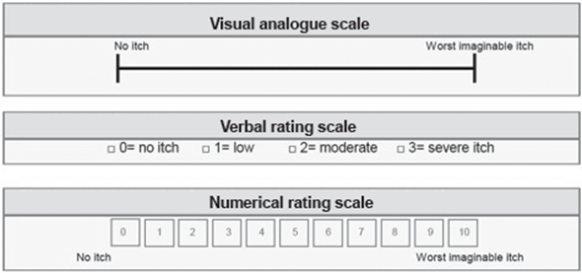
Monitoring Patient Response: Use of Validated Measures
1. Quan N, et al. Acta Derm Venereol. 2012;92:502-507. Used under terms of Creative Commons (CC-BY-NC 4.0 license). 2. Stander H, et al. J Am Acad Dermatol. 2020;82(2):460-468. 3. Finlay A, et al. Clin Exp Dermatol. 1994;19:210-216.

Slide 33
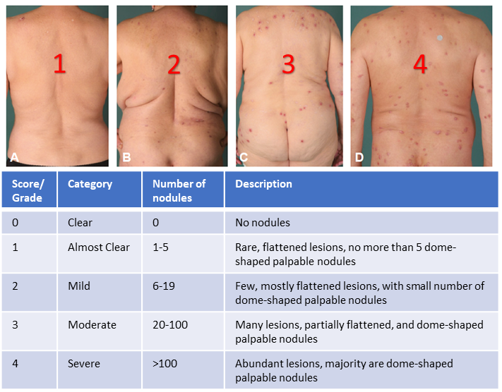
Monitoring Patient Response: Use of Validated Measures (continued)
1. Quan N, et al. Acta Derm Venereol. 2012;92:502-507. 2. Stander H, et al. J Am Acad Dermatol. 2020;82(2):460-468 , with permission from Elsevier. 3. Finlay A, et al. Clin Exp Dermatol. 1994;19:210-216.

Slide 34
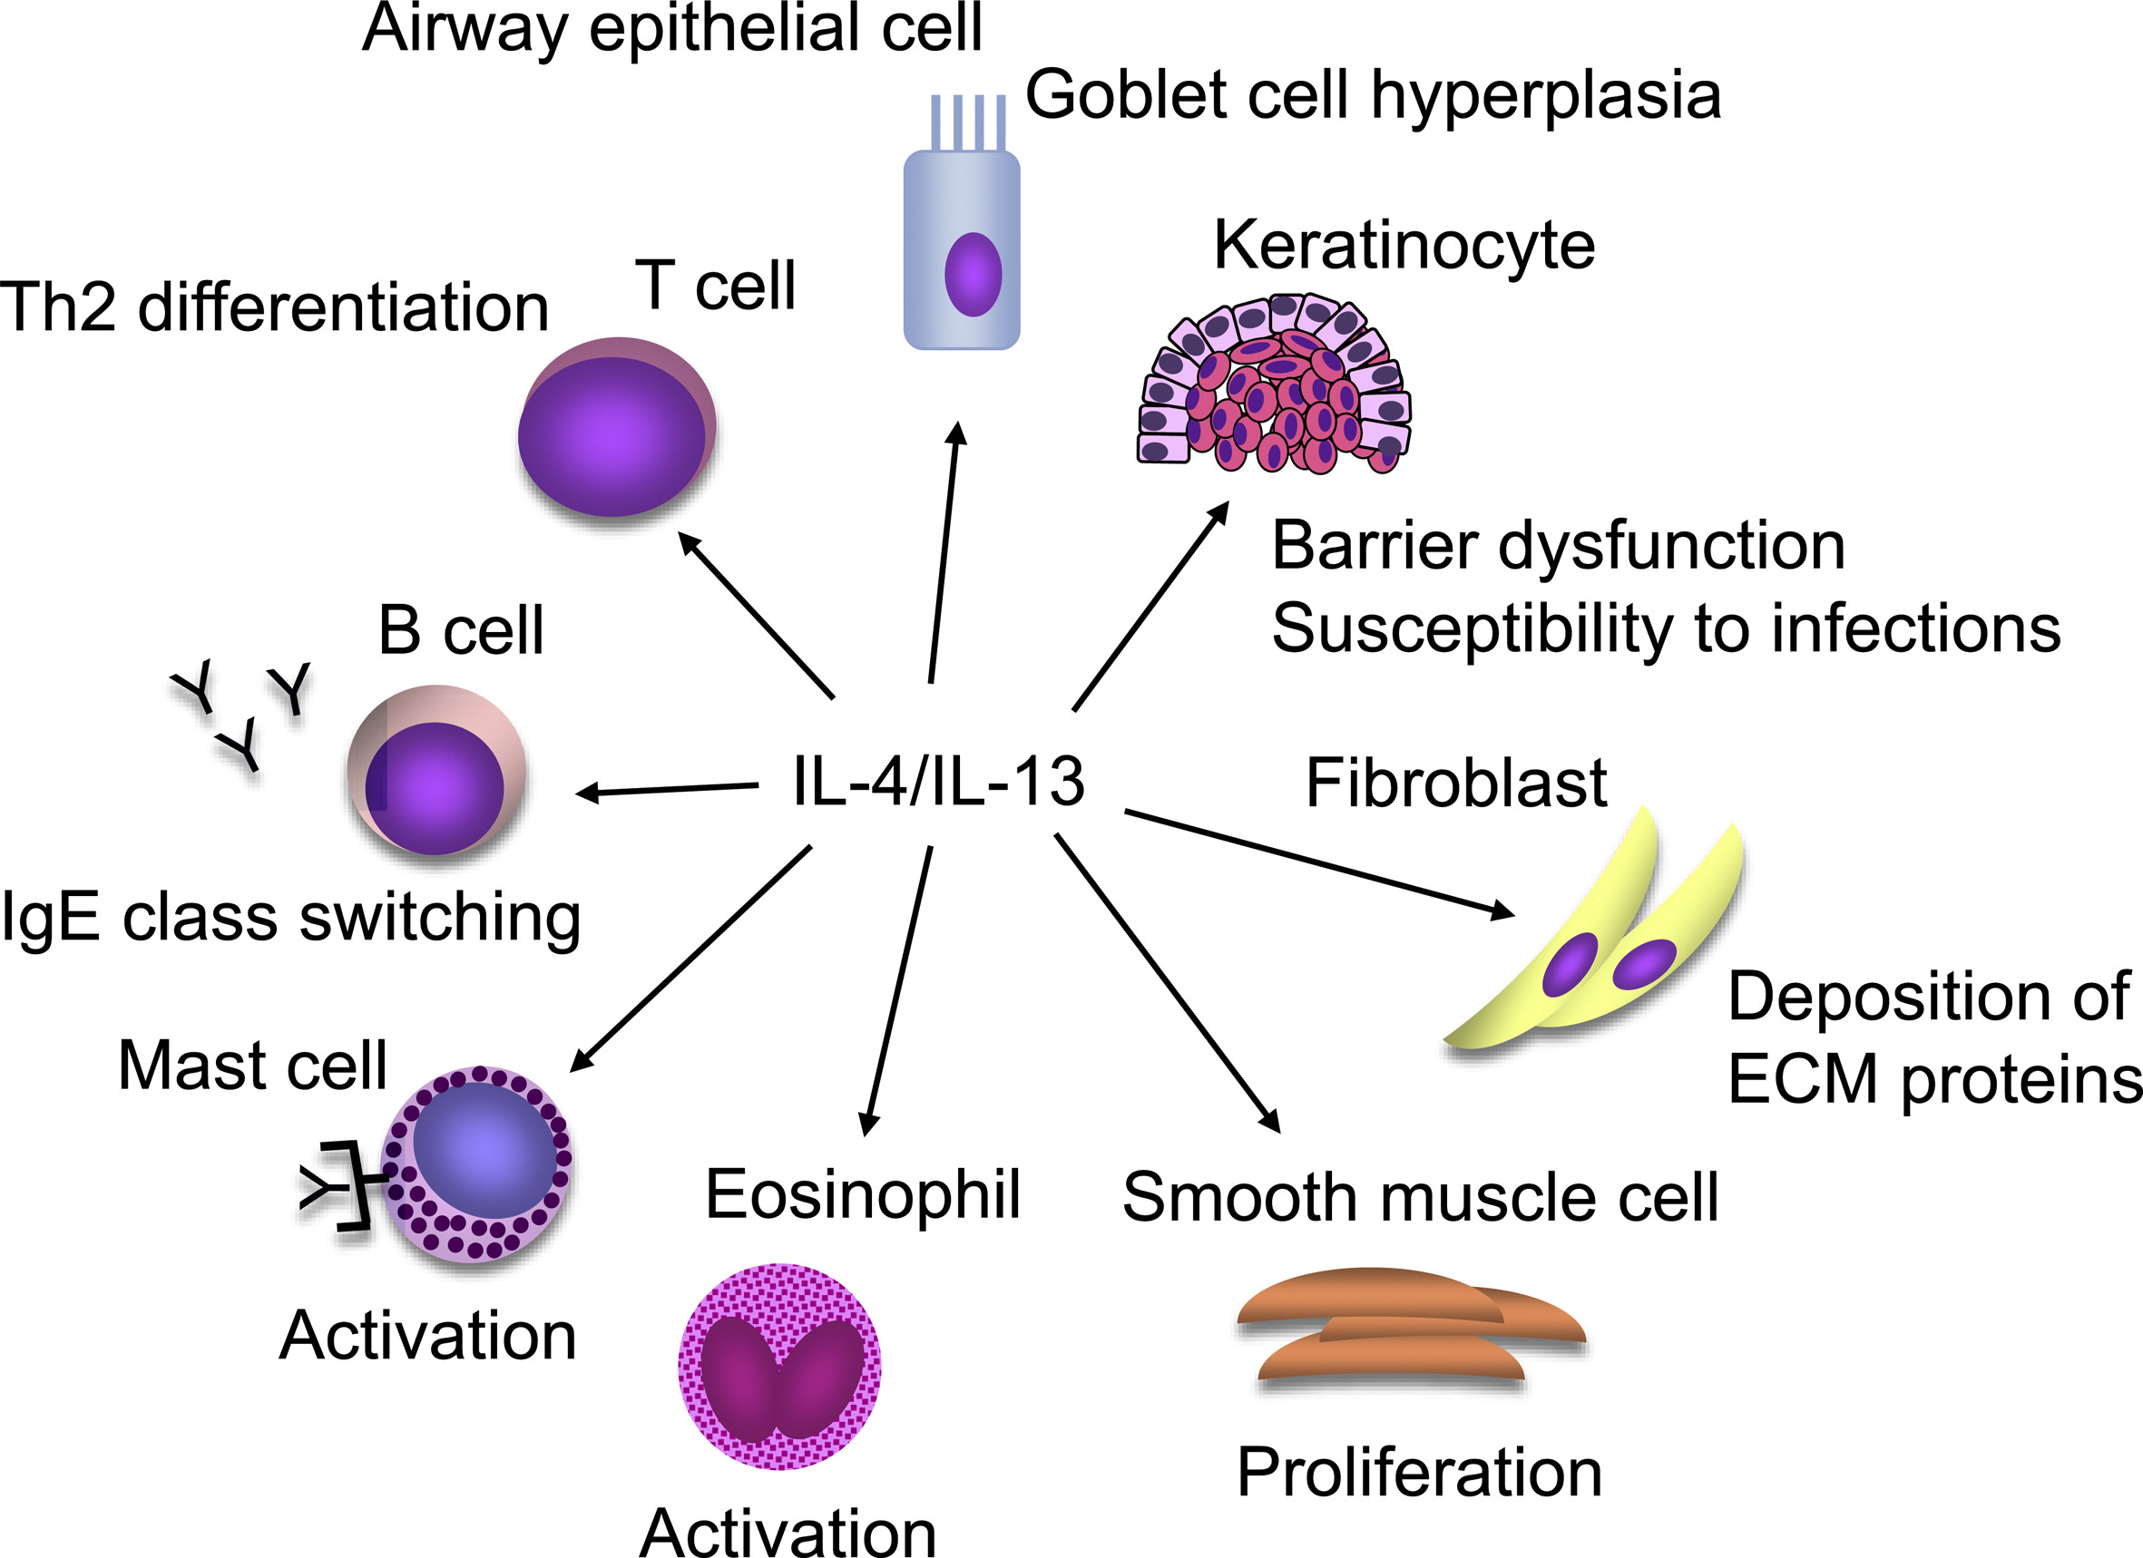
Dupilumab: Mechanism of Action¹⁻²
Human monoclonal antibody
Inhibits signaling of the IL-4 and IL-13 immune pathways by blocking the shared receptor component (IL-4Rα)
Reduces mast cell activation, Th2 cell differentiation, smooth muscle proliferation and eosinophil activation
Matsunaga K, et al. Allergol Int. 2020;69(2):187-196.
DUPIXENT (prescribing information). Bridgewater, NJ: Sanofi-Aventis; Sep 2022.

Slide 35
Dupilumab Efficacy: PRIME and PRIME2
 | PRIME (N=151) |  |  | PRIME2 (N=160)
 | Dupilumab | Placebo | P | Dupilumab | Placebo | P
At baseline, mean NRS | 8.5 |  | - | 8.5 |  | -
At baseline, AGI | 100% w/>20 nodules; 28.7% w/>100 nodules |  | - | 100% w/>20 nodules; 38.4% w/>100 nodules |  | -
At baseline, mean DLQI score | 16.7 |  | - | 18.2 |  | -
4-point reduction in NRS at wk 12 | 44.0% | 15.8% | <0.001 | 37.2% | 22.0% | 0.022
4-point reduction in NRS at wk 24 | 60.0% | 18.4% | <0.001 | 57.7% | 19.5% | <0.001
Clear/Almost clear at wk 24 | 48.0% | 18.4% | <0.001 | 44.9% | 15.9% | <0.001
ΔDLQI at wk 24 | -12.0 | -5.8 | <0.001 | -13.2 | -6.8 | <0.001
NRS, numerical rating scale
IGA, investigators global assessment
DLQI, dermatology life quality index
Yosipovitch G, et al. Nature Medicine. 2023;29:1180-1190

Slide 36
Dupilumab Safety: PRIME and PRIME2
 | PRIME (N=151) |  | PRIME2 (N=160)
 | Dupilumab (N=75) | Placebo (N=75) | Dupilumab (N=77) | Placebo (N=82)
Serious TEAE | 3 (4%)* | 5 (6.7%) | 2 (2.6%)* | 1(1.2%)*
TEAE leading to discontinuation | 0 | 2 (2.7%) | 0 | 1(1.2%)
Nasopharyngitis | 4 (5.3%) | 3 (4.0%) | 2 (2.6%) | 0
Herpes viral infections | 0 | 0 | 4 (5.2%) | 0
Conjunctivitis | 2 (2.7%) | 2 (2.7%) | 4 (5.2%) | 5 (6.1%)
*Considered unrelated to the study drug
TEAE, treatment-emergent adverse events
Yosipovitch G, et al. Nature Medicine. 2023;29:1180-1190

Slide 37
Dupilumab: Place in Therapy¹⁻²
The US Expert Panel Consensus and the International Forum on the Study of Itch guidelines were published before FDA approval
  These guidelines list dupilumab as a higher tier treatment
FDA-approved indication: Adults with PN
Given the published efficacy from randomized controlled trials, FDA approval, and the general lack of data for other therapies, dupilumab should be considered in patients with PN
1. Elmariah S, et al. J Am Acad Dermatol. 2021;84(3):747-760. 2. Stander S, et al. Itch. 2020;5(4):1-13.

Slide 38
Dupilumab: Dosing and Administration
Dose for PN is an initial dose of 600 mg subcutaneously followed by 300 mg subcutaneously every other week
Dupilumab is available as a single-dose prefilled syringe
(300 mg/2 mL) or a single-dose pre-filled pen (300 mg/2 mL)
Dupilumab should be refrigerated until the day of injection.
  Remove dupilumab from the refrigerator and allow to warm to room temperature for at least 45 minutes
  Dupilumab is stable for 14 days at room temperature
DUPIXENT (prescribing information).Bridgewater, NJ: Sanofi-Aventis; Sep 2022.

Slide 39
Dupilumab: Monitoring and Side Effects
Limited case reports have not shown any adverse maternal or fetal outcomes
  IgG antibodies have been shown to cross the placenta
Monitoring
  Arthralgias
  Eye problems
  Infection
Before beginning dupilumab, complete all age-appropriate vaccinations
  Avoid use of live vaccines while using dupilumab
DUPIXENT (prescribing information).Bridgewater, NJ: Sanofi-Aventis; Sep 2022.

Slide 40
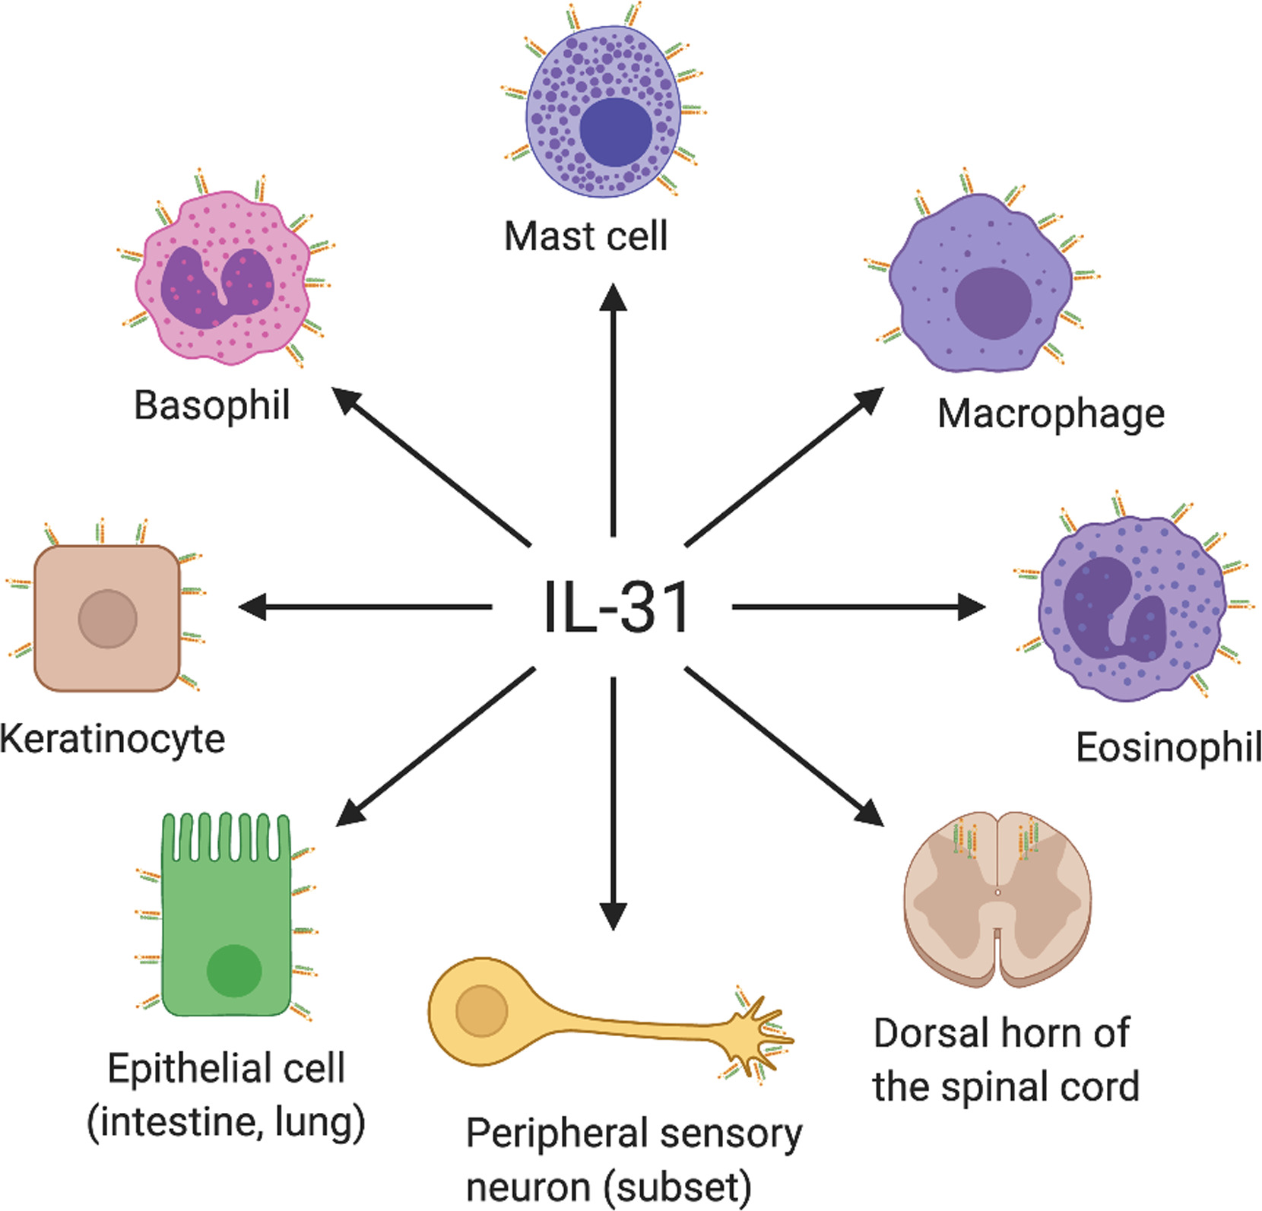
Nemolizumab: Mechanism of Action¹⁻²
Human monoclonal antibody
Inhibits binding of IL-31 to its receptor and subsequent signaling
Il-31/IL-31RA axis is an important factor in pruritus and acts as a bridge between the immunologic and neural components of itch
Granted FDA Breakthrough Therapy status in December 2019 for the treatment of PN
Datsi A, et al. Allergy. 2021;76(10):2982-2997.
Stander S, et al. NEJM. 2020;382:706-716.

Slide 41
Nemolizumab: Phase 2 Trial
Phase 2 randomized placebo-controlled trial comparing nemolizumab monotherapy to placebo in patients with moderate-to-severe PN and severe pruritus (N= 70)
Primary endpoint was the mean percent change of pruritus NRS at week 4
  -53% for nemolizumab compared to -20.2% for placebo (P<0.001)
Key secondary outcomes include changes in pruritus NRS at 12 weeks, and percent of patients achieving a 0 or 1 IGA score at week 12
  NRS score - 61.9% decrease for nemolizumab compared to 25.7% for placebo
  IGA score response – 23% for nemolizumab compared to 4% for placebo
Gastrointestinal symptoms were reported in 20% of patients in the nemolizumab group compared to 14% in the placebo group
Stander, et al. NEJM. 2020;382:706-716.

Slide 42
Nemolizumab: Olympia II (N=274)
 | Nemolizumab | Placebo | P
Percent of patients achieving a 4-point reduction in the peak-pruritus NRS at 16 weeks | 56% | 21% | <0.0001
% patients achieving IGA score of 0 or 1 at 16 weeks | 38% | 11% | <0.0001
Positive response in peak-pruritus NRS score at 4 weeks | 41% | 7.7% | <0.0001
% of patient achieving a 4-point improvement in sleep scores | 37.2% | 9.9% | <0.0001
Similar safety events (gastrointestinal or musculoskeletal) as reported in phase 2 trials
https://www.galderma.com/news/aad-2023-late-breaking-phase-iii-results-demonstrate-nemolizumabs-significant-impact-prurigo-1 - accessed 6/5/2023

Slide 43
Vixarelimab
Human monoclonal antibody that binds to the beta subunit of the oncostatin M receptor
Inhibits signaling of IL-31 and oncostatin M
Phase 2a trial of 50 patients with moderate-to-severe PN
  primary outcome was change from baseline in PCFB WI-NRS at week 8
  Mean change for vixarelimab was -50.6% compared to -29.4% for placebo (P=0.03)
Currently in phase 3 trials
PCFB WI-NRS, percent change from baseline
WI-NRS, worst itch numeric rating scale
Sofen H, et al. J eclinm. 2023;57:1-14

Slide 44
Nalbuphine
Oral mixed κ-opioid receptor agonist and μ-opioid receptor antagonist
Nalbuphine has been shown to reduce IL-31 and substance P¹
A phase 2 trial of 62 patients with moderate-to-severe PN compared nalbuphine ER 81 mg or 162 mg twice daily to placebo²
  Primary outcome was the number of patients achieving ≥ 30% reduction from baseline in 7-day WI-NRS at week 10.
  Primary outcome was achieved by 66.7% of patients in the
  162 mg group compared to 40% taking placebo (P=0.03)
WI-NRS, worst itch numeric rating scale
1. Iman S, et al. Eur J Pharmacol. 2019;864:172702 2. Weisshaar E, et al. J Eur Acad Dermatol Venereol. 2022;36(3):453-461

Slide 45
Case #1
54-year-old male with HIV being seen by his primary care clinician for follow-up. The patient complains of increasing itch on his legs over the past few months.
  Discussion of associated conditions

Slide 46
Initial Diagnosis and Referral
Diagnosis based upon patient history and physical exam
Symptomatic treatment can begin while awaiting further workup
All patients should be referred to a dermatology specialist
Elmariah S, et al. J Am Acad Dermatol. 2021;84(3):747-760.

Slide 47
Initial Diagnosis and Referral
Core Findings Essential for Diagnosis:
Firm, Nodular Lesions
Excoriated, hyperkeratotic and pruritic
Vary in size, location, color and quantity
Pruritus ≥6 weeks
Continuous, sporadic or paroxysmal
Severe
Repetition
Scratching
Picking
Elmariah S, et al. J Am Acad Dermatol. 2021;84(3):747-760.

Slide 48
Initial Diagnosis and Referral
Additional Findings:
  Symmetrical distribution of nodules on areas of the body accessible to scratching
  Lesions absent on the face, palms and soles
  Other lesions due to scratching or picking
  Burning, stinging or painful sensations in addition to pruritus
Elmariah S, et al. J Am Acad Dermatol. 2021;84(3):747-760.

Slide 49
Overview of Diagnostic Evaluation by
Dermatology
Confirm PN diagnosis
Look for treatable causes of pruritus
  Majority of PN has no identifiable cause
Rule out diseases that can mimic PN
Screen for associated conditions
Qualify and quantify disease burden using patient questionnaires and validated tools
Elmariah S, et al. J Am Acad Dermatol. 2021;84(3):747-760.

Slide 50
International Forum on the Study of Itch Guidelines
General principle in every step: use emollients
Interdisciplinary approach: treatment of the underlying disease, in cases of suspected psychological factors: cooperation with specialists or other health professionals
Individualize therapy: The order in the box is not mandatory; therapies can be combined, steps can be skipped if necessary. In step 3 depending on need for therapy on neuropathic or inflammatory component
Stander S, et al. Itch. 2020;5(4):1-13. Used under terms of a Creative Commons license (CC BY-NC-ND 4.0).

Slide 51
Team Role to Support Patient Self-Management
Important for specialists, primary care, nursing and pharmacy to work together
Establish a trusted relationship with the patient
Identify and remove barriers
Establish realistic goals with the patient
Educate about self-management and appropriate over-the-counter items
1. Elmariah S, et al. J Am Acad Dermatol. 2021;84(3):747-760. 2. Stander S, et al. Itch. 2020;5(4):1-13.

Slide 52
Case #2
71-yo female with type 2 diabetes mellitus, hypertension, and chronic kidney disease being seen in the dermatology clinic following referral by her primary care clinician. She was diagnosed with PN 5 months ago by her primary care clinician. She has received little benefit from skin care, emollients, topical corticosteroids.
Treatment considerations:
  Appropriate adherence to therapy
  Correct formulations and potency of steroid treatment
  How is the disease affecting the patient’s quality of life?

Slide 53
Case #2
Monitoring
  Assess factors at baseline and then compare at follow-up visits
  Measure not only disease progression/regression, but also quality of life
  Use a structured assessment such as the NRS itch
  Follow-up every 3-6 months

