Slide 1
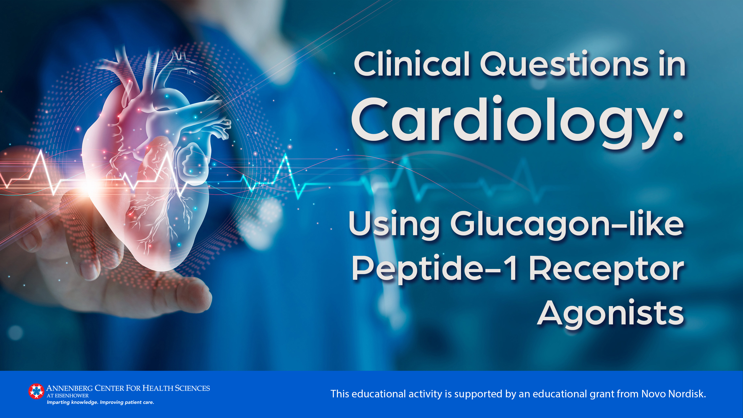

Slide 2
Faculty
Helena W. Rodbard, MD, FACP, MACE
Past President, American Association of Clinical
Endocrinologists
Past President, American College of Endocrinology
Founder and Medical Director, Endocrine and
Metabolic Consultants
Rockville, Maryland
Jorge Plutzky, MD, FACC
Director, Preventive Cardiology
Cardiovascular Medicine
Brigham and Women's Hospital
Boston, Massachusetts

Slide 3
Faculty Disclosures
It is the policy of the Annenberg Center to ensure fair balance, independence, objectivity, and scientific rigor in all programming. All faculty participating in accredited programs are expected to identify and reference off-label product use and disclose any relationship with those supporting the activity or any others whose products or services are discussed.
Helena W. Rodbard, MD, FACP, MACE
Consultant | Pacira
Research Support | Eli Lilly, Inversago, Medtronic, Novo Nordisk, Sanofi
Speakers Bureau | Bayer, Boehringer Ingelheim, Merck
Jorge Plutzky, MD, FACC
Consultant Altimmune, Amgen, Merck, Novartis, Novo Nordisk
Research Support Boehringer Ingelheim, Novartis
Speakers Bureau None

Slide 4
Learning Objectives
Explain how the mechanisms of action of glucagon-like peptide-1 receptor agonists (GLP-1 RAs) address key pathophysiologic mechanisms of type 2 diabetes
Compare and contrast the agents within the GLP-1RA class
Formulate strategies to ease patient safety concerns and improve tolerability to GLP-1 RAs
Justify the use of GLP-1 RAs for secondary prevention of cardiovascular disease in patients with type 2 diabetes
Apply current evidence-based recommendations from the ACC, ADA, and ADA/EASD to individualize GLP-1RA therapy in patients with type 2 diabetes
Notes:
Identify nutrients critical for brain and cognitive development during the first 1,000 days
Associate potential early nutrient deficiencies with long-term consequences
Synthesize current research to recommend infant feeding practices that provide optimal support for brain and neurodevelopment

Slide 5
Treatment of Patients With Type 2 Diabetes
2022 ADA/EASD Type 2 Diabetes Consensus Report
2023 ADA Standards of Care in Diabetes
2023 ACC/AHA Guideline for the Management of Patients With Chronic Coronary Disease

Slide 6
CJ: 60 yo M, hx ASCVD, T2D, returns for cardiology follow-up
56 yo: PCP – Overweight, HTN, “prediabetes,” dyslipidemia
  Lisinopril/HCTZ 20/25 mg/d, atorvastatin 20 mg/d
  BP 132/80 mmHg, BMI 31 kg/m², A1C 6.2%, LDL 110 mg/dL, TG 220 mg/dL
  “Patient wants to focus on lifestyle efforts, joined a gym”

Slide 7
CJ: 60 yo M, hx ASCVD, T2D, returns for cardiology follow-up
56 yo: PCP – Overweight, HTN, “prediabetes,” dyslipidemia
  Lisinopril/HCTZ 20/25 mg/d, atorvastatin 20 mg/d
  BP 132/80 mmHg, BMI 31 kg/m², A1C 6.2%, LDL 110 mg/dL, TG 220 mg/dL
  “Patient wants to focus on lifestyle efforts, joined a gym”
58 yo: EW, chest pain, inferior NSTEMI, SL NTG, asymptomatic
  Cath: RCI 90%, culprit lesion s/p drug-eluting stent; 50% LAD, no intervention

Slide 8
CJ: 60 yo M, hx ASCVD, T2D, returns for cardiology follow-up
56 yo: PCP – Overweight, HTN, “prediabetes,” dyslipidemia
  Lisinopril/HCTZ 20/25 mg/d, atorvastatin 20 mg/d
  BP 132/80 mmHg, BMI 31 kg/m², A1C 6.2%, LDL 110 mg/dL, TG 220 mg/dL
  “Patient wants to focus on lifestyle efforts, joined a gym”
58 yo: EW, chest pain, inferior NSTEMI, SL NTG, asymptomatic
  Cath: RCI 90%, culprit lesion s/p drug-eluting stent; 50% LAD, no intervention
59 yo: PCP, A1C 7.5%, dx T2D, metformin initiated, BMI 32 kg/m²

Slide 9
CJ: 60 yo M, hx ASCVD, T2D, returns for cardiology follow-up
56 yo: PCP – Overweight, HTN, “prediabetes,” dyslipidemia
  Lisinopril/HCTZ 20/25 mg/d, atorvastatin 20 mg/d
  BP 132/80 mmHg, BMI 31 kg/m², A1C 6.2%, LDL 110 mg/dL, TG 220 mg/dL
  “Patient wants to focus on lifestyle efforts, joined a gym”
58 yo: EW, chest pain, inferior NSTEMI, SL NTG, asymptomatic
  Cath: RCI 90%, culprit lesion s/p drug-eluting stent; 50% LAD, no intervention
59 yo: PCP, A1C 7.5%, dx T2D, metformin initiated, BMI 32 kg/m²
60 yo: Cardiology visit, asymptomatic
  Atorvastatin 80 mg/d, ezetimibe 10 mg/d, lisinopril/HCTZ 20/25 mg/d, metoprolol XL 50 mg/d, ASA 81 mg/d, metformin 1000 mg BID, sitagliptin 100 mg/d
  BP 124/80 mmHg, BMI 32 kg/m², LDL 70 mg/dL, TG 152 mg/dL, A1C 6.9%

Slide 10
56 yo: PCP – Overweight, HTN, “prediabetes,” dyslipidemia
Lisinopril/HCTZ 20/25 mg, atorvastatin 20 mg
132/80, BMI 31, A1C 6.2, LDL 110, TG 220 mg/dL
“Patient wants to focus on lifestyle efforts, joined a gym”
58 yo: EW, chest pain, inferior NSTEMI, SL nitro, asx
Cath: RCI 90%, culprit lesion s/p DES; 50% LAD, no intervention
59 yo: PCP, A1C 7.5, dx T2D, metformin initiated. BMI 32
60 yo: Cardiology, asymptomatic
  Atorvastatin 80 mg/d, ezetimibe 10 mg/d, lisinopril/HCTZ 20/25 mg/d, metoprolol XL 50 mg/d, ASA 81 mg/d, ticagrelor, metformin 1000 mg BID, sitagliptin 100 mg/d
  BP 124/80 mmHg, BMI 32 kg/m², LDL 70 mg/dL, TG 152 mg/dL, A1C 6.9%

Slide 11
56 yo: PCP – Overweight, HTN, “prediabetes,” dyslipidemia
Lisinopril/HCTZ 20/25 mg, atorvastatin 20 mg
132/80, BMI 31, A1C 6.2, LDL 110, TG 220 mg/dL
“Patient wants to focus on lifestyle efforts, joined a gym”
58 yo: EW, chest pain, inferior NSTEMI, SL nitro, asx
Cath: RCI 90%, culprit lesion s/p DES; 50% LAD, no intervention
59 yo: PCP, A1C 7.5, dx T2D, metformin initiated. BMI 32
60 yo: Cardiology, asymptomatic
  Atorvastatin 80 mg/d, ezetimibe 10 mg/d, lisinopril/HCTZ 20/25 mg/d, metoprolol XL 50 mg/d, ASA 81 mg/d, ticagrelor, metformin 1000 mg BID, sitagliptin 100 mg/d
  BP 124/80 mmHg, BMI 32 kg/m², LDL 70 mg/dL, TG 152 mg/dL, A1C 6.9%
Opportunities for CV Risk Reduction?
25% in MACE?

Slide 12
SUSTAIN-6: CVOT, Semaglutide in T2D
Semaglutide 0.5 mg or 1.0 mg vs placebo daily
 | Placebo (n=1649) | Semaglutide (n=1648) | Hazard ratio (95% CI)
MACE | 146 (8.9%) | 108 (6.6%) | 0.74 (0.58-0.95)
Nonfatal MI | 64 (3.9%) | 47 (2.9%) | 0.74 (0.51-1.08)
CV death | 46 (2.8%) | 44 (2.7%) | 0.98 (0.65-1.48)
Nonfatal stroke | 44 (2.7%) | 27 (1.6%) | 0.61 (0.38 to 0.99)
2,735 participants with T2D and high CV risk
Primary outcome first occurrence of
3-point MACE
Powered for noninferiority
CI, confidence interval; CV, cardiovascular; CVD cardiovascular disease; CVOT, cardiovascular outcomes trial; HR, hazard ratio; MACE, major adverse cardiovascular events; MI, myocardial
Marso SP, et al. N Engl J Med. 2016;375(19):1834-1844.

Slide 13
CJ: 58 yo M hx ASCVD, prediabetes, Cardiology visit post-PCI
56 yo: PCP – Overweight, HTN, “prediabetes,” dyslipidemia
Lisinopril/HCTZ 20/25 mg, atorvastatin 20 mg
132/80, BMI 31, A1C 6.2, LDL 110, TG 220 mg/dL
“Patient wants to focus on lifestyle efforts, joined a gym”
58 yo: EW, chest pain, inferior NSTEMI, SL nitro, asx
Cath: RCI 90%, culprit lesion s/p DES; 50% LAD, no intervention

Slide 14
CJ: 58 yo M hx ASCVD, prediabetes, Cardiology visit post-PCI
56 yo: PCP – Overweight, HTN, “prediabetes,” dyslipidemia
Lisinopril/HCTZ 20/25 mg, atorvastatin 20 mg
132/80, BMI 31, A1C 6.2, LDL 110, TG 220 mg/dL
“Patient wants to focus on lifestyle efforts, joined a gym”
58 yo: EW, chest pain, inferior NSTEMI, SL nitro, asx
Cath: RCI 90%, culprit lesion s/p DES; 50% LAD, no intervention
58 yo: Post-PCI cardiology follow-up visit. BMI 31 kg/m², A1C 6.4%.
  Atorvastatin 80 mg/d, ezetimibe 10 mg/d, lisinopril/HCTZ 20/25 mg/d, metoprolol XL 50 mg/d, ASA 81 mg/d, prasugrel; LDL 70 mg/dL, BP 120/80 mmHg

Slide 15
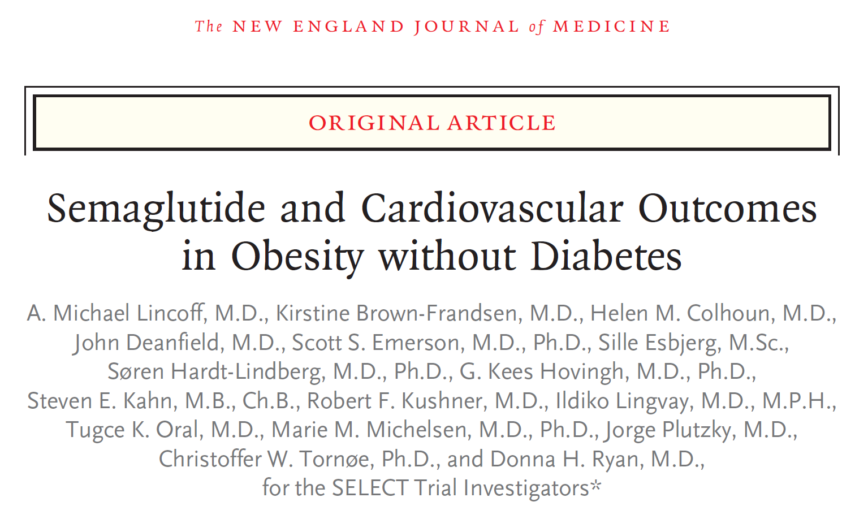


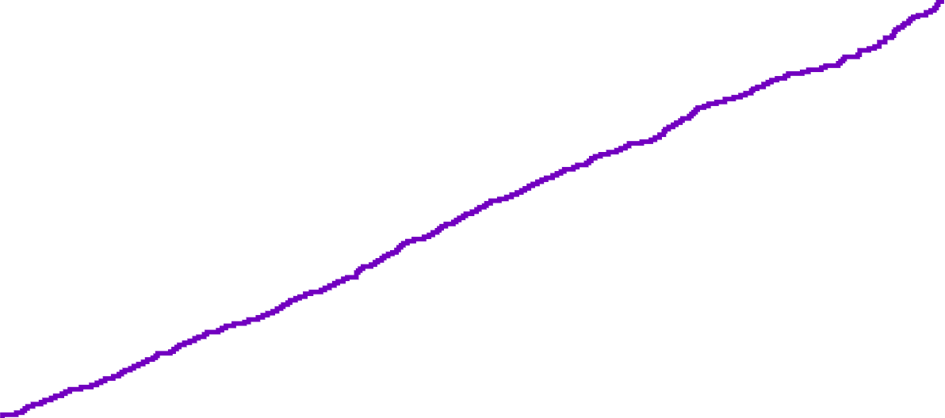
SELECT: CV Efficacy
Primary CV Composite Endpoint (MACE): CV Death, Nonfatal MI, or Nonfatal Stroke
10
Placebo – 701 events (8.0%)
Semaglutide – 569 events (6.5%)
8
Hazard ratio, 0.80 (95% CI, 0.72 to 0.90)
P (two-sided) <0.001 for superiority
6
Cumulative incidence (%)
4
Placebo
2
Semaglutide
0
0
6
12
18
24
30
36
42
48
Months since randomization
Lincoff AM, et al. N Engl J Med. 2023;389(24):2221-2232.
Semaglutide is not indicated for reducing MACE outside of diabetes

Slide 16
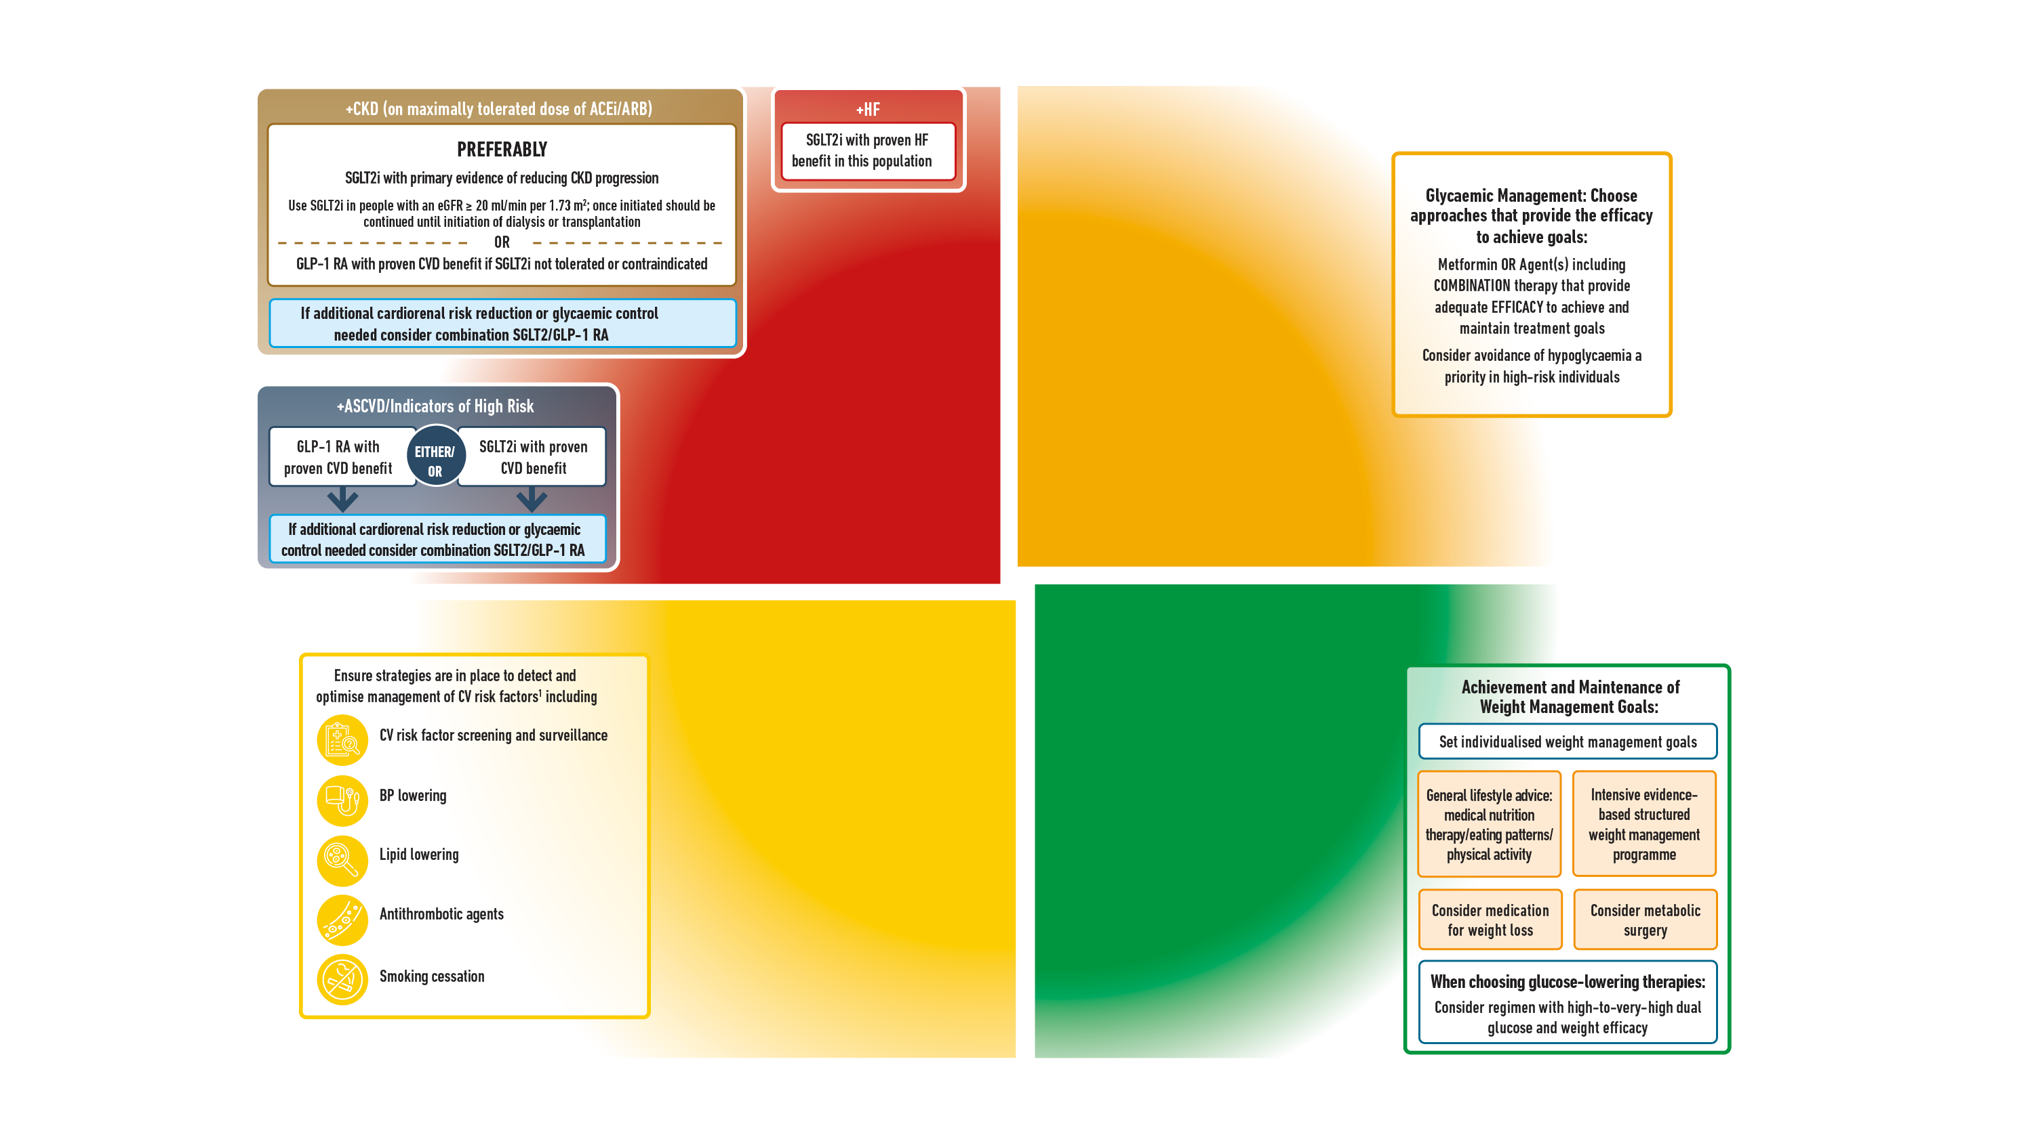
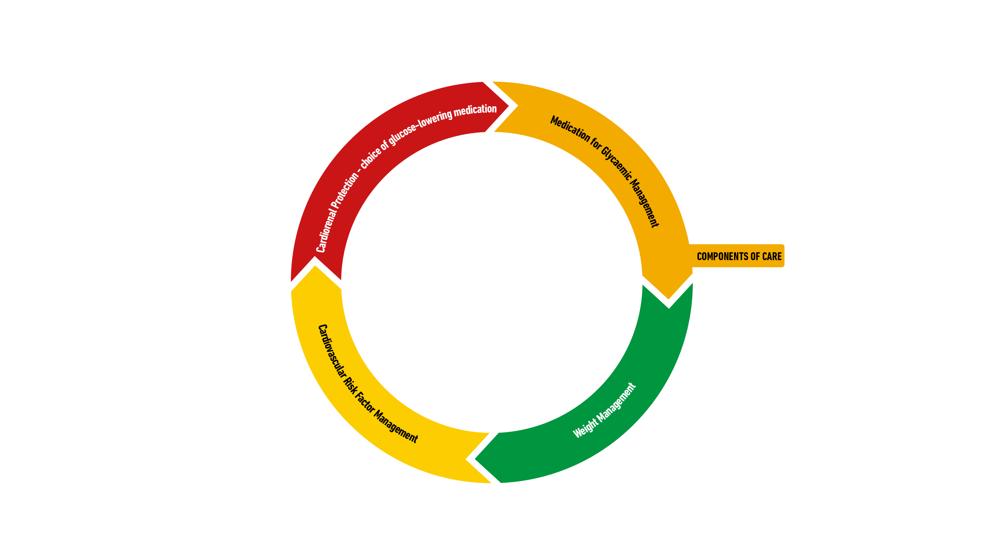
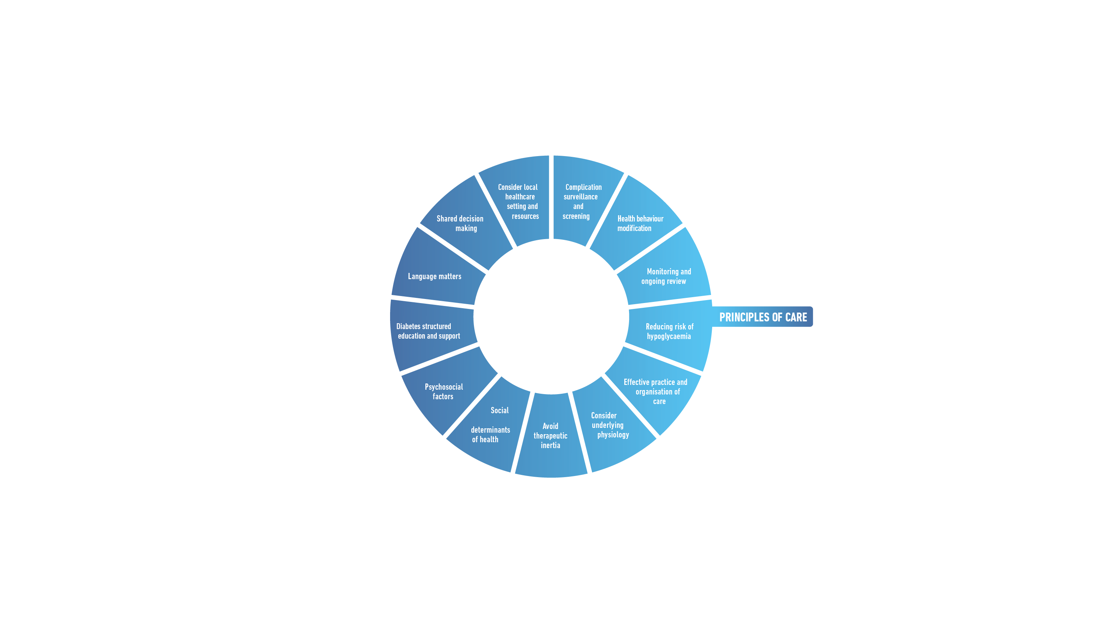

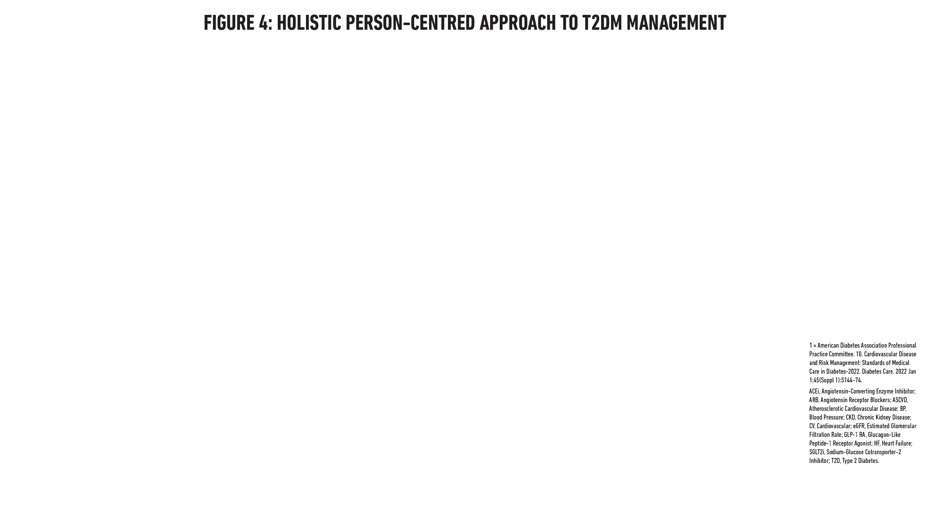
Davies MJ, et al. Diabetes Care. 2022;45(11):2753-2786.
Davies MJ, et al. Diabetologia. 2022;65(12):1925-1966.

Slide 17
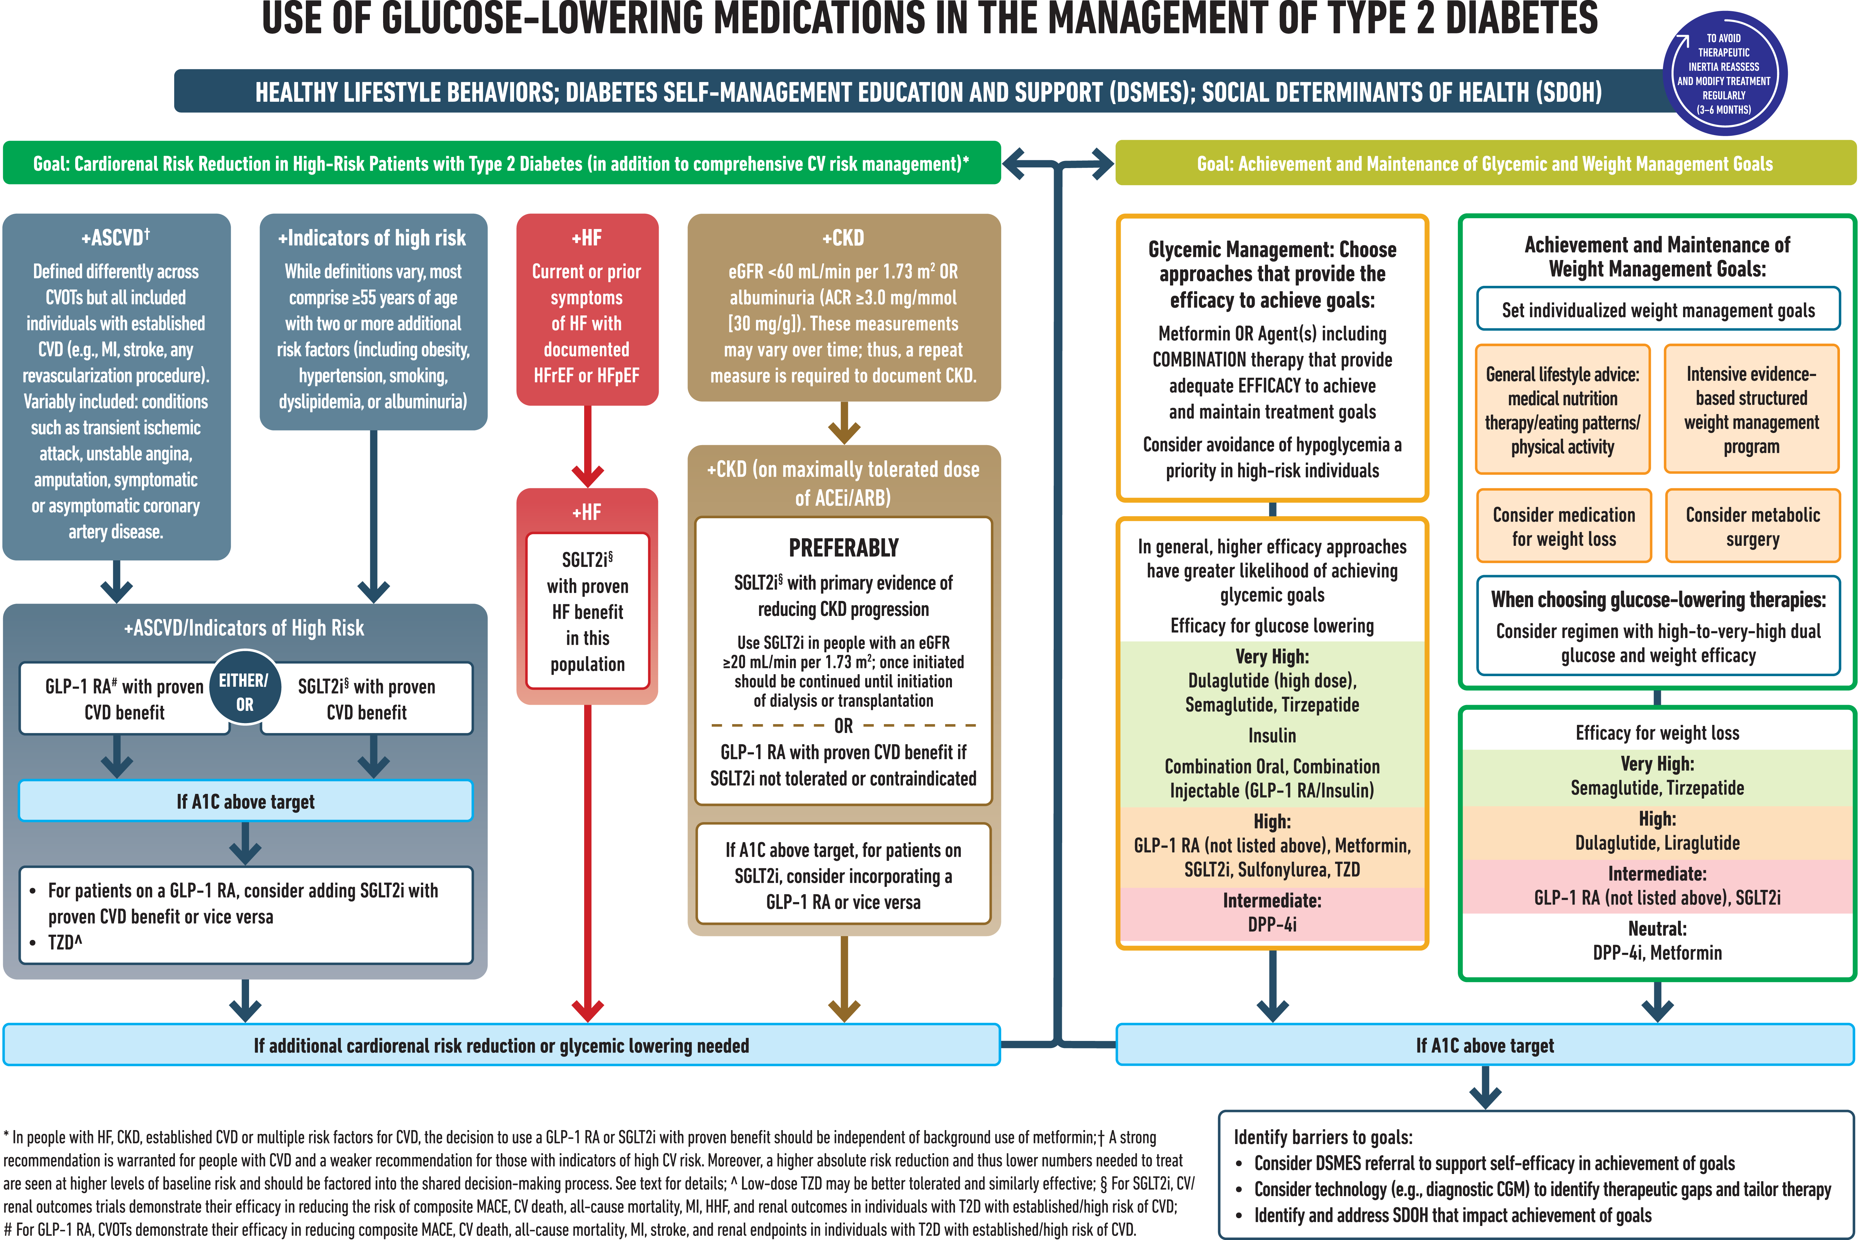
ElSayed NA, et al. Diabetes Care. 2023;46(Suppl 1):S140-S157.

Slide 18
+ASCVD or High Risk
+HF
(HFrEF or HFpEF)
GLP-1 RA w/ proven CVD benefit
SGLT2i w/ proven HF benefit
+CKD
eGFR <60 mL/min per 1.73 m² OR ACR >30mg/g
SGLT2i w/ primary evidence of reducing CKD progression
OR
GLP-1 RA with proven CVD benefit if SGLT2i not tolerated or contraindicated
SGLT2i w/ proven CVD benefit
OR if A1C above target on SGLT2i, incorporate GLP-1 RA
2022 ADA/EASD Consensus Recommendations
Goal: Cardiorenal Risk Reduction in High-Risk Patients With Type 2 Diabetes
ASCVD, atherosclerotic cardiovascular disease; ACR, albumin-creatine ratio; HFrEF, heart failure with reduced ejection fraction; HFpEF, heart failure with preserved ejection fraction; GLP-1 RA, glucagon-like peptide-1 receptor agonist; SGLT2i, sodium glucose cotransporter 2 inhibitor
Adapted from: Davies MJ, et al. Diabetes Care. 2022;45(11):2753-2786.
Davies MJ, et al. Diabetologia. 2022;65(12):1925-1966.

Slide 19
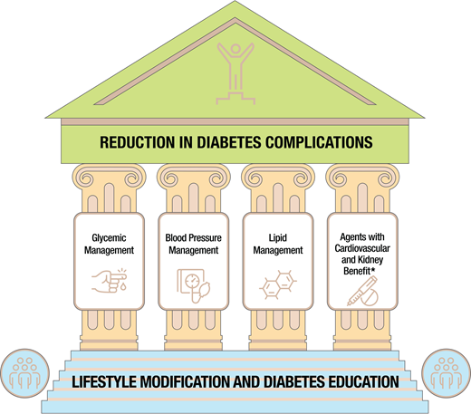
Cardiovascular Disease and
Risk Management:
ADA 2023
ElSayed NA, et al. Diabetes Care. 2023;46(Suppl 1):S140-S157.

Slide 20
Adults w/T2D and ≥1 of the following: ASCVD, HF, DKD, at high risk for ASCVD
Address concurrently
Optimize guideline-directed medical therapy for prevention
(lifestyle, BP, lipids, glucose, antiplatelet)
Cardiovascular Disease and Risk Management: ADA 2023
Recommend SGLT2i or GLP-1 RA with proven CV benefit
Discuss patient-clinician preferences and priorities
No additional action
SGLT2i selected
GLP-1 RA selected
Consider the addition of the alternative class, if benefits outweigh risks.
Adapted from: ElSayed NA, et al. Diabetes Care. 2023;46(Suppl 1):S140-S157.
Notes:
Approach to risk reduction with SGLT2 inhibitor or GLP-1 receptor agonist therapy in conjunction with other traditional, guideline-based preventive medical therapies for blood pressure, lipids, and glycemia and antiplatelet therapy.

Slide 21
Recommendations: Using SGLT2 Inhibitors and GLP-1 RAs; AHA/ACC in CCD 2023
COR | LOE | Recommendations
1 | A | 1. In patients with CCD who have T2D, the use of either an SGLT2 inhibitor or a GLP-1 receptor agonist with proven CV benefit recommended to reduce the risk of MACE
High Value | B-NR | 2. In patients with CCD and T2D, addition of a GLP-1 receptor agonist at US prices is projected to be of high value compared with standard of care
Intermediate Value | B-NR | 3. In patients with CCD and T2D, addition of an SGLT2 inhibitor at US prices is projected to be of intermediate value compared with standard of care
Class of Recommendation (COR) indicates the strength of recommendation, encompassing the estimated magnitude and certainty of benefit in proportion to risk
Class 1 (Strong) – Benefit >>>> Risk
Level of Evidence (LOE) rates quality of scientific evidence supporting the intervention based on the type, quantity, and consistency of data from clinical trials, other sources
Level A: high-quality evidence >1 randomized controlled trial (RCT); meta-analysis of high-quality RCTs; one or more RCTs corroborated by high-quality registry studies
Level B-NR (nonrandomized): moderate-quality evidence from ≥1 well-designed, well-executed nonrandomized studies, observational, registry studies; meta-analyses of such studies
Virani SS, et al. Circulation. 2023;148(9):e9-e119.

Slide 22
Recommendations for Weight Management: AHA/ACC in CCD 2023
COR | LOE | Recommendations
1 | C-EO | 1. In patients with CCD, assessment of BMI with or without waist circumference is recommended during routine clinical follow-up
1 | B-NR | 2. Patients with CCD and overweight or obesity should receive counseling on diet, lifestyle, and goals for weight loss
2a | B-R | 3. For patients with CCD and overweight or obesity in whom pharmacologic therapy is warranted for further weight reduction, a GLP-1 RA can be beneficial in addition to counseling for diet and physical activity; reasonable to choose semaglutide over liraglutide
Class of Recommendation (COR) indicates the strength of recommendation, encompassing the estimated magnitude and certainty of benefit in proportion to risk
Class 1 (Strong) – Benefit >>>> Risk. C-EO: Consensus, Expert Opinion
Level of Evidence (LOE) rates quality of scientific evidence supporting the intervention based on the type, quantity, and consistency of data from clinical trials, other sources
Level A: high-quality evidence >1 randomized controlled trial (RCT); meta-analysis of high-quality RCTs; one or more RCTs corroborated by high-quality registry studies
Level B-NR (nonrandomized): moderate-quality evidence from ≥1 well-designed, well-executed nonrandomized studies, observational, registry studies; meta-analyses of such studies
Virani SS, et al. Circulation. 2023;148(9):e9-e119.

Slide 23

Clinical Questions

Slide 24
Which pathophysiologic mechanisms of T2D do GLP-1 RAs target?

Slide 25
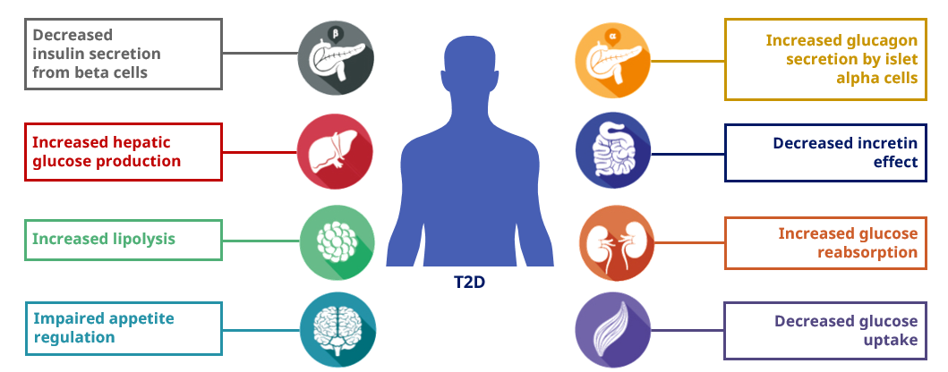
T2D Pathophysiology

Slide 26
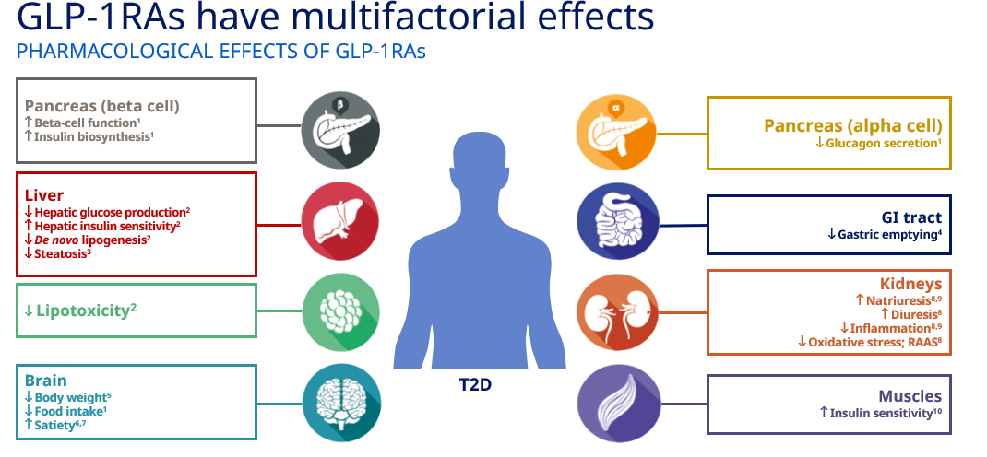
GLP-1: Pleiotropic Physiological Effects

Slide 27
Are there differences among the GLP-1 RAs with respect to glycemic effects?

Slide 28
Glycemic Effects: Short-Acting vs Long-Acting GLP-1 RAs
Parameters | Short-Acting GLP-1 RAs | Long-Acting GLP-1 RAs
Compounds | Exenatide BID Lixisenatide | Dulaglutide Exenatide OW Liraglutide Semaglutide (injectable and oral)
Fasting blood glucose levels | Modest reduction | Strong reduction
Postprandial hyperglycemia | Strong reduction | Modest reduction
Glucagon secretion | Reduction | Reduction
Adapted from Table 1 of Meier, J. J. (2012). GLP-1 receptor agonists for individualized treatment of type 2 diabetes mellitus.
Meier JJ. Nat Rev Endocrinol. 2012;8(12):728-742.

Slide 29
Are there differences among the GLP-1 RAs with respect to nonglycemic effects?

Slide 30
Nonglycemic Effects: Short-Acting vs Long-Acting GLP-1 RAs
Parameters | Short-Acting GLP-1 RAs | Long-Acting GLP-1 RAs
Compounds | Exenatide BID Lixisenatide | Dulaglutide Exenatide OW Liraglutide Semaglutide (injectable and oral)
Gastric emptying rate | Deceleration | No effect [or modest deceleration]
Heart rate | No effect or small increase (0 to 2 bpm) | Moderate increase (2 to 5 bpm)
Body weight reduction | 1 to 5 kg | 2 to 5[+] kg
Systolic blood pressure | Modest reduction (-1.4 mmHg) | Reduction
Lipids | Modest reduction: LDL-C −3.094 mg/dL | TC −5.03 mg/dL | TG −0.886 mg/dL
Adapted from Table 1 of Meier, J. J. (2012). GLP-1 receptor agonists for individualized treatment of type 2 diabetes mellitus. Meier JJ. Nat Rev Endocrinol. 2012;8(12):728-742.
Diallo A., et al. Acta Diabetol. 60(12):1651-1662. Berberich AJ, et al. Curr Opin Lipidol. 2021;32(3):191-199. Sun F, et al. Clin Ther. 2015;37(1):225-241.e8. Cornell S. J Clin Pharm Ther. 2020;45(S1):17-27. Htike ZZ, et al. Diabetes Obes Metab. 2017;19(4):524-536. Monami M, et al. Diabetes Obes Metab. 2014;16(1):38-47.

Slide 31
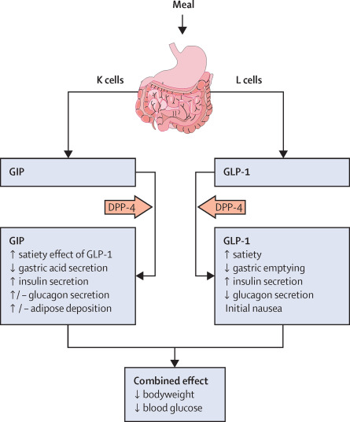
Tirzepatide: Dual GLP-1 RA + GIP
Characteristics
Mechanism of Action | GLP-1 RA and glucose-dependent insulinotropic polypeptide (GIP) receptor that increases glucose-dependent insulin secretion, decreases inappropriate glucagon secretion, and slows gastric emptying
Labeled Indications | As an adjunct to diet and exercise to improve glycemic control in adults with type 2 diabetes mellitus
Dosing | Subcutaneous: Initial: 2.5 mg once weekly x 4 wks, then increase to 5 mg once weekly. Maximum dose: 15 mg/wk
Bailey CJ. Lancet Diabetes Endocrinol. 2021;9(10):646-648.
Mounjaro (tirzepatide) [prescribing information]. Indianapolis, IN: Lilly USA LLC; September 2023.

Slide 32
Does it matter which GLP-1 RA is used in a patient with T2D and ASCVD/high risk?

Slide 33
GLP-1 RAs With Proven CVD Benefits: FDA Indications
GLP-1 RA | FDA CVD Indication
Liraglutide Semaglutide (injectable) | Risk reduction of major cardiovascular events (cardiovascular death, nonfatal myocardial infarction, nonfatal stroke) in adults with T2D and established CVD
Dulaglutide | Risk reduction of major cardiovascular events (cardiovascular death, nonfatal myocardial infarction, nonfatal stroke) in adults with T2D who have established CVD or multiple CV risk factors
Victoza (liraglutide) [prescribing information]. Plainsboro, NJ: Novo Nordisk Inc; July 2023.
Ozempic (semaglutide) [prescribing information]. Plainsboro, NJ: Novo Nordisk Inc; September 2023.
Trulicity (dulaglutide) [prescribing information]. Indianapolis, IN: Eli Lilly and Company; April 2023.

Slide 34
Meta-analysis: GLP-1 RA CVOTs in T2D, High CVD Risk
 | GLP-1 Receptor Agonist, n/N (%) | Placebo n/N (%) |  | Hazard Ratio (95% CI) | NNT (95% CI) | P Value
3-point MACE
ELIXA (lixisenatide) | 400/3034 (13%) | 392/3034 (13%) |  | 1.02 (0.89, 1.17) |  | .78
LEADER (liraglutide) | 608/4668 (13%) | 694/4672 (15%) |  | 0.87 (0.78, 0.97) |  | .01
SUSTAIN-6 (semaglutide SQ) | 108/1648 (7%) | 146/1649 (9%) |  | 0.74 (0.58, 0.95) |  | .016
EXSCEL (exenatide OW) | 839/7356 (11%) | 905/7396 (12%) |  | 0.91 (0.83, 1.00) |  | .061
Harmony Outcomes (albi – NA) | 338/4731 (7%) | 428/4732 (9%) |  | 0.78 (0.68, 0.90) |  | .0006
REWIND (dulaglutide) | 594/4949 (12%) | 663/4952 (13%) |  | 0.88 (0.79, 0.99) |  | .026
PIONEER 6 (oral semaglutide) | 61/1591 (4%) | 76/1592 (5%) |  | 0.79 (0.57, 1.11) |  | .17
AMPLITUDE-O (investigational) | 189/2717 (7%) | 125/1359 (9%) |  | 0.73 (0.58, 0.92) |  | .0069
Subtotal (I² = 44.5%, P = .082) |  |  |  | 0.86 (0.80, 0.93) | 65 (45, 130) | < .0001
Weights are from random effect analysis. In addition to primary cardiovascular outcome results papers, data were extracted from additional sources. AMPLITUDE-O data were provided by the authors. Three-point MACE consisted of cardiovascular death, myocardial infarction, and stroke. NNTs were calculated over a weighted average median follow-up of 3.0 years. P values are for superiority
Efpeglenatide not FDA-approved. Not all agents and formulations are indicated for cardiovascular risk reduction.
CVOT, cardiovascular outcomes trial; MACE, major adverse cardiovascular event; NNT, number needed to treat.
Sattar N, et al. Lancet Diabetes Endocrinol. 2021;9:653-662.
0.5
1
1.5
Weights are from random effect analysis. In addition to primary cardiovascular outcome results papers, data were extracted from additional sources. AMPLITUDE-O data were provided by the authors. Three-point MACE consisted of cardiovascular death, myocardial infarction, and stroke. NNTs were calculated over a weighted average median follow-up of 3.0 years. P values are for superiority. Efpeglenatide not FDA-approved. Not all agents and formulations are indicated for cardiovascular risk reduction. CVOT, cardiovascular outcomes trial; MACE, major adverse cardiovascular event; NNT, number needed to treat.
Favors GLP-1 RA
Favors placebo
Sattar N, et al. Lancet Diabetes Endocrinol. 2021;9:653-662.

Slide 35
Does it matter which GLP-1RA is used in a patient with T2D and CKD who is not a candidate for SGLT-2i therapy?

Slide 36
Recommended GLP-1 RAs in CKD
GLP-1 RA | FDA CVD Indication
Liraglutide Semaglutide (injectable) | Risk reduction of major cardiovascular events (cardiovascular death, nonfatal myocardial infarction, nonfatal stroke) in adults with type 2 diabetes mellitus and established cardiovascular disease
Dulaglutide | Risk reduction of major cardiovascular events (cardiovascular death, nonfatal myocardial infarction, nonfatal stroke) in adults with type 2 diabetes mellitus who have established cardiovascular disease or multiple cardiovascular risk factors
Victoza (liraglutide) [prescribing information]. Plainsboro, NJ: Novo Nordisk Inc; July 2023.
Ozempic (semaglutide) [prescribing information]. Plainsboro, NJ: Novo Nordisk Inc; September 2023.
Trulicity (dulaglutide) [prescribing information]. Indianapolis, IN: Eli Lilly and Company; April 2023.
ElSayed NA, et al. Diabetes Care. 2023;46(Suppl 1):S140-S157.

Slide 37
Meta-Analysis GLP-1 RA CVOTs
Composite kidney outcome including macroalbuminuria
 | GLP-1 Receptor agonist, n/N (%) | Placebo n/N (%) |  | Hazard ratio (95% CI) | NNT (95% CI) | P value
Composite kidney outcome including macroalbuminuria
ELIXA (lixisenatide) | 172/2647 (6%) | 203/2639 (8%) |  | 0·84 (0·68-1·02) |  | 0·083
LEADER (liraglutide) | 268/4668 (6%) | 337/4672 (7%) |  | 0·78 (0·67-0·92) |  | 0·003
SUSTAIN-6 (semaglutide SQ) | 62/1648 (4%) | 100/1649 (6%) |  | 0·64 (0·46-0·88) |  | 0·005
EXSCEL (exenatide OW) | 366/6256 (6%) | 407/6222 (7%) |  | 0·88 (0·76-1·01) |  | 0·065
REWIND (dulaglutide) | 848/4949 (17%) | 970/4952 (20%) |  | 0·85 (0·77-0·93) |  | 0·0004
AMPLITUDE-O (investigational) | 353/2717 (13%) | 250/1359 (18%) |  | 0·68 (0·57-0·79) |  | <0·0001
Subtotal (I²=47·5%, P=0·090) |  |  |  | 0·79 (0·73-0·87) | 47 (37-77) | <0·0001
0.5
1
1.5
Weights are from random effect analysis. In addition to primary cardiovascular outcome results papers, data were extracted from additional sources. AMPLITUDE-O data were provided by the authors. Data on kidney outcomes were not available in Harmony outcomes and PIONEER 6. The composite kidney outcome consisted of development of macroalbuminuria, doubling of serum creatinine or at least 40% decline in eGFR, kidney replacement therapy, or death due to kidney disease; for ELIXA, data are for new-onset macroalbuminuria alone NNTs were calculated over a weighted average median follow-up of 3.4 years.
CI, confidence interval; CVOTs. cardiovascular outcome trials; GLP-1, glucagon-like peptide-1; GLP-1 RAs, GLP-1 receptor agonists; NNT, number needed-to-treat
Favours GLP-1 receptor agonists
Favours placebo
Sattar N, et al. Lancet Diabetes Endocrinol. 2021;9:653-662.

Slide 38
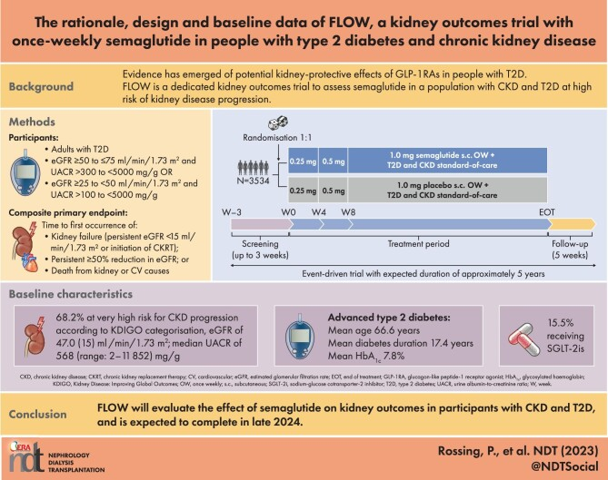
Rossing P, et al. Nephrol Dial Transplant. 2023;38(9):2041-2051.

Slide 39
What education should be provided to address patient concerns related to GLP-1 RA therapy?

Slide 40
GLP-1 RAs: Contraindications & Warnings
History of serious hypersensitivity reaction to drug
History of pancreatitis – debated given more trial data (SELECT)
Pregnancy or breastfeeding
Personal or family history of medullary thyroid cancer
Personal or family history of multiple endocrine neoplasia, type 2 (MEN2)
Das SR, et al. J Am Coll Cardiol. 2020;76(9):1117-1145.

Slide 41
Considerations for Patient Concerns
Diabetic retinopathy complications have been reported, perhaps due to rapid improvement in blood glucose control
  Advise patients to undergo appropriate, guideline-recommended eye exams before starting therapy if not done within the last 12 months
Inform patients regarding prescription assistance programs
Das SR, et al. J Am Coll Cardiol. 2020;76(9):1117-1145.

Slide 42
Considerations for Drug Initiation & Monitoring
Stop DPP-IV inhibitor before initiation
Hypoglycemia risk increased with insulin and sulfonylureas
If history of frequent hypoglycemic events, stop sulfonylurea and reduce insulin dose by ~20% when starting therapy
Das SR, et al. J Am Coll Cardiol. 2020;76(9):1117-1145.

Slide 43
What are common GLP-1 RA side effects?

Slide 44
Adverse Effects to Monitor, Anticipate for Patient
Gastrointestinal:
  Nausea/vomiting
  Diarrhea
  Improves with diet adjustments, drug exposure, slow titration, reverse titration as needed
Nongastrointestinal:
  Hypoglycemia when given with insulin or sulfonylureas
  Injection site reactions
Das SR, et al. J Am Coll Cardiol. 2020;76(9):1117-1145.

Slide 45
What education should be provided so that patients optimize treatment with GLP-1 RA therapy?

Slide 46
Recommendations to Minimize Occurrence + Severity of GI Adverse Effects with GLP-1 RAs
Improve eating habits:
  Eat slowly
  Eat only if you are hungry
  Eat smaller portions
  Avoid lying down after having a meal
  Stop eating in case of feeling of fullness
  Pay attention to the impact of certain foods
Gorgojo-Martínez JJ, et al. J Clin Med. 2022;12(1):145.

Slide 47
Recommendations to Minimize Occurrence and Severity of GI Adverse Effects with GLP-1 RAs
Additional recommendations for patients with nausea
  Wait ≥30 min since GLP-1RA dose → eat foods to ease nausea, if needed
    Crackers, apples, ginger root/ginger-based drinks
  Avoid strong smells
Additional recommendations for patients with vomiting
  Attentive to hydration
  Eat smaller amounts of food more frequently
Gorgojo-Martínez JJ, et al. J Clin Med. 2022;12(1):145.

Slide 48
Does dosing need to be adjusted based on kidney function?

Slide 49
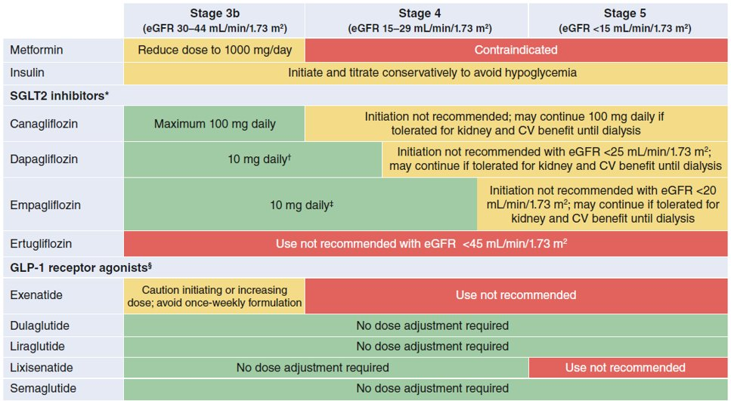
ADA/KDIGO: GLP-1 RA Dosing for eGFR <45​
Dual GIP + GLP-1RA
Tirzepatide | No dose adjustment required
de Boer IH, et al. Diabetes Care. 2022;45(12):3075-3090.​

Slide 50
How might the cardiologist collaborate with the multidisciplinary, interprofessional care?

Slide 51
2020 ACC Expert Consensus Decision Pathway on Novel Therapies for CV Risk Reduction in T2D
GLP-1 RA CV benefits are driving CV specialists to engage in prescribing drugs previously considered as T2D agents.
A need for collaborative, interdisciplinary care exists.
CV specialists have a role in DM management - 3 key areas:
  Screening for T2D in those with high CV disease risk: A1C, glucose
  Aggressive CV risk factor treatment
  Incorporate agents with known CV benefits that will help glucose control
Das SR, et al. J Am Coll Cardiol. 2020;76(9):1117-1145.

Slide 52
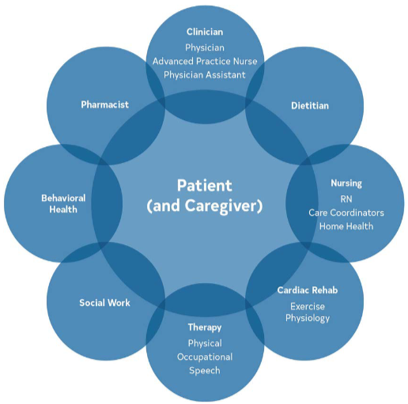
2023 ACC/AHA CCD Guidelines
A multidisciplinary team-based approach:
-Improves health outcomes
-Facilitates ASCVD risk factor control
-Improves health service utilization, equity
-Takes advantage of expertise, numbers…
Focus on:
-Shared decision-making
-Continuous communication
CV Specialists 2023 in Cardiometabolic Disorders: Learn, Partner, Suggest
Virani SS, et al. Circulation. 2023;148(9)e9-e119.

