Slide 1
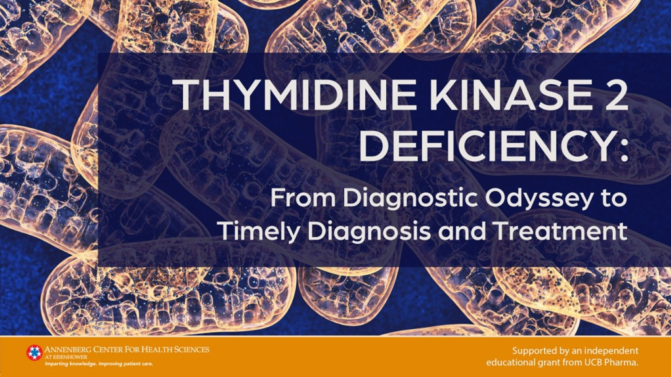

Slide 2
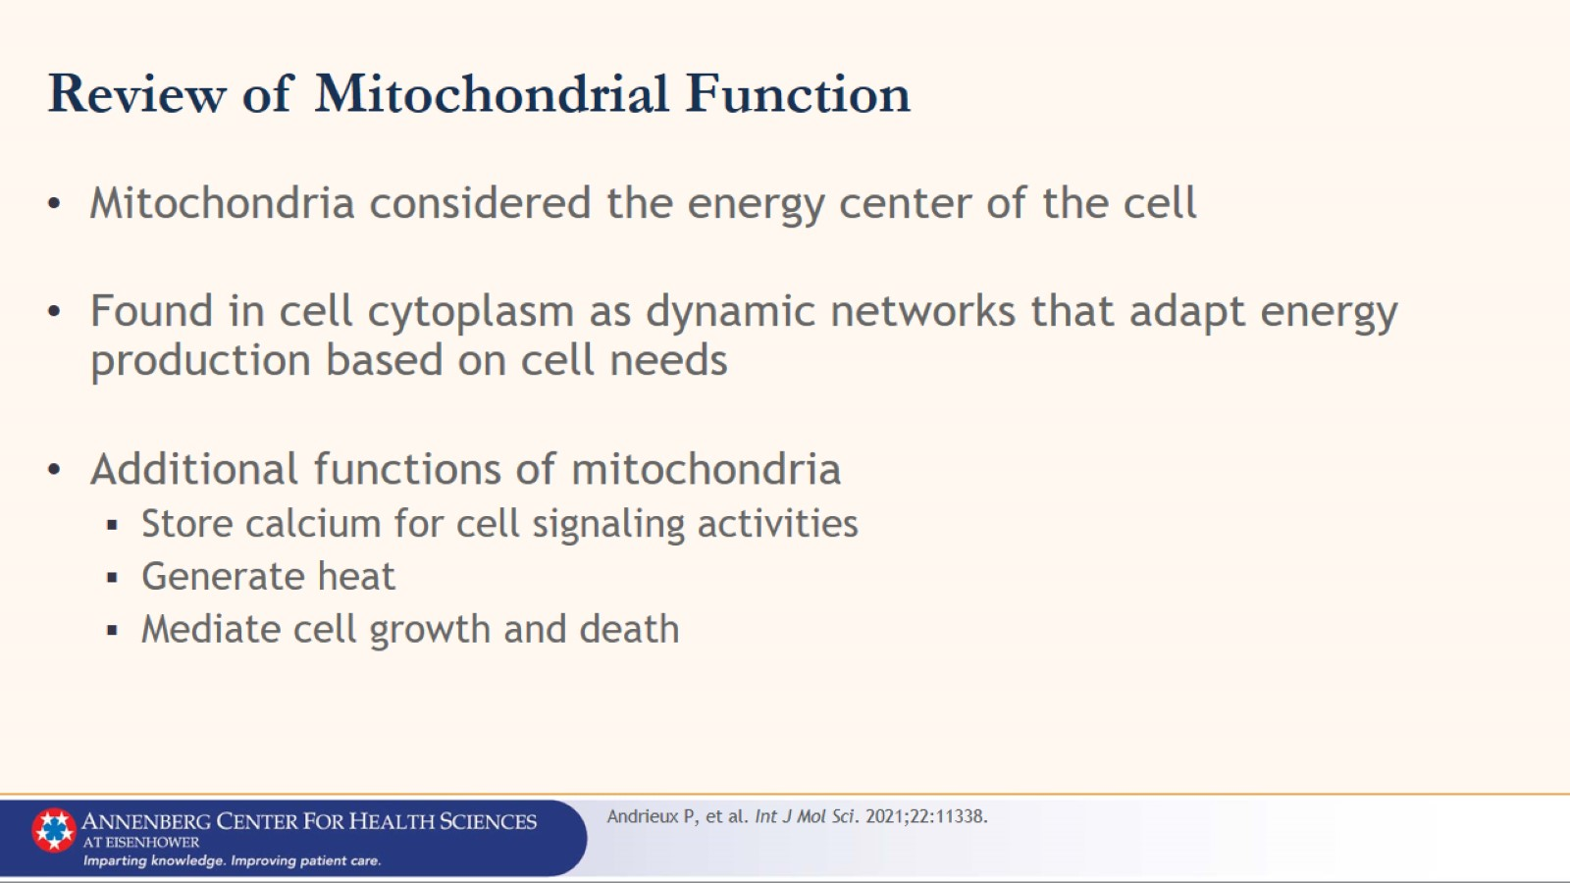
Review of Mitochondrial Function

Slide 3
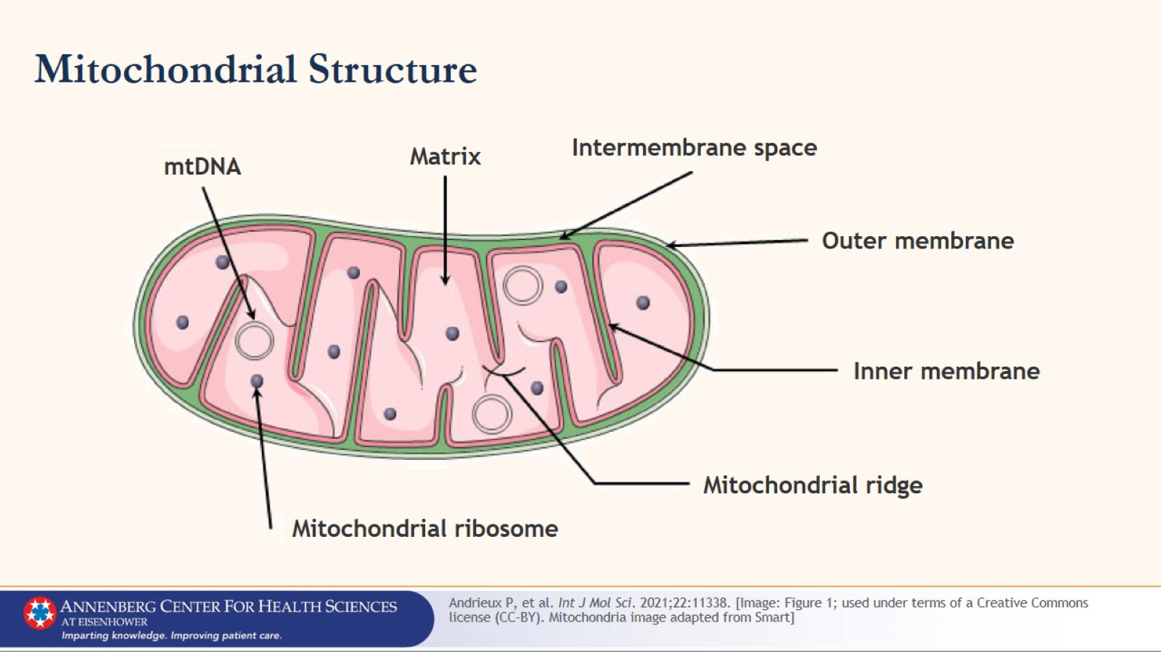
Mitochondrial Structure

Slide 4
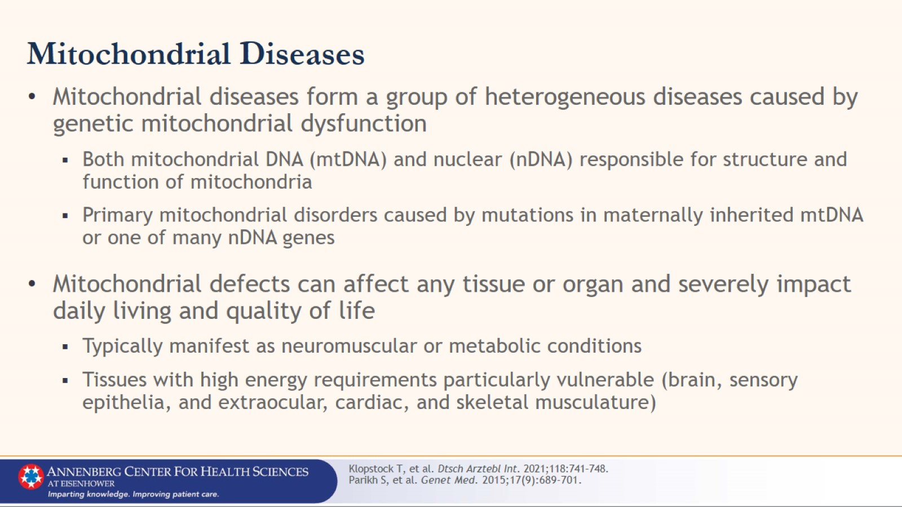
Mitochondrial Diseases

Slide 5
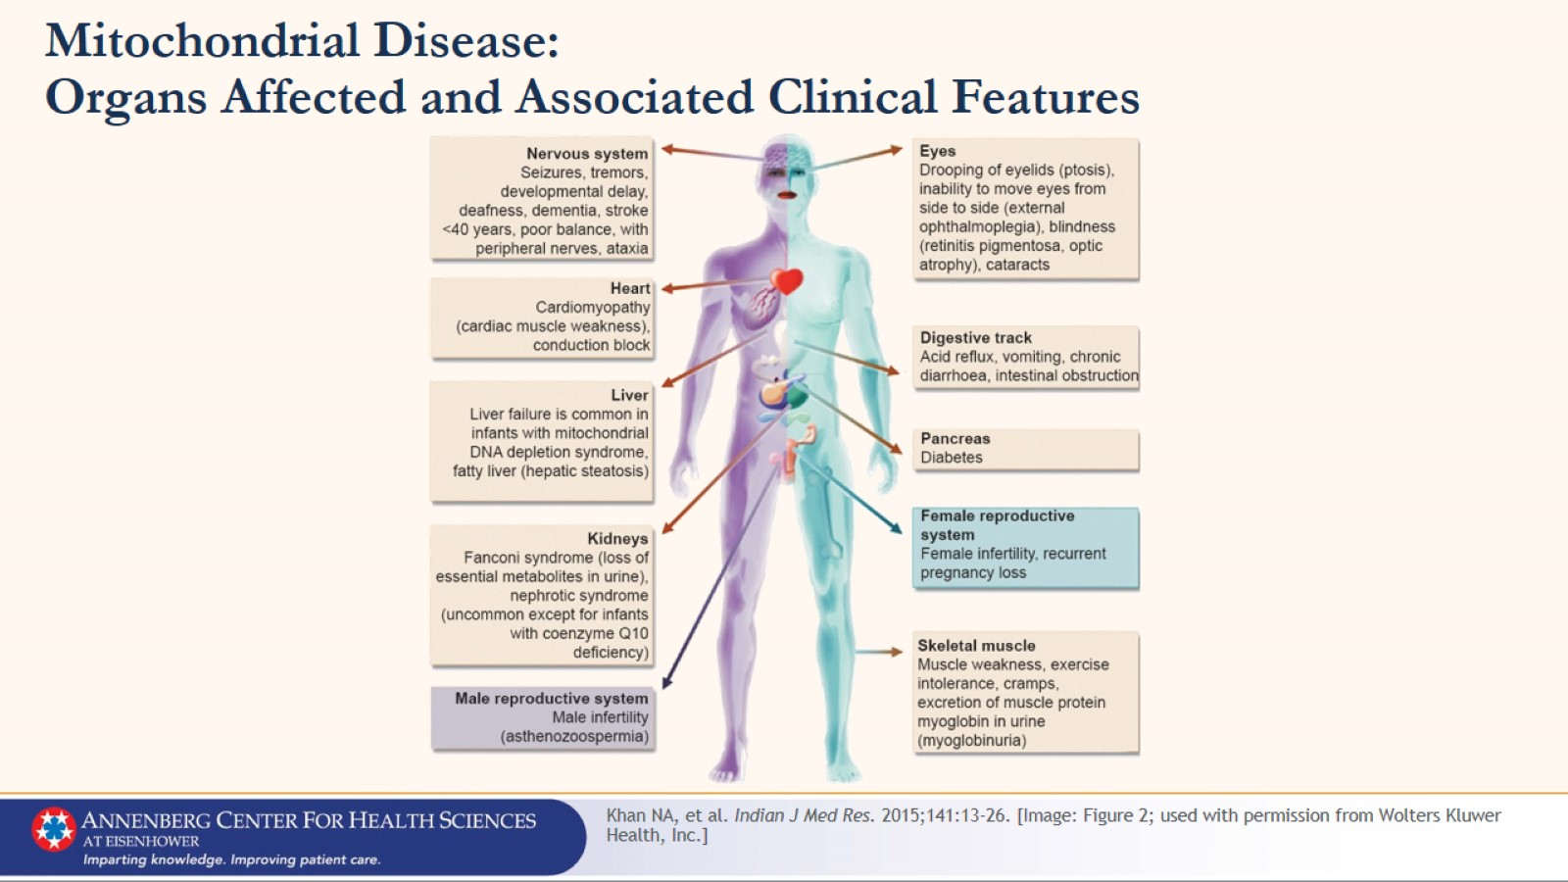
Mitochondrial Disease:
Organs Affected and Associated Clinical Features

Slide 6
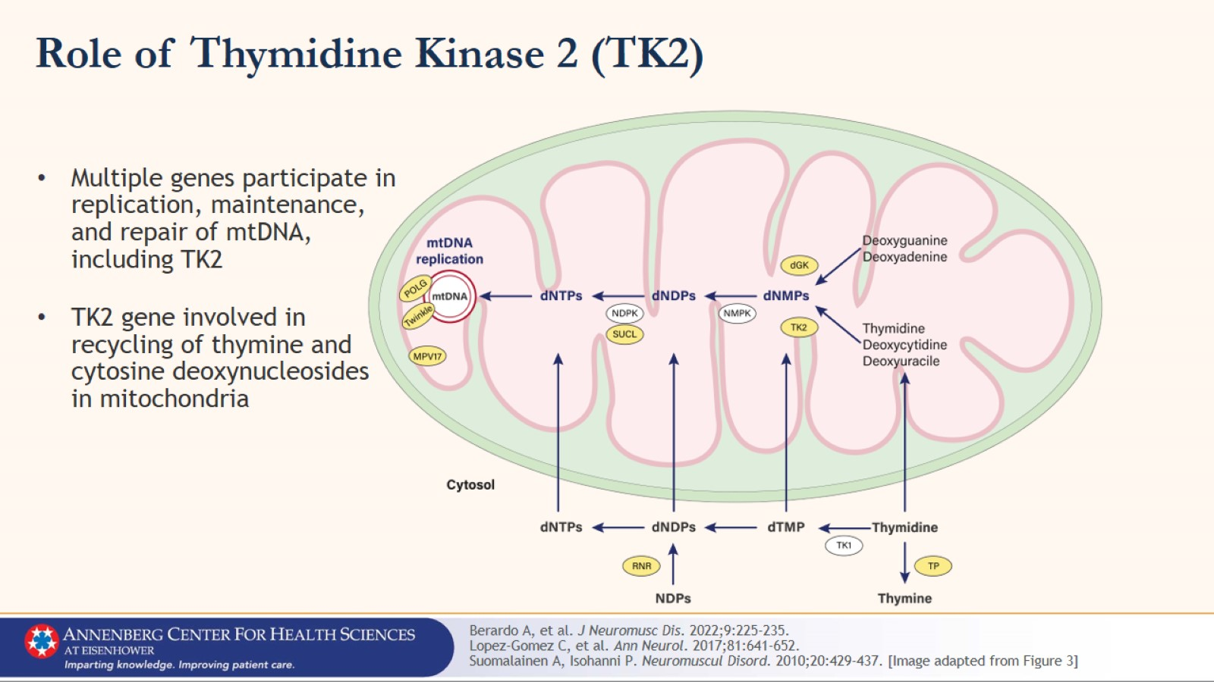
Role of Thymidine Kinase 2 (TK2)

Slide 7
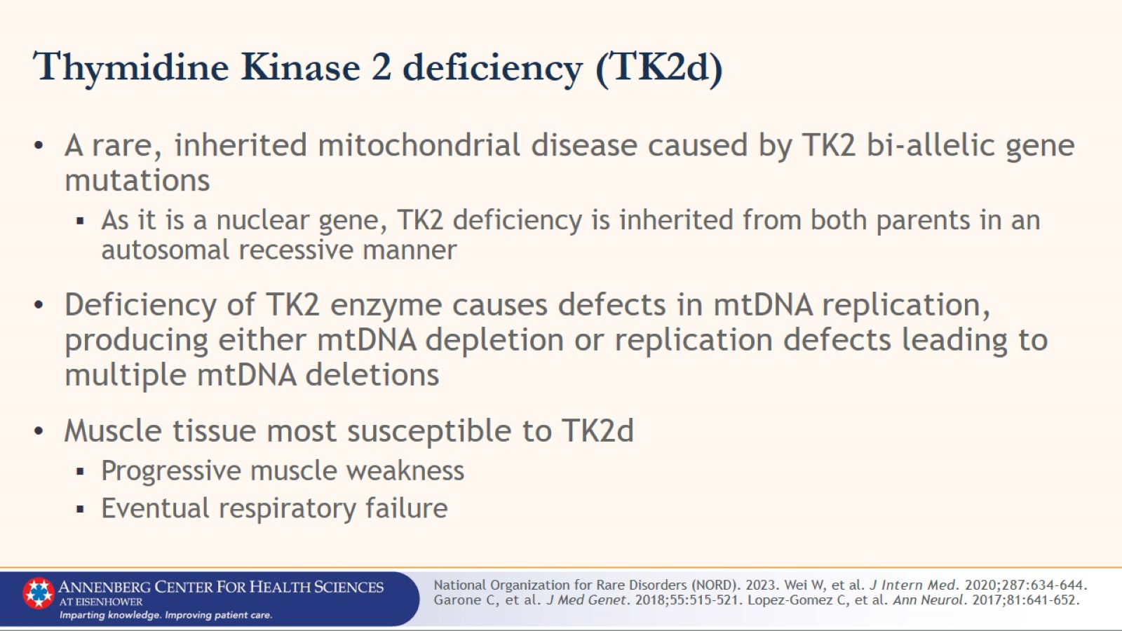
Thymidine Kinase 2 deficiency (TK2d)

Slide 8
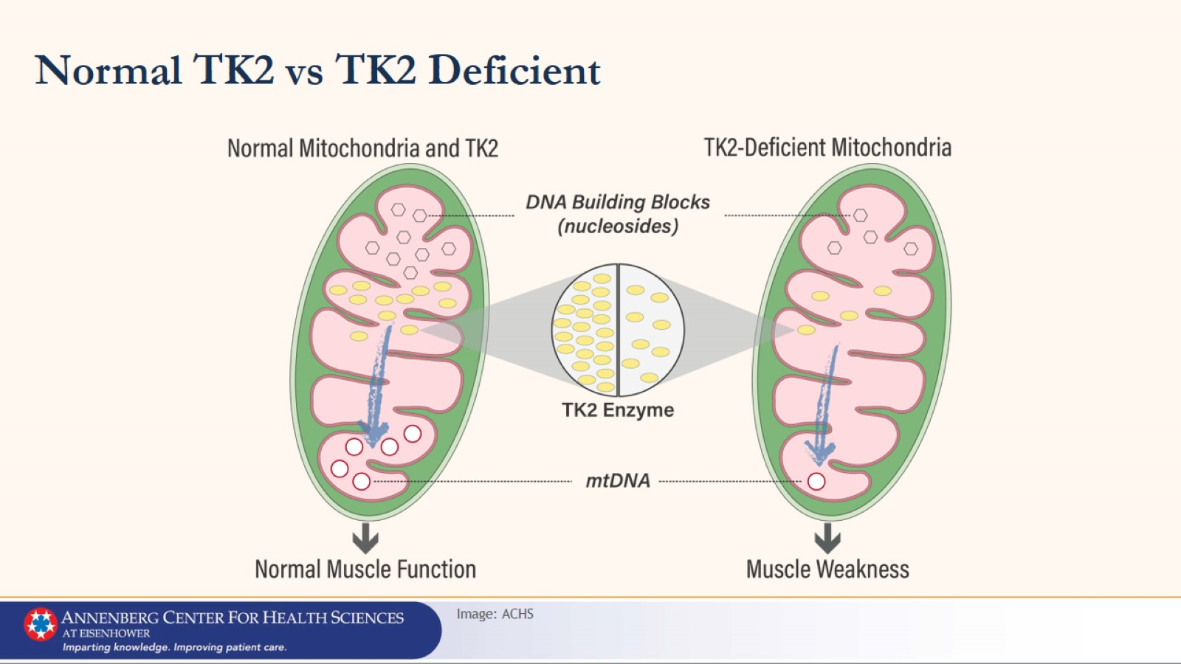
Normal TK2 vs TK2 Deficient

Slide 9
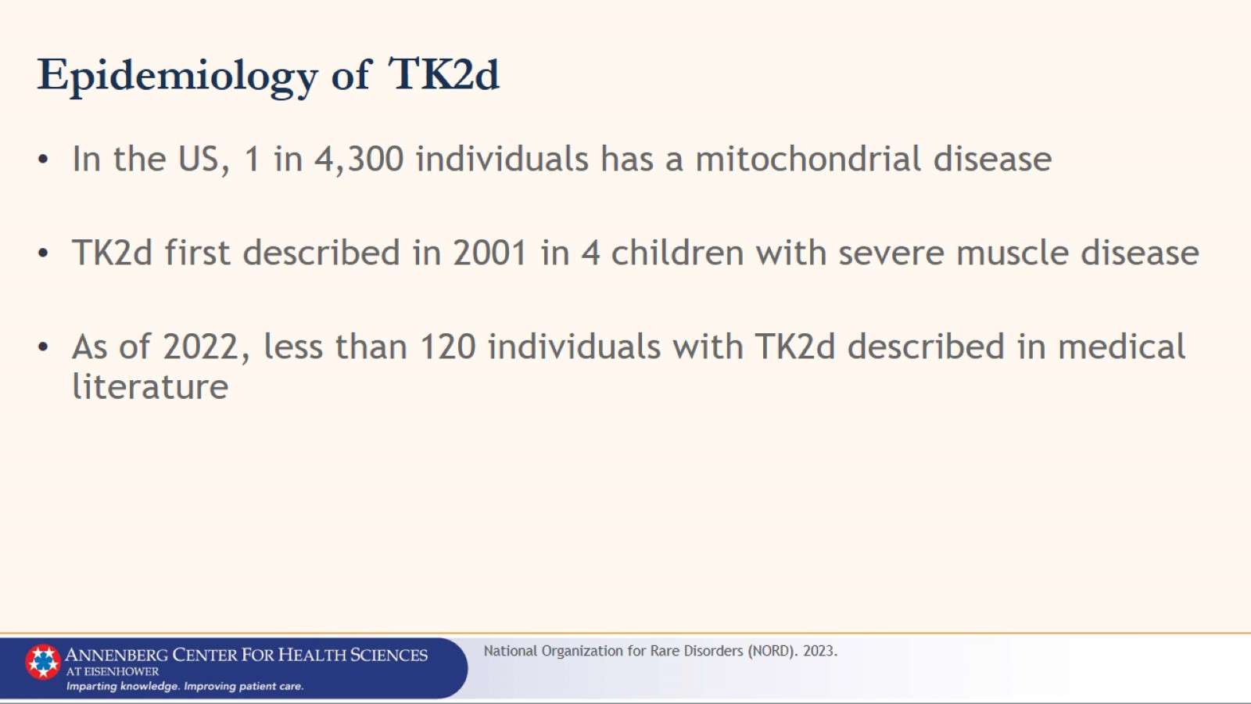
Epidemiology of TK2d

Slide 10
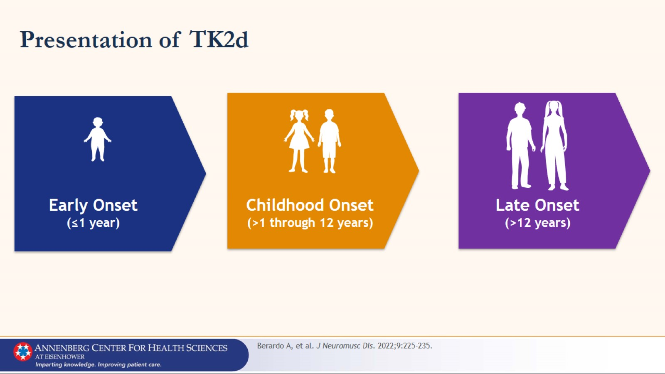
Presentation of TK2d

Slide 11
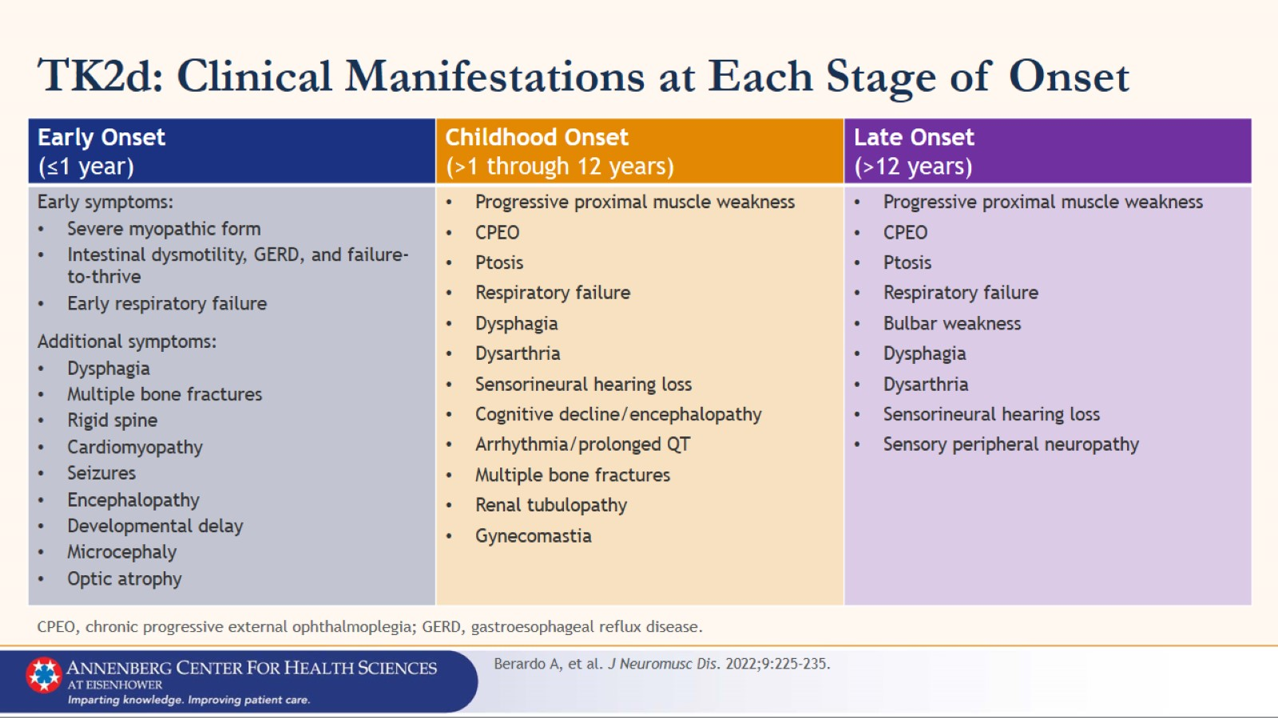
TK2d: Clinical Manifestations at Each Stage of Onset

Slide 12
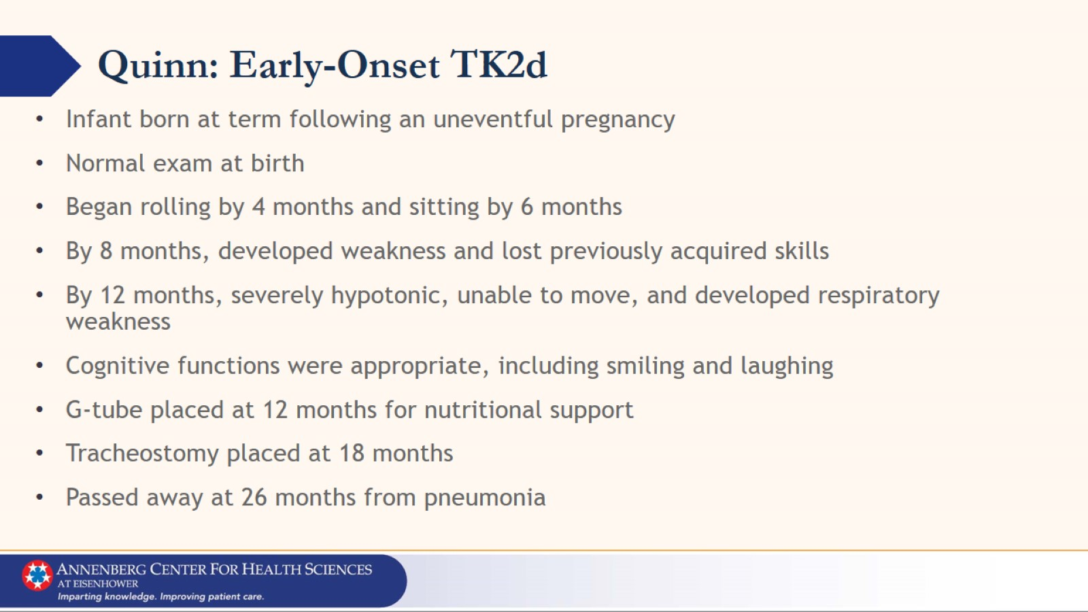
Quinn: Early-Onset TK2d

Slide 13
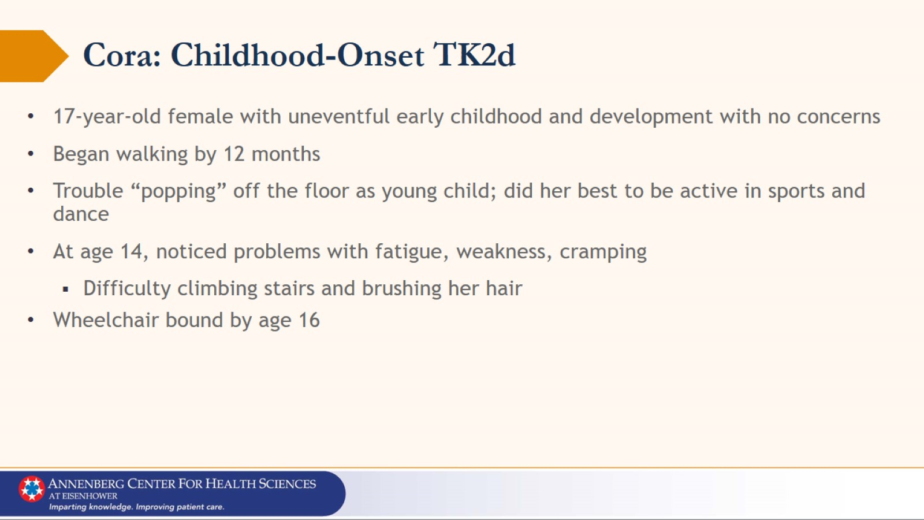
Cora: Childhood-Onset TK2d

Slide 14
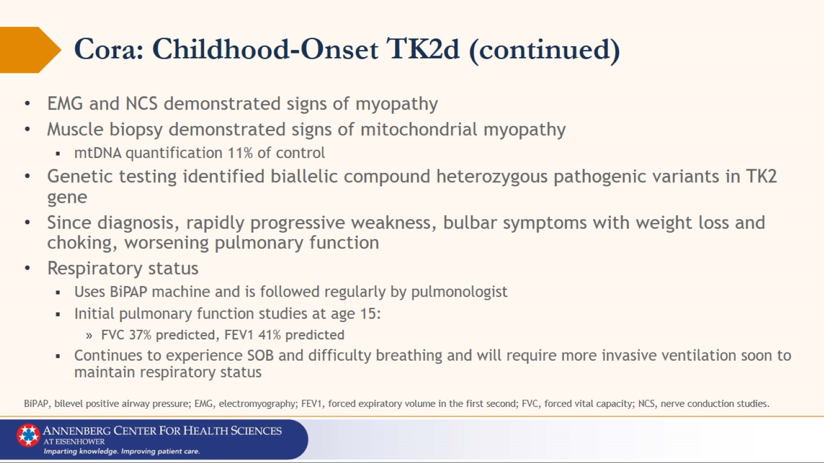
Cora: Childhood-Onset TK2d (continued)

Slide 15
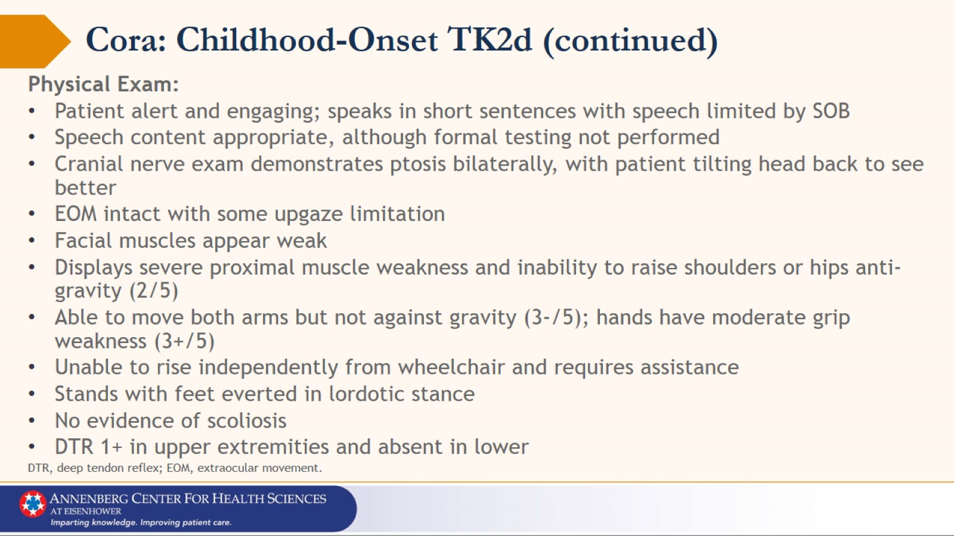
Cora: Childhood-Onset TK2d (continued)

Slide 16
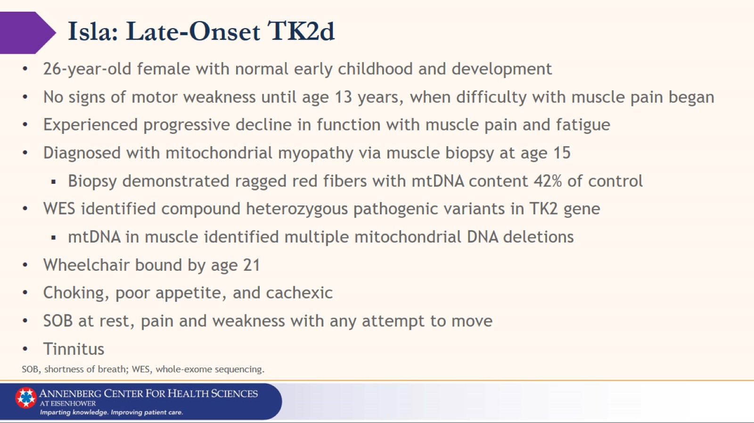
Isla: Late-Onset TK2d

Slide 17
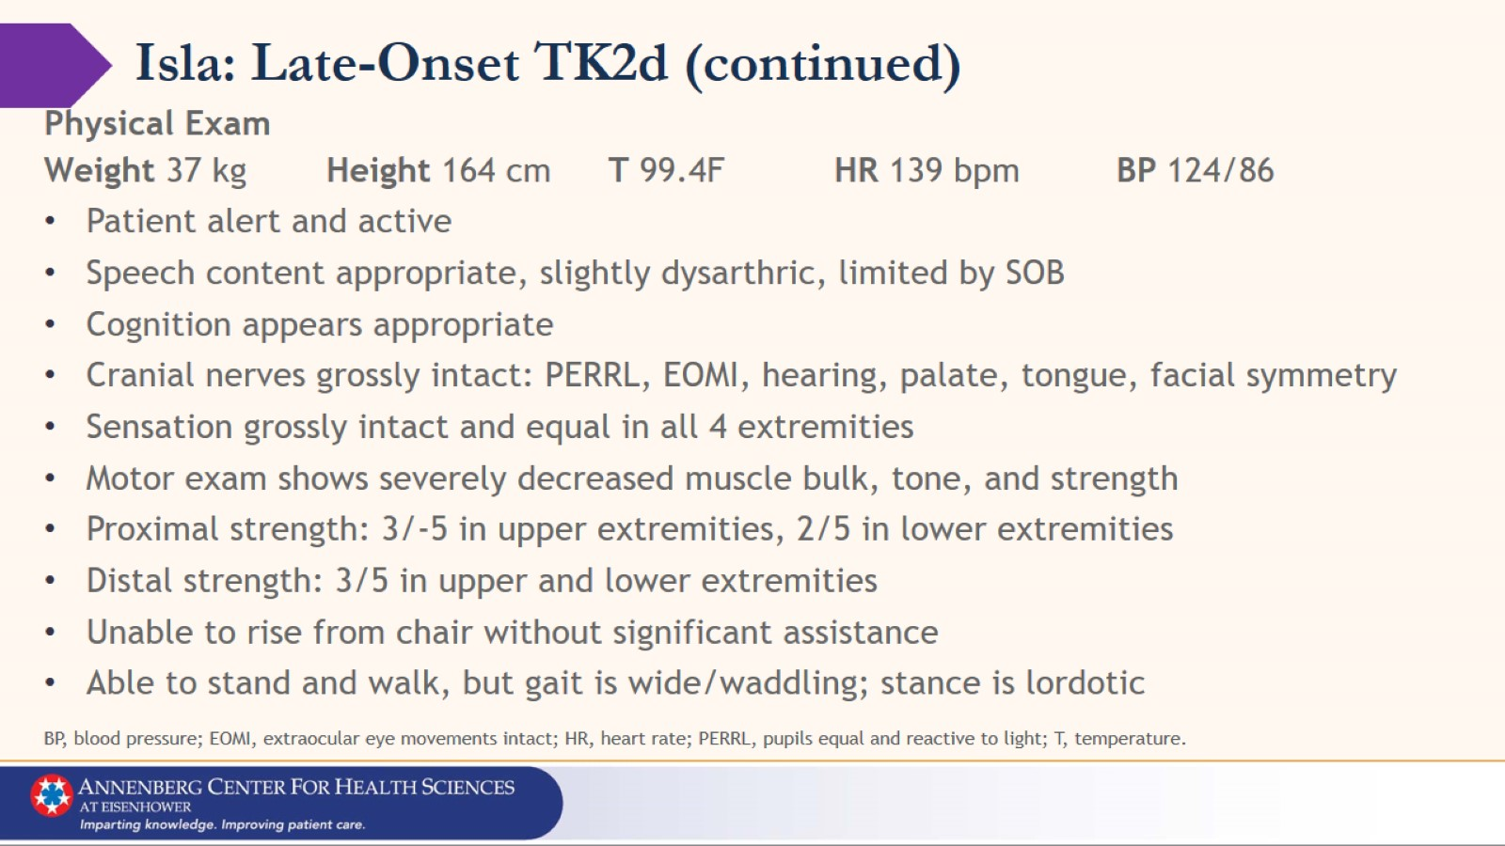
Isla: Late-Onset TK2d (continued)

Slide 18
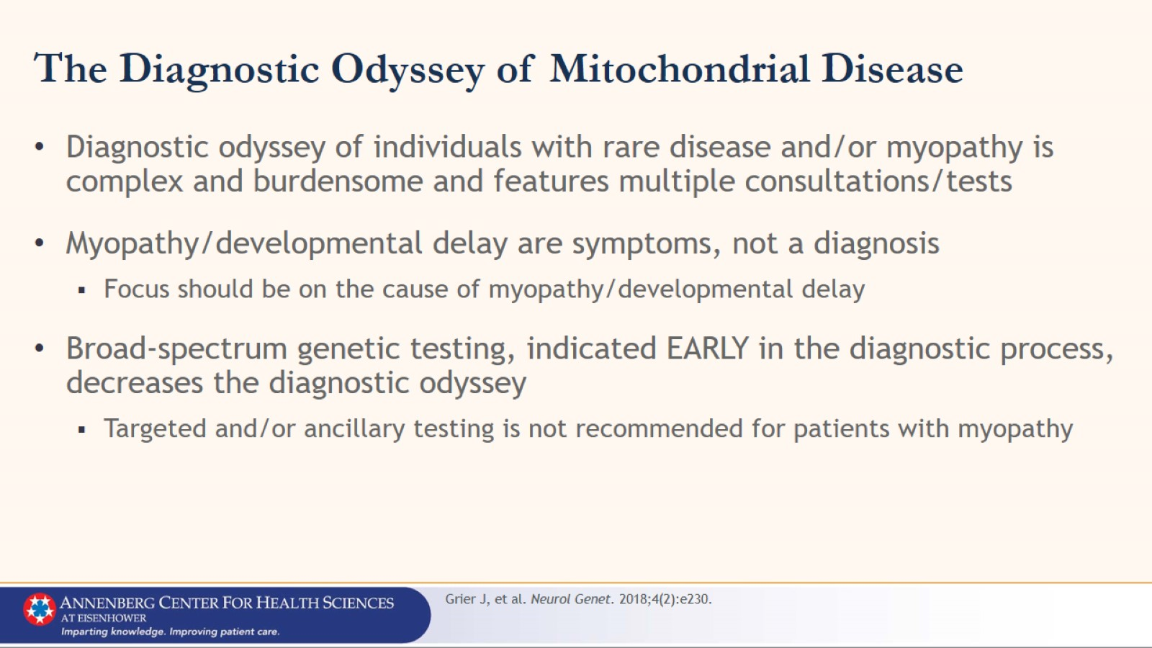
The Diagnostic Odyssey of Mitochondrial Disease

Slide 19
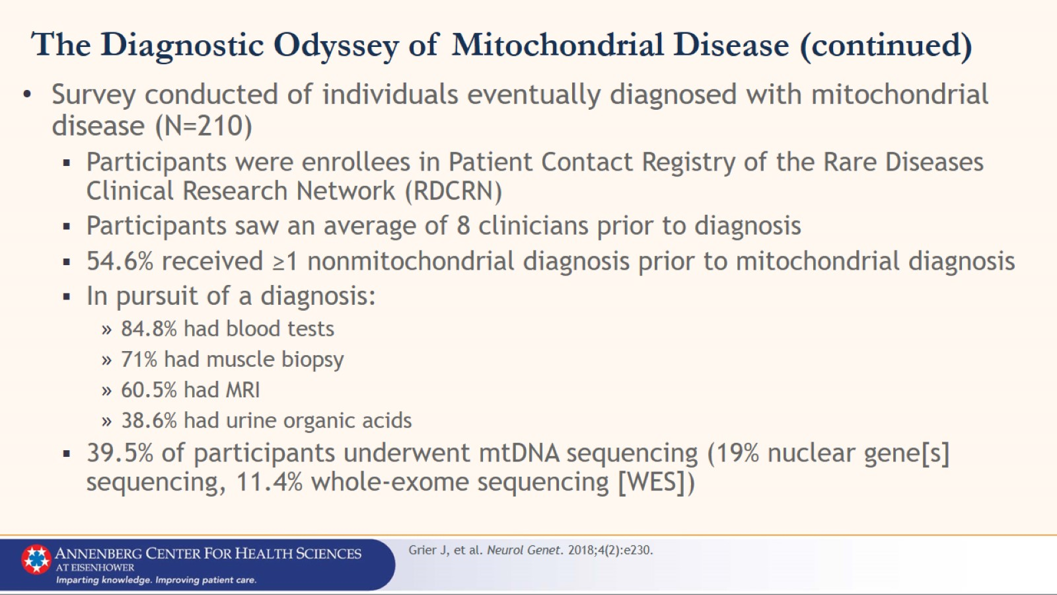
The Diagnostic Odyssey of Mitochondrial Disease (continued)

Slide 20
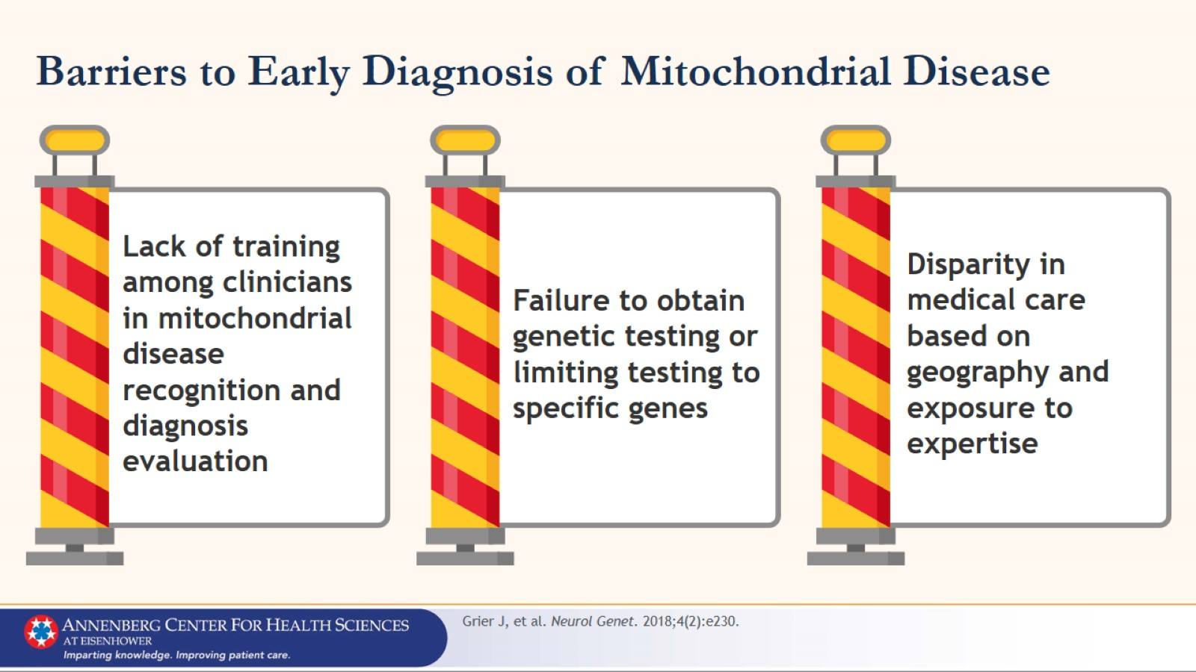
Barriers to Early Diagnosis of Mitochondrial Disease

Slide 21
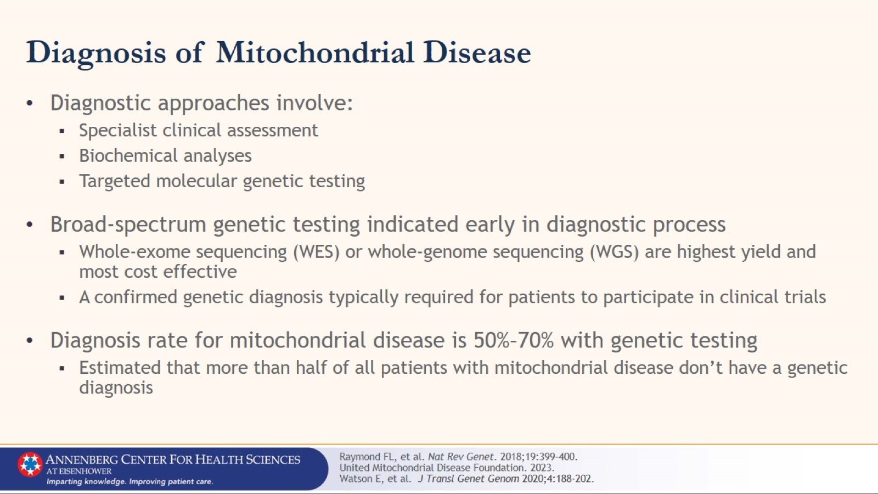
Diagnosis of Mitochondrial Disease

Slide 22
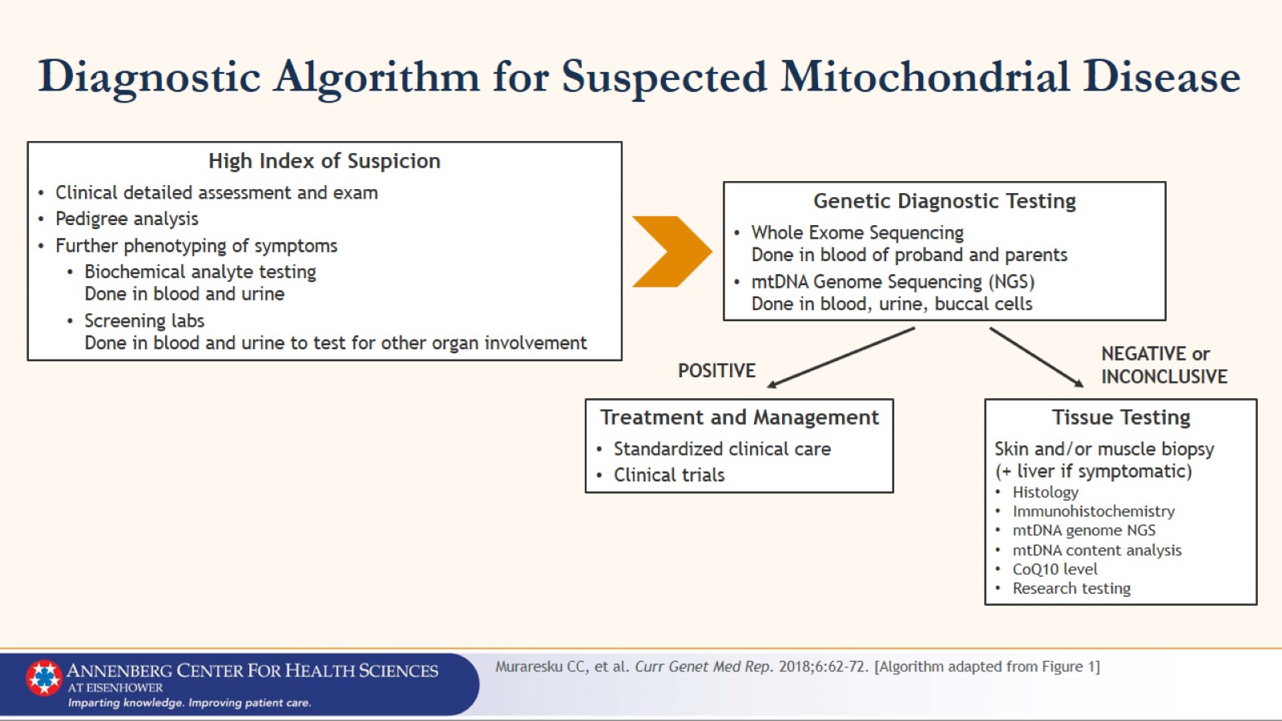
Diagnostic Algorithm for Suspected Mitochondrial Disease

Slide 23
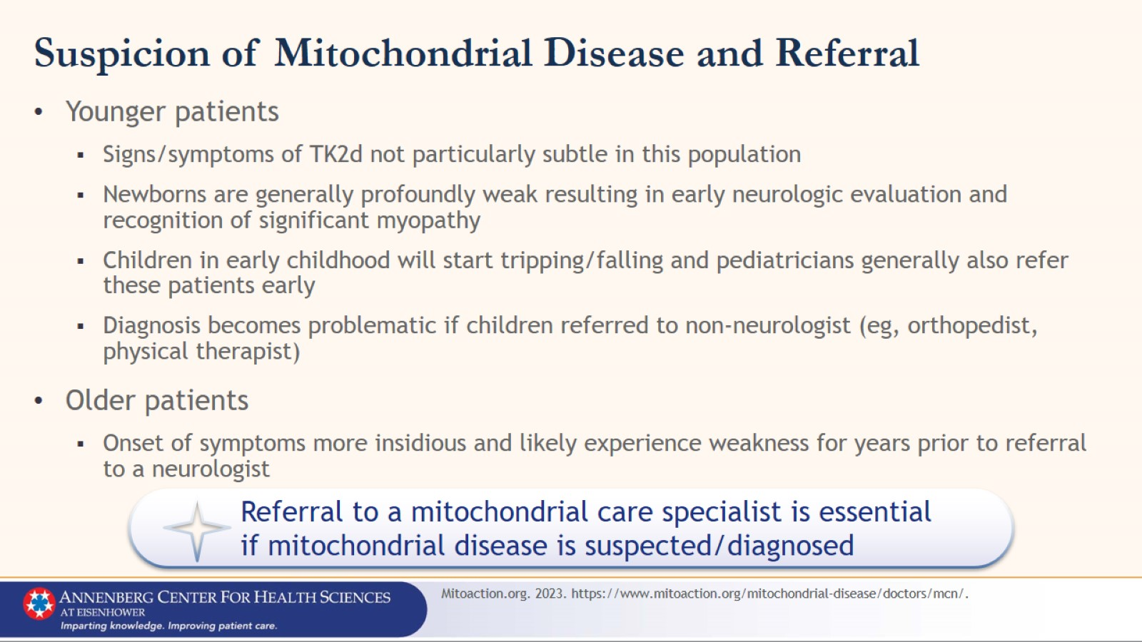
Suspicion of Mitochondrial Disease and Referral

Slide 24
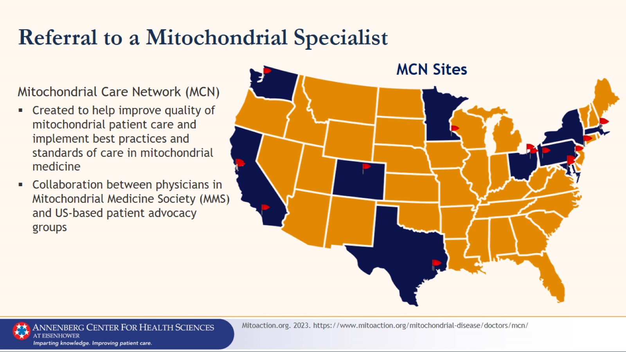
Referral to a Mitochondrial Specialist

Slide 25
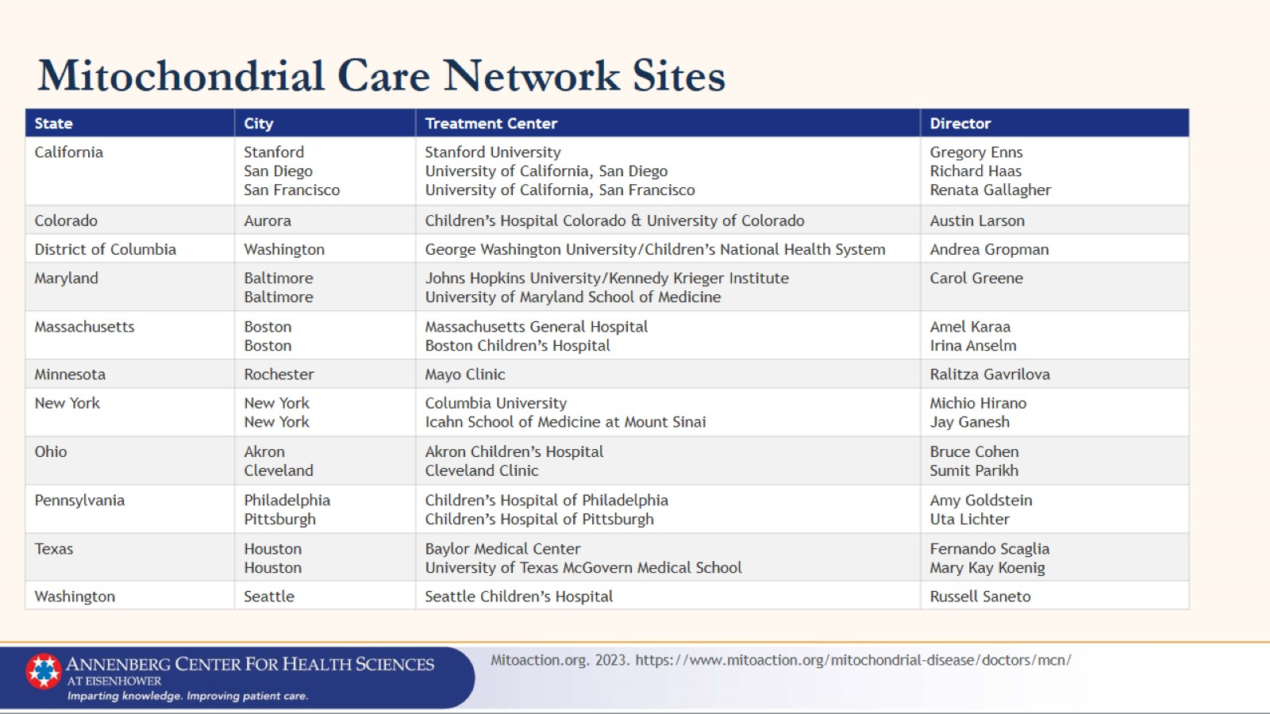
Mitochondrial Care Network Sites

Slide 26
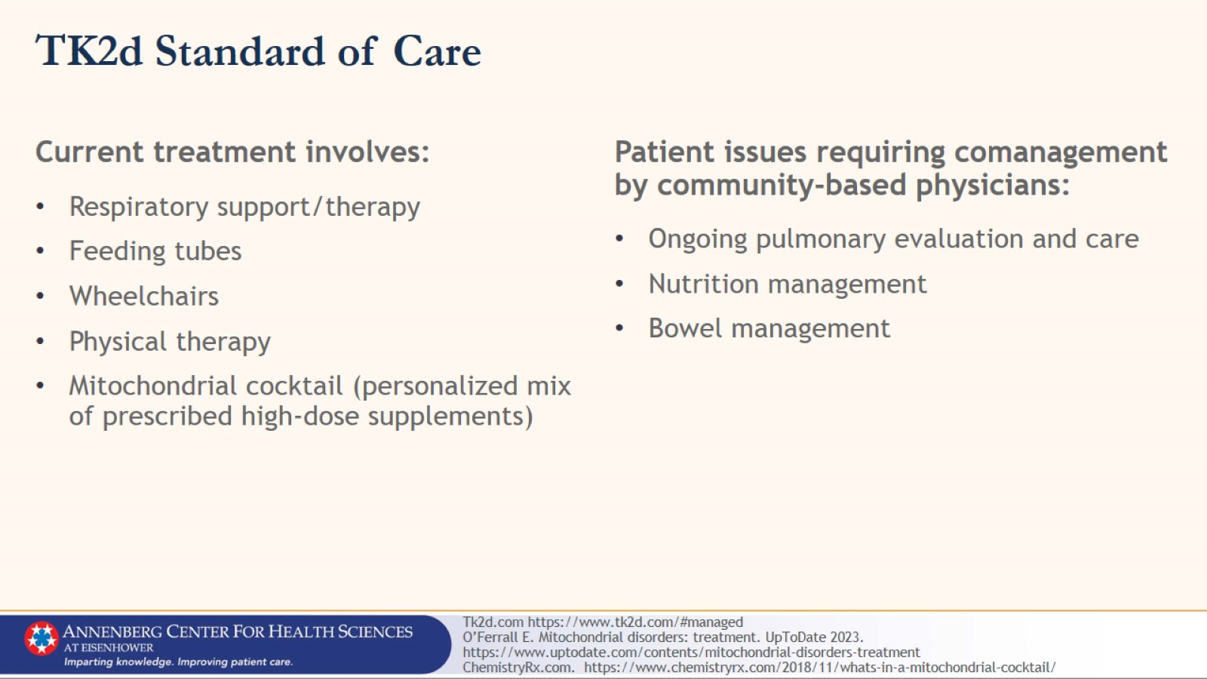
TK2d Standard of Care

Slide 27
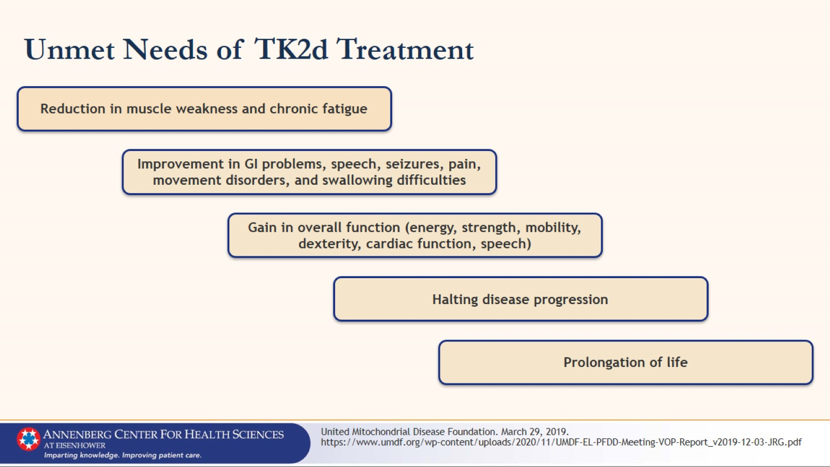
Unmet Needs of TK2d Treatment

Slide 28
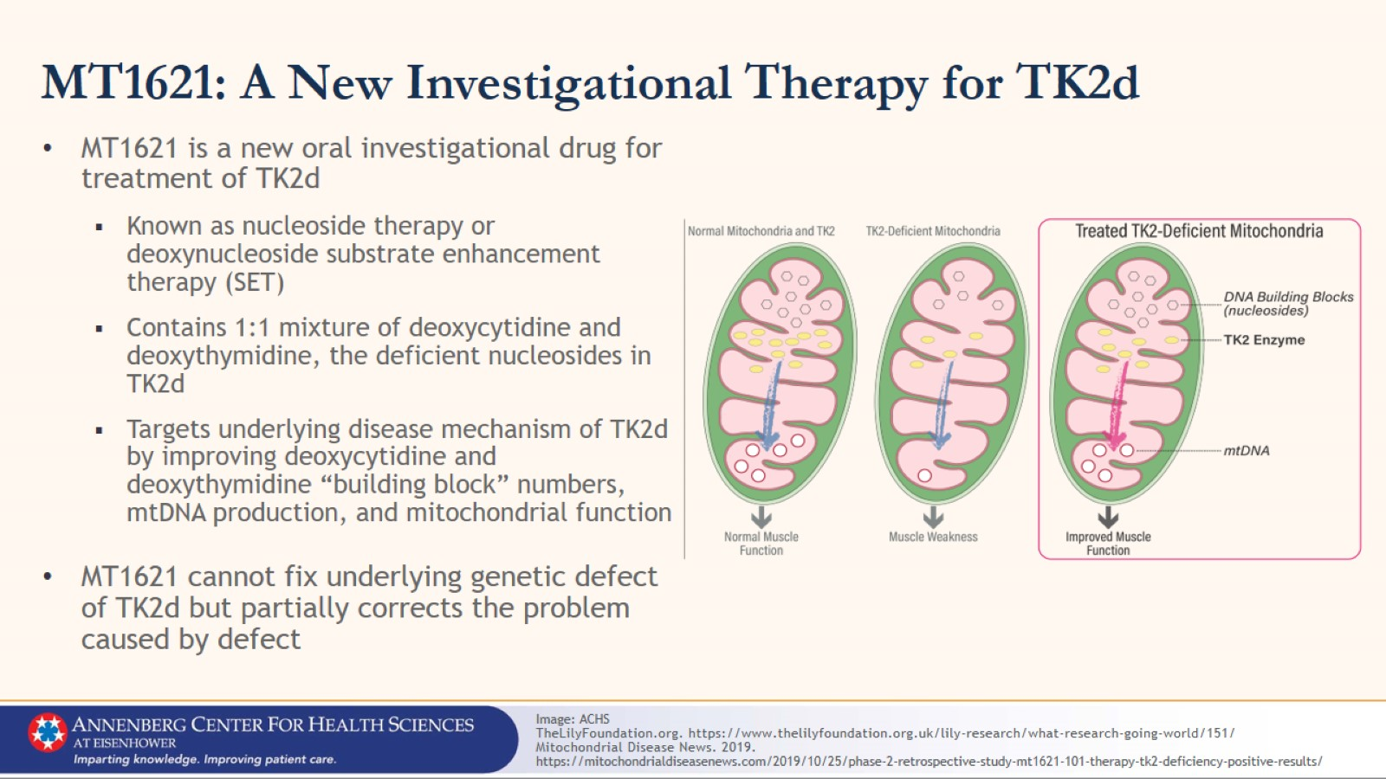
MT1621: A New Investigational Therapy for TK2d

Slide 29
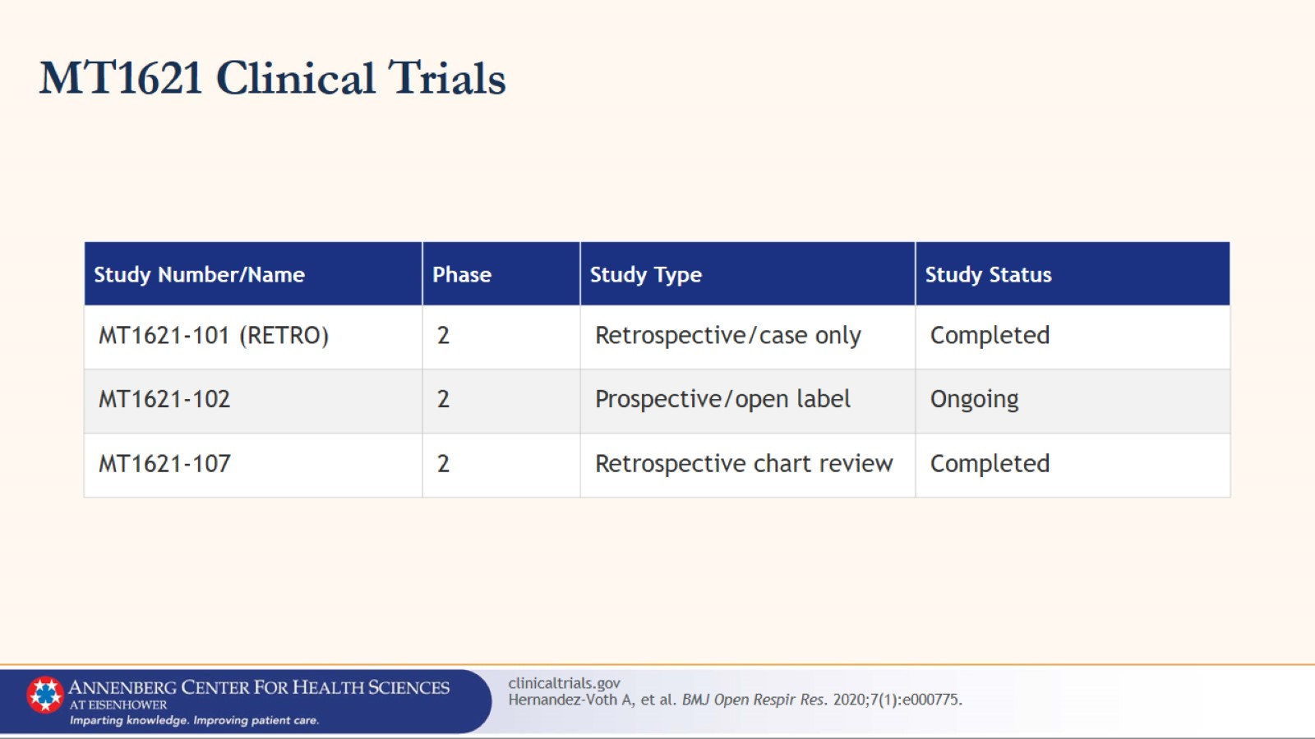
MT1621 Clinical Trials

Slide 30
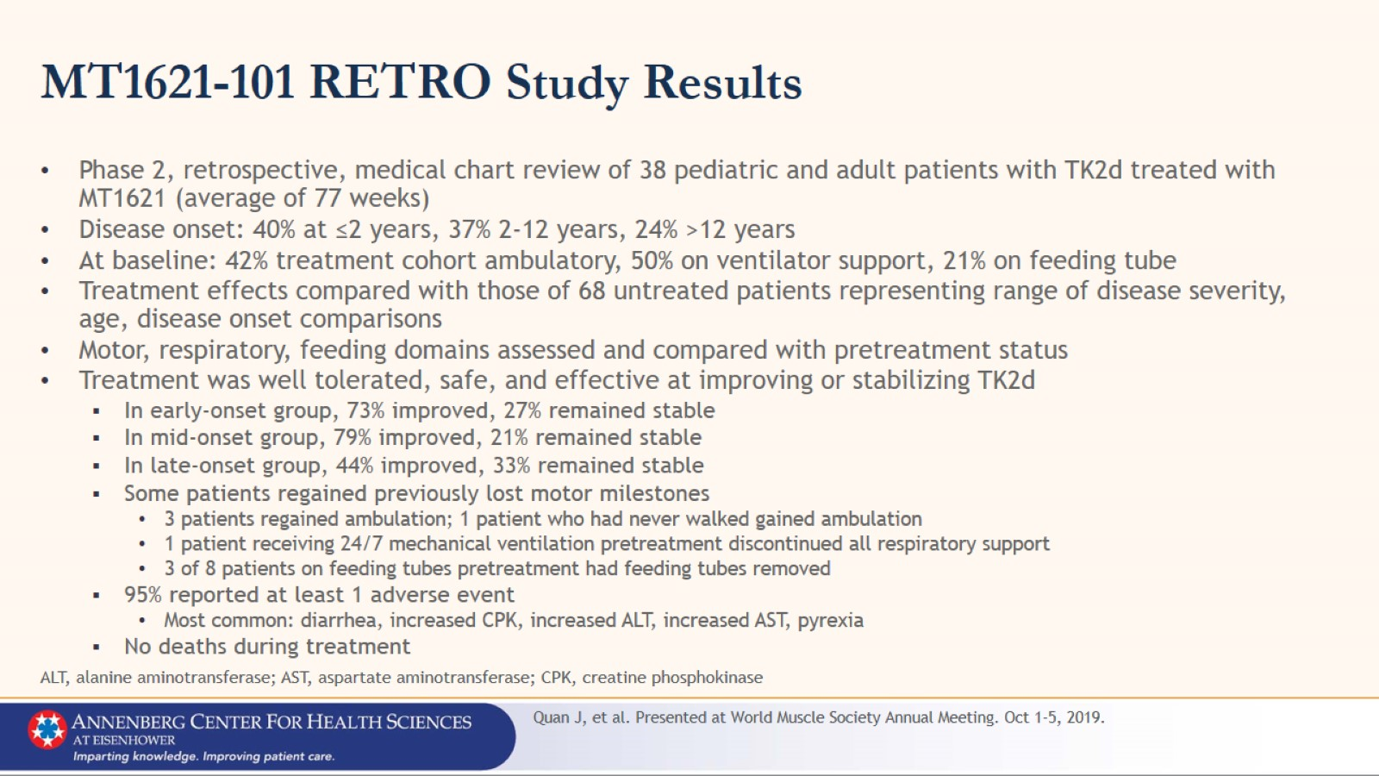
MT1621-101 RETRO Study Results

Slide 31
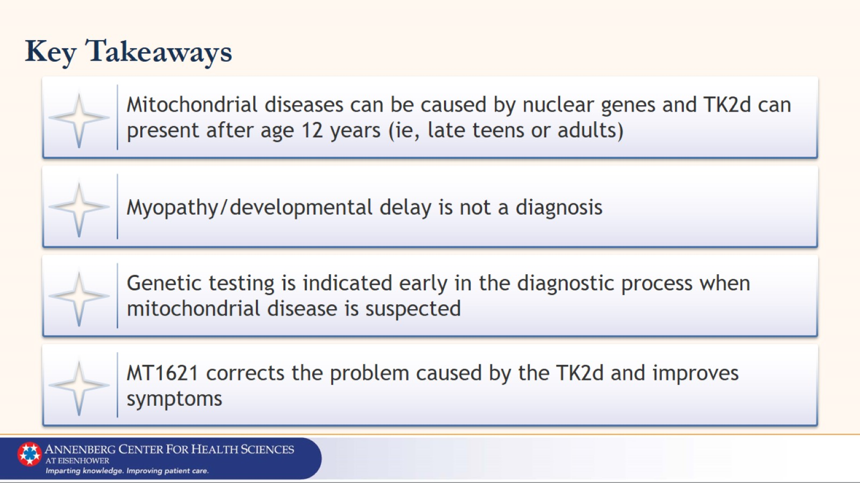
Key Takeaways

Slide 32


