Slide 1
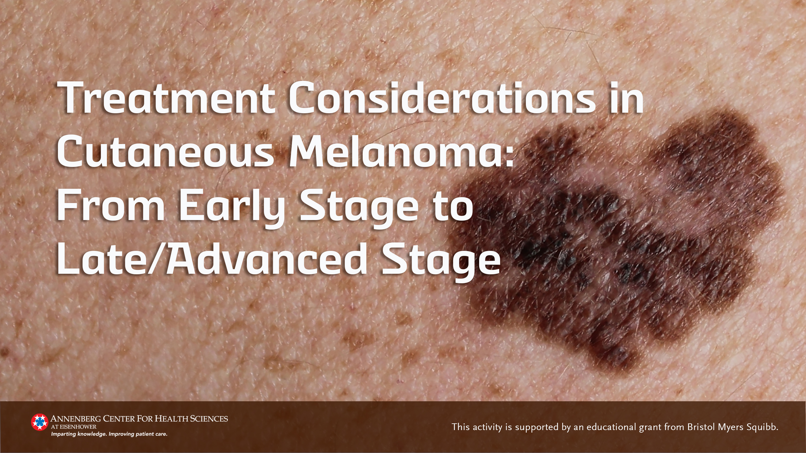

Slide 2
Faculty
Jason J. Luke, MD, FACP
Associate Professor of Medicine Hematology/Oncology Division
Director of Cancer Immunotherapeutics Center
University of Pittsburgh Hillman Cancer Center

Slide 3
Disclosures
Jason Luke, MD, FACP
Advisory Board:(no stock) 7 Hills, Affivant, BioCytics, Bright Peak, Exo, F-star, Inzen, RefleXion, Xilio (stock) Actym, Alphamab Oncology, Arch Oncology, Duke Street Bio, Kanaph, Mavu, NeoTX, OncAI, OncoNano, physIQ, Pyxis, Saros, STipe, Tempest
Consultant: AbbVie, Agenus, Alnylam, AstraZeneca, Atomwise, Bayer, Bristol Myers Squibb, Castle, Checkmate, Codiak, Crown, Cugene, Curadev, Day One, Eisai, EMD Serono, Endeavor, Flame, G1 Therapeutics, Genentech, Gilead, Glenmark, HotSpot, Ikena, Immatics, Immunocore, IO Biotech, Incyte, Instil, Inzen, Janssen, Kadmon, KoBioLabs, Krystal, KSQ, LegoChem, Macrogenics, Merck, Mersana, Nektar, Novartis, Partner, Pfizer, Pioneering Medicines, PsiOxus, Regeneron, Replimmune, Ribon, Roivant, Servier, Stingthera, Sumoitomo, Synlogic, Synthekine, Teva
The faculty have disclosed that there is discussion outside of the approved product labeling and about products not approved by the US Food and Drug Administration for cutaneous melanoma.

Slide 4
Objectives
Identify molecular treatment targets for melanoma
Compare various treatment considerations for adjuvant/neoadjuvant therapy in early-stage melanoma
Create individualized, guideline-recommended treatment strategies, including sequencing considerations, for frontline and later lines of therapy in patients with metastatic melanoma

Slide 5
Melanoma Prevalence and Risk Factors¹⁻²
Typical presentation involves a suspicious pigmented lesion¹
> 97,000 new cases of melanoma estimated for 2023²
~8,000 deaths due to melanoma expected in 2023²
Average age at diagnosis is 66 years²
Risk Factors¹
UV light exposure
Short, intense
Chronic, intermittent
Genetic features
Fair skin
Light-colored hair/eyes
Family history of melanoma
1. American Cancer Society. Melanoma Skin Cancer. Accessed Aug 10, 2023. https://www.cancer.org/cancer/types/melanoma-skin-cancer.html 2. National Cancer Institute SEER Program. Cancer Stat Facts: Melanoma of the Skin. Accessed Aug 10, 2023. https://seer.cancer.gov/statfacts/html/melan.html

Slide 6
Melanoma Incidence by Stage
Stage IV
2.5%
Stage III
7.5%
Stage II
15%
IIB+IIC ~7%
Stage I
75%
Poklepovic AS, et al. Cancer. 2020;126(6):1166-1174.

Slide 7
Melanoma 5-Year Overall Survival by Stage
Stage/SEER classification | 5-year OS 2000-2004¹ | 5-year OS 2013-2019²
All Stages | 90.4% | 93.5%
Localized (Stage I/II) | 97.7% | 99.6%
Regional (Stage III) | 62.6% | 73.9%
Distant/Metastatic (Stage IV) | 16.2% | 35.1%
Melanoma is more common in Caucasian patients, but survival outcomes are worse in African American patients
  5-year OS in African Americans is 74.4% vs 93.3% in Caucasian patients¹
OS, overall survival
1. National Cancer Institute SEER Program. SEER* Explorer. Melanoma of the Skin. Accessed Aug 10, 2023. https://seer.cancer.gov/statistics-network/explorer/application.html 2. National Cancer Institute SEER Program. Cancer Stat Facts: Melanoma of the Skin. Accessed Aug 10, 2023. https://seer.cancer.gov/statfacts/html/melan.html

Slide 8
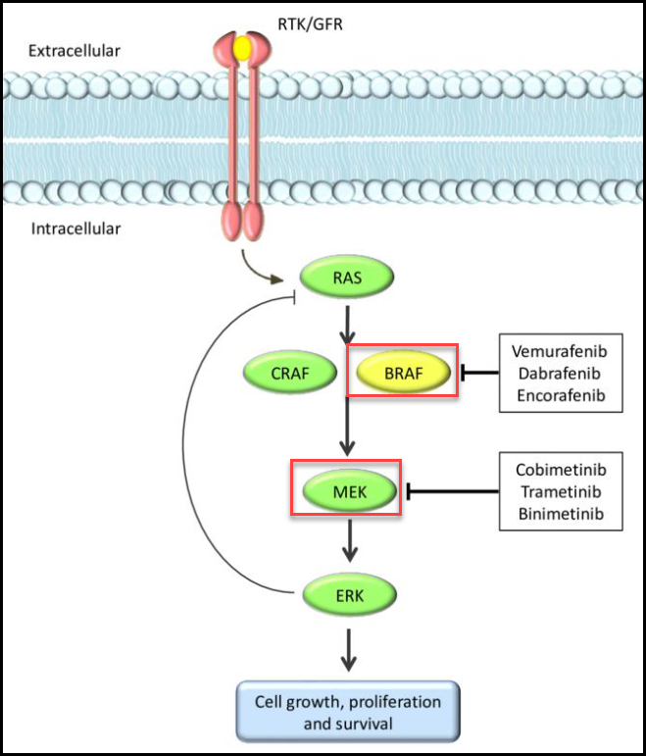
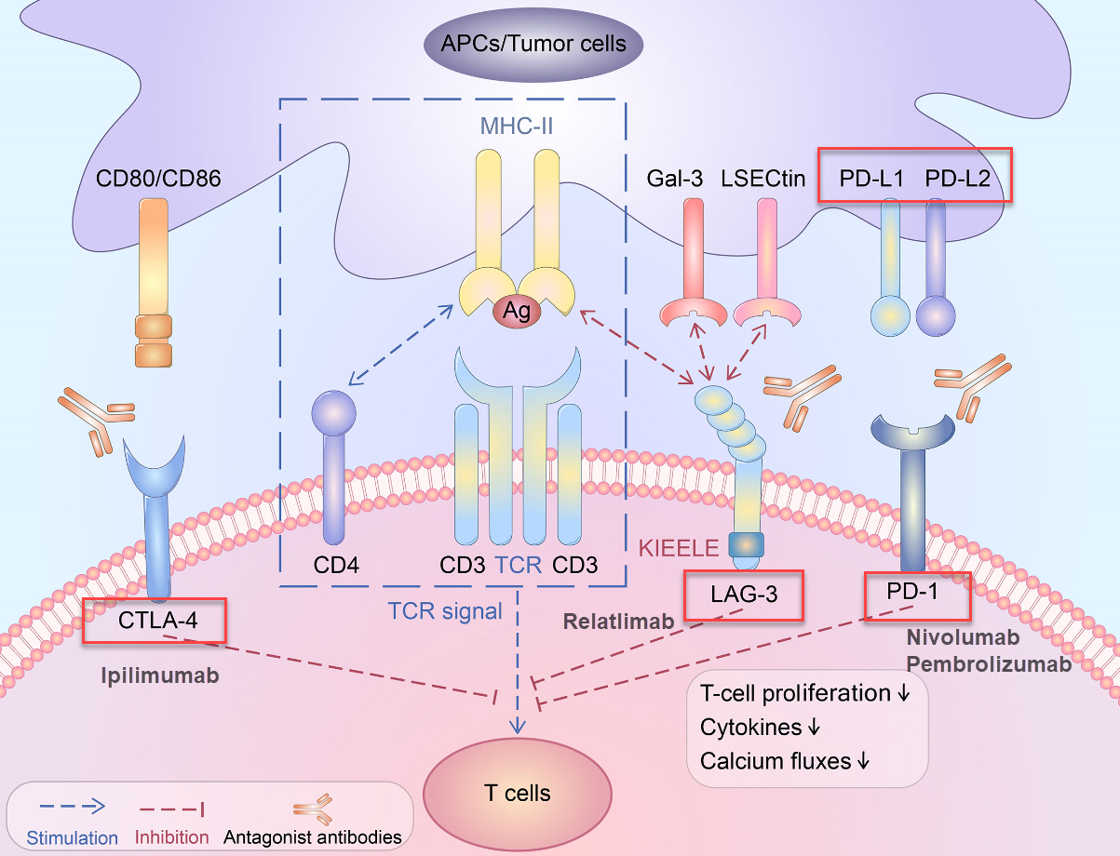
Biomarkers in Melanoma
MAPK Pathway²
Modulation of tumor microenvironment → advances in immunotherapy¹
BRAF activating mutations found in ~50% of cutaneous melanoma^{2,3}
MAPK, mitogen-activated protein kinase
1. Wei Y, et al. Front Oncol. 2022;12:831407. Figure used under approved terms of Creative Commons Attribution License. http://creativecommons.org/licenses/by/4.0/. 2. Tanda E, et al. Front Mol Biosci. 2020;7:154. Figure used under approved terms of Creative Commons Attribution License. http://creativecommons.org/licenses/by/4.0/. 3. Sanchez-Vega F, et al. Cell. 2018;173(2):321-337.e10.

Slide 9
Majority of Recurrences in Stage IIB/C Are Nodal or Systemic
Stage IIB (N=226)
Stage IIC (N=112)
Recurrence increases risk of developing metastatic disease and melanoma-specific death
Lee AY, et al. Ann Surg Oncol. 2017;24(4):939-946.

Slide 10
NCCN Guidelines for Resectable Perioperative Melanoma
Surgical wide excision ± sentinel node biopsy
Adjuvant Treatment Considerations*
Anti-PD-1 Monotherapy
Pembrolizumab (stage IIB/IIC, IIIA/B/C/D)
Nivolumab (IIIA/B/C/D)
Targeted BRAF/MEK Combination for BRAFV600 activating mutation
Radiation
Neoadjuvant Treatment Considerations
Currently recommended only in clinical trial setting per NCCN (evolving landscape)
Observation
Dabrafenib/trametinib (IIIA/B/C/D)
*Based on risk of recurrence
National Comprehensive Cancer Network. Melanoma: Cutaneous. v.2.2023.Accessed Aug 8, 2023. https://www.nccn.org/professionals/physician_gls/pdf/cutaneous_melanoma.pdf

Slide 11
Adjuvant Immunotherapy Clinical Trials
Clinical Trial | Population | Treatment | Efficacy |  |  | AE Any Grade (Grade ≥ 3)^{2,3,5,7}
 |  |  | RFS (%) | DMFS (%) | OS (%)
CheckMate 238^{1,2} (Phase 3) | IIIB/C IV (resectable) | Nivo + pbo (n = 453) Ipi + pbo (n = 453) | 5-yr: 50 vs 39 (HR: 0.72) | 5-yr: 58 vs 51 (HR: 0.79) | 5-yr: NR (HR 0.86) | 97% vs 99% (25% vs 55%)
CheckMate 76K³ | IIB/C | Nivo (n = 526) Pbo (n = 264) | 12-mo: 89 vs 79 (HR: 0.42) | 12-mo: 92% vs 87% (HR: 0.47) | − | 96% vs 87% (22% vs 12%)
KEYNOTE-054^{4,5} (Phase 3) | IIIA (>1mm), IIIB/C | Pembro (n = 514) Pbo (n = 505) | 5-yr: 55 vs 38 (HR: 0.61) | 5-yr: 61 vs 45 (HR: 0.62) | NR | 93% vs 90% (32% vs 19%)
KEYNOTE-716^{6,7} | IIB/C (high-risk) | Pembro (n = 487) Pbo (n = 489) | 36-mo: 76.2 vs 63.4 (HR: 0.62) | NR (HR: 0.64)⁷ | − | TRAE - serious (10% vs 2%)
AE, adverse event; DFS, disease-free survival; DMFS, distant metastasis-free survival; HR, hazard ratio; Ipi, ipilimumab; Nivo, nivolumab; NR, not reached; OS, overall survival; Pembro, pembrolizumab; Pbo, placebo; RFS, relapsed-free survival; TRAE, treatment-related adverse event; yr, year
1. Larkin J, et al. Clin Cancer Res. 2023;CCR-22-3145. 2. Weber J, et al. N Engl J Med. 2017;377(19):1824-1835. 3. Long GV, et al. SKIN The Journal of Cutaneous Medicine. 2023;7(2),s163. https://jofskin.org/index.php/skin/article/view/2021/1667 4. Eggermont AMM, et al. Ann Oncol. 2022;33(7_suppl):S912-S913. 5. Eggermont AMM, et al. N Engl J Med. 2018;378(19):1789-1801. 6. Luke JJ, et al. J Clin Oncol. 2023;41(17_suppl):LBA9505. 7. Long GV, et al. Lancet Oncol. 2022;23(11):1378-1388.

Slide 12
Adjuvant Targeted Therapy: COMBI-AD Phase 3 Trial
Dabrafenib 150 mg BID +
Trametinib 2mg QD
(n = 438)
Resected cutaneous melanoma
Stage IIIA (>1 mm), IIIB, IIIC
BRAF V600E/K mutation
ECOG PS 0/1
Primary endpoint: RFS
Secondary endpoints: OS, DMFS, FFR, safety
Matched Placebo
(n = 432)
Tx continued for 12 mo, or PD, unacceptable toxicity, withdrawal of consent, or death
Results^{1,2} | Dabrafenib + Trametinib | Placebo | HR
RFS¹ | NR | 16.6 mos | 0.51
5-yr RFS¹ | 52% | 36% | -
5-yr DMFS¹ | 65% | 54% | 0.55
3-yr OS² | 86% | 77% | 0.57
All Grade AE (gr 3-4)² | 97% (41%) | 88% (14%) | -
AE, adverse event; BID, twice daily; DMFS, distant metastasis-free survival; ECOG, Eastern Cooperative Oncology Group; FFR, freedom from relapse; gr, grade; HR, hazard ratio; mo, month; PD, progression of disease; PS, performance status; QD, once every day; RFS, relapse-free survival; Tx, treatment
1. Dummer R, et al. N Engl J Med. 2020;383:1139-1148.
2. Long GV, et al. N Engl J Med. 2017;377:1813-1823.

Slide 13
Neoadjuvant Pembrolizumab: SWOG S1801
Neoadjuvant + Adjuvant Arm
Randomized, open-label phase 2 trial resectable stage IIIB-IV cutaneous melanoma
Pembrolizumab
200 mg IV Q3W (x 3 cycles)
(n = 154)
Surgery
Pembrolizumab
200 mg IV Q3W
(x 15 cycles)
Surgery
(n = 159)
Pembrolizumab
200 mg IV Q3W
(x 18 cycles)
Primary endpoint: EFS
Secondary endpoints: OS & safety
Adjuvant Only Arm
Results
EFS at 24-mo: 72% vs 49% (HR: 0.58, P=0.004)
OS (data immature) (HR: 0.63, P=0.18)
Grade ≥3 AE: 12% vs 14%
AE, adverse event; EFS, event-free survival; IV, intravenous; OS, overall survival, Q3W, every 3 weeks
Patel SP, et al. N Engl J Med. 2023;388:813-823.

Slide 14
Other Key Clinical Trials
Adjuvant
Neoadjuvant
Neoadjuvant
KEYNOTE-942¹ → Pembrolizumab + neoantigen vaccine vs. pembrolizumab alone
Stage IIIB-IV resectable cutaneous melanoma (N=157)
Addition of mRNA vaccine (up to 9 doses) to pembrolizumab (up to 18 cycles for 1 year)
18-mo RFS: 78.6% vs 62.2% (HR: 0.561, P=0.0266)
OpACIN-neo² → Evaluation of different doses of ipilimumab + nivolumab
Stage IIIB/C cutaneous melanoma (N=86)
Primary endpoints: Safety (rate of grade 3/4 irAEs), RR/pRR at week 6
Results: no significant difference between arms → ongoing disease control at 3 years
Nivolumab + relatlimab³
Stage IIIB/C/D or IV resectable cutaneous melanoma (N=30)
pCR or near pCR observed in 19 patients (63.3%)
OS data immature
No grade 3-4 irAEs observed
HR, hazard ratio; irAE, immune-related adverse event; mRNA, messenger ribonucleic acid; OS, overall survival; pCR, pathologic complete response; pRR, pathologic response rate; RFS, relapse-free survival; RR, response rate
1. Khattak A, et al. J Clin Oncol. 2023;41(17_suppl):LBA9503. 2. Versluis JM, et al. Ann Oncol. 2023;34(4):420-430. 3. Amaria RN, et al. Nature. 2022;611(7934):155-160.

Slide 15
Melanoma Perioperative Considerations
Adjuvant therapy is standard of care for stage IIB/C and III melanoma following surgical resection
Emerging evidence highlights the impact of neoadjuvant therapy → consider in high-risk resectable melanoma
Risk/benefit considerations should be discussed with patients related to adjuvant/neoadjuvant therapy

Slide 16
Guideline Recommended First-line Treatment Options for Patients With Metastatic/Unresectable Melanoma
Dual checkpoint blockade
Anti–PD-1 monotherapy
For BRAF V600–mutant disease
Ipilimumab/nivolumab (category 1)
Nivolumab/relatlimab (category 1)
Pembrolizumab (category 1)
Nivolumab (category 1)
Dabrafenib/trametinib (category 1)
Vemurafenib/cobimetinib (category 1)
Encorafenib/binimetinib (category 1)
Pembrolizumab/low-dose ipilimumab (category 2B)
National Comprehensive Cancer Network. Melanoma: Cutaneous. v.2.2023. Accessed Aug 8, 2023. https://www.nccn.org/professionals/physician_gls/pdf/cutaneous_melanoma.pdf

Slide 17
Frontline Immunotherapy Clinical Trials
Clinical Trial | Population | Treatment | Efficacy |  | AE Any Grade (Grade ≥ 3)^{1,4,6,8}
 |  |  | PFS | OS
CheckMate-067¹⁻³ | Advanced/Metastatic Previously untreated | Nivo + Ipi → Nivo (n = 314) Nivo (n = 316) Ipi (n = 315) | 11.5 mos 6.9 mos 2.9 mos | 72.1 mos 36.9 mos 19.9 mos | 95.5% (55%) 82.1% (16.3%) 86.2% (27.3%)
Relativity-047^{4,5} | Advanced/Metastatic Previously untreated | Nivo + Relatlimab (n = 355) Nivo (n = 359) | 10.2 mos 4.6 mos | NR 33.2 mos | 81.1% (18.9%) 69.9% (9.7%)
KEYNOTE-002^{6,7} | Advanced/Metastatic Previously treated (ipi, BRAF/MEK, or both) | Pembro 2mg/kg (n = 180 Pembro 10mg/kg (n = 181) Chemo (n =179) | 2-yr: 16% 22% < 1% | 2-yr: 36% 38% 30% | 67% (11%) 73% (14%) 80% (26%)
KEYNOTE-006^{8,9} | Advanced/Metastatic 34% previously untreated | Pembro 10mg/kg Q2W (n = 279) Pembro 10mg/kg Q3W (n = 277) Ipi 3mg/kg Q3W (n = 278) | 2-yr: 31% 28% 14% | 2-yr: 55% 55% 43% | 79.5% (13.3%) 72.9% (10.1%) 73% (19.9%)
Monotherapy, combination
Frontline combination immunotherapy with nivo + ipi highlights extended OS and CNS activity along with significant increase in ≥ grade 3 irAEs^{1-3,10}
AE, adverse event; ipi, ipilimumab; irAE, immune-related adverse event; mo, month; nivo, nivolumab; NR, not reached; pembro, pembrolizumab; OS, overall survival; PFS, progression-free survival; Q, every; tx, treatment; W, week; yr, year
1. Larkin J, et al. N Engl J Med. 2015;373(1):23-34. 2. Wolchok JD, et al. N Engl J Med. 2017;377(14):1345-1356. 3. Wolchok JD, et al. J Clin Oncol. 2022;40(2):127-137. 4. Tawbi HA, et al. N Engl J Med. 2022;386(1):24-34. 5. Tawbi HA, et al. J Clin Oncol. 2023;41(16 Suppl):Abstr9502. 6. Ribas A, et al. Lancet Oncol. 2015;16(8):908-918. 7. Hamid O, et al. Eur J Cancer. 2017;86:37-45. 8. Robert C, et al. N Engl J Med. 2015;372(26):2521-2532. 9. Schachter J, et al. Lancet. 2017;390(10105):1853-1862. 10. Long GV, et al. J Clin Oncol. 2021;39(15 Suppl):9508.

Slide 18
1st line Targeted BRAF/MEK
Clinical Trial | Population | Treatment | Efficacy |  | AE Any Grade (Grade 3-4)^{2,3,4,7,9}
 |  |  | PFS | OS
COMBI-d^{1,2} | Advanced/Metastatic BRAFV600+ Previously untreated | Dabrafenib + trametinib (n = 211) Dabrafenib + pbo (n = 212) | 11 mos 8.8 mos | 25.1 mos 18.7 mos | 97% (48%) 97% (50%)
COMBI-v³ | Advanced/Metastatic BRAFV600+ Previously untreated | Dabrafenib + trametinib (n = 352) Vemurafenib (n = 352) | 11.4 mos 7.3 mos | NR 17.2 mos | 98% (52%) 99% (63%)
coBRIM⁴⁻⁶ | Advanced/Metastatic BRAFV600+ Previously untreated | Vemurafenib + cobimetinib (n = 247) Vemurafenib + pbo (n = 248) | 12.6 mos 7.2 mos | 22.5 mos 17.4 mos | 98% (75%) 99.2% (61%)
COLUMBUS^{7,8} | Advanced/Metastatic BRAFV600+ Previously untreated* | Encorafenib + binimetinib (n = 192) Encorafenib (n = 194) Vemurafenib (n = 191) | 14.9 mos 9.6 mos 7.3 mos | 33.6 mos 23.5 mos 16.9 mos | Grade 3-4: 58% Grade 3-4: 66% Grade 3-4: 63%
IMspire150^{9,10} | Advanced/Metastatic BRAFV600+ Previously untreated | Vem + cobi + atezolizumab (n = 256) Vem + cobi + pbo (n = 258) | 15.1 mos 10.6 mos | 39 mos 25.8 mos | 99% (79%) 99% (73%)
*30% of patients previously received immunotherapy (interleukin/interferon therapy). Monotherapy, doublet therapy, triplet therapy.
For BRAFV600+ advanced melanoma, BRAF/MEK combination increases PFS/OS and reduces incidence of cutaneous squamous cell carcinoma/keratoacanthoma
AE, adverse event; cobi, cobimetinib; mo, month; NR, not reached/report; OS, overall survival; pbo, placebo; PFS, progression-free survival; tx, treatment; vem, vemurafenib; w, week; yr, year
1. Long GV, et al. Lancet. 2015;386(9992):444-451. 2. Long GV, et al. Ann Oncol. 2017;28(7):1631-1639. 3. Robert C, et al. N Engl J Med. 2015;372(1):30-39. 4. Larkin J, et al. N Engl J Med. 2014;371(20):1867-1876. 5. Ascierto PA, et al. Clin Cancer Res. 2021;27(19):5225-5235 6. Dréno B, et al. Ann Oncol. 2017;28(5):1137-1144. 7. Dummer R, et al. Lancet Oncol. 2018;19(5):603-615. 8. Dummer R, et al. Lancet Oncol. 2018;19(10):1315-1327. 9. Gutzmer R, et al. Lancet;395(10240):1835-1844. 10. Ascierto PA, et al. Lancet Oncol. 2023;24(1):33-44.

Slide 19
DREAMseq: Immunotherapy Combination Frontline Improves OS in BRAF+ Metastatic Melanoma
Progression
Unresectable, treatment-naive advanced/ metastatic ECOG PS 0-1 BRAF V600E/K mutation; no active CNS metastases
(planned N = 300)
Arm A
Nivo 1 mg/kg + Ipi 3 mg/kg,
then Nivo 3 mg/kg*
Arm C
Dabrafenib 150 mg PO BID + Trametinib 2 mg PO QD
Continued until PD or unacceptable toxicity
Arm B
Dabrafenib 150 mg PO BID + Trametinib 2 mg PO QD
Arm D
Nivo 1 mg/kg + Ipi 3 mg/kg,
then Nivo 3 mg/kg*
*Ipi/Nivo on days 1, 22 for two 6-wk cycles; Nivo maintenance days 1, 15, 29 cycles 3-14.
Result | Arm A at initiation | Arm B at initiation | P-value
2-year PFS | 41.9% | 19.2% | -
2-year OS | 71.8% | 51.5% | 0.01
3-year OS | 66.2% | 42.8% | -
BID, twice daily; CNS, central nervous system; ECOG, Eastern Cooperative Oncology Group; ipi, ipilimumab; nivo, nivolumab; OS, overall survival; PD, progression of disease; PFS, progression-free survival; PO, by mouth; PS, performance status; QD, once every day; wk, week
Atkins MB, et al. J Clin Oncol. 2023;41(2):186-197.

Slide 20
2nd-line Treatment Considerations
Others
Targetable mutation therapies
Ipilimumab
KIT mutations (imatinib)*
ROS1 fusions (crizotinib, entrectinib)*
NTRK fusions (larotrectinib, entrectinib)
Non-V600 BRAF fusions (trametinib)*
NRAS mutations (binimetinib)*
High-dose IL-2
Dabrafenib/trametinib + pembrolizumab
Vemurafenib/cobimetinib + atezolizumab
Cytotoxic agents
Dual checkpoint blockade
Anti–PD-1 monotherapy
For BRAF V600–mutant disease
Ipilimumab/nivolumab
Nivolumab/relatlimab
Pembrolizumab
Nivolumab
Dabrafenib/trametinib
Vemurafenib/cobimetinib
Encorafenib/binimetinib
Pembrolizumab/low-dose ipilimumab
Combination therapy
Pembrolizumab/lenvatinib
Ipilimumab/intralesional T-VEC
* Off-label use
IL-2, interleukin-2; T-VEC, talimogene laherparepvec
National Comprehensive Cancer Network. Melanoma: Cutaneous. v.2.2023.Accessed Aug 8, 2023. https://www.nccn.org/professionals/physician_gls/pdf/cutaneous_melanoma.pdf

Slide 21
Other Key Trials in Advanced/Metastatic Melanoma
Frontline anti-LAG-3 (fianlimab) + anti-PD-1 (cemiplimab) combination (N = 98)¹
Phase 1 trial with new immunotherapy combination
SWOG 1616 phase 2 trial evaluating ipilimumab ± nivolumab (N = 92)²
6-month PFS: 34% (combination) vs. 13% (ipi alone) (HR: 0.63, P=0.04)
RELATIVITY-020 phase 1/2a trial evaluating nivolumab + relatlimab (N = 518)³
Two cohorts (D1 and D2)
D1 included 1 prior anti-PD-1 (39.3% had prior anti-CTLA-4) → PFS 2.1 mos; OS 14.7 mos
D2 included ≥ 1 anti-PD-1 (59.8% had prior anti-CTLA-4) → PFS 3.2 mos; OS 17.1 mos
LEAP-004 phase 2 trial evaluating pembrolizumab + lenvatinib (N = 103)⁴
ORR = 21.4% (CR in 2.9%)
C-144-01 phase 2 trial evaluating novel tumor infiltrating lymphocyte (TIL) therapy, lifileucel (N = 153)⁵
Cohorts 2 and 4 both included cryopreserved lifileucel (combined results)
ORR = 31.% (CR in 5.2%)
ORR = 61%
43.9% grade ≥ 3 treatment-related AE
DCR = 66%
DoR = 8.3 mos
Immunotherapy Refractory
AE, adverse event; CR, complete response; DCR, disease control rate; DoR, duration of response; HR, hazard ratio; ipi, ipilimumab; mo, month; ORR, overall response rate; OS, overall survival; PFS, progression-free survival
1. Hamid O, et al. J Clin Oncol. 2023;41(16_suppl):9501 2. Vanderwalde AM, et al. 2022 American Association for Cancer Research Annual Meeting. Abstr CT013. https://www.abstractsonline.com/pp8/#!/10517/presentation/20155 3. Ascierto PA, et al. J Clin Oncol. 2023;41(15):2724-2735. 4. Arance A, et al. J Clin Oncol. 2023;41(1):75-85. 5. Chesney J, et al. J Immunotherapy Cancer. 2022;10(12):e005755.

Slide 22
Advanced/Metastatic Melanoma Treatment Considerations
Combination immunotherapy (nivolumab + ipilimumab) is now standard of care for metastatic BRAF+ mutant melanoma
Superior OS compared to single-agent ICI
Sequencing (DREAMseq) resulted in improved OS vs frontline BRAF/MEK combination
Treatment decisions should be tailored to individual patients
Tumor burden
Patient symptoms
Rapid tumor growth
Comorbidities
Patient preference on route of administration
Inability to tolerate nivolumab + ipilimumab → multiple available options
ICI, immune checkpoint inhibitor; OS, overall survival

Slide 23
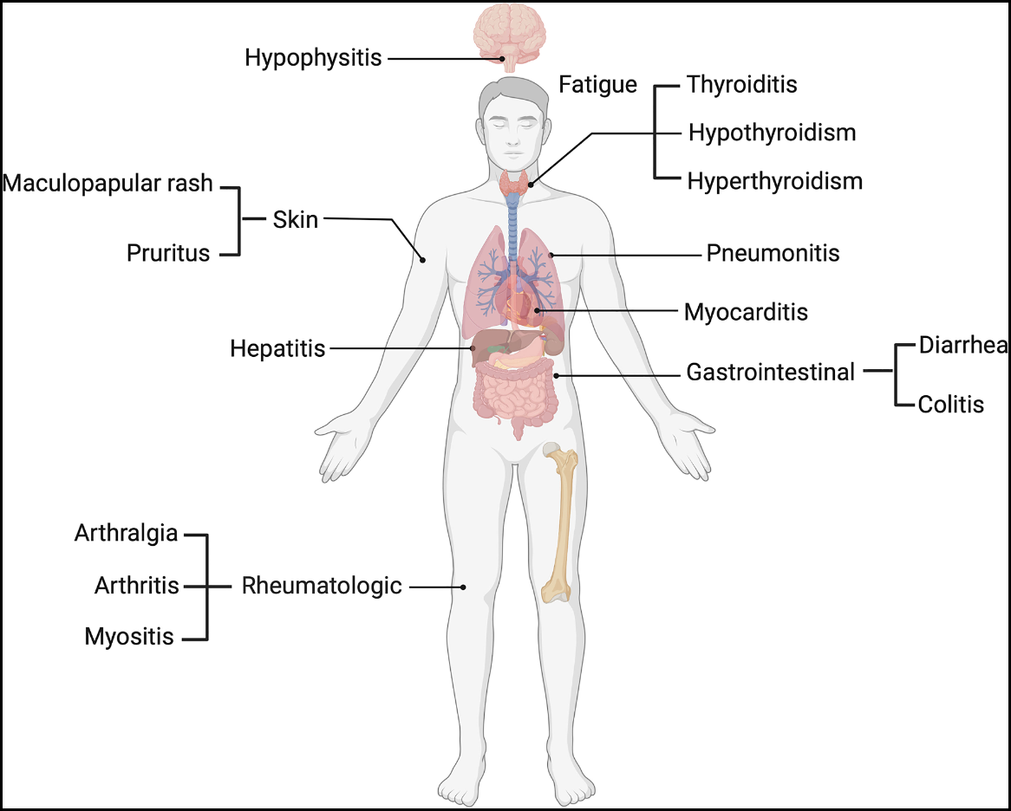
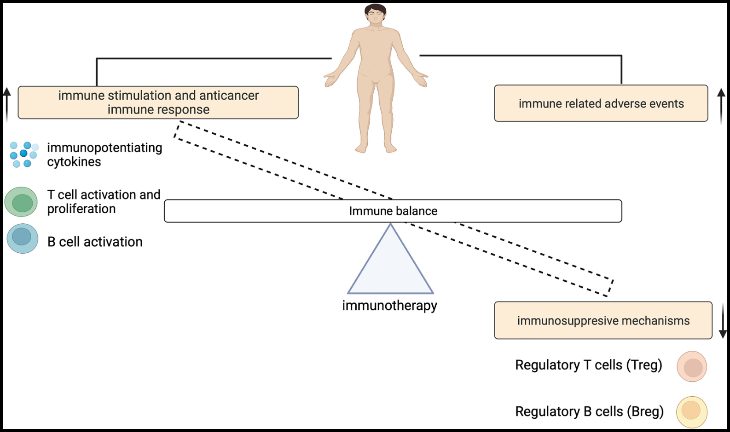
ICIs: Immune System Imbalance Leads to Immune-Related Adverse Events
Common Immune-Related Adverse Events
Immune System Imbalance
ICI, immune checkpoint inhibitor
Taylor J, et al. Front Immunol. 2023;13:991433. © 2023 Taylor, Gandhi, Gray and Zaenker. Figures used without modification under approved terms of Creative Commons Attribution License. http://creativecommons.org/licenses/by/4.0/

Slide 24
General Management of irAEs Associated With ICIs¹⁻³
Grade | Steroids | Treatment | Persistent/Recurring
1 | Treat symptomatically, no systemic steroids | Can continue
2 | Steroids for selected irAEs and recurrent irAEs | Continue Hold for selected irAEs | Systemic steroids Consider withholding; discontinue if ≥12 wk
3 | Systemic steroids, prolonged tapers | Withhold or discontinue* | Systemic steroids and discontinue
4 | High-grade systemic steroids, prolonged tapers | Discontinue (unless endocrine irAE) | Add other immune suppressants
*Discontinue for grade 3 renal toxicity, pneumonitis, and infusion reactions; provider discretion for grade 3 hepatotoxicity
Selected AEs: colitis, pneumonitis, liver/renal toxicity, hypophysitis, neurologic
Systemic steroids (PO or IV): 1-2 mg/kg/day prednisone or equivalent (slow taper over ≥ 4 wk recommended)³
For steroid-refractory AEs → consider adding infliximab, mycophenolate mofetil, vedolizumab
Avoid infliximab for steroid-refractory immune-related hepatitis (consider mycophenolate mofetil)
AEs, adverse events; ICI, immune checkpoint inhibitor; irAE, immune-related adverse event; IV, intravenous; PO, by mouth; wk, week
1. Brahmer JR, et al. J Clin Oncol. 2018;36(17):1714-1768. 2.Trinh S, et al. Asia Pac J Oncol Nurs. 2019;6(2):154-160.
3. National Comprehensive Cancer Network. Management of Immunotherapy-Related Toxicities. v.2.2023.Accessed Aug 8, 2023. https://www.nccn.org/professionals/physician_gls/pdf/immunotherapy.pdf

Slide 25
BRAF/MEK Inhibitor Adverse Event Management¹⁻²
Dermatologic
Baseline skin exam
Limit sun exposure (use sunscreen)
Ocular
Baseline retinal eval
Visual toxicities
Hepatic
LFTs at baseline then monthly
Hold BRAFi and MEKi for grade ≥ 3
GI
Pyrexia
Monitor up to 6 mo after d/c
Manage rash with topical steroids or antibiotic cream
Repeat as needed
Grade 1:
Grade ≥2:
Hold MEKi
Urgent ophthalmology consult
Continue tx
Cardiac
ECG at baseline and day 15
Then monthly x 3 → followed by Q3 mo
LVEF at baseline, 1 mo, then every 2-3 months
Hold MEKi for decreased LVEF
Hold MEKi if no improvement within 2 wks
Repeat Q2 mo
Acetaminophen or ibuprofen to manage
Infection workup as needed
Oral corticosteroids if necessary
May consider BRAFi dose reduction if needed
Manage with supportive care
Antidiarrheals
Antiemetics
Consider holding therapy for grade ≥ 3
d/c, discontinue; ECG, echocardiogram; i, inhibitor; LFTs, liver function tests; LVEF, left ventricular ejection fraction; mo, month; Q, every; tx, treatment; wks, weeks
1. Daud A, et al. Oncologist. 2017;22(7):823-833.
2. Schreck KC, et al. Neurooncol Pract. 2020;7(4):369-375.

Slide 26
Summary
Overall survival continues to improve for patients with melanoma thanks to novel therapies and education initiatives, but gaps remain
Stage IIB/C and IIIA cutaneous melanoma have significant risk of recurrence
Frontline combination ICI followed by BRAF/MEK inhibitors at disease progression in BRAF+ metastatic melanoma improves OS
Treatment recommendations should be individualized based on patient factors
Monitor patients for irAEs with immunotherapy and targeted AEs with BRAF/MEK combinations
Adjuvant therapy is standard of care for stage IIB/C and IIIA resected melanoma
AE, adverse event; irAE, immune-related adverse event; OS, overall survival

