Slide 1
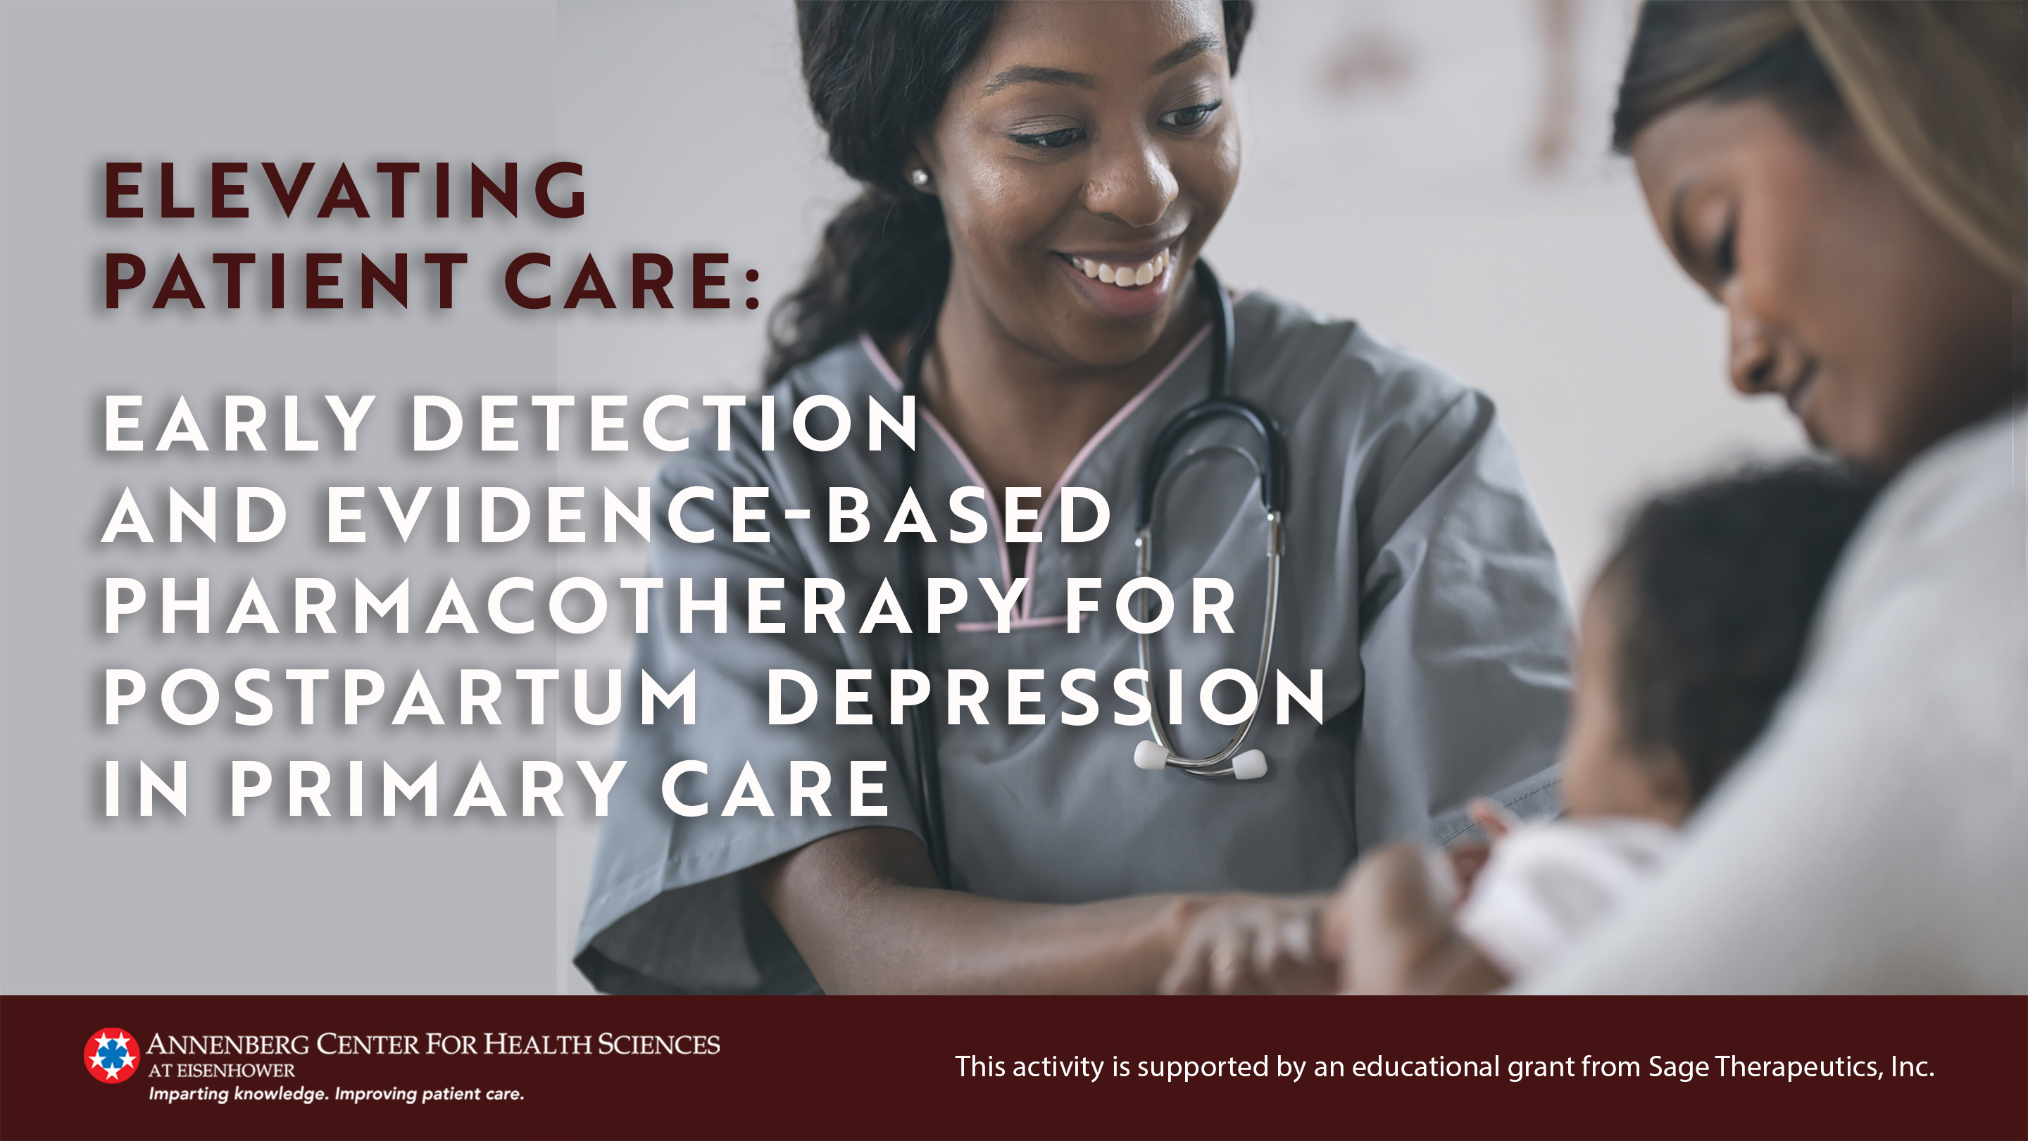

Slide 2

Depression During and After Pregnancy Is Common
Incidence of depression
  Postpartum period: 10% to 15%
  Pregnancy: ~15%
Leading contributor to maternal morbidity and mortality
Dama MH, et al. J Am Board Fam Med. 2024;36(6):1071-1086; Justesen K, et al. Am Fam Physician 2023;108(3):267-273; Ko JY, et al. MMWR Morb Mortal Wkly Rep 2017;66:153-158; Wisner KL, et al. JAMA Psychiatry. 2013;70(5):490-498.
Image by Freepik. https://www.freepik.com/free-ai-image/black-pregnant-women-posing_186574324.htm#fromView=search&page=1&position=4&uuid=b41f93d1-65dd-4060-accc-63e4aa9d8a31

Slide 3
Postpartum Depression Impacts Mothers, Babies and Families
Mothers at an increased risk for the following difficulties:
Children at an increased risk for the following problems:^{3,5,6}
Compromised parenting behaviors¹
Substance misuse²
Relationship problems³
Financial difficulties³
Suicidal ideation and suicide^{3,4}
Delayed developmental milestones
Lower IQ, poorer executive function
Sleep difficulties
Socioemotional difficulties
Psychiatric illness

Slide 4
Potential Effects of Unrecognized and Un- and Under-Treated Depression During Pregnancy¹
Inadequate nutrition
Increased hospital admissions
Pregnancy complications
Preterm delivery
Intrauterine growth restriction
Low birth weight infant
  Major depressive episode may follow pregnancy loss, with severity proportional to gestational age at loss²
1. Chan J, et al. Can Fam Physician. 2014;60(3):242-243; 2. Wisner KL, et al. JAMA Psychiatry. 2013;70(5):490-498

Slide 5
Summary of Consensus Recommendations
Society/Organization | Recommendation
US Preventive Services Task Force¹ | Routinely screen all pregnant patients for depression during peripartum
American Psychiatric Association² | Screen all pregnant patients for mood and anxiety disorders using a validated screening tool 2x during pregnancy 1x postpartum 1-, 2- and 4-month well-child visits
American College of Obstetrics and Gynecology³ | Screen all patients for mood and anxiety disorders before, during, and after pregnancy using a validated screening tool
American Academy of Pediatrics⁴ | Screen birth parents for depression at 1-, 2-, 4- and 6-month well-child visits
*Note that AAFP has not formalized its recommendations but supports evidence-based guidelines, including from USPSTF.⁵
AAFP, American Academy of Family Physicians; USPSTF, United States Preventive Services Task Force
1. USPSTF. JAMA 2023;329(23):2057-2067; 2. APA. 2018. https://www.psychiatry.org/getattachment/c5db4e7b-6405-4655-aecb-bc79d5efb4ea/Position-Screening-and-Treatment-Mood-Anxiety-Disorders-During-Pregnancy-Postpartum.pdf; 3. ACOG. Obstet Gynecol. 2023;141(6):1232-1261. 4. Earls YF et al. Pediatrics. 2019;143(1):e20183259; 5. Justesen K, et al. Am Fam Physician 2023;108(3):267-273.

Slide 6
USPSTF Recommendations
The USPSTF recommends that all adults, including those who are pregnant or postpartum, be screened for depression.
(Grade B recommendation*)
Provide intervention or refer patients for evidence-based diagnosis and care
*Grade B recommendation: USPSTF recommends the service with either high certainty of moderate benefit or moderate certainty of moderate to substantial benefit
USPSTF, United States Preventive Services Task Force
USPSTF. JAMA 2023;329(23):2057-2067.

Slide 7
APA Recommendations: A Deeper Dive
Note suicidal thoughts and behaviors
Diagnose MDE
Screen for other psychiatric disorders
  Bipolar disorder
  GAD
  OCD
  PTSD
APA, American Psychiatric Association; MDE, major depressive episode; GAD, generalized anxiety disorder; OCD, obsessive compulsive disorder; PTSD, post-traumatic stress disorder
Moore Simas TA, et al. JAMA. 2023;330(23):2295-2296; APA. 2018. https://www.psychiatry.org/getattachment/c5db4e7b-6405-4655-aecb-bc79d5efb4ea/Position-Screening-and-Treatment-Mood-Anxiety-Disorders-During-Pregnancy-Postpartum.pdf

Slide 8
Screening for PPD Is Important^{1,2}
Onset of Depression
A study of 10,000 women who completed the Edinburgh Postnatal Depression Scale 4 to 6 weeks postpartum¹
14% screened positive for PPD, with EPDS scores ≥10
Nearly 20% had self-harm ideation
22.6% of screen-positive participants had bipolar disorder

Slide 9
Screening Tools: EPDS & PHQ-9
Endorsed in multiple guidelines –
USPSTF, APA, ACOG, AAFP, AAP
Both assess suicidality in final question
AAFP, American Academy of Family Physicians; AAP, American Academy of Psychiatry; ACOG, American College of Obstetrics and Gynecology; APA, American Psychiatric Association; EPDS, Edinburgh Postnatal Depression Scale; PHQ-9, Patient Health Questionnaire-9; USPSTF, United States Preventive Services Task Force
Justesen K, et al. Am Fam Physician 2023;108(3):267-273; APA. 2018. https://www.psychiatry.org/getattachment/c5db4e7b-6405-4655-aecb-bc79d5efb4ea/Position-Screening-and-Treatment-Mood-Anxiety-Disorders-During-Pregnancy-Postpartum.pdf

Slide 10
Edinburgh Postnatal Depression Scale
Item scores range from 0-3
Total score ≥10 suggests depression
Laughing?
Enjoying things?
Blaming self?
Anxious?
Scared?
Trouble sleeping?
Sad?
Crying?
Always check item #10 for anything other than “Never”
“The thought of harming myself has occurred to me
Yes, quite often
Sometimes
Hardly ever
Never”
Cox JL, et al. Br J Psychiatry. 1987;150:782-786.

Slide 11
Screening Goes Beyond Depression^{1,2,3}
An estimated 20%–25% of individuals who screen positive 4-6 weeks postpartum may have bipolar disorder³
Bipolar Disorder
  MDQ
  CIDI
Substance Use Disorders
  4Ps
  NIDA Quick Screen
Generalized Anxiety Disorder
  GAD7
4Ps, Parents, Partners, Past and Pregnancy; GAD, generalized anxiety disorder; MDQ, Mood Disorder Questionnaire; Composite International Diagnostic Interview; NIDA, National Institute on Drug Abuse
1. Moore Simas TA, et al. JAMA. 2023;330(23):2295-2296; 2. APA. 2018. https://www.psychiatry.org/getattachment/c5db4e7b-6405-4655-aecb-bc79d5efb4ea/Position-Screening-and-Treatment-Mood-Anxiety-Disorders-During-Pregnancy-Postpartum.pdf; 3. Wisner KL, et al. JAMA Psychiatry. 2013;70(5):490-498

Slide 12
Mood Disorder Questionnaire
“Has there ever been a period of time when you were not your usual self and…”
Hyper
Irritable
Confident
Not sleeping
Racing thoughts
Foolishness
Trouble concentrating
Excessive energy
Increased sociality
Hypersexual
Risky behavior
Excessive spending
“Have several of these ever happened during the same period of time?”
“How much of a problem did any of these cause you?”
Hirschfeld RM, et al. Am J Psychiatry. 2000;157(11):1873-1875.

Slide 13
Who Should Screen, and When?
During pregnancy
MDs/DOs (FM, OB)
Doula/Midwives
NPs/PAs
Nurses
Office staff
Delivery/hospital
stay
MDs/DOs (FM, OB)
Doula/Midwives
NPs/PAs
Nurses
Well-child visit @ 2 weeks
MDs/DOs (FM, PED)
NPs/PAs
Nurses
Office staff
Postpartum visit @ 6 weeks
MDs/DOs (FM, OB)
Nurses
NPs/PAs
Office staff
Subsequent routine well-child visits
MDs/DOs (FM, PED)
NPs/PAs
Nurses
Office staff
Within 1-year of delivery
MDs/DOs (FM, PSY, PED)
NPs, PAs
Nurses
Office staff
Routine screening is important and can be part of routine care. Having a PND screening champion can facilitate.¹
FM, family medicine; NP, nurse practitioner; OB, obstetrician/gynecologist; PA, physician assistant; PED, pediatrician; PSY, psychiatrist; PND, perinatal depression
1. Yawn, B. P.et al. Ann Fam Med. 2012;10(4):320-329.

Slide 14
Use DSM-5 Criteria to Confirm MDE Diagnosis
≥1 Symptom
≥4 Symptoms
Depressed mood
AND/OR
Loss of interest or pleasure most of the day, nearly every day for ≥2 wks
Weight loss/decreased appetite; insomnia/hypersomnia
Fatigue or loss of energy; psychomotor agitation or retardation
Feeling worthless/inappropriate guilt; decreased ability to think, concentrate, or make decisions
Recurrent thoughts of death, suicidal ideation, plan or attempt
+
  Additional Criteria: Symptoms
    Cause significant distress or impairment in functioning
    Are not attributable to effects of a substance or another medical condition
DSM-V, Diagnostic and Statistical Manual of Mental Disorders, 5th edition
American Psychiatric Association. Diagnostic and Statistical Manual of Mental Disorders 5th ed. 2013.

Slide 15
Risk Factors = Prompt Screening and Early Intervention
Personal history of depression
Discontinuation of antidepressant medication for pregnancy
Family history of depression
Personal history of anxiety
Complicated pregnancy or birth
Ambivalence about the pregnancy
Stressful life events
Breastfeeding difficulties
Marital conflict/single motherhood/adolescent pregnancy
Abuse history
Substance use disorder (SUD)
Poor social support/high interpersonal conflict
Low socioeconomic status
Preexisting diabetes mellitus/ gestational diabetes
Beck CT. J Obstet Gynecol Neonatal Nurs. 2002;31(4):394-402.
Chechko N, et al. BJPsych Open. 2024;10(1).e3.
Justesen K, et al. Am Fam Physician 2023;108(3):267-273.

Slide 16
Overcoming Barriers in Diagnosis and Beyond
  Many women with untreated PPD still depressed 3-5 years after delivery, particularly mothers with a history of
  Mood disorder³
  Gestational diabetes mellitus³
  Preterm delivery⁴
Greater acceptability when mental health services provided within FM¹ or OB² clinic
1. Yawn BP, et al. Ann Fam Med. 2012;10(4):320-329. 2. Goodman JH, et al. Birth. 2009;36(1):60-69. 3. Putnick DL, et al. Pediatrics. 2020;146:e20200857. 4. Roubinov D, et al. Arch Womens Ment Health. 2022;25:807-817.

Slide 17
Overview of Evidence-Based Treatment Options
VS
or
plus
Pharmacotherapy
Psychotherapy
The USPSTF recommends offering psychotherapy to patients who are at an increased risk of developing depression, can decrease perinatal depression by 39%.
USPSTF, U. S. Preventive Services Task Force
ACOG. Obstet Gynecol. 2023;141(6):1262-1288; Justesen K, et al. Am Fam Physician 2023;108(3):267-273; Simas TA, et al. JAMA. 2023;330(23):2295-2296; USPSTF. JAMA 2023;329(23):2057-2067.

Slide 18
Treatment Approach Based on Severity
Mild-to-moderate
First-line if prior AD response
  AD that previously was effective
First-line if no prior AD therapy
  Online or in-person CBT or IPT
  OR
  SSRI monotherapy (sertraline vs fluoxetine)
Second-line: Other AD monotherapy (SNRI, atypical AD)
Consider adjuncts
  Psychotherapy
  Social/peer support groups
  Exercise programs
Moderate-to-severe
First-line
  Medication previously effective or SSRI monotherapy
Second-line
  Other AD monotherapy
Possible adjuncts
  CBT
  Evidence-based AD adjuncts, eg, atypical antipsychotics, buspirone, T3/T4
NAS GABA-A receptor PAM may be indicated if depressed during pregnancy, but not in remission with SOC antidepressants

Slide 19
Key Treatment Goal:
Minimize Risk While Treating to Remission
Risk of untreated maternal depression on mother and fetus
VS
Risk of medications during pregnancy and lactation
What is the lowest effective dose for symptom remission, without underdosing your patient?
Betcher HK et al. J Womens Health. 2020;29(3):310-318.

Slide 20
The Collaborative Care Model
Primary Care
Clinician
Behavioral Health Care Manager
Patient, Family
Psychiatric Consultant
Registry
American Psychiatric Association. https://www.psychiatry.org/psychiatrists/practice/professional-interests/integrated-care/learn.
The Community Guide. https://www.thecommunityguide.org/findings/mental-health-and-mental-illness-collaborative-care-management-depressive-disorders.html

Slide 21
Meta-Analysis and Systematic Review: SSRIs
Selection criteria
  RCTs of women within 12 mos postpartum period
  Compared AD (alone/in combination) vs any other treatment, placebo, or treatment as usual
SSRIs > placebo
  Response (55% vs 43%; RR 1.27, 95% CI 0.97 to 1.66)
  Remission (42% vs 27%; RR 1.54, 95% CI 0.99 to 2.41)
  Reduced depressive symptoms (SMD -.30, 95% CI -0.55 to -0.05)
  There is a critical need for more efficacy data surrounding SSRIs in the postpartum period
SSRI, selective serotonin reuptake inhibitors; AD, antidepressant; CI, confidence interval; RR, pooled risk ratio; SMD, standard mean deviation; Use is not within current product labels approved by the US FDA for SSRIs.
Brown JEV, et al. Cochrane Database Syst Rev. 2021;2(2):CD13560.

Slide 22
Risk During Pregnancy More Likely Related to MDE Than Medications
Teratogenicity?
Obstetric complications?
  Preterm delivery
  Spontaneous abortion
Neonatal toxicity?
  Persistence of drug effects (eg, sedation) after delivery
  Drug withdrawal when infant is no longer exposed
Long-term neurobehavioral effects?
Underdosing leads to exposure to both effects of the depression and the antidepressant drug (worse outcome)¹
1. Betcher HK et al. J Womens Health. 2020;29(3):310-318.

Slide 23
SSRIs and Teratogenicity
Current data shows no consistent information to support specific teratogenic risks
Except Paroxetine¹
  Unpublished data from manufacturer (2005): risk of cardiac malformations → warning on label
  Meta-analysis of 23 studies (2015) concluded statistically significant increased risk of:
    Any major congenital malformation (OR 1.23)
    Major cardiac malformations (OR 1.28)
      Cardiac septal defects (OR 2.38)
      RV outflow tract defects (OR 2.29)
SSRIs, selective serotonin reuptake inhibitors; Use is not within current product labels approved by the US FDA for SSRIs.
1. Berard A, et al. Br J Clin Pharmacol. 2016;81(4):589-604.

Slide 24
SSRIs and Other Pregnancy Complications
Preterm delivery
  Rates exceeding 20% vs 6% without
Spontaneous abortion
  Associated with small elevation in risk (HR 1.17)
  Underlying depression vs SSRI?
Small gestational age infants
  Absolute difference in incidence risk = 0.033
Underlying depression vs SSRI?

Slide 25
No Documented Association of SSRIs and Persistent Pulmonary Hypertension of the Newborn (PPHN)
Only 1 case-control study has shown an association¹
  Infants with PPHN were 6x more likely to have been exposed to SSRIs during 2nd half of gestation
  Two major caveats:
    Only 14 infants
    No control for maternal depression
  Analysis of data inappropriate
No association evidenced in follow-up studies²⁻⁴
SSRIs, selective serotonin reuptake inhibitors; Use is not within current product labels approved by the US FDA for SSRIs
1. Chambers CD, et al. N Engl J Med. 2006;354(6):579-587. 2. Andrade SE, et al. Pharmacoepidemiol Drug Saf. 2009;18(3):246-252. 3. Kallen B, et al. Pharmacoepidemiol Drug Saf. 2008;17(8):801-806. 4. Wilson KL, et al. Am J Perinatol. 2011;28(1):19-24.

Slide 26
SSRIs and Poor Neonatal Adaptation
Clinical Pearls
Much less of a problem vs exposure to untreated MDE
Exposure to SSRI in breast milk is lower than in utero, but high enough to alleviate symptoms of discontinuation syndrome; weaning may further taper exposure
SSRI, selective serotonin reuptake inhibitor; CPAP, continuous positive airway pressure; MDE, major depressive episode; Use is not within current product labels by the US FDA for SSRIs
Liu C, et al. JAMA Netw Open. 2023;6(8):e2331270; Viguera AC, et al. J Clin Psychiatry. 2023;84(1):22m14492

Slide 27
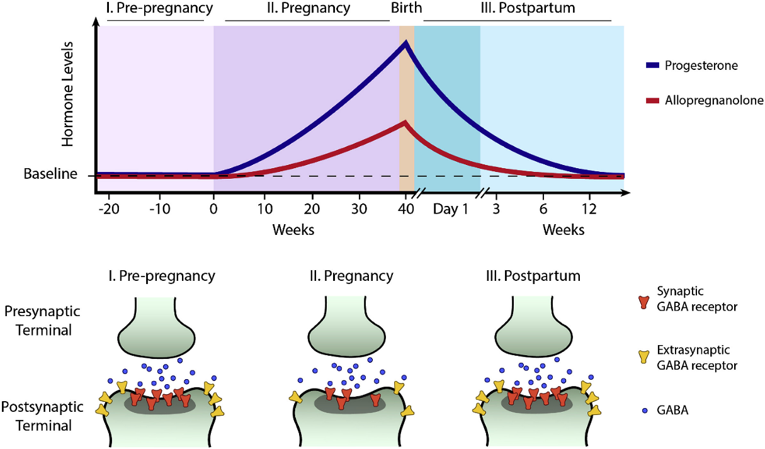
New PPD Therapy Considerations: Allopregnanolone Variations Across Pregnancy and Postpartum

Slide 28
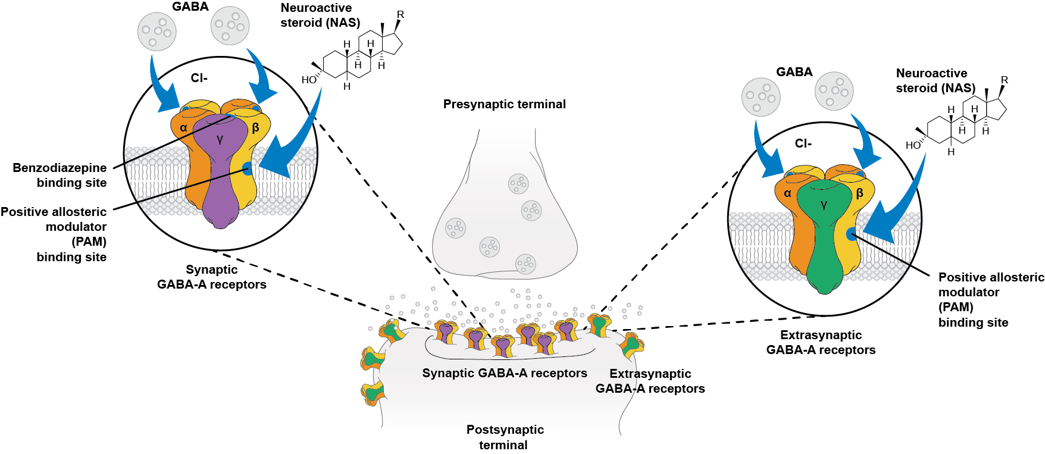
Neuroactive Steroid Binding Sites on GABA-A Receptor^{1,2}
Image courtesy of Anita Clayton, MD.
1. Jacob TC et al. Nat Rev Neurosci. 2008;9:331-343. 2. Reddy DS et al. Trends Pharmacol Sci. 2016;37:543-561.

Slide 29
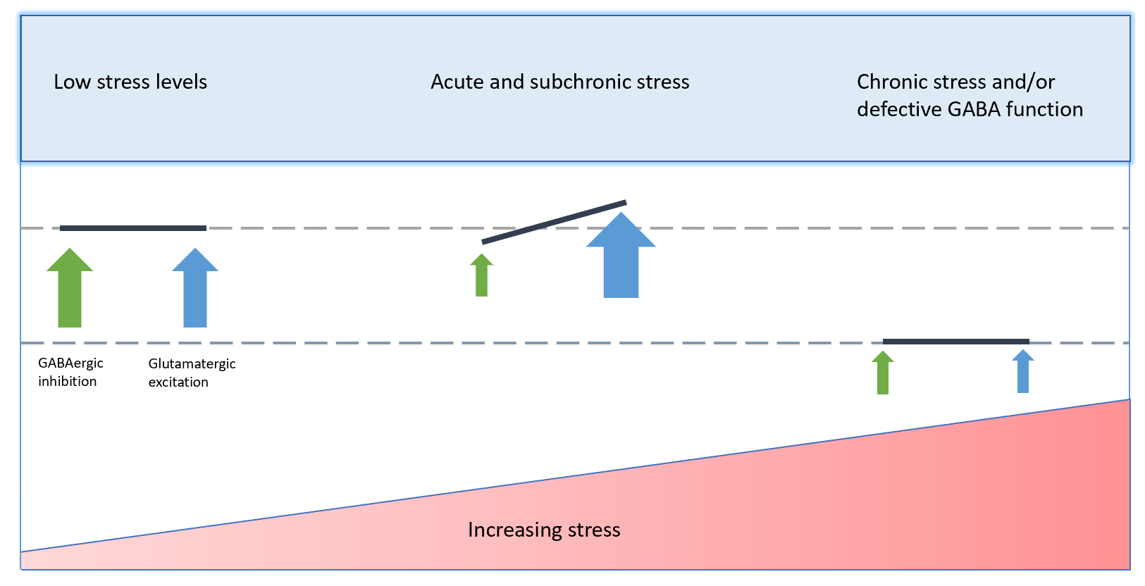
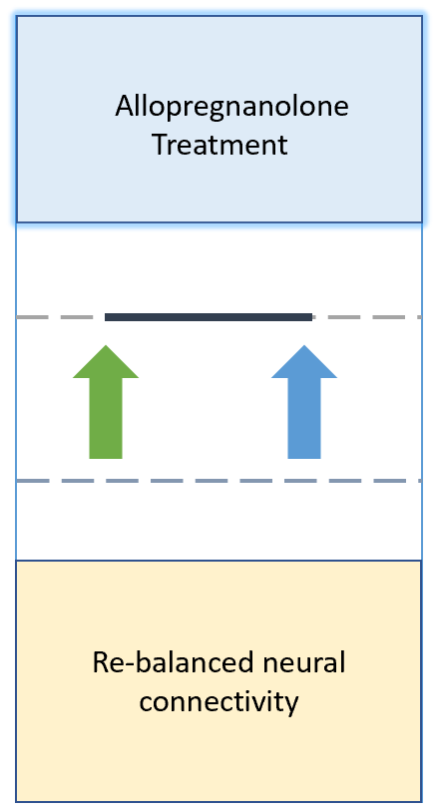
HPA Hyperactivity in PPD/MDD
Acute and subchronic stress
Chronic stress and/or defective GABA function
Allopregnanolone
For PPD Treatment
Low stress levels
Euthymic
Depressed
Image courtesy of Anita Clayton, MD.
HPA, hypothalamic pituitary axis; MDD, major depressive disorder; PPD, postpartum depression;
Antonoudiou P, et al. Biol Psychiatry. 2022;91(3):283-293; Edinoff AN, et al. Front Psychiatry. 2021;12:699740; Meltzer-Brody S, et al. Neurobiol Stress. 2020;12:100212.

Slide 30
Brexanolone IV: 3 Placebo-Controlled Randomized Controlled Trials in Postpartum Depression (Hummingbird)
Studies A and C Randomized: 1:1
Study B Randomized: 1:1:1
Women with PPD
Study A: HAMD-17 ≥26 (severe PPD)
Study B: HAMD-17 ≥26 (severe PPD)
Study C: HAMD-17 20-25 (moderate PPD)
Placebo (PBO)
Hour 60
Complete 12-hour observation period
BRX 90 μg/kg/h
(BRX90, Studies A-C)
BRX 60 μg/kg/h
(BRX60, Study B)
Primary endpoint HAMD-17
Integrated Efficacy Analysis
Study A: Phase 2; N=21
Study B: Phase 3; N=138
Study C: Phase 3; N=108
60-hour continuous IV infusion
BRX90: −17.0
vs
Placebo: −12.8;
P<.0001

Slide 31
Brexanolone: Change From Baseline HAMD-17 Total Score
End of infusion at 60h
LSM: least squares mean
Meltzer-Brody S, et al. Lancet. 2018;392(10152):1058-1070.

Slide 32
Zuranolone: Placebo-Controlled Randomized Controlled Trial in Postpartum Depression (ROBIN)
1:1 Randomized double-blind, N=151
Day 15
Primary Endpoint: HAMD-17
Placebo (PBO)
Zuranolone: −17.8
vs
Placebo: −13.6;
P=0.0028
Women with PPD
HAMD-17 ≥26
Zuranolone 30 mg
14 Days Outpatient Oral Treatment

Slide 33
Zuranolone: Placebo-Controlled Randomized Controlled Trial in Postpartum Depression (SKYLARK)
1:1 Randomized double-blind, N=200
Placebo (PBO)
Day 15
Primary Endpoint
Day 45
Study Endpoint
Women with PPD
HAMD-17 ≥26
Zuranolone 50 mg
14 Days Outpatient Oral Treatment
Zuranolone: −15.6
vs
Placebo: −11.6;
P=0.0007

Slide 34
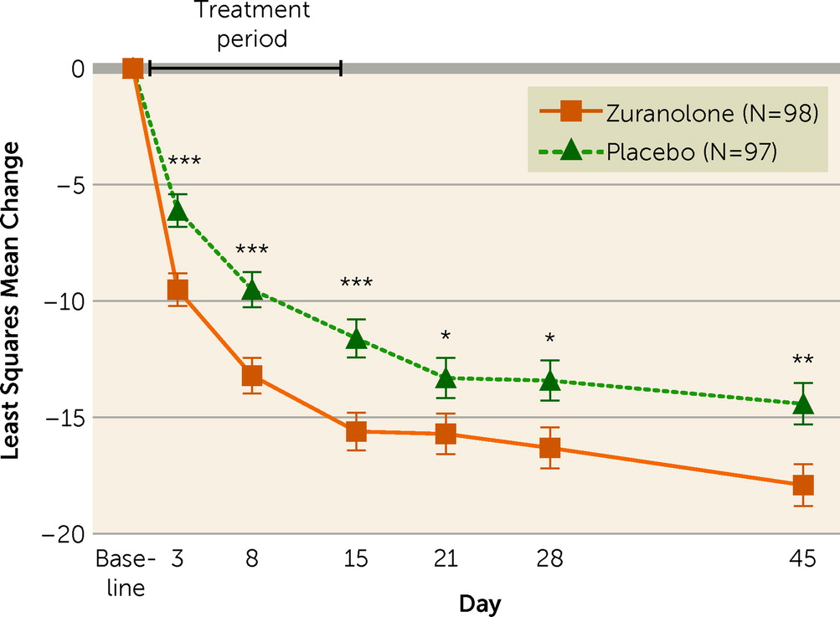
Zuranolone − SKYLARK Trial: Change in HAMD-17 Total Score From Baseline
*
*Note that dosage of zuranolone is 50 milligrams per day
Image created by and reproduced without modification from Deligiannidis KM, et al. Am J Psychiatry. 2023;180:668-675 (https://pubmed.ncbi.nlm.nih.gov/37491938/) under the terms and conditions of the Creative Commons Attribution (CC BY-NC-ND 4.0) as is and as available. ©2023 by the authors.

Slide 35
Zuranolone − SKYLARK Trial: Safety Results
Boxed Warning:
Do not drive or operate heavy machinery within 12 h of taking zuranolone
Most (≥5%) common AEs in zuranolone-treated patients
  Somnolence
  Headache
  Dizziness
  Urinary tract infection
  Diarrhea
  Sedation
No episodes of loss of consciousness
No increase in suicidal ideation or suicidal behavior
Clinical Pearl
Take dosage at night
AE, adverse events
Deligiannidis KM, et al. Am J Psychiatry. 2023;180:9; Zurzuvae. Prescribing Information. Sage Therapeutics, Inc. Accessed May 13, 2024. https://www.accessdata.fda.gov/drugsatfda_docs/label/2023/217369s000lbl.pdf

Slide 36
General Guidelines and Clinical Pearls
Lowest EFFECTIVE dose
Treat to REMISSION
Consider previous responses to therapy
Utilize EPDS/PHQ-9:
  Screening/early detection
  Treatment response/outcomes to remission
Avoid medications with long elimination half-life

Slide 37
General Guidelines and Clinical Pearls:
During Pregnancy
Don’t undertreat: Risks of medication exposure are not dose-related
  Maximize the use of 1 medication as opposed to polypharmacy
  Increase dose as pregnancy progresses if symptoms increase
    Greater volume of distribution
    Faster drug metabolism
Avoid exposure to both drug and continued depression
  Do not reduce dose or stop antidepressant in third trimester
If patient is unsure of plan, assume patient will breastfeed when making decisions in pregnancy

Slide 38
General Guidelines and Clinical Pearls:
Beyond Pregnancy
If patient has a history of a prior episode of postpartum depression and is not depressed in pregnancy
  Start previously effective antidepressant upon delivery
  Rapidly titrate to dose known to work for the individual
Do not withhold treatment due to breastfeeding
  Exposure is much lower than in utero
  Self-tapering will occur with weaning

Slide 39
Case 1: Christine
30-year-old G1P1 Caucasian female
24 weeks pregnant
Routine prenatal visit
1 month of depressive symptoms
EPDS score 12 at 20 weeks; now 22 (#10=1).
EPDS, Edinburgh Postnatal Depression Scale; MDE, major depressive episode

Slide 40
Christine, Continued
PMH: GAD, managed via individual psychotherapy
SH: multiple stressors, including
  Preschool teacher and after-school nanny- demoted at work
  Struggles with husband’s infidelity
  Possibilities of separation/divorce
  Stressed about finances and husband’s erratic spending patterns
  Husband recently diagnosed with bipolar disorder
PMH, past medical history; GAD, generalized anxiety disorder; SH, social history

Slide 41

“My boss keeps acting like I’m being whiny because she had such an easy pregnancy, but my pregnancy is hard, and she makes me feel like I’m nothing.”
“I never wanted to see 200 lbs on the scale. I feel so fat and ugly. I hate myself. I can’t believe what’s happening to me.”
“I can’t be pregnant again. I can’t feel like this again. I’m never doing this again.”
“My husband keeps saying I’m mean. I feel angry, sad and irritable all the time.”
Image by rawpixel.com on Freepik. https://www.freepik.com/free-photo/teen-girl-bullied-through-social-media_18641789.htm#query=depression&position=2&from_view=keyword&track=sph&uuid=ca96db1c-e3c4-4ab2-96a0-a57845ab8a6c

Slide 42
Case 2: Nitya
31-year-old G1P1 Indian-American female with 6-week-old son
First-time patient
Reports depressive symptoms
EPDS 25, #10=0
EPDS, Edinburgh Postnatal Depression Scale

Slide 43

“I don’t want to kill myself, but I do picture myself being hit by a car and feeling relieved at the possibility of escape.”
“Everyone says my baby is beautiful. I barely feel anything, and I feel horrible about myself for this.”
“When I picture my future, I see darkness. I don’t know how I can live a life where I keep on feeling like this.”
“I’m losing my pregnancy weight so fast. Everyone is complimenting me, but really, I am too sad to eat.”
Image on Freepik. https://www.freepik.com/free-photo/composition-depression-mental-disorder_41550081.htm#query=depression&position=0&from_view=keyword&track=sph&uuid=67e83bf3-468a-493a-bfa2-21485e434ccd

Slide 44
Nitya, continued
PMH: OCD (10-years); MDE- moderate severity (mid-20s)
  Previous treatment – psychotherapy, 80 mg/day fluoxetine
  Discontinued medication during pregnancy due to severe nausea and vomiting during 1st trimester
MDE, major depressive disorder; OCD, obsessive compulsive disorder

Slide 45
Case 3: Ugochi
34-year-old G2P2 African-American female with infant daughter
6-week postpartum visit
Missed 1-, 2-, and 4-week well-child visits
PMH: PPD in previous pregnancy, managed with sertraline 50 mg/d
  Pregnant with twins during this pregnancy, suffering a late-term pregnancy loss of 1 twin at 35.5 weeks; both twins delivered via
  C-section at 36 weeks (1 live, 1 stillborn)
  Prescribed sertraline 50mg/d upon discharge from hospital
PMD, past medical history; PPD, postpartum depression; Use is not within current product labels approved by the US FDA for sertraline hydrochloride on 3/2024.

Slide 46

“I keep replaying the moment I found out that she didn’t have a heartbeat, each time picturing it happening differently.”
“I can’t stop going over everything I could have possibly done wrong, wondering if that is why it happened, if this was somehow my fault.”
“In fact, I do feel joy. I feel joy over my daughter who is alive. She is my saving grace. But then I am overridden with guilt for feeling that too.”
“This can’t really be happening. I keep replaying what happened. This can’t be real. How can I go back and change it? I want to change it so badly.”
Image by Freepik. https://www.freepik.com/free-photo/young-depressed-adult-home_29973227.htm#fromView=search&page=1&position=12&uuid=0dceb315-6c01-4d2b-bddb-b2c3668d9f5d

Slide 47
Ugochi, continued
Reports depressive symptoms
Also notes significant weight loss due to poor appetite, stomach-aches; also reports frequent headaches
EPDS is 26, #10=2
EPDS, Edinburgh Postnatal Depression Scale

