Slide 1
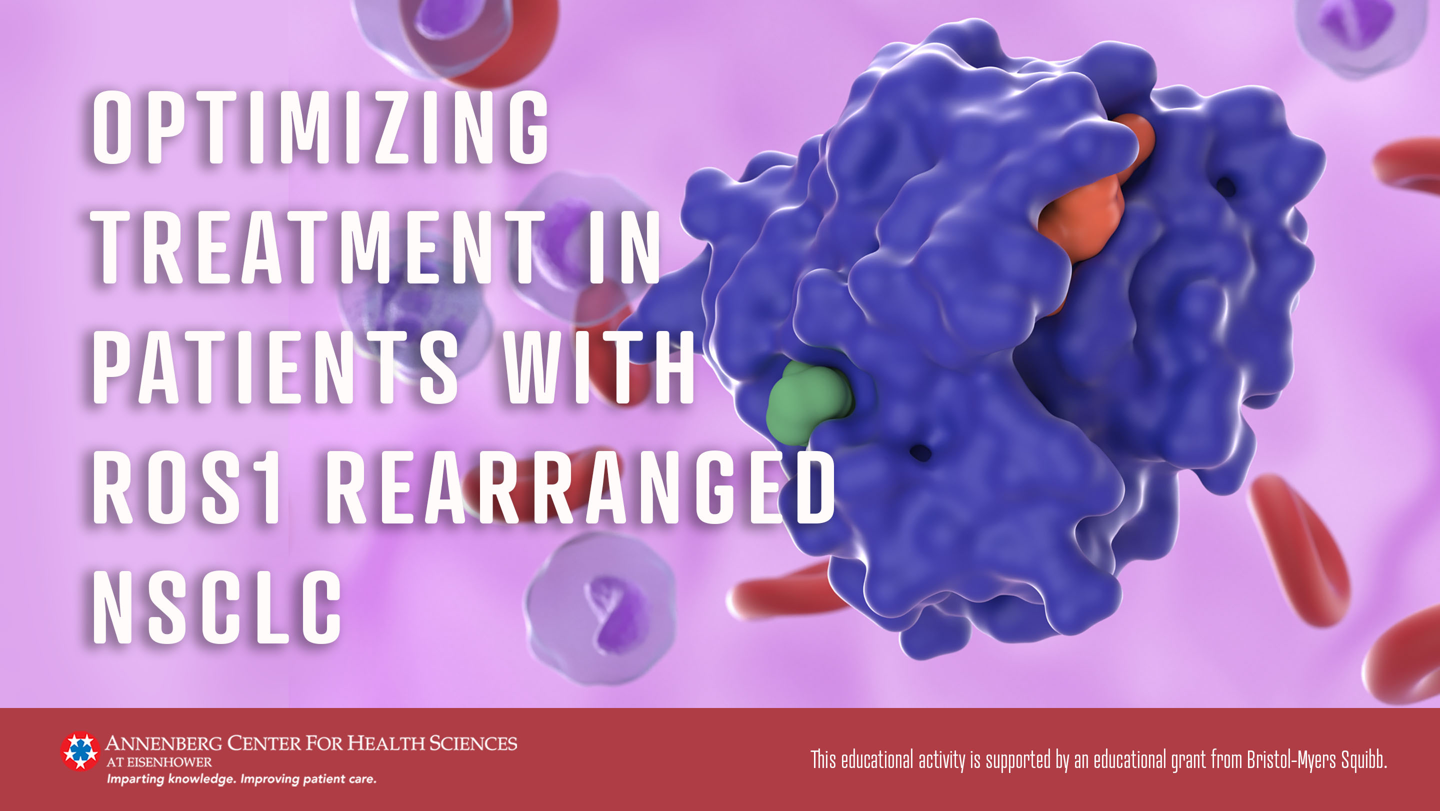

Slide 2
Faculty
Jonathan Dowell, MD
  Professor, University of Texas Southwestern Medical Center
  Chief of Hematology and Oncology, Dallas Veterans Affairs Medical Center
  Education Director, University of Texas Southwestern, Division of Hematology and Oncology

Slide 3
Learning Objectives
Evaluate current first-line treatment options in patients with ROS1 rearranged NSCLC
Optimize ROS1 targeted tyrosine kinase inhibitors in individual patients consistent with current evidence-based guideline recommendations
Assess recent clinical data for emerging therapies in ROS1 rearranged NSCLC

Slide 4
Lung Cancer Overview and ROS1 Rearrangement in Non-Small Cell Lung Cancer (NSCLC)

Slide 5
Survival Gaps: Lung Cancer Incidence & Mortality
Lung Cancer Statistics¹
>234,000 new cases in US for 2024 estimated
12% of new cancer diagnoses
20% of total cancer deaths
5-Year Survival by Stage for Lung Cancer²
Localized: 63.7%
Regional: 35.9%
Distant: 8.9% → accounts for 53% of lung cancer cases
Breast
Pancreatic
Lung
Colorectal
1. Siegel RL, et al. CA Cancer J Clin. 2024;74(1):12-49; 2. National Cancer Institute. Cancer Stat Facts: Lung and Bronchus Cancer. Accessed Jul 20, 2024. https://seer.cancer.gov/statfacts/html/lungb.html

Slide 6
Non-Small Cell Lung Cancer (NSCLC)¹⁻⁴
NSCLC Histology Subtypes^{1,4}
NSCLC most common subtype → ~80%-85%^{1,4}
5-year OS for NSCLC = 25% in United States¹⁻⁴
  Survival continues to increase with advances in targeted and immunotherapy, but treatment gaps remain
1. Thai AA, et al. Lung cancer. Lancet. 2021;398(10299):535-554; 2. Siegel RL, et al. CA Cancer J Clin. 2024;74(1):12-49; 2. National Cancer Institute. Cancer Stat Facts: Lung and Bronchus Cancer. Accessed Jul 20, 2024. https://seer.cancer.gov/statfacts/html/lungb.html; 4. NCCN Guidelines. Non-Small Cell Lung Cancer. V7.2024. Accessed Jul 20, 2024. https://www.nccn.org/professionals/physician_gls/pdf/nscl.pdf

Slide 7
Molecular Alterations in NSCLC^{1,2}
Several predictive and prognostic genomic alterations are of interest in NSCLC
Certain alterations may increase risk for central nervous system (CNS) metastasis compared to NSCLC without a mutation
Other/ Unknown
KRAS
RET
ROS1
ERRB2/ HER2
EGFR
BRAF
MET
ALK
1. Friedlaender A, et al. Biomark Res. 2024;12:24, figure adapted under the terms and conditions of the Creative Commons Attribution (CC BY) license (http://creativecommons.org/licenses/by/4.0/; 2. NCCN Guidelines. Non-Small Cell Lung Cancer. V7.2024. Accessed Jul 20, 2024. https://www.nccn.org/professionals/physician_gls/pdf/nscl.pdf

Slide 8
ROS1 Rearrangements: Rare, Important Genetic Alteration in NSCLC
ROS1 rearrangements identified in ~1%-2% of patients with NSCLC¹⁻³
ROS1 oncogene encodes a tyrosine kinase related to ALK⁴
Rearrangement leads to fusion of ROS1 portion with various partner proteins → drives cellular transformation and act as potent oncogenic drivers⁵
Common presentation related to ROS1 NSCLC⁶⁻⁸:
Younger patients
Female
Adenocarcinoma histology
Never smoker
1. Bergethon K, et al. J Clin Oncol. 2012;30(8):863-870 2. Dugay F, et al. Oncotarget. 2017;8:53336-53351 3. Davies KD, Doebele RC. Clin Cancer Res. 2013;19(15):4040-5 4. Acquaviva J, et al. Biochim Biophys Acta. 2009;1795(1):37-52 5. Davies KD, Doebele RC. Clin Cancer Res. 2013;19(15):4040-4045 6. Bi H, et al. Transl Cancer Res. 2020;9(7):4383-4392 7. Gainor JF, Shaw AT. Oncologist. 2013;18(7):865-75 8. Marchetti A, et al. JCO Precis Oncol. 2017;1:1-9

Slide 9
ROS1 Targeted Therapy in NSCLC

Slide 10
ROS1 Targeted Agents for Frontline Treatment
Ceritinib²
2nd generation ROS1 and ALK targeted multikinase inhibitor
Dosing: 450 mg once daily with food
Crizotinib³
1st generation ROS1 and ALK targeted multikinase inhibitor
Dosing: 250 mg twice daily
Entrectinib⁴
1st generation ROS1 and NTRK targeted multikinase inhibitor
Repotrectinib⁵
Next generation ROS1 and NTRK targeted multikinase inhibitor
Dosing: 600 mg once daily
Dosing: 160 mg once daily for 14 days, then twice daily
**NCCN guidelines recommend testing for ROS1 gene rearrangements prior to first line therapy in metastatic NSCLC¹
1. NCCN Guidelines. Non-Small Cell Lung Cancer. V7.2024. Accessed Jul 20, 2024. https://www.nccn.org/professionals/physician_gls/pdf/nscl.pdf 2. Zykadia. Prescribing Information. Novartis Pharmaceutical Corp; Oct 2021. Accessed Jul 20, 2024. https://www.novartis.com/us-en/sites/novartis_us/files/zykadia.pdf 3. Xalkori. Prescribing information. Pfizer, Inc.; Sept 2023. Accessed Jul 21, 2024. https://labeling.pfizer.com/ShowLabeling.aspx?id=676 4. Rozlytrek. Prescribing Information. Genentech, Inc.; Jan 2024. Accessed Jul 21, 2024. https://www.gene.com/download/pdf/rozlytrek_prescribing.pdf 5. Augtyro. Prescribing Information. Bristol-Myers Squibb Company; Jun 2024. Accessed Jul 21, 2024. https://packageinserts.bms.com/pi/pi_augtyro.pdf

Slide 11
NCCN ROS1 Rearrangement Treatment Algorithm
Preferred 1st-line
Crizotinib
Repotrectinib
Other Recommended
Ceritinib
Entrectinib
*If ROS1 rearrangement discovered after 1st-line treatment has already begun:
Complete planned systemic therapy (including maintenance)
Or
Interrupt therapy and initiate 1 of the ROS1 targeted agents listed above
Adapted from National Comprehensive Cancer Network Guidelines. Non-Small Cell Lung Cancer. V7.2024. Published Jun 26,2024. Accessed Jul 22, 2024. https://www.nccn.org/professionals/physician_gls/pdf/nscl.pdf

Slide 12
Subsequent Therapy For Metastatic ROS1 NSCLC
Progression on 1st-line therapy
Evaluate if patient is symptomatic due to disease progression
Asymptomatic
Consider definitive local therapy (surgery or stereotactic ablative radiotherapy)
Symptomatic
Consider definitive local therapy
Continue 1st-line ROS1 targeted therapy
Repotrectinib (if not used previously) or lorlatinib
Entrectinib (if crizotinib or ceritinib used previously) or repotrectinib (if not used previously) or lorlatinib
Brain
Systemic
  Repotrectinib (if not used previously) or lorlatinib
  Or systemic therapy options (chemotherapy/immunotherapy)
Multiple lesions
Adapted from National Comprehensive Cancer Network Guidelines. Non-Small Cell Lung Cancer. V7.2024. Published Jun 26,2024. Accessed Jul 22, 2024. https://www.nccn.org/professionals/physician_gls/pdf/nscl.pdf

Slide 13
ROS1 Targeted Therapy Safety

Slide 14
Crizotinib Safety Profile^{1,2}
Common Adverse Events
(*Majority low grade)
Vision disorders (71% of patients)
GI toxicity (nausea-56%, vomiting -46%, diarrhea – 61% or constipation – 43%)
Edema (49% of patients)
Serious/Rare Adverse Events
Hepatotoxicity – monitor liver function tests every 2 weeks for first 2 months
Interstitial Lung Disease (ILD)
Bradycardia (13% of patients) – monitor heart rate and blood pressure
QT Prolongation – monitor ECG and electrolytes in at risk patients
Severe Vision Loss – insufficient data to characterize patients at risk
Dose Reduction
(250 mg twice daily)
1st dose reduction: 200 mg twice daily
2nd dose reduction: 250 mg once daily (discontinue permanently if not tolerated after 2nd dose reduction)
1. Xalkori. Prescribing information. Pfizer, Inc.; Sept 2023. Accessed Jul 21, 2024. https://labeling.pfizer.com/ShowLabeling.aspx?id=676 2. Shaw AT, et al. Ann Oncol. 2019;30(7):1121-1126

Slide 15
Entrectinib Safety Profile^{1,2}
Common Adverse Events
(*Majority are low grade)
Fatigue (48%)
GI toxicity (nausea – 34%, vomiting – 24%, diarrhea – 35%, or constipation – 46%)
Dysgeusia (48%)
Edema (40%)
Weight gain (25%)
Vision disorders (21%)
Serious/Rare Adverse Events
Congestive Heart Failure (CHF) – assess left ventricular ejection fraction prior to starting therapy
CNS effects – dizziness, cognitive impairment, mood disorders, sleep disturbances
Skeletal fracture risk increase
Hepatotoxicity – monitor liver function tests every 2 weeks during first month of therapy then monthly
QT Prolongation – monitor at risk patients
Dose Reductions
(600 mg once daily)
1st dose reduction: 400 mg once daily
2nd dose reduction: 200 mg once daily (discontinue permanently if not tolerated after 2nd dose reduction)
1. Rozlytrek. Prescribing Information. Genentech, Inc.; Jan 2024. Accessed Jul 21, 2024. https://www.gene.com/download/pdf/rozlytrek_prescribing.pdf 2. Drilon A, et al. Lancet Oncol. 2020;21(2):261-270

Slide 16
Repotrectinib Safety Profile^{1,2}
Common Adverse Events
(*Majority are low grade)
Dizziness (65%)
Dysgeusia (54%)
Peripheral neuropathy (49%)
GI toxicity (nausea – 20% and constipation – 38%)
Cognitive impairment (25%)
Serious/Rare Adverse Events
CNS Effects – dizziness, ataxia, and cognitive impairment (common toxicities – serious events were rare <5%)
Interstitial Lung Disease (ILD)/Pneumonitis
Hepatotoxicity – monitor liver function tests every 2 weeks during first month then monthly
Skeletal fracture risk increase
Hyperuricemia – monitor serum uric acid levels prior to starting therapy and periodically
Dose Reduction
(160 mg twice daily)
Myalgia with Creatine Phosphokinase (CPK) elevation – Monitor serum CPK every 2 weeks during first month as then as needed based on patient symptoms
Fatigue (30%)
Muscular weakness (20%)
1st dose reduction: 120 mg twice daily
2nd dose reduction: 80 mg twice daily (discontinue permanently if not tolerated after 2nd dose reduction)
1. Augtyro. Prescribing Information. Bristol-Myers Squibb Company; Jun 2024. Accessed Jul 21, 2024. https://packageinserts.bms.com/pi/pi_augtyro.pdf 2. Drilon A, et al. N Engl J Med. 2024;390(2):118-131

Slide 17
Sequencing Considerations in ROS1 Rearrangement NSCLC

Slide 18
Clinical Considerations for ROS1 Rearrangement in NSCLC
Repotrectinib as a next generation ROS1 TKI is able to overcome resistance mechanisms and have increased CNS penetration and activity^{1,2}
Unique option for patients with brain metastasis or those who progress on other ROS1 targeted therapies¹
Lorlatinib is a highly potent next generation ROS1 TKI with CNS penetrating capabilities and efficacy^{3,4}
Utilized as subsequent therapy in patients who have progressed on ROS1 TKI therapy (including patients with progression in the CNS)
Not approved for frontline therapy
Factors to consider for frontline and subsequent lines of therapy for ROS1 rearranged NSCLC¹
Patient characteristics, patient preferences, and shared decision making
Disease features including CNS disease/progression
1. NCCN Guidelines. Non-Small Cell Lung Cancer. V7.2024. Accessed Jul 20, 2024. https://www.nccn.org/professionals/physician_gls/pdf/nscl.pdf 2. Drilon A, et al. N Engl J Med. 2024;390(2):118-131 3.
Girard N, et al. ESMO Open. 2022;7(2):100418 4. Lorbrena. Prescribing Information. Pfizer, Inc.; Apr 2023; Accessed Jul 22, 2024. https://labeling.pfizer.com/ShowLabeling.aspx?id=11140

Slide 19
Summary
ROS1 rearrangements are a rare but key genetic alterations found in ~1%-2% of patients with NSCLC
Targeted therapy with tyrosine kinase inhibitors are standard 1st line therapy
However, resistance and CNS progression limit the use and impact of 1st generation ROS1 targeted agents
Next generation ROS1 targeted therapies, including repotrectinib, offer enhanced CNS penetration and activity
Overcomes ROS1-resistant mutations and produce strong responses and disease control in CNS
All patients with metastatic NSCLC should undergo broad next generation sequencing including testing for ROS1 rearrangements
Therapy for ROS1 rearrangements in patients with metastatic NSCLC should be optimized based on patient factors and shared decision making including monitoring and adverse event management

