Slide 1
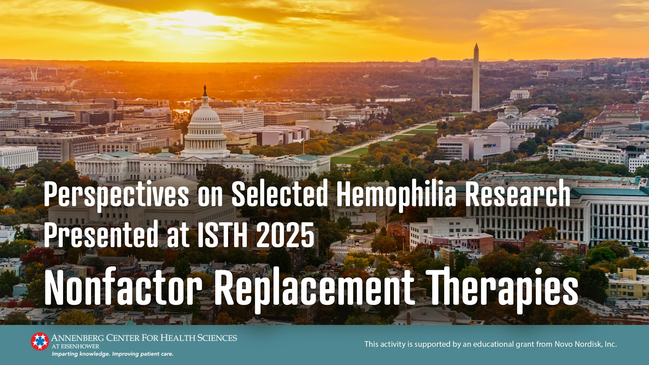

Slide 2
Faculty
Annette von Drygalski, MD, PharmD, RMSK
Professor of Clinical Medicine
Director, Center for Bleeding and Clotting Disorders
Associate Director, Center of Excellence for
Hereditary Hemorrhagic Teleangiectasia
Program Director, Coagulation Medicine Fellowship
Associate Program Director, Hematology Fellowship
University of California, San Diego

Slide 3
Module 1
A Focus on Rebalancing Agents

Slide 4
Introduction
30% of patients with hemophilia A develop inhibitors (neutralizing antibodies)
Rebalancing agents
  Act through the factor-independent clotting pathway to promote hemostasis
  Designed to overcome some of the limitations with clotting factor concentrates (CFCs)
  Limited availability
  Diminished efficacy in patients who develop inhibitors
  Frequent intravenous administration, with potential impacts to patient adherence and convenience
  3 rebalancing agents approved in the United States
    Concizumab
    Fitusiran
    Marstacimab

Slide 5
OC 59.3 - Association of antithrombin levels with efficacy of fitusiran prophylaxis in people with hemophilia A or B with and without inhibitors: a predictive modeling approach
Young G, et al.
https://s2.goeshow.com/isth/annual/2025/conference_program_sessions.cfm?session_key=DD5AC907-FCB5-F2B8-1169-B83FD8C6058E&session_date=Tuesday,%20Jun%2024,%202025 -

Slide 6
Methods
Andersen-Gill model with frailty utilized to analyze the relationship between AT levels & ABR
Data analyzed from phase 2 and 3 trials
  ATLAS-INH
  ATLAS-A/B
  ATLAS-PPX
  ATLAS-OLE
Included patients receiving ≥1 dose of fitusiran during the steady-state period:
  80 mg once monthly ODR regimen
  AT-DR based regimen targeting AT levels between 15% to 35%
ABR, annualized bleeding rate; AT, antithrombin; AT-DR, antithrombin-base dose regimen (AT-DR); ODR, original dose regimen

Slide 7
Results
N=254 with 552.9 pt-y of observation
Individual mean AT levels
  ODR 11.5% (10.4%-13.3%)
  AT-DR 23.2% (20.7%-25.8%)
A monotonic increasing relationship between ABR and AT levels was observed
Median ABR by AT activity level
As AT activity level increased, median ABR also increased
 | 10% AT Activity Level | 15% AT Activity Level | 35% Activity Level
Median ABR (95% CI) | 0.73 (95% CI: 0.48, 1.05) | 2.31 (95% CI: 1.69, 3.18) | 4.58 (95% CI: 3.55, 6.30)
ABR, annualized bleeding rate; AT, antithrombin; AT-DR, antithrombin-base dose regimen (AT-DR); ODR, original dose regimen; pt-y, patient-years

Slide 8
Clinical Implications
Appears advantageous to strive for lower antithrombin levels for less risk of bleeds
  FDA prescribing information recommends antithrombin percentages between 15% to 35%
Antithrombin-based rebalancing agents can be used for both hemophilia A and B

Slide 9
OC59.2 Annualized bleeding rates in hemophilia A/B and target joints: Concizumab explorer8 study
Wheeler A, et al.
https://s2.goeshow.com/isth/annual/2025/conference_program_sessions.cfm?session_key=DD0BE5CA-0232-F3E6-B4F5-3E4C79BAB79E&session_date=Tuesday, Jun 24, 2025

Slide 10
Methods
Prospective, multicenter, open-label, phase 3 explorer8 study
Patients
  Randomized 1:2 to on-demand (arm 1) or concizumab (arm 2) or
  Assigned to nonrandomized concizumab (arms 3/4)
Concizumab dosing
  Day 1: 1.0 mg/kg loading dose
  Day ≥2: 0.20 mg/kg/d with potential adjustments (5-8 wks) to 0.15-0.25 mg/kg based on concizumab plasma levels after wk 4
Target joints: ≥3 spontaneous bleeds into a single joint within a consecutive
6-mo period
Treated spontaneous/traumatic bleeding episodes assessed at 32- and 56-wk cut-offs

Slide 11
Results
173 Patients screened
At 32 wks, significant reduction in treated spontaneous and traumatic bleeding episodes with concizumab prophylaxis (arm 2) vs on-demand (arm 1)
Zero treated spontaneous and traumatic bleeds in concizumab arm
        35.1% with target joints
        60% without target joints
Median ABRs remained low at 56 wks
Estimated mean ABR | On-Demand | Concizumab Prophylaxis | % Reduction
With Target Joints | 14.9 | 3.4 | 77%
Without Target Joints | 26.9 | 0.4 | 99%
ABR, annualized bleeding rate

Slide 12
Clinical Implications
Rebalancing using tissue factor pathway inhibitor (TPFI) modulation with concizumab is suitable for hemophilia A and B to reduce or avoid bleeding
Concizumab is very helpful for hemophilia B prophylaxis, including with inhibitors

Slide 13
OC 20.1 - Long-term efficacy of marstacimab in participants with severe hemophilia
A or B without inhibitors
Matino D, et al.
https://s2.goeshow.com/isth/annual/2025/conference_program_sessions.cfm?session_key=E8156261-BE07-AEFA-824B-1392918CCDF7&session_date=Sunday, Jun 22, 2025

Slide 14
Methods
OLE study following eligible male participants from phase 3 BASIS trial
Participants continued marstacimab dose
  150 or 300 mg weekly
Bleeding episodes and doses recorded via electronic diary
Primary focus: long-term efficacy
OLE, open-label extension

Slide 15
Results
92.2% (107/116) of noninhibitor participants from the BASIS trial enrolled and were dosed in the OLE
  89 (83%) adults
  18 (17%) adolescents
Median exposure to marstacimab
    OLE: 18.9 mos (range 1.2-29.4)
BASIS + OLE: 30 mos (range 0.9-41.5)
23.3% of participants had their dose escalated from 150 mg to 300 mg QW
OLE, open label extension; QW, once weekly

Slide 16
Results (continued)
Mean estimated ABR
Marstacimab generally well tolerated
  1 participant reported deep vein thrombosis with multiple pre-existing risk factors
 | BASIS (n=116) | OLE (n=107)
Treated bleeds | 4.52 | 2.94
Total bleeds | 6.39 | 3.57
ABR, annualized bleeding rate; OLE, open label extension

Slide 17
Clinical Implications
Rebalancing agents such as marstacimab are suitable for hemophilia A and B prophylaxis
Weekly subcutaneous dosing seems very advantageous
Not currently approved for patients with inhibitors

Slide 18
Additional Key Posters
Lead Author Poster # | Title | Key Finding
Chowdhary P PB0844 | Low incidence of antidrug antibodies to fitusiran in people with hemophilia A or B with or without inhibitors | Fitusiran has a low risk for immunogenicity. Antidrug antibodies did not impact efficacy or safety.
Shapiro A PB0851 | Non-joint bleeds in patients with hemophilia A or B with inhibitors: Concizumab explorer7 study | Concizumab had few non-joint bleed reports and annualized muscle bleeding rates were reduced compared to on-demand treatment.

Slide 19
Module 2
Factor VIII Mimetics

Slide 20
Introduction
Factor VIII mimetics function by bridging activated FIX and FX, effectively mimicking the cofactor function of FVIII
Emicizumab is the only approved factor VIII mimetic
Mim8 (denecimig), a FVIIIa mimetic bispecific antibody, is in late-phase investigation
  Causes the replacement of the FVIII function allowing for the restoration of thrombin within normal limits
  Delivers improved potency and sustained efficacy across flexible dosing intervals up to once-monthly prophylaxis
FIX, factor IX; FVIII, factor VIII; FX, factor X

Slide 21
PB0280: Effectiveness of emicizumab in hemophilia A: A 4th interim analysis of the real-world study EMIIL
Oldenburg J, et al.
https://s2.goeshow.com/isth/annual/2025/poster_networking_sessions.cfm?session_key=E1867262-FAF1-F8D5-4C58-1A9B3E519C2C&session_date=Sunday, Jun 22, 2025

Slide 22
Methods
EMIIL: single-arm, 2-cohort, prospective, multicenter, noninterventional study
Primary endpoint: ABR of treated bleeds
  Number of treated bleeds for the whole study duration/study duration in years
  Study duration: max visit date with treated bleed assessment-date of first emicizumab administration/365.25
Cohort | Severe at baseline | FVIII Inhibitor History
 |  | Yes | Missing
A (n=125) | 100% | 4.0% | 92.3%
B (n=7) | 71.4% | 85.7% | 14.3%
ABR, annualized bleeding rate

Slide 23
Results
Cohort A
  Median treatment duration: 918 d
  Model-based ABR: 0.67 (95% CI 0.516-0.832).
  Zero treated bleeds: 44.8%
  Zero treated spontaneous bleeds: 76%
  Zero treated joint bleeds: 66.4%
  Zero treated target joint bleeds: 95.2%
Cohort B
  Median treatment duration 378 d
  Zero treated bleeds: 100%
Safety: 87 of 132 evaluable patients reported 313 adverse events, no new safety concerns emerged

Slide 24
Clinical Implications
Prophylaxis with emicizumab yields low annualized bleed rates long term; however, joint bleed rates were non-zero
Joint bleed rates were 66%, which leaves room for improvement with newer formulations in development

Slide 25
OC 64.3 - Prospective evaluation of a defined replacement protocol for peri-operative hemostasis in patients with severe hemophilia A with and without inhibitors on emicizumab prophylaxis undergoing elective major surgeries-final results. (EmiSurg Study)
Abraham A, et al.
https://s2.goeshow.com/isth/annual/2025/conference_program_sessions.cfm?session_key=ECF79BDA-C0DA-F8C1-6D00-C7E5824D1CAE&session_date=Tuesday, Jun 24, 2025

Slide 26
Methods
Investigator-initiated, prospective study
Patients undergoing elective major surgery
  Emicizumab prophylaxis for ≥4 wks
Age 2-60 y with severe hemophilia A
Defined protocol for additional hemostasis
Without inhibitors: standard half-life rFVIII
With inhibitors: rFVIIa
Outcomes/Measurements:
  Efficacy of surgical and postoperative hemostasis (ISTH SSC criteria)
  Blood counts
  FVIII levels
  Rotational thromboelastrometry (ROTEM)
  Thromboelastography (TGT)
  Screening for deep vein thrombosis (DVT)

Slide 27
Results
39 patients (15 with inhibitors)
  40 procedures (30 orthopedic, 6 abdomino-pelvic)
  Median age 30.5 y, range 14-56 y
Hemostasis
 | Standard Risk (n=37) | High Risk (n=3)
Hemostatic Efficacy | 91.9% excellent 5.4% good 2.7% fair | 67% fair 33% poor
Overall hemostasis | 97.3% excellent 2.7% good | 67% good 33% moderate

Slide 28
Results (continued)
Preoperative ROTEM and TGT parameters were normal or near-normal after rFVIII or rFVIIa infusion
Standard risk:
  BTB occurred 12 times in 9 standard risk procedures
    Most resolved within 1-2 doses of replacement and occurred after stopping initial therapy during physiotherapy and mobilization
High risk:
  rFVIII/rFVIIa support continued; additional transfusion support required
  1 death due to septic complications
No thromboembolism or thrombotic microangiopathy reported
BTB, breakthrough bleed; ROTEM, rotational thromboelastrometry; TGT, thromboelastography

Slide 29
Clinical Implications
Major surgeries while treated with emicizumab were feasible with continuous hemostatic support with FVIII or rFVIIa
To avoid breakthrough bleeding, consideration can be given to a priori factor coverage
No need to interrupt perioperative emicizumab

Slide 30
OC 20.4 - FRONTIER5 direct switch study: Safety of initiating Mim8 prophylaxis without washout of emicizumab
Oldenburg J, et al.
https://s2.goeshow.com/isth/annual/2025/conference_program_sessions.cfm?session_key=E49DBBC8-BDBB-7D6B-6666-4B7CFB07AB4E&session_date=Sunday, Jun 22, 2025

Slide 31
Methods
Single-arm, open-label, 26-wk, phase 3b study
Patients
  Males/females age ≥12 y with hemophilia A (any severity)
  Received emicizumab prophylaxis for ≥8 wks
Mim8 administered
  Subcutaneously via pen injector
  QW, Q2W, or QM using a weight-based tiered dosing
No Mim8 loading dose or emicizumab washout period
Primary endpoint: Number of TEAEs
QW, once weekly; Q2W, once every 2 wks; QM, once monthly; TEAE, treatment-emergent adverse event

Slide 32
Results
61 patients exposed to Mim8,
  90.2% inhibitor-negative
  93.4% severe hemophilia
  Completing 26 wks of treatment (30.77 pt-y exposure)
Previous emicizumab dosing frequency
  QW: 50.8%
  Q2W: 37.7%
  QM: 11.5%
pt-y, patient-years; QW, once weekly; Q2W, once every 2 wks; QM, once monthly

Slide 33
Results (continued)
107 TEAEs observed in 70.5%; 3.48 TEAE/pt-y
  Mild: 65.6%
  Moderate: 23%
  Severe: 3.3%
  4 serious TEAEs; none related to Mim8
18 patients (29.5%) reported 24 TEAEs possibly or probably related to Mim8
  Injection site reactions reported in 12 patients (19.7%)
    15/990 total injections (1.5%)
    Most transient, all mild
No thromboembolic events or TEAEs leading to permanent discontinuation
Steady state Mim8 concentration achieved by wk 16
Emicizumab eliminated by wk 26
pt-y, patient-years; TEAE, treatment-emergent adverse event

Slide 34
Clinical Implications
Seamless transition from emicizumab prophylaxis to Mim8
is possible
Fully therapeutic Mim8 levels are feasible within a short period
of time
Mim8 prophylaxis allows flexible dosing intervals

Slide 35
Additional Key Posters
Lead Author Poster # | Title | Key Finding
Chrisentery-Singleton T OC15.3 | Factor VIII inhibitor titers in people with hemophilia A on emicizumab prophylaxis in ATHN 7 | FVIII inhibitor titers remained stable from emicizumab initiation over median 116.4 wks.
Manhlangu J PB0812 | Evaluating pen-injector handling and PROs in patients switching from emicizumab to Mim8 in FRONTIER5 | Mim8 pen-injector was easy to use and highly preferred. No unexpected findings observed.
Tardy B PB1481 | The PHILEOS (haemoPHILia and ostEporOSis) study: results of a multicentre case-control study | Osteoporosis prevalence is higher in severe hemophilia without prophylaxis vs controls. Early prophylaxis in childhood (vs age >20y) more effective preventing osteoporosis.

Slide 36
Conclusions
The studies presented at ISTH 2025 highlight significant progress in nonfactor replacement therapies
Rebalancing agents demonstrate significant advancements
Factor VIII mimetics continue to show high effectiveness and favorable long-term safety
Ongoing investigations will further refine treatment approaches, ensuring personalized and effective care

